Slide 1
2017 Mid-year CAFR Training
August 23, 2017

Slide 2
AGENDA
CAFR Staff and Assignments
NM CAFR Audit for FY16
New MAPs Requirements to be aware of
New Accounting Policy Statements
Issue that came up in FY17 that affected a few agencies
Other Financial Statement Issues to be aware of for upcoming year
Submission of the CAFR Packet
Common Errors on Audit Reports for FY16
Appendix

Slide 3

HOUSEKEEPING

Slide 4
Make sure to sign-in.
  Only CFO’s and Co-CFO’s that attend the training will be given access to the OpenLearning Quiz. The sign-in sheet will be used as the reference to allow access.
On Thursday (8/24), you should have access to the Quiz on OpenLearning.
  You don’t need an email invite to access the Quiz. Just go directly to OpenLearning.
  The Course is called “2017 CAFR August Training Quiz”
  If you do not have access to the quiz, contact either Renae Herndon or Laura Montoya.
You will have until August 28th at 4:00pm to complete the quiz.
  OpenLearning will then be turned off and all the test scores tabulated.
  CFO’s and Co-CFO’s will then be notified of their grade
  If you did not pass with an 80% or better, you will be given further instructions on the next steps.

Slide 5


Slide 6
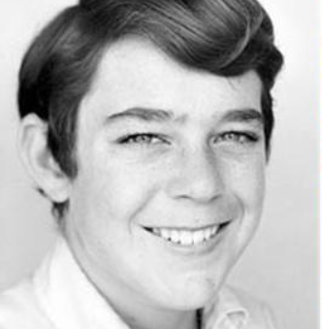
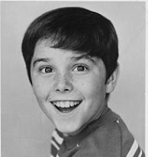
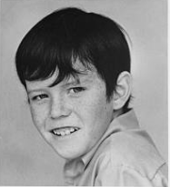
CAFR Staff
Richard Torrence
476-8533
Will Crespin
476-8530
John Severns
476-8518

Slide 7
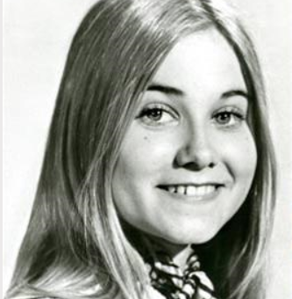
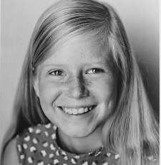

CAFR Staff
Christina C’De Baca
827-3988
Renae Herndon-Lopez
476-8527
Silvia Rodarte
476-8543

Slide 8
CAFR Staff Assignment – Christina C’de Baca
-Posts all CFR/CSH/OPR journal entries.
- Assists agencies to resolve issues with journal errors.
- Trains CFOs on how to use the journal upload process.
CAFR Staff Assignment – John Severns
-Reviews all OPR journal entries.
- Reconciles the Transfers In/ Transfers Out for the State of NM.
- Reconciles the Capital Assets for the State of NM

Slide 9
FCD.CAFR@state.nm.us
This is the email address for auditors to communicate with the CAFR staff.

Slide 10
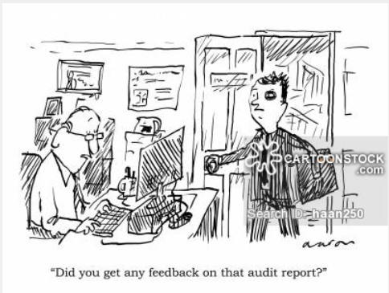
CAFR Audit for FY16

Slide 11
CAFR Audit Findings on INCONSISTANCIES – and how that will affect agencies
Subsequent to the FY15 CAFR issuance and during the development of the FY16 CAFR, an issue came up that resulted in the CAFR Unit, State Auditor, numerous IPAs and CLA having to have 3 conference calls with Governmental Accounting Standards Board (GASB) officials.
  February 28, 2017
  March 22, 2017
  May 2, 2017
In the course of these conference calls, discussions arose on how the State of NM handles accounting issues. GASB stressed that the State of NM cannot have inconsistent accounting practices – i.e. separately issued financial statements of departments that do not follow the accounting policies of the State’s CAFR.

Slide 12
Summary of information learned during GASB conference calls
Legally separate entities that meet the GASB criteria to be reported as component units of the State of New Mexico must comply with governmental generally accepted accounting principles (GAAP) as defined by GASB standards.
GAAP generally does not allow for presentation of a beneficial interest in the assets of another government as assets of the reporting entity, however sub-entities of a primary government (State of NM) may report all or a share of the primary government’s assets.
Governmental GAAP as defined by GASB standards generally does not address department-level financial reporting, such as that used by agencies that are part of the State of New Mexico but which issue separate department-level financial statements. Such entities are not legally separate from the State of New Mexico and therefore, are not component units.
Because department-level financial reporting is not addressed by governmental GAAP, it falls upon the principal accountant of the primary government, in this case, the New Mexico State Controller, to set consistent accounting presentation for the State as a whole and all departments therein, through policy.

Slide 13
Summary of information learned during GASB conference calls continued:
Financial reporting consistency is required between the primary government and all departments. The presentation of the Land Grand Permanent Fund (LGPF) in the CAFR must be consistent and aligned with the presentation in department-level financial statements. Presentation decisions should be made at the CAFR level and the State Controller is responsible for setting policy to ensure that department-level financial reporting follows the State, regardless of the timeline over which the reporting occurs (i.e. issuing the department-level financial reports prior to the CAFR, while a complicating factor, does not change decision-making relationship between the State and the individual department agencies).
Note disclosure alone is not sufficient to achieve financial reporting consistency – asset presentation in the Statement of Net Position and the Balance Sheet, if applicable, must be in alignment.

Slide 14
RESULT OF ALL THIS????
This resulted in a finding for the State of NM and ultimately, a disclaimed opinion.

Slide 15
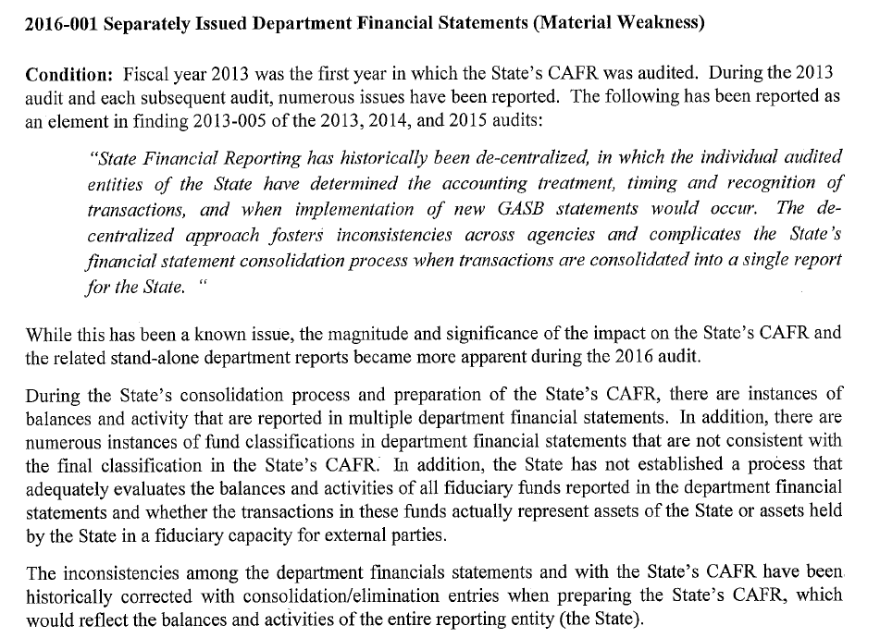
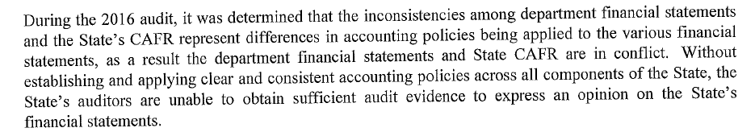

Slide 16


Slide 17
How does this affect you???
All agencies and higher education institutions are classified as “departments” of the State per GASB. Agencies do NOT stand on their own regarding financial reporting. You are all departments of the larger entity – i.e. the State of NM.
DFA’s plan is to start phasing in new accounting policies for certain agencies that have policies that are in direct conflict with the State CAFR.
  Most of these new Statewide policies are in FIN 17 in MAPs issued June 30, 2017.
The plan is to start with the larger agencies and move to the small agencies over time.
  For FY17, analyzing the Agency Funds.
This process will probably take a couple of years to implement since it is a massive undertaking.
This is just your “heads-up” that DFA might be contacting you to work on all your internal accounting practices to change them to address accounting at a State-wide level.

Slide 18
For FY17 – Each agency needs to do an Agency Fund Review
Agencies that have Agency Funds need to really analyze the monies in these funds and ask these questions:
  Do you have an agency fund?
  What statute set this fund up?
  Are the funds restricted by statute?
  What is the source of the funds?
  Who does the money belong to?
  If revenue is recorded, which agency or state entity records it and what object code is used?

Slide 19

New MAPs changes to be aware of
“MAPS”
“I LOVE MAPS”

Slide 20
NEW MAPs Requirements CFOs need to be aware of
There are not only modifications to MAPs for FY18, there are also new requirements that are applicable for FY18 and also for financial reporting for FY17.
  FIN 16.11 CFO Requirements
  FIN 3.6 More detailed instructions on the proper way to submit a journal entry to FCD.

Slide 21
NEW MAPs Requirements CFOs need to be aware of continued
In MAPs there is now a new section – FIN 17.
This section is designed for Statewide Accounting Policies
  FIN 17.1 Compensated Absence Reporting (Discussed further in presentation)
  FIN 17.2 Transfers In/Out Reporting (Discussed further in presentation)

Slide 22
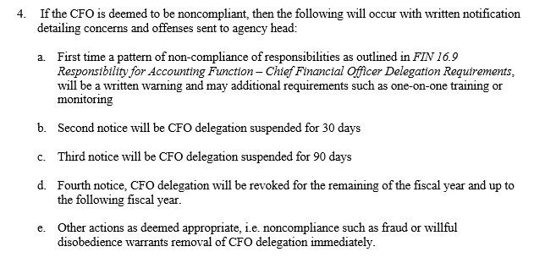
FIN 16.11
A section was added to FIN 16- (FIN 16.11) to address issues that were occurring regarding continuous errors by agencies
This standard now creates quantitative measurements

Slide 23
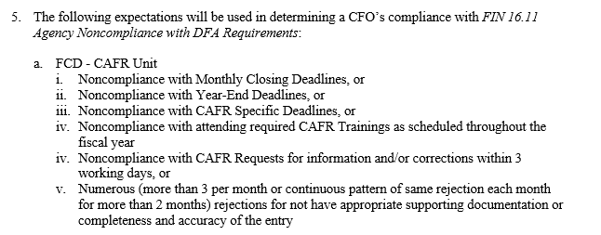
FIN 16.11 Cont.
Each division at DFA has as separate set of standards to rate based on the criteria.
These are the CAFR Unit Standards.
  There are different standards for Budget Division, Accounts Payable Division, Cash Unit and Vendor Division.

Slide 24
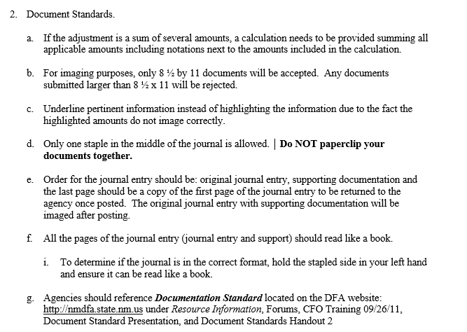
FIN 3.6
A section was added to FIN 3.6 to address issues that were occurring regarding the proper way to submit a journal entry – document standards were established.
This will be modified after going live with 9.2 Upgrade

Slide 25
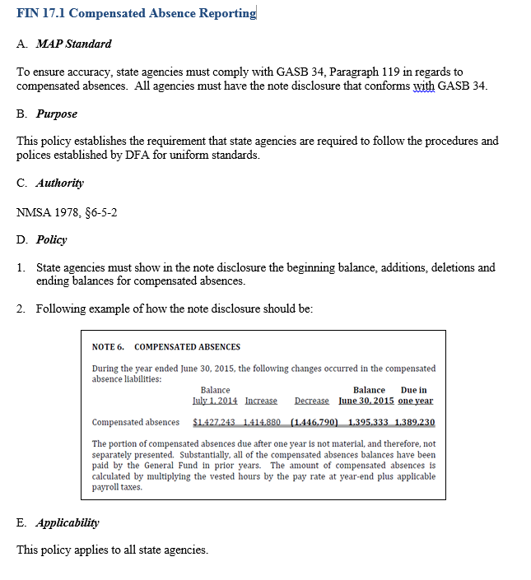
FIN 17.1
A section was added to MAPs for creation of Accounting Policy.
FIN 17.1 was to address issues that were occurring on the proper way to report Compensated Absences in the notes to the financial statements.

Slide 26
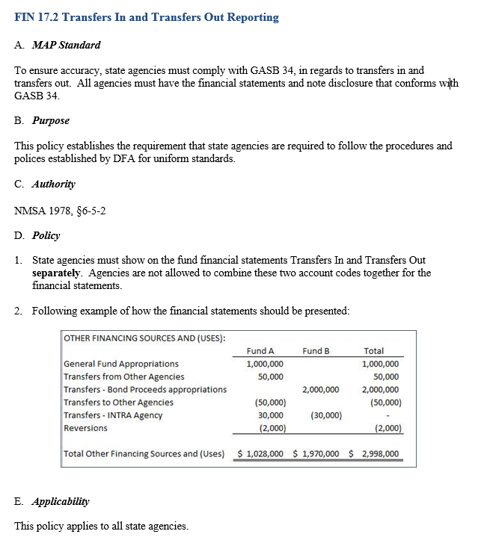
FIN 17.2
A section was added to FIN 17- Accounting Policy (FIN 17.2) to address issues that were occurring on the proper way to report Transfers In and Transfers Out

Slide 27
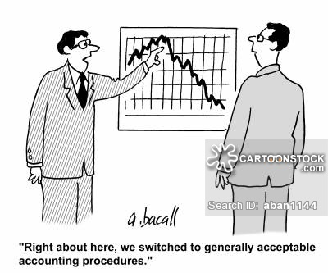
Accounting Policy Statements

Slide 28
Account Policy Statements
Number 1 – Land Grant Permanent Fund
Number 2 – Long Term Debt
Number 3 – Interfund Transactions and Accounting
Number 4 – Custodial (Agency) Funds
Number 4A – Custodial (Agency) Funds Flow Through
Number 5 – Intra Entity Receivables and Payables

Slide 29
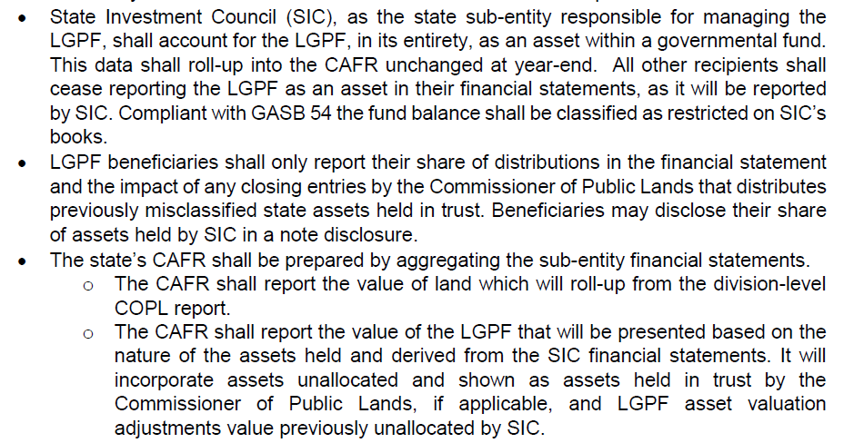
Account Policy Statements
Number 1 – Land Grant Permanent Fund (LGPF)

Slide 30
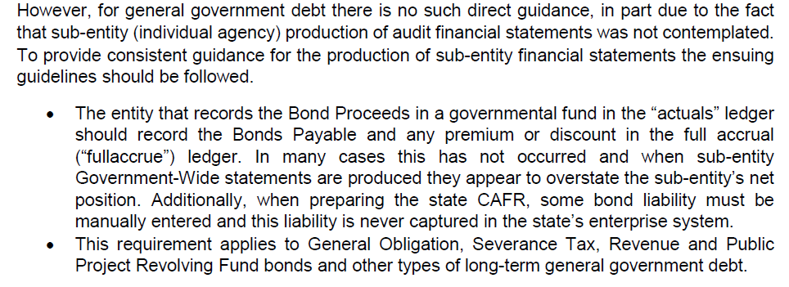
Account Policy Statements
Number 2 – Long Term Debt

Slide 31
Account Policy Statements
Number 3 – Interfund Transactions and Accounting
  There are 4 types of transactions impacted by this policy.
    Interfund Reimbursement – Transaction that is initially recorded in one fund and then allocated between other funds from other agencies.
    Interfund Transfers – Move assets (like cash) accounted for in one fund to another fund at another agency without reciprocal service or value.
    Interfund Loans – These affect the balance sheet only. A Due To and Due From should be established.
    Interfund Services – services provided by one fund to another between agencies should be accounted for as a sale and purchase between funds.

Slide 32
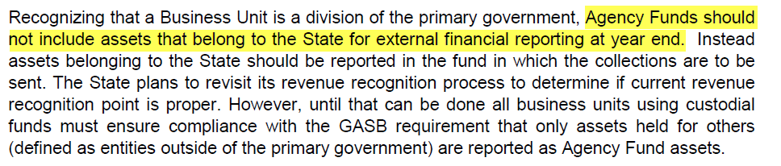
Account Policy Statements
Number 4 – Custodial (Agency) Funds

Slide 33
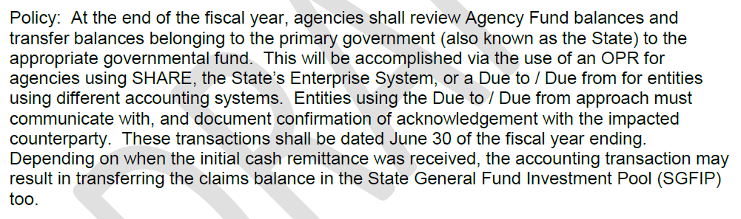
Account Policy Statements
Number 4A – Custodial (Agency) Funds Flow Through

Slide 34
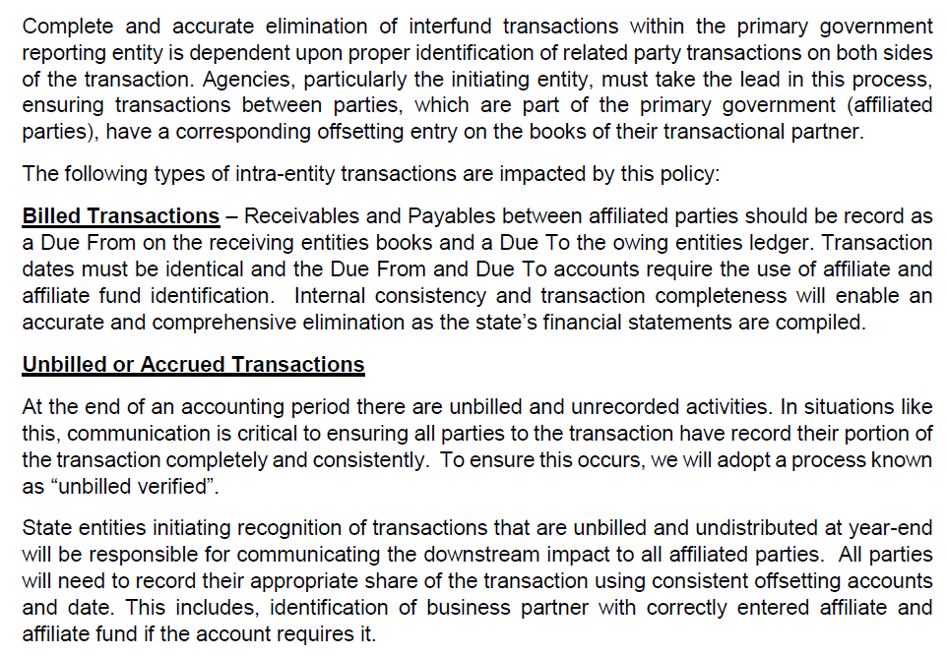
Account Policy Statements
Number 5 – Intra Entity Receivables and Payables

Slide 35

Issue that came up in FY17 that affected a few agencies

Slide 36
Copying a journal that was originally posted in Period 998
Some agencies were wanting to do the reversing accrual entry and instead of entering the whole entry again, they were wanting to copy the entry over and reverse the signs.
ISSUE – period 998 for FY16 was the default on the header.
  If this is not changed, then the journal will post to period 998 for FY16 BUT have the current year date on the journal instead of 6/30.
  See following slides for example.

Slide 37
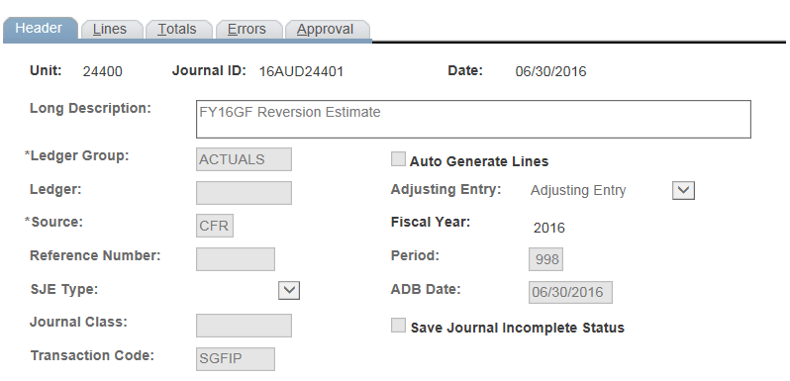
Here’s the header when the entry was originally posted
Notice – it’s an Adjusting Entry/ FY2016/Period998/ dated 6/30

Slide 38
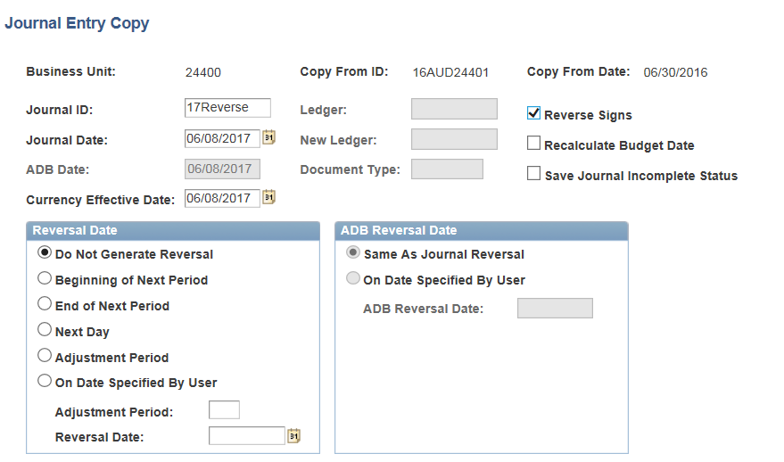
Copying the journal over
Notice: You can’t change the Period

Slide 39
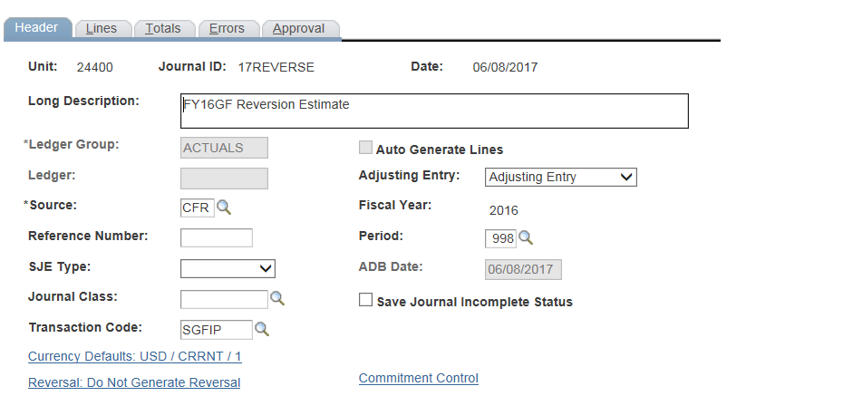
NEW Journal Entry
NOTE: All the elements from the audit entry for FY16 carried over into the new fiscal year
Adjusting Entry
Fiscal Year
Period
If these are not changed – the reversing journal will post incorrectly.

Slide 40
Option for agencies to consider when reversing prior year accruals
In doing the reversal – instead of doing the reversal with a current period opening date- do the reversal in period 998 with a date of 7/1/xxxx (new current year).
Example: Posted an entry in FY16 (16AUD34101) and now need to reverse it in FY17 during the month of November
  Number the journal R6AUD34101
  Date the journal 7/1/17
  Enter the journal in period 998 (even if SHARE only had period 5 open)

Slide 41

Year End Processing for FY17 & new process for 202900

Slide 42
Changes to Journal entries
Instructions regarding year end changes was sent in a memo from Ron Spilman dated 7/13/17. Many CFO’s did not comprehend the changes.
Large entries that affect “cash” between agencies will be backdated to 6/30 but processed in July/early August to allow the settlement of the cash as long as the cash was available at 6/30.
All Reversion entries before September 30th are to be done as an OPR, dated 6/30/17 in Period 998. There will be no Due To/Due From relationship for reversions done before 9/30.

Slide 43
AP Issue that occurred for FY17 closing
Voucher processing of accounts payable payments changed in that if an agency got a rejection, the agency was not allowed to correct the voucher the following week. It was rejected in its entirety.
ISSUE – most agencies did not receive the rejection until AFTER the due date for the AP Accrual Request.
The CAFR Unit is now aware of this new process and will ensure that the year end closing for FY18 will incorporate more time for the request to ensure rejections can be addressed.

Slide 44
Issues regarding Accounts Payable Request Form and Entry
Numerous issues arose this year with this process:
Agencies received AP voucher rejections after the AP Request Form due date (discussed in previous slide).
Agencies received the approval but did not do the journal entry to accrue this amount in SHARE.
Agencies received the approval but decided to send in the journal entry for an amount that was different (higher and/or lower) than the approval form.
    If an agency estimated the amount and received the invoice when the journal is being processed and wants to do the accrual for the actual amount, the agency needs to work with the CAFR Unit to amend the form to adjust for actuals.
    The form and the journal entry must match for a proper audit trail.
Agencies revised their Excel document to list the vendor for payment, printed it and sent it to Accounts Payable for payment, not having CAFR approval.

Slide 45
Multi-year POs and year end accrual
Agencies that have POs that rollover were encountering issues with the PO balances.
  When an agency does the accrual, the expenditure is accrued in SHARE therefore reducing the available budget.
  ISSUE– the PO still shows a higher amount due to the fact that expenditure payment is done via a balance sheet account and done as a direct pay, not attached to a PO.
  So – as the year goes on, the budget will be showing not only the expenditures that were paid, the PO will still be showing the original amount, therefore causing the budget projections in SHARE to be incorrect.
SOLUTION – agencies will be adding a line to the PO for a negative dollar amount. The reference of the new PO line will be the journal entry number for the journal entry that accrued the expenditures.

Slide 46
New Process for 202900
This process is new for FY17 but was addressed in April 2017 during the Year-End closing instructions.
Summary:
  If the auditor (or agency) identifies that an invoice that should have been for the previous year and the deadline for AP Request has past, the agency needs to fill out the AP (202900) Request Form. (Attachment AG)
    Need to fill out the form – 1 per vendor.
    The agency’s auditor must sign.
    Need to attach a copy of the invoice.
    Need to attach a print screen of the commitment control to show there is sufficient budget for the Pcode.

Slide 47
New Process for 202900 Continued
If there is not enough budget in the Pcode,
Ron will not sign the 202900 form.
The agency will be allowed to accrue the expenditures in the current year to ensure fiscal integrity.
  The agency will NOT be allowed to pay the invoice until the agency receives a deficiency appropriation to cover the overage.
The agency should expect to receive an audit finding regarding exceeding budget.

Slide 48
MISCONCEPTION regarding the New Process for 202900
MISCONCEPTION: Agencies believe that if they follow this new process and not the old one for Request to Pay Prior Year, that vendors cannot be paid until December 1st. THIS IS INCORRECT.
CORRECT: Agencies can pay vendors immediately after the State Controller approves the accrual and the journal entry is done in SHARE providing there is sufficient budget.

Slide 49

Other Financial Statement Issues to be aware of for upcoming year

Slide 50
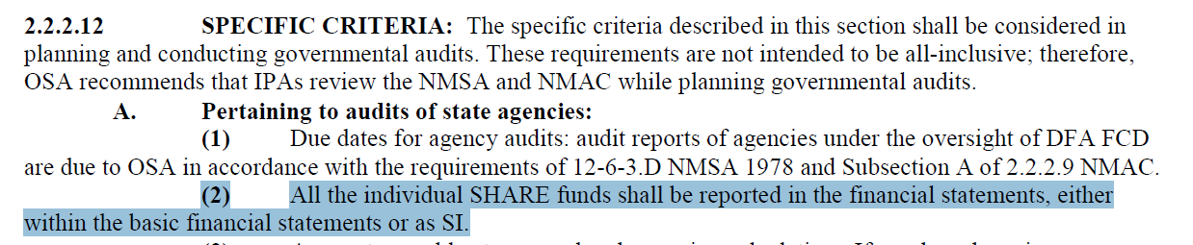
Fund Presentation in Financials
CFO’s need to ensure that ALL funds are reported in the financial statements.
If your auditor does a “combining”, then there should be a schedule in the Supplemental Information Section of the report that details the individual funds and the amounts the combining schedules were derived from.
Per State Audit Rule:

Slide 51
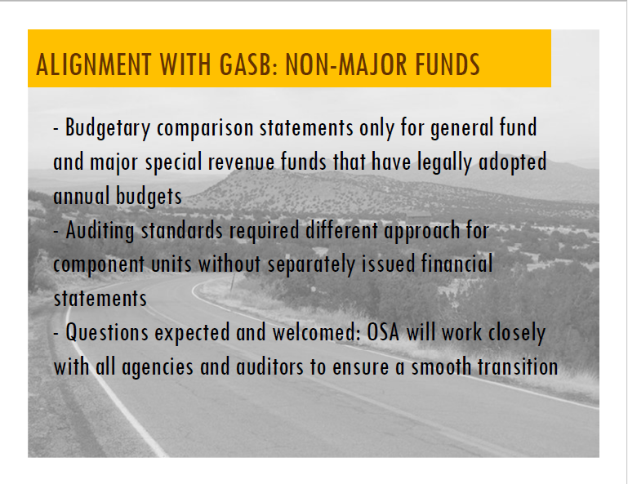
Fund Presentation in Financials Cont.
ONLY BUDGET COMPARISON STATEMENTS have now changed to only being completed for General Fund and major Special Revenue Funds.

Slide 52
Relationship between Agency Fund and General Fund
Agency funds that hold money on behalf of the agency’s Governmental Funds should not be disclosed as a Due To/Due From relationship. (Per GASB34)
The only amounts that should be remaining in the Agency funds are monies owed to external parties or other agencies.
If your agency has balances in your agency fund that are due to one of your Governmental funds, an elimination entry needs to be done.
See attached guidance from GASB34 on next slide.

Slide 53
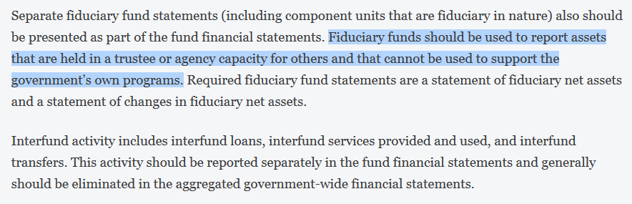
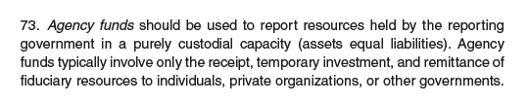
Relationship between Agency Fund and General Fund Cont.

Slide 54
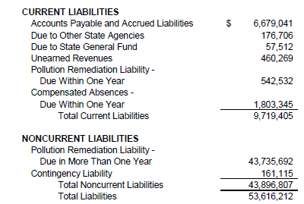
Short Term and Long Term Liabilities
Some Auditors will break down the liabilities into short-term and long-term.
If your auditor does that, then an entry needs to be done in SHARE to match your financial statements.
Short Term Liability accounts end in “00”
Long Term Liability accounts end in “01”

Slide 55
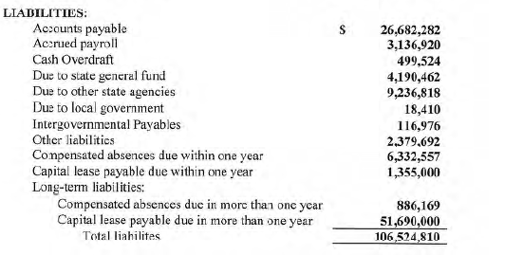
Compensated Absences
Some Auditors will break-down the compensated absences into short-term and long-term.
If your auditor does that, then an entry needs to be done in SHARE to match your financial statements.
260900 – Short Term
260901 – Long Term

Slide 56
New MAPs Rule for Compensated Absences
Please be aware there is a new MAPs rule regarding reporting of Compensated Absences – FIN 17.1
This rule goes into effect for the FY17 financial statements.

Slide 57
Payroll Liabilities – THIS SLIDE HAS CHANGED
DFA (CAFR Unit) did an entry yesterday (8/22/17) in period 998 dated 6/30/17 to reconcile the 223500/223900/226900 accounts.
  DFA Payroll ran a query showing the amounts that should be on agency financials after the final payroll for the fiscal year – including garnishments.
  CAFR Unit had to wait to do this entry for DFA Payroll to reconcile the year-end payroll and to calculate all the outstanding garnishment amounts.
NOTE: DFA’s entry will be going against 101981 and not current year expenditures.
  There was only ONE agency that the journal entry had to be done to Fund Balance.

Slide 58

Elimination Entries
Auditors will sometimes do elimination entries.
  Intra-funds (141900/231900)
Agencies are not recording these entries in SHARE.
  Some auditors do these entries in the fund financial statements (ACTUALS) and usually note them on the audit adjustments as “for presentation purposes only – do not post”.
  Some auditors do these entries in the government-wide (FULLLACCRUE).
  Agencies need to post these entries in SHARE mirroring how the auditor presents them in the financials.
  SHARE must tie to the audited financials.

Slide 59


RICHARD BLAIR

Slide 60
Budgeting Fund Balance
Some agencies are allowed to budget fund balance.
  Must prove to the Budget Division that there is a positive fund balance amount that can be used. This is normally done via audited financial statements.
  Must use the fund balance code (328900/312900) as the “revenue” for the transaction. This will ensure the budget is self-balanced.
The agency will not receive any new monies for this budgeted amount. This amount was already in the balance for the agency.
  Using these monies during the year will ultimately reduce the fund’s balance down and be reflected in the change in fund balance on the financial statements.

Slide 61
Legal Level of Budgetary Control
Auditors need to be looking at the legal level of budgetary control – not per fund.
  This legal level for agencies normally is the P-code.
  It can also be the A-code or Z-code
Guidance regarding this legal level can be found at: (See following slides)
  State Audit Rule: 2.2.2.10 Q(2)
  NMAC: 2.2.2.12 Subsection A

Slide 62
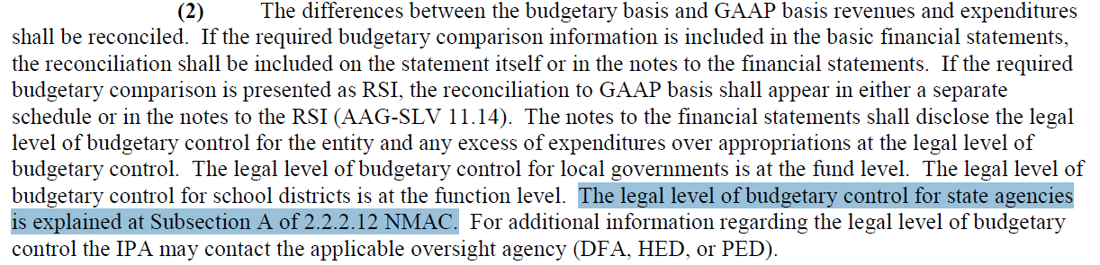
Legal Level of Budgetary Control Cont.
State Audit Rule: 2.2.2.10 Q(2)

Slide 63
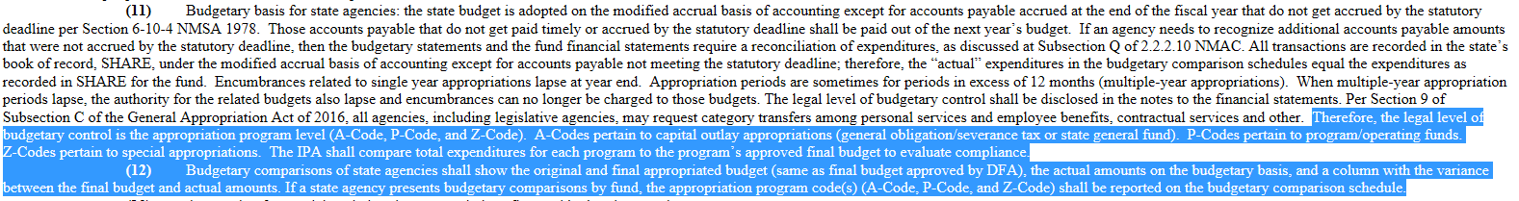
Legal Level of Budgetary Control Cont.
NMAC: 2.2.2.12 Subsection A

Slide 64

BREAK
We’ll take a 15 min break

Slide 65


Slide 66
CAPITAL ASSETS
For FY17 financials- Some agencies need to move expenditures out of the 300 category to the 548xx category so the assets additions note ties for the financial statements.
  Example: Agency bought a server. To have the server work, it required services by the vendor to install the server. The services are still part of the cost of the asset and need to be accounted as such.
This journal entry might cause a budget error. If that is the case, DFA will allow a journal entry (do NOT do an AP journal) and will process a budget override. The Pcode should not be impacted and no cash lines should be generated.
REMEMBER – all expenditures in 548XX should balance to the note disclosure “additions”. If they don’t – there should be a note disclosure noting the discrepancy.

Slide 67
CAPITAL ASSETS Continued
For FY18 – DFA created an account code in the 300 series that is to be utilized for Capital Projects Professional Services that need to be capitalized. (Ron Spilman sent out email dated 8/2/17 regarding this new procedure.)
  535800
  Agencies will no longer need to do journal entries moving professional services related to a capital asset to the 400 category.
  Agencies will need to ensure the note disclosure for additions now includes 535800 and the 548XX’s accounts.

Slide 68
FULLACCRUE
Agencies have the choice of doing the FULLACCRUE ledger either as all entries into one fund or keeping each fund separate – the choice is up to the agency.
If the agency has Business-Type funds and also Governmental funds, the capital asset note disclosure needs to separate assets between the two types instead of combining into one schedule.

Slide 69

“IT’S MINE!!!”
“NO – IT’S MINE!!!”

Slide 70
Capital Asset bought by one agency on behalf of another agency
In some cases, one agency has the budget authority to buy assets on behalf of another agency.
The agency that did not pay for the asset must disclose on their government-wide (and in their notes) that they have ownership of the asset and received a transfer.
  Capital Asset Note Disclosure
  Transfer In/Out Note Disclosure

Slide 71
Capital Asset bought by one agency on behalf of another agency
MAJOR PROBLEM:
  Agency that bought the asset does the OPR entry to move the asset to the receiving agency AFTER the financials have been completed, audited and even released by the State Auditor’s office for the receiving agency.
  This causes MAJOR timing issues and discrepancies.
OTHER PROBLEMS:
  Agencies are not doing the government-wide entry in SHARE.
  Agencies are not disclosing these assets in their capital asset note disclosure.

Slide 72
Capital Asset bought by one agency on behalf of another agency cont.
Agency that has OWNERSHIP of the asset should be showing the transferred asset as an addition along with an explanation in the note disclosures.
Agency that transferred the asset should be showing the transfer in the Transfer Note along with disclosing the information in the Capital Assets Note.
Best way to handle the movement of the asset is to do an OPR for the transactions. OPR would have both agencies book each side.
Next few slides demonstrate the journal entries required.
  New Asset
  Already acquired asset that has been in use for some time.

Slide 73
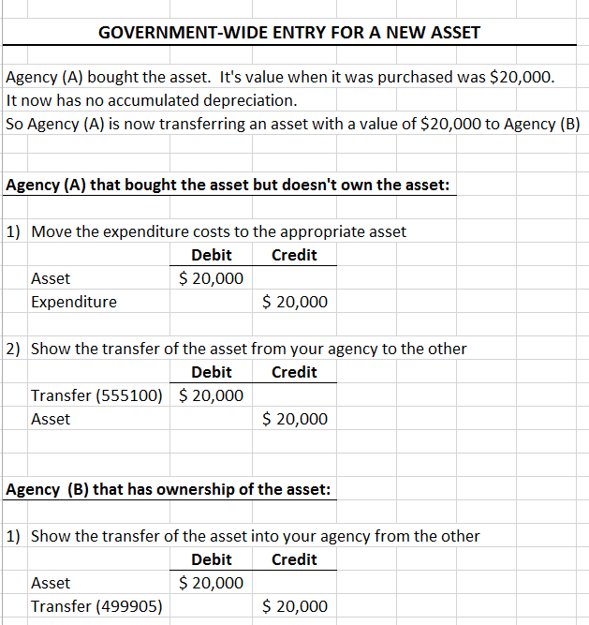
ENTRIES For The Transfer Of A New Asset:
Note: Some auditors will have the agency do a whole year depreciation on the asset even though the actual “transfer date” is 6/30

Slide 74
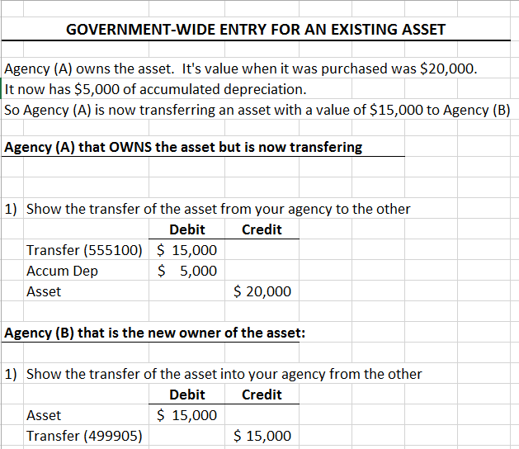
ENTRIES For The Transfer Of an EXISTING Asset:
Note: Transferring “net cost” of the asset not historical.

Slide 75



Slide 76
Usage of Affiliate/Fund Affiliate on Transfers In and Transfers Out
To reconcile the Transfers In/Out for the State of NM – the CAFR Unit has to utilize the affiliate and fund affiliate chartfields.
  These fields are used exactly as the affiliate/fund affiliate is used for Due To and Due From State Agencies.
Agencies need to ensure that the proper affiliate/fund affiliate are populated for Transfer In/Out account codes.
The CAFR Unit, in the yearly review of an agency’s financials, does monitor and make sure the Transfers In/Out have the proper affiliate/fund affiliate chartfields populated to match the note disclosure.

Slide 77
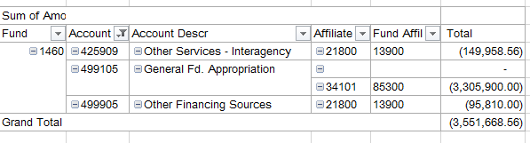
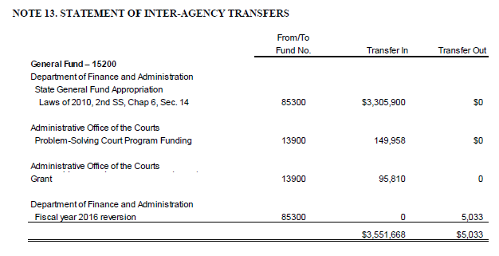
EXAMPLE of Correct Method
Affiliate/Fund Affiliate on Transfers In/Out

Slide 78
Affiliate/Fund Affiliate – IS & BTA
Remember – affiliate and fund affiliate chartfields are NOT required when the business interaction your agency is having is with an Internal Service Fund or an Enterprise Fund.
  Examples:
    GSD
    DoIT
    Correction Industries
    State Fair (EXPO)
    Secretary of State – notary
    REFUNDS – when one agency is paying back another agency for expenditures. This is NOT a service type relationship but a true refund.

Slide 79
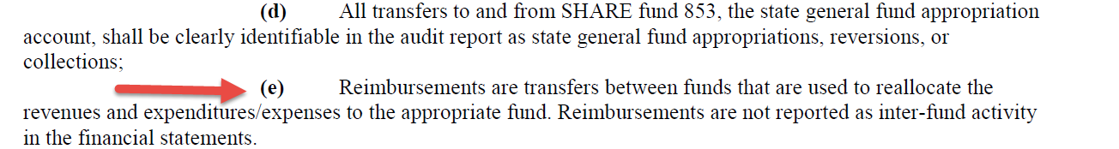
Affiliate/Fund Affiliate - REFUND
Remember – affiliate and fund affiliate chartfields are NOT required when the relationship is a true REFUND.
  REFUNDS – when one agency is paying back another agency for expenditures. This is NOT a service type relationship but a true refund.
State Audit Rule: 2.2.2.12 A(7)e

Slide 80
Affiliate/Fund Affiliate
These chartfields are in SHARE to ensure proper interagency and intra-agency accounting is maintained and reconciled.
The intent of the system is that these interagency and intra-agency transactions should reconcile every month.
These chartfields are used on accounts (balance sheet and income statement) that relate to an inter (or intra) business relationship between your agency and another (or one of your funds to another of your funds).
  Example: 141900/231900 – one of your own funds owes another of your own funds.
  Example: 232900 – your agency owes money to another agency.

Slide 81
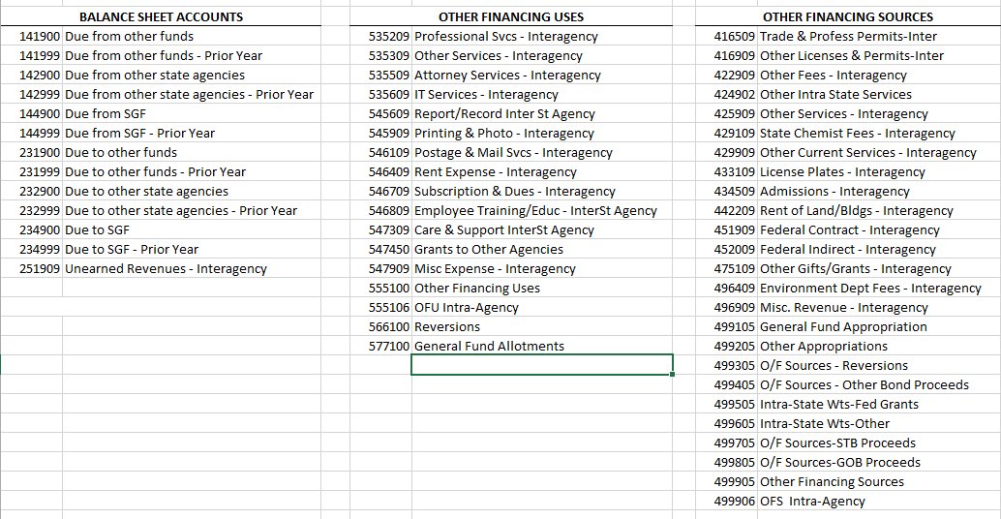
Account Codes that require Affiliate/Fund Affiliate

Slide 82



Slide 83

CAFR Circle of Life
CAFR is notified by State Auditor to review audit.
CAFR group finds issues and notifies State Auditor and CFO.
CFO notifies CAFR that IPA did the financials
The CFO calls/emails the IPA to discuss the issues CAFR found.
IPA calls CAFR and notifies them that the “financials are the responsibility of management” per the Management Representation Letter the agency signed and that the issue is the CFO’s responsibility to resolve.
CAFR Unit is back to calling the CFO.

Slide 84
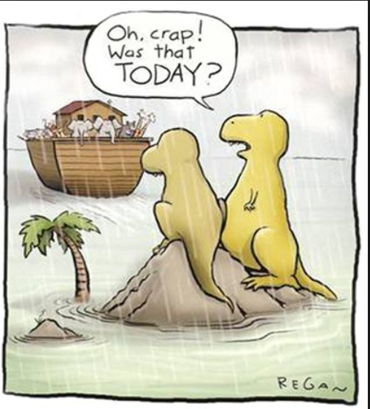
Submission of the CAFR Packet

Slide 85
Submission of CAFR Packet
ALL ELEMENTS of the CAFR Packet must be turned in before the CFO is deemed to have complied with DFA Year-End Deadlines.
  If the CFO only sends in the financials but not the rest of the packet, the submission is considered late and could impact the CFO designation. (Per MAPs FIN 16.9 and FIN 16.11)
  ALL elements of the packet must be turned in ELECTRONICALLY to their designated CAFR accountant.
  The Excel documents for the Due To/Due From Reconciliation and the Transfers In/Out Reconciliation MUST BE maintained in Excel format and not converted to a PDF.
  See the next slide to view all the elements due for the CAFR Packet.

Slide 86
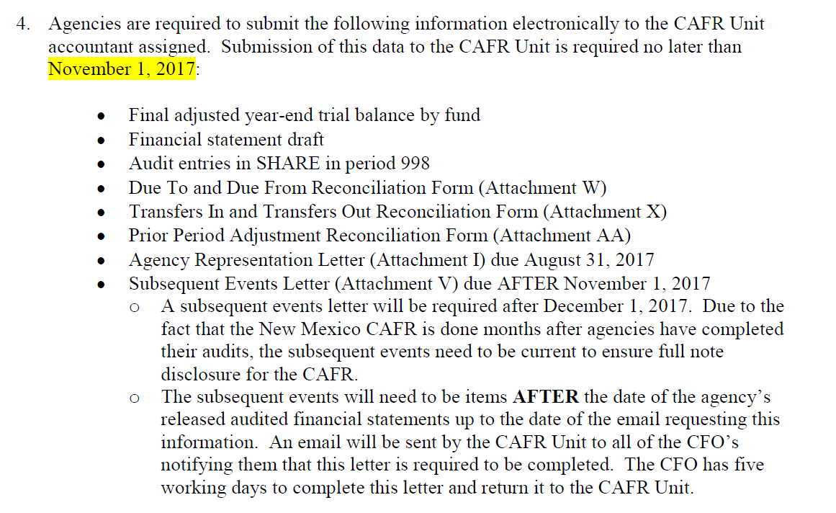
Audit Entries:
Include BOTH
Fund financial entries
Government-wide entries
Due November 1st

Slide 87
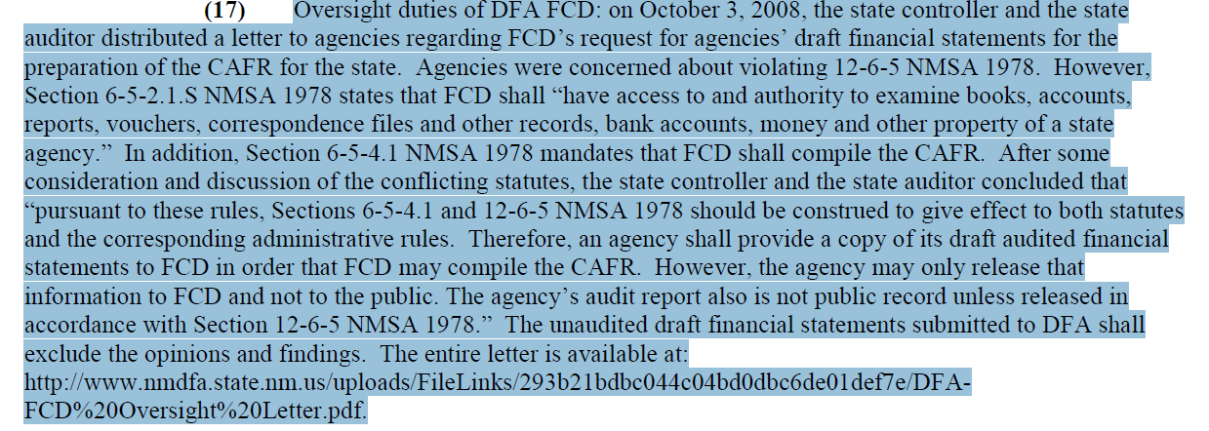
Submission of CAFR Packet Cont.
Agencies are told by their auditors that the audit is not “final” and therefore cannot be given to DFA before approved by the State Auditor’s Office.
Per State Audit Rule: 2.2.2.12 A(17)

Slide 88
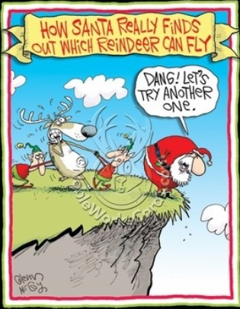
Common Errors on Audit Reports for FY16

Slide 89
Common Errors
SHARE and financials do not balance
Non-compliance with GASB 54 (Fund financial fund balances)
Non-compliance with GASB 34 (Government-wide fund balances)
Deficiency in State General Fund Investment Pool (SGFIP) and how to report
Abnormal Balances
Netting Transfers In/Out instead of showing separately
No Note disclosure for Due To/Due From’s
Footing
Local Government Investment Pool
Over-reversions
Inconsistencies

Slide 90
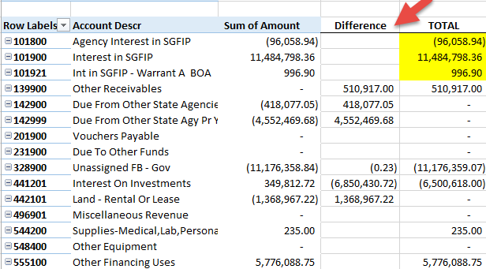
1) Common Error – SHARE and Financial Statements don’t reconcile
Agencies are required to ensure financial statements and the amounts in SHARE reconcile to each other.
Some agencies submit audit entries, submit the financials and notify the CAFR group that everything balances. BUT when the CAFR group does the review, it still needs a lot of entries to make it reconcile.

Slide 91
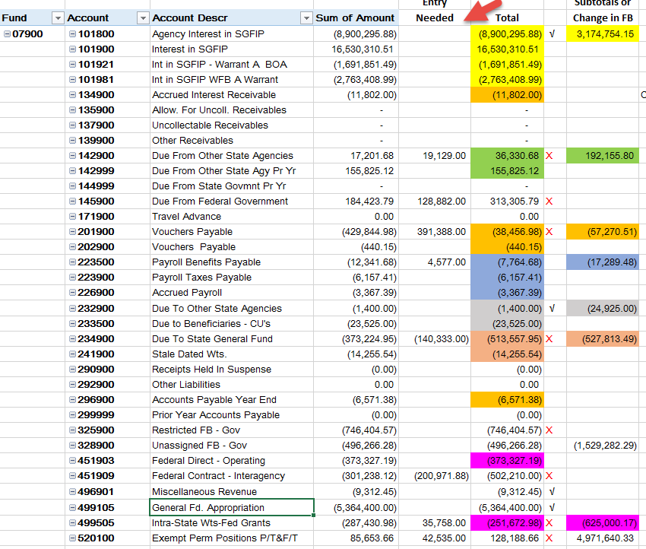
Another Example of CAFR group having to work with agency to do entry since SHARE and financials did not reconcile.

Slide 92
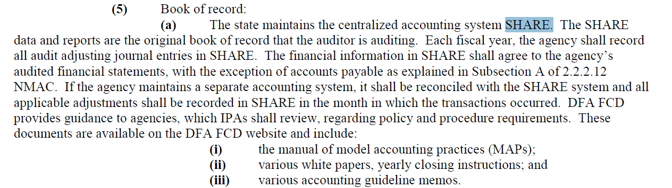
1) SHARE and Financial Statements don’t reconcile Cont.
Per the State Audit Rule 2.2.2.12 A(5)a – SHARE and the financials must reconcile.
SHARE is the book of record.

Slide 93
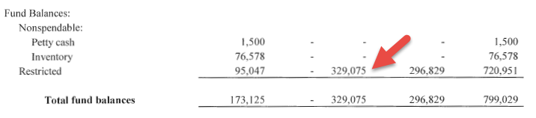
2) Common Error – Still not complying with GASB54
Agencies are required to ensure the fund balances are in the proper classification.
In this example: The remaining fund balance should all be in Restricted (Per financials below).
The balance in SHARE (next page) did not reconcile to that amount and the agency had to do a journal entry to ensure SHARE and the financial statements are reconciled.

Slide 94
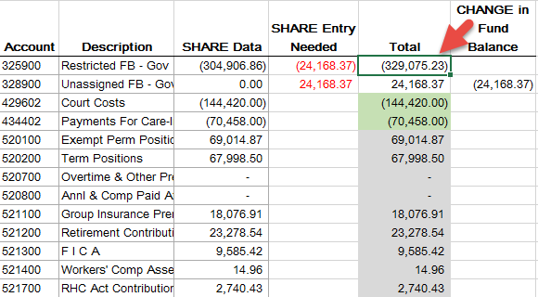
2) Still not complying with GASB54 Cont.
The change in the fund balance will default to 328900.
To ensure the Restricted Fund balance was correct – a journal entry is needed to move the change in fund balance into the Restricted Fund balance.

Slide 95
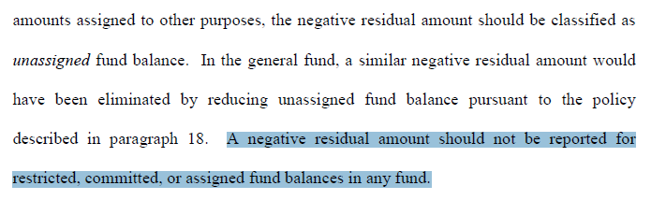
2) Still not complying with GASB54 Cont.
Per GASB54 – a negative fund balance should only be recorded in Unassigned fund balance.

Slide 96
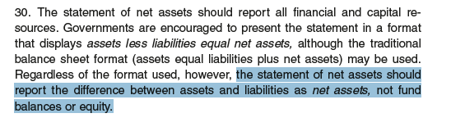

3) Common Error – Government-wide Fund Balances are not complying with GASB34
The classifications for fund balance in the fund financial statements (GASB 54) are different than those on the government-wide (GASB 34).
Below is an excerpt from GASB34

Slide 97
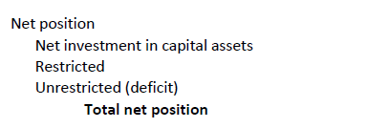
3) Government-wide Fund Balances are not complying with GASB34 Cont.
Basically – all the work to do the fund balance classifications for the fund financial statements must now be redone to accommodate the fund classifications required for GASB34 on the Government-wide financials.
The classifications below are the ones allowed in the FULLACCRUE Ledger (Government-Wide).
  Now – restricted can be broken out more by major classifications on the financials (see next slide).

Slide 98
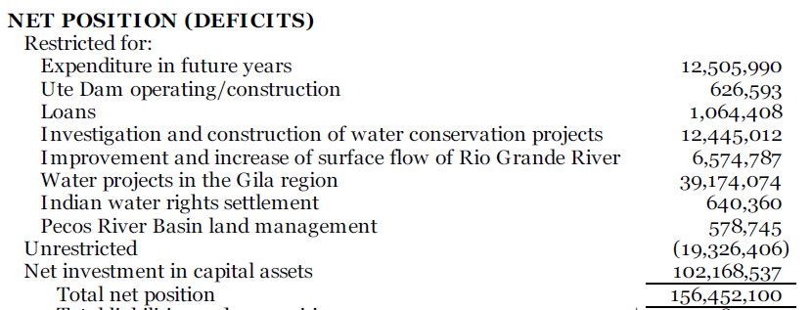
3) Government-wide Fund Balances are not complying with GASB34 Cont.
  Example – restricted broken out more by major classifications.

Slide 99
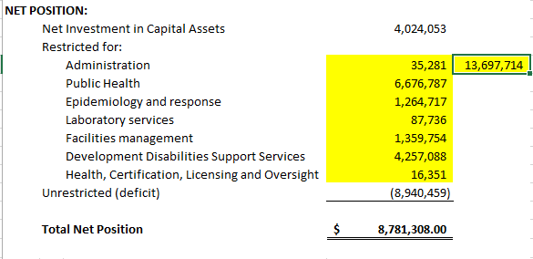

3) Government-wide Fund Balances are not complying with GASB34 Cont.
  Agencies need to do journal entries in FULLACCRUE to ensure the fund balance classifications for the Government-wide are correct.
This agency had to do a journal entry in FULLACCRUE to ensure the fund balances reconciled to the financials.

Slide 100

4) Common Error – Reporting Deficiency in SGFIP
A negative balance in SGFIP should be shown as a liability labeled “Deficiency in SGFIP”. (Some agencies label it “SGFIP Overdraft”)
This example is the correct way it should be shown:

Slide 101



4) Reporting Deficiency in SGFIP Cont.
In this example: There was a negative SGFIP balance of $26,261 The auditor netted the negative SGFIP and combined that with the Due to Other Funds.
In doing this – another problem arose – the Intrafunds did not balance.

Slide 102



4) Reporting Deficiency in SGFIP Cont.
In this example: There was a negative SGFIP balance in these two funds. The auditor called these amounts “Due to the General Fund”.
This money was not Due to the General Fund – it was just a negative SGFIP balance.

Slide 103



5) Common Error - Abnormal Balances
Agencies are required to ensure the account balances are correct
In this example: Auditor netted Asset accounts along with Liability accounts to make the total for “Other Assets”.

Slide 104


5) Abnormal Balances Cont.
Most common is netting a group of liabilities (including the abnormal balance one) into one large amount on the financials
Auditor netted all these accounts to be the total of “Other Liabilities” on the financials – even though there is a debit in one of the liability accounts.

Slide 105

5) Abnormal Balances Cont.
Another Example of netting abnormal balance accounts:
Auditor netted all these accounts to be the total of “Due To State General Fund” on the financials – even though there is a debit balance in Stale Dated Warrants Accounts.

Slide 106

INSANITY

Slide 107
6) Common Error -Netting Transfers In/Out
Transfers In/Out should be disclosed separately
There is a new MAPs rule addressing this issue: FIN 17.2

Slide 108


6) Netting Transfers In/Out Cont.
Transfers In/Out should be disclosed separately
Auditor netted Transfers In (499905) with Transfers Out (555100) to show as “Intra-Agency Transfers” in total

Slide 109

7) Common Error – No Note regarding Due To/Due From’s
Not having this note disclosure is a violation of State Audit Rule 2.2.2.12 A7(b)ii

Slide 110

7) No Note regarding Due To/Due From’s Cont.
This agency had Due To –Due From balances but there was NO note.

Slide 111

7) No Note regarding Due To/Due From’s Cont.
The only note done was Due To State General Fund.
ISSUE– there is still an amount for prior fiscal years that should have already been reverted to the General Fund.

Slide 112


8) Common Error - Footing
In this note – the amount for the deletions did not foot correctly.

Slide 113

9) Common Error – Local Government Investment Pool
State Audit Rule 2.2.2.10 P(5)

Slide 114


9) Local Government Investment Pool Cont.
THIS WAY IS INCORRECT: This agency had money in the pool ($1,128,821) but did not disclose the information on the financial statements but lumped all the cash accounts together.
The money was entered into the correct account code in SHARE.
(SHARE account code for LGIP is 112905)

Slide 115


9) Local Government Investment Pool Cont.
THIS WAY IS CORRECT: This agency had money in the pool and did the proper note disclosure AND showed the amount correctly on the financial statements.

Slide 116
10) Common Error – Over Reverting
NMSA 1978 Section 6-5-10
MAPs Fin 1.2
Some agencies are netting current year reversions with prior year over-reversions in which the agency did not properly request a correction within the 45 days as required.
After the 45 days have past, the agency must show a deficit fund balance for the amount of the over-reverted and ask for a deficiency appropriation.
Note: The agency cannot just book a Due from the General Fund for a prior year over-reversion. There is no statutory authority for the General Fund to send the money back to the agency after the 45 days have passed. Based on that, the monies do not qualify for the recognition standards of GASB33.
Agencies cannot use current year appropriations to offset a prior year budget deficiency without Budget and Legislative approval. (MAPs FIN 1.2)

Slide 117


10) Over Reverting Cont.
In this example: The agency had over-reverted $425.95.
The current year reversion was $12,418.12.
There needed to be an entry to move the over-reverted amount out of account 234900 and move to 328900 – therefore creating the deficit fund balance.

Slide 118


11) Common Error – Inconsistencies
In this example: The financial statements had the whole fund balance as Unassigned but the Note Disclosure had Assigned and Unassigned.

Slide 119


11) Common Error – Inconsistencies
In this example: Capital Asset Increases in the Note was $59,173 but the financials had $52,312.
There was no explanation for the difference.

Slide 120


Slide 121

BEST PRACTICE for FINANCIALS
Fund Financial statements should have the fund along with the fund name listed on the financials.
Example of NOT including the fund numbers:

Slide 122

INCLUDING THE FUND NUMBERS WITH DESCRIPTION

Slide 123

Appendix – Review of items that were in the Year-End Closing

Slide 124
CAFR Progress regarding Audit Review
State Auditor sends an email to the CAFR group notifying them of audits turned in that day.
CAFR group has 10 calendar days (not business days) to finalize the review and send comments back to the State Auditor.
  These comments are sent to the agency’s CFO.
  The agency CFO is responsible for addressing the issues identified.
  THE CFO MUST RESPOND WITHIN 3 DAYS OF NOTIFICATION.
The State Auditor’s Office can decide to either incorporate the CAFR staff comments in their review or ignore.
If the CAFR Staff do not respond within the 10 days, the audit will be released by the State Auditor without incorporating the changes noted by DFA.

Slide 125


QUESTIONS??

