Slide 1

CAFR Training
August 21-23, 2018

Slide 2
Outline
Status of CAFR
Lessons Learned
Upcoming Processes
Issue with Prepaids
New GASB
Audit Rule Changes
New MAPs
CAFR Packet
Common Errors
Misc. Items
Total Confusion & Time to Go

Slide 3

Can’t see the forest for the trees…..

Slide 4
CAFR Staff
CAFR Unit is comprised of 7 people
Renae Herndon-Lopez
Will Crespin
Richard Torrence
John Severns
Christina C’de Baca
Silvia Rodarte
James Chadburn

Slide 5
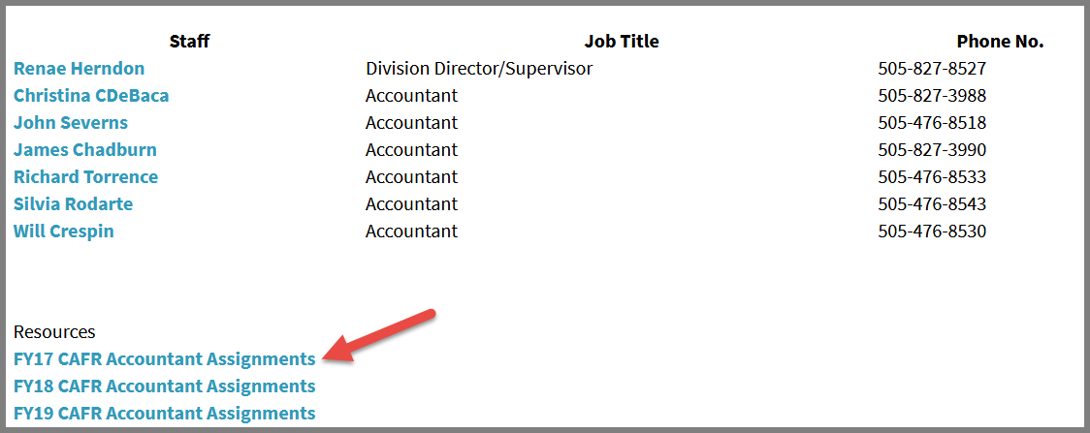
CAFR Staff cont.
To find your CAFR accountant assigned to your agency, go to
http://www.nmdfa.state.nm.us/Statewide_Financial_Reporting_and_Accountability_Bureau.aspx

Slide 6
Status of CAFR
This year, due to both an agency and a component unit deemed material to the CAFR, receiving a Disclaimer of Opinion in their general fund and business type activity, respectively, the CAFR also received a Disclaimer of Opinion.
The CAFR for FY17 was so close to not having a disclaimed opinion on its general fund component.

Slide 7
Remember – per GASB 14, State Agencies are not independent – they are merely departments of the State of New Mexico, the primary government.

Slide 8


In simple terms – we are all a slice of the large pizza called the State of NM CAFR.

Slide 9
Lessons Learned regarding the determination of accruals with the new workflow process

Slide 10


Slide 11
Voucher was in pending status
Agencies need to check to ensure not only that the voucher was submitted, but paid also.
Many vouchers were in pending status and agencies forgot to take them into consideration when they did the AP Accrual Request
  Any invalid voucher needs to be removed. Either the agency needs to complete the removal or work with the HelpDesk to do so.

Slide 12
WEX Bank Charges/GSD Charges
Since GSD and DoIT do not require PO’s – many agencies omitted amounts owed to them from the list of outstanding payables.
  Remember – DoIT and GSD are Internal Service (Enterprise Funds); therefore, do not represent a Due To/Due From relationship and should be included on a 202900 request.
Agencies omitted the WEX Bank Charges and did not realize this until after they had received the statement.

Slide 13
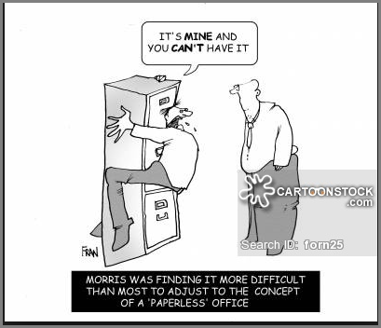
Upcoming Processes

Slide 14
FY18 Bud Ref/Class Codes Used in FY19
Accounts Payable staff at the agencies changed the budget date on accounts payable vouchers to 6/30/18 even though the voucher date was in July/August 2018.
In doing this, this caused expenditures to be charged to FY18 (budget module), while being posted in FY19 general ledger.

Slide 15
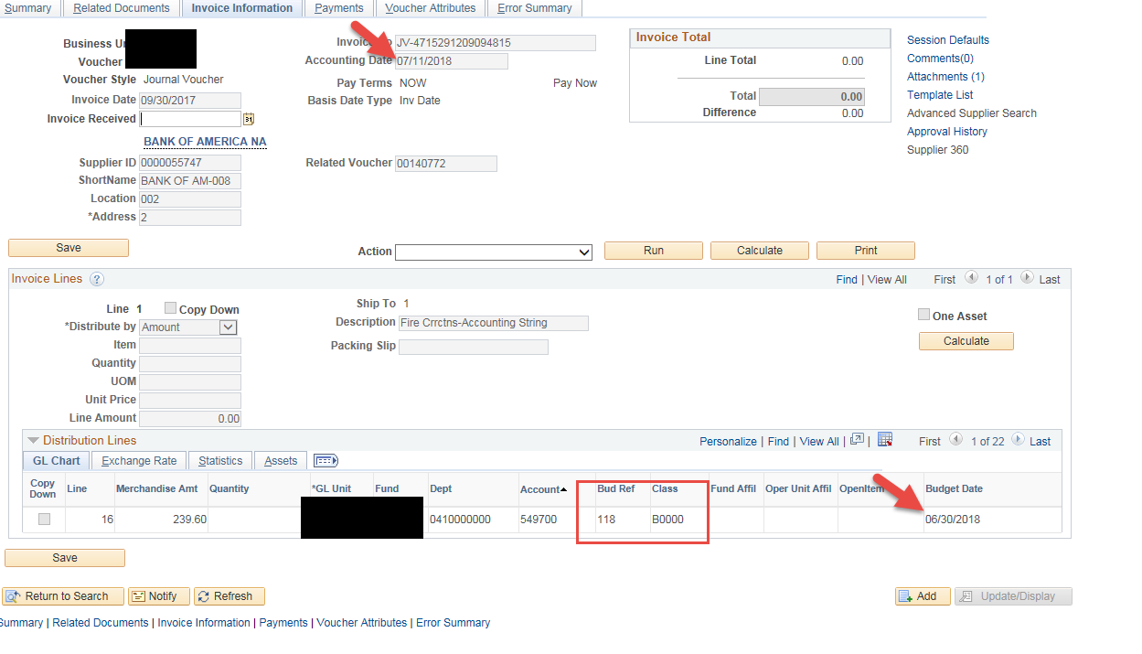
FY18 Bud Ref/Class Codes Used in FY19 cont.

Slide 16
FY18 Bud Ref/Class Codes Used in FY19 cont.
CAFR Unit has a listing from DoIT of all these transactions and will be working with agencies to reverse in FY19 and charge them to FY18. Process to correct will be:
  FY 18 – journal entry in period 998 to debit expenditure and credit 202900.
  FY19 – journal dated 7/1/18 or later – debit 202900 and credit expenditure.

Slide 17
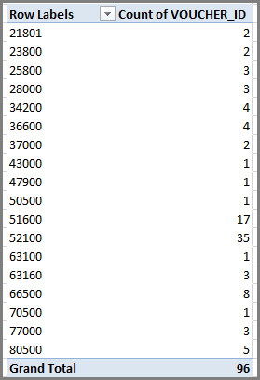
FY18 Bud Ref/Class Codes Used in FY19 cont.
Listing as of 8-15-18 of Business Units and number of vouchers that have been posted and need to be corrected.

Slide 18
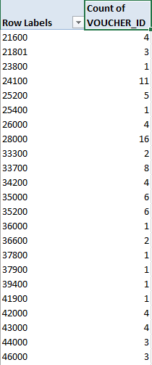
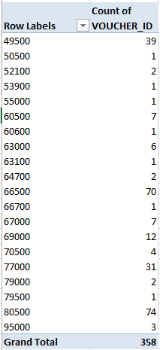
FY18 Bud Ref/Class Codes Used in FY19 cont.
Listing as of 8-15-18 of Business Units and number of vouchers that are unposted and need to be deleted

Slide 19
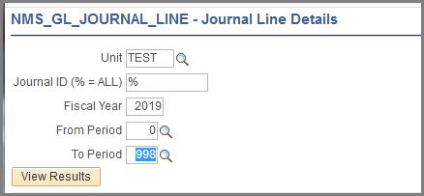
FY18 Bud Ref/Class Codes Used in FY19 cont.
If you want to verify this information and not wait for CAFR to contact you, run the query
NMS_GL_JOURNAL_LINE for FY19 and see if there are any Bud Ref’s of 118.
  If there are – you have to prepare journal entries to correct.

Slide 20
When can you do a Request for Prior Year?
If you are needing to pay for anything PRIOR to FY18 (any invoice prior to 7/1/17) – immediately.
  Then it needs to go on the 202900 listing.
If your AUDITOR stipulates in writing that the invoice is immaterial and will NOT be accrued in the financials for FY18 – immediately.
Any other invoice for FY18 that is material and will be accrued in the financials, the agency must follow the 202900 process.

Slide 21
202900 Less than $1,000,000
Attachment AC
  Numerous vendors as long as total amount of request stays less than $1,000,000 and no single vendor is owed more than $500,000.
  Signatures of both the Agency Head and the CFO must be on the form.
  2 forms must be emailed to Renae and Christina
    Need the EXCEL version
    PDF Version with signatures.
  In Column F – must detail BOTH 1) why the 296900 deadline was not met and 2) how to ensure this will not happen in the future
Location: Financial Control/ Resource Information/ Year-End Closing

Slide 22
202900 Greater Than …..
Attachment AD
    * If amount to a single vendor is over $500,000 – must use this form.
    * If numerous vendors add up over $1,000,000, - must use this form.
  * The form must be emailed to Renae and Christina.
  * 2 forms must be emailed to Renae and Christina
    1) Need the EXCEL version
    2) PDF Version with signatures.
    * In Column F – must detail BOTH 1) why the 296900 deadline was not met and 2) how to ensure this will not happen in the future
    * Form must be signed by:
    CFO
    AGENCY Head
    IPA (Acknowledgement)
Location: Financial Control/Resource Information/Year-End Closing

Slide 23
Due dates for payment for 296900 and 202900
296900 – All payments to vendors must be completed (level 2) by Wednesday, October 31, 2018.
202900 – All payments to vendors must be completed (level 2) by Friday, February 15, 2019.

Slide 24
226900 – New Payroll Process
Ron Spilman, State Controller, sent out an email on 7/19/18 informing all CFO’s about the new process regarding payroll.
How it works:
  When payroll runs on Wednesday morning – instead of crediting account 101981, account 226900 will now be credited.
  By the following Wed after payday, The Cash Control Bureau will prepare an allocation journal to eliminate the accrual and settle the cash using the actual payroll date.

Slide 25
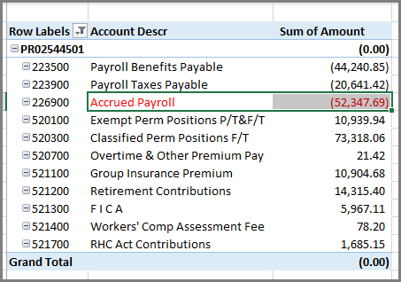
226900 – New Payroll Process Cont.
This is how Payroll now posts in SHARE for FY19

Slide 26
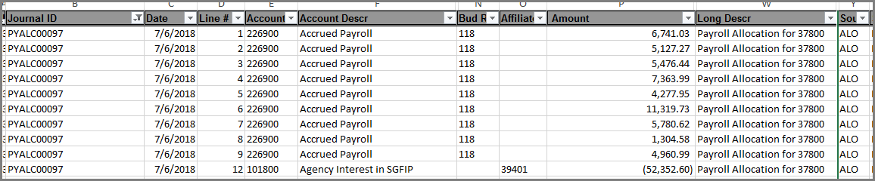
226900 – New Payroll Process Cont.
The allocation that is done in SHARE will be posted ON payday Friday BUT the date the journal is actually reconciled and completed will not be until the following Wednesday of payroll.

Slide 27

226900 – New Payroll Process cont.
Was supposed to be an easy process, turned out not so much.
Note: Cash Unit and Ron Spilman will be doing bi-weekly reconciliations of this account.

Slide 28

Issue with Prepaids

Slide 29
Problems that are occuring with some agencies having pre-paid postage.
Causing the reversion calculation to be overstated.
  Issue – the expenditures are not recognized and when the reversion calculation is done, these expenditures are not included causing the reversion to be more than it should be.
Ensuing fiscal year – causing the agency to have an over-reversion therefore causing the agency to request a deficiency appropriation.
  Issue – the following year the expenditures are now recognized but it is now going against current year appropriations, thereby, creating a deficiency in the agency’s current appropriations.

Slide 30
Problems that are occuring with some agencies having pre-paid postage cont.
Not having budget authority to recognize expenditures if using the consumption method. This can cause a budget finding.
  Issue – the following fiscal year is not when the agency had the appropriation to buy the item. As a result, there might not be sufficient current year appropriation budget to cover the cost, causing a negative budget and a finding.
Agencies are trying to correct this issue by getting approval to do budget increases against NONSPENDABLE FUND BALANCE.
  This makes no sense. This money has been spent and should not be available for current year increase in appropriation.

Slide 31
SOLUTION TO ALL THAT:
USE THE PURCHASE METHOD

Slide 32
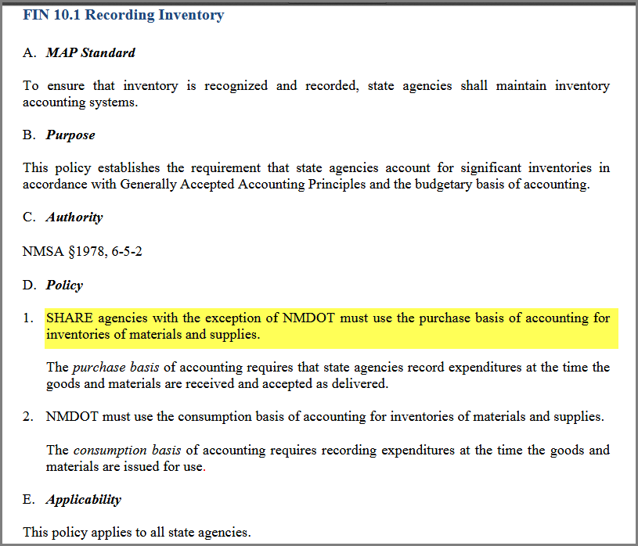
Purchase Method – MAPs 10.1

Slide 33
Purchase Method – Exemption
If an agency decides to use the consumption method versus the purchase method (except for DOT), the agency MUST submit a policy exemption request form to the State Controller.

Slide 34
Purchase Method
Purchase the item and record the expenditure.
Leave the expenditure in the fund financials!!
  This will ensure your budget and reversion are correct.
On the balance sheet is where the change (or the addition) regarding the inventory balance would be reflected.
Example: Prepaid Postage. Bought $2,000 for the year. Remaining at the end of the year is $1,500.
  When the postage was purchased:
  1) Debit: Postage $2,000
    Credit: Cash $2,000
  If amount remaining in postage is MATERIAL (GASB 54):
  2) Debit: Prepaid Asset $1,500
  Credit: Non-Spendable fund balance $1,500
  If the amount is NOT MATERIAL – there should be no prepaid.

Slide 35
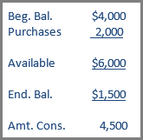
Consumption Method
Purchase the item.
Adjust the fund financials to only record the amount consumed during the current fiscal year.
  This will affect your budget and reversion.
On the balance sheet prepaid and nonspendable for end amounts.
Example: Prepaid Postage. Bought $2,000 for the year. Already had $4,000 on the books from prior fiscal year. Remaining at the end of the year is $1,500. (Consumed $4,500 total).
  When the postage was purchased:
  1) Debit: Postage $2,000
    Credit: Cash $2,000
  Adjust for recording postage used – total was $4,500:
  2) Debit: Postage $2,500
  Credit: Reversion to State General Fund $2,500
  Adjust End of Year Balance:
  3) Debit: Non-spendable fund balance $2,500
    Credit: Prepaid Asset $2,500

Slide 36
New GASB Pronouncements to be aware of

Slide 37
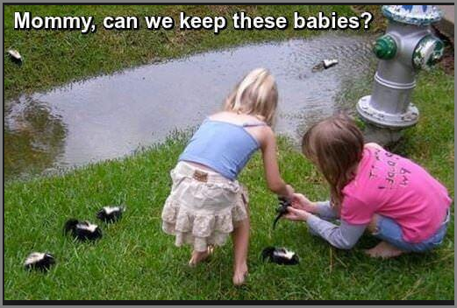

Slide 38
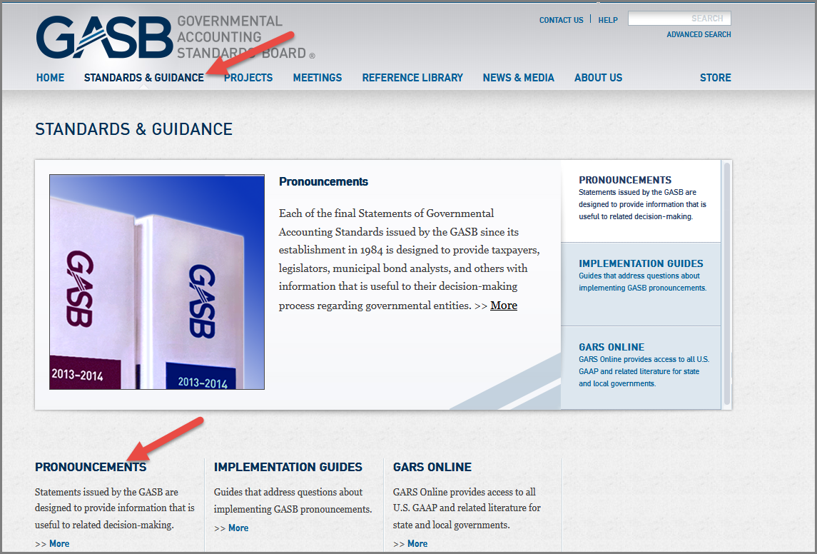
GASB – Governmental Accounting
Standards Board
www.gasb.org
Can go reference all the new GASB Pronouncements.

Slide 39
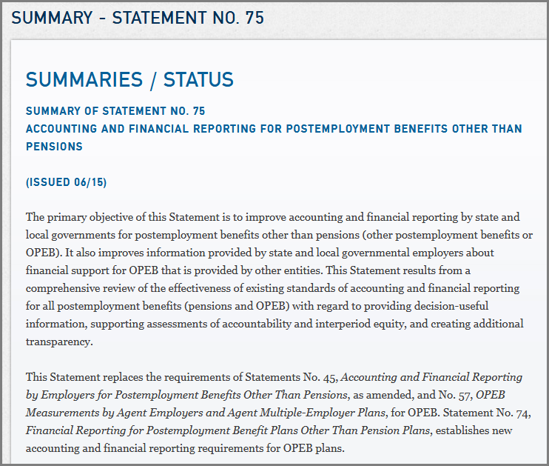
GASB 75 – OPEB Liability

Slide 40
GASB 75 – OPEB Liability cont.
Effective for FY18 financial reporting.
Agencies will need to prepare a note disclosure like GASB68
State of NM will record the OPEB Liability in the CAFR

Slide 41
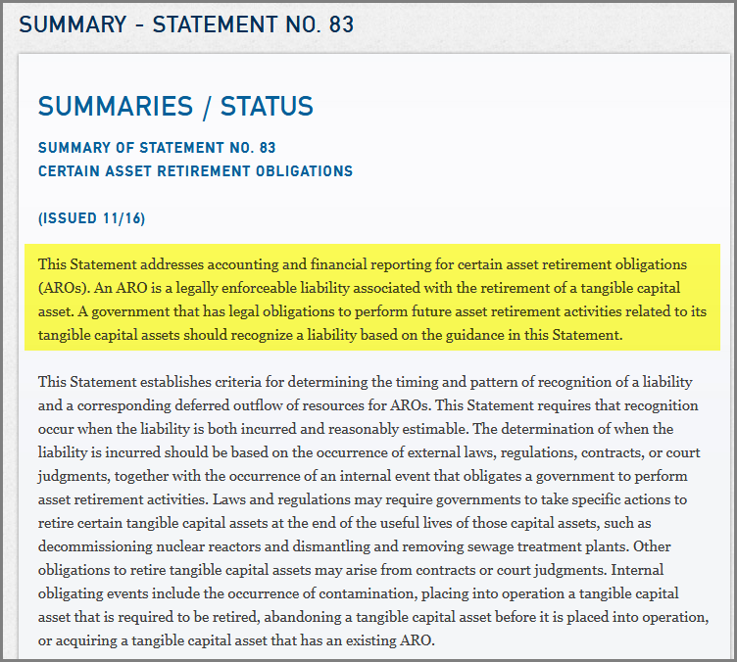
GASB 83 – Asset Retirement Obligations

Slide 42
GASB 83 – Asset Retirement Obligations Cont.
A liability associated with the retirement of a tangible capital asset. (pay someone to dispose of the asset).
  Effective for fiscal years beginning after June 15, 2018
Could apply to state hospitals

Slide 43
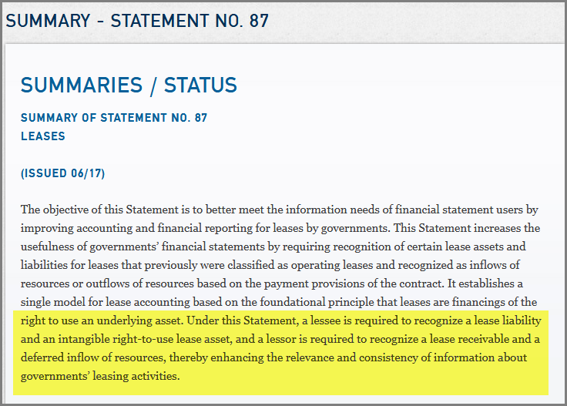
GASB 87 - Leases

Slide 44
GASB 87 – Leases cont.
New accounting requirements on how to account for lease agreements – effective for fiscal years beginning after December 15, 2019.
Agencies that could be impacted:
  Expo/ GSD/ State Land Office/ Game & Fish/ Spaceport

Slide 45
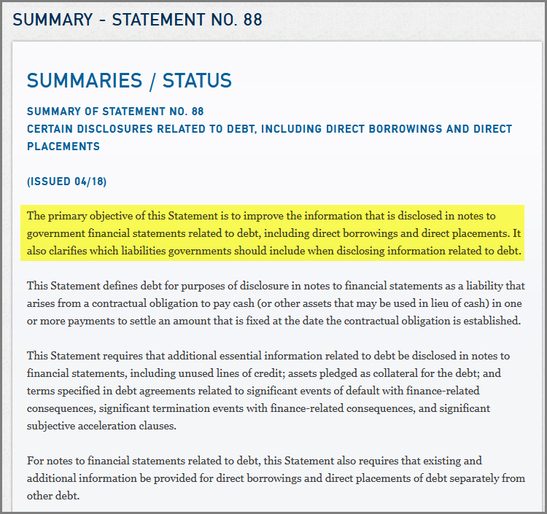
GASB 88 – Debt Disclosures

Slide 46
GASB 88 – Debt Disclosures cont.
Agencies that have debt need to ensure the note disclosures related to debt, including direct borrowing and direct placements are prepared.
                Effective for fiscal year beginning after June 15, 2018.
    Separate information in debt disclosures regarding direct borrowings and direct placements of debt from other debt.
                Agencies that have debt should notify CAFR Unit early in the process. This will allow the CAFR Unit time to review the documentation.

Slide 47
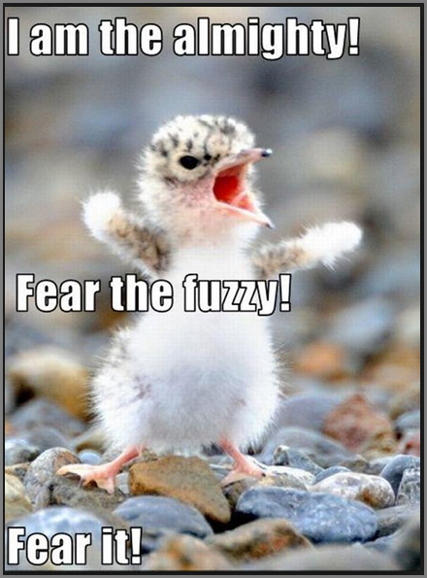
Audit Rule Changes

Slide 48
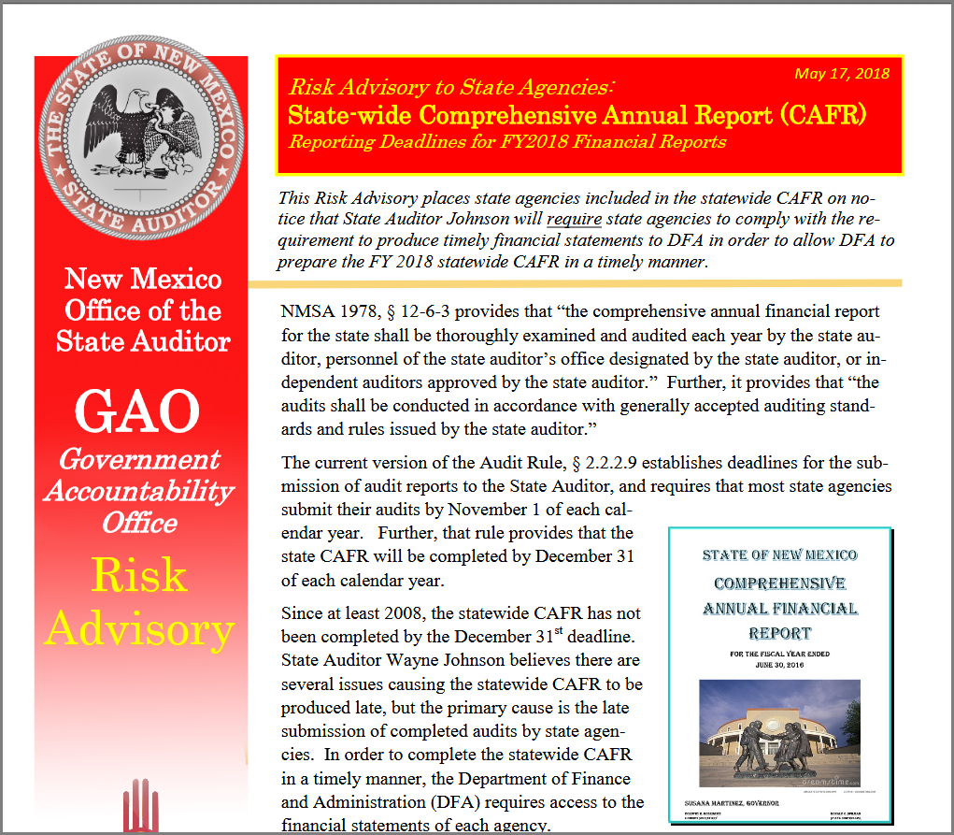

Slide 49
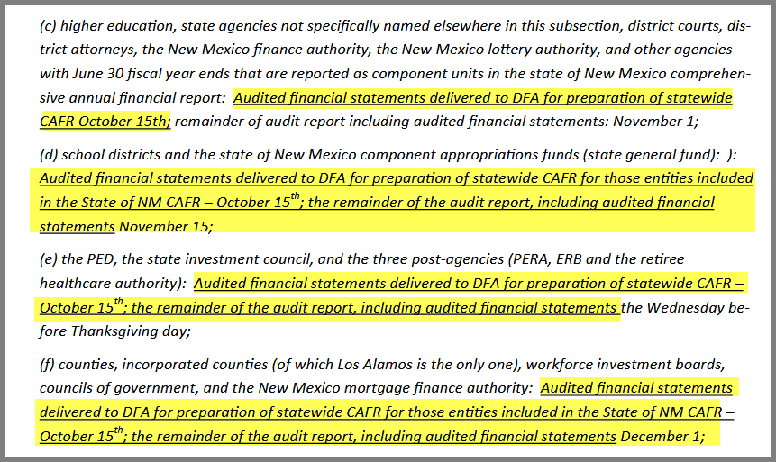

Slide 50
Results of State Audit Rule Hearing on August 20th…..

Slide 51
Result of the Audit Rule Hearing
NO MORE
OCTOBER 15th DEADLINE

Slide 52
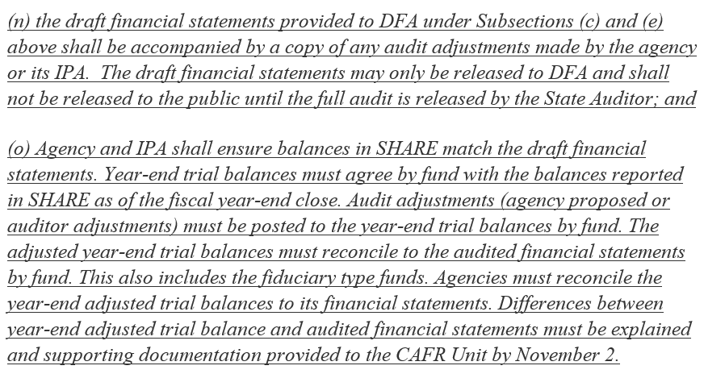
Proposed State Audit Rule Changes
2.2.2.9 A Report Due Dates

Slide 53
Proposed State Audit Rule Changes cont.
The two paragraphs listed on the slide before are staying with one minor change.
As a result of the Audit Rule Hearing, instead of it stating “November 2” it will now read “report due date”.

Slide 54

New MAPs

Slide 55
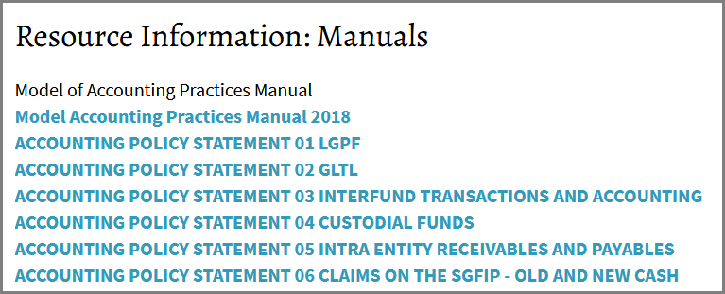
MAPs and Accounting Policies
How to navigate to MAPs and the 6 accounting policies.
www.nmdfa.state.nm.us
Financial Control
Resource Information
Manuals

Slide 56
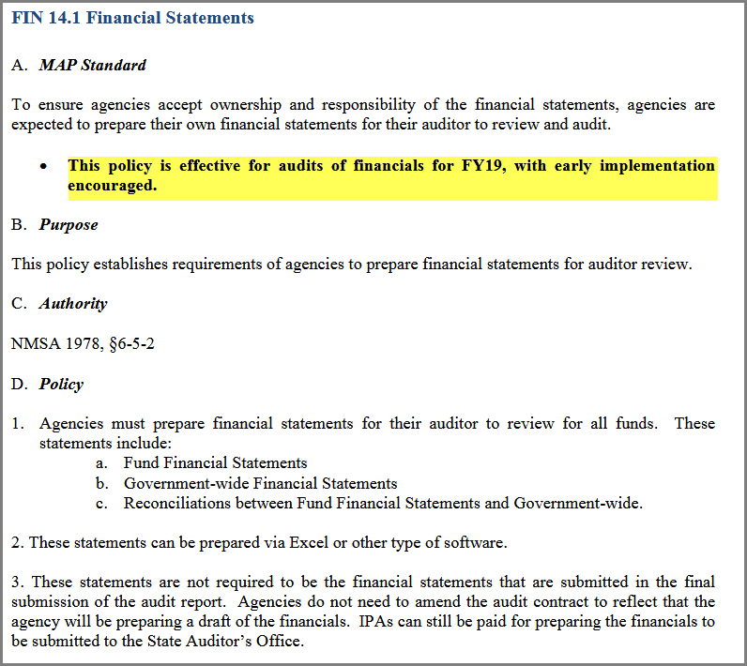
NEW MAPs 14.1 Financial Statements

Slide 57
MAPs 14.1 Financial Statements cont.
For FY19 Audit – agencies will be responsible for creating financial statements to give to their IPA’s.
  Government-wide
  Fund Financials
  Reconciliations
Agencies are encouraged to try this year to create their own financial statements after receiving training from the CAFR Unit.
  These statements do NOT have to be the “pretty” statements that go in the audit report.
  These statements do NOT require the audit contract to be amended. The auditor can still prepare the financial statements that are to be turned in for the audit report.

Slide 58
DISREGARD
FIN 14.2 and 14.3 – these are NOT new pronouncements and should not be in this section
These are a duplicate for FIN 13.2 and FIN 13.3

Slide 59

FIN Section 17
FIN Section 17 is now FIN Section 15…..

Slide 60
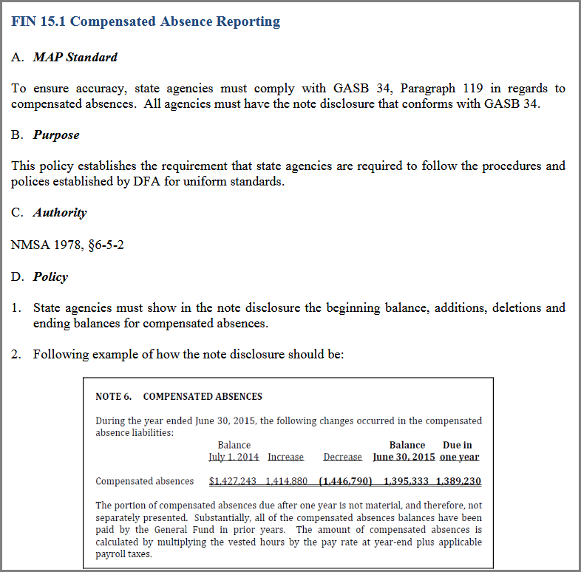
FIN 15.1 – Compensated Absences

Slide 61
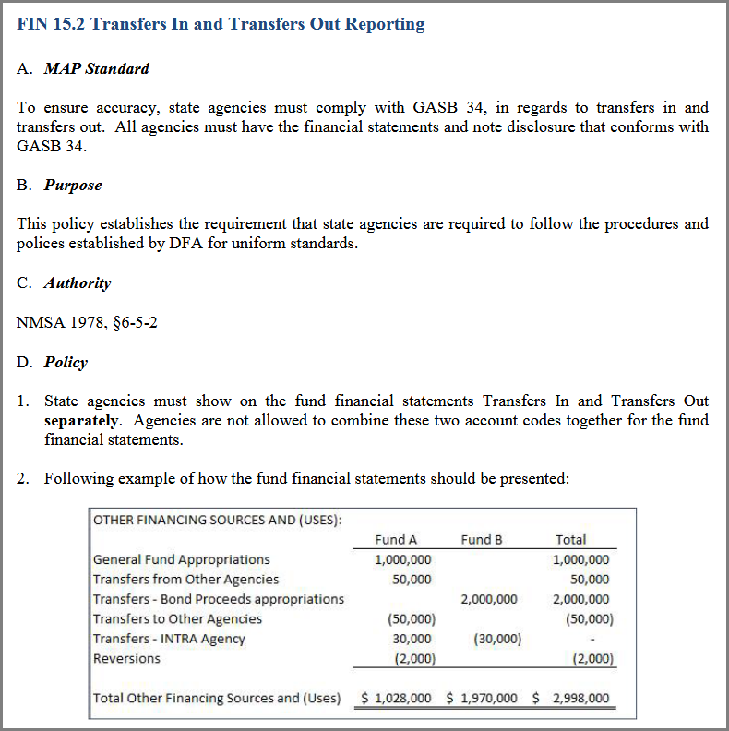
FIN 15.2 Transfers In/Out

Slide 62
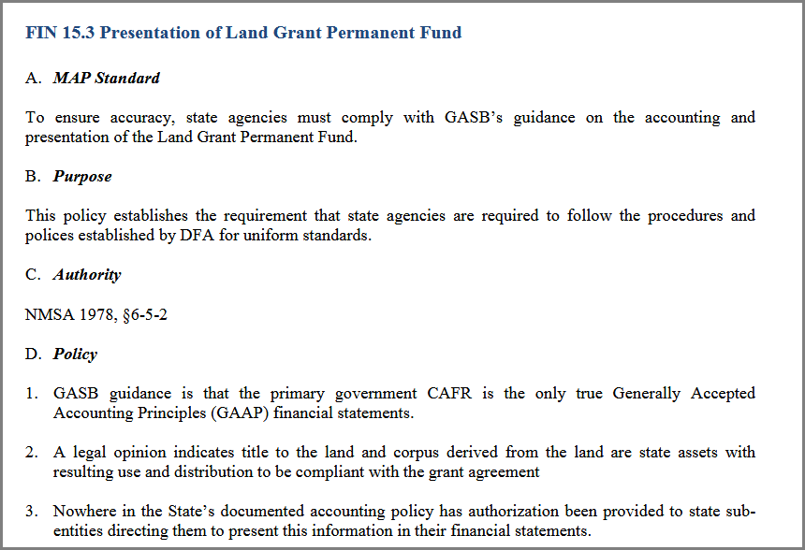
NEW MAPs 15.3 Presentation of Land Grant Perm. Fund

Slide 63
NEW MAPs 15.3 Presentation of Land Grant Perm. Fund cont.
Instead of each agency claiming an interest in the Land Grant Permanent Fund (LGPF), State Investment Council (SIC) will account for LGPF in its entirety as an asset.
SIC will be the entity that records all earning related to the Land Grant Fund.
Agencies will receive “Transfer In” (Other Financing Source) for the monthly allocations.
DFA implemented this change for FY17 financials.

Slide 64
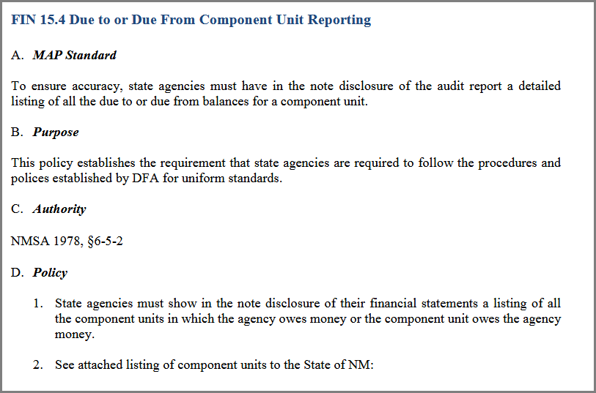
NEW MAPs 15.4 Due To/From Component and/or Component Unit of State of New Mexico

Slide 65
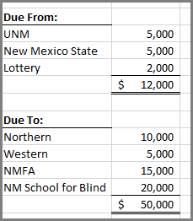
NEW MAPs 15.4 Due To/From Component and/or Component Unit of State of New Mexico cont.
If an agency has any balance in 143500 (Due from Component of State of NM) or 233500 (Due to Component of State of NM), then the agency must have a note disclosure listing the Components and Component Units of the State of NM entities to which the monies are applicable:
Example: Agency has $12,000 in 143500 and $50,000 in 233500. The note disclosure should look like:

Slide 66

CAFR Packet

Slide 67
AGENCY REPRESENTATION LETTER
Audits that have a due date of November 1st – the agency representation letter is due Friday, August 31st – ELECTRONICALLY to either JohnJ.Severns@state.nm.us or FCD.CAFR@state.nm.us
Agencies in which the audit due date is after November 1st, the representation letter is due 60 days prior to the due date.

Slide 68
AGENCY REPRESENTATION LETTER cont.
The Agency Representation Letter is on DFA website:
www.nmdfa.state.nm.us
Financial Control
Resource Information
Year End Closing
Attachment I

Slide 69
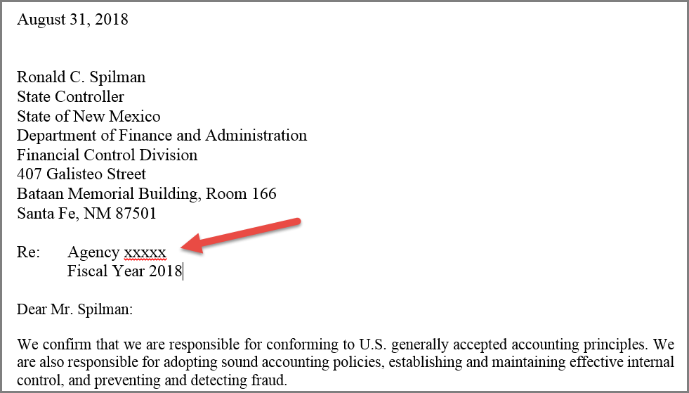
AGENCY REPRESENTATION LETTER cont.
Make sure the representation letter has your agency number.
Some agencies just sign the letter and we can’t read the handwriting to determine which CFO signed.

Slide 70
CAFR Packet is due NOVEMBER 2nd at 5pm
ELECTRONICALLY to CAFR Accountant or generic CAFR email (FCD.CAFR@state.nm.us)
  Financial adjusted year-end trial balance by fund
  Financial Statements
  NOTES
  Listing of auditor proposed entries
  ALL audit entries must be in SHARE (both ACTUALS and FULLACCRUE).
  If agency has any – Prior Period Adjustment Reconciliation Form (Attachment AA)
Note: This year the Due To/Due From Reconciliation form and the Transfers In/Out Reconciliation Form are NOT required.

Slide 71
Have all your journal entries in SHARE by report due date comply with State Audit Rule

Slide 72
Proper format for Journal Entries in Period 998
AUD entries can be either CFR/CSH or OPR.
These entries are in the ACTUALS Ledger
  18AUDBU#JE
  Example: BU 21800 and 10th entry
    18AUD21810
FAL entries can be either CFR/CSH or OPR.
These entries are in the FULLACCRUE Ledger
  18FALBU#JE
  Example: BU 42000 and 3rd entry
    18FAL42003

Slide 73
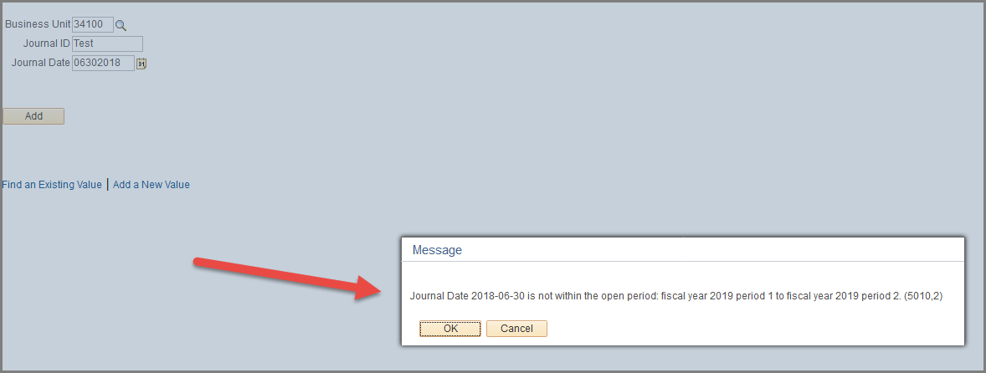
Don’t Forget – any journal entered with a 6/30/18 date will get this error message…just click “OK”

Slide 74
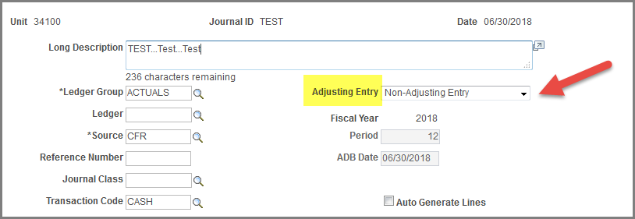
Change the Adjusting Entry Field
Don’t forget to change the Adjusting Entry field from “Non-Adjusting Entry” to Adjusting Entry.
  This will ensure that the fiscal year and period are changed from the default.
Default:

Slide 75
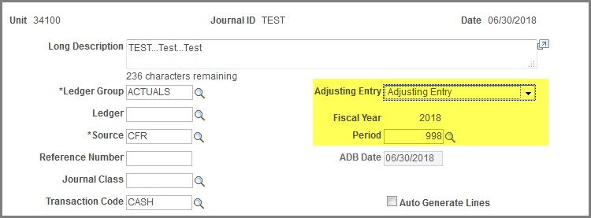
Change the Adjusting Entry Field cont.
Changed:

Slide 76
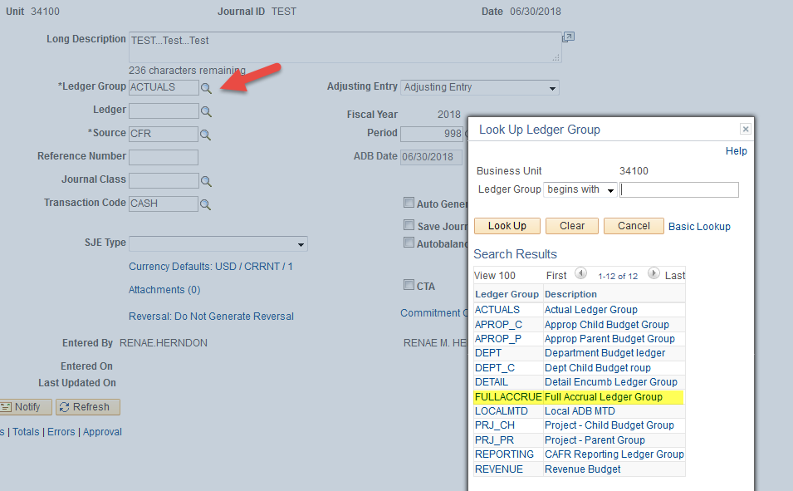
If you need to change the Ledger Group
Change the field called “Ledger Group”.
ACTUALS is the default. If FULLACCRUE is needed, you need to change the Ledger Group.

Slide 77
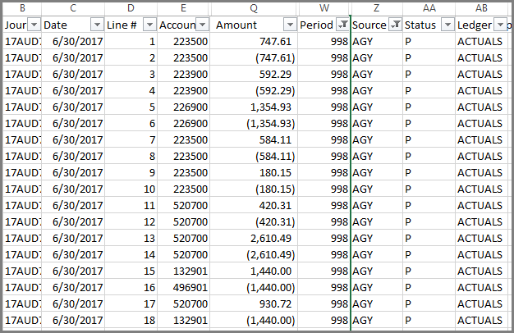
No AGY entries in period 998
Agencies are not allowed to post AGY entries in period 998
All year end entries must be reviewed by the CAFR Group

Slide 78

Custodial Funds

Slide 79
Custodial Funds (Agency Funds)
Should have NO:
Intrafunds (141900/231900)
Due To/Due From Other State Agencies.
Due To/Due From the General Fund
There should only be monies held for EXTERNAL
All agencies are part of the primary government, so therefore there cannot be monies in a Custodial Fund that belongs to another department (or even own agency) of the primary government.

Slide 80
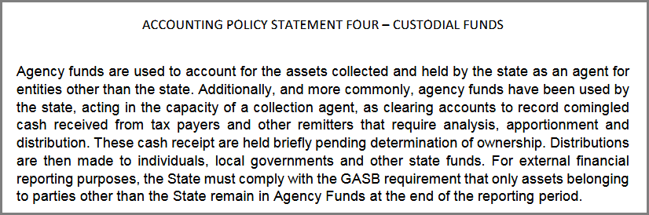
Custodial Funds (Agency Funds) cont.
Accounting Policy #4

Slide 81

Custodial Funds being classified as Special Revenue or General Fund when there are Due To/Due From balances to other State Agencies …which way to record?

Slide 82
Best Way to Record???
When we first started moving Custodial Funds to Special Revenue, DFA informed agencies that this was the first step. Next step was to reexamine revenue recognition.
Step 2 has not been done yet.
Some auditors do not like there is no revenue recognized in these funds and claim it should not be a Special Revenue Fund but instead reflect it as a General Fund – THAT IS FINE.

Slide 83
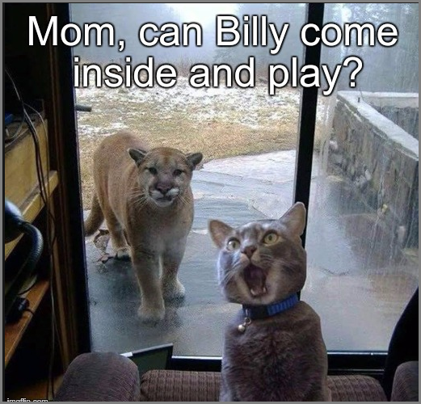
Denied Journals

Slide 84
Do not approve a journal entry that is already in denial status…..
Once denied, it can never be posted until the denials are removed…..

Slide 85
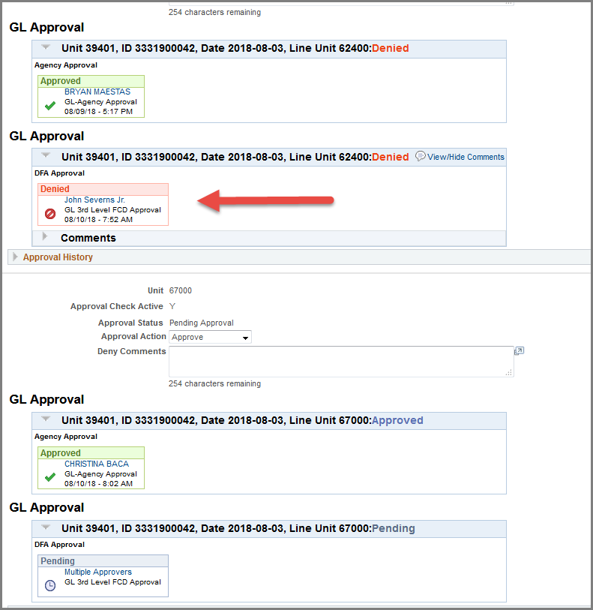

Slide 86
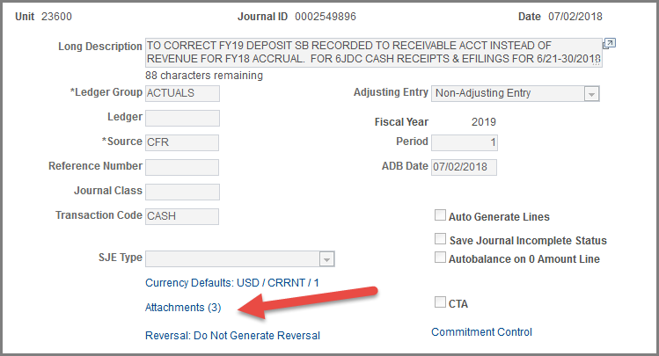
CAFR Unit enters the denials in the attachments
Remember – not everyone can see the denials that are typed in. The CAFR Unit attaches the denial in the attachments.

Slide 87
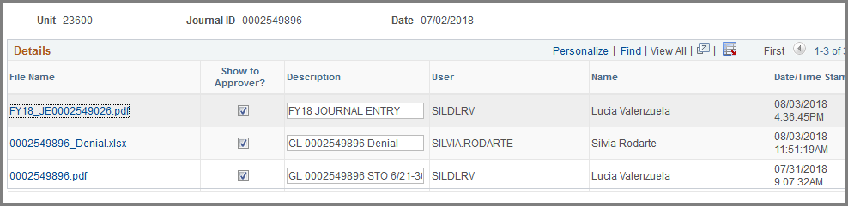
CAFR Unit enters the denials in the attachments cont.
Do NOT delete the journal entry once a denial is attached. Many agencies are still trying to delete a journal entry so it doesn’t show that a denial was ever done.

Slide 88

Let’s Take a 20 Minute Break

Slide 89
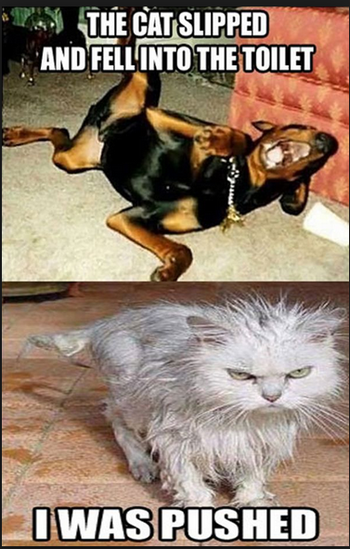
Common Errors

Slide 90
1) Common Error - Settle cash for reversion/ Due TOs & FROMs up to 9/30
Per accounting policy #6, up to 9/30/18, cash for reversions will be “settled” instead of creating a “Due To the General Fund”.
This also applies to other monies between agencies that meet the “economic event” criteria.

Slide 91
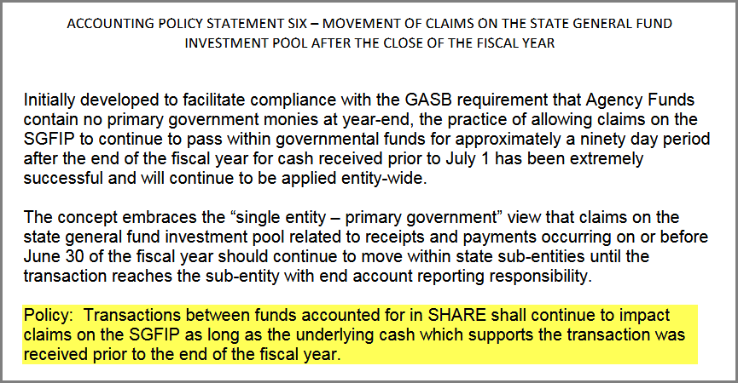
Accounting Policy #6
1) Common Error - Settle cash for reversion/ Due TOs & FROMs up to 9/30 cont.

Slide 92
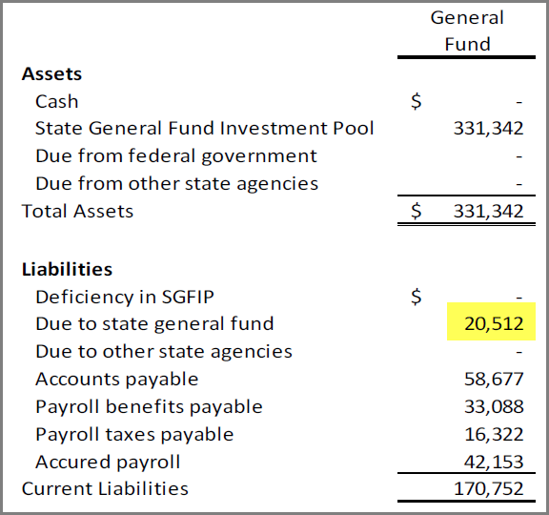
1) Common Error - Settle cash for reversion/ Due TOs & FROMs up to 9/30 cont.
This example: The reversion OPR was “settled” but the financials were showing it as a Due To – causing the cash to be incorrect.

Slide 93
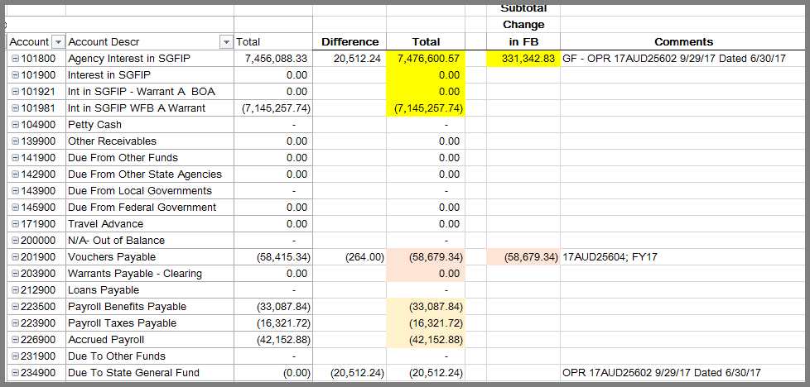
1) Common Error - Settle cash for reversion/ Due TOs & FROMs up to 9/30 cont.
When the reconciliation was done between financials and SHARE – the difference between SGFIP and the liability was discovered.

Slide 94
2) Common Error – SHARE and Financial Statements don’t reconcile
Agencies are REQUIRED to ensure the audited financial statements and the balances in SHARE reconcile to each other for both ledgers (ACTUALS / FULLACCRUE)!!!
When CAFR Unit was performing the reviews, we discovered many entries that needed to be made to reconcile.
  In some cases, the CAFR Unit actually had to do the entry since we could not get the agency to do so. (Note: Those agencies were notified that they did not comply with MAPs FIN 16.11)

Slide 95
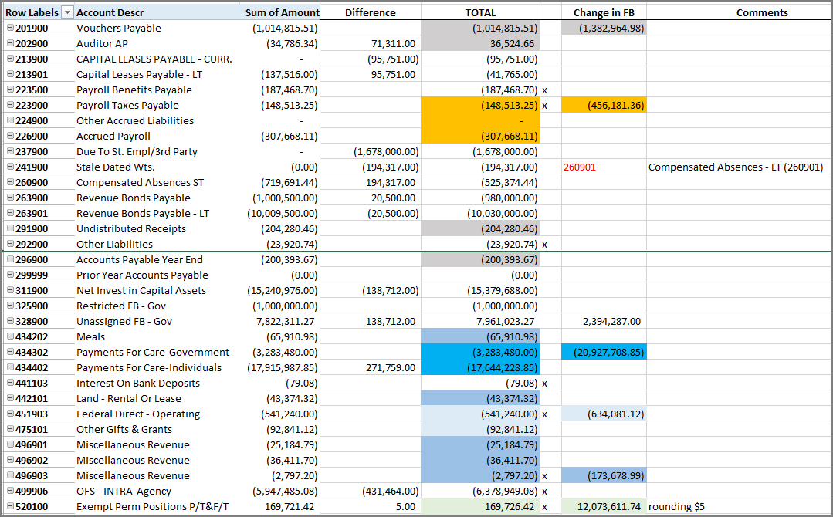
2) Common Error – SHARE and Financial Statements don’t reconcile cont.
Example of one agency in which their funds needed a lot of entries – even after audit was turned in on time Nov. 1st.

Slide 96
3) Common Errror - Over-reversions
NMSA 1978 Section 6-5-10
MAPs FIN 1.2
Some agencies are netting current year reversions with prior year over-reversions in which the agency did not properly request a correction within the 45 days as required.
After the 45 days have passed, the agency must show a deficit fund balance for the amount of the over-reverted and ask for a deficiency appropriation.
Note: The agency cannot just book a Due from the General Fund for a prior year over-reversion. There is no statutory authority for the General Fund to send the money back to the agency after the 45 days have passed. Based on that, the monies do not qualify for the recognition standards of GASB33.
Agencies cannot use current year appropriations to offset a prior year budget deficiency without Budget and Legislative approval. (MAPs FIN 1.2)

Slide 97
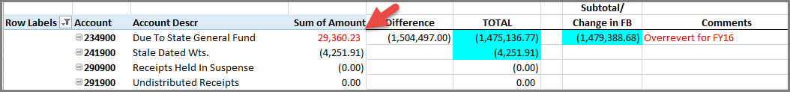
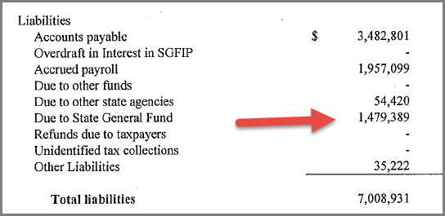
3) Common Errror - Over-reversions cont.
In this example: The agency had overreverted from FY16 by $29,360.23 and it was being “netted” against the current year reversion.

Slide 98
3) Common Errror - Over-reversions cont.
For Agencies that encounter this – the over-reversion must stay on the books until the Agency receives a deficiency appropriation from the Legislature.
Your budget analysist can assist with this request.
This amount needs to remain as a debit fund balance.

Slide 99
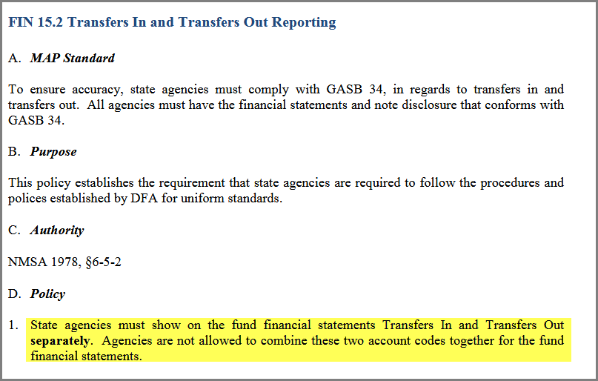
4) Common Error - Netting
Transfers In/Transfers Out should be disclosed separately and not all together.
  FIN 15.2

Slide 100
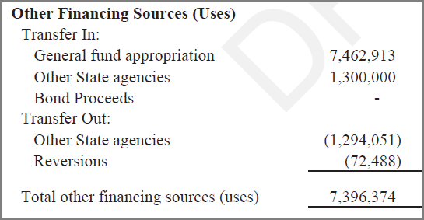
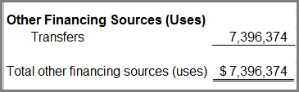
4) Common Error – Netting cont.
Presentation for Other Financing Sources (Uses)
Correct Method:
Incorrect Method:

Slide 101
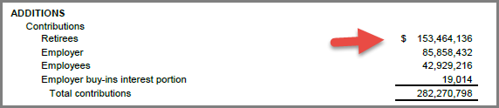

4) Common Error – Netting cont.
Netting a Revenue against an expenditure
Agency netted Contributions against the expenditure “refunds” to net to the amount for the Additions: Contributions Retirees

Slide 102

NOOOOOO!!

Slide 103
5) Common Error - Capital Asset Transfers in Fund Financial not Government-wide
In some cases, one agency has the budget authority to buy capital assets on behalf of another agency.
The agency that has the budget authority will show the expenditure in the fund financials.
The agency that bought the asset items will then prepare a Transfer journal entry in the Government-wide financials moving the capital asset from their books to the receiving agency’s books.

Slide 104
5) Common Error - Capital Asset Transfers in Fund Financial not Government-wide cont.
This transfer should NOT be in the fund financials due to the fact the receiving agency did not have budget authority to purchase the item.
These transfers need to occur in the FULLACCRUE ledger (government-wide).

Slide 105

5) Common Error - Capital Asset Transfers in Fund Financial not Government-wide cont.

Slide 106
6) Common Error - Capital Outlay doesn’t match note
Capital Outlay Additions should be a separate line in the Statement of Revenues, Expenditures & Changes in Fund Balance
These expenditures should reconcile to the Note Disclosure in the financial statements.

Slide 107


6) Common Error - Capital Outlay doesn’t match note cont.
INCORRECT Method:
Agency has capital outlay included with Other Costs, and the amount does not match note disclosure

Slide 108


6) Common Error - Capital Outlay doesn’t match note cont.
CORRECT Method:
Agency has correctly accounted for the expenditures on the financial statements, which agrees to the note disclosure.

Slide 109
7) Common Error - Capitalize Outlay expense in Government-wide financials
In the government-wide financial statements, the expenditures for the capital asset should be eliminated and the capital outlay item should then be capitalized.
In the fund financials – the expenditure is classified under Capital Outlay (previous slide).
In the government-wide financials – the expenditure now becomes a capital asset.
Example: Bought a car (548800) for $30,000.
Entry:
      Debit: Automobile Asset (183900) $30,000
      Credit: Automotive Expense (548800) $30,000

Slide 110

7) Common Error - Capitalize Outlay expense in Government-wide financials cont.
In preparing the Government-wide reconciliation for this agency – there were still balances in the capital outlay account line items.
      Note: There was also a credit in 555100 in which the amount should be a debit.

Slide 111

8) Common Error – Amounts in the capital expenditure account codes that are not amounts to be capitalized
Agencies reflect amounts in the capital expenditure account codes (548xx) that are not above $5,000 or in a combination of accounts that should not be capitalized.
  Need to move to consumable account code

Slide 112
9) Common Error - Abnormal Balances
Agencies are required to ensure the account balances are correct.
Basic Accounting:
  Liabilities are credit balances
  Assets are debit balances
  Fund balances are credit balances
  Revenues are credit balances
  Expenditures are debit balances

Slide 113


9) Common Errors - Abnormal Balances cont.
Debit balances in a Liability Account:
Agency A:
Agency B:

Slide 114

9) Common Errors - Abnormal Balances cont.
Accounts with balances that need to be corrected – along with having balances in accounts that should not be used
These 2 accounts need to have a journal entry to clean up
WHAT IS THIS? Using a non-standard account code

Slide 115

10) Common Error - Note disclosure for Due To/Due From & Transfers
State Audit Rule 2.2.2.12 A(7b)ii
Agencies need to not only have the corresponding agency number but also the SHARE fund number

Slide 116

10) Common Error - Note disclosure for Due To/Due From & Transfers cont.
Agency lists the corresponding state agency – but no funds listed (not even for their own)
Incorrect Method:

Slide 117

10) Common Error - Note disclosure for Due To/Due From & Transfers cont.
CORRECT Method:

Slide 118

11) Negative Cash Presentation
Remember – negative cash balance should be shown as a liability.

Slide 119


11) Negative Cash Presentation cont.
When CAFR finds issues, notifies CFO’s. As you can see with the comment below, the presentation for negative SGFIP was not done correctly.

Slide 120
12) Stale Dated Checks
Agencies are leaving balances (years worth) in the stale dated account code (241900).
MAPs FIN 5.4 explains the process for agencies to follow regarding stale dated checks.
Basically, if the check is not to be reissued, then:
  If you are a reverting fund, that money is to then be reverted to the State General Fund in the current fiscal year (just like when you do a reversion).
  If you are a non-reverting fund, then a journal entry needs to be done to move that money from 241900 to misc. revenue.

Slide 121
13) Revenue/Expenditure Accounts in Other Financing
Accounts that have been established as a elimination entry on the State-wide level (revenue/expenditures with “09) are not Other Financing Sources to agencies.
These accounts need to be recorded as a true revenue or expenditure.

Slide 122

14) Fund Balance Classifications Incorrect
Agencies are not ensuring the fund balance classifications match the classifications listed in the financial statements.
After CAFR does review, we are having to work with agencies to do entries.

Slide 123

To make it easier to reconcile –
Put the fund on top of the financial schedules
Please include the fund number on top of the fund column – this will ensure cleaner/faster reconciliation.

Slide 124

Misc. Items

Slide 125
Affiliate and Fund Affiliate
Remember – only certain accounts require the affiliate and fund affiliate chartfields to be populated.
Do NOT include them on accounts that do not need them.
At the sign-in table was a hand-out for the most recent copy of the listing.

Slide 126


Numbering convention for journal attachments
Correct Way
Incorrect Way

Slide 127
White Paper on Chart of Accounts
Please note – the white paper that details the chart of accounts is EXTREMELY outdated and not completely reliable.
Take that into consideration when you are using it as a reference point.
DFA is planning to revamp the chart of accounts here soon to accommodate all the new GASB accounting changes such as accounting for cash flows.

Slide 128
Training from CAFR Staff
CAFR Staff have currently been training CFO’s and financial staff on 2 areas:
  How to create financials using SHARE
  New CFO training which encompasses Budget/Accounts Payable/General Ledger/Payroll Reconciliation/Encumbrance Reporting/etc.
If you feel you might need any of these trainings listed above (even if not new CFO), let us know.

Slide 129

Helpful Queries in FIN

Slide 130

Helpful Queries in HCM

Slide 131
CPE Certificates
CPE Certificates are available for those that need one.
Get one from John on your way out of the training.

Slide 132

Thanks!
Any questions?

