Slide 1
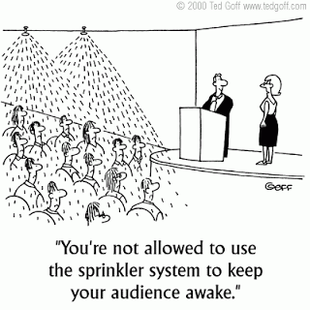
Mid-year cafr training
September 1, 2016

Slide 2

Housekeeping
1) Please turn Cell Phones to vibrate or Shut Them Off.
  If you need to take a call, please leave the auditorium.
  If you receive a text, please leave the auditorium to respond.
2) Please no talking.
3) Please raise your hand if you have a question during the presentation. You don’t have to wait until the end of the presentation.
4) Please be courteous to your fellow CFO’s.
  There are varying levels of experience in the room. Some people already know this information while others are just learning it.
5) If you require CPE for this class, please see either Norma or Silvia at the sign- in desk on your way out of training. They will NOT give certificates out before 15 minutes of class ending.

Slide 3
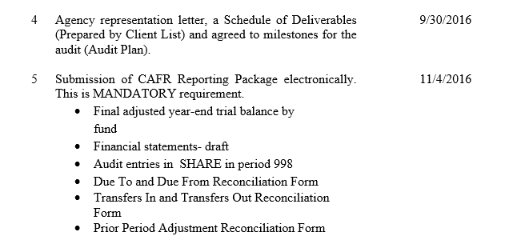
REMINDER
Agency Representation Letter – see below - due September 30, 2016.
  (electronic copy emailed to John Severns and Renae Herndon.)
The CAFR Year-End Packet for FY16 is due NOVEMBER 4th by 5PM.
  (Please send this information to your CAFR accountant electronically.)
This information is located in
Year End Closing Instructions.

Slide 4

Agenda
BEFORE CAFR TRAINING
How to do audit entries
Full Accrual Process/Full Accrual Entries
Explain difference between 201900/202900/ 296900
265900 for GRT
Due To/Due From’s
Affiliate and Fund Affiliate
Miscellaneous Information:
  547999 payments in FY17 that were accrued in FY16
  SHARE being book of record
  State Audit Rule
Common Errors on audit reports
CAFR Staff and other resources
AFTER CAFR TRAINING

Slide 5
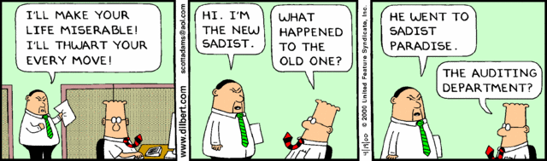
Process for audit entries

Slide 6
AUDIT ENTRIES
***Cannot use “AUD” as a Source Code in FY16***
There can be 3 different types of source codes for audit entries in period 998.
CFR – this entry has NO cash lines but creates entries impacting the same fund.
  On this entry, the business unit is your own business unit BUT the first line of the journal entry MUST have a department so the transaction can go into workflow.
  CFR can be entered either directly into SHARE or via the upload.
CSH – this entry creates cash lines. This entry has numerous funds (in your business unit – your own funds and even subfunds) being affected.
  On this entry, the business unit must be anchored to 39401 and the first line must be the dummy cash line. (BU 39401/Department 0000000000/Account 200000)
  CSH entries can only be done via the upload.
OPR – this entry is to do the accruals for BOTH agencies. This entry cannot have any cash lines but must have a minimum of 2 accounting lines for each entity.
  OPR entries can only be done via the upload.
  Send the corresponding agency the information regarding the journal entry.
Agency1.142900 150.00 (debit)
Agency1.499905 150.00 (credit)
Agency2.555100 150.00 (debit)
Agency2.232900 150.00 (credit)

Slide 7
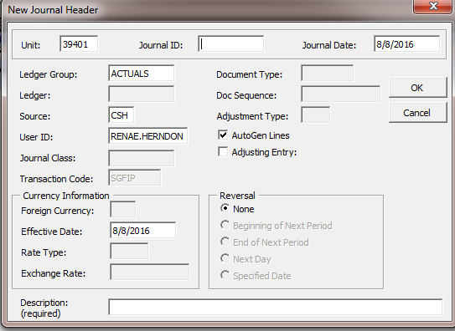
AUDIT ENTRIES – numbering sequence
Journal Entry - Create
1. Verify your Business Unit
2. Journal ID numbering sequence should be in the following form "16AUDXXX01"
a. First 2 digits are the fiscal year
b. Positions 3 through 5, "AUD"
c. Positions 6 through 8, First 3 digits of your business unit
d. Last 2 digits is the sequence of your journal entries. If the entry is the first entry, then the number would be 01.
3. Journal date for fiscal year 2016 adjusting entries should be 06/30/2016
Default Screen:

Slide 8
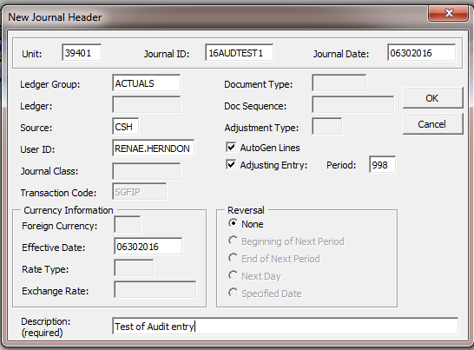
AUDIT ENTRIES
Cannot use “AUD” as a Source Code in FY16
Enter the 10 digit journal ID using the format on the previous slide.
Enter journal date of 6/30/16
If the entry has any cash impacted, then the source must be CSH and the Unit 39401.
If NO cash is impacted, then the source is CFR and unit is YOUR business unit.
If OPR – there can be no cash on this entry but the source would be OPR and the unit is 39401
Check the box marked “Adjusting Entry” and then enter 998 in “Period”.
Enter the effective date to be 6/30/16.
Enter a description of the journal entry.
3
1
2
3
4
5
6

Slide 9
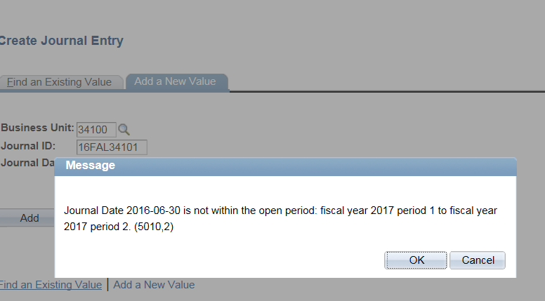
Audit entries
  You will get this standard error message when you first do a journal entry dated for 6/30/16. Click “OK”.

Slide 10
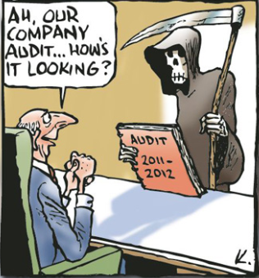
Process for full accrual

Slide 11
Full accrual process
The Full-Accrual Ledger is a PeopleSoft ledger in SHARE used to track Capital Assets, Compensated Absences, Other Liabilities, etc. It basically takes the fund financial statements from modified accrual to full-accrual.
Fiscal Year 2015 ending balances have been input by CAFR Staff for all Agencies not currently using the FULLACRUE Ledger except for those agencies that have not finalized their FY15 audits.
Some examples of the entries input into the Full-Accrual Ledger include Capital Assets, Compensated Absences, and Other Liabilities.
Posted entries in SHARE agree to agency’s FY15 Financial Statements.
During your FY16 audit, your auditor will provide you with your Year-end Audit Entries and your Full-Accrual Entries. Entries should be reviewed and entered into SHARE prior to submitting to your CAFR Accountant.

Slide 12
Full accrual process continued
If your Agency is already using the Full-Accrual Ledger, then you need to ensure amounts agree to SHARE and to your FY15 Audited Financial Statements.
  You will need to post AUD’s for any adjustments that may be needed.
  AUD source code is only allowed for FY15 and prior.
Training times and dates are forthcoming for agencies not currently using the FULLACRUE ledger.
  Training will be in September/early October.
  Training will be provided as needed in small groups or one-on-one basis.
CAFR Staff in charge of this process are:
  John Severns
  Silvia Rodarte
12

Slide 13
Full accrual process continued
NOTE: If your agency is required to have full-accrual financials (and not modified accrual fund financials), then you will NOT be using the FULLACRUE ledger to record your transactions. You will continue to use the ACTUALS ledger with all of the full-accrual entries.
Some agencies for example:
  Retiree Health Care
  PERA
  ERB
  EXPO
13

Slide 14
Full accrual entries
Full Accrual Entries will predominately be entered directly into SHARE.
  Some agencies that have a lot of entries, will have the option of the upload process.
ALL FULL ACCRUAL ENTRIES WILL BE “CFR” SOURCE CODE AND IN PERIOD 998.
Numbering Sequence:
“16FALXXX01”
  Digits 1-2: Fiscal Year
  Digits 3-5: “FAL” (Full Accrual Ledger)
  Digits 6-8: First 3 numbers of your business unit
  Digits 9-10: number of the actual entry

Slide 15
Full accrual entries
  You will get this standard error message when you first do a journal entry dated for 6/30/16. Click “OK”.

Slide 16
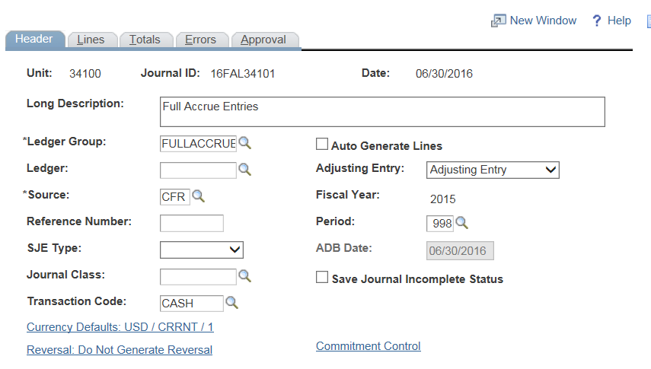
Full accrual entries
Change the “Ledger Group” to FULLACCRUE
Change the “Adjusting Entry” to Adjusting Entry
Make sure the “Source” code is CFR
Make sure the “Period” is 998
Make sure the “Fiscal Year” is 2016
Enter the journal entry lines like a normal entry.
1
2
3
5
4

Slide 17

Difference between 201900/202900/296900

Slide 18
Account 201900
201900 – System generated account for processing vouchers payable.
  Keeping system integrity by not doing manual entries into that account unless it is deemed it is the only way to correct an issue.
  Many times – a process does not complete all the way through. Once it is identified, it can be “released in the current period”.
  No entries are allowed in that account unless HelpDesk allows.
Process:
1) System does accrual
  Expenditure 150.00 (debit)
  Account 201900 150.00 (credit)
2) System processes payment:
  Account 201900 150.00 (debit)
  Cash – 101800 150.00 (credit)

Slide 19
Account 296900
296900 – this account is DFA allowing agencies to estimate year-end accruals.
  The intent is for agencies to estimate the remaining amounts due by their agencies that were not paid by the July due date but must come out of the current year’s budget (FY16).
  The request for the accrual must match the actual entry in SHARE.
  No amounts can be accrued to this account after the request date.
  No audit entry can be done to this account to INCREASE. Audit entries can be done to this account to lower the amount if the accrual was too high.
Note: Payments via Accounts Payable (AP) must have a department on line #1 to ensure it will process correctly and go into workflow.

Slide 20
296900 & year-end accruals
296900 account is only used for amounts that were already approved on the Year End Accrual Request Form.
The forms are reviewed for accuracy and to determine if the correct liability account code is being utilized (among other fields of the form). Some vendors need to be changed from a 296900 liability to:
  233500 – Due to a Component Unit (Agencies owed UNM, Lottery, etc.)
  233900 – Due to a Local Government (Agencies owed Sandoval County, Zuni Pueblo, Santa Fe County, etc.)
  232900 – Due to a State Agency (Agencies owed another agency).
If the CAFR unit changed the account code from 296900 to another account code (the code was highlighted in yellow), this new account code is the one that the journal entry should be done to, along with the payments to the vendors.

Slide 21
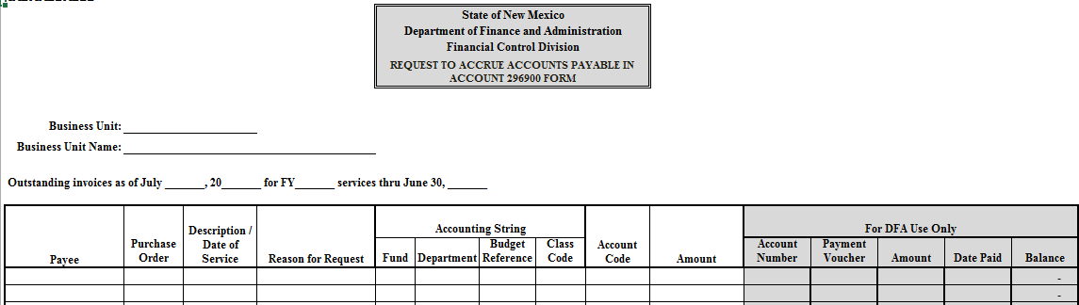
296900 Over – estimated
IF you discover that you over estimated your AP accrual (296900) or any of the other liability accounts (233500, 233900, etc.) on the Request to Accrue Accounts Payable Form, prepare the entry to correct this over-estimation in FY16 not FY17 ONLY if your audit is still ongoing.
  Some agencies during August determined that the amount for 296900 was too high and were doing entries in FY17 to reduce 296900.
  The best way is to correct this is to do an audit journal entry in FY16 to ensure the accruals totals are more accurate for the financial statements and also to properly reflect the FY16 budget.

Slide 22
296900 Payment Deadline
REMINDER – Wednesday, November 30, 2016 is the last day to submit vouchers to pay fiscal year 2016 accounts payable established in account 296900.

Slide 23
Account 202900
202900 – this account is for ensuring agencies follow GAAP basis accounting.
  The intent for this account is to ensure that agencies can still do voucher accrual entries even if all the DFA deadlines have past.
  Normally – this account is used when the auditor finds additional items that need to be accrued in the current fiscal year (16) but was paid in the following fiscal year (17)
    Example: Auditor is reviewing all the accounts payable listing for July and August. Finds travel that was paid in August but the travel was actually for June 2016. The auditor then wants these expenditures accrued in FY16.
    Example: An estimation was done for an invoice and the amount was on the Year End Accounts Payable Request. The invoice came in materially higher than anticipated. The additional amount needs to be recorded to 202900.

Slide 24
Account 202900 cont.
Many times – agencies forget to clear out the balance since the actual payment was done in the following fiscal year.
  If the auditor finds one of these, agencies then need to realize that this account needs to be cleaned out and that the expenditure has been counted twice.
    When the auditor had you do the accrual for FY16, the expenditure was done.
    When the voucher payment was done in FY17, the expenditure was done again.
  Agencies will need to do an entry such as:
    Account 202900 150.00 (debit)
    FY17 Expenditure 150.00 (credit)
Note: some agencies have to do a Request to Pay Prior Year Bills to get these payments done. Remember: the expenditure was already captured in FY16 so these costs in FY17 need to be eliminated.
    Account 202900 150.00 (debit)
    FY17 547999 150.00 (credit)

Slide 25

Gross receipts tax

Slide 26
265900 for grt payments
GRT (Gross Receipts Tax)
There are a handful of agencies that owe TRD gross receipts tax.
  CAFR Unit found out that during the year, each agency does the process different.
    Some agencies deposit the money directly into a liability account and then pay TRD from that liability account. But not all agencies use 265900 – some use 292900, 293900, etc.
    Some agencies deposit the money directly into a revenue account and then pay TRD from that revenue account.
    Some agencies deposit the money directly into a revenue account and then pay TRD from an expenditure account.
Currently, the CAFR Unit is not going to change business process of agencies. The CAFR Unit feels option #1 with depositing the monies into liability account 265900 and then paying from that account is the better business practice.
At the end of the fiscal year, the agency needs to ensure that GRT monies owed to TRD is in the correct liability account (265900).

Slide 27

Due To and Due From

Slide 28
Due to & due from reconciliations
Agencies need to complete the Due To/Due From Reconciliation form listing all the corresponding agencies (See following slide).
  Year end closing, Attachment W
Agencies need to ensure the listing completed above matches 1) the note disclosure and 2) the financial statements.
Agencies then need to ensure the affiliate and fund affiliate in SHARE for those account codes (142900/142999/232900/232999) balances to the Reconciliation form completed.
  Easiest way to ensure this is to run a query and pivot utilizing those fields. (See following slide)

Slide 29
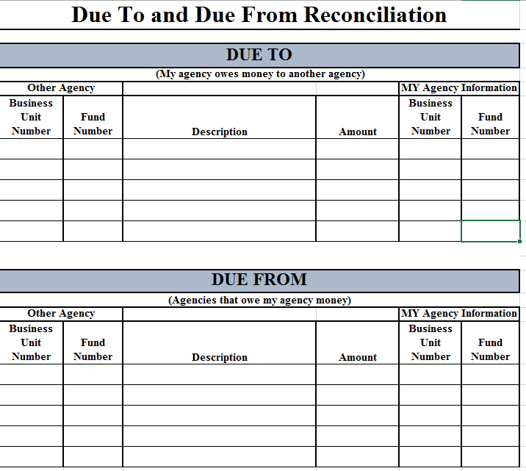
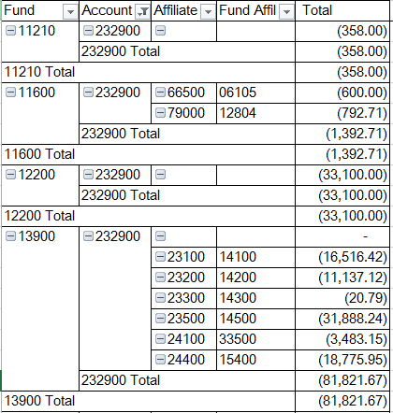
Pivot off: 1) fund 2) account
3) affiliate 4) fund affiliate

Slide 30
Due to & due from
Be sure that the amounts shown on your financials as being owed from TRD, STO and/or Board of Finance match the amounts these agencies are reflecting on their financials.
Many agencies have amounts on their books for interest being owed by STO from prior years that the agency has already received. This interest needs to be adjusted off the agency’s books. The only interest that should be on the books is the interest for June that was received in July 2016.
The CAFR Unit has obtained the “Due To” listing from these 3 agencies. The CAFR Unit will be verifying the amounts agencies are reflecting as a “Due From” these 3 agencies match the amounts these 3 agencies have reflected as a “Due To”.

Slide 31

Affiliate and fund affiliate

Slide 32
Affiliate and fund affiliate
The purpose of the affiliate and fund affiliate chartfields are to move the State forward in having a system generated process to reconcile all inter and intra agency transactions on a monthly basis. (i.e. the monthly closing process)
The affiliate represents the Business Unit of the corresponding agency.
  The affiliate should NOT be your own agency unless you are preparing an intra-agency (141900/231900) transaction.
The fund affiliate represents the fund of the corresponding agency.
  The fund affiliate should NOT be your own agency fund number unless you are preparing an intra-agency (141900/231900) transaction.
The affiliate and fund affiliate are only required for certain accounts.
  The listing was given as a hand-out
These chartfields should not be populated if not required – this causes needless information being entered into SHARE and carried over for years.

Slide 33
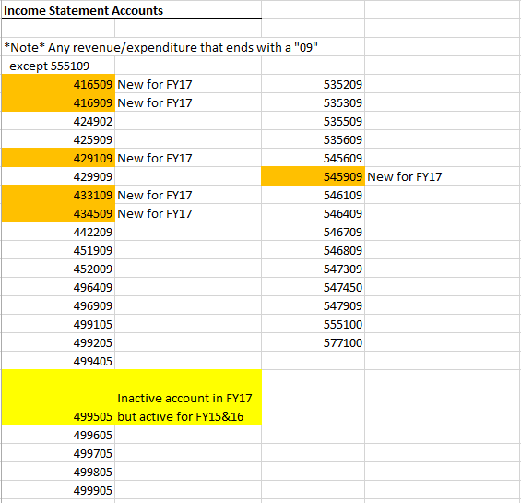
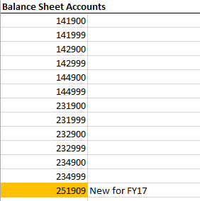

Slide 34
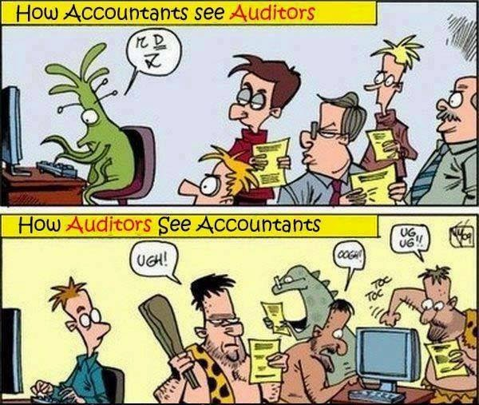
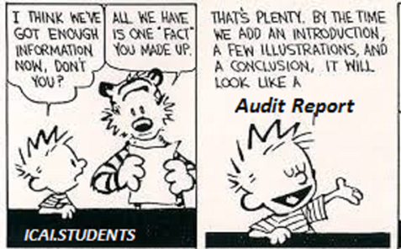
Miscellaneous information

Slide 35
547999 payments in fy17, accrued in fy16
In FY17, some agencies might have to do a “Request to Pay Prior Year Bills” to pay for items that have already been accrued in FY16. This would happen if the invoice came in after the July due date, but wasn’t on the “296900 Request to Accrue”
  Since these vendors were not on the Accrue Request – the payment is considered late and needs to follow the process to ask for the “Request”.
Agencies will have to finalize the “Request to Pay Prior Year Bills” process with FCD to ensure the payment to the vendor.
After the vendor has been paid out of the expenditure account 547999, then agencies will have to do a journal entry (CFR) to debit the liability and credit the expenditure (547999) in the current fiscal year.
  202900 150.00 (debit)
  547999 150.00 (credit)

Slide 36
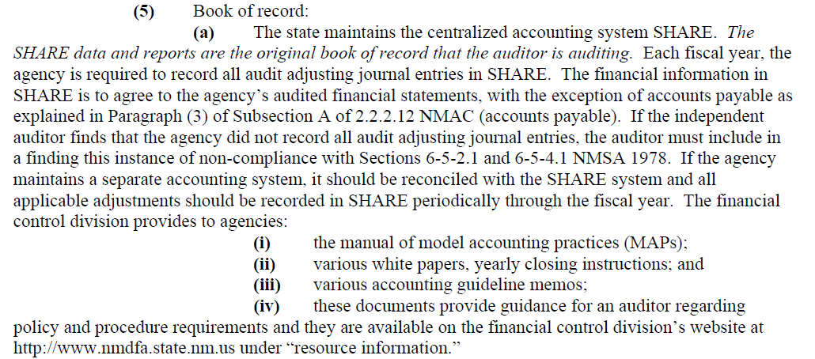
Share is the book of record
NMAC 2.2.2.12 A

Slide 37
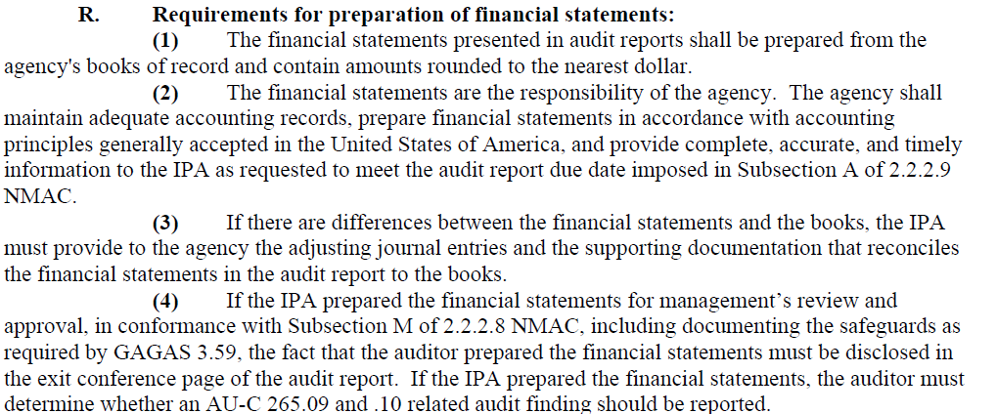
Items in State Audit Rule to be aware of
NMAC 2.2.2.8.R
Many firms do not do this

Slide 38
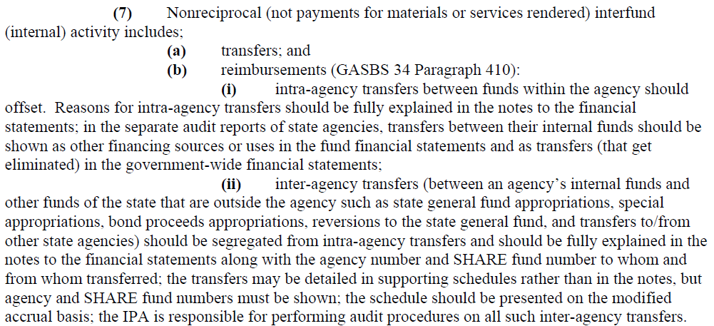
Items in State Audit Rule to be aware of
NMAC 2.2.2.12 A.7.b.(i) Disclosure regarding intra-agency transfers
NMAC 2.2.2.12 A.7.b.(ii) and NMAC 2.2.2.12 A.13 Disclosure regarding inter-agency transfers

Slide 39
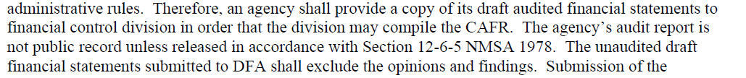
Items in State Audit Rule to be aware of
NMAC 2.2.2.12 A.16 Gives authority for the CAFR group to receive the financial statements and the notes before they are publically released. The CAFR group does not receive the opinions and findings.

Slide 40
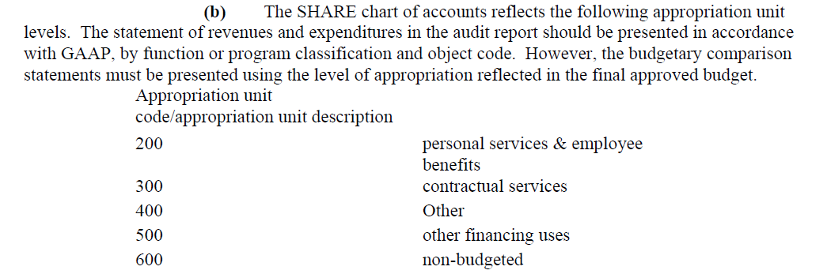
Budget comparisons
Budget is to be reviewed at the appropriation level (Pcode) and not the department level.
Agency Appropriations from Section 4 of the Appropriation Act could be assigned the same department code; therefore, can have the same Pcode.
NMAC 2.2.2.12 A (5)

Slide 41
Budget ISSUES
There are some ongoing issues the Budget Division would like mentioned:
  Make sure the revenue used in the approved budget is the same revenue code utilized when the deposit is entered into SHARE. DFA has noticed that the person that is responsible for deposits doesn’t necessarily know the correct revenue code that was in the approved budget. Especially since Budget Division has been reviewing agency practices better and has been changing revenue account codes that are more appropriate to define the source of the revenue. These changes are not filtering down to the person that does deposits.
    If you feel the revenue code in the budget is incorrect, please contact your Budget Analyst so the budget can be changed to be more accurate.
  Miscellaneous Revenue. If your agency has a lot of money that is deposited into Miscellaneous Revenue, please do a review of the revenue source.
    For example: one agency had millions in miscellaneous revenue. Upon review, it was determined that almost all that revenue was truly federal revenue and not miscellaneous.

Slide 42
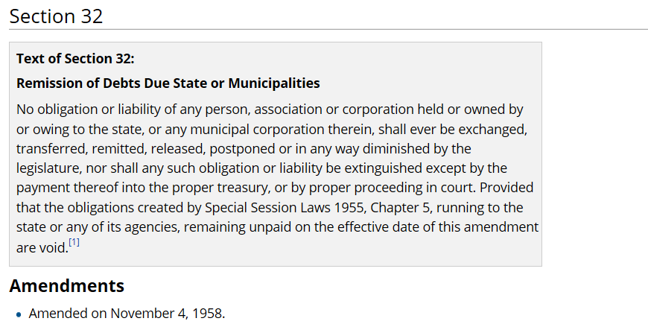
New Mexico constitution regarding writing off debt
Article IV

Slide 43
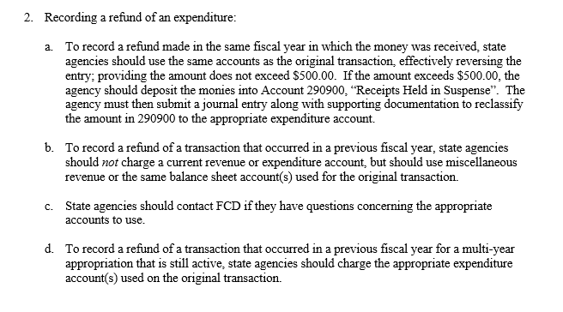
Refunds for Multi-Year Appropriations
Per MAPs FIN 11.3 – refunds that were applicable to a prior year expenditure don’t have to be posted to miscellaneous revenue for a multi-year appropriation that is still open in the fiscal year the money is received in.

Slide 44
***** slide had changed *****
DFA and SAO review of audit reports
State Auditor (SAO) and DFA started working together last year to review financial statements.
IPA’s will be receiving an email soon from the State Auditor’s Office notifying them that for any state agency audit, they must electronically send the audited financials to the CAFR Unit.
State agencies will receive the “Ok to Print” within the 10 business day timeframe required from the date the audit is turned into SAO.
  The CAFR group will be reviewing SHARE information against financial statements, along with information in the notes.
  Any corrections noted by the CAFR group will be communicated to the CFO’s and also SAO.
  The CAFR group will be working directly with the CFO’s and not the IPAs. If the IPA feels that a conversation needs to occur, the CAFR group will ensure that it is a conference call in which the CFO is involved.

Slide 45
Tentative plan for OLD payroll liability balances
Many agencies have discrepancies in their payroll liability accounts (223500/223900) since the inception of SHARE (2006).
It is a VERY tedious task to go back and reconcile numerous fiscal years, especially if your agency has a large number of employees.
Tentative Plan - DFA is planning to prepare a journal entry in which the amounts in these two liability accounts will be “trued up” to the actual payroll accrual for 6/30/16. One slight issue holding this up - garnishments.
ONCE THIS ENTRY IS DONE - AGENCIES WILL THEN BE RESPONSIBLE FOR RECONCILING PAYROLL ON AN ONGOING BASIS.
  Note: the biggest problem occurs when either an employee leaves your agency for another, or you hire an employee that was at another agency.
  The first payroll after that employee starts working for you will surely have the liability accounts incorrect.

Slide 46
Balance sheet accounts used in a voucher
Many agencies utilize a balance sheet account code when paying a vendor via a voucher in AP.
  If the agency has an exemption to use that balance sheet, then the voucher will be allowed to process.
  If the agency is doing a single payment voucher with no exemption, then the AP Auditor will ask for the CAFR Unit to review the payment. The CAFR unit reviews the paperwork to ensure that:
    The proper account code is being utilized.
    The supporting documentation proves that the balance sheet balance was established BEFORE the voucher. For example: A check is received that is owed to a vendor. The deposit is put in 293900 (Deposits Held for Others) instead of a revenue account. The check is then issued to the vendor using account 293900 as the “expenditure”. The deposit establishing the liability needs to be included with the voucher to show proof that the liability was established before the payment is to be sent out.

Slide 47

Break time

Slide 48


Common errors in audit reports

Slide 49
#1 MOSt Common error in audit reports
1) Classification Issues
  An amount is in an account code in SHARE that is different than the account definition on the financial statements.

Slide 50

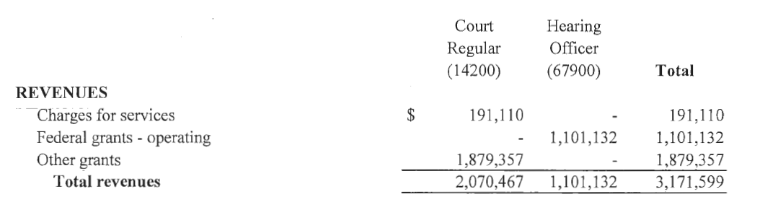
Classification Issue – example 1
In SHARE – amount was in code 424902 (Other Intra State Services)
On Financials – this amount was in Federal Grants - Operating

Slide 51
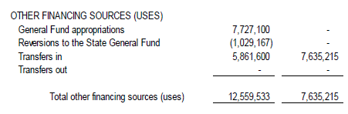
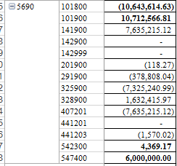
Classification issue – example 2
On the financial statements, the amount is classified as “Transfer In”
In SHARE, the amount was in the 407201 account (Fire Insurance Tax) not a Transfer In account such as 499905.

Slide 52
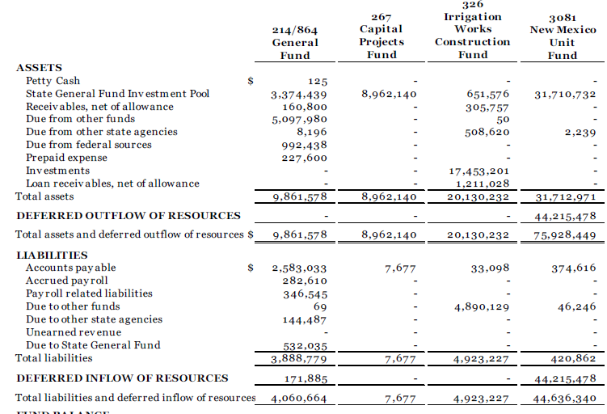
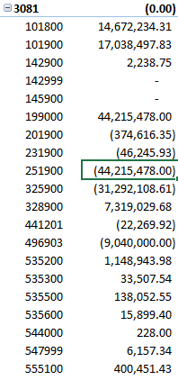
Classification issue – example 3
Deferred Inflow is completely separate from Unearned Revenue (this used to be deferred revenue).
This agency had the Deferred Inflow in account 251900 instead of the proper account of 299998.
This agency had the correct account code in SHARE for Deferred Outflow (199000).
Please note: Unearned Revenue is still used in some agency financials.

Slide 53
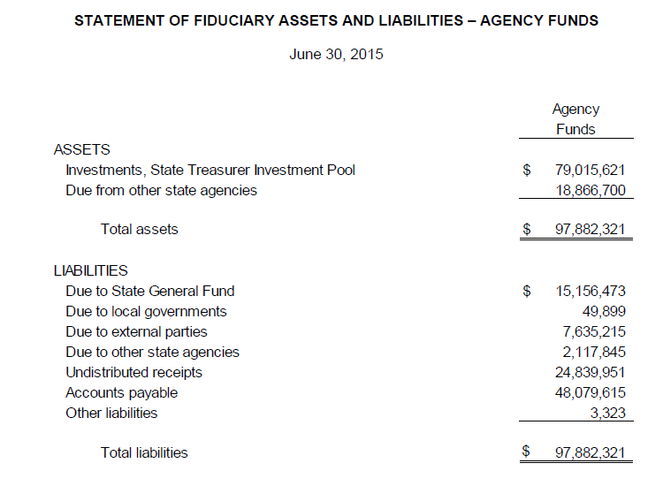
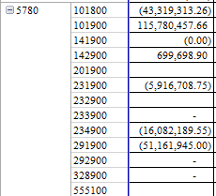
Classification issue – example 4
As you can see – there are quite a few discrepancies between SHARE and the financial statements.
Numerous categories on the financial statements but the breakdown is not in SHARE
Agency had to do a reclassification entry to get the financials and SHARE to tie.

Slide 54
#2 Common error in audit reports
2) SGFIP, LGIP vs. Other Cash Accounts
  Separate disclosure between SGFIP, LGIP and other cash needs to occur
  Financials should not be lumping all the “cash” together.
  SGFIP – State General Fund Investment Pool
  LGIP – Local Government Investment Pool

Slide 55
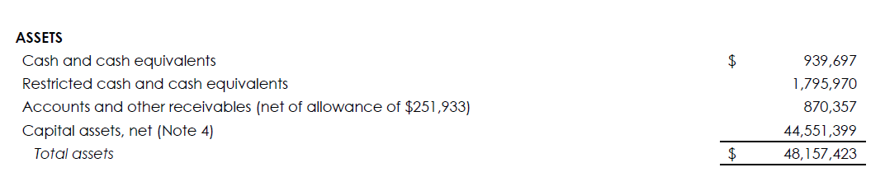
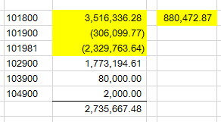
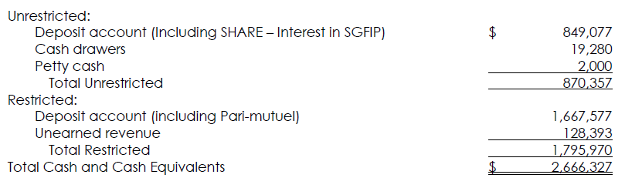
SGFIP Issue – EXAMPLE 1
Financial Statements:
Financial statements did not have the correct classification for all the cash for the agency.
In SHARE,
only $880,473 was SGFIP
Cash and Cash Equivalent was $1,855,295
2,735,667
SHARE amount:
The Note disclosure did not reconcile to SHARE or the financials

Slide 56
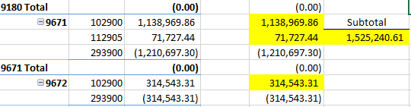
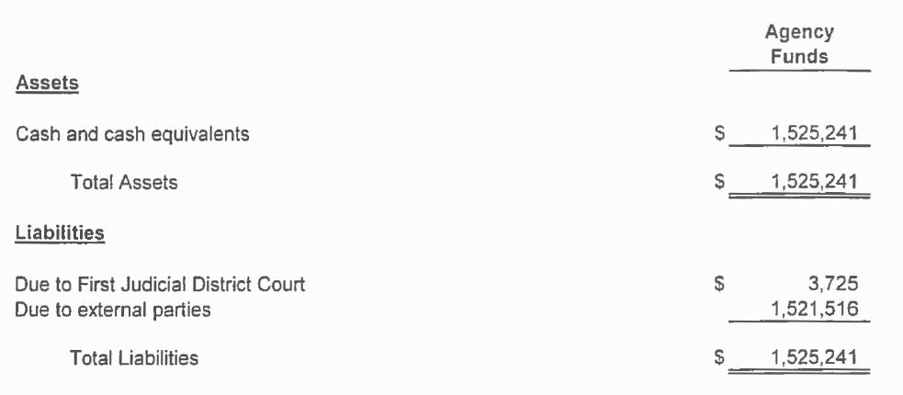
SGFIP Issue – Example 2
Some agencies invest in the LGIP.
LGIP cash needs to be segregated and reflected as LGIP (112905).
Cash in external bank accounts (102900) needs to be shown as Cash and Cash Equivalents.
Reclassification: there is a Due To listed on the financials but not in SHARE

Slide 57
#3 Common error in audit reports
3) Capital Assets
  Additions do not tie to the note disclosure.
  Financial statements do not segregate Personnel Services, Contractual Services, Other Expenditures and Capital Outlay.
  Agencies that are required to have full accrual in the ACTUALS ledger do not ensure that the asset and depreciation classifications are correct in SHARE versus the financial statements.

Slide 58
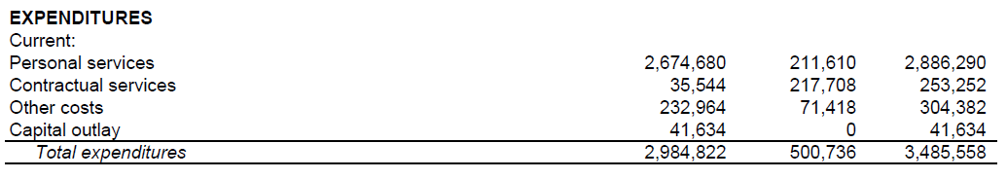
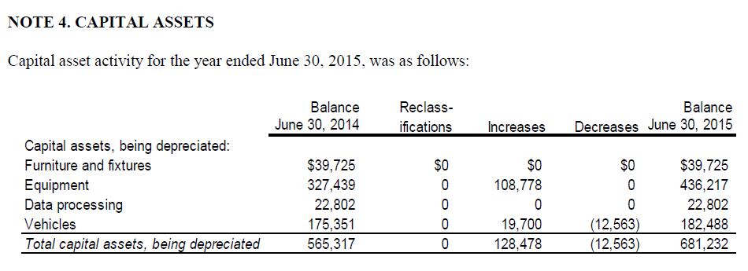
Capital Assets – example 1
Increases in Note 4 does not agree to the financial statements - $41,634 vs $128,478

Slide 59
Capital Assets – Example 1
The amount in SHARE did agree to the financial statements ($41,634).
After researching, it was discovered that another agency bought capital assets on the behalf of this agency – yet this was not disclosed in the notes.

Slide 60
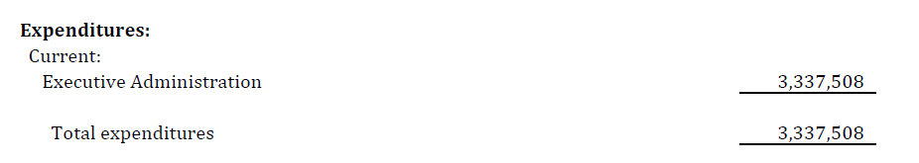
Capital assets – example 2
Financial statements do not disclose capital assets separately – all lumped into 1 Total Expenditure category instead of 200/300/400/Capital Outlay.
Information in SHARE shows that capital assets were purchased - 548300

Slide 61
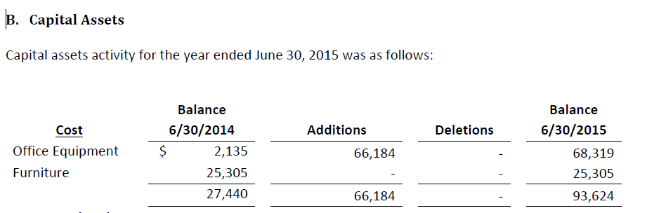
Capital assets – example 2
Note disclosure shows additions of $66,184

Slide 62
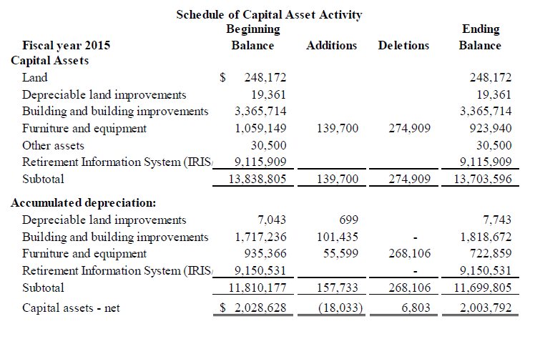
Capital assets – example 3
Even agencies that require full accrual financials in SHARE’s ACTUAL ledger do not ensure that their audited financial data tie to SHARE.

Slide 63
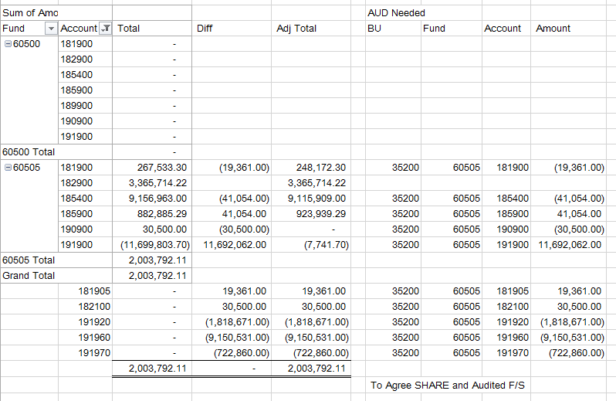
Capital assets – example 3
To ensure that the financials and SHARE balanced – the CAFR group had to do an entry in SHARE to ensure that the accurate asset definitions were being used in SHARE.
Note the “Diff” column and all the amounts that had to be adjusted in SHARE to tie to the financials.

Slide 64
#4 Common error in audit reports
4) Over-reversions
  Some agencies have over-reverted money to the General Fund and do not follow Section 6-5-10, NMSA 1978 and MAPS Fin 1.2.

Slide 65
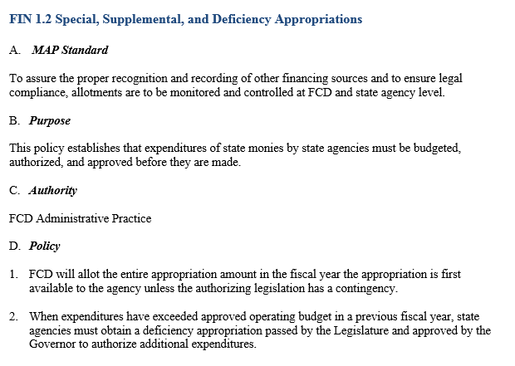
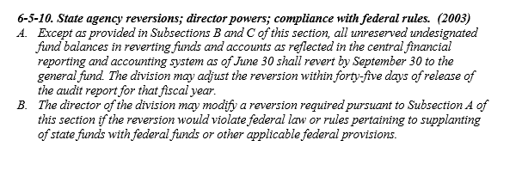
Over-reversions

Slide 66
Over-reversions
Agencies are netting current year reversions with a prior year over-reversion in which the agency did not properly request a correction within the 45 days required (Section 6-5-10, NMSA 1978).
  In this netting, the agency then offsets the reversion amount that is required to be sent by this amount – therefore making the reversion amount smaller.
The agency MUST show a debit fund balance for the amount over-reverted then must ask for a deficiency appropriation.
  Agencies can work with their appropriate budget staff to obtain the deficiency.
The agency cannot just take the deficiency amount and book a Due From the General Fund. There is no statutory authority for the General Fund to send the money back to the agency after the 45 days have passed. Based on that, the monies do not qualify for the recognition standards in GASB33.
Agencies cannot use current year appropriations to offset a prior year budget deficiency without Budget and Legislative approval. (MAPs FIN 1.2)

Slide 67
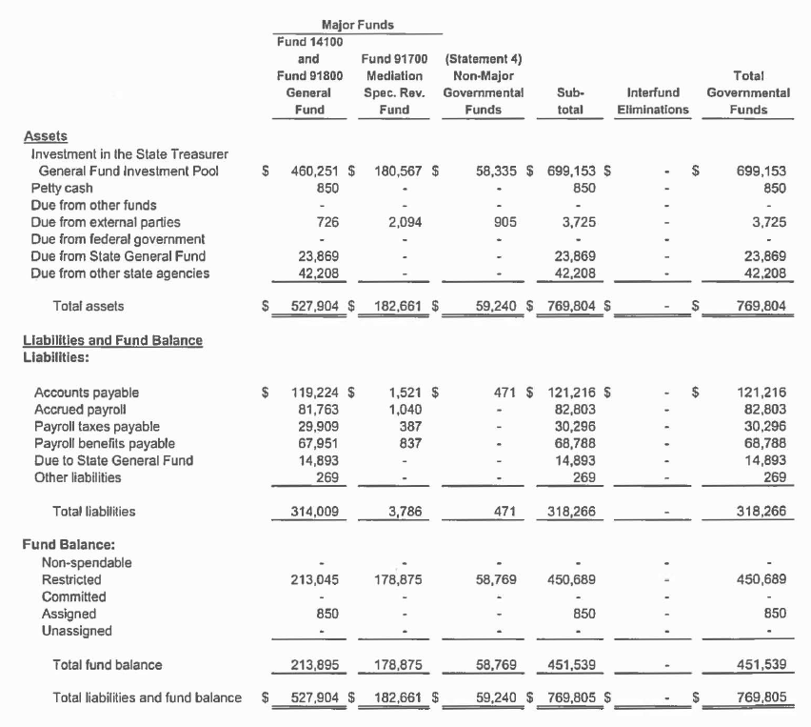
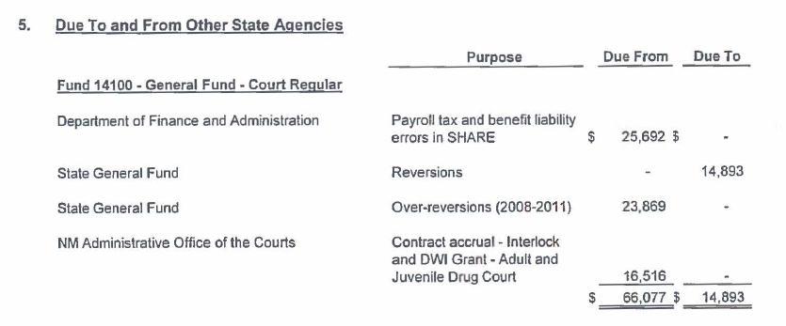
This agency has over-reverted monies all the way from 2008-2011.
Instead of showing a debit fund balance for this amount – the auditor is showing an amount Due From the State General Fund that is not a true Due From.

Slide 68
#5 Common error in audit reports
5) Compensated Absences
  Some agencies do not disclose in the notes the proper disclosure regarding compensated absences.

Slide 69
Compensated absences
The Statewide NM CAFR follows GASB 34, Paragraph 119 regarding compensated absences.
  The increases and decreases have to be derived from each agency’s individual audit report and compiled into one total for the State of NM CAFR report.
  All state agencies need to ensure they are in compliance with GASB 34 and report compensated absences in their note disclosures (even if they feel it is immaterial).
  Per Section 6-5-2, NMSA 1978 agencies are required to follow the procedures and policies established by DFA for uniform standards.

Slide 70
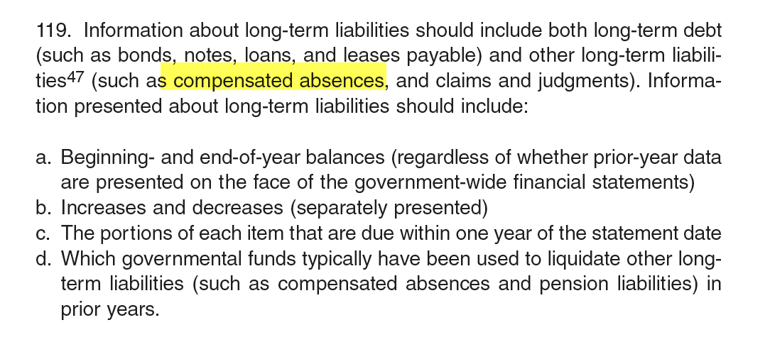
Compensated absences
GASB 34 – Paragraph 119

Slide 71
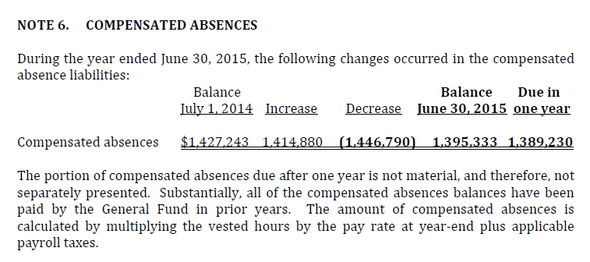
Compensated absences
Here’s a correct example of how the note disclosure should be:

Slide 72
#6 Common error in audit reports
6) Not disclosing in the audit report that the financials were prepared by the IPA.
  NMAC 2.2.2.8.R

Slide 73
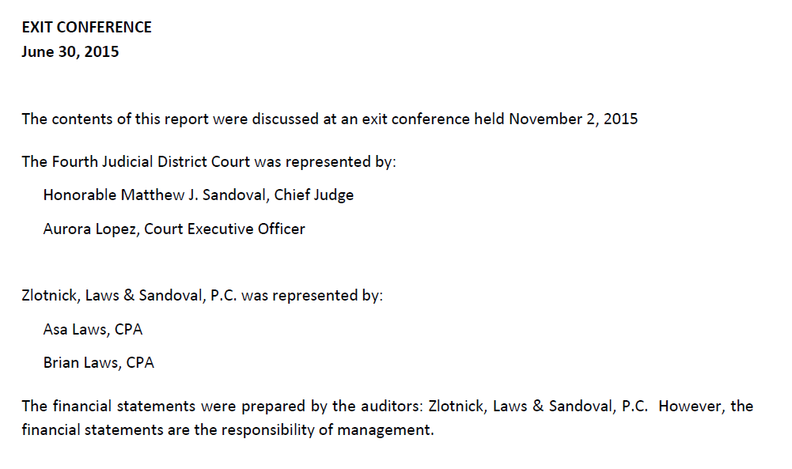
Example of correct way to note in audit report that the financials were done by the IPA and not the agency

Slide 74
Other errors in audit reports
7) Combining Schedules:
  Some agencies combine more than one fund for the financial information on the financials – Combined General Fund (for example)
  A Combining Schedule is required to be in the Required Supplemental Information in the back of the financial statements.
  See next slide for an example.

Slide 75
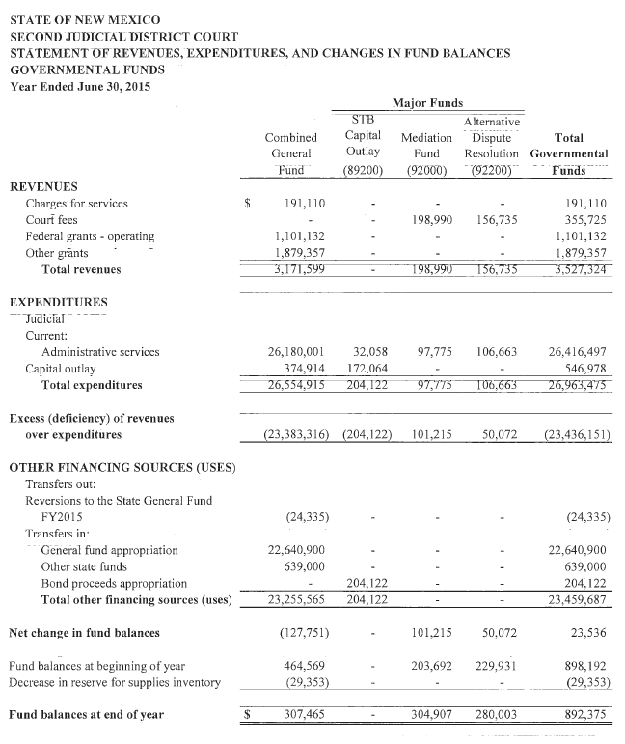
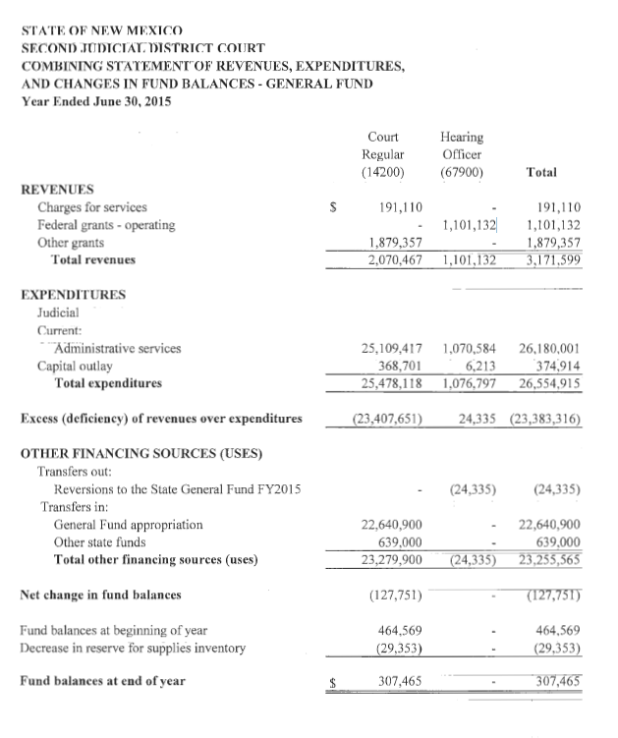

Slide 76
OTHER errors in audit reports
8) Notes do not have information regarding interagency transactions
  NMAC 2.2.2.12 A.7.b.(ii) requires that the notes disclose information regarding interagency transactions.
  Transfers may be done in a schedule and not in the notes BUT the other business unit code and their fund number are required. (some schedules list the corresponding agency but do not list the fund number)
  See following slides for correct examples

Slide 77
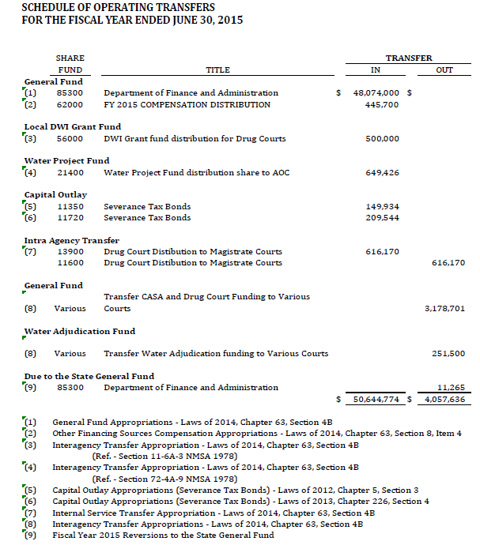


Slide 78
OTHER errors in audit reports
9) Tax Intercepts
  Some agencies have tax monies that are paid directly from TRD to New Mexico Finance Authority to pay either a bond or loan.
  These agencies need to record on their financial statements that:
    They received the tax monies and,
    That they made a payment to the NMFA.
  The CAFR group worked diligently the last 2 years to identify these agencies and work with them regarding the proper way to handle these intercepts.

Slide 79
OTHER errors in audit reports
10) Monies in AR or AP that is applicable to a Component Unit
  The State CAFR has received an audit finding regarding the presentation of transactions between state agencies and component units, especially receivables and payables.
  Transactions between state agencies and component units are currently being buried in Accounts Receivable (AR) and/or Accounts Payable (AP). The proper presentation of these transactions should be as Due From Component Units (143500) or Due To Component Units (233500).
  Everyone received a listing of the component units for the State of NM. Double check your AP listing and AR listing to ensure that none of those component units are in those balances.

Slide 80

CAFR Staff and other resources

Slide 81
New CFO’s
The CAFR Unit has done a training in the past on how to prepare financial statements out of SHARE.
  This training was recorded and put on DFA’s website
  Under Financial Control – Resource Information – DFA Instructional & Training Videos
  http://www.nmdfa.state.nm.us/dfa-instructional-training-videos.aspx
  There are also other trainings available from other divisions of DFA.

Slide 82


Slide 83
As always – if you have any questions or issues – don’t hesitate to contact your CAFR accountant!!

Slide 84


Will Crespin
476-8530

Slide 85


Norma Henderson
476-8541

Slide 86


Renae Herndon-Lopez
476-8527

Slide 87


Richard Torrence
476-8533

Slide 88



The end!!
Any Questions??

