Slide 1
Budget Formulation and Management (BFM) Training: Core 4 performance measures
Dr. Andrew Miner, DPA
Acting Deputy Director, State Budget Division
827-3812, Andrew.miner@state.nm.us

Slide 2
Performance measure 4000 form
Demonstration of form and how to update data – actuals, targets, narrative
Number format is predetermined by measure and will display on reports – just enter raw numbers here
Columns with asterisk (*) can be entered
Can import/export this form to/from Excel as with other BFM forms
Non-numeric codes to enter in data fields:
  999999.1 = New measure
  999999.2 = N/A
  999999.3 = TBD
  999999.4 = Discontinued
Once done submit as with other BFM forms

Slide 3
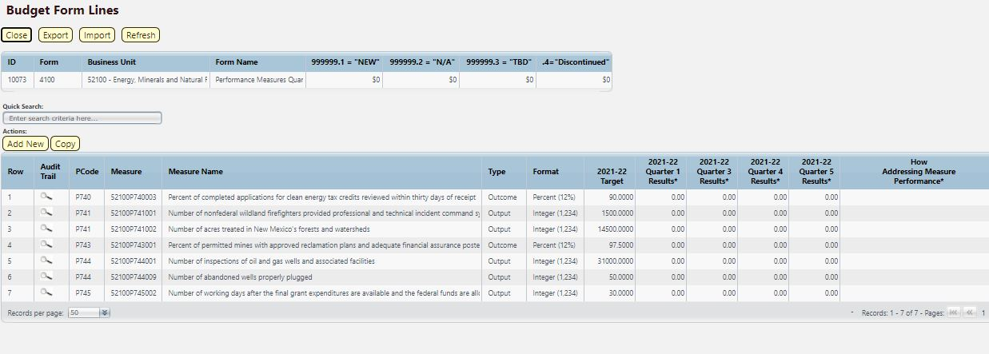
Pm 4100 form: quarterly data
Used by quarterly reporting (key) agencies ONLY to enter PM data by quarter
Enter quarterly data in each field, can also import/export from Excel
Note this is a completely separate form from 4000 – data entered here will not sum or carry over to form 4000

Slide 4
Performance measure change requests (form 4400)
Demonstrate how to use to submit requested changes to PMs by July 15 – add new measures, change existing measures, inactivate measures
Existing measures will pre-populate, click Add New to enter proposed change
  To propose new measure, select NEW which should be the last option in list of measure
Inactive Year box: Select next FY if requesting to inactivate a current measure
Measure Format: How should measure data be displayed (integer, date, percent, etc.)
Good Direction: “Over” if the target is met if the result is higher, “Under” if target is met if the result is lower
Some fields are for SBD analyst use, do not need to complete these
Can update methodology, reliability, validity, etc. on Narrative Changes tab

Slide 5
Performance measure reports
Demonstration: In BFM Reporting, pull data from PM Forms and correspond roughly to reports from prior PBB system
  Annual Performance Report
  Full Program and Measure Report
  Performance Measure Table 2 Summary
  Performance Monitoring Plan
  PB-1 Summary of Requested PM Changes (former Word document, also incorporates PB-2 for quarterly reporting agencies)

