Slide 1
LFC Performance Measures and Reports
Helen Gaussoin, LFC Analyst
Jennifer Faubion, LFC Economist

Slide 2
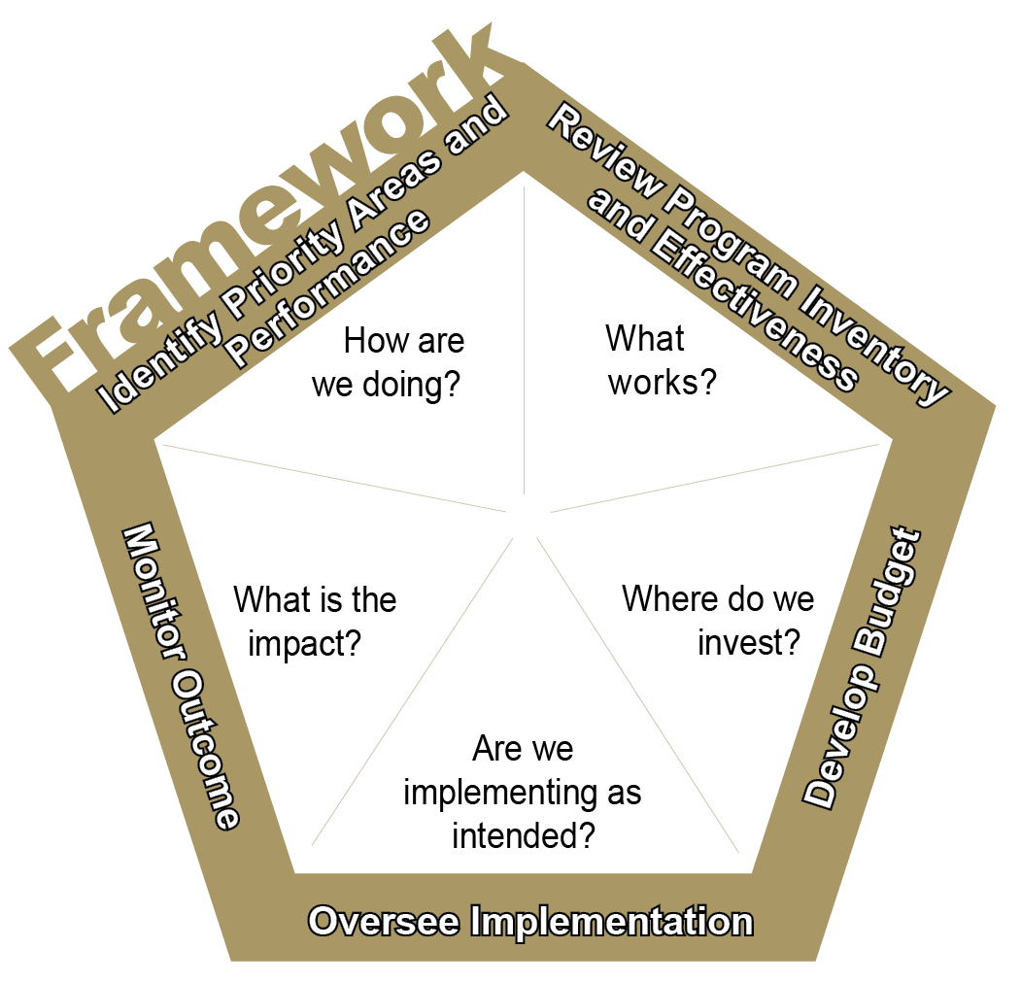
Performance measures and report cards are components of the Legislating for Results framework.
Identify priority areas and performance. Performance data helps highlight the need for additional attention through the budget process.
Review program inventory and effectiveness. A systematic review of the evidence, either through research or performance data, on the effectiveness of these activities can identify whether agencies are spending money on what works.
Develop Budget. Evidence of program effectiveness is incorporated into the budget process with the intent to move money toward programs likely to work.
Implementation Oversight. Performance reports (report cards) and other tools are used to ensure programs are effectively implemented to ensure the taxpayers’ investment is protected.
Outcome Monitoring. A combination of performance reports and program evaluations assess whether programs are achieving desired results.
Notes:
Performance measures are a foundational step. They tell us how we are doing. They show us what’s working and what isn’t. They don’t tell us why it’s not working. Is it underfunded, a bad practice, a good practice poorly implemented? The Legislating for Results framework attempts to answer all those questions but it must start with how are we doing.

Slide 3
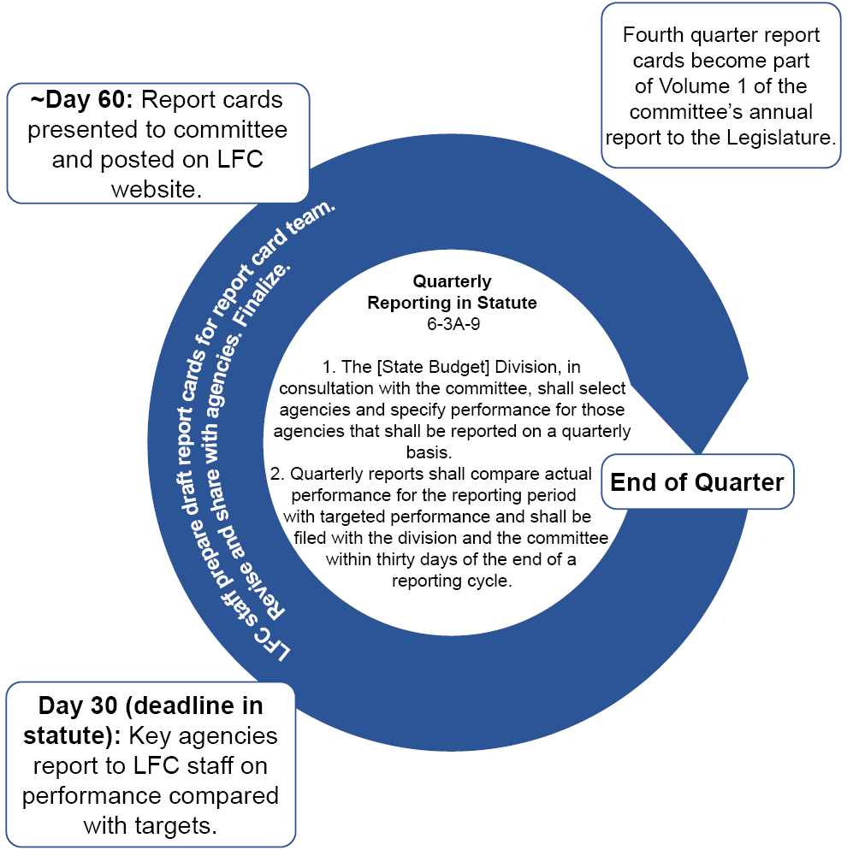
The report card cycle starts with the agency.
Notes:
Quarterly performance reports are required by statute. Report cards are the way LFC communicates performance information to the committee and the public. They are not intended to “judge” the agency but to assess effectiveness. The Accountability in Government Act traded micromanagement of agency budgets for information. In exchange for greater flexibility in how they spend their funding, agencies must identify their core services (programs) and ways to measure program effectiveness and report on whether programs are demonstrating that effectiveness.

Slide 4
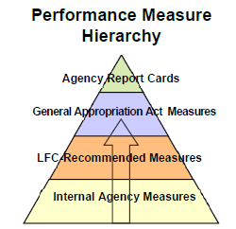
Report cards generally reflect what is in the General Appropriation Act.
Notes:
The measures included in report cards are generally those in the General Appropriation Act. But that’s not strictly true. Other factors come into play, such as whether the information is available quarterly.

Slide 5
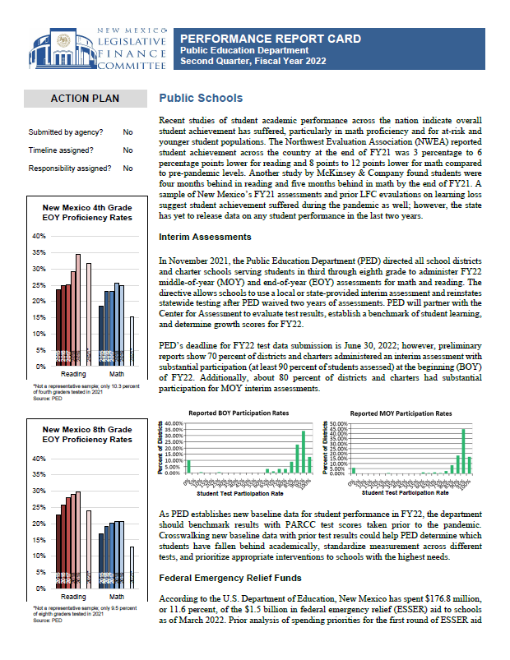
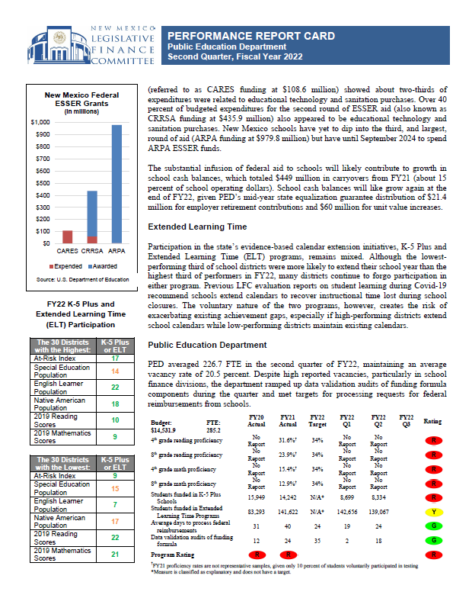
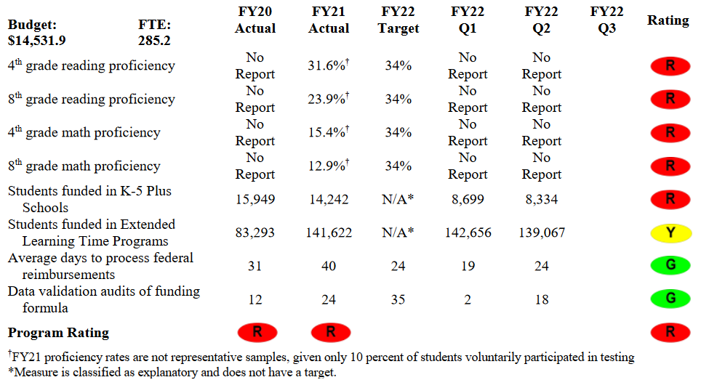
Example Report Card
Notes:
<zooms into the table>Report cards include some discussion and tables with ratings from green to red. The red does not mean failure and this report card is a good example of that. In this case, from a report from more than a year ago, the red is reflection of the lack of data.

Slide 6
Green is not always good; red is not always bad.
Green
Agency has met the quarterly target or is on track to meet the annual target.
Yellow
Agency slightly missed the target or is off track for meeting the annual target.
Red
Agency slightly missed the target or is off track for meeting the annual target.
Fine Tuning
Did the agency provide the data? How reliable is the data? Is the collection method transparent?
Does the measure gauge a core function of the agency? Is the measure a good gauge of effectiveness?
Does the agency use the information internally? Does the agency have a plan to maintain or improve performance.
Notes:
Green is not always good and red is not always bad. Sometimes a consistent green means the target has been set too low. Raising that target can result in better information on the effectiveness of the program. A red isn’t failure but a red flag that something is off. It could be missing data or bad data. And again, ratings show us what’s working and what isn’t but they don’t tell us why it’s not working.

Slide 7
Performance data can help improve policy development and budgeting.
According to the National Conference of State Legislatures, performance data
• Enable legislators to ask state agencies the right questions—about both past performance and expected future results.
• Improve oversight of state programs and policies to encourage program management to focus on results.
• Provide useful information about state programs that can be communicated easily and clearly to constituents.
• Provide objective evidence on outcomes of agency, which can help enable legislators to ask meaningful questions about politically sensitive programs.
• Help identify areas for potential budget reductions, increases, or reallocations, including identifying the estimated consequences of such changes.
• Enhance state strategic planning efforts by encouraging a long-term focus on results.
Notes:
Generally, performance measures means legislators are better informed, can ask better questions, can be more objective, and can help them make better budget decisions based on results.

Slide 8
A good performance measure provides a meaningful assessment of the effectiveness of a program.
Ideal performance measures should be
Results-Oriented: Focus on outcomes
Relevant: Assess the core function of the program or significant budget expenditures
Useful: Provide valuable and meaningful information to the agency and policymakers
Clear: Communicate in a plain and simple manner to all stakeholders (employees, policymakers, and the general public)
Responsive: Reflect changes in performance levels
Valid: Capture the intended data and information
Reliable: Provide reasonably accurate and consistent
Comparable: Allow direct comparison of performance at different points in time
Economical: Collect and maintain data in a cost-effective manner
Accessible: Provide regular results information to all stakeholders
Benchmarked: Use best practice standards
Notes:
The bottom line on measures is that they should provide for the meaningful assessment of the effectiveness of a program. A measure of the number of miles of highway in good condition is more meaningful than a measure of the number of hours road crews spent on repairs. It’s also important to get the best possible measure from the start. Evolving conditions can necessitate the need to change, add, or abandon a measure but constantly changing measures make it impossible to gauge progress.

Slide 9
Measures can be categorized as outcome, output, efficiency, and explanatory.
As defined in the General Appropriation Act:
Outcome means the measurement of the actual impact or public benefit of a program.
An example from the Tourism Department:
Percent change in New Mexico leisure and hospitality employment
Output means the measure of the volume of work completed or the level of actual services or products delivered by a program.
Another example from the Tourism Department:
Number of entities participating in collaborative applications for the cooperative marketing grant program
Explanatory means information that can help users to understand reported performance measures and to evaluate the significance of underlying factors that may have affected the reported information. They do not have targets, although are sometimes rated in report cards based on factors like whether performance has improved.
An example from the district attorneys:
Number of pretrial detention motions made
Notes:
Measures are categorized by the type of information they provide. The three most common categories in the General Appropriation Act at outcome, output and explanatory. Together, they are the categories for 417 measures. While outcome measures provide the important information on the actual impact of a program, other measures provide important information on context.

Slide 10
Measures can be categorized as outcome, output, efficiency, and explanatory.
Efficiency means the measure of the degree to which services are efficient and productive and is often expressed in terms of dollars or time per unit of output.
An example from the Taxation and Revenue Department:
Average call center waiting time to reach an agent, in minutes
Quality means the measure of the quality of a good or service produced and is often an indicator of the timeliness, reliability or safety of services or products produced by a program.
An example from the Aging and Long-Term Services Department:
Percent of calls to the aging and disability resource center answered by a live operator
Notes:
Efficiency and quality are used much less frequently

Slide 11
Common Performance Measure Concerns
Measure Not Focused on Performance
Some measures offer surface-level information, providing no insight into the effectiveness of an agency or information that could help with policy decisions.
Example 1: Board of Veterinary Medicine: “Number of veterinarian licenses issued annually.”
Discussion: This measure fails to address important questions that could easily be answered. Is the agency reviewing all license applications that it receives in a timely manner? How effective is the agency at informing licensees of the requirements they must meet to get a license renewed? How does the licensed veterinarian-to-pet ratio differ from New Mexico to other states?
Example 2: Public School Insurance Authority: “Number of loss control prevention seminars.”
Discussion: The measure simply demonstrated that seminars are occurring. It does not provide information on the impact of Public School Insurance Authority-led seminars on schools.
Takeaway: Agencies should institute measures that provide a fuller picture of agency performance.
Notes:
This is information pulled from an old presentation and measures generally have improved but these issues continue to crop up.

Slide 12
Common Performance Measure Concerns
Unclear or Confusing Language
Measures with unclear language are less effective than well-written measures because legislators, the governor, the public, and even analysts may have difficulty interpreting targets and results.
Example 1: Department of Health-Facilities Management: “Percent of collectable third-party revenues at all agency facilities.”
Discussion: This measure is actually trying to gauge the percent of third-party revenues collected by DOH out of the total amount that can be reimbursed to DOH from third-parties, like Medicaid.
Example 2: School for the Blind and Visually Impaired: “NMSBVI will foster an atmosphere of creativity that results in innovative practices and programs.”
Discussion: This measure is vague and more of a goal than a performance measure. When this measure was in place, the school routinely reported 100 percent.
Takeaway: Performance measures should provide information to the public and anyone outside the agency on agency effectiveness. They must be easy to understand and free of jargon..
Notes:
The first example also illustrates an example of a missing denominator. Is it the percent of all revenue?

Slide 13
Common Performance Measure Concerns
No Target or a Target that is Easily Achievable
Measures that have no target because they are explanatory or have a target that is easily achievable are less effective because they lack an incentive to improve performance.
Example 1: Energy, Minerals and Natural Resources Department: “Number of visitors to state parks”
Discussion: The number is readily available and easy to compare with past numbers or numbers from other states. Without a target, it is unclear what number should be the goal.
Example 1: Economic Development Department: “Film and media worker days”
Discussion: The agency easily met the target in FY22 and is on track to exceed the target in FY23. Targets that are set too low are little different than nonexistent targets.
Takeaway: While explanatory measures have no target by design and can provide important context to agency performance, their use should be limited. Targets provide the public and policymakers with the information needed to assess performance.

Slide 14
Tips on Number Use in Measures
Be clear on the denominator
When crafting measures, keep in mind the difference between a number, a percentage, a rate, and a ratio.
Number: A raw data point that is not relative to any other number
Example: Number of stolen livestock reported: 500 head
Percentage: A data point divided by the total possible, expressed as a percentage of the total
Example: Percent of total livestock reported as stolen: 5% (500/10,000 = 0.5 = 5%)
Rate: A certain quantity of one thing considered in relation to a unit of another thing, often expressed with “per”
Example: Number of livestock reported stolen per 1,000 head: 50
Ratio: A relationship between two numbers indicating how many times the first number contains the second. The total is not included but is derived by adding the two numbers together.
Example: Ratio of stolen livestock to non-stolen livestock: 50:950 (=50/1,000 = 5%) Note: Ratios are seldom appropriate for measures. Craft carefully and accurately.

Slide 15
Outline of a Good Performance Report (Workforce Solutions Department)
Agency Description
Mission
Goals and Objectives
Programs
Program/Division
Program Description, Purpose and Objectives
Budget Sources and Uses
Performance Measures
Performance Measure
Measure verbatim
Results with graph
Measure Description
Data Source and Methodology
Story Behind the Data
Improvement Action Plan
Notes:
A good agency performance report is clear, provides policy, data, and strategic plan context, and includes an action plan.

Slide 16
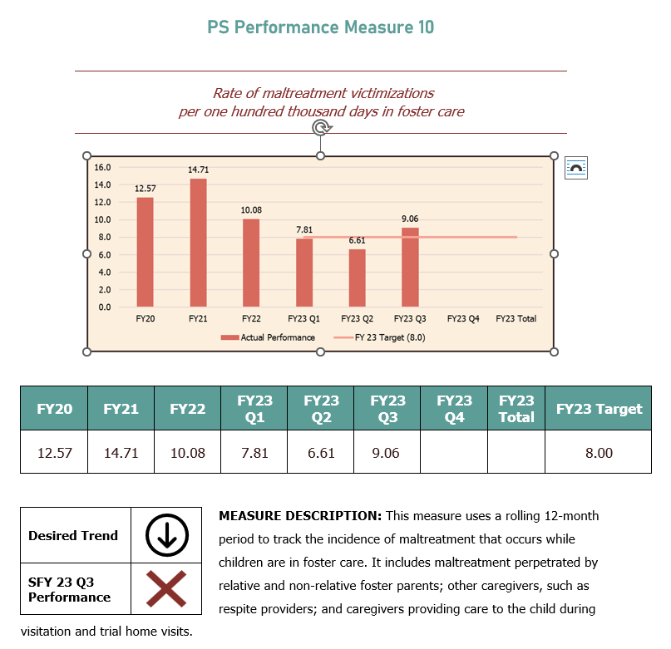
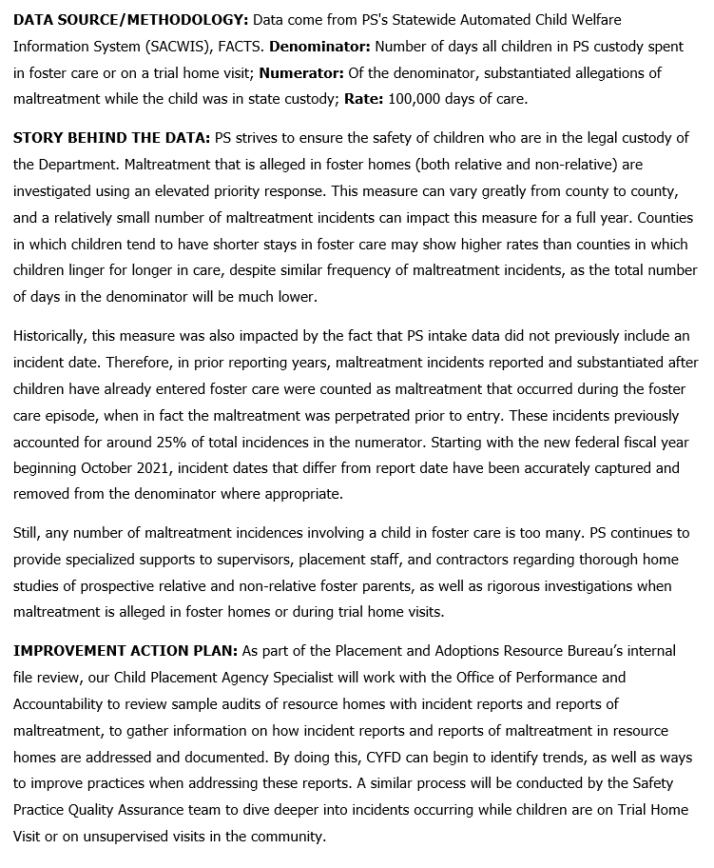
Close-Up of a Good Performance Report (Children, Youth and Families Department)

Slide 17
Questions?
Helen.Gaussoin@nmlegis.gov
Jennifer.Faubion@nmlegis.gov

