Slide 1

Prevention Outside the Box (and Classroom)
Local DWI Workshop
May 1, 2019
Notes:
To change the image on this slide, select the picture and delete it. Then click the Pictures icon in the placeholder to insert your own image.

Slide 2
Topics to Cover
Classroom Direct Services vs. Environmental Approaches
New Audiences for Prevention
Discussion/Examples
Leveraging Other Resources

Slide 3
Comparison of Direct Services and Environmental Strategies in Prevention
Direct Services
Environmental
Focus on serving individuals
Most often in classroom settings
Often come with pre and post tests for assessing increases in knowledge
For classroom activities, require school time and buy in
Focus on changing the context in which substance misuse/abuse takes place
Effects a whole community (as it is defined)
Example: seatbelt laws to prevent traffic fatalities

Slide 4
Types of Alcohol-Related Environmental Strategies
Changing Norms (perceptions, attitudes) about acceptable use through use of media/marketing Examples:
  Parents Who Host Lose the Most
  Media aimed at reducing alcohol in Quinceaneras
  Media and marketing aimed at whole community
  Media aimed at older adults to inform of particular risks such as effects of alcohol and medicines used together
Changing policies such as school or work policies
Examples:
  Model school policies covering all students and without suspension
  Work policies to identify and intervene in alcohol in the workplace
Limiting social access to alcohol for youth.
Examples:
  Campaign to publicize 4th degree felony law for providing alcohol to minors
  Improving safe storage at home of alcohol and prescription drugs

Slide 5
New Audiences for Prevention
Traditional audiences
New Audiences
Youth
Parents
Older adults
Returning Citizens/Ex Offenders
Employers
Military

Slide 6
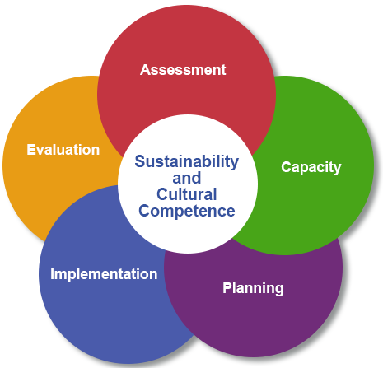
Strategic Prevention Framework (SPF)
SAMHSA Process for Prevention Planning
Continuous Improvement
Data-driven Decision Making Model
Considered Evidence-Based Practice

Slide 7
Put another way…
If you have clearly named your goals, you can plan strategies and activities that support them and rally the resources you need
All of your activities should support your goal
Measuring your progress will lead to the right adjustments

Slide 8
Resources
Introductory online class on the Strategic Prevention Framework
https://nmpreventionworkforce.org/jlms-alias-for-578/guru-test/guruPrograms/3-osap-training-resources/5-using-the-spf
New Mexico ATODA Prevention Workforce Training System
https://nmpreventionworkforce.org
NIDA Principles
https://www.drugabuse.gov/publications/preventing-drug-abuse-among-children-adolescents-in-brief/prevention-principles
Blueprints for Healthy Youth Development
http://www.blueprintsprograms.com/
The Guide to Community Preventive Services (The Community Guide)
https://www.thecommunityguide.org/
The Community Toolbox
https://ctb.ku.edu/en/toolkits
New Mexico National Guard – Sgt. Thomas Hammer
thomas.j.hammer6@gmail.com

