Slide 1


Department of Finance and Administration
Bond Tracking System

Slide 2

New Mexico Board of Finance has the opportunity to modernize its Bond Tracking System by providing a comprehensive solution designed to manage and oversee the financial activities related to projects funded by bonds. By embracing a centralized solution to dated processes, New Mexico can streamline processing transactions, draw requests, and loading each appropriation by bond series to maintain a clear and organized financial overview.

Slide 3

BOND TRACKING SYSTEM TRAINING
Today’s Agenda
Item
1. High-Level Overview of New Bond Tracking System’s Key Functionality
2. Timeline for Launch
3. Overview of Agency User Roles
4. How to View Projects
5. How to Submit a Draw Request
6. Live Walk-Through of Submitting a Draw Request to BOF and Tracking its Status
7. Q&A with BOF and System Development Team

Slide 4
INTRODUCING
Bond Tracking System
A centralized, unified system designed for managing transactions, draw requests, and
loading each appropriation across agencies.
The system will be accessible from an internet browser using state email address
Multi-factor authentication by text or email is required
This may be one of multiple modules a user will have access to

Slide 5
NEXT STEPS FOR
Bond Tracking System
Date(s) | Item
Feb. 13, 2-3pm | Live training on Teams (recording will be made available)
Feb. 17, 2-3pm | Live training on Teams (recording will be made available)
Feb. 17, by end of day | Users will receive an invitation to access the system Invitation will come from platform@dfa.nm.gov
Feb. 18 | New system goes live at https://platform.dfa.nm.gov/
Thursdays, recurring, 3-4 pm Feb. 20 and 27 March 6 and 13 | Office Hours – This is an open time frame for you to join and ask questions about the new system as you become familiar with it. Attendance is not required, but you are welcome to hop on at any time to ask a question or listen in on others’ questions.

Slide 6

Bond Tracking System
Key Functions
The Bond Tracking System empowers the Board of Finance and agency partners to manage and oversee the financial activities related to projects funded by bonds—from initial requests to approvals. The system’s components include:
Project Details
Project profiles highlight appropriation details, including expenditure progress and draw request history, conditions, reauthorizations, and reversions.
Request Submission and Tracking
Empowers agencies to submit draw requests directly and track the status of their request, ensuring a streamlined process for communicating needs.
Payment Processing
The Bond Tracking System generates CSV files for the Board of Finance to upload to SHARE for payment processing to ensure a smooth transition from approved draw requests to payments.
Historical Data and Reporting
Reporting capabilities and historical data storage will provide insights into past appropriations, request volumes and processing times, helping users understand and improve request processing.
1
2
3
4

Slide 7
Bond Tracking System: Agency User Roles
Agency User Roles
The Bond Tracking System allows for two agency roles. These are:
Agency Employee
An agency employee can initiate a draw request for projects the agency oversees.
If a request is denied by a signer or BOF, the employee will receive notification and have the ability to correct or delete the draw request.
Agency Signer
An Agency Signer can approve or deny draw requests initiated by Agency Employee for project the agency oversees.

Slide 8
Viewing Projects

Slide 9
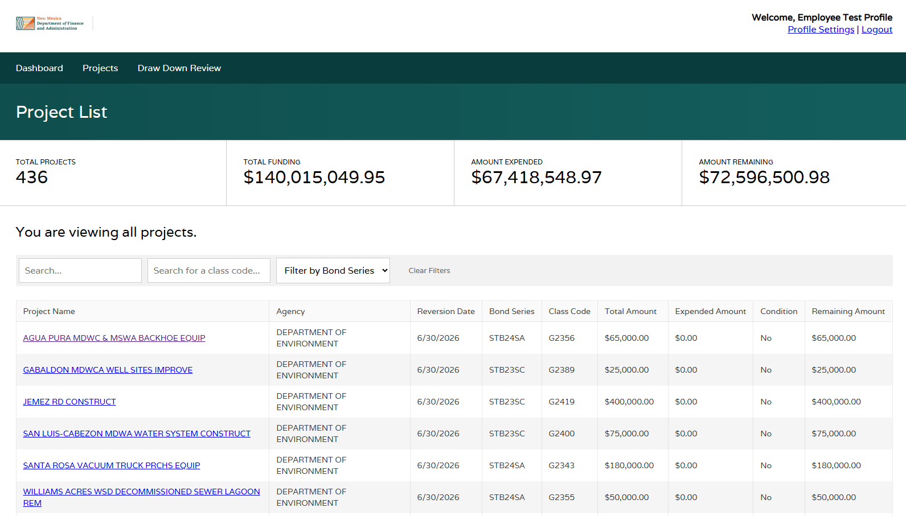
Bond Tracking System: Viewing Projects
In the “Projects” tab, users can view a list of projects. Agency users can only view projects for their respective agency.
Search functions and filters have been implemented to find projects quickly.
From here, a project can be clicked to enter the “Project Profile” and view all details.
EMPLOYEE VIEW (same for signer)

Slide 10
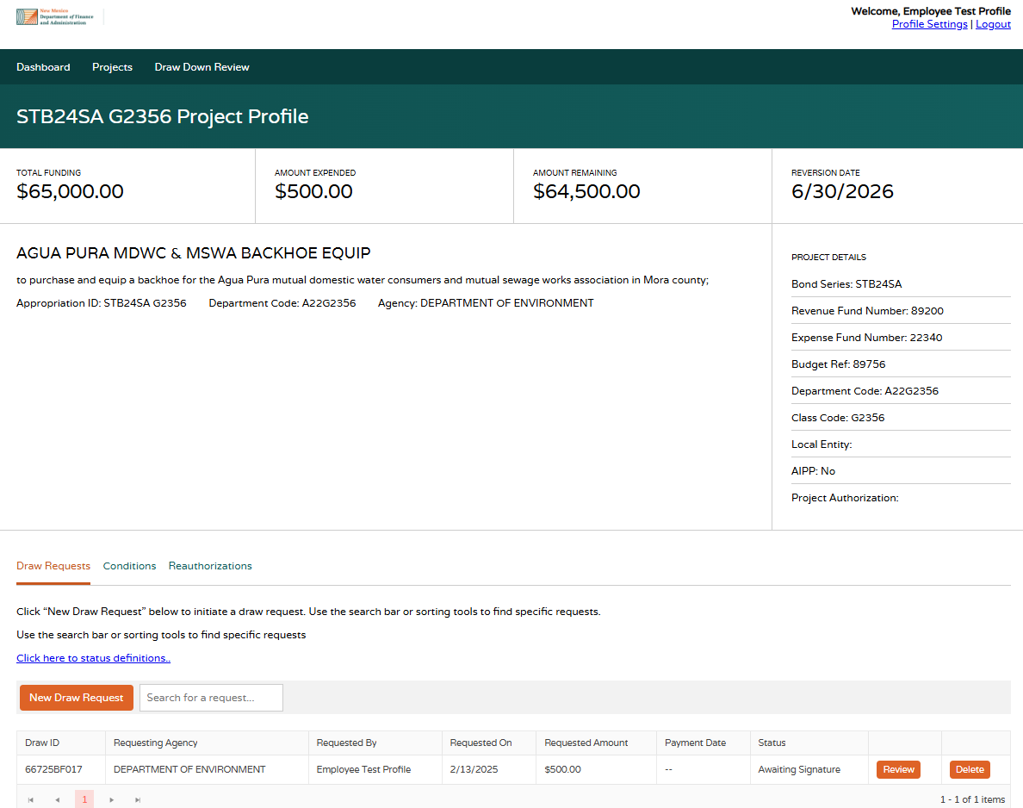
Bond Tracking System: Viewing Projects
“Project Profile” details appear once a project is selected. In the project profile, users can:
View project details.
View/Submit Draw Requests.
View project history, including previously requested draws, conditions, and reauthorizations.
EMPLOYEE VIEW (same for signer, with the exception of submitting a draw request)

Slide 11
Draw Request Process
Draw Requests are initiated by “Employee” users to request payment for a project.

Slide 12
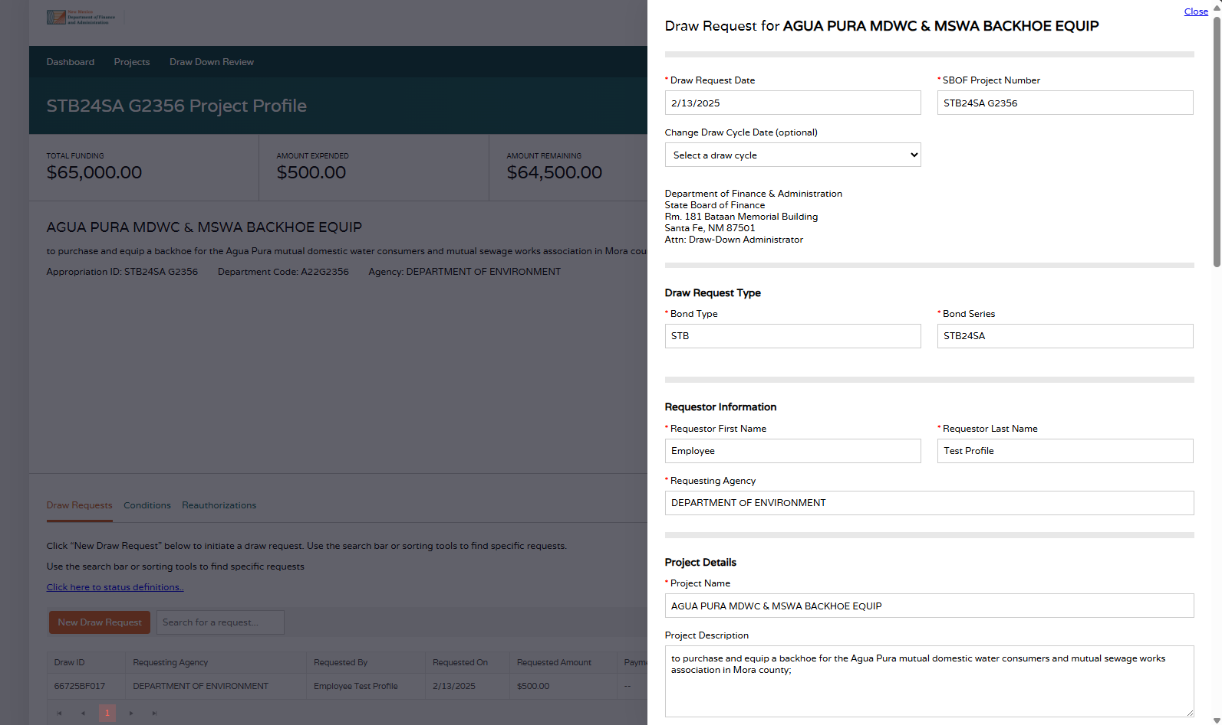
Bond Tracking System: Draw Request Process
Employees submit a draw request by clicking “New Draw Request” under the Draw Requests tab in the Project Profile.
Most information is pre-populated:
  Draw Request Date
  SBOF Project Number
  Draw Cycle Date
    Employees may modify the Draw Cycle Date to one previous or one future draw cycle to accommodate holidays or other reasons approved by BOF.
  Draw Request Type Section
  Requestor Information Section
  Project Details Section
  Payment Information Section
    Some projects may be missing information in this section. If so, Employees will be prompted to fill in the fields.
Employee is required to populate the following fields:
  Draw Request Amount
  Additional Documentation
Notes field is optional.
EMPLOYEE VIEW

Slide 13
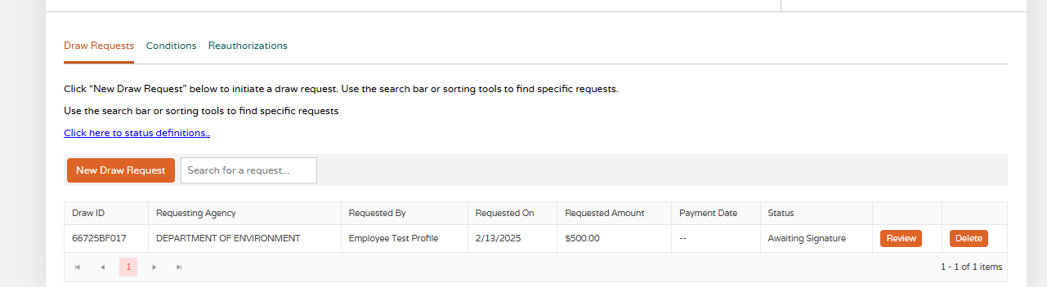
Bond Tracking System: Draw Request Process
Once the Employee submits a new draw request, an email is sent to Signer and it will appear in their queue for signature.
The Status updates to “Awaiting Signature.”
EMPLOYEE VIEW

Slide 14
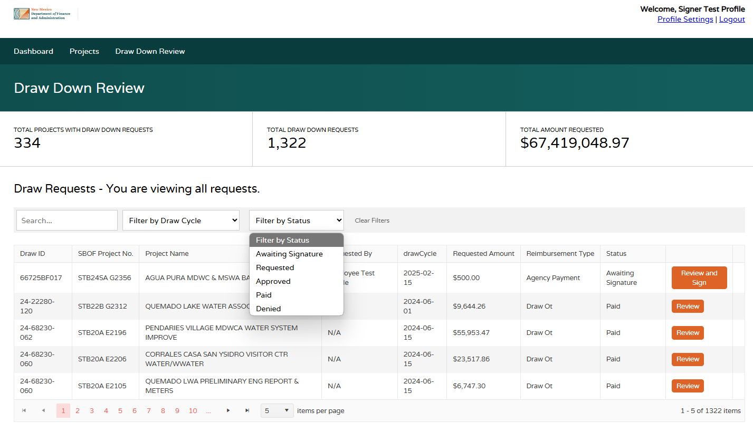
Bond Tracking System: Draw Request Process
Signers log in and goes to “Draw Down Review” tab to sees a grid of Draw Requests for the agency.
The default view is set to view all requests with those “Awaiting Signature” at the top. Users can filter to other status to see certain requests.
Signers will click “Review and Sign” to approve/deny a Draw Request.
SIGNER VIEW

Slide 15
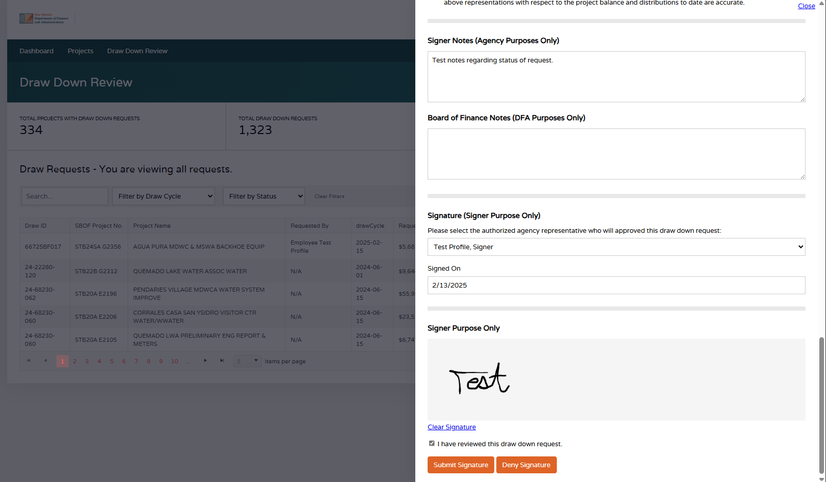
Bond Tracking System: Draw Request Process
Signer can review the draw request and add comments.
Signers are required to submit their signature and check box that they have reviewed the request. They may submit:
Submit Signature
  Request is approved and submitted to BOF
Deny Signature
  Request needs correction or is otherwise denied back to the Employee
SIGNER VIEW

Slide 16
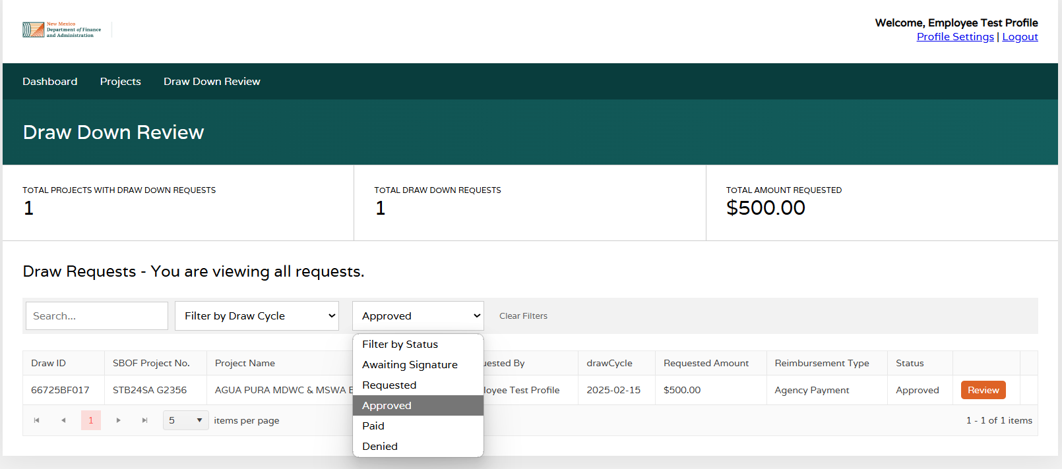
Bond Tracking System: Draw Request Process
Employees and Signers can visit the “Draw Down Review” tab and filter the status of all Draw Requests.
“Status” reflects DFA Bond Tracking Draw Request process:
Awaiting Signature: Draw Requests has been initiated by the Employee and is awaiting signature by the agency’s Signer.
Requested: Draw Requests has been approved by the Signer and submitted to BOF for review.
Approved: Draw Requests has been approved by BOF.
Paid: Draw Requests has been paid and has been entered in SHARE.
Denied: Draw Requests was denied. In this status, agency “Employee” roles may resubmit. Please see notes from BOF and make corrections before resubmitting.
Employees may delete a request if the status is “Awaiting Signature” or “Denied”. This action can be taken in the Project Profile. If you need assistance at another time, please reach out directly to the BOF.
EMPLOYEE VIEW (same for Signer)

Slide 17

Questions?
support@rtsolutions.com

