Slide 1


Department of Finance and Administration
Central Payroll Bureau (CPB) Form Submission System (FSS)

Slide 2
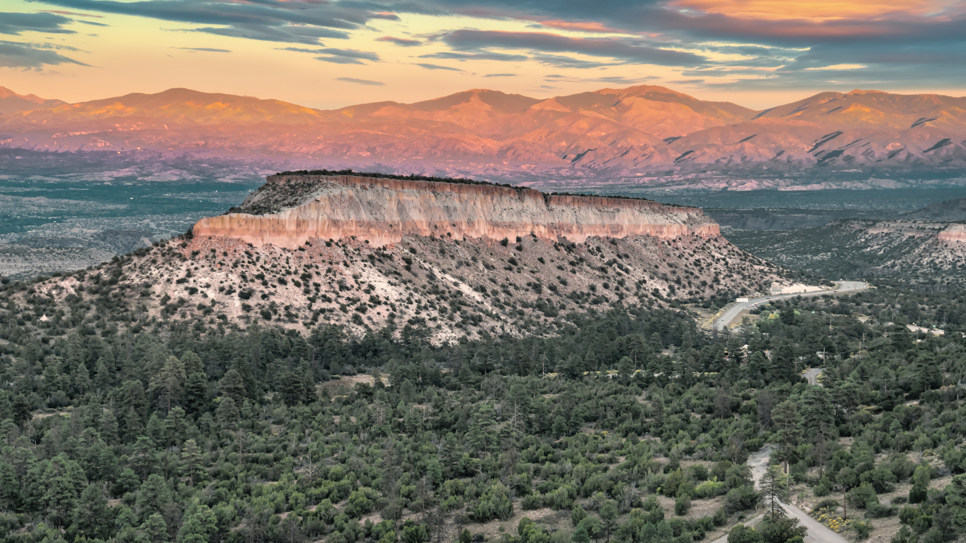
New Mexico has a unique opportunity to modernize its payroll processing management by enhancing collaboration across DFA Central Payroll Bureau and state agencies. By embracing a centralized solution to dated processes, New Mexico can streamline processing payroll requests. This modernization will drive faster response to requests, ensuring more efficient services to current and former state employees.

Slide 3

INTRODUCING
Central Payroll Bureau Form Submission System
A centralized, unified system designed for processing payroll request forms across agencies.
The system is in the final stages of development and user testing will begin this month
Anticipated launch on January 1st
The system will be accessible from an internet browser using state email address
This may be one of multiple modules a user will have access to

Slide 4

Central Payroll Bureau Form Submission System
Key Functions
The Form Submission System empowers DFA’s Central Payroll Bureau and agency partners to manage the payroll request processes effectively—from initial requests to approvals. The system’s components include:
Request Submission
Empowers agencies to submit their payroll requests directly.
Request Tracking
Agencies can track the status of their request, ensuring a streamlined process for communicating needs.
Reporting
Reporting capabilities will provide insights into request volumes and processing times, helping users understand and improve request processing.
1
2
3

Slide 5
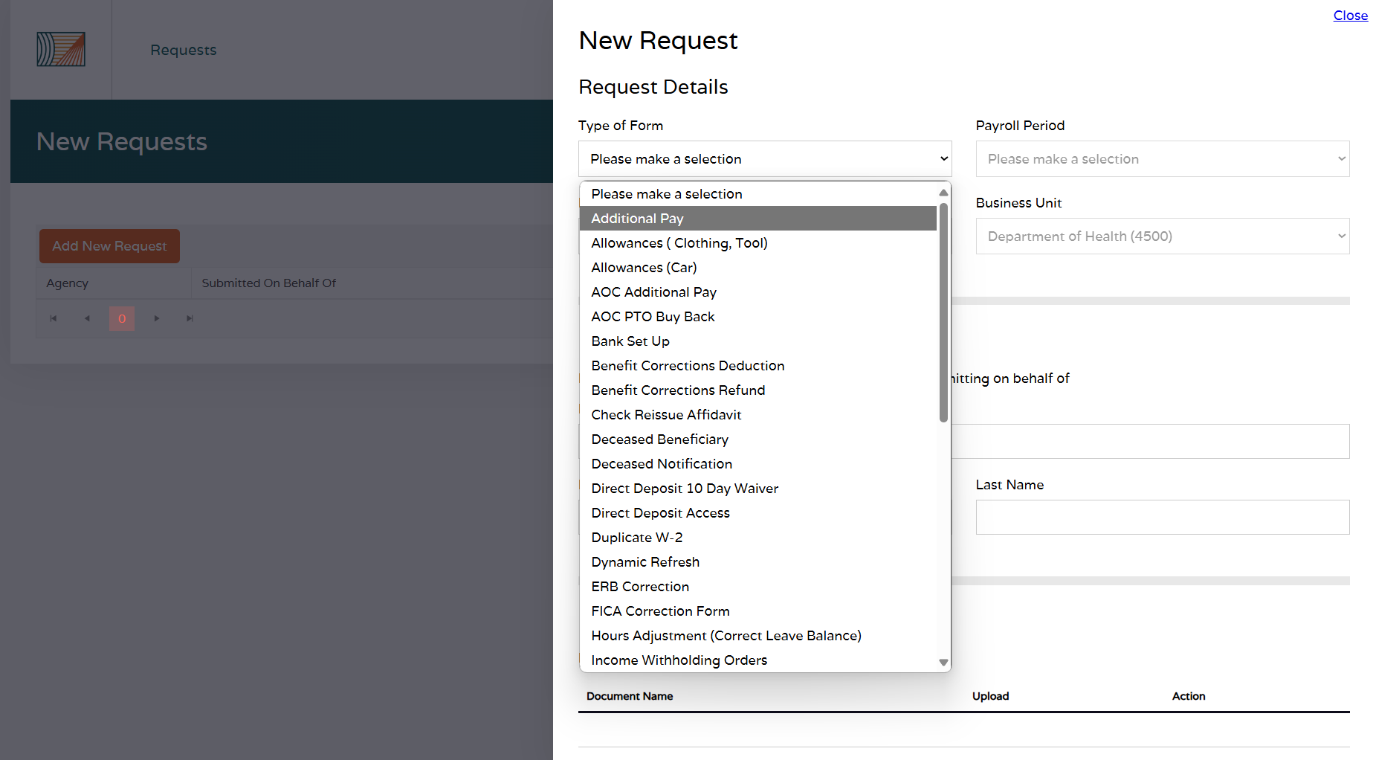
Central Payroll Bureau Form Submission System
Request Submissions
Request submissions are streamlined by allowing agency HR representatives to submit a variety of payroll requests for review and approval, from Payroll Offers to Legislature Annual Buy Backs.

Slide 6
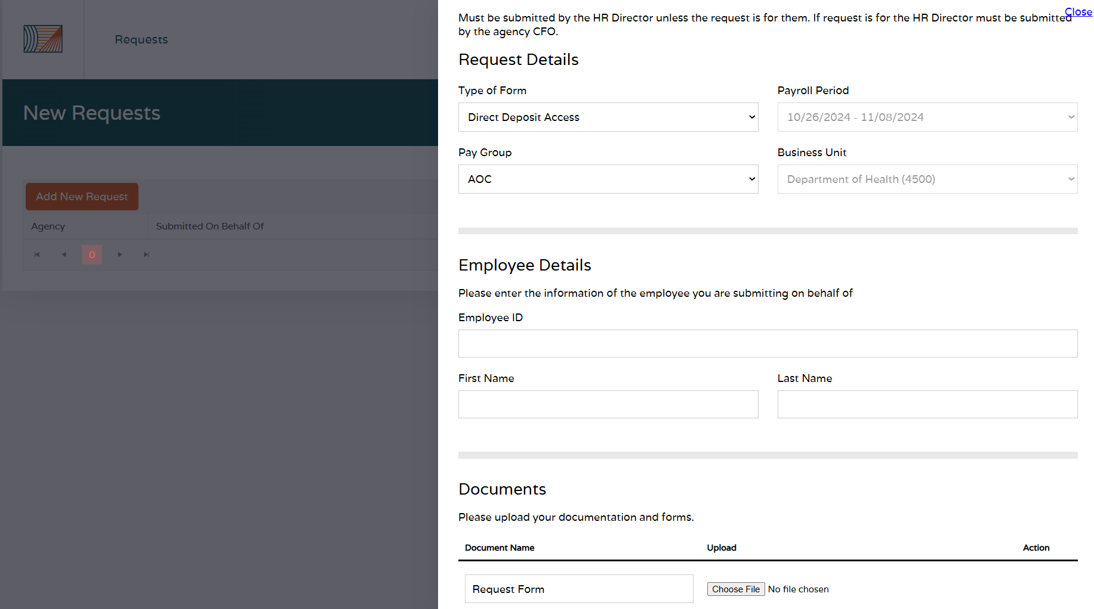
Central Payroll Bureau Form Submission System
Quality Control
The Form Submission System helps ensure quality of submissions by providing instructions by request type, establishing deadlines for which payroll period a request can be submitted for, and clarifying the types of documents to be uploaded. Fields will pre-populate as appropriate.

Slide 7
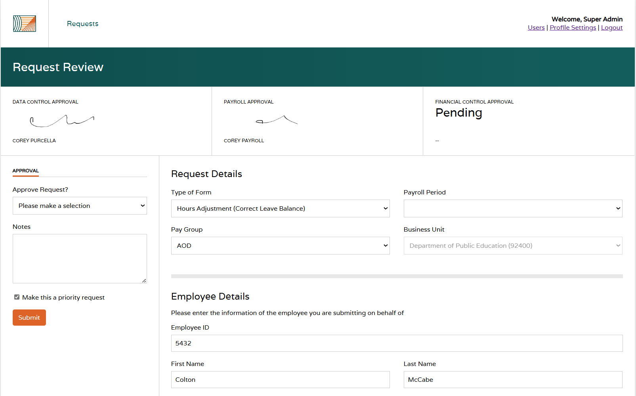
Central Payroll Bureau Form Submission System
Processing Workflow
Requests will go through three levels of approval: Data Control, Payroll, and Financial Control.
Upon approval at each level, the request will automatically route to the next approval’s queue.

Slide 8
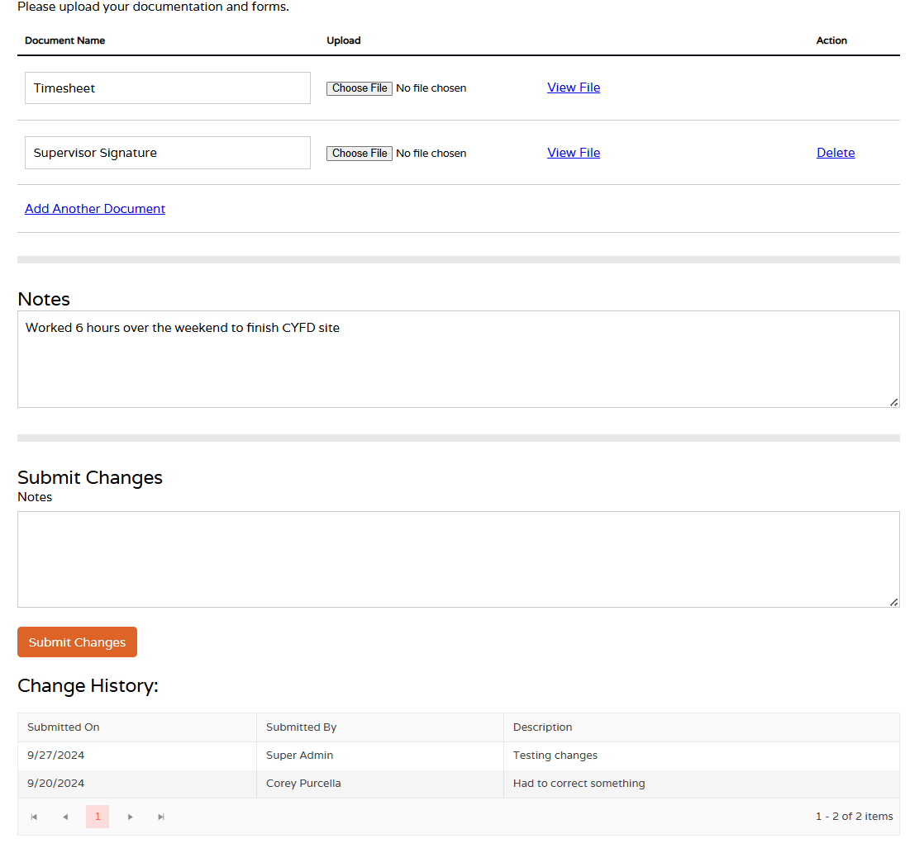
Central Payroll Bureau Form Submission System
Processing Workflow
Request documents will be available to view/download and the request will be edit-able by the reviewer as needed. A change history will be documented for the submitter.

Slide 9
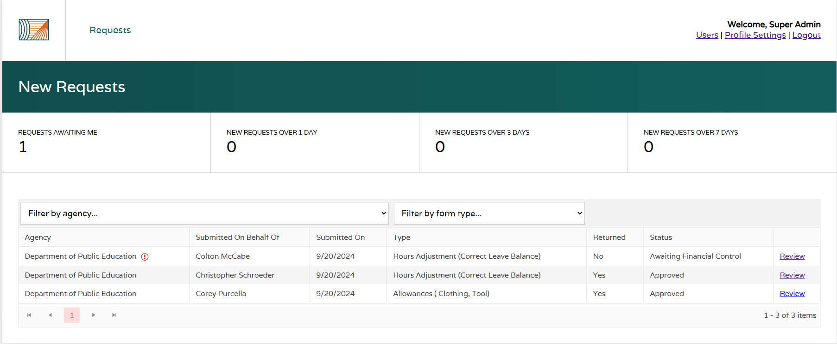
Central Payroll Bureau Form Submission System
Monitor Request Status
DFA CPB and agencies can view the status of each request.
Once approved, DFA CPB and agencies can review for backup as needed.

Slide 10
NEXT STEPS FOR
Central Payroll Bureau Form Submission System
Volunteers are needed to serve as Form Submission System user testers, which will allow staff to become familiar with the system, provide feedback and suggestions on functionality, and identify potential fixes in advance of launching the system for use.
Date(s) | Item
By November 8, 2024 | Volunteer user testers by emailing Alex Guzman at Alejandro.Guzman@dfa.nm.gov
November 18-December 18, 2024 | User testing takes place (including training)
December 19-31, 2024 | Formal training, date TDB
January 1, 2025 | System is launched and the form submission and approval processes will shift to utilize the system

Slide 11

Questions?

