Slide 1
Calculating the New FLSA Rate for Additional Pay Requests
April 6, 2016

Slide 2
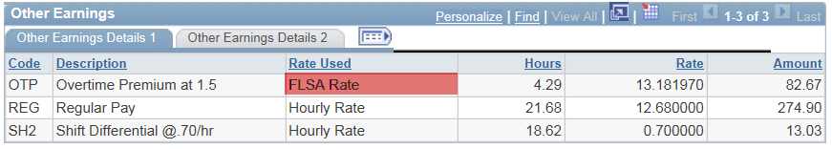


Step 1: Identify the earnings codes for the FLSA period
OTP 4.29 x 13.18197 x 1.5 = 84.82
REG 12.68 x 21.68 = 274.90
SH2 18.62 x 0.70 = 13.03
?%#*&!

Slide 3
Step 2: Determine the effect on FLSA for each earning code
Run query: NMS_PY_EARN_CODES_FLSA
Run the query as of the week begin date for the week you are calculating.
Run for each earning code in that week.
OTP – Both Hours and Amounts
REG – Both Hours and Amounts
SH2 – Amounts Only

Slide 4
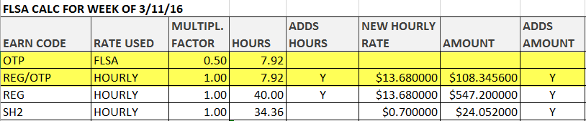
Step 3: Create a spreadsheet with the earnings the EE should have been paid by week
Split the OTP earnings code into two separate lines, one that includes OTP with a multiplication factor of 0.5, and one that includes REG with a multiplication factor of 1.0. In the "Adds Hours" and "Adds Amount" Columns, put a 'Y' next to the REG earnings, but not next to the OTP earnings.
Insert the “New Hourly Rate” the employee should have been paid during that time period, NOT the amount listed on the paycheck.

Slide 5
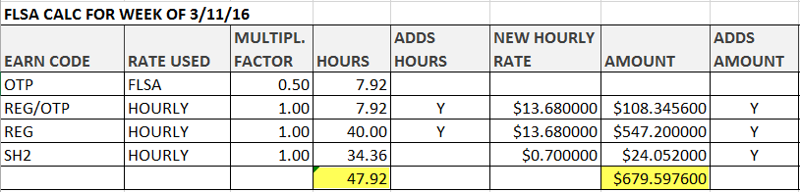
Step 4: Total the Hours and Amounts Columns where
Adds to Hours/Amount = Y
Total FLSA Hours = 7.92 + 40 = 47.92
Total FLSA Amount = 108.3456 + 547.20 + 24.052 = 679.5976

Slide 6
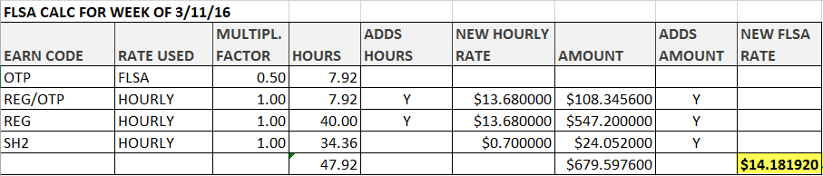
Step 5: Find the FLSA Rate
Divide the FLSA Amount (679.59) by the FLSA Hours (47.92) to find the FLSA Rate
  679.5976 / 47.92 = 14.181920

Slide 7
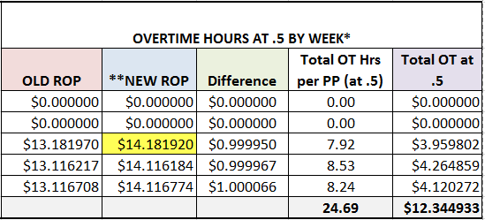
Step 6: Insert amount into Additional Pay Spreadsheet
Take the New FLSA Rate from the prior spreadsheet and insert it into the Additional Pay Worksheet

