Slide 1

Debt Module and Corrections to Debt
Required @ Interim Budget
Department of Finance & Administration,
Local Government Division, Budget and Finance Bureau
Presented By:
Kathleen Coates, Harold Quintana & Bryce Roth
Budget & Finance Budget Analysts
Notes:
Budget season is approaching quickly. As your analysts, we want you all to be prepared, ready and have a smooth budget process on entering budgets and submitting the required documents.
This presentation will provide you with information the debt module.

Slide 2
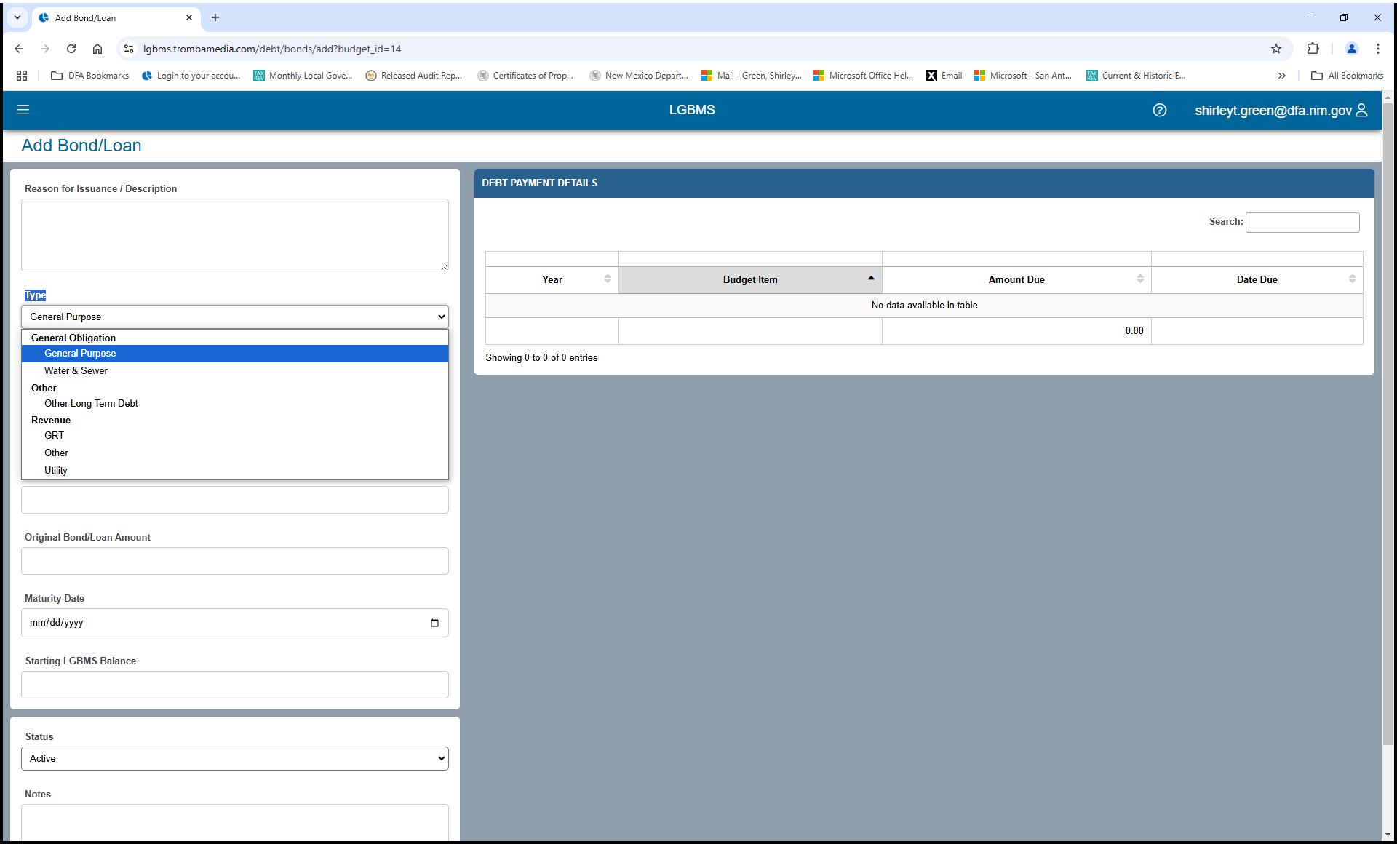
DEBT MODULE – ADDING NEW DEBT
Notes:
Any new debt acquired during the FY 25-26 that was NOT included in your budget will need to be entered for this new budget year.
CATAGORIZING DEBT CORRECTLY: When you are adding debt, If your debt falls under Water & Sewer, please do not place it in General Purpose. When this data is extracted for report purposes, placing it in the wrong General Obligation, results in the data being incorrect. If you do have debt such as Water & Sewer, ensure you have correctly identified the debt. General Purpose is used only if it does not fit with other categories that you see listed in slide.
This year when recording your new debt in debt module, you must correct debt already entered that was categorized incorrectly. All analyst will be checking for this and will return the budget if not categorized correctly.

Slide 3
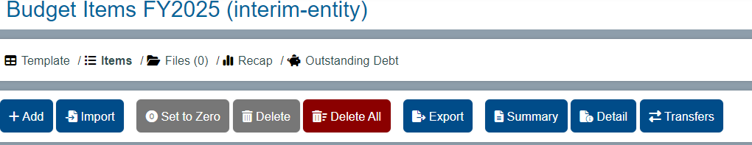
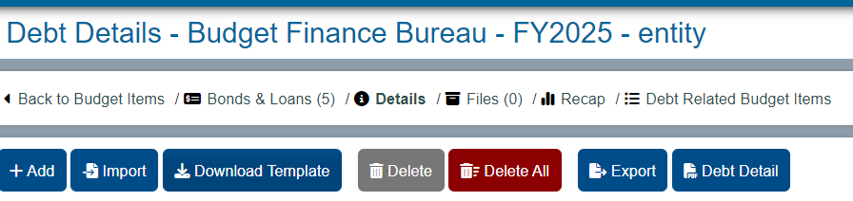
DEBT MODULE
Step 1: Click on Outstanding Debt
Step 2: Click on Bonds & Loans
Notes:
Make sure it is correct Fiscal Year you are working in. CORRECT FISCAL YEAR WILL BE BUDGET ITEMS FY 2026
Start by clicking on the Outstanding Debt link.
Then click on Bonds & Loans

Slide 4
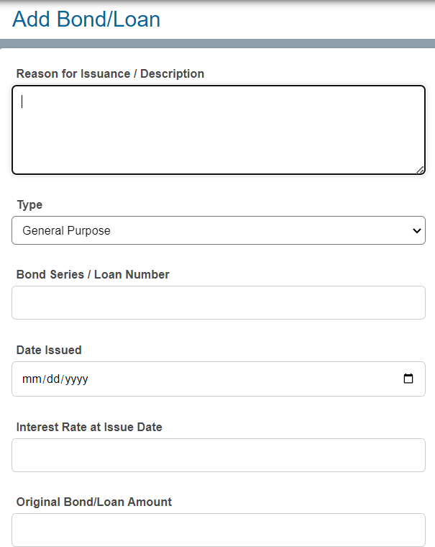
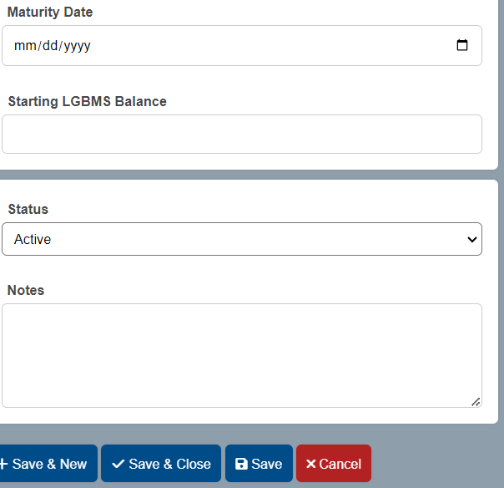
Step 3: Enter Each Bond/Loan Information – Save & Close or Save & New if more than one bond/loan
Notes:
Step 3: Enter each bond/loan information. Then hit close & save. If you are entering multiple debts, then click on Save & New.

Slide 5
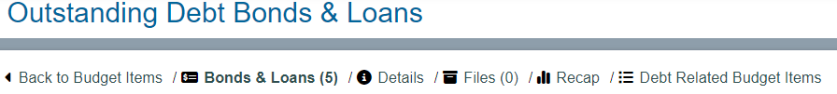
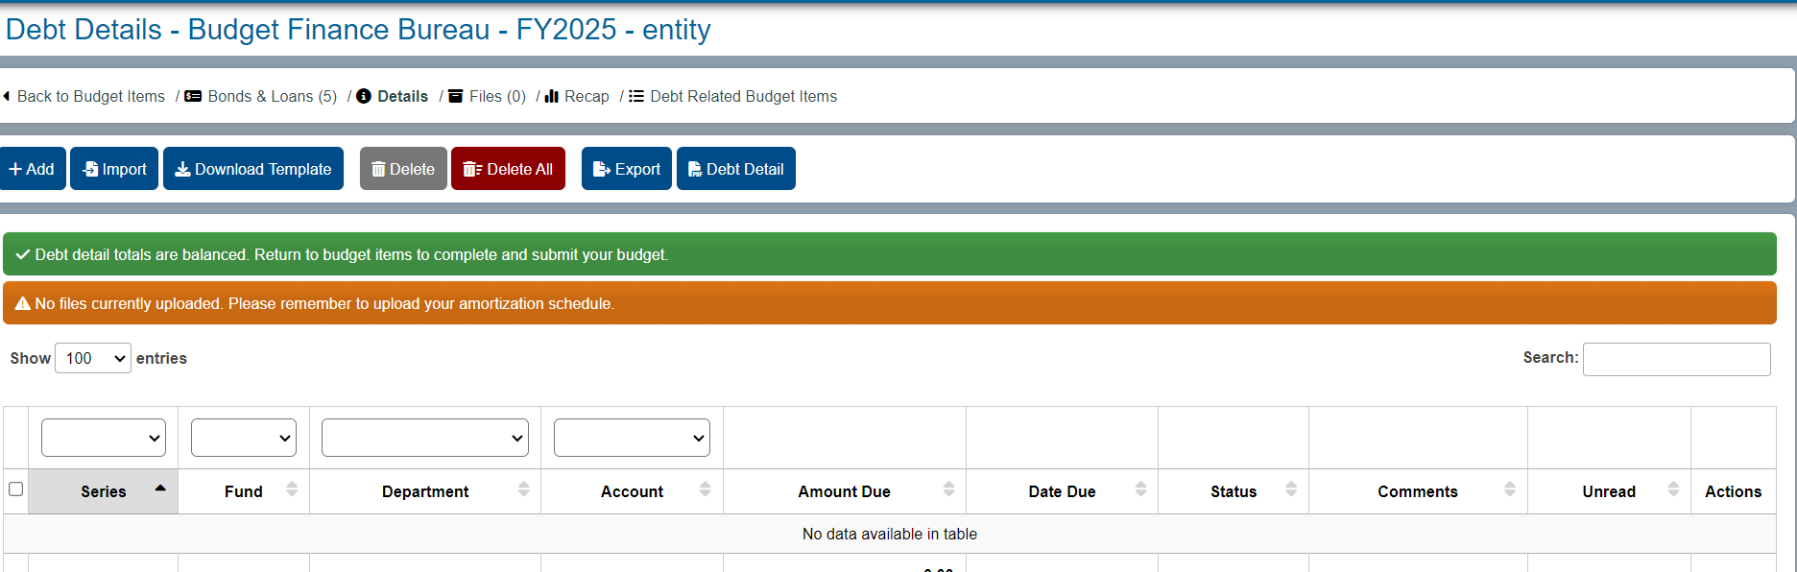
Step 4: Click on Details
Step 5: Click on Add
Notes:
Step 4: Click on the Details
Step 5: Click on Add

Slide 6
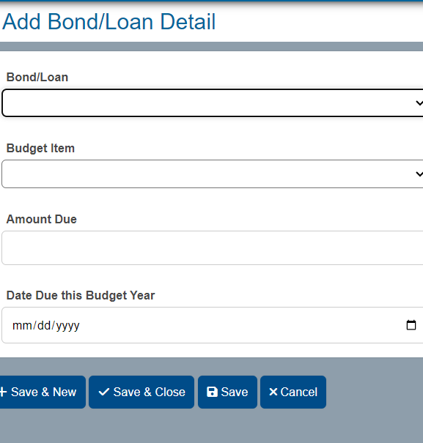
Enter the information from the amortization schedule into the appropriate fields in LGBMS.
Click Save & New if more debts need to be entered.
Click on Save & Close if you are done entering debt.
Notes:
Once you have clicked on Add this page will populate. Here you will enter all relevant information. Click on save & Close, again, if you are entering multiple debts then click on Save & New.

Slide 7
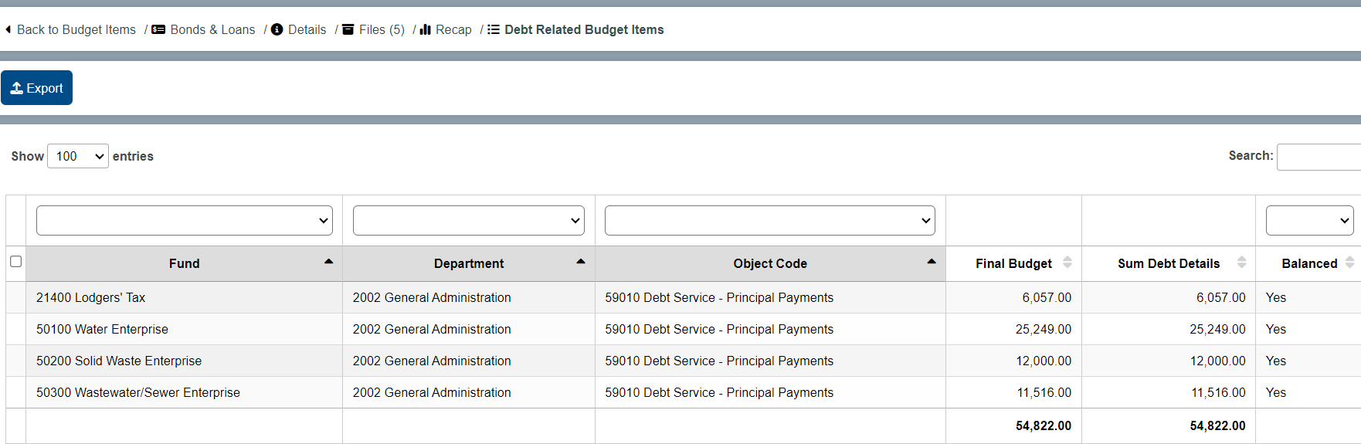
Verify Final Budget and Sum Debt Details Columns Balance (Notice to the right it says balanced)
IF not in balance it will be in Red and will say No on Balanced Column
Notes:
Make sure to Verify the Final Budget and Sum Debt Details Columns Balance. If it is not in balance, it will be in Red and will say No on the Balanced Column. If it says no then go back and review the amount information and adjust accordingly.
IF THIS DOES NOT BALANCE YOUR ANALYST WILL RETURN TO YOU FOR CORRECTION

Slide 8
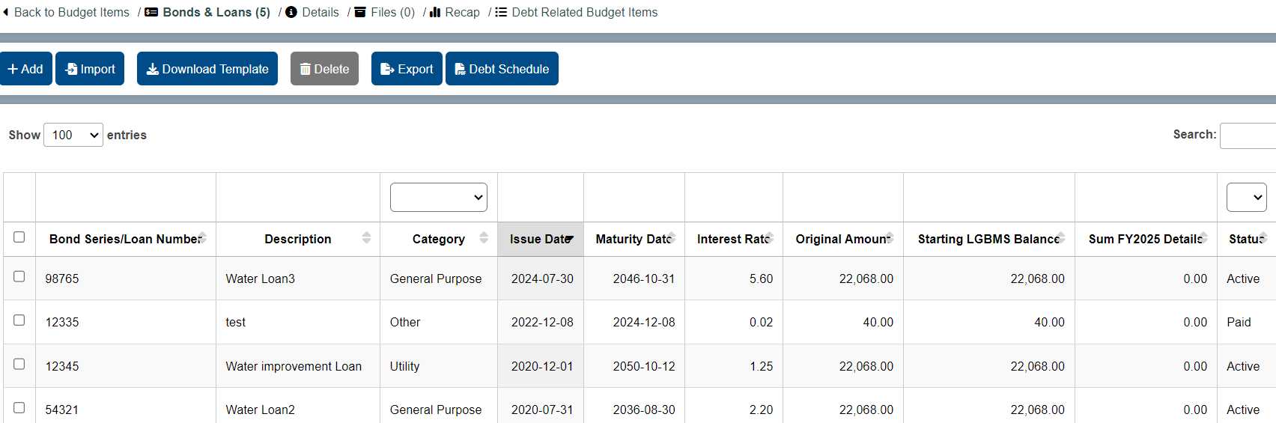
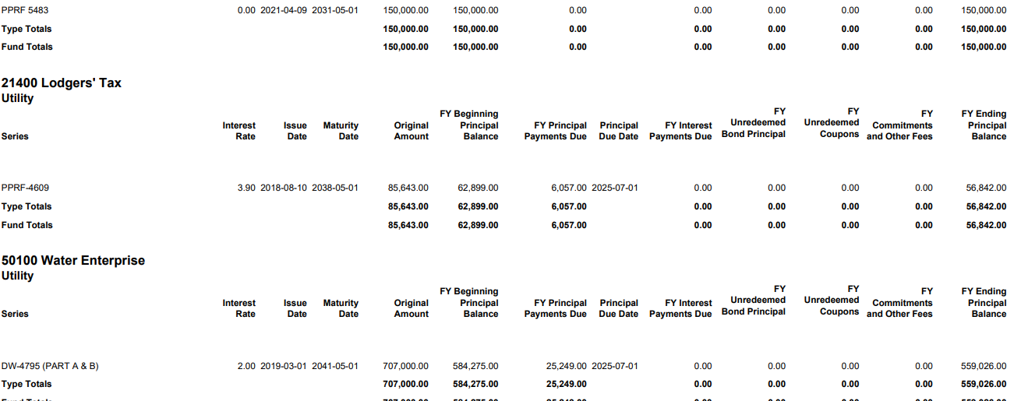
To review the Debt Schedule:
Click on Bonds & Loans
Then click on Debt Schedule
The Original Amount is the total amount of the bond/loan from the amortization schedule.
The FY Beginning Principal Balance is the balance as of 6/30 from the amortization schedule.
Notes:
Make sure to review Debt Schedule --- The Original Amount is the original amount of the bond/loan. The FY Beginning Principal Balance is the balance as of 6/30.

Slide 9
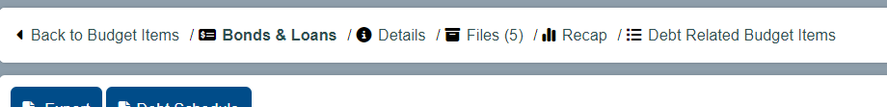
Make sure to upload Amortization Schedules into Files
Notes:
Last Step is to upload the amortization schedules into Files. The amortization schedules are required.

Slide 10

CWSRF 005 | LGBMS Debt Schedule | Outstanding + Paid
Beginning amount | $ 36,303.23 | $ 762,367.79
12/17/2018 | $ - | $ 36,303.23
12/17/2019 | $ - | $ 36,303.23
12/17/2020 | $ - | $ 36,303.23
12/17/2021 | $ - | $ 36,303.23
12/17/2022 | $ - | $ 36,303.23
12/17/2023 | $ - | $ 36,303.23
12/17/2024 | $ - | $ 36,303.23
12/17/2025 | $ 36,303.23
12/17/2026 | $ 36,303.23
12/17/2027 | $ 36,303.23
12/17/2028 | $ 36,303.23
12/17/2029 | $ 36,303.23
12/17/2030 | $ 36,303.23
12/17/2031 | $ 36,303.23
12/17/2032 | $ 36,303.23
12/17/2033 | $ 36,303.23
12/17/2034 | $ 36,303.23
12/17/2035 | $ 36,303.23
12/17/2036 | $ 36,303.23
12/17/2037 | $ 36,303.23
12/17/2038 | $ 36,303.19
Total | $ 508,245.18 | $ 254,122.61
LGBMS Outstanding | $ 430,770.95
SAMPLE OF RECONCILIATION REVIEW
EXCEL SHEET PROVIDED
BY YOUR BUDGET ANALYST
Notes:
ANALYSTS DID A COMPLETE COMPREHENSIVE RECONCILIATION OF ALL ENTITIE’S DEBT ENTERED INTO LGBMS LAST FISCAL YEAR WITH THE AMORTIZATION SCHEDULES FOR EACH LOAN.
YOUR ANALYST WILL BE REACHING OUT TO YOU WITH ANY CORRECTIONS THAT NEED TO BE MADE W/EXISTING LOAN INFORMATION IN LGBMS. PLEASE MAKE SURE TO CORRECT THIS INFORMATION WITH YOUR DEBT AT INTERIM BUDGET – THIS IS REQUIRED FOR INTERIM.

Slide 11
Total debt amount entered in LGBMS
Fund Name
Total debt amount from amortization schedule
Review the Total Debt amount entered in LGBMS. Compare it to the Total Debt amount from the amortization schedule. LGBMS should match the amortization total amount.
The Total Outstanding amount in LGBMS should also match the Outstanding amount from the amortization schedule.
Ensure the correct interest rate is entered in LGBMS.
Check to be sure the Principal Payment for each debt is correct (refer the amortization schedule for verification).
Each Debt/Loan must be correctly categorized by Type in LGBMS
Update the Date Principal Due if necessary.
CWSRF 005 | LGBMS Debt Schedule | Outstanding + Paid
Beginning amount | $ 36,303.23 | $ 762,367.79
12/17/2018 | $ - | $ 36,303.23
12/17/2019 | $ - | $ 36,303.23
12/17/2020 | $ - | $ 36,303.23
12/17/2021 | $ - | $ 36,303.23
12/17/2022 | $ - | $ 36,303.23
12/17/2023 | $ - | $ 36,303.23
12/17/2024 | $ - | $ 36,303.23
12/17/2025 | $ 36,303.23
12/17/2026 | $ 36,303.23
12/17/2027 | $ 36,303.23
12/17/2028 | $ 36,303.23
12/17/2029 | $ 36,303.23
12/17/2030 | $ 36,303.23
12/17/2031 | $ 36,303.23
12/17/2032 | $ 36,303.23
12/17/2033 | $ 36,303.23
12/17/2034 | $ 36,303.23
12/17/2035 | $ 36,303.23
12/17/2036 | $ 36,303.23
12/17/2037 | $ 36,303.23
12/17/2038 | $ 36,303.19
Total | $ 508,245.18 | $ 254,122.61
LGBMS Outstanding | $ 430,770.95
Total outstanding amount from amortization schedule
Total outstanding amount entered in LGBMS
Notes:
For each loan/debt, review the total amount entered in LGBMS and make sure it matches the total amount from the amortization.
The total outstanding amount for each debt should match the total outstanding amount from the amortization schedule.
Be sure each debt is correctly categorized by type.
Review the interest rate, the principal payment and the payment date to be sure they are entered correctly in LGBMS.

Slide 12
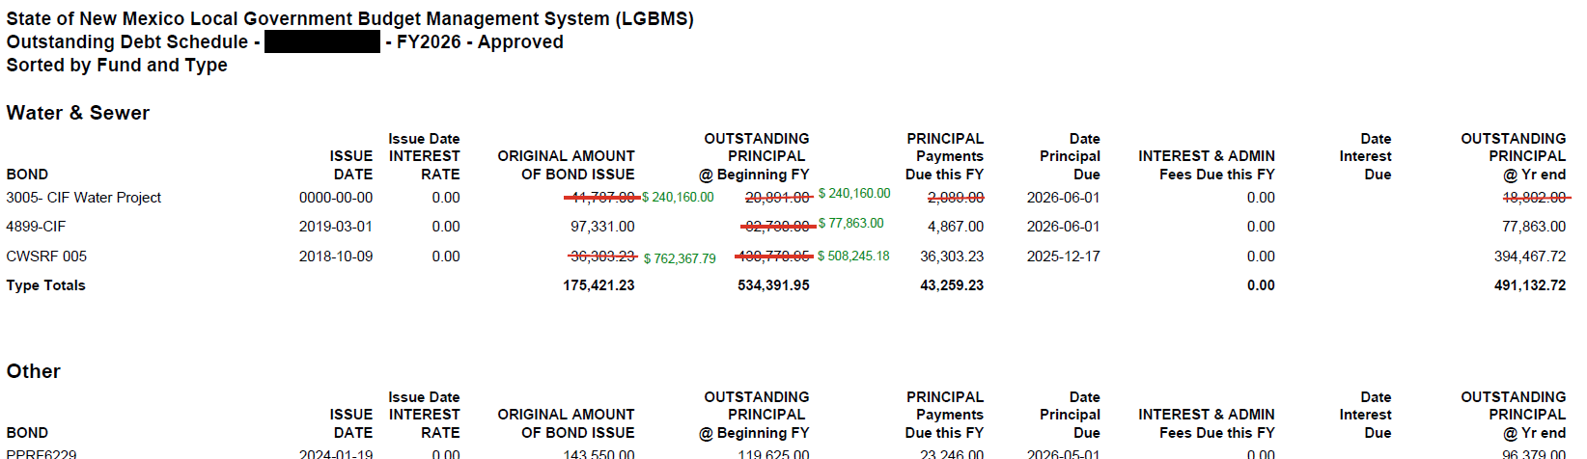
You may also receive an Outstanding Debt Schedule from your analyst that summarizes the changes required for your debt.
Notes:
Changes to the Debt Module MUST be completed during the Interim Budget stage!

Slide 13
Budget & Finance Bureau: Webpage and Links
Budget Forms: https://www.nmdfa.state.nm.us/local-government/budget-finance-bureau/budget-forms/
Budget Memos: https://www.nmdfa.state.nm.us/local-government/budget-finance-bureau/budget- memos/
Home Page: https://www.nmdfa.state.nm.us/local-government/budget-finance-bureau/
NM EDGE nmedge@nmsu.edu
LGBMS: https://www.nmdfa.state.nm.us/local-government/budget-finance-bureau/lgbms/
Notes:
Here are important links within the Budget and Finance section of the DFA website that you and your staff will be using throughout the year. We suggest that you familiarize yourself with the information provided herein.
The Home Page contains contact information for BFB staff and access to past trainings and conference material.
Budget Memos: this link compiles all Memos that have been distributed through out this year and well into past years.
Budget Forms: provides all forms required by the BFB and LGBMS.
LGBMS (Local Government Budget Management System): This page contains numerous valuable links, including SAFs, Disable SAF, the LGBMS interface link, LGBMS User’s Guide, FAQ, Chart of Accounts Structure and COA Crosswalk Tips. In the future, this will also include an LGBMS Crosswalk Tutorial Video.
NM Edge: this link leads you to certification programs for local government and government employees.
A note on Security Access Forms (SAFs): PLEASE NOTE— For the remainder of this fiscal year (2023-24), please continue to use the SAF and Disable-SAF links (found on the LGBMS homepage) to download the appropriate forms and submit to your assigned analyst. Security Access Forms are\ completed and processed internally through the LGBMS interface.

