Slide 1

FY 26-27 INTERIM BUDGET TRAINING AND GUIDELINES
Department of Finance & Administration,
Local Government Division, Budget and Finance Bureau
Presented By:
Kathleen Coates, Harold Quintana and Bryce Roth
Budget & Finance Analysts
Notes:
Good morning my name is Kathleen Coates, Budget & Finance Analyst. I have the privilege to be presenting with Harold Quintana and Bryce Roth, Budget and Finance Analysts.
Budget season is approaching quickly. As your analysts, we want you all to be prepared, ready and have a smooth budget process on entering budgets and submitting the required documents.
We will be presenting “FY 26-27 Interim Budget Training and Guidelines”. This presentation will provide you with information on the interim budget process and provide information on how to enter the Interim Budget and the required supporting schedules. We have a lot of information to cover in the presentation.

Slide 2
THE BUDGETING PROCESS
Current
Conditions
Historical Data
THE BUDGETING PROCESS
Project Revenue/Expenditures
Development Patterns
Uncertainty
Fiscal Capacity
Formulate Policies
Goals
(Short Term – Long term)
Other Public Agencies
Public Hearings
Community Needs
& Expectations
Elected Officials
Goals & Objectives
Budget
Notes:
Here is a basic flow chart example of the budget process. The budgeting process should start late January early February, determine the projected revenues and gather historical department budgets and start conversations with the department heads about their historical budget to develop their budget needs to include any new expenditures or large projects they are aware of.

Slide 3
Budget
Forecasted Financial Plan for a Fiscal Year (FY);
Using historical data, projected revenues and expenditures for upcoming year.
Local entities will enter and upload into LGBMS.
ONE BUDGET that will be reviewed and approved in
TWO STAGES
Interim and Final.
Notes:
Kathleen
A budget is a Forecasted Financial Plan for a Fiscal Year (FY); Using historical data and economic trends to project revenues and expenditures for upcoming year. It is used as a:
- Monetary Plan
- Communication Tool
- Legally Binding Contract
As we prepare for the Fiscal Year 26-27; there is ONE BUDGET TWO STAGES. The first step will be entering the Interim Budget. There are two ways to enter the interim budget, either manually or upload into LGBMS. The interim budget is reviewed and analyzed by your analyst to ensure you have a balanced budget. Upon approval you will be provided the approved copy.

Slide 4
Property Tax
Verify the September 1st Tax Certificate for accuracy
Utilize the “Property Tax Revenue Estimate Form” on BFB’s website: https://www.nmdfa.state.nm.us/local-government/budget-finance-bureau/property-taxes/property-tax-revenue-estimate-forms/
Submit mill levy resolutions to no later than final budget deadline of July 31st
Gross Receipts Tax (GRT) historical data, review past trends
New Businesses
Business closures
New enactment tax increase
Utilize CMP 41259 and ITG 41260 revenue object codes
Construction one-time revenue should be used to build or maintain reserves
Small Cities Assistance Fund 7-1-6.2 NMSA 1978,
Small County Assistance- Assistance Section 4-61-1 through 4-61-3, NMSA 1978 if applicable
Debt Service
GO Bond- Property Tax revenues -Voter approval required
Revenue Bond - GRT, Gas Tax- pledged for re-payment of Debt
Revenue Forecasting
Tips
Notes:
Before we begin the actual budget process, here are some forecasting tips to keep in mind when you begin the budget development process.
Property Tax - Finance staff should Utilize the “Property Tax Revenue Estimated Form” to determine the forecasted property tax revenue. This Form can be found on our website, follow link which is provide on the slide. This form can also be used as a tool to provide the mill rate information to the governing body for estimating “what if” scenarios when a local government is contemplating increasing the imposed operational mill rate.
Any changes to the imposed operational mill rate must be via a governing body approved resolution submitted no later than July 31st, please email the resolution to Catrina Chavez, the Special Project Analyst Please submit this information with your final budget and email your analyst that your entity will be increasing the mill rate, so they can verify with Catrina she received the information. This information is needed when calculating the property tax rates.
Gross Receipts Tax- LGBMS has now been in full operation since 2018, five full budget years, you can utilize the historical data to analyze the GRT trends to assist you in forecasting the GRT amounts. Remember to analysis and disrupters such as a business closing or any new expected revenue such as new business coming, new construction projects, etc.
. Keep in mind any new business will generate additional revenue- You may want to check with your Zoning Department if there are any permits for any new business that are opening in your area?
. Is your governing body enacting a new tax increase? If so, you need to contact the Tax and Revenue for guidance on the process.
Construction or Road projects bring in additional tax revenue up until the project ends; it is recommended to places these additional revenues in a reserve fund for a raining day-since it is considered at a one-time revenue and should no be used for recurring expenditures (such as salary increases, insurance cost).
Small Cities and County Assistance distributions if applicable. Small Counties Assistance Act was established by the NM Legislature in 1982 to provide funding to small counties to be used for general operating purposes. Counties must meet specific qualifications; this revenue is distributed by BFB- for more information you can look up the statue that is provided on this slide.
Small Cities is distributed by TRD; the distribution is based on population of each municipality in the state. The population information is provided by the Bureau of Business and Economic Research located at UNM. Additional information can be found in the statue that is also provide on this slide.
Debt Service:
General Obligation Bond referenced as GO Bond- This revenue comes from property taxes. This does require voter approval
Revenue Bonds can be from GRT, Gas Tax, Lodgers Tax. This revenue is obligated and/ or restricted for a certain purpose and is considered a Debt.
DO NOT budget grants until you have legally secured the grant with the appropriate signatures and an award letter. . Also Please DO NOT comingle Grants with your operational fund which is your general fund. Grants have a purpose with specific scope of work. Mark sure you understand the grant requirements.

Slide 5
Revenue Timing & Cash Flow Management
Property Tax – Typically received in December and May
Gross Receipts Tax (GRT) – Typically received monthly
New GRT enactments will not be received until the third month
Deadline to submit to TRD March 31st for an effective date of July 1st and September 20th for an effective date of January 1st
Reference – FYI-M121-Municipal-Gross-Receipts-Tax-Programs-Final-Draft.pdf
Special Appropriations – Determined by statute or grant agreement signoff
Grant – Reimbursement Based (make sure to understand the grant and the applicable expenditure(s)
Notes:
Property Taxes are collected and distributed by your county Treasures Office typically in December and May.
New enactments are also handled by the Tax and Revenue. All enactments must be approved by your governing body; there are two deadlines to submit to TRD. March 31st deadline is for the effective date of July 1st. September deadline is for the effective date of January 1st. For more information you can go to the link as shown on the slide to attain tax & revenues GRT reference guide
Please note the July 1st or January 1st newly GRT enactment distribution will not be received until 3 months later-The process is the Vendor collects the taxes in July and reports the taxes generated to TRD on their August report in their CRS report, September TRD makes the distribution.
Special Appropriations are usually distributed through grant agreements, where all required parties have to signoff. Always make sure to review and understand the scope of work and the applicable expenditures to ensure the entity receives the 100% reimbursements.

Slide 6
Special revenues distributed by LGD/Budget & Finance Bureau:
    County Detention Facility Reimbursement Act, NMSA 1978, 33-38-3B-1 thru 33-3B-4
    Forest Reserve, Secure Rural Schools Act reauthorized 4/16/15 (Sect 524 of P.L.114-10)
    Taylor Grazing Act distributions 43 CFR Pat 4100 and NMSA 1978, 6-11-5 & 6-11-6
    Law Enforcement Protection Fund (LEPF), NMSA 1978, 29-13 and Rule 2.110.3 NMAC
Special Revenue
(CANNOT BE USED FOR GENERAL OPERATIONS)
Notes:
It is important to know what types of special revenue the entity will receive for the upcoming new fiscal year.
This slide provides the Special Revenue that is distributed by LGD/BFB.
Please remember Special Revenues are restricted funds and cannot be used for general operations.
Please make sure you have these appropriations in the correct fund. Please reach out to your budget analyst for more information and/or guidance.

Slide 7
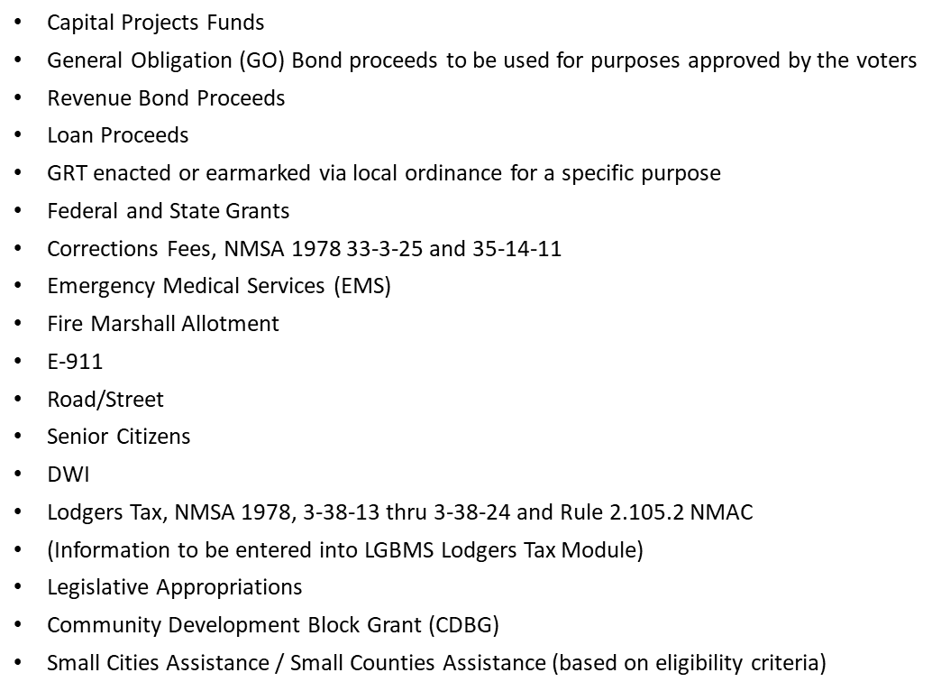
Other Special Revenue
(CANNOT BE USED FOR GENERAL OPERATIONS)
Notes:
It is important to know what types of special revenue the entity will receive for the upcoming new fiscal year.
This slide provides the Special Revenue that is distributed by LGD/BFB.
Please remember Special Revenues are restricted funds and cannot be used for general operations.
.

Slide 8
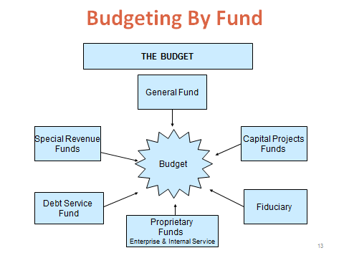
Fund 11000 General Fund – non-restrictive, used for operating purposes
Fund 20000 Special Revenue Funds - account for the proceeds of specific revenue sources that are legally restricted to expenditure for specific purposes
Fund 30000 Capital Projects Funds - account for financial resources to be used for the acquisition or construction of major capital projects
Fund 40000 Debt Service Funds - account for the accumulation of resources for the payment of general obligation and long-term debt principal and interest.
Notes:
READ NOTES
General Fund- is the catch all fund- non-restricted-used for operating purposes. This fund is also used as a flow-through fund or utilized as a temporary loan to other funds until your grant reimbursements are received.. Again, it is so important to build a strong healthy cash balance reserves in the general fund as it appears this fund is going to be the primary resource for all your supplemental revenues. You can temporarily borrow from this fund to cover any negative balances or permanently depending on your local governing board.
Special Revenue- these funds all have their own purpose and identity and are legally restricted for that purpose. Refer to the appropriate guidelines pertaining to each specific fund. You cannot transfer revenues from this fund to the general fund for operations.
Capital Projects: Financial resources for any acquisition or construction of major capital projects, including the entities required match for state and federally funded projects. Transfer the resources from your general fund to the specific capital project. This also includes the Community Development Block Grant. The cleaner you have your funds separated out for each specific purposes and not comingled with any other fund or projects. Most importantly remember at the beginning of the presentation on General Accepted Accounting Principles, GAAP: it establishes greater accountability and transparency between a government and its citizens, legislative, and oversight bodies, investors, and creditors and zero audit findings.
GAAP (Generally Accepted Accounting Principals) are standards that encompass the details, complexities, and legalities of business, corporate, and governmental accounting. The Financial Accounting Standards Board (FASB) for private companies and the Governmental Accounting Standards Board (GASB) for governmental entities both use GAAP as the foundation for its comprehensive set of approved accounting methods and practices.
4.Debt Service: this is where you properly track your short and long-term liabilities- known as bonds or loans. The only thing that should be budgeted here is the loan principal and interest payment due for the entire Fiscal Year. This is for all bonds and loans your entity have including intercept revenue from the Fire Protection, EMS, and LEPF; usually the intercepts are for a new fire truck, ambulance or police car.
A local government can have any number of funds, which can range from hundreds to under ten. It is recommended that governments use the least number of funds possible.
Governmental units should establish and maintain those funds required by law and sound financial administration. Only the minimum number of funds consistent with legal and operating requirements should be established, however, because unnecessary funds results in inflexibility, undue complexity, and inefficient financial administration.

Slide 9
Fund 50000 Proprietary Funds
Enterprise Funds - account for operations of providing
goods or services to the general public on a continuing
basis be financed or recovered primarily through user
charges, i.e. Electric, Water, Gas, Sewer, Solid Waste
Utility-These funds should be self-sustaining.
Fund 60000 Internal Service Funds - account for the financing of goods or services provided by one department or agency to other departments or agencies of the governmental unit on a cost-reimbursement basis. i.e. Risk management, motor pool, etc.
Fund 70000 Fiduciary Funds
Trust and Agency Funds - account for assets held by
a governmental unit in a trustee capacity or as an
agent for individuals, private organizations, other
governmental units, and/or other funds. They include:
expendable trust funds, (b) nonexpendable trust
funds, (c) pension trust funds and (d) agency funds.
i.e. motor vehicle, meter deposits, etc.
Notes:
Proprietary funds should be self-sustaining; ran like a business so there is little or no impact to your general fund.
Internal Service Funds: Example: Motor Pool services the police cars; motor pool is to reimburse or pay for the maintenance service from the Police Department.
Fiduciary Funds: Assets held by the entity; assets do not belong to the entity. Funds such as meter deposits, GRT charged for service that is submitted to TRD via , Common Reporting Standard (CRS) Common Reporting Standard Report.

Slide 10
EXPENDITURES
  What goes into operating expenditures:
        Personnel Cost/Benefits (largest cost)
        Daily operating expenses
        Capital Outlay
        Debt Service
            Intercepts
            GRT Administration fees
            Other loans
  Must follow Special Revenue guidelines/regulations
        Lodgers Tax Act
        Law Enforcement Protection Fund (LEPF)
        Other Special Revenues & Grants
        Grants-The purpose of federal and state grants are restricted to approved activities and not related to the “general fund” use
    Must follow the Procurement Code Process
    Per 13-1-95.2-need Chief Procurement Officer (CPO) registered with
    New Mexico State Purchasing Division
    https://generalservices.state.nm.us/state-purchasing/online-procurement/
Notes:
Now we come to expenditures when preparing a budget:
Personnel costs usually consume at least 80% of the budget.
For Daily operating expenses – make sure to allot for utility increases – this is something that is forgotten and then there are increases and expenditures are more than what was anticipated or forecasted.
Any capital outlay matching funds should be transferred out from the General Fund to the appropriate Capital Outlay fund.
Debt Service: these are bonds and loans which also include intercepts or contracts. Make sure to budget the intercepts amount in the budget. Perfect example is: Your entity is awarded LEPF funds and have purchased a new police car by taking a loan out from the New Mexico Finance Authority; in the loan agreement you stated the payment amount would be intercepted from your LEPF distribution. The interception is deducted and sent to NMFA, and the net balance is sent to you.
The gross revenue of the LEPF must be reported and the intercept must be expended out using the 59010 Debt Service Principal Payment object code. LGBMS was upgraded to include a debt schedule module. During the budget season you will be required to complete the Debt Schedule Detail Module for every debt service object code you have entered in your budget. The information you will enter will be the Bond Series or loan number, description of the debt, category and issue date.
Another Loan Example: Your entity pledged a portion of your GRT for a Water Infrastructure Project. TRD intercepts the loan payment from your GRT; on your RP-500 you will see that deduction under contracts. Again, that intercept amount needs to be booked as revenue and expended out in the 59010 Debt Service Principal Payment Object code. It is the Gross amount you need to report, not the net distribution.
The GRT administration fees must be recorded as revenues and expended out using an object code such as Commitment & other Fees. The object code selection is local autonomy option; However, you must be able to identify and track it.
Keep in mind that The GRT administration fees are part of your revenues; it is an expense to your entity, that the Tax and Revenue Dept. charges you for collecting and distributing your GRT.
A Chief procurement officer is a requirement as per the Procurement Code 13-1-95-2. .If the entity does not have a Chief Procurement Officer in place this will result in an audit finding. For additional information contact the NM State purchasing Division. We have provided that link for you, which is listed in this slide.
Lodgers Tax Act, LEPF, Special Revenues and Grants are all considered restricted funds, because their distribution has a specific scope of work on how these funds need to be utilized. The General Fund is the only fund that is not a restricted fund and is the Catch all fund.

Slide 11
Expenditure
Timing
and
Management
Expenditure Timing
&
Management
Coverage of all debt service payments
Communication with internal departments and/or other agencies
Conservative planning with new tax enactment and new expenditures associated with the enactment
Expenditure Disruptors Examples
GRT base-closing of major store, oil & gas industry
Claw backs-monies that need to be paid back (overpayments by federal government, state government, grant unallowable expense or late submission after grant has expired)
Utility Rate Increases – Electric, Gas, Insurances, etc.
90% of large maintenance emergencies are unforeseen & can be costly
Small Cities Assistance reduction amount
Notes:
Make sure the entity has the appropriate resources to cover any debt service payments.
Communicate effectively and frequently with internal departments and/or other agencies-to make sure everyone understands how to monitor the budget efficiently and effectively. Provide training to individuals if need be.
Conservative planning with any new revenue resource; new GRT enactments usually have a purpose. Please be aware of that purpose.
Expenditure Disruptors:
Unforeseen expenditures not taken into account or prepared for can create hardship to your entity.
Small Cities distribution expenditures- Here is an example: you forecasted $130,000 of Small Cities Assistance revenue in your approved budget. However, what was distributed and received by the entity was $90,000- for a $40,000 revenue shortfall.
By incorporating “Best Practices” in the Small Cities revenue short fall; prepare a Budget Adjustment Request (BAR) and a Resolution to be presented at your next governing body meeting, reducing the revenues and expenditures by $40,000
The Goal here is to build your cash balance to have reserves for any unforeseen emergency expenditures.

Slide 12




STEPS IN DEVELOPING A BUDGET
 | Techniques/Areas
 | Forecasting revenues and expenditures, cost analysis, capital budgeting, debt administration and other personnel issues, assessing financial conditions, and economic development
 | Review of information developed in preparation stages
 | Accounting, revenue administration, expenditure administration, purchasing, cash management, and investments
 | Reviewing with Governing Body, Auditing
Preparation…….
Approval……….
Execution………
Review ………..
Notes:
There are 4 stages or steps in developing a budget and each step has a specific purpose and outcome.
The preparation stage (starting point) uses data to forecast future revenues/expenditures. This data includes different components such as cost analysis, capital budgeting, debt administration, personnel costs, economic trends/factors and development. Communication is key with your department heads and community input along with open public meetings for community members to have input.
Once this stage is completed the budget then goes through the approval process, internally and externally (BFB)
Execution stage – is the actual day to day operations. Again, the budget on file with LGD-BFB is the official budget and should be executed in your internal accounting software as approved by DFA..
Last but not least is the Review stage - reviewing the outcomes of the budget with the governing body and also thru the external audit process.

Slide 13
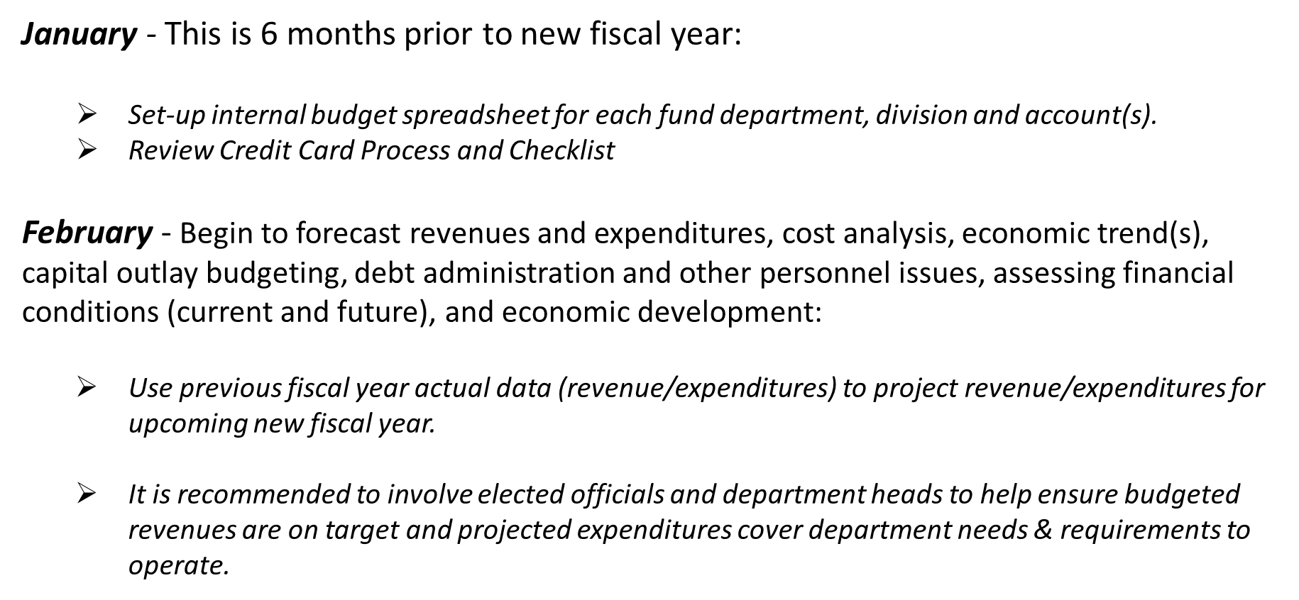
Preparation Stage
Notes:
It is important to know what types of special revenue the entity will receive for the upcoming new fiscal year.
This slide provides the Special Revenue that is distributed by LGD/BFB.
Please remember Special Revenues are restricted funds and cannot be used for general operations.
Please make sure you have these appropriations in the correct fund. Please reach out to your budget analyst for more information and/or guidance.
.

Slide 14
March - Send instructions and local budget request forms with the appropriate budget analysis based on previous year actuals to elected officials and department heads:
        Elected officials and department heads review, provide recommendations and return proposed budget request and justifications to their Finance Department
April - Review elected officials and departmental recommendations/requests, update revenue/expenditure projections and proposed adjustments:
        Hold workshops with elected officials, department heads to include conducting
  hearings for public input
        Send budget preparation worksheet proposal with attached justifications
  to elected officials and/or department heads for final review and comments
May - Estimate ending cash balance as of June 30th:
        Finalize Interim budget and submit to DFA using LGBMS
        Recommendation: Send to governing body for review and approval
        Prepare budget to submit on the Local Government Budget Management System (LGBMS)
Notes:
.

Slide 15
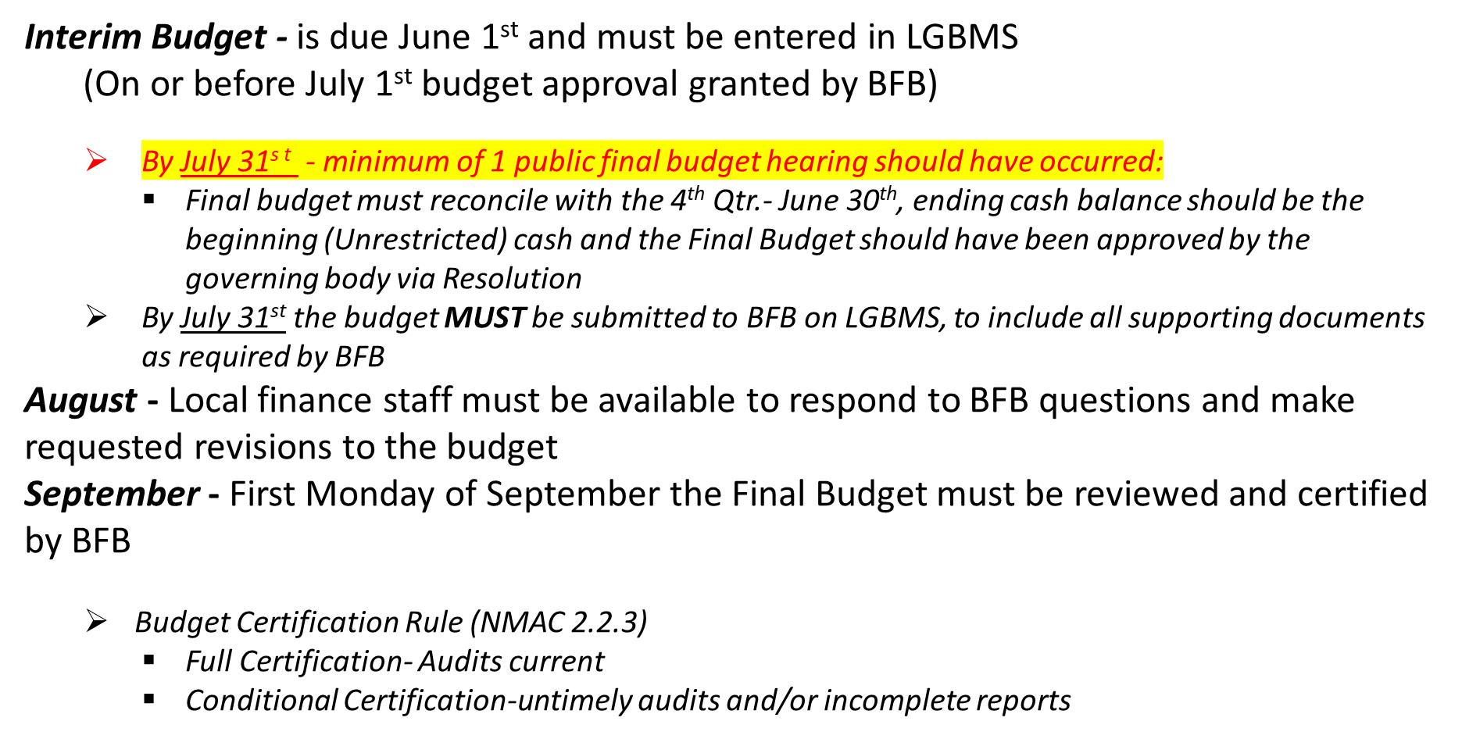
Approval Stage

Slide 16
Never budget recurring costs, such as salary increases, full-time equivalent (FTE’s) and/or new position from NON-Recurring (one-time) revenues.
1
Start a capital equipment reserve; use sales of equipment proceeds towards a “Capital Improvement Program” fund.
2
Put one-time revenue windfall(s) in a Reserve Fund in the event of emergency, unforeseen issues and for future Capital Improvements.
3
Review insurance premium(s) vs. coverage yearly.
4
Establish a loss prevention program to assist governing body in adhering to by-laws, statutes and policies/procedures; this can avoid adverse actions by the governing body and other public officials that can lead to legal ramifications.
Include a fund that will allow for reserves to be utilized in the event of legal actions against the entity.
Routinely review the need for programs, short/long term goals of the entity including projects and departments using historical data, economic trends and revenue streams.
Try to minimize the number of funds and bank accounts established.
Budgeting DO’s
And
DON’T’s
Notes:
Some Do’s and Don’ts of budgeting:
- Never budget recurring costs with non-recurring costs.
-Non-Recurring revenue is revenue that is for a short period of time such as:
Example you are generating GRT revenues, while a capital outlay project such as a new school building being built in your area. This GRT is additional revenues for a short period during the construction phase. Once the project is completed the additional GRT stops.
Sale proceeds of equipment that were purchased from your General Fund should be reverted back to be used to start a capital improvement fund.
Special Revenue equipment must be reverted to that specific special revenue it was purchased from. Example: If you sell a piece of equipment that was purchase through LEPF funds; the sale proceeds must go back into the LEPF fund. Same applies to your Fire Protection and EMS Funds.
Non-recurring revenue is also known as a one-time windfall of revenue; as I mentioned earlier- The increased GRT from a capital project, you may want to consider starting building a reserve fund for future capital improvements.
Insurance Premiums/Coverage – continuously change and increase. It is good idea to review the coverage vs. the premiums. Make sure coverage is adequate and up to date and covers the full value of the entity’s assets. In the event there is not 100% coverage after the deductible can lead to unforeseen expenditures, causing hardship to the budget.
Establish a loss prevention program. This can avoid any lawsuits. And this is considered best practices and creates transparency.
Make sure to routinely review the needs to the entity’s programs and projects.
Last but not least try to minimize the number of funds and also bank accounts established.

Slide 17
REQUIRED SUPPORTING
SCHEDULES for Interim Budget
S1 Salary & Personnel
S2 Insurance
S5 Reserved revenue for a specific project
Credit Card & Electronic Policy
Debt Service
Budget Work Plan Questionnaire
Notes:
This is a new requirement and process when submitting Interim Budgets this year. A new Interim Budget Schedule has been created, and all entities will receive this schedule to use for the Interim Budget.
The schedule includes S1, S2 and S5. Generally, at the time of Interim entity’s have this information for their upcoming budget year. In the event any of these items change between Interim and Final Budget, it can be updated at Final Budget stage.
Credit Card & Electronic Policy form this has not changed, this has always been required.
Debt Service- we will go over this information in depth later in the training
Budget Work Plan Questionnaire – please have it completed and uploaded with the Interim Budget

Slide 18
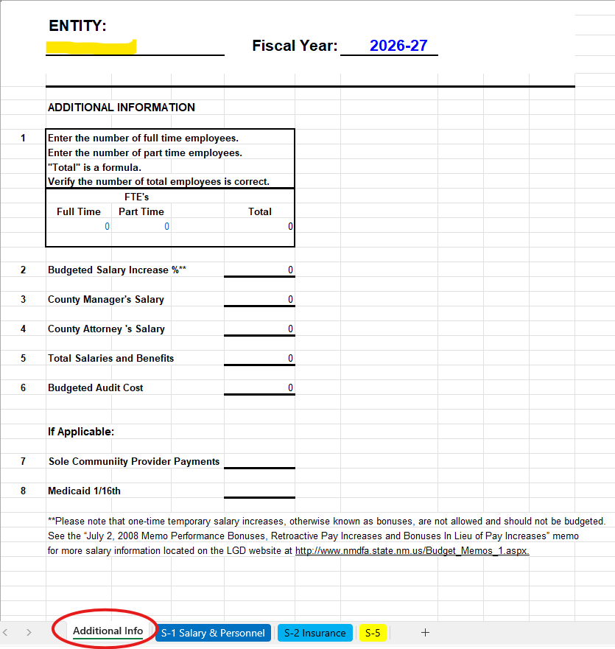
Interim Budget Supporting Schedule Workbook
Additional Info Tab
Notes:
In the Interim Budget Supporting Schedule workbook, fill out the entity name and ensure the correct fiscal years are entered on the Additional Info tab. These values will auto populate on the other tabs. Fill out the rest of the page as needed. Please upload current information, not information from previous years.

Slide 19
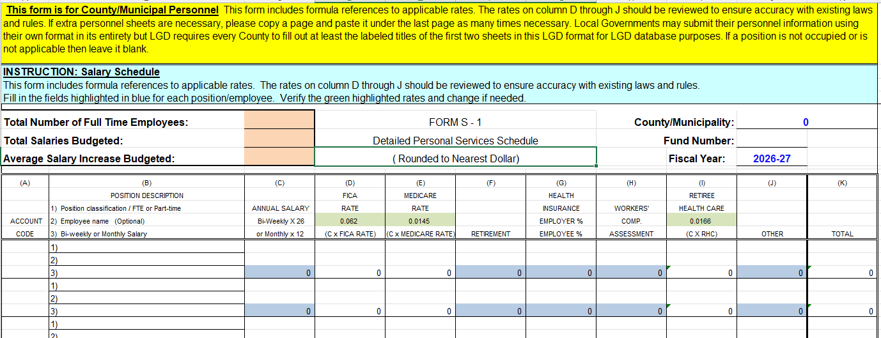
Interim Budget Supporting Schedule Workbook
S-1 Salary & Personnel Tab
Notes:
The S-1 Salary & Personnel tab of the Interim Budget Supporting Schedule workbook has some auto calculating features. Verify the rates highlighted in green. When the annual salary is entered for each employee/position in column C, the FICA (column D), Medicare (column E) and Retiree Health Care (column I) will automatically calculate. Entry is still manually required for columns (F), (G), (H) and (J). The Total in Column (K) will automatically sum columns (C) through (J).
Be sure to complete all the tabs on the workbook and upload it to your Interim Budget before submitting.

Slide 20
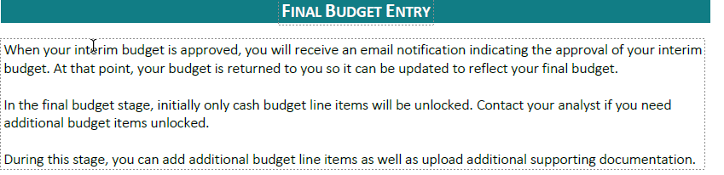
Notes:
Once the interim budget is entered, submitted and approved the individual will receive an email notification indicating the approval of the interim budget.
The budget is then returned to the entity so that it can be updated to reflect the final budget. As a reminder, in the final budget stage, only cash budget line items can be unlocked. In the event additional items need to be unlocked please reach out the budget analyst.
Please refer to the LGBMS Entity User Guide for full details and step by step instructions regarding entering the budget. You may also reach out to the budget analyst for your entity with any questions you may have or issues you are experiencing.

Slide 21

BEST PRACTICES
Work Together: Local budget and accounting staff should work together to ensure the accuracy of all data submitted for state approval.
Start Early: Begin budget development in January for upcoming fiscal year (FY).
One Budget: Develop one annual budget that will go through two review/approval stages – Interim & Final. Projections/Forecasts: Use 3 years of history to establish trends and consider national, state and local economic factors.
Interim to Final: Very few revisions are necessary and should be coordinated with Budget & Finance Analyst.
Beginning Cash Balances: June 30th cash balances of FY ended becomes the July 1st beginning cash balances for new FY final budget – NO exceptions.
Report beginning cash & investments to balance the budget!
Notes:
Best Practices to keep in mind – Expenditures do not exceed revenues – review historical expenditure data,
This is quick flow chart of preparing for the upcoming budget process; Work with department heads/managers to ensure everyone is on the same page when developing the budget.
The Interim Budget will become the Final Budget. Once the Interim is approved, it becomes the Final budget. The only revisions available, will be to “Cash”, allowing to update for July 1 beginning cash balances by Fund. For any unforeseen changes (such as completion of union negotiations that affect salaries & benefits and new grant awards) Interim to Final, entity must coordinate with analyst, for any revisions, such as unlock Funds, and Line Items.
Your LGBMS account is considered your signature on the system. Therefore, entities should keep all user accounts current and immediately submit a SAF to disable employees who have left the entity. Maintenance of user accounts is each entity’s responsibility. Also, keep in mind that all submissions and subsequent revisions to data are strictly handled by the entity. Entity is required to meet LGD deadlines by state statue.
Larger entities may have several LGBMS users with some focusing on just budget and others on just reporting year-to-date actuals. However, the data belongs to the entity as a whole and it is important that all departments within a local entity work together to ensure the accuracy of the data, is reported on LGBMS.

Slide 22
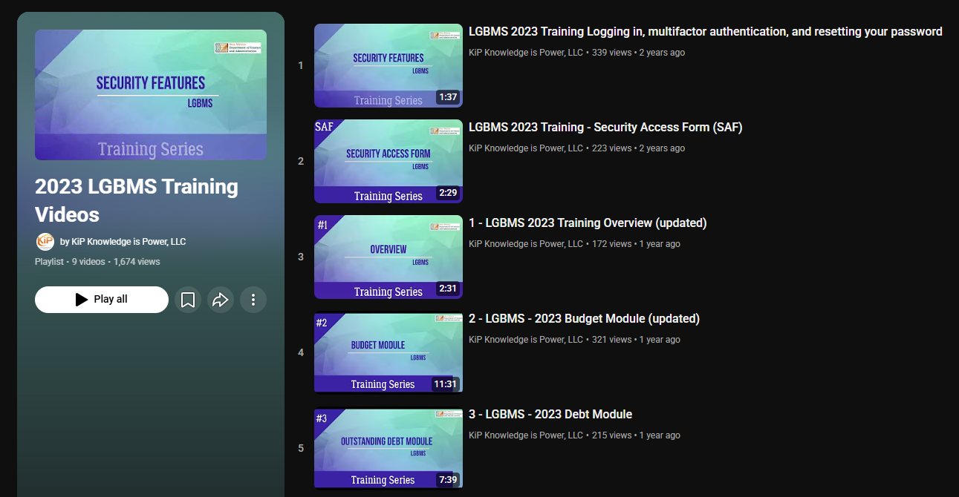
Reference To User Guide
LGBMS User Guide Link
https://www.youtube.com/playlist?list=PL9zQ343fcksE-RGeHlzDUa5DTcxaPhuIX
Notes:
You can also reference our User Guide. When clicking on the link you will see YouTube Videos. You can go through all or look at each one individually.

Slide 23
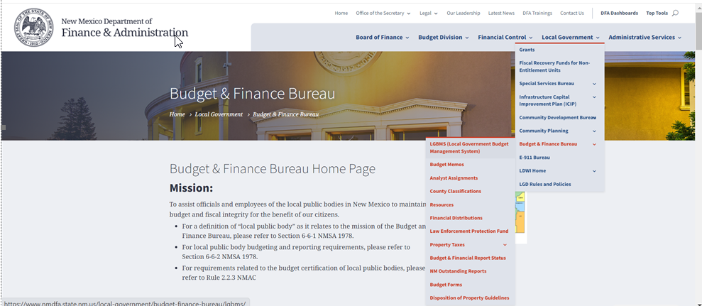
LGBMS User Guide
Click on Local Government
Click on Budget & Finance Bureau
Click on LGBMS (Local Government Budget Management System)
Notes:
It is a good idea to have a handy copy of the LGBMS User Guide, please visit our DFA website to download a copy. This slide demonstrates the full steps on how to locate the user guide.
This concludes the Presentation Introduction to Budget 101.

Slide 24

FAQ posted on website:
https://www.nmdfa.state.nm.us/local-government/budget-finance-bureau/lgbms/
This concludes the presentation on the Interim Budget.
Notes:
This concludes the presentation. We will continue with training for the Debt Module and Debt Corrections.

