Slide 1



GASB 96 subscription-based technology arrangements (SBITA)
New Mexico Department of finance & administration

Slide 2
Training purpose
The purpose of this training is to provide the State of New Mexico state agencies guidance for identification and reporting SBITA’s as required by GASB 96.

Slide 3
Defining a sbita
GASB 96 defines a SBITA as a contract that conveys control of the right to use another party’s IT software, alone or in combination with tangible capital assets (the underlying IT asset), as specified in the agreement for a period of time in exchange or exchange-like transaction.

Slide 4
When?
Effective for fiscal year beginning 7/1/2022 (Fiscal Year 2023)
Measurement of subscription term is based on time remaining in agreement as of that date.

Slide 5
what qualifies as a sbita?
Using a threshold of $5,000 a contract will qualify as a SBITA if there is a:
Right to use vendor’s software
Defined subscription period
Identified payment amount
Both parties receive and give up something of equal value

Slide 6
EXCLUSIONS
Contracts that do not meet qualifications
Service only agreements
Interagency software agreements
Short-term agreements-agreements with a maximum possible term of 12 months (or less) and/or have a cancel with convenience clause where either party may cancel
Contracts that qualify as a lease under GASB 87
Software that an agency owns or has a perpetual license agreement

Slide 7
SBITA implementation
Implementation is prospective as of June 30, 2023. GASB 96 does not require agencies to go back to prior years for subscription expenditures that occurred.
Agencies will recognize a subscription liability and a subscription asset as an addition in the financial statement footnotes.

Slide 8
Expenses other than subscription payments
(For new SBITA’s after 7/1/2022 (adoption date))
Preliminary project stage
Initial implementation stage
Operation & additional implementation stage
Includes activities such as:
Evaluating alternatives
Determining technology need
Selecting SBITA vendor
COSTS ARE EXPENSED AS INCURED
Ancillary charges to place the subscription asset into service:
Configuration
Coding
Testing
Installation
COSTS ARE CAPITLIZED
Includes costs after implementation activities:
Maintenance
Other activities for ongoing operations.
COSTS ARE GENERALLY EXPENSED (Costs are capitalized if specific criteria are met)

Slide 9
It software with a tangible capital asset
If the software component is more than insignificant, the agreement falls under GASB 96 scope.
If the tangible capital asset component is more significant, the agreement falls under GASB 87 scope.
If the contract breaks out the software, hardware, and services components, and the software is an insignificant component of the contract and is less than 10% of the value of the entire contract, then it is out scope. If it is more than 10% then capitalize software separately under GASB 96.

Slide 10
FOOTNOTE DISCLOSURE
The footnote disclosure should include the following:
A general description of the SBITAs.
The total amount of subscription assets recognized (NEW ASSET ACCOUNT CREATED).
Related accumulated amortization, disclosed separately from other capital assets (NEW ACCUMULATED AMORTIZATION AND NEW AMORTIZATION EXPENSE ACCOUNT CREATED).
Amount of subscription assets by major classes of underlying assets, disclosed separately from other capital assets.
Principal and interest requirements to maturity, for the liability for each of the five subsequent fiscal years, and in five‐year increments thereafter (NEW LIABILITY ACCOUNTS CREATED).
A description of variable payments and other payments not included in the subscription liability, and the recognized in the reporting period for these payments.
Commitments under SBITAs before the commencement of the subscription term.
Impairment losses and any significant related changes in the liability.

Slide 11
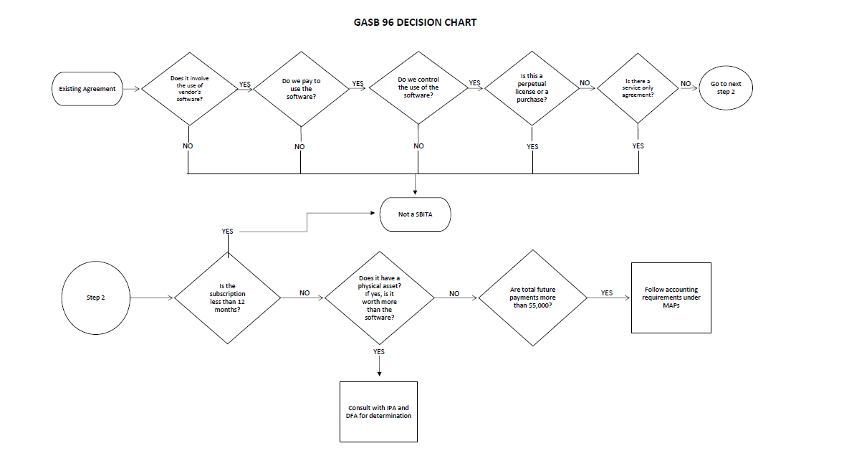
GASB 96 Decision chart

Slide 12
Schedule of ibr’S
Fiscal Year 2023 (July 1, 2022)
  Lease Term IBR
  > 1 Year to 5 Years 2.21%
  > 5 Years to 10 Years 2.86%
  Over 10 Years 3.27%

Slide 13
Chart of accounts
Account Number | Description
189590 | Depr IT Subscriptions
192090 | Amort IT Subscriptions
276000 | IT Subscription Liability ST
276001 | IT Subscription Liability LT
499890 | O/F Sources IT Subscrip Fin
568890 | Amortization Exp IT Subscr

Slide 14
EXAMPLE #1
Grant of License: Subject to the terms and conditions of this Agreement, Example, Inc. grants to Customer a personal, nonexclusive, nontransferable license solely to use, copy, and Deploy quantities of the Products listed in Table A – List of Products for the Term of Agreement for the applicable fee and in accordance with the Master Agreement.
Annual License Agreement: $150,000 per year.
Maintenance Agreement: $500 per month.
Original Agreement from 10/1/18 – 9/30/21. Renewal agreement from 10/1/21 – 9/30/25 (Currently in renewal period).
Capitalize annual payments starting 7/1/22 – 9/30/25.

Slide 15
EXAMPLE #1 CONT:
Maintenance is NOT capitalized.
Term: This Agreement and all licenses hereunder will commence on the Effective Date and continue for the duration identified in the Term of Agreement, unless this Agreement is terminated earlier as provided herein. Customer is only authorized to use Products during the Term of Agreement. For an Agreement with a limited term, Example, Inc. does not grant Customer an indefinite or a perpetual license to Products.
No Use upon Agreement Expiration or Termination. All product licenses, all Maintenance, and User Conference registrations terminate upon expiration or termination of this Agreement.
Termination for a Material Breach. Either party may terminate this Agreement for a material breach by the other party. The breaching party will have 30 days from the date of written notice to cure any material breach.
For an Agreement with government or government-owned entities, either party may terminate this Agreement before any subsequent year if Customer is unable to secure funding through the legislative or governing body’s approval process.

Slide 16
Example #2
We will use a hypothetical subscription to ABC IT to demonstrate the appropriate SBITA accounting for a governmental entity. In our example, DFA uses ABC IT to account for its lease portfolio. DFA recognizes its contract with ABC IT as a SBITA due to the following facts:
The agreement does not meet the definition of a lease under GASB 87 or scoping criteria for GASB Statement No. 94, Public-Private and Public-Public Partnerships and Availability Payment Arrangements.
The agreement provides DFA the use and control of an instance of ABC IT’s software in an exchange-like transaction.
The agreement has a defined, finite, non-cancelable subscription term of three years.
Below are the additional details of the SBITA:
Subscription Start Date: July 1, 2022
Subscription End Date: June 30, 2025
First Payment Date: July 1, 2022
Payments: $5,000 annually, paid in advance (on July 1st)
Discount Rate: 2% (See FCD website or agreement)

Slide 17
Example #2 cont:
In addition to the annual subscription payments of $5,000, DFA also incurs additional costs during the following stages:
Preliminary project stage costs
DFA hired an outside consultant to assist with the selection and evaluation of the lease accounting software. They incurred fees of $1,000, paid to the consultant during the evaluation process.
Initial implementation stage costs
During the initial implementation stage, DFA needed to migrate data from their existing lease accounting system into ABC IT. The data migration cost DFA $2,000 and was paid directly to ABC IT.
Operation and additional implementation stage costs
Subsequent to placing ABC IT in service, DFA experienced operational challenges, which required additional support services and cost an additional $300. These services did not add to the functionality of ABC IT.
Additional costs evaluation
Let’s walk through these different costs to determine whether they are capitalized as part of the subscription asset or expensed as incurred.

Slide 18
Example #2 cont:
Preliminary project stage
Activities in the preliminary project stage are generally associated with an entity’s decision to procure the technology provided by the SBITA. Per GASB 96, any cash outlays made by the government while in this stage are expensed in the period incurred. Therefore, the $1,000 cost for the outside consultant will be expensed as incurred and not capitalized as part of the subscription asset.
Initial implementation stage
During the initial implementation stage, the government may spend money implementing the software through system customizations, testing, data migration, installation, etc. GASB 96 allows for cash outlays during this stage to generally be capitalized as part of the subscription asset. Therefore, the $2,000 of data migration costs will be capitalized as an addition to the subscription asset.
Operation and additional implementation stage
Governments may experience operational challenges throughout the subscription term which require technical support, maintenance, troubleshooting, or other assistance with the SBITA. Per GASB 96, cash outlays during the operation and additional implementation stage are expensed in the period incurred, unless the activity is related to increasing the efficiency of or adding to the functionality of the subscription asset in a way that didn’t exist before.
Because the additional support services did not add to the functionality or efficiency of the software, the $300 cost will be expensed as incurred and not capitalized as part of the subscription asset.
After walking through the additional costs to DFA (outside of the subscription fees) and determining what to include in the calculation of the subscription asset, let’s calculate the initial subscription liability.

Slide 19
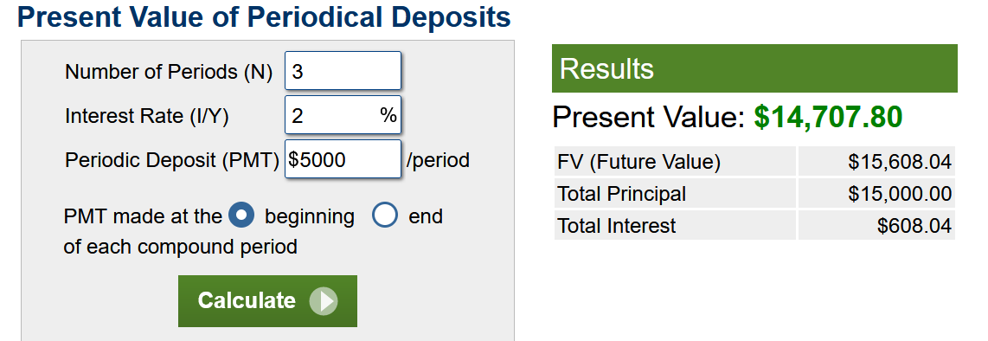
Example #2 Cont:
Calculation of subscription liability
The initial subscription liability is measured as the present value of the subscription payment expected to be made to the vendor during the subscription term. By utilizing a present value calculator and populating the terms noted above:
$5,000 annual subscription payments, paid in advance,
3-year (36 months) subscription term,
2% borrowing rate, (IBR rates, if not described in agreement will be posted on FCD website)
we calculate a present value of $14,708. This is the value of the initial subscription liability.

Slide 20
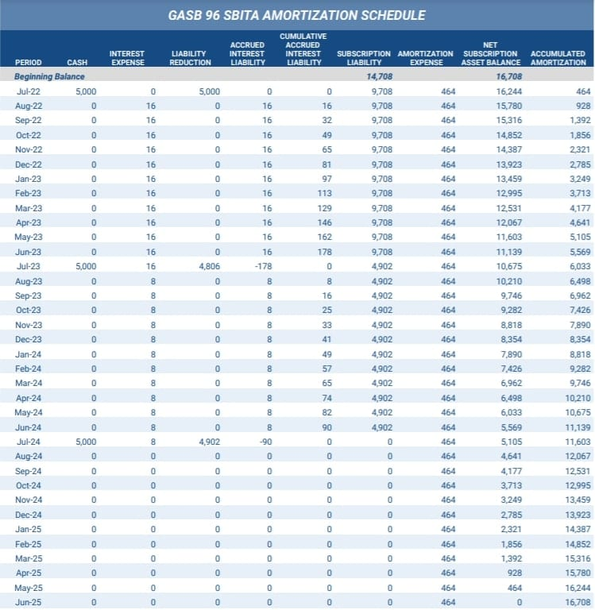
Example #2 cont:
Calculation of subscription asset
To calculate the initial subscription asset, take the subscription liability of $14,708 and add the capitalizable initial implementation costs for data migration of $2,000. Therefore, the starting subscription asset value is $16,708 ($14,708 + $2,000).
Amortization of subscription asset and liability
The amortization schedule for both the subscription liability and subscription asset recognized for this SBITA:

Slide 21
Example #2 Cont:
The interest expense in each month is calculated by multiplying the outstanding liability balance at the end of the prior month by the 2% (IBR rate) borrowing rate divided by 12 months. In a period when no payment is made, the government accrues interest expense in a separate liability account called “accrued interest liability” and does not increase the balance of the outstanding subscription liability. Any subscription payments that the government makes should be allocated first to the cumulative accrued interest liability balance and then to the outstanding subscription liability.
The opening subscription asset of $16,708 is amortized on a straight-line basis over the subscription term. To calculate the $464 monthly amortization of the subscription asset, divide the gross subscription asset of $16,708 by the subscription term of 36 months ($16,708 / 36 = $464).
On the date of the last payment (July 1, 2024), the subscription liability is reduced to $0 because all payments have been made and the government has no further obligation to the vendor. The subscription asset, however, is amortized over the entire subscription period because the entity has the right to use the SBITA until the last day of the subscription term (June 30, 2025).

Slide 22
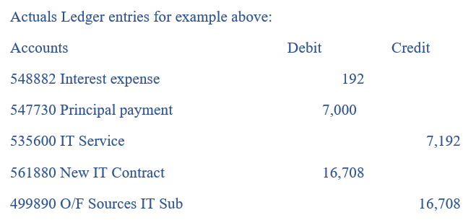
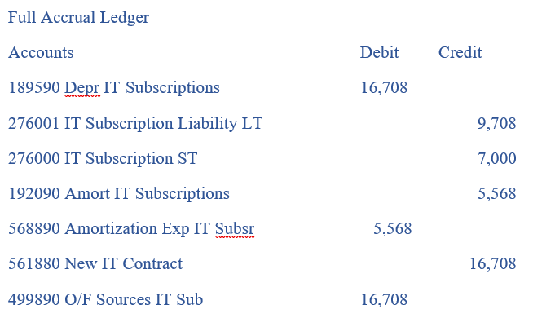
Journal Entries
Based on the calculations and the amortization schedule above, the following are the journal entries for both the initial recognition of the subscription asset and liability and the subsequent recognition of payments and expenses.

Slide 23
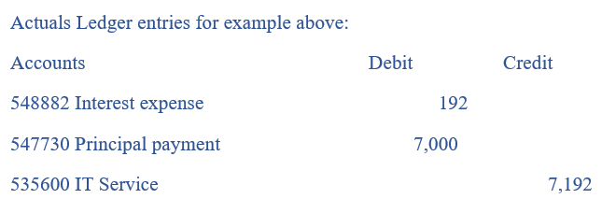
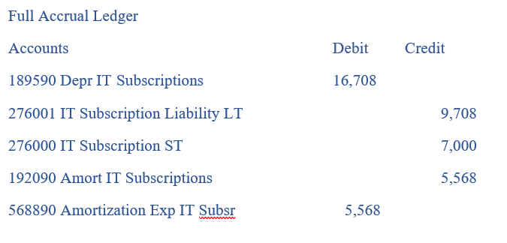
Journal Entries
Based on the calculations and the amortization schedule above, the following are the journal entries for an already existing SBITA at July 1, 2022.

Slide 24
Where you will find GASB 96 Resources
GASB 96 Decision Guide
IBR Schedule
NEW GASB 96 Accounts
https://www.nmdfa.state.nm.us/financial-control/gasb-87and96-resources/

Slide 25

QUESTIONS?

