Slide 1
Compensated Absences:
GASB 101 Guidance for New Mexico State Agencies
New Mexico Department of Finance and Administration

Slide 2
Agenda
1
Purpose
2
What is GASB Statement No. 101?
3
The Details of Statement No. 101 and State of New Mexico Approach
4
Recap of Key Changes

Slide 3
Purpose
The purpose of this training is to provide the State of New Mexico state agencies guidance for the identification and reporting of compensated absences as required by GASB 101 and Model Accounting Practices (MAPs).

Slide 4
What is GASB Statement No. 101?

Slide 5




Fast Facts About Statement No. 101
  Aims to create more consistent accounting for compensated absences
Creates a unified recognition and measurement framework applicable to all types of compensated absences
Supersedes Statement No. 16, Accounting for Compensated Absences
Issued in June 2022 with an effective date for fiscal years beginning after December 15, 2023

Slide 6
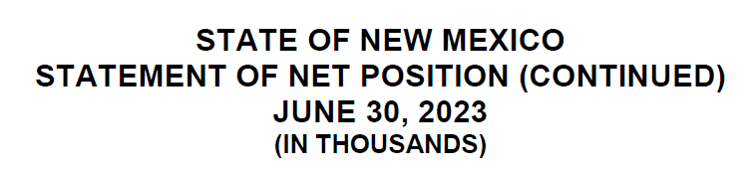
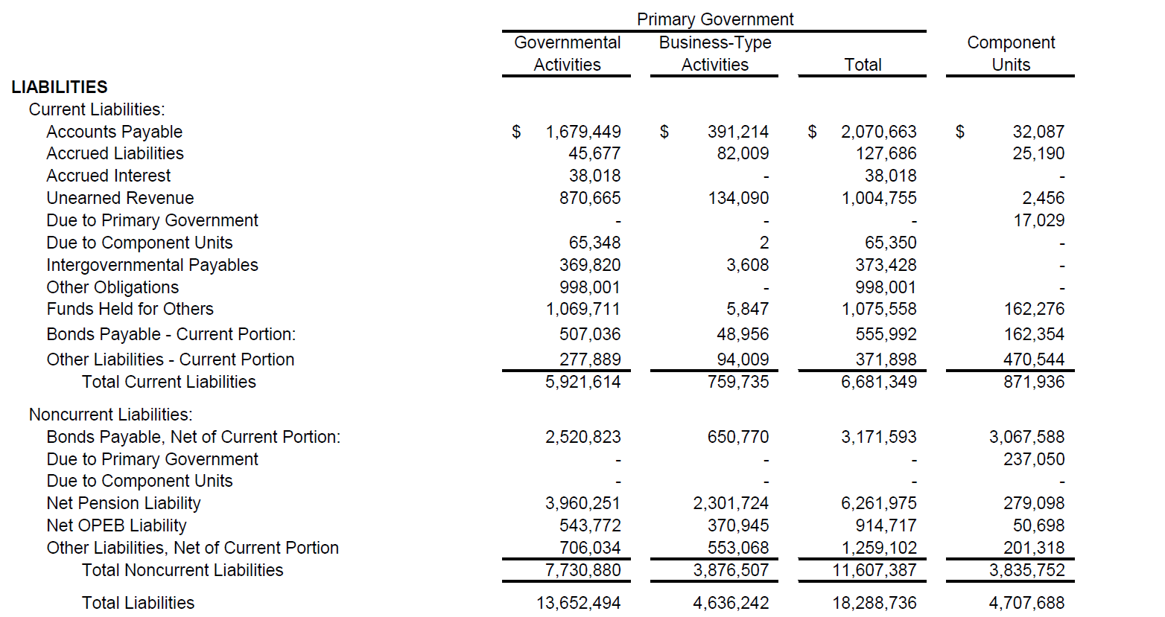
Where is the Compensated Absence Liability?

Slide 7
The Details of Statement No. 101 and State of New Mexico Approach

Slide 8
Compensated Absence Defined
Compensated absence is a term used to describe leave that entitles employees to receive one or more:
Cash payments when leave is used for time off
Other cash payments (e.g., payment for unused leave upon termination of employment)
Noncash settlements (e.g., conversion to defined benefit postemployment benefits)
GASB 101 Compensated Absences Summary Template

Slide 9
Compensated Absence Examples
Examples of compensated absences include:
Vacation
Sick Leave
Holidays
Parental Leave
Bereavement Leave
Certain types of Sabbatical Leave
Compensated absences do not include:
Sabbatical Leave during which an employee is required to perform duties of a different nature for the government
Termination Benefits (apply Statement No. 47)
GASB 101 Compensated Absences Summary Template

Slide 10
How to Identify Compensated Absences
Before even thinking about the new recognition criteria set forth under Statement No. 101, first determine whether a particular type of leave qualifies as a compensated absence and is not classified as an exception. Here is a look at what to consider when making that determination:
Compensated Absence Criteria (para. 3)
Specific Exceptions (para. 4, 14, 15)
Is an employee able to receive one or more of the following for this type of leave?
1. Cash payments when the leave is used for time off;
2. Other cash payments, such as payment for unused leave upon termination of employment; or
3. Noncash settlements, such as conversion to defined benefit postemployment benefits.
Does the leave fall into one of the following “exceptions” categories: parental leave, military leave, jury duty, restricted sabbatical leave, or holiday leave taken on a specific date (not at the employee’s discretion)?
No
Recognition exceptions not applicable
Yes
Review the statement for specific recognition exceptions
Continue to the application of the Recognition Criteria in para. 9
No
Not a Compensated Absence
Yes
Compensated Absence
Ensure everything is documented but can likely stop here
GASB 101 Compensated Absences Summary Template

Slide 11
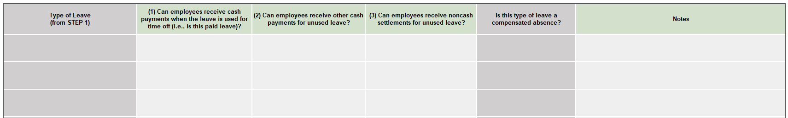
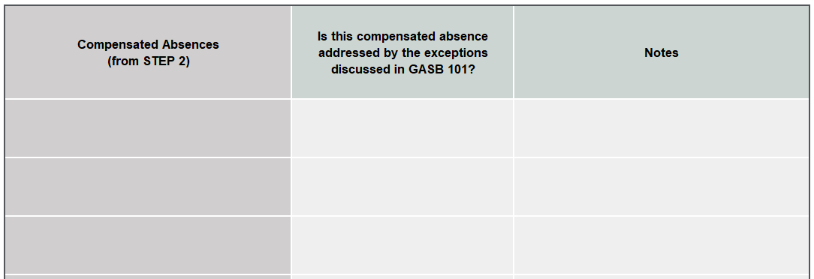
How Should We Document This?
GASB 101 Compensated Absences Summary Template

Slide 12
Recognition Criteria
Exceptions
1
2
3
Leave settled through conversion to defined postemployment benefits
Leave dependent upon sporadic events affecting a small proportion of employees:
  Parental leave
  Military leave
  Jury duty
Holiday leave
Attributable
Accumulates
More Likely Than Not
Employee must have performed the services necessary to earn the leave
Leave must be carried forward to future reporting periods
Leave must be more likely than not to be used or paid
More likely than not refers to a likelihood of greater than 50%
GASB 101 Compensated Absences Summary Template

Slide 13
Compensated Absences to be Included in the Liability
Utilizing the criteria in the preceding slides, the Department of Finance and Administration has determined that all state agencies will include the following compensated absences in their liability calculation:
Annual Leave
Sick Leave
Premium Overtime
Compensatory Time Leave Balances
  The Compensatory Time Leave Balances category includes COMPTIME, ADMINCOMP, HOLIDAYCMP, HOLIDAYACC, NOTEACHDAY, PERSONAL, and STANDBY.
If a state agency identifies a compensated absence other than those discussed above which meets the recognition criteria of attributable and accumulates, is not removed from the liability by provisions in GASB 101 and is believed to be material to the agency’s financial statements, the agency shall contact the Department of Finance and Administration for guidance in making the more likely than not determination.
GASB 101 Compensated Absences Summary Template

Slide 14
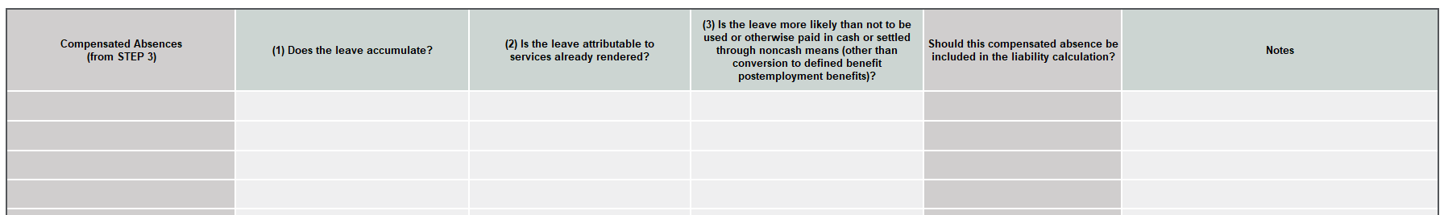
How Should We Document This?
The template has been designed to auto-populate using the determinations made by the Department of Finance and Administration.
GASB 101 Compensated Absences Summary Template

Slide 15
Where Does “More Likely Than Not” Fall?
One of the determinations made by the Department of Finance and Administration was whether certain types of leave would be considered “more likely than not” to be used or paid. Here is a visual representation of “more likely than not:”
Reasonably Possible
Reasonably Certain
Remote
Probable
0%
50%
100%
More Likely Than Not

Slide 16




“More Likely Than Not” Criteria to Consider
Employment Policies
Eligible for use or future payment?
Historical use/payment of leave
Are historical trends representative of current reality?
1
2
3
4

Slide 17
Calculating the Liability
The Department of Finance and Administration utilized employment policies, organizational knowledge, and historical data from fiscal years 2023 and 2024 to develop “more likely than not” expectations for each of the compensated absences to be included in the liability.
These expectations have been integrated into MAPs and will be utilized by the agencies to calculate the compensated absence liability.
More on this in the next slide…
GASB 101 Compensated Absences Liability Calculation Template

Slide 18
Calculating the Liability (cont.)
Sick Leave determined using historical, state-wide data and comparing Sick Leave used and/or sold (accounting for caps) vs leave available.
Compensated Absence | Description
Annual Leave | More likely than not to be paid or used: 100% This percentage shall be applied to the aggregate balance of unused Annual Leave at the measurement date.
Sick Leave | More likely than not to be paid: 60% This percentage shall be applied to the aggregate balance of unused Sick Leave hours at the measurement date greater than 600 but less than 1,000 hours per employee. More likely than not to be used: 50% This percentage shall be applied to the aggregate balance of unused Sick Leave hours at the measurement date up to 600 hours per employee.
Premium Overtime | More likely than not to be paid or used: 100% This percentage shall be applied to the aggregate unused Premium Overtime balance at the measurement date.
Compensatory Time Leave Balances | More likely than not to be paid or used: 100% This percentage shall be applied to the aggregate unused Compensatory Time Leave Balances amount at the measurement date.
GASB 101 Compensated Absences Liability Calculation Template

Slide 19

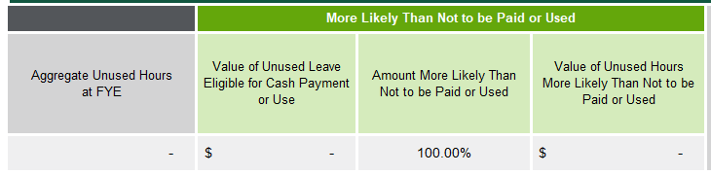
How Should We Calculate This?
Extracted from SHARE report
Calculated value
Set by the Department of Finance and Administration
GASB 101 Compensated Absences Liability Calculation Template

Slide 20
Calculating the Liability (cont.)
The liability should be measured using the pay rate as of the date of the financial statements.
  Exception: some or all of the compensated absence is more likely than not to be paid at a different rate – use that rate instead!
  Any changes in future periods due to a change in pay rate are recognized in that future period (i.e., don’t estimate/anticipate future rate changes).
Governments must consider salary-related payments, which are obligations incurred related to providing leave. Examples include Medicare taxes and Social Security taxes.
  Salary-related payments must be included in the liability measurement if they are directly associated or incrementally associated with the leave.
  Do not include salary-related payments related to defined benefit pension or OPEB plans.
Both the pay rate and the salary-related payments have already been accounted for in the liability calculation template!
GASB 101 Compensated Absences Liability Calculation Template

Slide 21
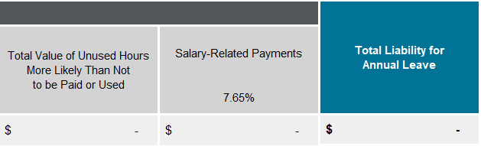
How Should We Calculate This?
Set by the Department of Finance and Administration
Calculated in the last illustration
GASB 101 Compensated Absences Liability Calculation Template

Slide 22
Amount Due Within One Year
To enhance the consistency of reporting, the Department of Finance and Administration developed at the state level an estimate of the amount due within one year.
The Department of Finance and Administration utilized historical, state-wide data to develop reasonable percentages.
  The rate of 70% (the amount of the compensated absence liability considered due within one year) was developed by reviewing fiscal year 2024 data. The percentage represents the amount of leave used in fiscal year 2024 compared to the total balance at the beginning of the fiscal year.
This percentage will be reviewed on an annual basis and updated as appropriate.
GASB 101 Compensated Absences Liability Calculation Template

Slide 23
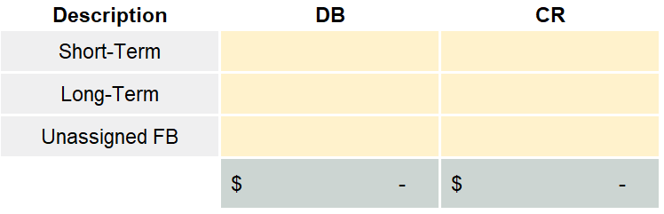
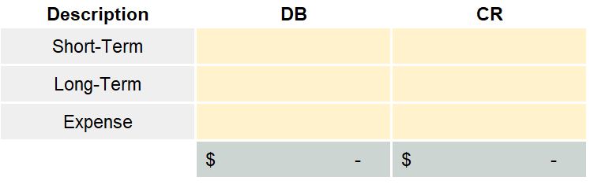
Transition and Journal Entries
Statement No. 101 is treated as a change in accounting principle so according to GASB 100 the agency will restate the FY24 compensated absence liability
The journal entry for the restatement of the FY24 compensated absence liability will flow through Unassigned FB
The journal entry for all future periods, including the FY25 compensated absence liability, will flow through an expense account
Year of Implementation
Future Reporting Periods
The exact account numbers to use have been provided by the Department of Finance and Administration in the Compensated Absence Liability Calculation Template.
GASB 101 Compensated Absences Liability Calculation Template

Slide 24
Note Disclosures
Statement No. 101 does not introduce new disclosures and simplifies existing disclosures!
In the long-term liability roll forward, increases and decreases in the compensated absence liability can be netted together
    Must indicate that the amount is net
No longer required to disclose the fund typically used to liquidate compensated absences

Slide 25
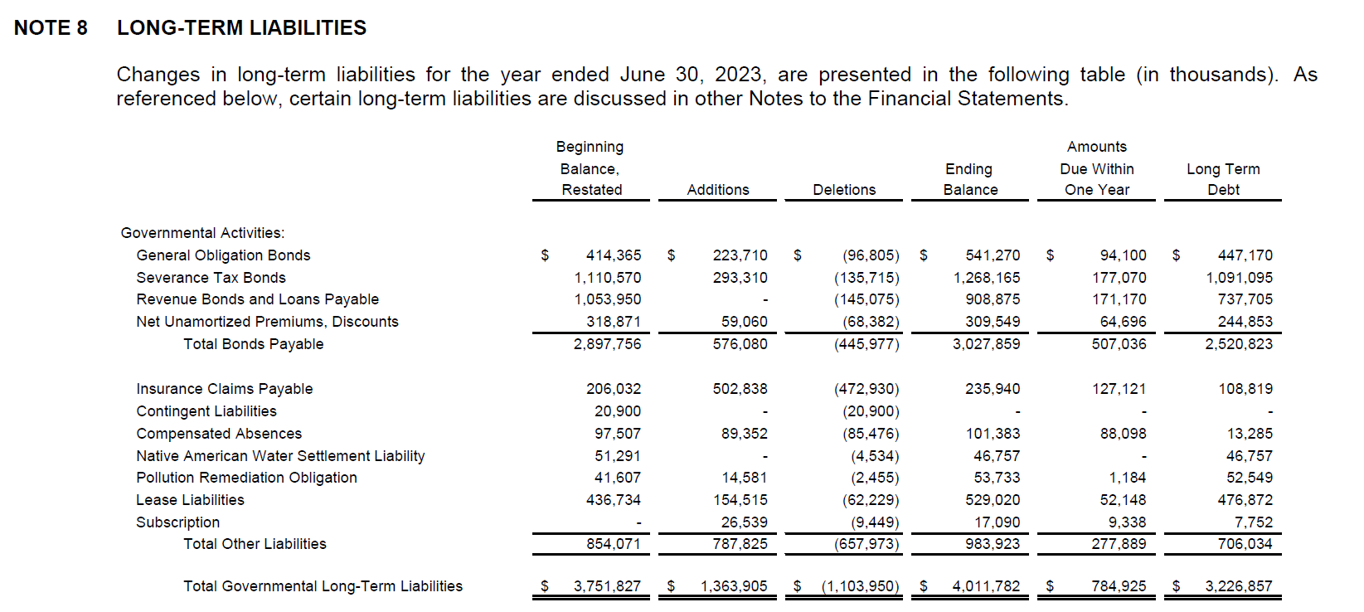
FY23 Note Disclosure Presentation for the State of New Mexico

Slide 26
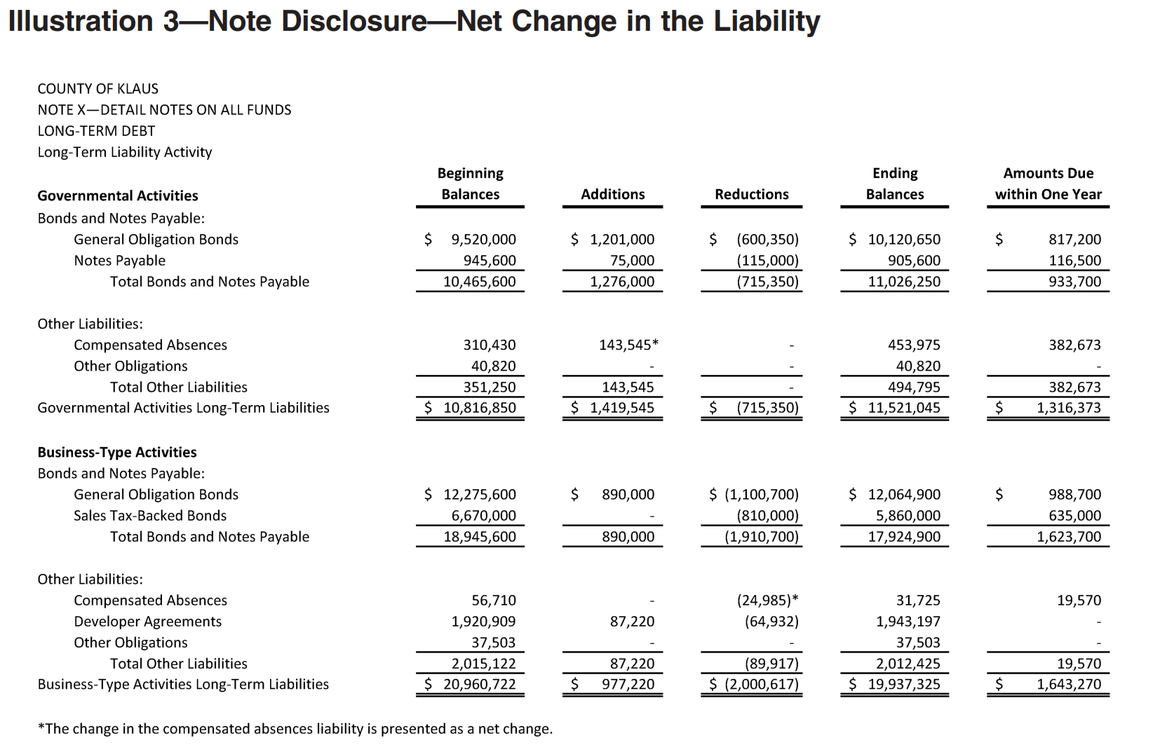
Updated Note Disclosure Presentation Example
Example from GASB in Statement No. 101

Slide 27
Recap of Key Changes

Slide 28
Key Changes in Statement No. 101
Under Statement No. 101, there are no longer specified methods of accounting for specific types of leave (e.g., sick leave).
All types of leave are accounted for under a unified framework (i.e., they are accounted for in the same way).
Principles-Based Approach
Governments must accrue a liability for leave meeting the recognition criteria (i.e., attributable, accumulates, and more likely than not to be used/paid out), even if it will not be paid out at termination.
This brings a substantial change, particularly for the accounting for sick leave.
Used vs Paid
The threshold for recognizing a liability has decreased to “more likely than not.” This means a likelihood of greater than 50%.
This is a change from the “probable” criteria in Statement No. 16.
More Likely Than Not

Slide 29
What DFA is Providing
Statement No. 101 is bringing changes! However, the Department of Finance and Administration has worked to develop implementation guidelines and policies to enhance the implementation and reporting of Statement No. 101 for State agencies.
Materials provided:
MAPs policies outlining specific requirements for State agencies to follow
Compensated Absence Summary Template
  Identifies types of leave to be included in the liability
  Makes determinations for exceptions and recognition criteria
Compensated Absence Liability Calculation Template
  Pre-populated formulas and percentages
  Journal entry and note disclosure templates
SHARE reports have been configured with the data needed for the liability calculation template
Key determinations already made:
More likely than not assessment for Annual Leave, Sick Leave, Premium Overtime, and Compensatory Time Leave Balances
Amount due within one year assessment

Slide 30
Questions?

