Slide 1


HCM Quarterly Meeting
Presented by Central Payroll Bureau & the SHARE HCM Team

Slide 2


HCM Team
Helpdesk Tickets
Longevity Pay Changes
Additional Approvers Cleanup

Slide 3
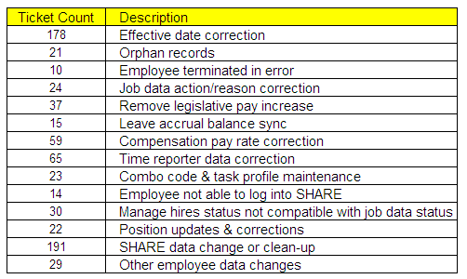
SHARE HCM Helpdesk Tickets
718 tickets from June 12, 2025 to August 12, 2025

Slide 4
SHARE HCM Helpdesk Tickets
Most important– please double (triple) check the SSN and Direct Deposit information before saving
Take an extra 15 seconds to validate the effective date is correct
When submitting a ticket, please give all relevant details.
Please do not have your non-HR employees submitting tickets. Work with the employee first to see if you can resolve the issue, if not, the ticket should come from HR.

Slide 5


Longevity Rate Changes
Effective August 30th (Pay period end Sept 12, 2025) the rates for Longevity Pay will be changing. These changes will be made automatically; no action is required to update the rates.
If the Longevity TRC needs to be modified/deleted please submit a help desk ticket or contact CPB. Please do not modify the LNGTY TRC.
NMS_PY_LONGEVITY_PMTS will provide information on Longevity payments thus far for employees at your agency.
At the end of the FY, SHARE will work with CPB to make employees whole on longevity if any payments were missed or rounding occurred.
Longevity Pay Table
Years of Continuous Service | Payment Per Pay Period | Annual Amount
5 – less than 10 | $29.67 | $700.00
10 – less than 15 | $64.11 | $1,500.00
15 – less than 20 | $81.32 | $1,900.00
>20 | $89.01 | $2,100.00

Slide 6
Additional Approvers Clean Up
We need your assistance in cleaning up Additional Approvers and keeping the setup up-to-date
There are three types of approvers at an agency level-- Agency-Wide approvers (HR or designee), “Reports To” Approvers and Additional Approvers
+ An agency wide approver can be identified by this query NMS_TL_APPROVER_POSN_WHOLE_BU Agency wide approvers should not be additional approvers.
+ A “reports to” approver occupies a position that is listed as the “reports to” position on another position; the supervisor in this position can automatically approve their employee’s time if they have the manager time approval role. A “reports to” should not be listed as an additional approver on the employee they can already approve through “reports to” functionality
+ An additional approver is an employee who is in a position that is listed as an additional approver on an employee’s additional approver page. This allows for delegation of time approval to someone who is not the direct supervisor nor an agency-wide approver.

Slide 7
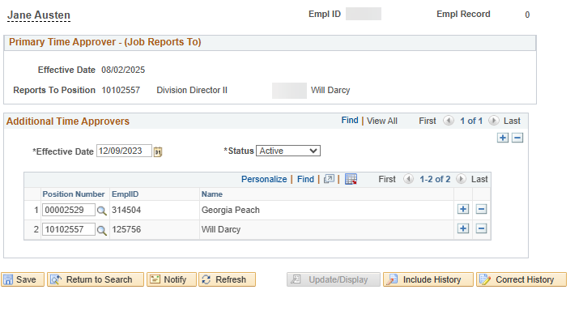
Additional Approvers Clean Up
There are three ways to access the additional approvers page:
+ Job Data > Employment Data > Time Reporter Data > Time Approvers
+ Time and Labor > Enroll Time Reporters > Maintain Time Reporter Data > Time Approvers
+ Time and Labor > Enroll Time Reporters > NMS Time Approvers

Slide 8
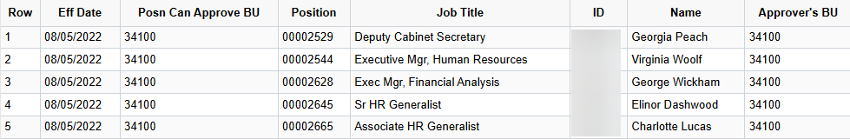
How to Clean Up
Run NMS_TL_APPROVER_POSN_WHOLE_BU
Make sure the positions/employees listed are the ones who should have the ability to approve the whole business unit
If a position needs to be added/removed, please submit a ticket to the SHARE Team.
Run NMS_TL_ADDL_APPROVER
Ensure the additional approvers are the appropriate positions/employees. Remove positions that are listed as agency wide approvers, “Reports to” approver for that employee, or the position is inactive or no longer belongs to your agency.
Query has been updated to show employee’s reports-to position

Slide 9
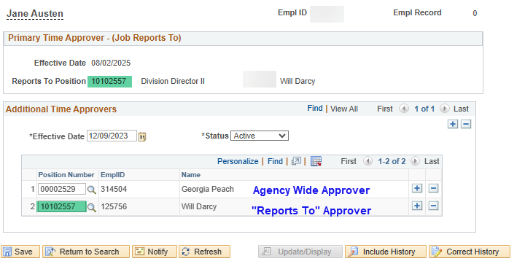
Example of Clean Up
For this employee, both Additional Approvers can be removed by adding a new effective dated row.
+ The first approver is an agency wide approver
+ The second approver is the “reports to” approver
We suggest adding a future dated row at the beginning of the next pay period when making changes to additional approvers.
Time already entered when these changes are made will be routed to the approvers listed when the timesheet is submitted.

Slide 10
Timesheet Access Restrictions
Current Basic Access
By default, managers/supervisors can see all timesheets within their agency, including terminated/retired employees. They can also enter/update time on any timesheet within their agency.
Managers by default can only approve time for employees who report to them or for whom they’re listed as an additional approver.
Custom Timesheet Access
Timesheet access can be restricted to employees reporting to a manager and who are listed as an additional approver.
With this restriction, a manager may only see and approve timesheets for employees who report to them or have their
position listed as an additional approver.

Slide 11
Thank You

Slide 12
Central Payroll Bureau
Important Updates & Information

Slide 13
Direct Deposit 101
Certificate is required to retain access!
ELM course SoNM-2074-1 Direct Deposit 101 for Administrators is now a required course. If an employee has access to enter or change direct deposit information in HCM, they must provide a copy of the certificate from the completed course. The certificate should be uploaded to the FSS as either direct deposit access or other form submission. CPB will accept either submission.
As of last Friday, 178 employees have successfully completed the course. Unfortunately, 36 agencies still have people with direct deposit access that have not taken it. There are 51 employees with this access that are at risk of having access removed on September 1st.
Any new request for direct deposit access must be submitted through FSS with both the confidentiality agreement and the certificate of completion for Direct Deposit 101.

Slide 14
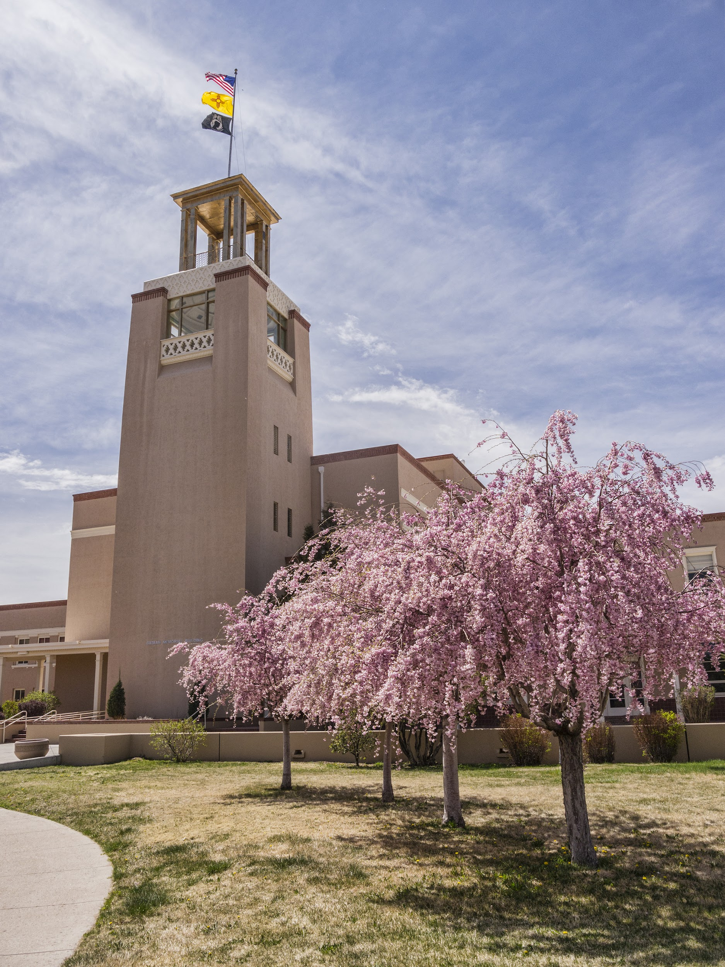
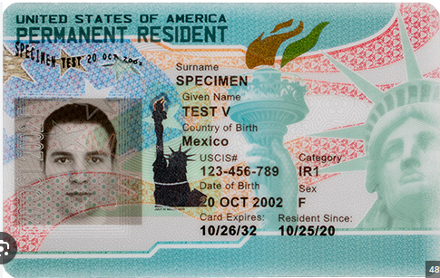
Payroll Taxes on State Employees
Employment tax categories:
US Citizen—subject to Federal Withholding per W-4 selections and deductions on all income earned.
Subject to Medicare and Social Security deductions based on PERA agreements.
Subject to State Withholding per W-4 selections and residency.
Resident Alien—must have a green card and meet the presence test. Same taxation rules as US Citizen. May have tax treaty to eliminate non-US earned income. Must provide a Social Security number and valid green card if one on file is expired.
Example

Slide 15
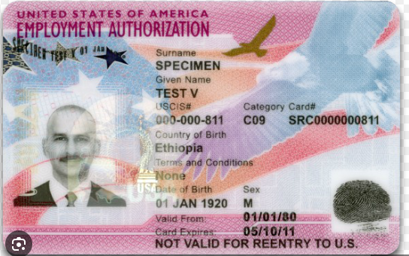
Payroll Taxes on State Employees
Employment tax categories:
Non-Resident Alien –subject to graduating Federal Withholding on wages with additional base added, unless valid form 8233 (tax treaty) submitted. Cannot file exempt, married, head of household or have dependent credits on W-4. Subject to Medicare and Social Security unless they meet requirement for exemption. Subject to State Withholding for wages earned in New Mexico.
Hire date in job data cannot be before the valid date on the employment authorization, and termination must occur on or before expiration date. New card must be presented if the one on file is expired and the employee is active. Must posses a valid Social Security number.
Example

Slide 16
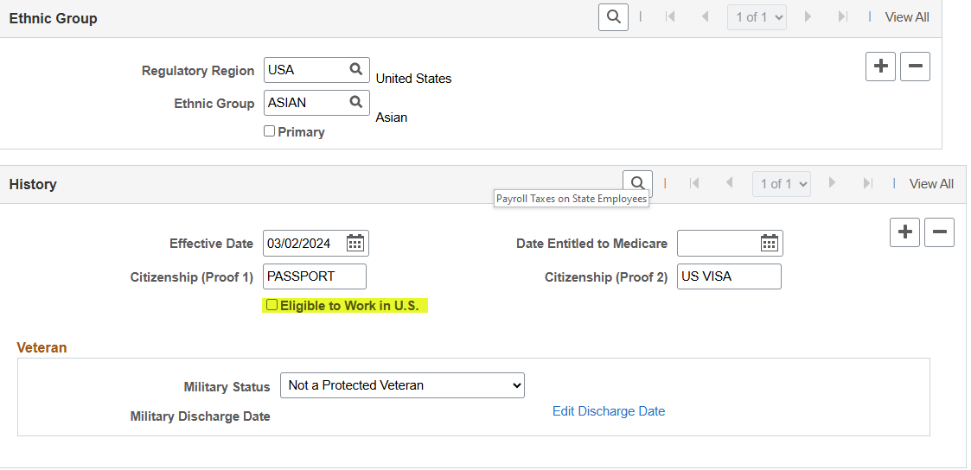
Employee Set Up
Modify a Person Regional Tab
If the employee is not a US citizen, the eligible to work in the U.S. box must be checked.
CPB and the SHARE team are reviewing options in HCM for tracking eligibility of non-citizens to ensure we are in compliance with State and Federal work regulations.

Slide 17
Calendar
End of Year Maximum Contributions
Maximum contribution limit.
FICA limit on Social Security Contributions for 2025 is 6.2% of $176,100.00 for a maximum contribution of $10,918.20. HCM will automatically stop withholding for Social Security when this deduction maximum is reached. This will usually occur on wages in the middle of the pay period.
PERA maximum contribution. The end of September, is when some employees begin to exceed allowable contributions to PERA/ERB. If an agency receives a notification that the max contribution has been reach by an employee, the agency must change the benefit eligibility in job data to NORET before the next pay period ends.
Agencies will be required to refund excess FICA or PERA contributions before 12/31/2025 to prevent W-2 corrections.

Slide 18
Every Pay Period
Payroll Pre-Audit
To ensure a successful payroll, agencies should be running the necessary reports and queries at the end of payroll period and until payroll has processed. The agency should be auditing the data to ensure all employees have reported 80 payable hours (or scheduled part-time hours); managers, supervisors and/or timekeepers have approved reported time by Friday (adjustments can made on Monday); appropriate deductions have been taken; and that all forms submitted to DFA CPB have been processed.
Central Payroll sends biweekly emails of the list of reports and queries that agencies should be running every pay period. Agencies are responsible for ensuring employees are paid correctly and timely.
Some reports and queries require specific system processes to have occurred to get the most accurate information (i.e., Time Admin, time loaded, loaded time calculated, etc.).
Notes:
Suzette’s slides

Slide 19
List of beneficial queries and reports to be run biweekly:
Queries:
  NMS_TL_NEEDS_APPROVAL_STATE
  NMS_TL_REQ_APPROVAL_BY_DEPT
  NMS_TL_UNDER80_RPTD
  NMS_TL_OVER80
  NMS_TL_ALL_EXCEPTIONS
  HRT_TLX20023_BUDREF_CLASS_DET
  NMS_PY_TL_TAKEN_BY_PY
  NMS_TL_MISSING_PAY_TIME
  HRT_HOL_PAID_NO_REPORTED_TIME
  NMS_BN_DEDUCTIONS_NOT_TAKEN
  NMS_TL_UNDER40_REPORTED
  NMS_TL_UNDER80_PAY
  NMS_PY_HOL_MISSING
Reports:
  Time and Labor>Reports>NMS EMPLOYEES NO TIME RPTD
  Time and Labor>Reports>REPORTED TIME AUDIT
  Time and Labor>View Time>UNPROCESSED REPORTED TIME
  Time and Labor>View Time>UNPROCESSED PAYABLE TIME
  Time and Labor>View Time>EXCEPTIONS
  Time and Labor>Reports>PAYABLE STATUS
Payroll for NA>Payroll Processing>Pay Period Reports:
  NMS Agency Payroll Register
  Deductions Not Taken
Notes:
Suzettes slides

Slide 20
Payroll Reconciliation
Reconciling Payroll For A Pay Period: Reconciling Cash & Liability Accounts from HCM to FIN
It is recommended that you process this reconciliation at the end of every pay period and can be started the Wednesday of the pay week.
Central Payroll will not ask you to submit your reconciliation, but it should be saved for auditing purposes.
There are two parts to the Reconciliation:
PART ONE: Reconcile the HR ACCT LINE DETAIL cash & liabilities to the PR JOURNAL cash & liabilities.
PART TWO: Reconcile the PR JOURNAL cash and liabilities to the AP JOURNAL cash and liabilities.
This process requires information that can be found from the HR Account Line Detail data.
HR Account Line Detail data is created from the batch process PAYGL02A, which consists of account information such as gross pay, net pay, benefits and taxes.
In order to extract the HR_ACCT_LINE_DETAIL data you will need to run the following query:
Query: NMS_PY_ACCOUNTING_LINE_DETAILS

Slide 21
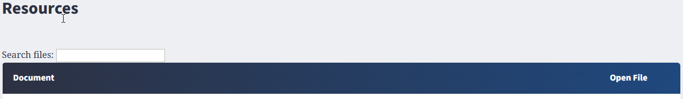
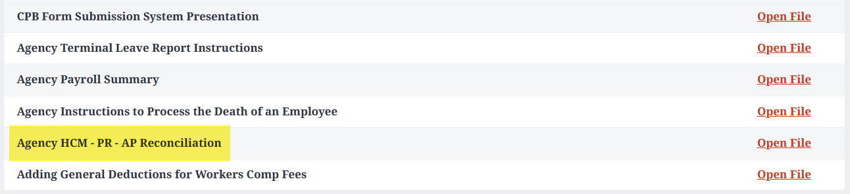
Payroll Reconciliation
Central Payroll has posted the procedure for this reconcilaiton on the CPB page of the DFA Website:
https://www.nmdfa.state.nm.us/financial-control/central-payroll-bureau/
Agencies can request to schedule training by submitting a Training Request form to CPBTrainers@dfa.nm.gov

Slide 22
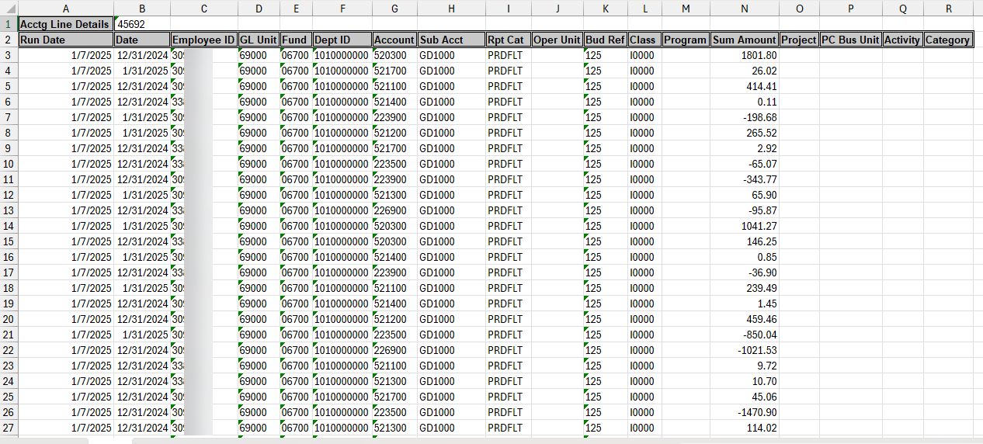
How to research errors?
Time and Labor task profile ID’s is where the accounting information is stored and is the funding source tied to the employees’ time reported in HCM.
When payroll processes are run in HCM, it creates NMS_PY_ACCOUNTING_LINE_DETAILS data in HCM and is sent over to FINANCIALS.
The NMS_PY_ACCOUNTING_LINE_DETAILS data is a result of all the payroll transactions processed in a pay period. It is the input file, to generating the PR Journals in Financials, which get posted to the General Ledger.
QUERY: NMS_PY_ACCOUNTING_LINE_DETAILS

Slide 23
Payroll Journals
Correcting Errors
Central Payroll will notify agencies by email of all payroll errors generated. Agencies will need to provide CPB with the appropriate accounting information to correct the journal within 24 hours of notification. Additionally, the agency must correct the error in HCM prior to the next payroll cycle. If the errors are created due to budget errors, the agency will need to have the budget corrected or reclassify the expenses to a holding account and then journal the expenses after budget is posted.
Most of the errors are caused by project costing associated with combo codes and task profiles. Agencies should provide Central Payroll with contact information for financial staff that are responsible for maintaining this information.
Payroll journals are essential to the State financial accounting system accurately reflecting payroll activity, therefore if an agency has the same errors for two pay periods, all agency stakeholders will be required to meet with DFA Financial Control Division and Central Payroll prior to the journal corrections being made the second time.

Slide 24
Liability vs Expense Accounts
Payroll Journal Corrections
When correcting payroll journals it is imperative to understand how the corrections will alter the posting into FIN. Budget is based on expenses and a correction to an expense line item should not impact the liability account. Issues arise when expenses are moved from one funding source into a different funding source.
CPB will not split funding sources on accounts. If you are moving the expense to a different funding, it must be moved in whole and any allocation needed made through a journal entry after posting. Because all expense accounts create an offset of a liablility, it is imperative that the liablility is also changed. A liability can only be moved between funds, if the entire liablility is moved. One expense will have multiple liabilities associated with it.
Cash control allocates cash based on liability payments. If you move a liability, it will impact the cash allocation posted after payroll. Negative cash balances are not allowed and payroll journal adjustments may impact on cash.

Slide 25
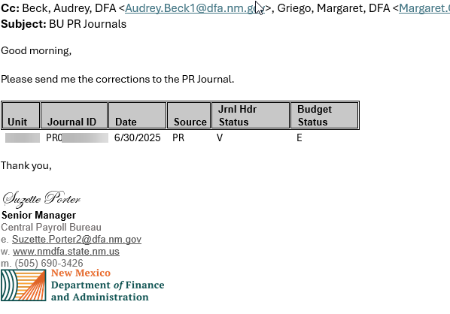
Payroll Journal Job Aid
New Job Aid for Payroll Journal Errors *Coming Soon!
You may receive an email from Central Payroll regarding an error in a payroll journal.
Central Payroll has created a new job aid that will assist in finding what is causing the error in your payroll journals using the information provided in the email. We will post this new job aid on the CPB page of the DFA website.
https://www.nmdfa.state.nm.us/financial-control/central-payroll-bureau/
The majority of the errors will require help from your agencies budgeting departments to fix.

Slide 26
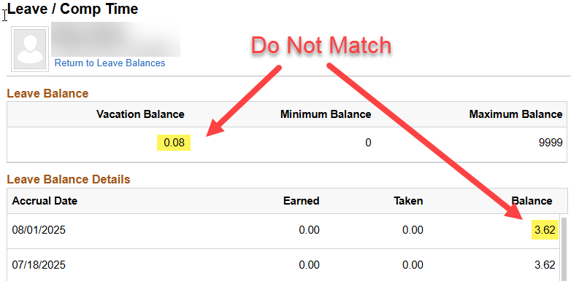
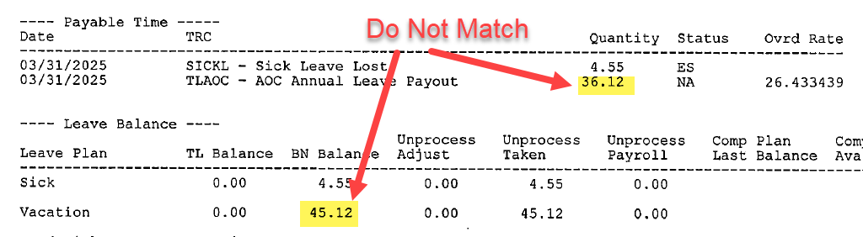
Leave Balance Discrepencies
An employee has a discrepency in their Sick and/or Annual leave buckets.
These discrepancies are usually discovered by looking at an employees Leave/Comp Time screen in Team Time or on the TLV report when processing a Terminal Leave.
These balances must be corrected before a Terminal Leave Request can be processed by Central Payroll.

Slide 27
Leave Audits
Processing an Audit for Annual & Sick Leave.
A leave audit must be conducted when a discrepency is found in an employees leave balances. This audit will help determine what the employees correct balance should be. Once determined, you will submit your findings to Central Payroll in order to correct the balances in HCM.
There are two queries that you use when conducting a Leave Audit.
NMS_TL_LEAVE_ACCRUAL
NMS_TL_RPTD_TIME
Nearly every audit is different, and some require more research to find the correct balance.
Please submit a request to schedule training with the CPB training team to learn how to process a Leave Audit.

Slide 28
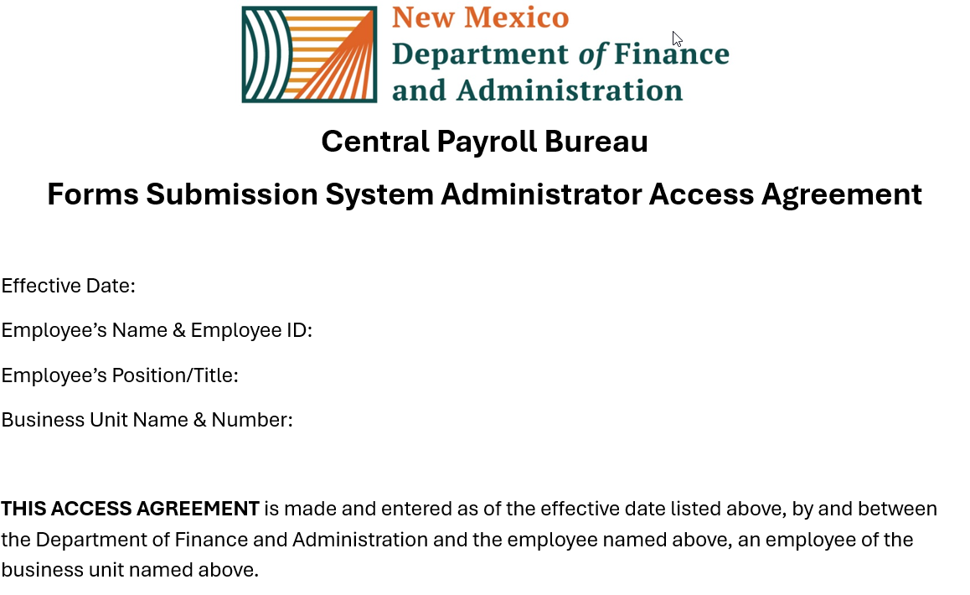
Form Submission System (FSS)
Agencies will need to designate 1 Person, preferably their HR Managers, to become their agencies administrator for FSS. An administrator access form will need to be submitted to CPB via the FSS to be given this access.
This Admin will be responsible for granting and adding users from their agency to the FSS.
They will maintain their user list ensuring that all their users are current and deactivate those that no longer need access.
The Admin will be responsible for maintaining their agencies requests and ensuring they are updated as needed.

Slide 29
Form Submission System (FSS)
To help ensure the metrics being pulled into the reporting tools are as accurate as possible it is essential that you keep your FSS requests up to date.
We currently have over 100 requests that are in the “Returned” status.
This status indicates that the request is currently awaiting the agencies next step and Central Payroll cannot do anything with this request until this status changes.
These requests need to be corrected and resubmitted or canceled.
If you experience issues or errors when attempting to cancel a request, please submit a ticket to the RTS help desk via email at: support@rtsolutions.com
Account Lock Out
Central Payroll does not have the ability to unlock accounts that have been locked due to “to many failed log in attempts”. You will need to wait the time given in the popup or you can email Real Time Solutions support team to have them unlock your account at support@rtsolutions.com

Slide 30
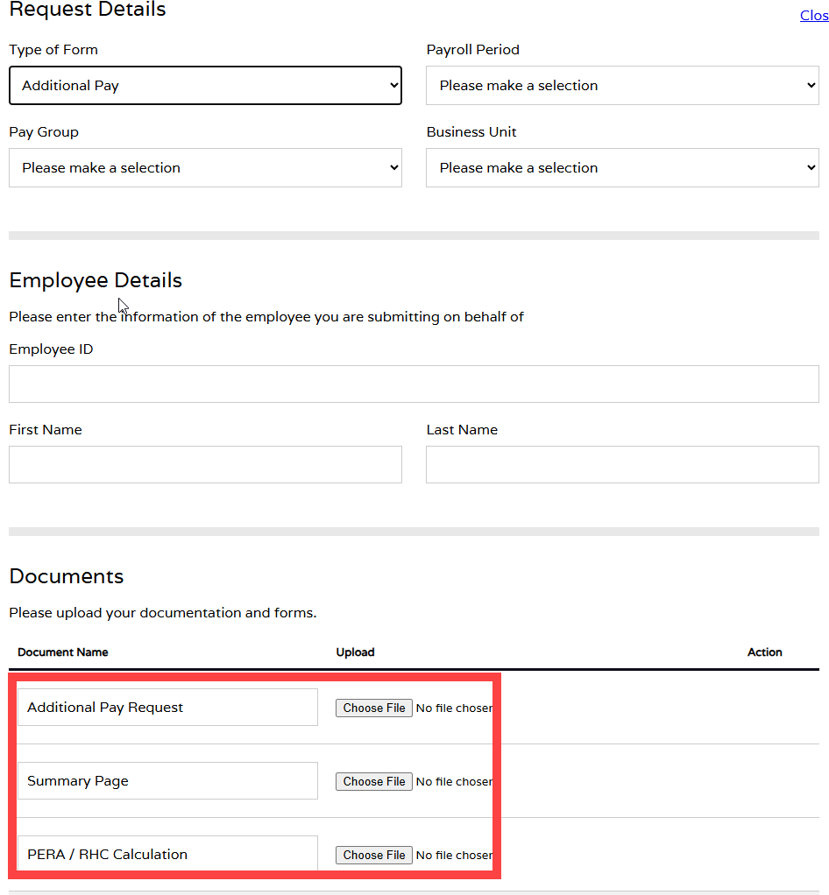
Form Submission System (FSS)
Friendly Reminder
Please only upload the required documents into FSS. Each form type from the “Type of Form” drop down will change the type of documents that need to be uploaded and will show under the Documents area
Screenshots of HCM screen such as JOB DATA info or REVIEW PAYCHECK info are no longer needed.
This will help quicken Central Payrolls review of your request by not having to scroll through attachments that are no longer needed which in turn means a quicker processing time of your request.

Slide 31
CPB Trainers
Central Payroll Trainers Open Hours
The Central Payroll Training team will hold an open Teams meeting weekly on Wednesdays from 2pm to 4pm.
Anyone can join at anytime within those hours to ask questions regarding Central Payroll Forms, existing requests in the FSS or the FSS in general.
This is also a great way to share best practices with you peers regarding the FSS and the forms.
Teams Meeting Link: https://tinyurl.com/CPBTrainers
Just a note, this will be an open forum where people from any State agency can join, so please refrain from sharing sensitive information during this time.
Notes:
Will need to verify with Elizabeth Jaramillo if we are allowed to use TinyURL.

Slide 32
Payroll Resources
Central Payroll Trainers
Alex Guzman, Payroll Trainer Supervisor P:(505)469-2910 E: Alejandro.Guzman@dfa.nm.gov
Claudette Romero, Payroll Trainer P:(505)376-3067 E: Claudette.Romero@dfa.nm.gov
  Preferred E-mail: CPBTrainers@dfa.nm.gov
Central Payroll Web page
https://www.nmdfa.state.nm.us/financial-control/central-payroll-bureau
Department of Finance & Administration YouTube Channel
https://www.youtube.com/@nmdfa8097

Slide 33
Thank You

