Slide 1


HCM Quarterly Meeting
Presented by Central Payroll & the SHARE Team

Slide 2


SHARE HCM Team
Important Announcements

Slide 3
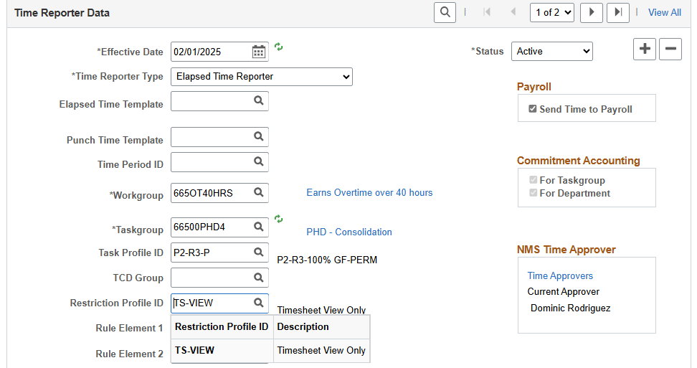
Timesheet View-Only Access
Time and Labor has functionality to allow some users View-Only access to their timesheet through Employee Self-Service.
To set this up, access the employee’s Time Reporter Data, insert a new effective dated row and add TS-VIEW to the Restriction Profile ID field.
You can see in the lookup window that there is only 1 valid value for this field.
Access is not immediate, it’s effective after the hourly security process completes.

Slide 4
Donated Leave
TRCs used for Donated Leave Transactions
Donor
ANNLD – Annual Leave Donated (reduces the annual leave balance for the donor)
ANLDR – Annual Donated Returned (adds annual leave back to the donor)
Donee
ANNLR – Donated Annual Received (increases the donated annual leave balance)
ANLDT – Donated Annual Taken (reduces the donated annual leave balance)
ANLDL – Donated Annual Lost (reduces the donated annual leave balance)
ANLDA – Donated Annual Adjust (increases donated annual leave balance if positive, reduces if negative)
Queries:
NMS_BN_LEAVE_BALANCE_BY_EMPLID
NMS_BN_LEAVE_BAL_BU

Slide 5
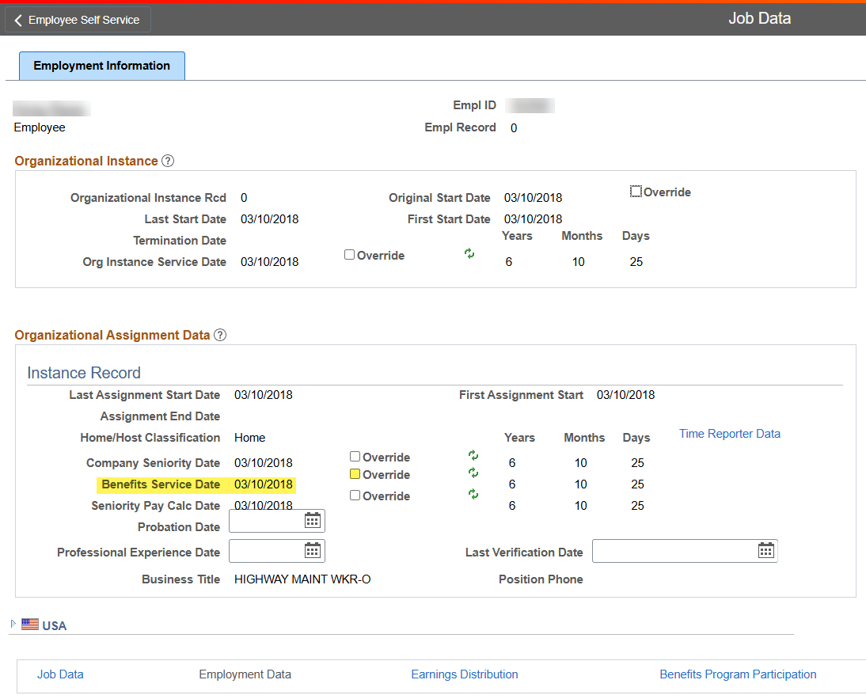
Benefits Service Date
The accrual rate for annual leave is based on the Benefits Service Date on Job Data.
To ensure that employees are accruing at the correct rate, please review the Benefits Service date. This is especially important for rehires and employees with a Local Public Body (LPB) record.
To update the date, insert a new effective dated row in Job Data with Data Change/Employment Data Page Update as the action and reason. Then click the override box and enter the adjusted hire date.
Query:
NMS_BN_BENEFIT_SERVICE_DATE

Slide 6
1095-C Forms
HCA will be mailing out the 1095-C forms to employees in the near future. Also, these forms will be available in employee self service at the end of February.
Navigation: Employee Self Service Homepage -> Benefit Details Tile -> View Form 1095-C

Slide 7
Reusing Old Departments
Prior to using a department that hasn’t been used in years, please check with the SHARE team to ensure that everything is configured correctly. Depending on the usage, a department may need to be updated with current Fiscal year information.
When in doubt…. Submit a ticket to: enterprisesupportdesk@doit.nm.gov
Query:
NMS_TL_DEPTID_BY_SETID

Slide 8
Query Cleanup
The SHARE Team is working on cleaning up queries.
We currently have over 900 public queries, many of which give
Identical information, or very similar information to other queries
Some queries give the same information but have different prompt criteria.
Many of these queries can be consolidated down and deleted.
As we work on cleanup, we will be standardizing queries and coming up with a query catalogue.

Slide 9
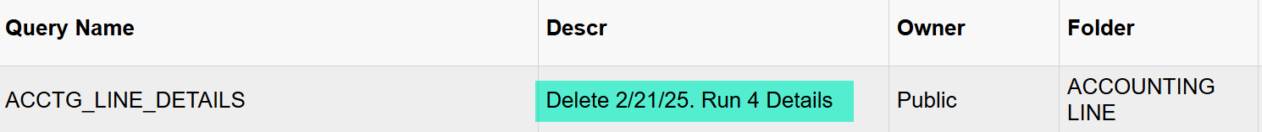
Query Cleanup
For frequently run queries, we will communicate when we
Will be making changes.
As an example, we have identified all the queries that report off of
HR Accounting Lines, and we have consolidated the queries down to
one query we think you’ll find helpful.
We are communicating this change in two ways—
The description field shows when the query will be deleted

Slide 10
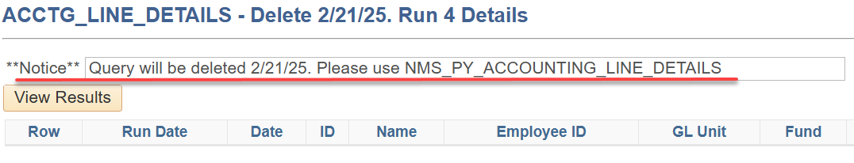
Query Cleanup
2. When you go to run the query, the prompt will give info
Showing what query we suggest running as a replacement
Our team also perform normal query clean up. If a query has not been run, or is not frequently used, we delete it without notification. If you have questions about a query, you can submit a help desk ticket and we can assist you in finding a suitable query.

Slide 11
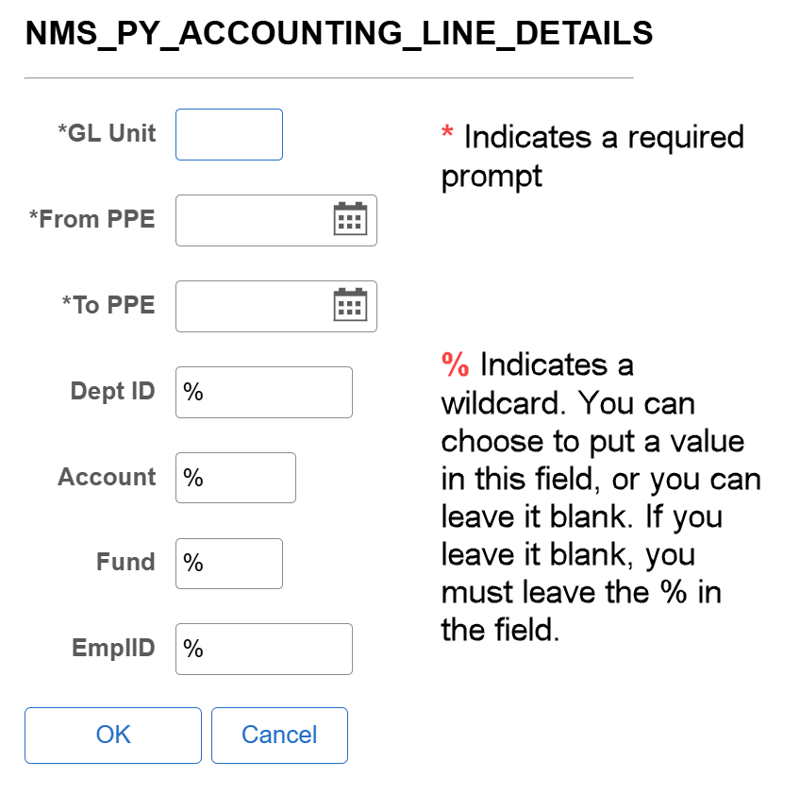
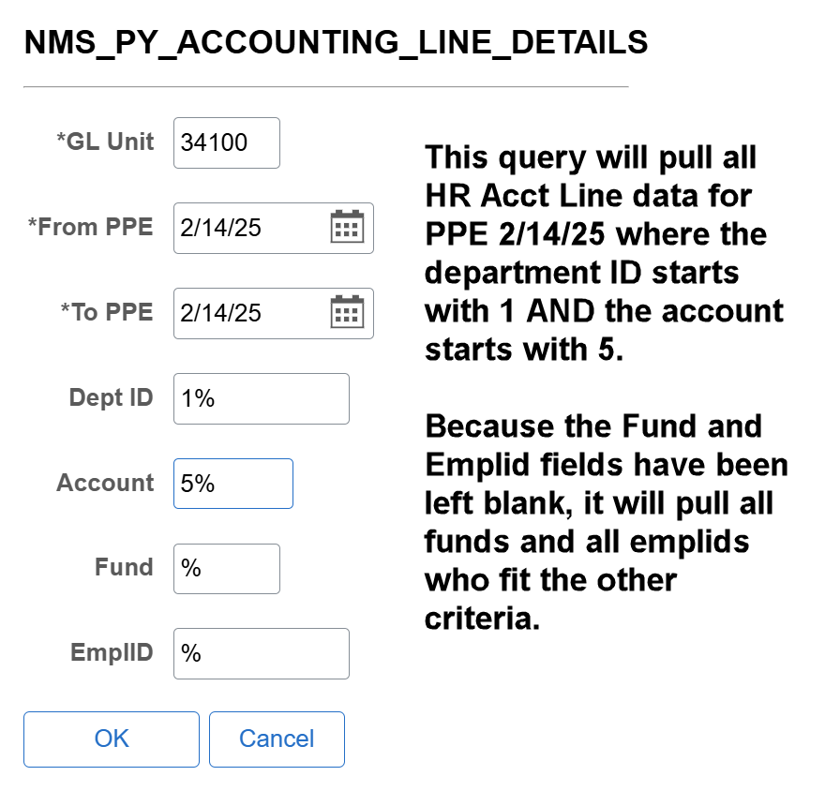
Running Queries
As we work on consolidating queries, you may notice that there
are more prompts. This is an effort to give you multiple ways
to run the query.

Slide 12
Job/Empl Record Numbers
National Guard members serving on State Active Duty are now being added into SHARE as employees.
This is requiring us to now use mutiple employee/job record numbers.
Historically, we pushed all HR to use empl rcd 0 for all hires, but you may now have a situation that requires an Empl rcd 1 be used, like if you are hiring an employee who is already in SHARE as an active NG member under empl rcd 0.
Remember to always utilize the NMS employee search function when bringing on an employee to see if an employee ID already exists in SHARE, even if the employee insists they’ve never worked for the state before.

Slide 13
Thank You

Slide 14
Central Payroll Bureau

Slide 15


Forms Submission System
The new Central Payroll Forms Submission System (FSS) has been live for a few weeks and has replaced e-mails as the way to submit any forms to CPB.
Central Payroll will reject any forms submitted via email and you will be asked to resubmit via the FSS.
You may request access via the following website: https://platform.dfa.nm.gov/request-access.html
Access is NOT granted automatically upon request and is reviewed by Central Payroll before approval to ensure proper access.
We are always looking to improve your FSS experience and feedback regarding ways to improve or errors you may encounter is appreciated

Slide 16
To Do:
1. Employees claiming exempt from Federal or State
Withholding must update their W-4 by Monday, or
Agencies must change their tax status to Single.
2. Review Benefit Service Date of Employees. Several
Employees are over accruing leave due to incorrect
Service dates and are having to repay agencies for excess
Leave usage upon termination. The longer this occurs the more
Complicated the overpayment becomes.

Slide 17
Task Profiles & Task Groups
The Impact on Financials

Slide 18

What are Taskgroups & Task Profile ID’s?
This Photo by Unknown Author is licensed under CC BY-NC-ND

Slide 19
Most agencies only need 1 Task Group. A Task Group can have up to 999 Task Profiles.
Task Profiles indicate where the TRC codes will charge. A Task Profile can have up to 6 combo codes.
A combo code creates the accounting string.
TASK GROUPS
TASK PROFILES
COMBO CODES

Slide 20
Taskgroup and Task Profile Defined.
Task Group determines what timesheet is used and the task profile determines the accounting chartfields that are used to charge a particular task for payroll.
Task profiles are controlled by the task group. A task profile ID has to be assigned to the task group before you can assign it to the employee.
Each employee must have a task group. The task profile ID is optional, but highly recommended. If an employee is not assigned a task profile, the default task profile on the task group will be used for payroll.
Taskgroup and Task Profiles are assigned to an
employee through Maintain Time Reporter Data.

Slide 21
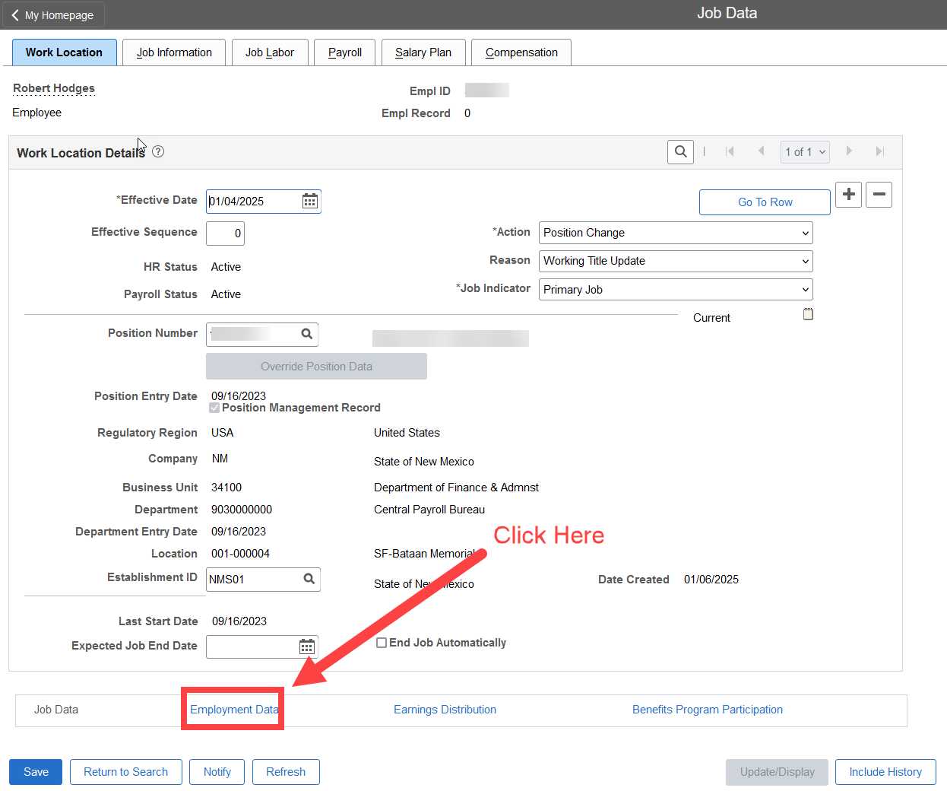
Task Profiles
Where can you find your employees Task group and Task Profile?
In HCM you will go into Job Data and search for your employee.
On the landing page in Job Data, you will see a link near the bottom that says Employment Data. Click on that link.

Slide 22
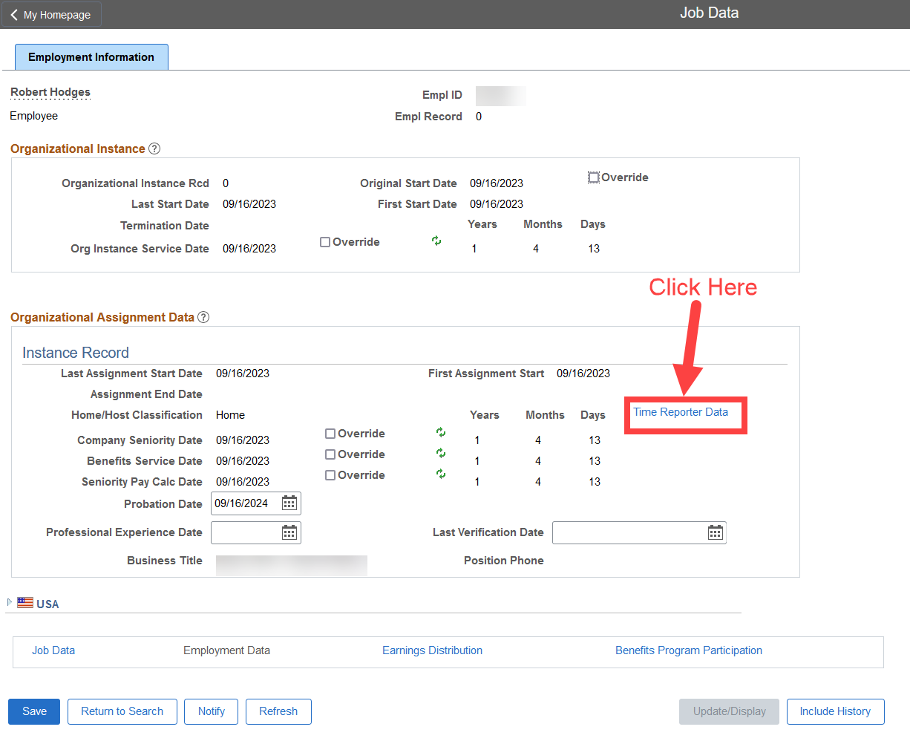
Task Profiles
You are now on a screen that shows more of the employee's information.
You will click on the link titled Time Reporter Data

Slide 23
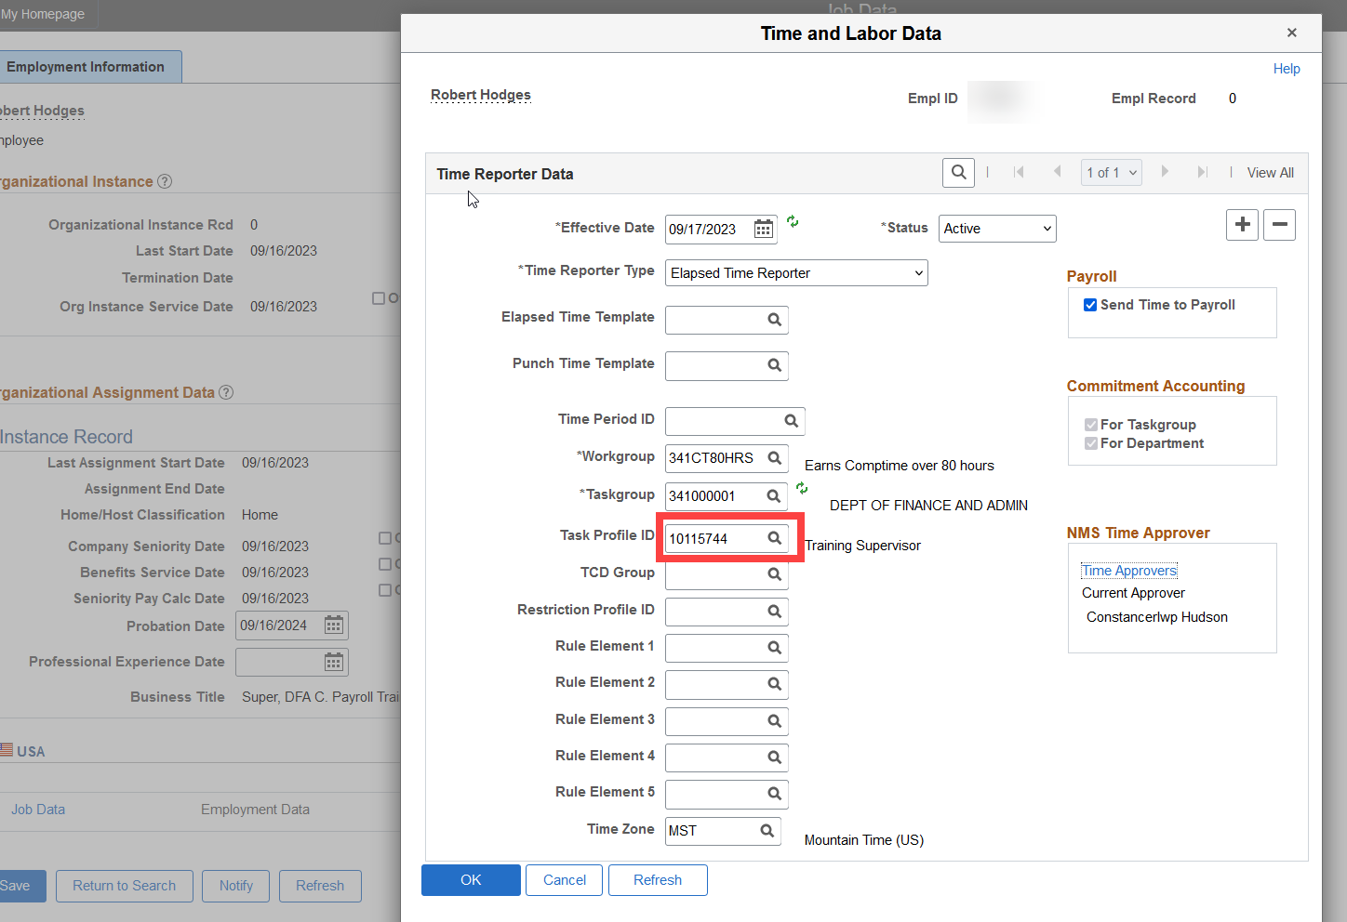
Task Profiles
Finally, you will get a pop-up window that shows the employees Time and Labor Data.
Within this window you will find the employees Taskgroup & Task Profile ID.

Slide 24
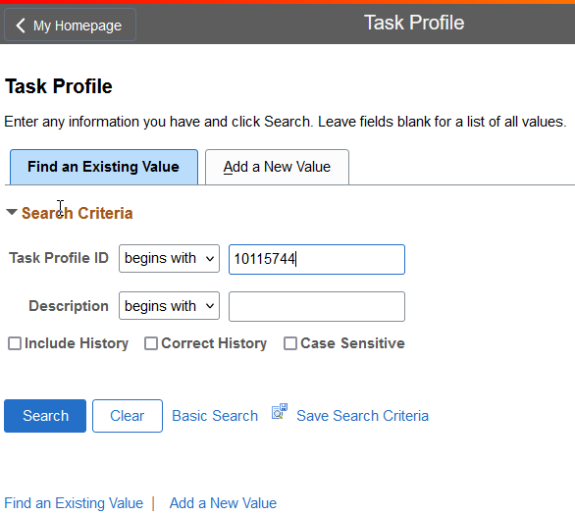
Combo Codes
With this Task Profile ID you can now find the combo codes that attached to the Task Profile ID.
Navigation Path: Menu>Setup HCM>Product Related> Time & Labor>Task Configurations>Task Profile

Slide 25
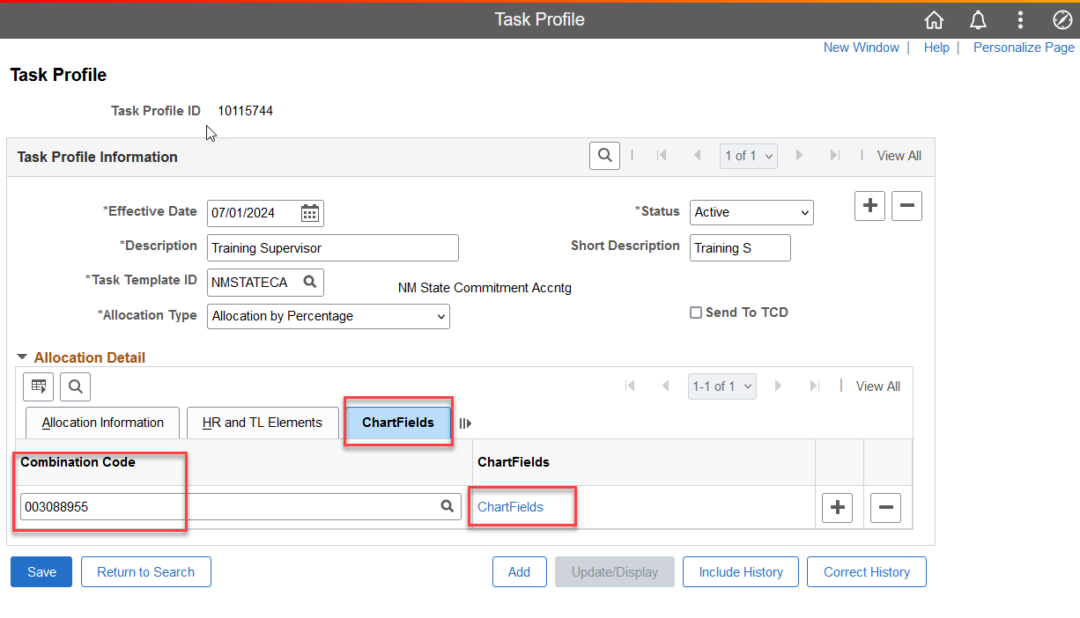
Combo Codes
Once in the Task Profile window, click on the ChartFields tab.
This will now show the Combo Code that is attached to this Task Profile.
You can also click on the blue Chartfields link that will give you more details.

Slide 26
What is a Combo Code?
A Combo code is a key that defines a combination of Chartfields. The payroll process posts these transactions to the General Ledger. The combo code identifies the ChartFields to include on each transaction. A valid combo code is a combination of ChartFields that are valid in the general ledger.

Slide 27
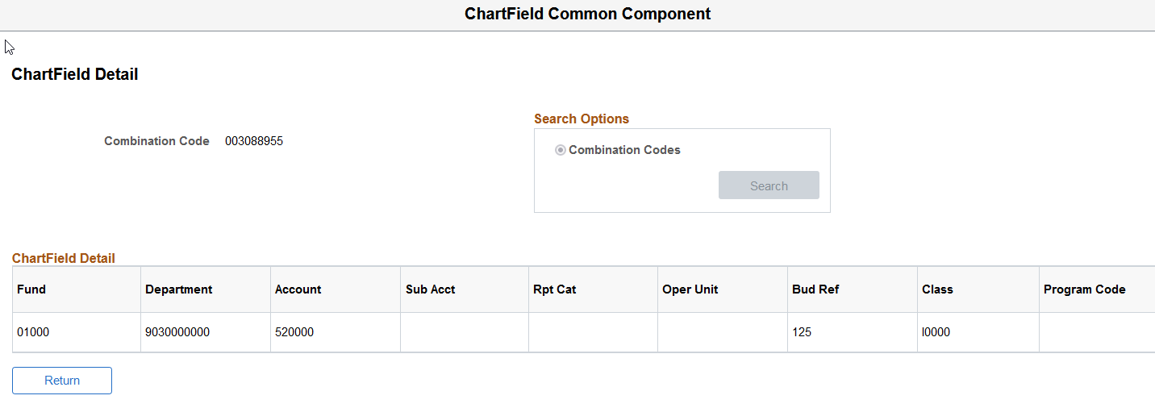
Combo Codes
In this window you can view the financial information attached to the Combo Code such as Fund, Department, Account, Bud Ref, Class, etc.

Slide 28
More On Task Profiles
Each employee has a task profile ID that will be the default chartfield distribution for payroll, unless the combo code is overridden on the timesheet.
Task profiles tell the system how to divide the labor costs.
Task profiles may contain more than one combo code but should limit total combo codes to 6 with a minimum distribution of 15%.
A task profile should not be used arbitrarily to meet budget requirements.

Slide 29
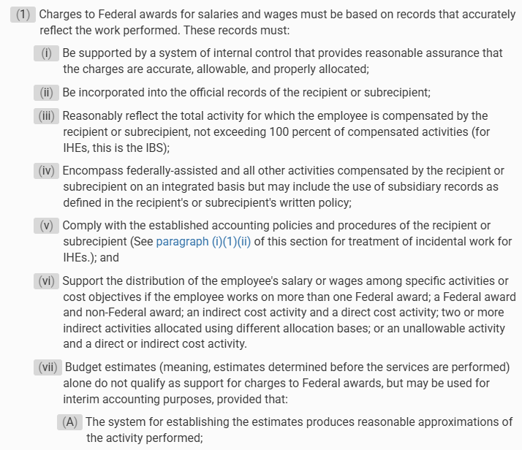
Rules to consider for Task Profiles and Combo Codes
Maps PR 5.2
This policy establishes requirements for submitting Task Profile changes. Task profiles will be limited to six different combo codes and allocation percentages for each will be limited to 15% or more.
2 CFR 400.230 Uniform Grants Guidance

Slide 30
Usefull Queries
Here are a couple queries to allow agencies to easily see all active employees and combo codes/chartfields info. Here are two queries we recommend:
NMS_TL_TSKPROFILE_COMBO_CD2
NMS_CA_TSKPRFL_COMBO_BU

Slide 31

Combo Codes
How do combo codes impact FINANCIALS?
HCM generates an accounting line for each payroll transaction by combo code.
This information is imported into FIN by the created payroll journal.
The more complicated the task profile the more lines of code that will be generated for that employee.
Example: 1 employee, 1 default task profile containing 29 combo codes, 1 payroll cycle would generate over 300 lines of accounting on the payroll journal.

Slide 32
Payroll Journals
Correcting Errors
Central Payroll will notify agencies by email of all payroll errors generated. Agencies will need to provide CPB with the appropriate accounting information to correct the journal within 24 hours of notification. Additionally, the agency must correct the error in HCM prior to the next payroll cycle. If the errors are created due to budget errors, the agency will need to have the budget corrected or reclassify the expenses to a holding account and then journal the expenses after budget is posted.
Most of the errors are caused by project costing associated with combo codes and task profiles. Agencies should provide Central Payroll with contact information for financial staff that are responsible for maintaining this information.
Payroll journals are essential to the State financial accounting system accurately reflecting payroll activity, therefore if an agency has the same errors for two pay periods, all agency stakeholders will be required to meet with DFA Financial Control Division and Central Payroll prior to the journal corrections being made the second time.

Slide 33
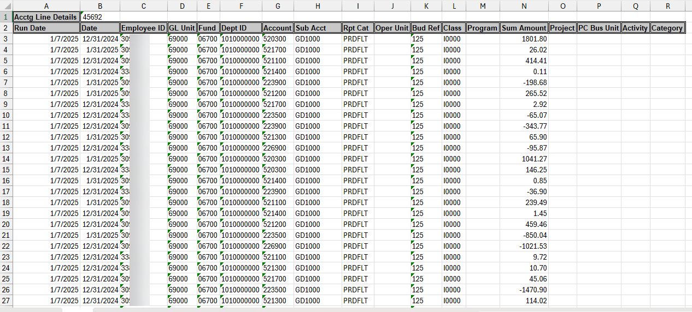
How to research errors?
Time and Labor task profile ID’s is where the accounting information is stored and is the funding source tied to the employees’ time reported in HCM.
When payroll processes are run in HCM, it creates NMS_PY_ACCOUNTING_LINE_DETAILS data in HCM and is sent over to FINANCIALS.
The NMS_PY_ACCOUNTING_LINE_DETAILS data is a result of all the payroll transactions processed in a pay period. It is the input file, to generating the PR Journals in Financials, which get posted to the General Ledger.
QUERY: NMS_PY_ACCOUNTING_LINE_DETAILS

Slide 34
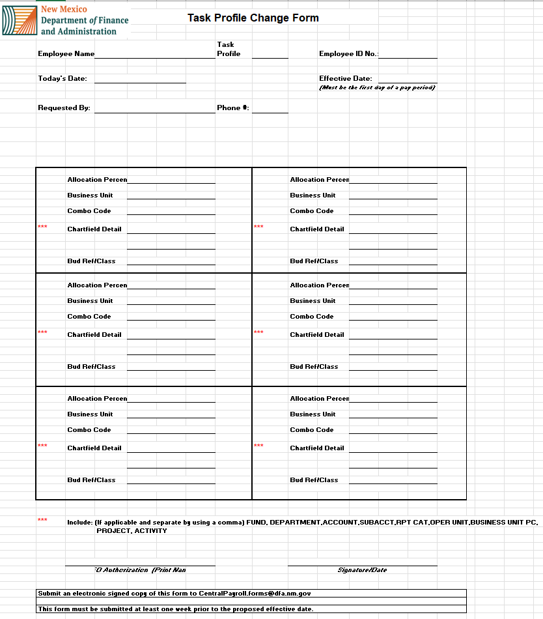
Updating Task Profiles
Central Payroll has a Task Profile Change form located on the DFA website that can be submitted via the Forms Submission System to make changes to a Task Profile.
The form must be submitted at least one week prior to the proposed effective date.
Form location:
https://www.nmdfa.state.nm.us/financial-control/central-payroll-bureau/
Forms Submission System website:
https://platform.dfa.nm.gov/login.html
We also provide more in-depth training, in person or via video conference.

Slide 35
Items to Consider
Combo Codes must be updated at minimum annually to ensure that the proper Bud Ref and Class are current.
Effective dates will cause a combo code to fail if it is no longer active.
Budget must be in place for any combo code used.
Complicated chart fields require more oversight.
Entering and approving time will not necessarily meet grants requirements for 2 CFR 400.230.
A new task profile does not necessarily need to be created when a new position is created.
Task profiles can be used for many employees, do not create a new task profile if the cost accounting is already created in an existing task profile.
Every TRC is allocated based on the task profile. If 15 minutes of sick leave is used, it will be allocated based on the task profile.
A new Task group rarely needs to be created.

Slide 36
Payroll Resources
Central Payroll Trainers
Alex Guzman, Training Supervisor
  Phone# (505)469-2910
  Via E-mail at: CPBTrainers@dfa.nm.gov
Central Payroll Web page
https://www.nmdfa.state.nm.us/financial-control/central-payroll-bureau
Department of Finance & Administration YouTube Channel
https://www.youtube.com/@nmdfa8097

Slide 37
Thank You

