Slide 1


HCM Quarterly Meeting
Presented by Central Payroll Bureau & the SHARE HCM Team

Slide 2


HCM Team
Validating EE Info
NMS Statewide Employee Search
SHARE Security Form
Terminated EE access to Self Service
Workgroups and Time Reporter Data
Temp employee benefits/retirement
Query Trick: XLOOKUP

Slide 3
Information Verification
Should be validated for every hire, rehire, transfer, promotion, etc.
Personal Data
Legal Name – Name on SSN Card
Date of Birth
Gender
Highest Education Level
Home Address
Phone Number
Work Email Address
I-9 Documents
Ethnicity
Job Data
Start Date
Position Number
Position Type
Pay Group
FICA Status
Hourly Rate
Retirement Plan
Time Reporter Data

Slide 4

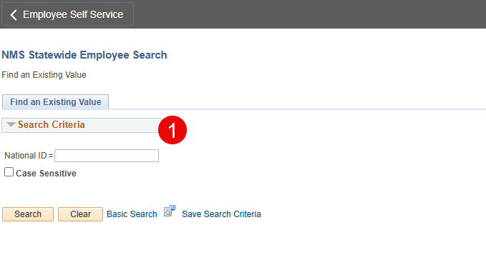

SSN Check, Applicant Type, and Hire Processing
NMS Statewide Employee Search
Before creating or processing a hire, it is critical to search for the candidate in NMS Statewide Search to determine any existing or prior job information.
Navigation: Workforce Administration > Job Information > NMS Statewide Employee Search
Using This Function:
Data Accuracy & Compliance | Process Efficiency & Impact
Identifies existing or prior job records | Prevents duplicate or override of employee job records
Ensures correct applicant type (new hire, rehire, transfer) | Reduces processing delays and rework
Supports accurate SSN verification and compliance | Avoids payroll, benefits, and security access issues
Determines correct hire action and effective dating | Improves coordination with HR, Payroll, and the Service Desk

Slide 5
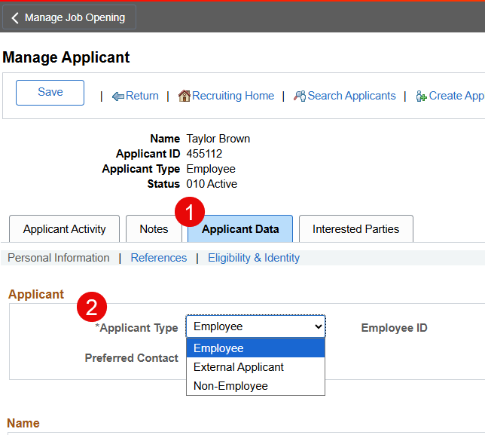
SSN Check, Applicant Type, and
Hire Processing Cont’d
Applicant Type & Action Decision Flow
After reviewing NMS Statewide Employee Search results, use the checklist below to process the correct recruitment action:
Existing employee or job record?
No → Applicant Type: External → Action: Hire
Yes ↓
Employee currently active?
No → Applicant Type: External Previous Employee → Action: Rehire
Yes ↓
Active National Guard record?
Yes → STOP!
  Do not use Manage Hires
  Do not override the NG row
  Contact share.help@dfa.nm.gov
No ↓
Moving to a different agency or position?
Yes → Applicant Type: Employee → Action: Transfer

Slide 6
SHARE Security User Access Requests
All SHARE user access requests must be submitted by Agency HR.
Access cannot be granted and accounts cannot be created without a completed, approved request form.
New SHARE Security Requests must include:
  Required access request forms
  All proper approvals and signatures
  Active state email is required
  Completion certificate of any required trainings
Transfers:
  The losing agency must submit documentation to remove any additional high-level access roles.
  The hiring agency must submit the access form with requested roles. (Note: verify job data, confirm email make any updates to profile)
Separations:
  Submit a security access removal form for any high-level access immediately upon employee separation, using the correct effective date.
Important : We have seen an increase in employees directly contacting the SHARE Service Desk for their system access when no access request form has been submitted. Please ensure agency staff follow the established access request process to avoid delays.

Slide 7
Self Service Access – Terminated Employees
Self Service Access
Employees who terminate employment with the State of New Mexico retain HCM self service access in SHARE for 30 days. Terminated employees will be able to print pay stubs, access forms, view timesheets, etc.
Employees who have additional access in SHARE HCM (ex. HR Admin, Time admin, FIN access) will have that access removed once the termination is entered on Job Data. This security job runs every 30 minutes.
If the former employee’s MFA phone number or device needs to be updated, please submit a ticket to the helpdesk at share.help@dfa.nm.gov.

Slide 8
Workgroups & Time Reporter Data
All GOVX employees should be in 1 of 3 workgroups (based upon their FLSA status)
  EXHEXEMPT: Exception Hourly – Exempt
  EXHOT40HRS: Exception Hourly 40 HRS
  EXHOT40PAY: Exception Hourly OT 40 Pay
EXHEXEMPT
  Auto populates Reg Hours based upon employee Work Schedule
  Limits the entries allowed on the timesheet
  Limited rule processing (no comptime/OT, etc)
Currently, there are about 175 employees in non-GOVX workgroups that should be corrected
  Use this Query to validate GOVX workgroup: NMS_TL_MAINTAIN_TR_DATA_BU
Changes to Workgroup assignment should only be effective dated at the beginning of a pay period
  Mid pay period effective dated changes can cause unexpected payable time results and/or exceptions
  For assistance, send an email to the helpdesk: share.help@dfa.nm.gov
State Racing Commission (BU 46900) has an exception from using GOVX workgroups. Exceptions & Questions should be sent to Jennifer Vigil (jennifer.vigil@exec.nm.gov)

Slide 9
Temporary Employees
Benefits:
Temporary employees who have been employed for 6 or more months and who work a minimum of 20 hours per week must be offered benefits at the beginning of their 6th month.
If the temp employee is in an NB180 position, they must be moved into a 1 year temp position, or the position must be reclassified to a 1 year temp position.
Retirement:
Temp employee who have been employed for 9 or more months and who work a minimum of 20 hours per week must be enrolled in PERA at the beginning of their 9th month.
The only exception for mandatory PERA membership beyond the 9 month mark is for student employees (See member handbook for more details).

Slide 10
Join Query data using the “XLOOKUP” Formula
The SHARE Team gets a number of requests to add additional information to existing queries, or to create a new query altogether. We don’t always grant these requests because:
Modifying an existing query might make the query unstable, more complicated, or run inefficiently.
We have too many queries that give small variations on the same data and don’t want to add to the inventory unless absolutely necessary.
A tool that you have at your disposal to get the data you need is the “XLOOKUP” Function in Excel and Sheets

Slide 11
Join Query data using “XLOOKUP”
The XLOOKUP function can join data from two different queries, but you have to have a common field and you should have a 1:1 relationship.
Let’s say you want to add an employee’s business email address to a list of your current active employees, and you can’t find a query that will do that.
Run all the queries that have the data you need. For this example, we will use data from NMS_HR_ORG_LIST_REPORT and NMS_HR_BUSINESS_EMAIL_ADDR
In Excel, copy the data from the business email query and paste it to a separate sheet on the org list query spreadsheet (shown on next slide).

Slide 12
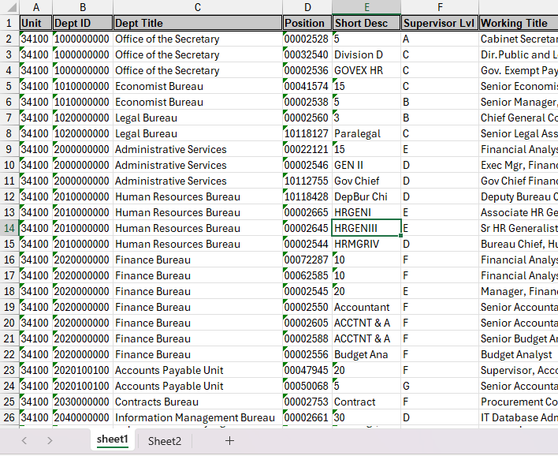
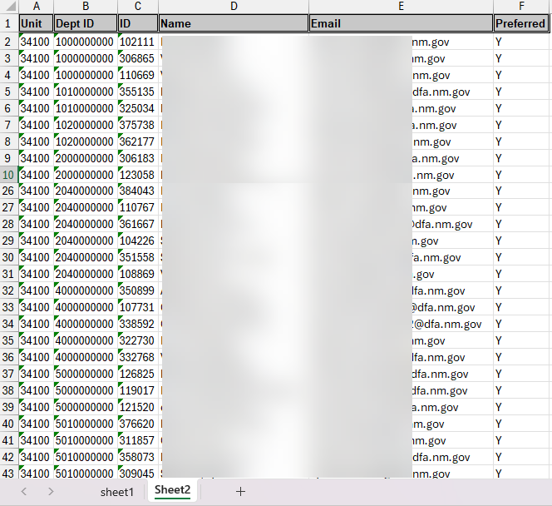
NMS_HR_ORG_LIST_REPORT
NMS_HR_BUSINESS_EMAIL_ADDR

Slide 13
Join Query data using “XLOOKUP”
To join the data on the two spreadsheets using the XLOOKUP function, you need to have a key data field that you can use to match the data up.
Both data sets contain emplid, and will be the key to matching the email address up to the employee data on the Org List query.
The standard formula for XLOOKUP is =XLOOKUP(Key Field 1, Key Column 2, Data Column 2 containing the data you want)
For this example, the 1 represents data on Sheet1 and the 2 represents data on Sheet2

Slide 14
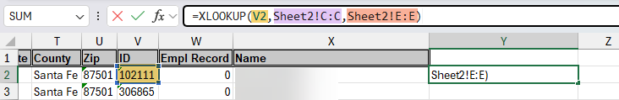
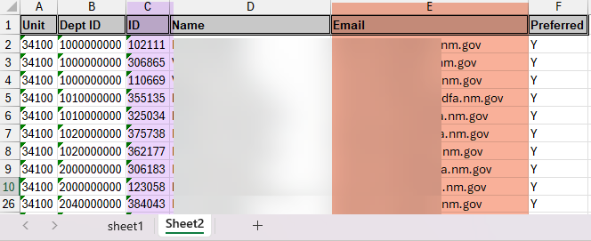
Sheet 1
Start the formula to the right of the last data column. Make sure you’re starting at the top of the spreadsheet.
Sheet 2

Slide 15
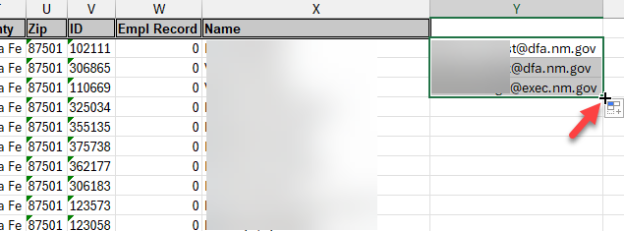
To populate the business email address for all employees, click on the bottom right corner of the field containing the formula and pull down, or double click the corner in order to populate to the end of the spreadsheet.
Large data sets may take a while to process.
Recommend copying the formula column and pasting as “values” if you want to sort the data after you have completed the Xlookup

Slide 16
Thank You

Slide 17

Central Payroll Bureau
Important Updates & Information

Slide 18
Retro Additional Pay
Agencies are submitting retro active additional pays with the explanation of SPO & DFA approved “TRET effective 7/05/25-6/30/2026”.
For these actions the DFA approval is for budget purposes. The DFA staff approving these requests are indicating that the budget was available for the time in question and current budget can support the expense. It is not an approval by DFA that the action is within the payroll rules.
Retroactive Pay Increases and Performance Bonuses: These are prohibited by the New Mexico Constitution as they constitute "extra compensation" for services already performed, violating Article IV, Section 27, and the "anti-donation clause" in Article IX, Section 14. ​ Retroactive pay increases or bonuses are considered gifts/donations of public money, which is unconstitutional.
CPB will request supporting documentation showing these requests were made prior to the effective date, or that there is a valid reason for the request. Otherwise, CPB will reject them.

Slide 19
Multiple Employment Records - 1 vs 0
January 2025, the State input National Guard Employees into HCM. Prior to January, employees could only have one active position. Because of the temporary nature of NG, they may have a full-time position with a State agency. It is imperative when a new employee is hired, that the agency review job data to verify that they do not have an active NG position. If an active NG position is set up as empl record 1, the agency will need to set up the new position with the employee record of 0. If the NG position is 0, the new position should be a 1.

Slide 20
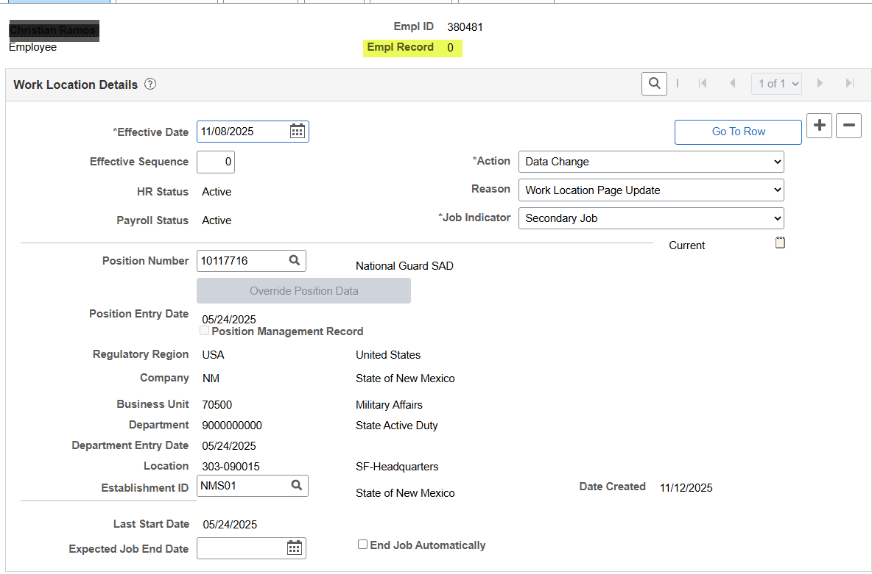
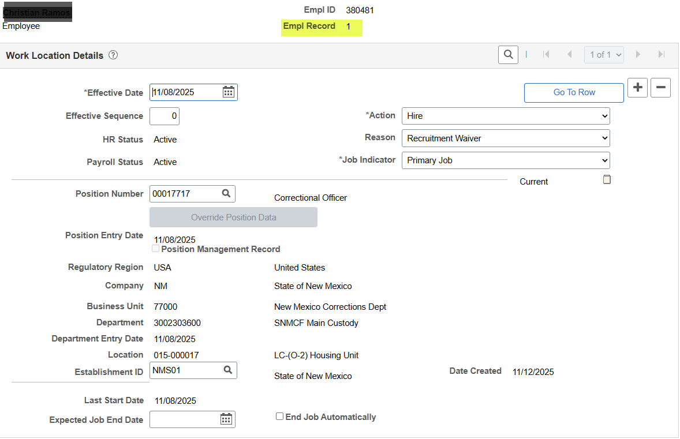
Examples:
National Guard
Full time position

Slide 21
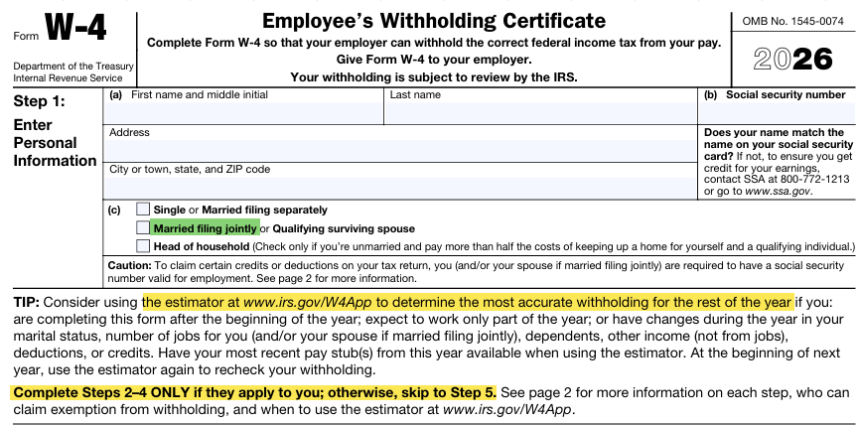
2026 W-4
Some employees are required to submit new W-4 each year. (Non-Resident Aliens and employees claiming exempt). Non-Resident Aliens should indicate at the top of the form their status.
Otherwise, a new W-4 is only required if you have a status change or need to adjust your withholdings. Most employees will only need to complete the top portion of the W-4.
Step 1 (a), (b), and (c) are required to be completed.
Follow the tip and instructions for the remainder of the form.

Slide 22
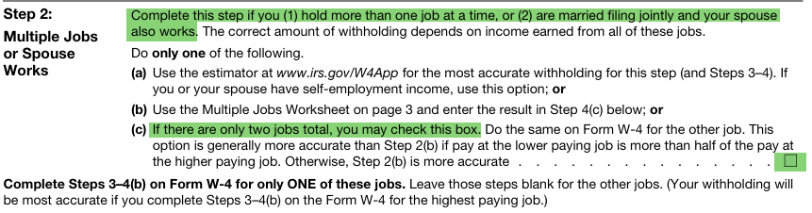
Step 2 is used if the filing status is married and your spouse works or if you are single and have multiple jobs. This is easier than trying to determine how much additional withholding is needed.

Slide 23
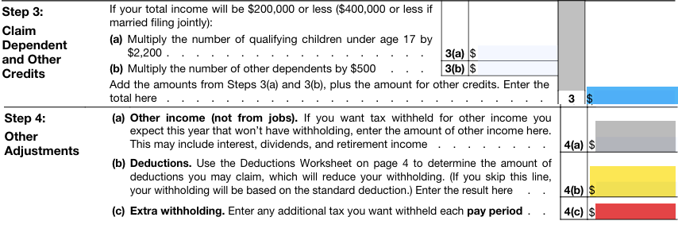
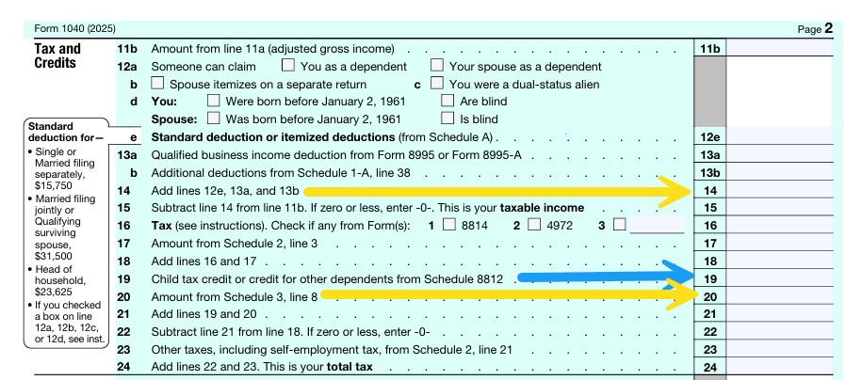
Step 3 is to add child/dependent credits (1040 Line 19)
Step 4(a) is if you have additional income (most employees do not want to report this and should use line 4c instead)
Step 4(b) is to add additional deductions (add 1040 lines 14 and 20)
Step 4(c) is for any additional withholding. This should be the amount per pay period, not per year.
Form 1040
Form W-4

Slide 24

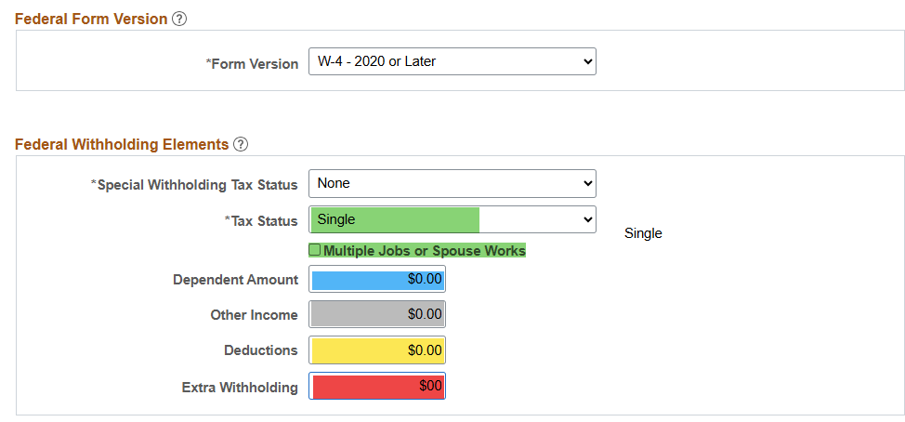
To input the W-4 in HCM, use the color coding to enter the data into the correct element.
Form W-4
Only one box can be checked in the top portion of section ( c ).
HCM Input
Use the drop downs for the appropriate tax status. Special withholding will apply to non-resident aliens.

Slide 25
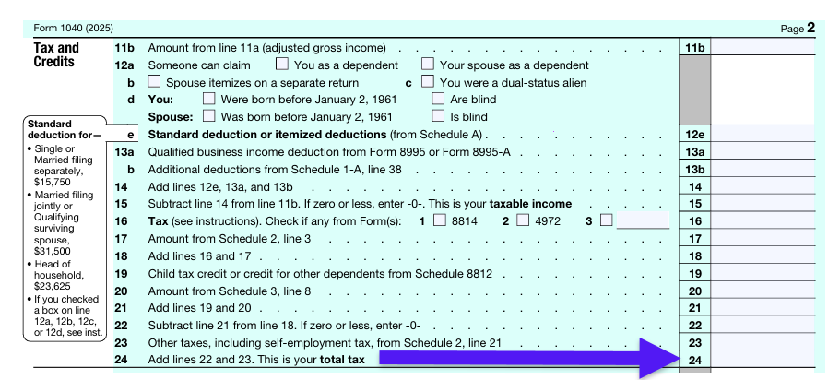
Exempt from withholding.
Very few State employees meet the requirements of being exempt from withholding. Exemption requires there to be no tax obligation in the prior year (2025) (Form 1040 line 24) and no tax obligation in the current year (2026).
The OBBB has provided several tax reduction measures that may cause line 24 to be zero in 2025.
For 2026, this would generally be a yearly salary of less than $32,200. This equates to $15.48 per hour. The State’s minimum wage is $15.00.
Employees should use the IRS tax estimator at www.irs.gov/W4App before claiming exempt.
Form 1040
Form W-4

Slide 26
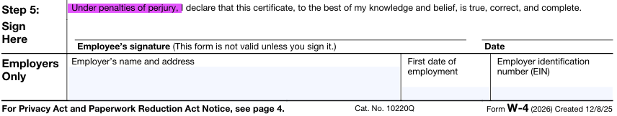
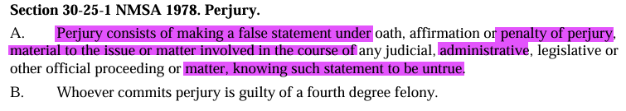
Step 5 must be signed and dated by employee and completed by employer upon acceptance.
W-4 are signed under penalty of perjury. Employers may refuse to accept a W-4 if they know the information is not accurate or if the document has been altered or changed.
Form W-4

Slide 27
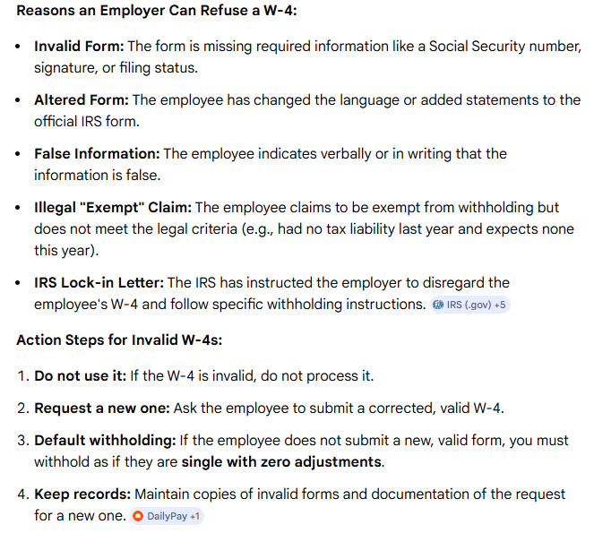
Agencies can refuse to accept a W-4 for any of the shown reasons.
If the W-4 is rejected, keep the form and document the request for a corrected W-4.
If a new W-4 is not provided, either default the employee to single with zero adjustments or maintain the last W-4 on file.

Slide 28
Payroll Withholdings
CPB does not refund withholding taxes after payroll completes. Any excess taxes withheld will be included on W-2 and can be claimed on the employee’s tax return. The only exception is if HR input the W-4 information incorrectly.
Corrections to FICA withholdings are made by the system automatically. If an employee was over or under withheld on FICA, the system will adjust the next paycheck for the difference.
Non-resident aliens have special tax rules. It is imperative that these employees are set up correctly to avoid adjustments.
All tax information is shown on employee’s W-2. A new code OBBBOT indicates the amount an employee can deduct for overtime.

Slide 29

W-2 Requests/Issues
Duplicate W-2
Thank you for not submitting requests for duplicate W-2 unless requested after February 15th. We have gone from over 800 requests last year to about 120 requests this year.
National Guard are receiving W-2 this year instead of 1099. If you get a question on why they received a W-2 when they are not a State employee, it is generally because they served in the Guard.
If an employee notifies the agency that there is an issue with their W-2, please reach out to CPB for assistance. If there is a SSN issue, those must be corrected immediately.

Slide 30
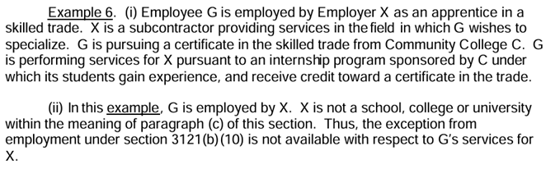
F-1 Visa Holders
Several F-1 Visa holders are requesting refunds of FICA taxes.
Refer them to the IRS website:
https://www.irs.gov/charities-non-profits/student-exception-to-fica-tax
Page 23 Example 6:

Slide 31
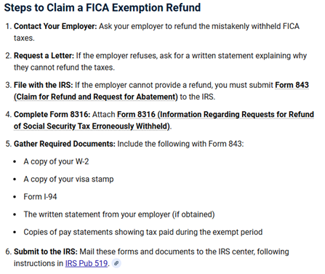
If they still disagree, they can apply to the IRS for a refund.
Provide them with the instructions on Steps to Claim a FICA Exemption refund (shown on the right).
Provide them with a copy of the letter from CPB (link below).
https://acrobat.adobe.com/id/urn:aaid:sc:va6c2:a7b56bbf-afb4-414f-bf80-58f165af6493

Slide 32
Health Benefits Update – CPB Form Changes & Benefit Plan Codes
Benefit Refund and Deduction Forms
  Benefit Plan Code fields are now open so agencies must ensure to input the correct Benefit Plan Codes
Dental Benefits (Effective January 2026)
2 New Dental Provider Options Available
Delta Dental
MetLife
Vision Benefits (Effective January 2026)
Vision Provider change from: EyeMed to Davis Vision

Slide 33
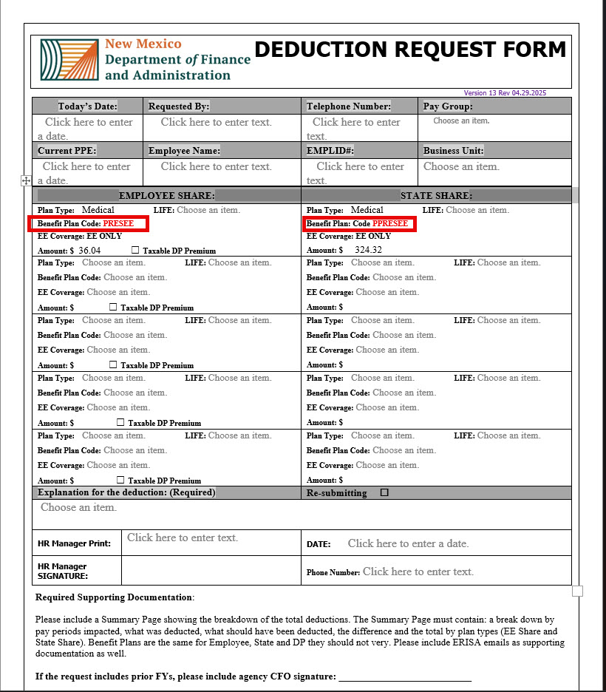
Health Benefits Form Update
How to Locate and Enter Your Benefit Plan Code in HCM
🔔 Important Reminder
You must input the correct Benefit Plan Code from Health Benefits (in HCM) onto the form.
Locate Your Plan Code in HCM
  Menu→Benefits→Enroll in Benefits→Health Plan Enrollment
Select Plan Type = Medical.
Locate the Benefit Plan field.
Benefit Plan Code:PRESEE
This plan code is for: Pres HMO EE ONLY <50K

Slide 34
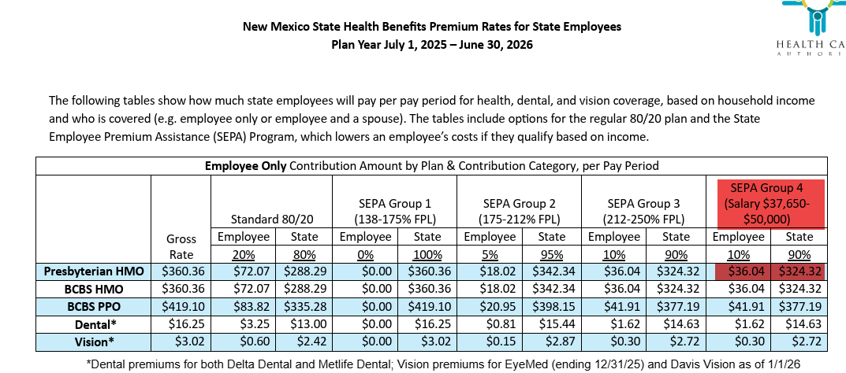
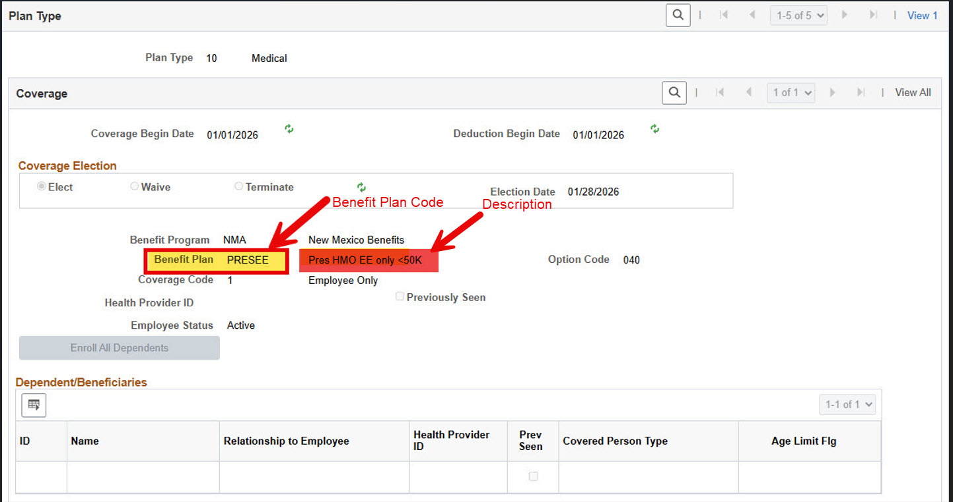
Health Benefits Update – Form Changes & Plan Codes
Menu→Benefits→Enroll in Benefits→Health Plan Enrollment

Slide 35
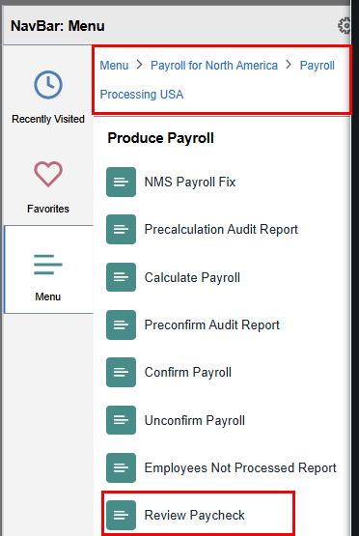
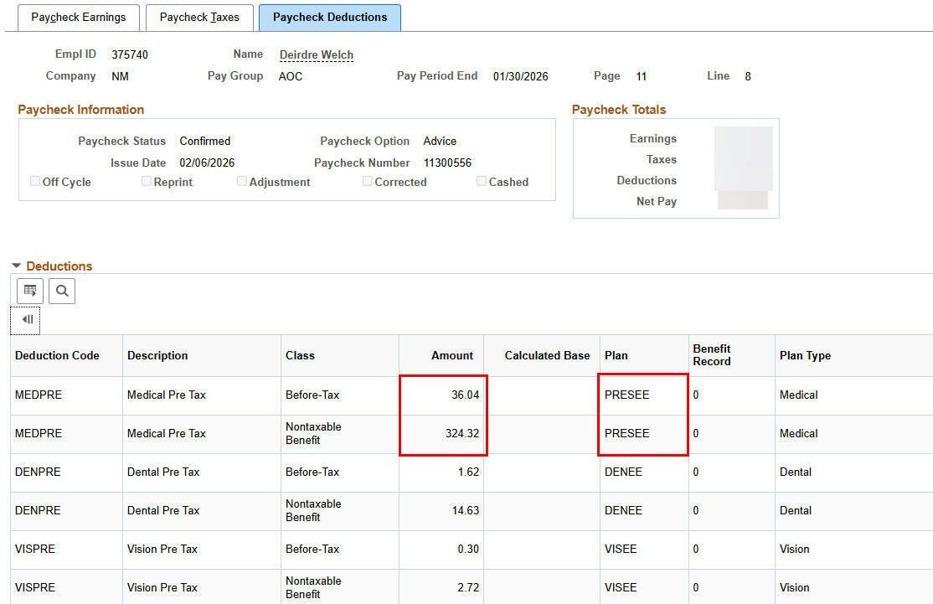
Review Paycheck & Plan

Slide 36
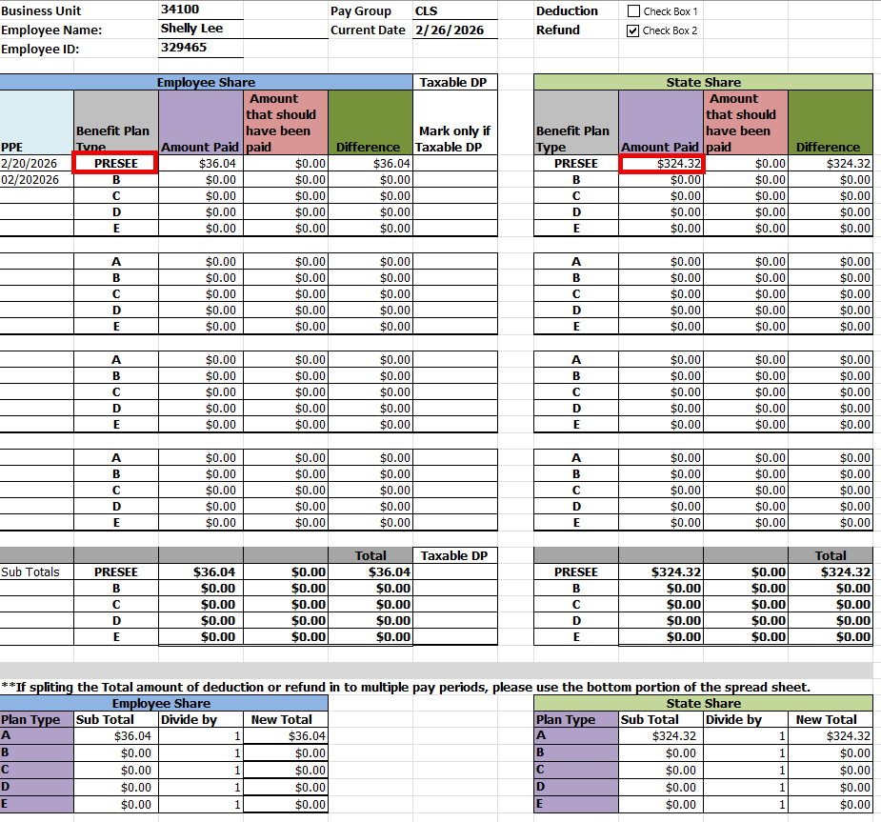
Summary Page

Slide 37
To do list:
Any employee currently claiming exempt from withholding must complete a new W-4. If agencies have not received a new W-4, change their withholding to single by next pay period.
Each agency needs to designate a FSS Administrator by filling out the Forms Submission System Administrator Access Agreement
Deceased Employee –deceased employee whose payroll funds are still being held—Agency should reach out to family to get these funds released.

Slide 38
Payroll 101
Payroll 101 Course coming soon!

Slide 39
CPB Trainers
Central Payroll Trainers Open Hours
The Central Payroll Training team will hold an open Teams meeting weekly on Wednesdays from 2pm to 4pm.
Anyone can join at anytime within those hours to ask questions regarding Central Payroll Forms, existing requests in the FSS or the FSS in general.
This is also a great way to share best practices with you peers regarding the FSS and the forms.
Teams Meeting Link: https://tinyurl.com/CPBTrainers
Just a note, this will be an open forum where people from any State agency can join, so please refrain from sharing sensitive information during this time.

Slide 40
Payroll Resources
Central Payroll Trainer
Claudette Romero, Payroll Trainer P:(505)376-3067 E: Claudette.Romero@dfa.nm.gov
  Preferred E-mail: CPBTrainers@dfa.nm.gov
Central Payroll Web page
https://www.nmdfa.state.nm.us/financial-control/central-payroll-bureau
Department of Finance & Administration YouTube Channel
https://www.youtube.com/@nmdfa8097

Slide 41
Thank You

