Slide 1


HCM Quarterly Meeting
Presented by Central Payroll & the SHARE Team

Slide 2


SHARE HCM Team
Important Announcements

Slide 3
SHARE AGENDA
6/2/25 – Combo Code Update Process
7/1/25 – Longevity Pay
7/5/25 – Benefit Changes
7/5/25 – Legislative Salary Increases
8/22/25 – Multi Factor Authentication
Query Catalog

Slide 4

FY26 Combo Code Updates 06/02/25 – 6/20/25
Combo Code Update Process –
The process to mass update combo codes assigned to task profiles will happen June 1st. Central Payroll will cover more on this topic in later slides.
Combo Code Overrides on Timesheet–
Because the FY26 begin date July 1st is in the middle of the 2nd week of a pay period, to enter combo code overrides on the timesheet with combo codes that are effective July 1st 2025 will require a change in the timesheet view to be able to select the combo code.
If an employee enters a combo code on the timesheet that contains a bud ref/class belonging to FY25 on or after July 1, an exception will be generated.

Slide 5
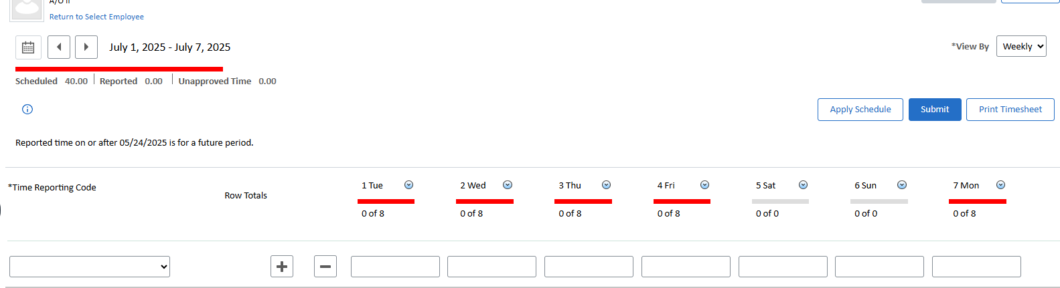


FY26 Combo Code Updates
Combo Code Overrides on Timesheet
1. Click on View By (top right of the timesheet) and select Week
2. Click the calendar icon (top left of the timesheet) and select 7/1/25
  This will change the timesheet view to begin on Tuesday July 1st and will allow you to select the combo code for the override that’s effective dated 7/1/25.

Slide 6
Longevity Pay –7/1/25
Longevity Pay will go into effect on July 1, 2025, meaning all eligible employees will see “LGV – Longevity Pay” on their July 11, 2025, paycheck.
Eligible Employees:
Employees in the CLSS, GOVX, or STPL Sal Admin Plans.
Employees with >5 years continuous service as of 06/30/2026.
Ineligible Employees:
Probationary Employees
Salaried Employees
Temporary Employees

Slide 7
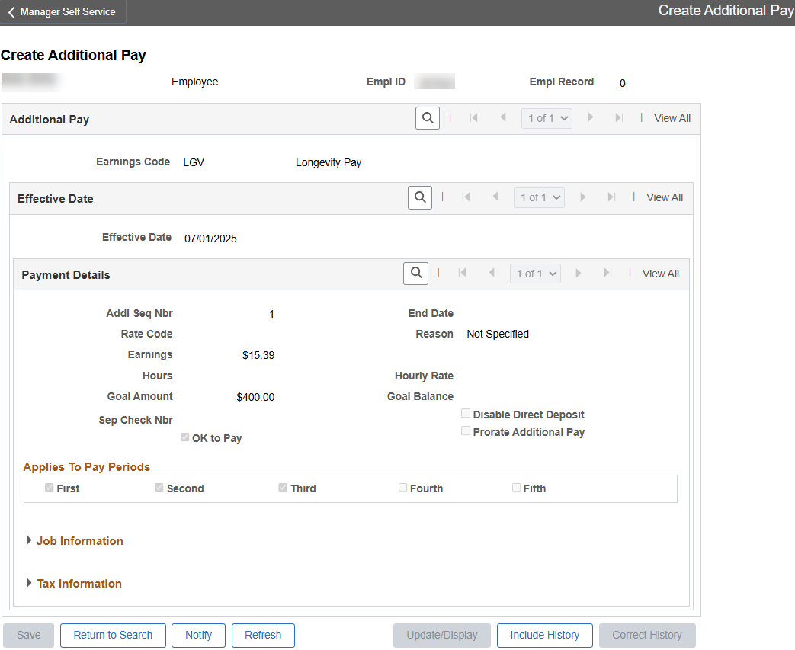
Longevity Pay — Additional Pay
Longevity Pay will be administered through Create Additional Pay. Agencies will have view-only access to this page.
We anticipate loading the longevity pay data to this page on June 27th.
Navigation: Menu -> Payroll for North America -> Employee Pay Data USA -> Create Additional Pay

Slide 8
Longevity Pay — Other Notes
Employees who terminate state employment or transfer to an ineligible position will have their Longevity Pay ended. If they terminate/transfer mid pay period, the employee will still receive the longevity for that pay period. No action is required to end the Longevity Pay; a weekly process will programmatically stop the payments.
Longevity Pay Table
Tier | Years of Continuous Service (6/30/26) | Payment Per Pay Period * | Annual Amount
Tier 1 | 5 – less than 10 | $15.39 | $400.00
Tier 2 | 10 – less than 15 | $30.77 | $800.00
Tier 3 | 15 – less than 20 | $38.47 | $1,000.00
Tier 4 | >20 | $46.16 | $1,200.00
*The pay period amounts are applicable to 25 payments. The 26th payment will be slightly lower to prevent exceeding the annual amount.

Slide 9
Longevity Pay Queries
NMS_HR_LONGEVITY
  This query provides the employee’s continuous years of service and the biweekly amount they will receive.
NMS_PY_LONGEVITY_PMTS
  This query provides the LGV amount on the employee’s paycheck. You can run this query for a specific date range (e.g., 07/04/2025 – 12/19/2025).
NMS_PY_ADDITIONAL_PAY_BY_BU
  This query identifies employees with an active Additional Pay. It also displays the total amount of Longevity Pay the employee has received.

Slide 10
Benefits Update– 07/05/25
There will no longer be a tiered benefit system (A, B, C)
All employees will be moved into the base tier (20/80 split) with an effective date of 7/5/25
HR will not need to make any changes. This move will be handled by the SHARE Team
Some employees may qualify for SEPA (State Employee Premium Assistance). EasiGov will do the setup on these employees.

Slide 11
Benefits Update– 07/05/25
Premium Breakdowns by percentage Employee/Employer
Most employees will be in this category
Elig Fld 1 | Blank (or A, B, C) | FPL1 | FPL2 | FPL3 | EEONLY | SP | LD
Household Type | All Others | SEPA Group 1 138-175% FPL | SEPA Group 2 >175-212% FPL | SEPA Group 3 >212-250% FPL | EE<50K | Non-Medicaid Elig | Line of Duty
EE Only | 20/80 | 0/100 | 5/95 | 10/90 | 10/90 | 0/100 | 0/100
Employee + Spouse | 20/80 | 0/100 | 5/95 | 10/90 | -- | 0/100 | 0/100
Employee + Children | 20/80 | 5/95 | 10/90 | 15/85 | -- | 0/100 | 0/100
Family | 20/80 | 5/95 | 10/90 | 15/85 | -- | 0/100 | 0/100

Slide 12
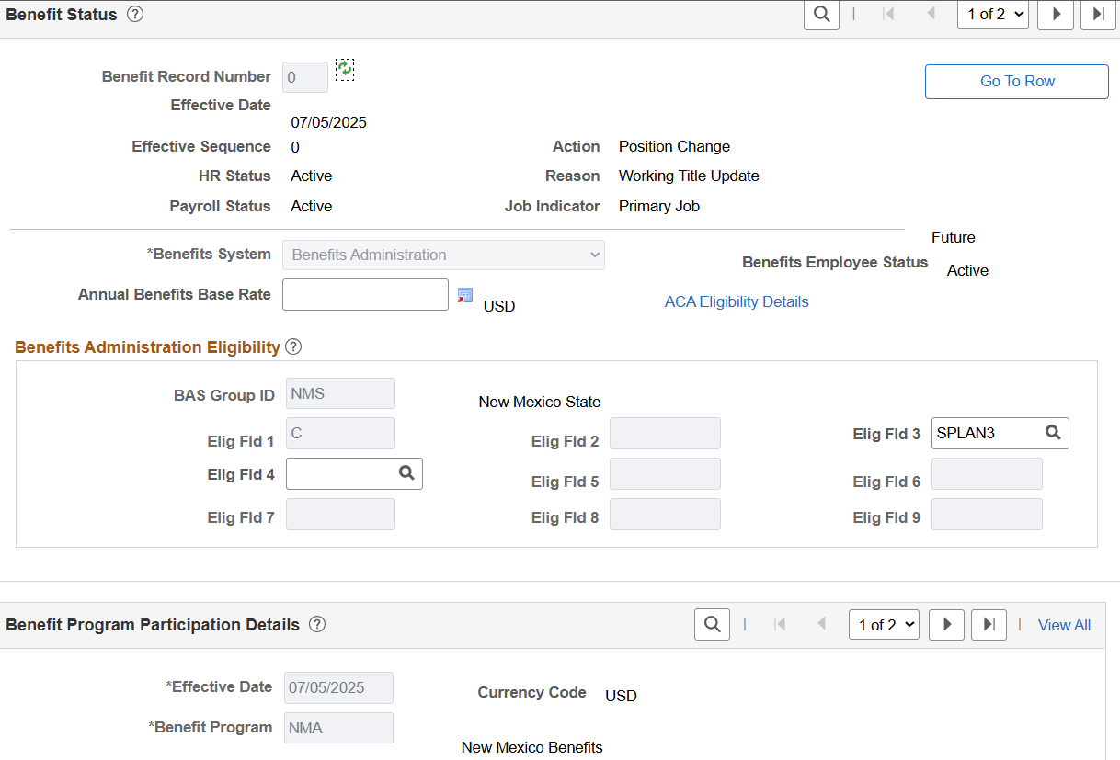
Eligibility Fields 3 and 4 will be the only ones available for election.
All other elig fields are for use by HCA/EasiGov
Going forward, Elig Fld 1 will be blank for all new hires. We will work towards removing A, B and C from all active employees. EasiGov will use this field for SEPA qualified employees.

Slide 13
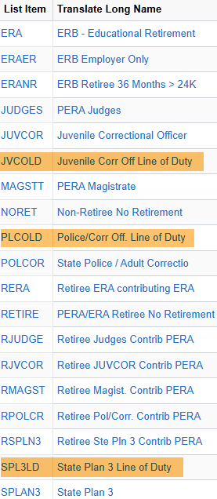
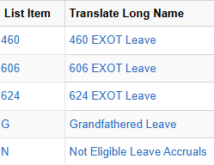
Do not select the highlighted values. These are special use only.
Do Not enter a value into Elig Fld 4 unless your agency uses one of the valid values for leave accruals.

Slide 14
Benefits Update– 07/05/25
If you or your employees have questions about benefits eligibility for FY26, contact HCA at
SHB.Questions@hca.nm.gov

Slide 15
FY26 Legislative Salary Increase 7/5/25
4% increase will be calculated based on the NAHRLY rate in effect on the max row dated 7/5/25
Employees must have completed their probationary period and must have a satisfactory EDA rating
The salary increase process will be run some time between 7/9/25 and 7/11/25. A notice will be sent out once the process has run.
Temporary and EXOT employees are excluded as are employees in the “INACTIVE” workgroup

Slide 16
FY26 Legislative Salary Increase 7/5/25
What you must do—
Have all EDAs entered prior to 7/8/25 (effective dated 6/30/24-7/4/25)
Update the expected end date on Job Data for all employees whose expected end date is less than or equal to 7/5/24 (query: NMS_HR_JOB_END_DATE)
Do not enter any job rows dated greater than 7/5/25 until you have been notified that we have run the increase process.

Slide 17
FY26 Legislative Salary Increase 7/5/25
Once the process has been run, review your employees.
Query: NMS_HR_EMPL_COMPENSATION
If you think an employee has erroneously received the increase, or should have received the increase, please reach out to SPO or your sal plan administrator. They will work with you and instruct you on next steps, if necessary.

Slide 18
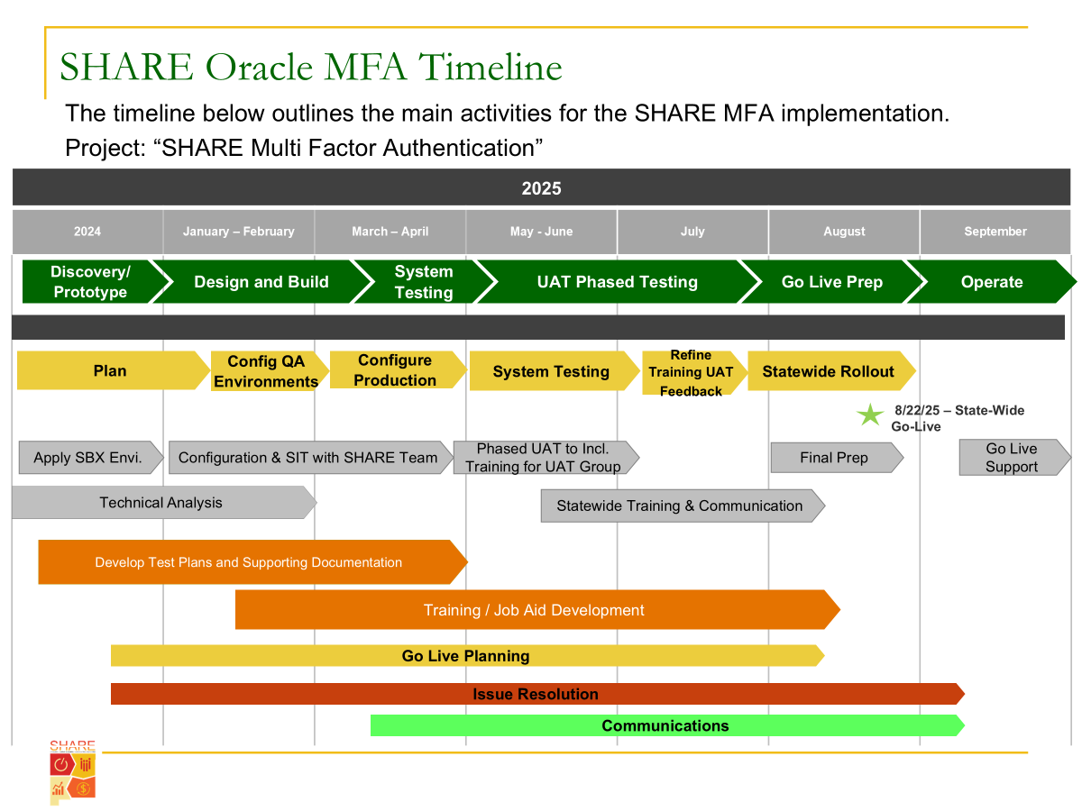
Title

Slide 19
Query Cleanup and Cataloging
The SHARE team is continuing its efforts to consolidate queries. Currently, we are looking at cleaning up and consolidating leave balance queries. The HR community will be notified via email of any changes before they occur in SHARE.
The NMS_QUERY_CATALOG query provides useful information on commonly used queries in SHARE. This is an ongoing project, and more queries will be added to the catalog over time. If you are looking for a specific query that is not in the catalog, you should still be able to find it through the query search function.

Slide 20
Thank You

Slide 21
Central Payroll Bureau

Slide 22

GASB 101 UPDATES
GASB 101 Compensated Absences
Governmental Accounting Standards Board (GASB) has issued statement 101 which changes the way agencies must recgonize compensated absenses on their finanacial statements.
DFA is currently working with an outside contractor to provide guidance on how to calculate these changes. New queries will be provided before the end of the fiscal year to assist with these calculations. The new rule requires we consider not just sick and annual leave, but all leave balances that are recorded on employees accounts.
This is normally financial accounting staffs responsibility, but may require HR/PR staff to run queries in HCM. Additionally, your knowledge of how these leaves are earned and recorded maybe required to identify which leaves should and should not be considered in these accruals. This is a significant change from prior years so please work closely with your financial accounting staff as the accrual is anticipated to be highly scrutinezed by auditors.

Slide 23
M.A.P.S 2026
MAPS 2026
1.) Social Security Masking
2.) PR 7.1 Forms Submission System (FSS)
3.) Withholdings due to overpayments
4.) Benefits when an employee is on a Leave of Absence
5.) Correcting payroll journals
6.) Settlement agreements
All agencies should review MAPS at minimum yearly, to ensure that they are following the requirements and up to date on changes.
Notes:
I looked at the changes indicated by the blue font on the MAPS update file. May need to add or remove information on this slide a.g.

Slide 24

Settlement Requirements
PR 2.6 in MAPS
Any agreement by a representative of the State that requires payment through the payroll system must first be approved by the parties to the dispute. If the represented agency is part of the Executive Branch, the approval of the SPO Secretary is also necessary.
After the document is approved as outlined above, the designated agency should reach out to PERA to find out if any necessary contributions need to be withheld from the settlement amount. Should a PERA interest be assessed, the deductions must be made prior to submission to payroll
After a PERA contribution determination is established, the agency concerned must reach out to their State Budget Analyst to verify the budget's ability to support the settlement amount.
Once the agency receives a PERA determination and budget capacity approval from the State Budget Division, it may submit the settlement agreement to the Office of General Counsel at the Department of Finance and Administration for review. The Office of General Counsel will check for the necessary approvals and assist in facilitating the Secretary of Finance and Administration's execution of the Settlement Agreement.
Notes:
Created the place holder for End of Fiscal Year Processes.

Slide 25
Settlements (continued)
Following approval by the Secretary of Finance and Administration, the agency may submit the settlement agreement to payroll for payment of the agreement. Please note that these payments are made only after the payroll has completed the regular payroll cycle. Agencies must submit the following documents to the Central Payroll Bureau for payment of the settlement amount:
1. A redacted version of the settlement agreement with all approval signatures or transmissions.
  2. A statement from PERA regarding the contributions due based on the agreement.
  3. A letter addressed to the Chief of the Central Payroll Bureau, signed by the agency's Human Resource (HR) manager and Chief Financial Officer (CFO), requesting the Department of Finance and Administration (DFA) to process the payment. This letter should contain:
    A summary of the amounts to be paid in the settlement through payroll;
    Effective pay period start and end dates;
    Gross pay deductions, such as unemployment insurance collected and amounts earned at other employment by pay period, as stated in the settlement agreement, along with all documentation for any gross pay deductions.
    Identification of what deductions to withhold in addition to applicable taxes.
    Any deductions for PERA and Retiree Health Care that should be withheld.
    If the settlement is subject to PERA deductions with interest, the memo should state that arrangements have been made to pay all amounts due directly to PERA.
  4. Authorization for DFA to approve on your agency's behalf anytime your agency does not have access to approve in the Time and Labor module of HCM.
  5. An Excel spreadsheet displaying gross pay due by pay period, along with applicable benefit deductions.
  Completed settlement packets must be submitted through the FSS.
CPB will process the settlement and notify the agency when the warrant is ready for pickup or distribution.

Slide 26
Social Security Verification
Taxpayer Identification Number (TIN) Matching
CPB will be sending out TIN mismatch lists to agencies monthly beginning in July. If an agency receives a notice, they should use the below guidelines for corrections/validation. In all cases, a copy of the employee’s Social Security card should be requested.
2 – indicates TIN entered is not currently issued. Employee must provide proof of Social Security number validated by SSA.
3 – indicates the name/TIN combination do not match IRS records. HCM must match Social Security card. If the employee has a name change and did not notify SSA, then they must either notify SSA and provide a SS card with the correct name, or HCM must be changed to reflect the exact name on the SS card presented.
4 - indicates an invalid TIN Matching request. Employee needs to reach out to SSA and provide validation of their SS #.
5 – indicates a duplicate TIN Matching request. Employee needs to provide validation of their SS#.
If a Social Security number is changed, PERA or ERB must be notified.

Slide 27
HB43
PERA SERVICE CREDIT FOR CERTAIN INJURED MEMBERS ON APPROVED WORKERS' COMPENSATION LEAVE.
If the employee was injured while performing a work-related function in an inherently dangerous location or under inherently dangerous circumstances is absent from work and has been placed on approved workers’ compensation leave as a result of the injury shall accrue service credit for the period of absence from work while on workers' compensation leave
The member's affiliated public employer pays the injured employee's member contributions as well as the employer contributions and remits to the association the total amount of employee and employer contributions that would have been paid if the member had not been absent from work while on approved workers' compensation leave. The contribution amounts shall be calculated based upon a salary equal to the member's salary at the time of the injury.

Slide 28
End of Fiscal Year Reconciliation
Year-End Payroll Reconciliation
Year-end payroll reconciliations are important to ensrue budgets that were allocated to various funding sources are properly recorded in HCM and FIN.
All agencies are required to reconcile their payroll to ensure proper funding sources have been allocated to the correct accounting lines.
It is critical that agencies reconcile their payroll timely and report any discrepancies prior to Year-end closing.
Year-end payroll processes typically take a bit longer and journals may not be posted as quickly as any other payroll cycle, partly due to two fiscal year-end dates that the system must process.
Be prepared for any questions Central Payroll may have when PR Journals are being processsed and posted to the General Ledger
This Year we will be running an off-cycle payroll to ensure any manual warrants are issued and posted at the correct pay rate.
Notes:
Created the place holder for End of Fiscal Year Processes.

Slide 29
End of Fiscal Year Reminders
Don’t Forget!
Final pay for FY25 will be PPE 07/04/2025. The Payroll Cycle will record the appropriate expenses in the fiscal year they were incurred. Agencies do not need to accrue payroll expenses.
Any additional pay, payroll corrections or changes needing input after July 4th for FY25 must be signed by the CFO or they will be returned.
Budget will need to be entered for the new fiscal year prior to posting of the July 4th payroll.
Bud Ref & Class will be automatically updated for combo codes without a project. Any Combo Code that contains a project code will need to be manually updated by the agency.

Slide 30
Bud/Ref Update
Task Profile ID and Department Budget Table Update
The new fiscal year requires changes to task profiles for budget references and class codes. The SHARE team will run a process to update all task profiles with a 7/1 effective date.
The Automated combo Code Process will be run on June 1st 2025.
This process looks at all active task profile IDs and updates them if they meet the following criteria:
1. If the task profile ID contains a combination code with budget reference 125 and class I0000 (values for FY25), the process inserts a 7/1/2025 row and updates the budget reference to 126 and class to J0000 (values for FY26).
2. If the task profile ID contains a combination code with budget reference 925 and class I0000, the process inserts a 7/1/2025 row and updates the budget reference to 926 and class to J0000.

Slide 31
Bud/Ref Update
The automated process does not update the task profile ID if it does not contain either of the budget reference/class combinations listed above. If you have any task profile IDs that were not updated and need to be updated for the new fiscal year, you are responsible for updating them manually. The following HCM query identifies all task profile IDs, both active and inactive, for your agency:
NMS_CA_TASKPROFILE_ALL_BY_BU
Larger agencies are advised to schedule this query. When running this query, you will be prompted for your business unit and an ‘As of Date.’ Enter an ‘As of Date’ of 7/1/2025 in order to see the updates made to the task profile IDs for the new fiscal year. If a task profile ID has been incorrectly updated, you can delete the 7/1/2025 row as long as you are completing the deletion action prior to 7/1/2025 (the system allows you to delete future dated rows without the use of “Correct History”). Once you have deleted the 7/1/2025 row, you can leave the task profile ID as is, or you can add a 7/1/2025 row back in with the correct accounting information

Slide 32
Bud/Ref Update
The automated process that updates the combo codes for the task profile ID also updates the combo codes specified in the department budget table, as long as it meets the same criteria as mentioned for the task profile IDs. The Department Budget Table is important because it gives the system a default combo code to use if it cannot determine where it should charge an employee’s payroll. Therefore, it is important to keep the combo codes within the department budget table up-to-date. The following query has been created to assist you in identifying the combo code assigned to the Department Budget Tables for each fiscal year:
NMS_CA_DEPT_BUDGET_TBL_COMBOCD
This query prompts for fiscal year and business unit. Enter fiscal year 2026 to see the accounting information that has been assigned to each department. If this information needs to be updated, please contact the Central Payroll Bureau. Provide a spreadsheet with the correct chartfield information, including the combination code (if known).

Slide 33

Benefit Correction Refunds Changes
The New Mexico Healthcare Authority (HCA)will be handling most of the benefit corrections forms that are the result of a refund. This process is for all State agencies.
HCA only has access to submit and view Benefit refunds and deductions in FSS.
As an agency you will still see the requests submitted by HCA on your behalf in the FSS and it is recommended to review these requests in case your employee has any questions.

Slide 34
Direct Deposits
Direct Deposit Security & Accuracy
Direct Deposit setup and changes continue to create issues due to mistakes and errors.
Identity theft and fraud are on the rise and changes to direct deposit are the #1 issue seen in payroll fraud.
Inputting incorrect or incomplete information when setting up or changing a direct deposit can delay your employees receiving their pay on time.
These mistakes also mean more unnecessary work for the HR team.
Always double check or triple check all information input for direct deposits

Slide 35
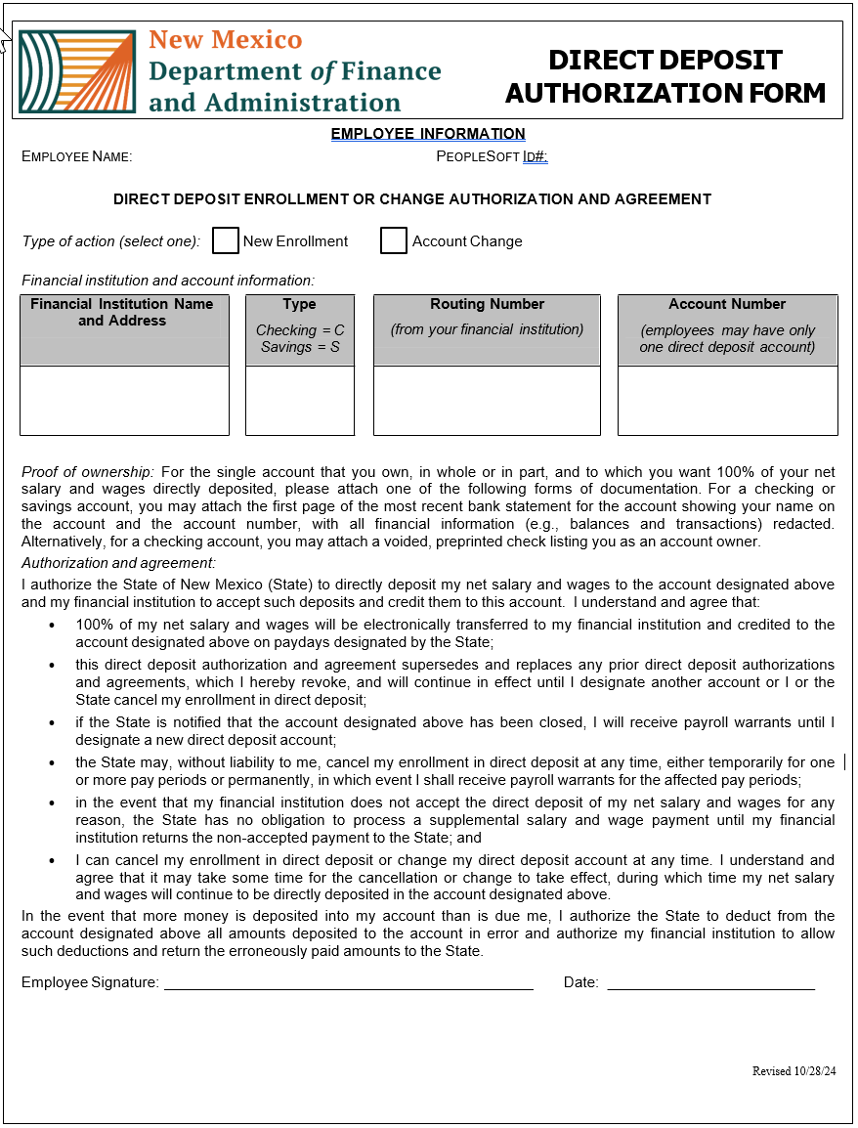
Reminders when entering direct deposit information.
All employees direct deposit additions or changes are completed by the hiring agency. Central Payroll will not add or change an employee’s direct deposit.
All Direct Deposit input must have the appropriate documentation before being input into HCM.
Required Documentation:
  Direct Deposit Authorization form, signed, and dated.
  The first page of the MOST RECENT bank statement for the account, showing the employee’s name on the account and the account number with all the financial information redacted.
  OR for a checking account, a voided pre-printed check listing the employee as the account owner

Slide 36
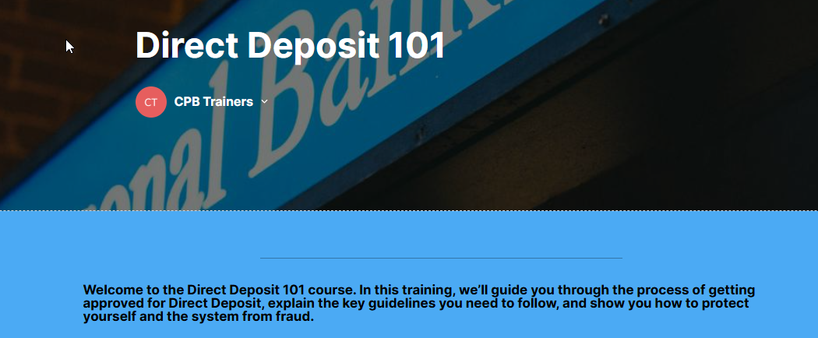
Direct Deposits
New ELM course coming soon!
A Direct Deposit ELM course is in development and will be required for any employee who currently has direct deposit access, as well as any employee requesting access.
You will need to submit your ELM-generated certificate as well as the Direct Deposit Confidentiality Agreement to Central Payroll via the Forms Submission System(FSS) when requesting access.
Reminder CPB restricts the number of employees that can have Direct Deposit access within an agency .

Slide 37
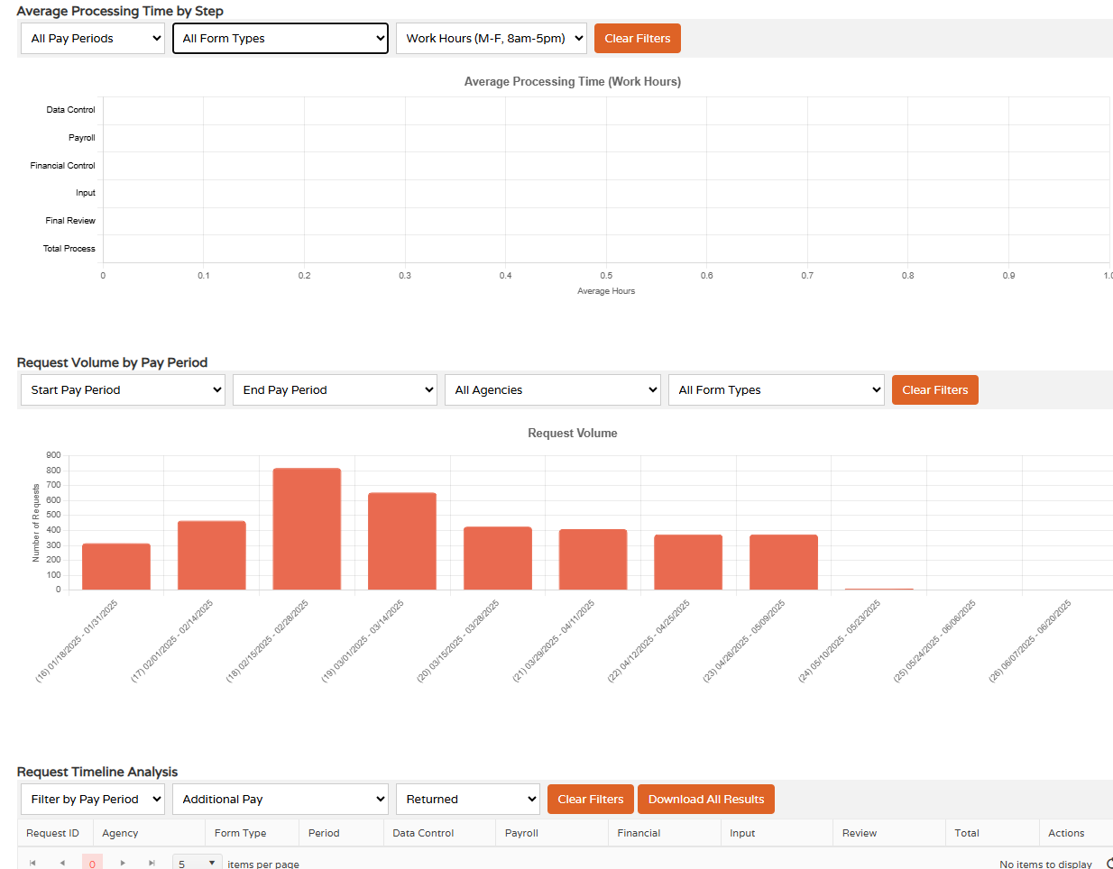
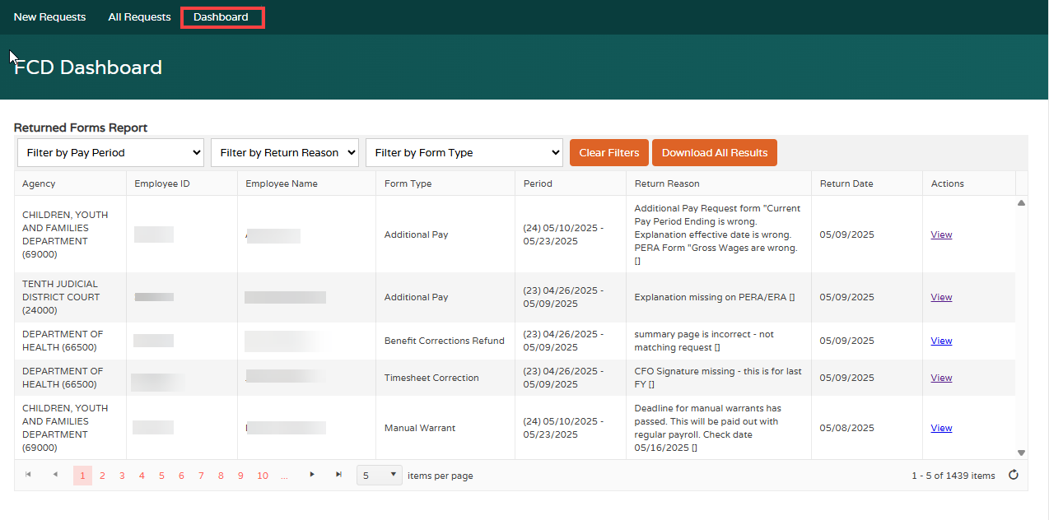
Updates to FSS!
FSS Dashboard in progress!
This dashboard will have multiple uses and will give a variety of information that agencies will be able to use to track the efficiency and quality of submissions.

Slide 38
Cleaning up FSS
To help ensure the metrics being pulled into the reporting tools are as accurate as possible it is essential that you keep your FSS requests up to date.
We currently have over 200 requests that are in the “Returned” status.
This status indicates that the request is currently awaiting the agencies next step and Central Payroll cannot do anything with this request until this status changes.
Requests per PPE:
PPE 01/31/25 – 11 PPE 02/14/25 – 36
PPE 02/28/25 – 47 PPE 03/14/25 – 21
PPE 03/28/25 – 12 PPE 04/11/25 – 21
All these requests need to be corrected and resubmitted or canceled.
*If you experience issues or errors when attempting to cancel a request, please submit a ticket to the RTS help desk via email at: support@rtsolutions.com

Slide 39
CPB Trainers
Central Payroll Trainers Open Hours
The Central Payroll Training team will hold an open Teams meeting weekly on Wednesdays from 2pm to 4pm.
Anyone can join at anytime within those hours to ask questions regarding Central Payroll Forms, existing requests in the FSS or the FSS in general.
This is also a great way to share best practices with you peers regarding the FSS and the forms.
Teams Meeting Link: https://tinyurl.com/CPBTrainers
Just a note, this will be an open forum where people from any State agency can join, so please refrain from sharing sensitive information during this time.
Notes:
Will need to verify with Elizabeth Jaramillo if we are allowed to use TinyURL.

Slide 40
Payroll Resources
Central Payroll Trainers
Alex Guzman, Payroll Trainer Supervisor P:(505)469-2910 E: Alejandro.Guzman@dfa.nm.gov
Claudette Romero, Payroll Trainer P:(505)376-3067 E: Claudette.Romero@dfa.nm.gov
  Preferred E-mail: CPBTrainers@dfa.nm.gov
Central Payroll Web page
https://www.nmdfa.state.nm.us/financial-control/central-payroll-bureau
Department of Finance & Administration YouTube Channel
https://www.youtube.com/@nmdfa8097

Slide 41
Thank You

