Slide 1


HCM Quarterly Meeting
Presented by Central Payroll Bureau & the SHARE HCM Team

Slide 2


SHARE HCM Team
Important Announcements

Slide 3
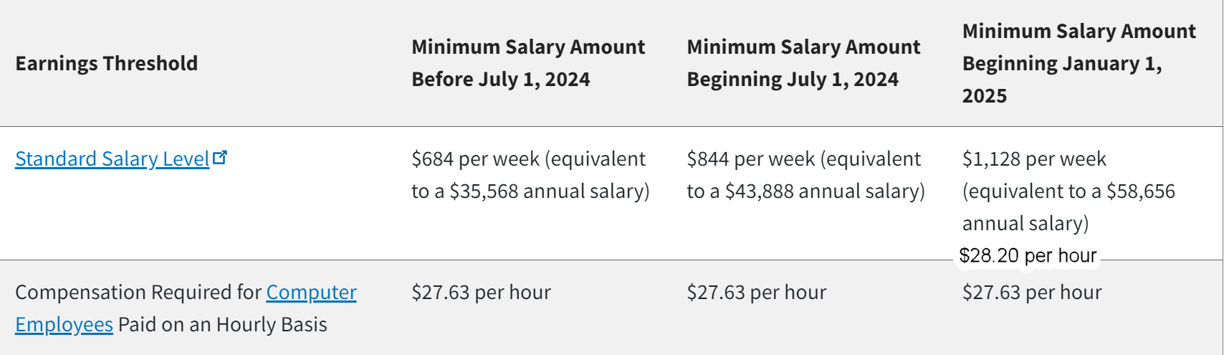
FLSA Changes Effective Jan 1, 2025

Slide 4
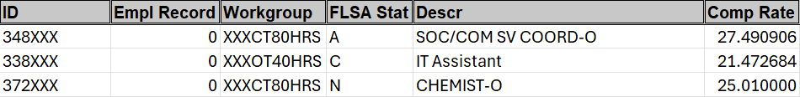
2025 FLSA Changes
1. Run query: NMS_HR_FLSA_THRSHLD_2025
2. Determine if the employee’s pay needs to change, if the FLSA status needs to be changed,
and/or the workgroup needs to be changed.
3. Work with your sal plan administrator if you have questions. For assistance with
system processing, contact the HCM help desk: EnterpriseSupportDesk@doit.nm.gov

Slide 5
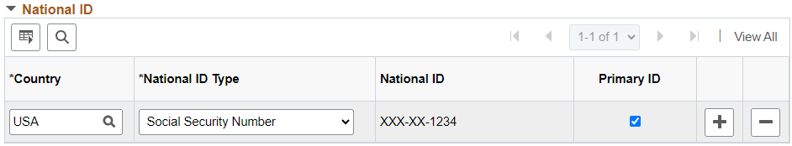
SSN Masking
Beginning soon, SSNs will be masked throughout HCM. If you need to know an employee’s full SSN for business purposes or to make a correction, contact Central Payroll Bureau for assistance.

Slide 6


New Security Form
The SHARE Security Team is rolling out a new form effective today. The form is available on our website here:
    https://info.share.nm.gov/ (Navigation: HCM Dropdown menu > User Access Form)
Make it a part of your business process to submit a form for new hires, transfers (including promotions, if the job duties are changing), and terminations (if the employee has more than self-service access).
We will no longer be auto-assigning the Time Approver role to an employee listed as a direct report, or an additional approver. If a manager/supervisor needs to approve time for employees, you must submit a security form and select the Time Approver Role under the non-HR section of the form. This only applies going forward, though we will be cleaning up employees who have the role but do not approve time.
“Approval in Process” issue: If a manager does not have the approval role before their employee(s) submit time, OR if the manager has locked themselves out of HCM and the employee(s) report time while the manager is locked out, the manager will not be able to approve this time and will get a message of “Approval in Process”. The best way to deal with this is for HR or a different manager to approve this time on behalf of the manager who sees this message.

Slide 7
T&L Approvals
Additional Approver Tips
Run the query NMS_TL_ACTIVE_EE_REPORTS_TO_BU for active employees with reports-to manager and any additional approvers assigned
Blanks in reports-to or additional approver columns mean positions that are unfilled
Reports-to manager should not also be listed as an additional approver
Effective date on additional approver means the start date for access to approve that employee’s time
Time already entered and needing approval will be displayed as “Approval in Process”
Time entered after the save edit of additional approver and after effective date should allow for approval
Manager Locked Out – if a manager is locked out (password issue), time entered during the lockout will not be part of approvals
Once the lockout has been corrected, managers can approve time entered from that point forward

Slide 8
T&L Approvals
Additional Approver Enhancements
New functionality for additional approvers is on the way
Save edit to not allow assigning positions with a different Business Unit
Nightly process to clean up existing data when an employee transfers to another Business Unit
Process will insert a new effective dated row and remove invalid additional approvers
Approvals Reminders
    Employees not setup with Time Reporter Data will not be seen in Fluid Timesheets and employee may not access their timesheet
    Agencies may grant time approvers agency-wide on the adhoc approval table (should be reserved for HR personnel or those needing agency-wide approval access)-submit a help desk ticket

Slide 9
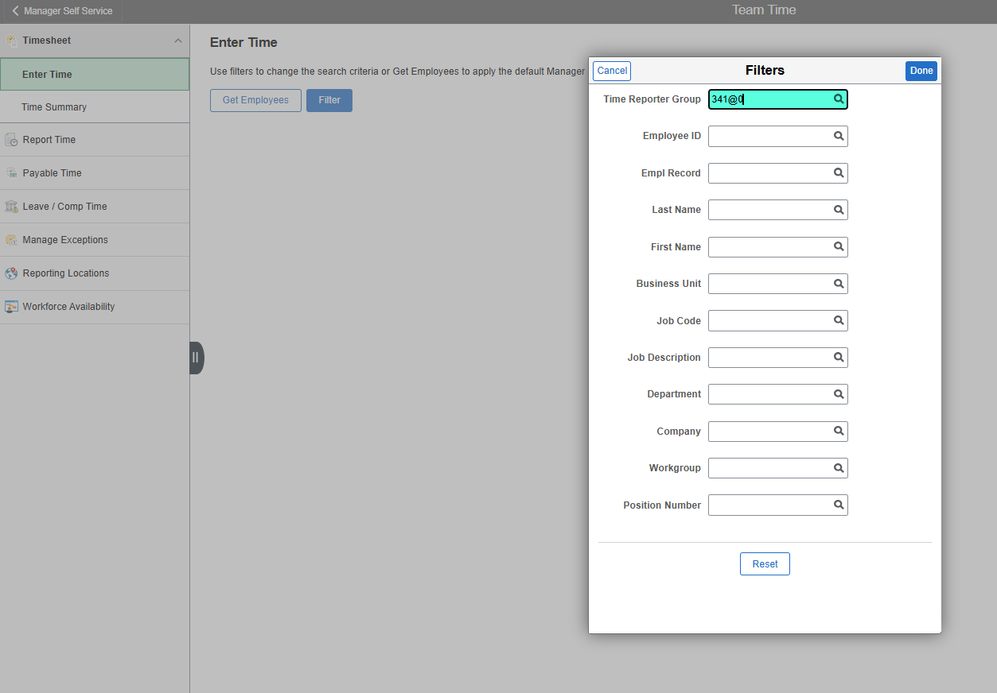
Manager Search Options
Managers can set filters in Time and Labor.
Enter the desired search criteria and select “Done”. This will help managers easily find timesheets.
Notes:
We have been seeing a lot of requests/questions on limiting the manager’s timesheet view to only active employees.
Seeing terminated employees under approvals is an Oracle delivered functionality, but they have delivered a filtering option for managers. Navigating to Manager Search Options will allow the manager to set that filter.
The time reporter group is the first 3 digits of the Business Unit, then the “@” followed by a “0”. It is recommended to only set the time reporter group otherwise managers may miss employees needing timesheet approvals.

Slide 10
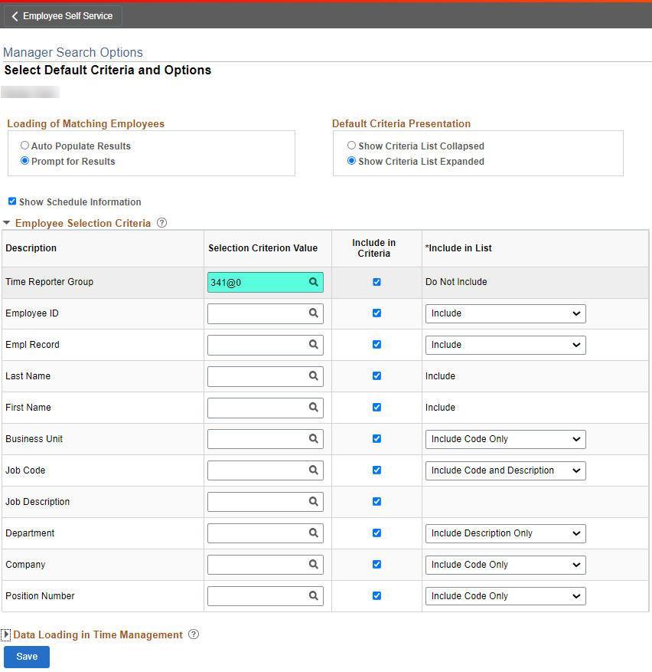
Manager Search Options
Managers can save their search preferences in Time and Labor via “Manager Search Options”.
Enter the active Time Reporter Group for your agency and save. This will limit the manager’s view to active employees. Ex. 341@0
Navigation: NavBar -> Manager Self Service -> Time Management -> Manager Search Options
Notes:
We have been seeing a lot of requests/questions on limiting the manager’s timesheet view to only active employees.
Seeing terminated employees under approvals is an Oracle delivered functionality, but they have delivered a filtering option for managers. Navigating to Manager Search Options will allow the manager to set that filter.
The time reporter group is the first 3 digits of the Business Unit, then the “@” followed by a “0”. It is recommended to only set the time reporter group otherwise managers may miss employees needing timesheet approvals.

Slide 11
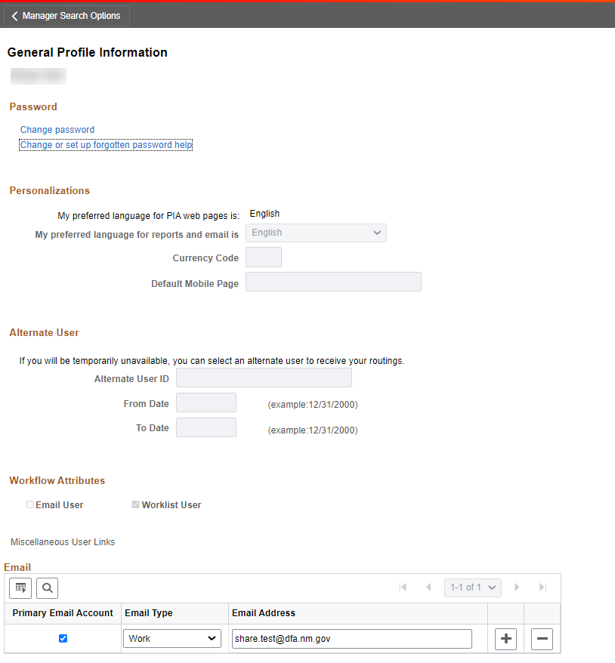
Forgot Password
Users can set up the Forgot my Password function under “My System Profile”.
Navigation: NavBar -> Menu > My System Profile
Notes:
We get a lot of help desk tickets from employees who forgot their password and have not set up the “Forgot my password” utility.

Slide 12
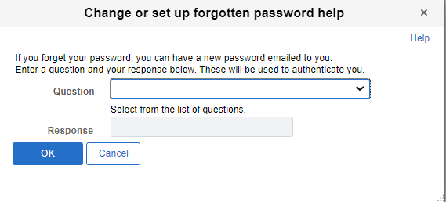
Forgot Password
Select the security question and enter your response.
Navigation: NavBar -> Menu > My System Profile
Notes:
Select the security question that is memorable and enter a response. This is not case sensitive.

Slide 13

Forgot Password
Now that the security question is set up, the user will be able to use the Forgot your password option when needed.
Notes:
Reminder: the user must have a valid business email in order to receive the temporary password.

Slide 14
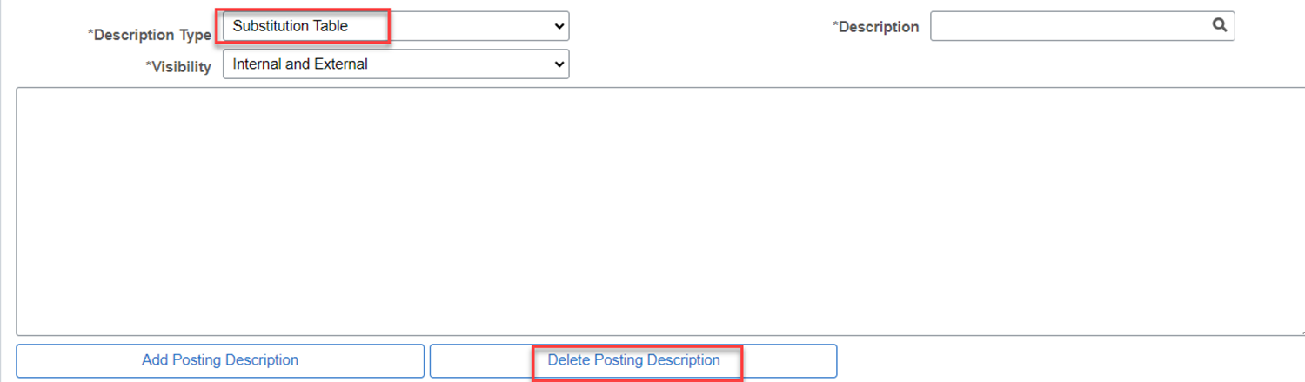
SHARE Recruiting Reminders
SHARE Job Posting Section Changes:
State Personnel is implementing changes to their Minimum Qualification
Things to remember:
Job Posting Freeze 11/8 – 11/12
  Do not create or submit new or draft postings
Updated job titles will not have a substitution table defaulted in the posting.
  Delete the blank posting description section for the Substitution Table Description Type
Notes:
Their format is changing adding the substitution language within the minimum qualification. The first phase will be upcoming in Mid-November.

Slide 15
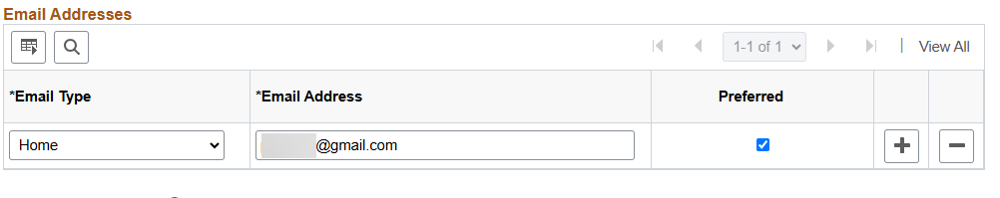
Recruitment Reminder Cont’d
Transfers - Manage Hire/Personal Data
Extremely important that you validate/update data
  Emails for state employees need to be added under Personal Data
Business Email Type > Email address (agency.nm.gov) > Preferred
Continuous Postings
Can not be more than 30 days unless approval obtained from State Personnel Office.

Slide 16
Central Payroll Bureau
Important Updates & Information

Slide 17
Slide Topic
Payroll Pre-Audit
To ensure a successful payroll, agencies should be running the necessary reports and queries at the end of payroll period and until payroll has processed. The agency should be auditing the data to ensure all employees have reported 80 payable hours (or scheduled part-time hours); managers, supervisors and/or timekeepers have approved reported time by Friday (adjustments can made on Monday); appropriate deductions have been taken; and that all forms submitted to DFA CPB have been processed.
Central Payroll sends biweekly emails of the list of reports and queries that agencies should be running every pay period. Agencies are responsible for ensuring employees are paid correctly and timely.
Some reports and queries require specific system processes to have occurred to get the most accurate information (i.e., Time Admin, time loaded, loaded time calculated, etc.).
Notes:
Suzette’s slides

Slide 18

List of beneficial queries and reports to be run biweekly:
Queries:
  NMS_TL_NEEDS_APPROVAL_STATE
  NMS_TL_REQ_APPROVAL_BY_DEPT
  NMS_TL_UNDER80_RPTD
  NMS_TL_OVER80
  NMS_TL_ALL_EXCEPTIONS
  HRT_TLX20023_BUDREF_CLASS_DET
  NMS_PY_TL_TAKEN_BY_PY
  NMS_TL_MISSING_PAY_TIME
  HRT_HOL_PAID_NO_REPORTED_TIME
  NMS_BN_DEDUCTIONS_NOT_TAKEN
  NMS_TL_UNDER40_REPORTED
  NMS_TL_UNDER80_PAY
  NMS_PY_HOL_MISSING
Reports:
  Time and Labor>Reports>NMS EMPLOYEES NO TIME RPTD
  Time and Labor>Reports>REPORTED TIME AUDIT
  Time and Labor>View Time>UNPROCESSED REPORTED TIME
  Time and Labor>View Time>UNPROCESSED PAYABLE TIME
  Time and Labor>View Time>EXCEPTIONS
  Time and Labor>Reports>PAYABLE STATUS
Payroll for NA>Payroll Processing>Pay Period Reports:
  NMS Agency Payroll Register
  Deductions Not Taken
Notes:
Suzettes slides

Slide 19
Third Party Process
Agencies are required to run the necessary queries after payroll processes have completed to reconcile their respective Business Units Bi-Weekly payroll. The agency must reconcile the data in HCM vs FIN to ensure all employees liabilities and expenses have posted to the correct funding source. Requests to update Task Profiles should be sent to the Central Payroll Forms website with the request Form attached. Central Payroll will not post PR journals that have reoccurring errors until corrections in either HCM or FIN are made. Failure to make necessary corrections will delay the State’s posting of payroll.
Central Payroll sends email notifications to staff regarding their PR Journals errors needing corrections; for example, NO BUDGET ERRORS. Please respond timely to our request so we can post your Journal. Failure to respond will require payroll to escalate the issue to the CFO. If payroll modify the accounting string for your payroll to post, the agency should immediately create a journal to correct to the appropriate funding source.
Notes:
Margaret Slide

Slide 20
Direct Deposits
Direct Deposit Security & Accuracy
Direct Deposit setup and changes continue to create issues due to mistakes and errors.
Identity theft and fraud are on the rise and changes to direct deposit are the #1 issue seen in payroll fraud.
Inputting incorrect or incomplete information when setting up or changing a direct deposit can delay your employees receiving their pay on time.
These mistakes also mean more unnecessary work for the HR team.
Always double check or triple check all information input for direct deposits

Slide 21
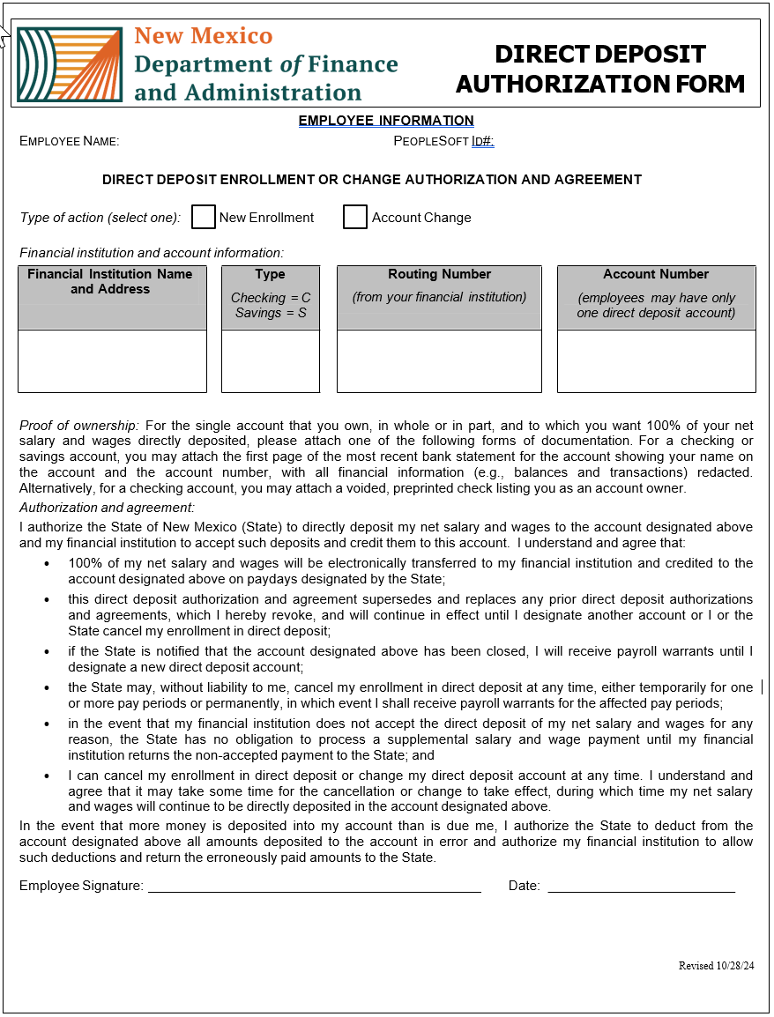
Reminders when entering direct deposit information.
All employees direct deposit additions or changes are complete by the hiring agency. Central Payroll will not add or change an employee’s direct deposit.
All Direct Deposit input must have the appropriate documentation before input into HCM.
Required Documentation:
  Direct Deposit Authorization form, signed and dated.
  The first page of the MOST RECENT bank statement for the account, showing the employees name on the account and the account number with all the financial information redacted.
  OR for a checking account, a voided pre-printed check listing the employee as the account owner

Slide 22
FLSA Change Jan. 1st 2025
Exempt or Non-Exempt?
Proper Worker Classification Under the FLSA
On August 30, 2023 the Department of Labor proposed to significantly increase the minimum salary level to qualify for the “white collar” overtime exemptions under the Fair Labor Standards Act (FLSA).
New threshold
The weekly salary threshold will increase from $844 to $1,128, or $58,656 annually
Impact
To ensure FLSA compliance, affected employees' changes should be made effective at the beginning of the pay period which includes the January 1st deadline.
Employees that are affected could potentially have both comp time and OT leave balances. CPB encourages identifying these employees to resolve the multiple buckets.
Effect on employees
Non-instructional employees making less than the new threshold must receive at least 1.5 times their regular pay for each hour worked over 40 in a workweek

Slide 23
HR PAYROLL RECON
New reconciliation developed for HR
Your Central Payroll Bureau has developed a process to reconcile your employee's payroll deductions. This reconciliation will utilize the query NMS_PY_DEDUCTIONS_BY_PPE.
WHY is this reconciliation needed?
This will help ensure that all your employees deduction amounts are correct and to find any missing deductions minimizing corrections and errors in your journals.
This reconciliation does not replace or change any other form of reconciliation that you may be required to process.

Slide 24
What specifically will this reconcile?
Insurance deductions
  Verify percentage amounts for dental, vision, and medical
FICA deductions
  Verify OASDI & FEDMED calculations vs actual withheld
Retirement Deductions
  Verify amounts to percentages
Retiree Healthcare Deductions
  Withheld vs calculated amounts

Slide 25
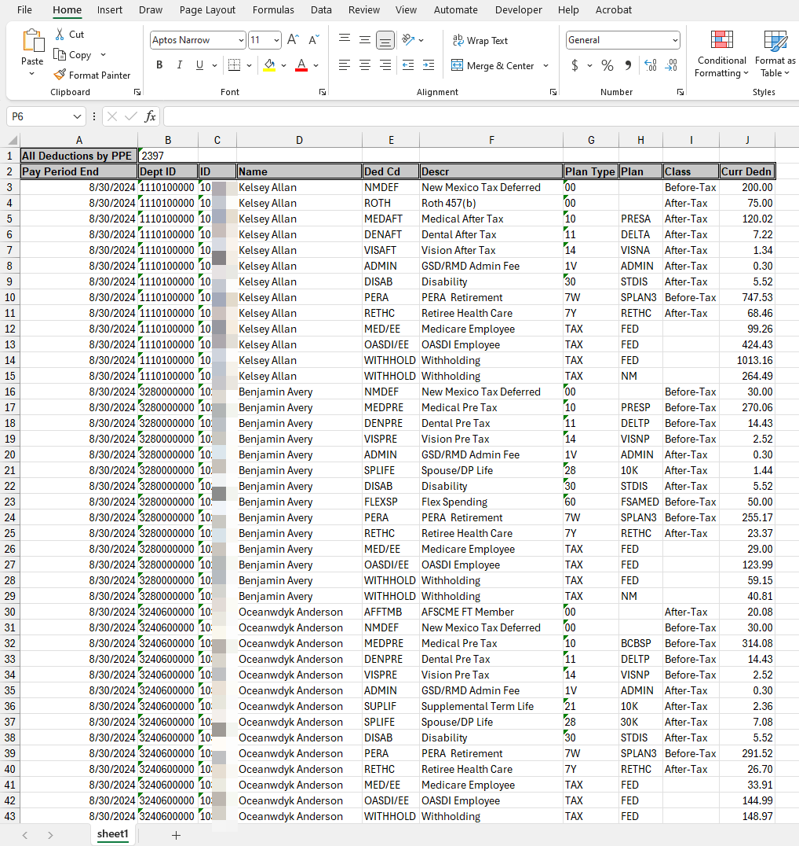
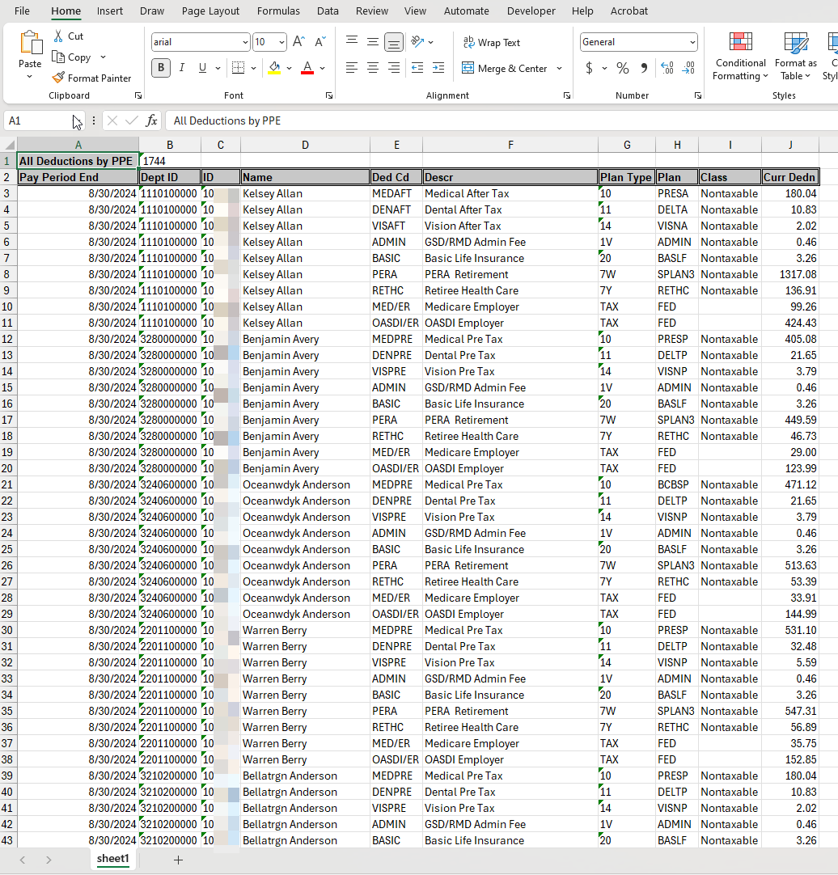
Query Results
NMS_PY_DEDUCTIONS_BY_PPE
Employee Employer

Slide 26
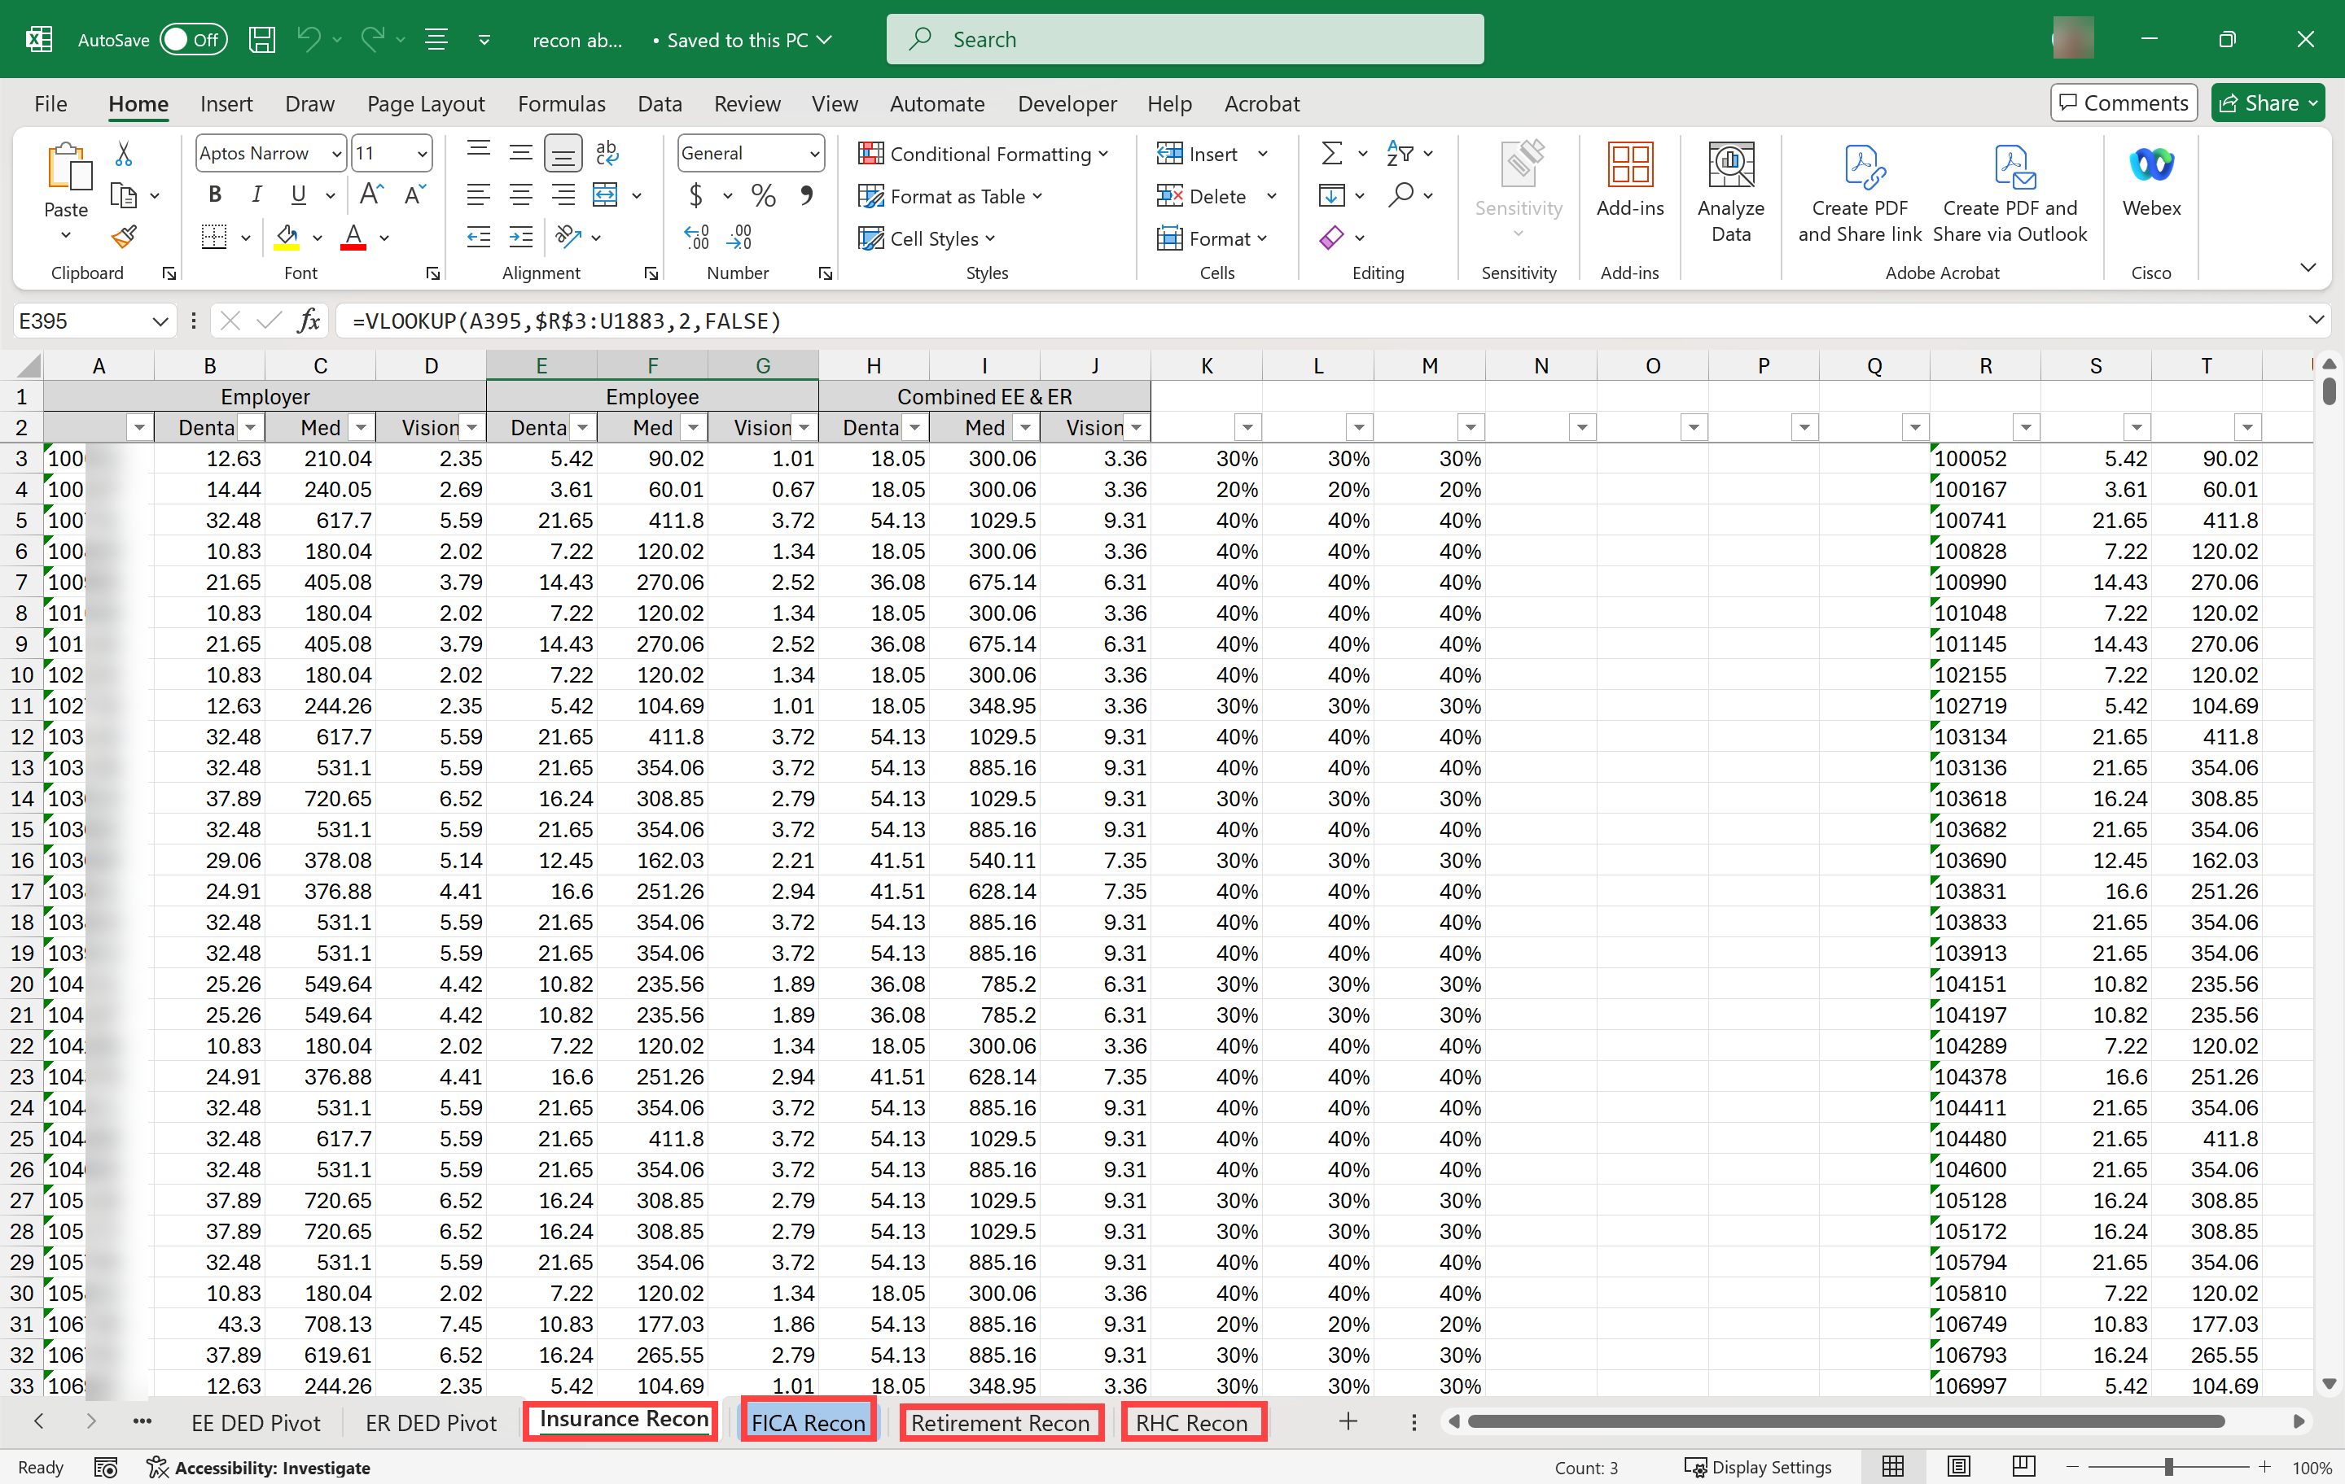
Final Results

Slide 27
Compliance with Social Security Protection Act of 2004
Social Security Form SSA-1945
Federal Law requires State and local government employers to provide a statement to workers (1) who are hires on or after January 1, 2005 and (2) whose jobs are not covered by Social Security. The statement must advise the workers of how noncovered employment may affect future Social Security benefits. Employers meet this requirement by giving each work FORM SSA 1945 at the time they are hired, obtaining the worker's signature on the form, and sending the signed copy to the agency that provides the worker’s pension.
CPB will be sending out notifications and instructions for agencies that are impacted by this requirement.
Copies of the SSA-1945 are available online at the Social Security Website. https://www.ssa.gov/forms/ssa-1945.pdf

Slide 28
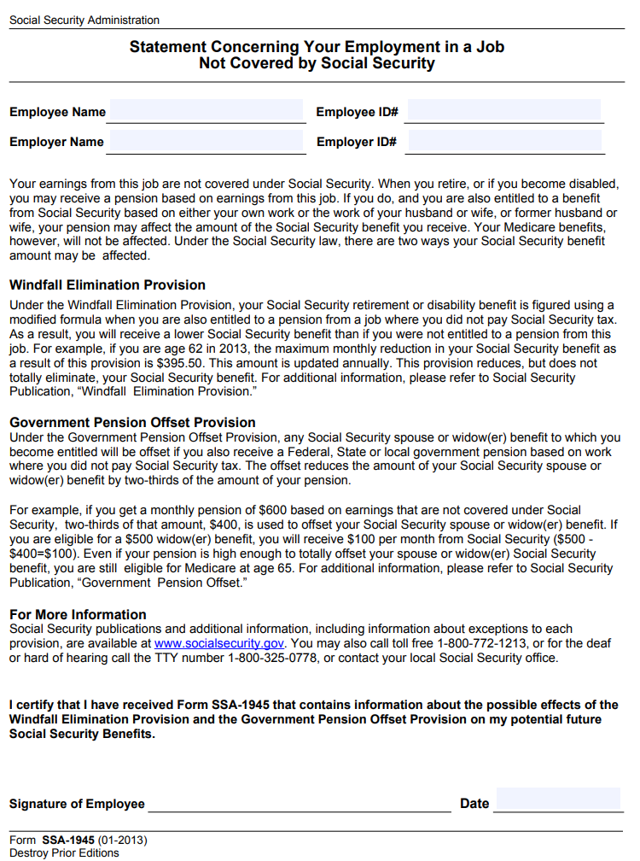
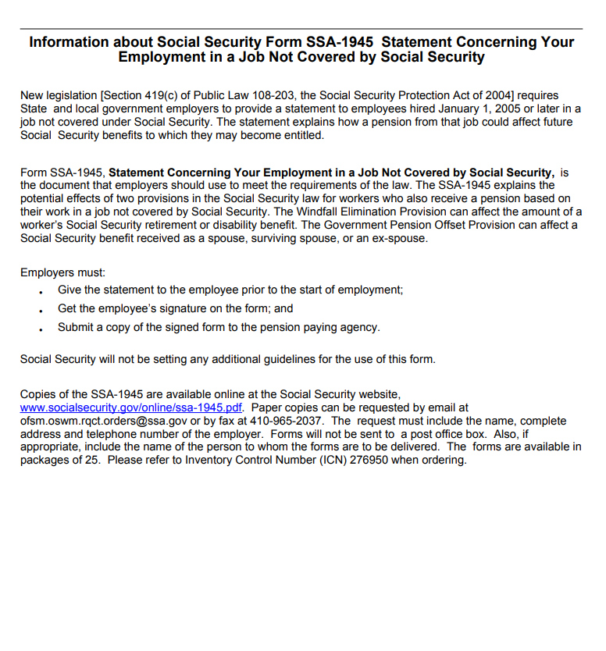
Form SSA- 1945

Slide 29
Holiday Reminders
Accelerated Payroll
Central Payroll will be sending out e-mails reminding agencies that payroll will be accelerated for the coming holidays.
Veterans Day: Monday, November 11th
Thanksgiving weekend: Thursday, November 28th & Friday November 29th
Christmas day: Wednesday, December 25th

Slide 30
Payroll Resources
Central Payroll Trainers
Alex Guzman, Training Supervisor
  Phone# (505)469-2910
  Via E-mail at: CPBTrainers@dfa.nm.gov
Central Payroll Web page
https://www.nmdfa.state.nm.us/financial-control/central-payroll-bureau
Department of Finance & Administration YouTube Channel
https://www.youtube.com/@nmdfa8097

Slide 31
Thank You

Slide 32
Form Submission System
Breanna Henley with Real Time Solutions

