Slide 1


HCM Quarterly Meeting
Presented by Central Payroll Bureau & the SHARE HCM Team

Slide 2


SHARE Team
Presented by SHARE Team

Slide 3

SHARE Service Desk & MFA
As of Monday, November 17, 2025, all SHARE HCM, ELM, Financial, & Security support tickets and issues must be submitted to:
Email: share.help@dfa.nm.gov
Phone: 505-827-1234
MFA Reminders:
Use Your SHARE ID, Not Your Email: Nothing has changed about your SHARE login. Use your original SHARE User ID in ALL CAPITAL letters - email addresses will not work as a login.
Forgot Your Password? Click the “Forgot Password” link on the login screen to reset it.
New Employee Onboarding - Please have new staff watch the SHARE MFA Training Video on YouTube: MFA Training Video

Slide 4
Additional Approvers
Cleanup Process
The SHARE team has been working on a process that will clean up outdated/unnecessary additional approvers. There are four scenarios where this clean up process will occur:
The additional approver’s position is at a different agency. Example: Employee John Doe works at DOH and has an additional approver that is at OSE. The OSE additional approver will be removed.
The manager listed as an additional approver is also the employee’s direct report.
The manager listed as an additional approver can approve time for the entire agency.
The position listed as an additional approver is inactive.
We are anticipating this process will run biweekly; it will insert a row that is effective the same day. So, if the process ran on the first Saturday of the current pay period, the effective date would be 11/22/2025. If a row needs to be added prior to this row, please submit a help desk ticket to SHARE.help@dfa.nm.gov.

Slide 5

1095-C
1095-C Forms
H.R. 3797: The Paperwork Burden Reduction Act modifies the Affordable Care Act, allowing employers and providers to only send 1095-B and 1095-C tax forms upon request.
As a result, HCA will no longer be mailing out the 1095-C form to each individual employee. The forms, however, will continue to be available to employees in SHARE, accessible via the benefits tile. If an employee requests the form, HR will have the ability to print the 1095-C.
HR’s Navigation to the form is: Navbar -> Benefits -> ACA Annual Processing -> Transmittal and Forms -> View Form 1095-C
Employee Navigation to the form is: Employee Self Service Homepage -> Benefit Details Tile -> View Form 1095-C tile
A job aid on printing the 1095-C is available on the SHARE information center (info.share.nm.gov).

Slide 6
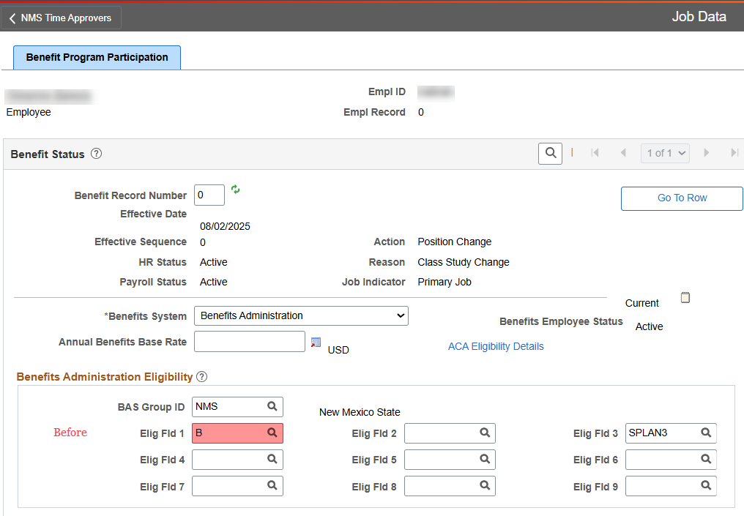
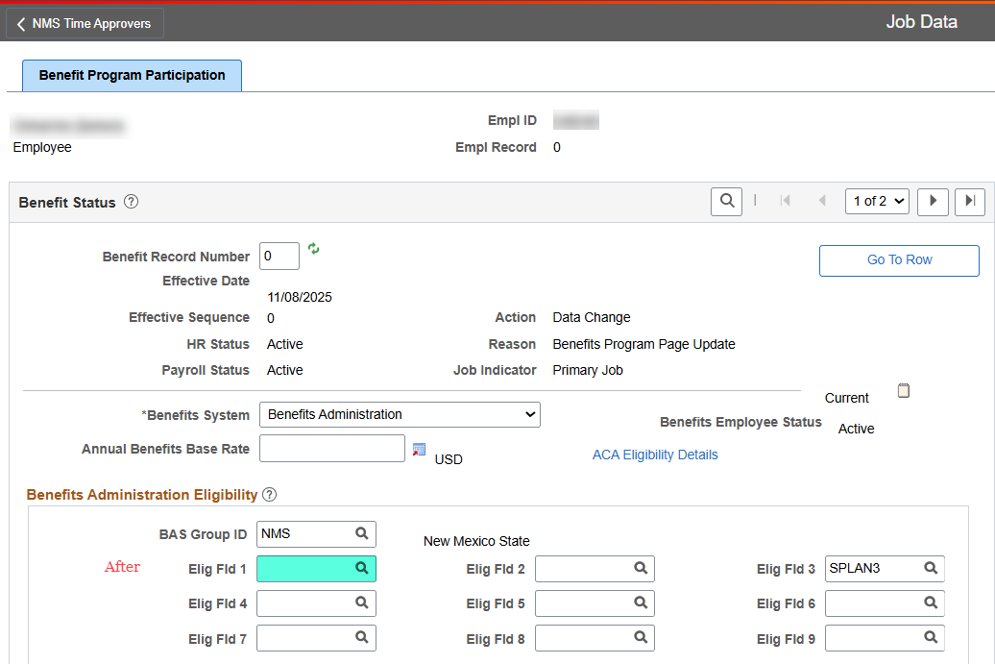
Eligibility Field 1
Save Edit
To facilitate removing the legacy A, B, or C values from eligibility Field 1 on Job data, we have put in a “Save Edit”.
A save edit changes data once a transaction has been saved. In this case, if there is an “A”, “B”, or “C” value in eligibility field 1, saving a new row will remove that value.
This edit will only occur if the row being added on Job Data is dated after July 5th,2025.

Slide 7
2025 OBBB Overtime
OBBB Overtime W2 Reporting
One Big Beautiful Bill: The OBBBA allows for a temporary tax deduction for qualified overtime pay from 2025 through 2028, exempting up to $12,500 of qualified overtime pay from federal income tax for individuals ($25,000 for joint filers).
This means that the premium portion of overtime pay, the extra half-time pay (.5X) above the regular hourly rate, qualifies for this deduction.
For 2025, The State of New Mexico will report the qualified overtime pay in box 14 of the W-2.

Slide 8
Timesheet Access Restrictions
Current Basic Access
By default, managers/supervisors can see all timesheets within their agency, including terminated/retired employees. They can also enter/update time on any timesheet within their agency.
Managers by default can only approve time for employees who report to them or for whom they’re listed as an additional approver.
Custom Timesheet Access
Timesheet access can be restricted to employees reporting to a manager and who are listed as an additional approver.
With this restriction, a manager may only see and approve timesheets for employees who report to them or have their
position listed as an additional approver.

Slide 9
Thank You

Slide 10
Central Payroll Bureau
Important Updates & Information

Slide 11
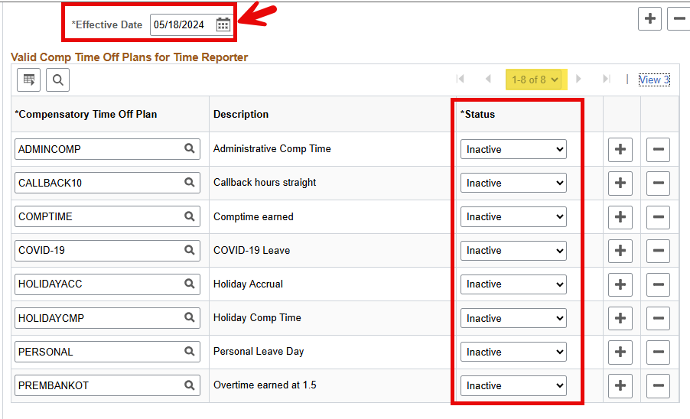
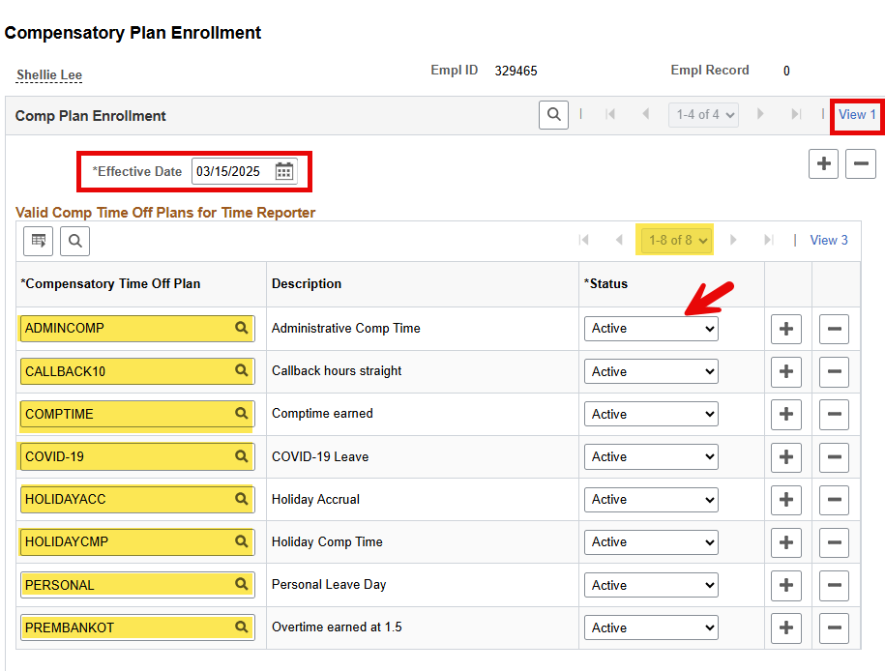
Ensure that rehires are enrolled in the correct compensation leave plans.
Accessing Plan Information:
  Navigate to HCM > Time & Labor > Compensatory Plan Enrollment. Select "View All" to check that all plan types are in active status before entering time on the timesheet.
Timely Updates: If leave plans are not updated upon rehire, you must coordinate with Central Payroll to correct leave balances.
*Note* Share inactivated records in 2024 and now must be reactivated by agency HR upon rehire*
Compensation Plan Enrollment

Slide 12
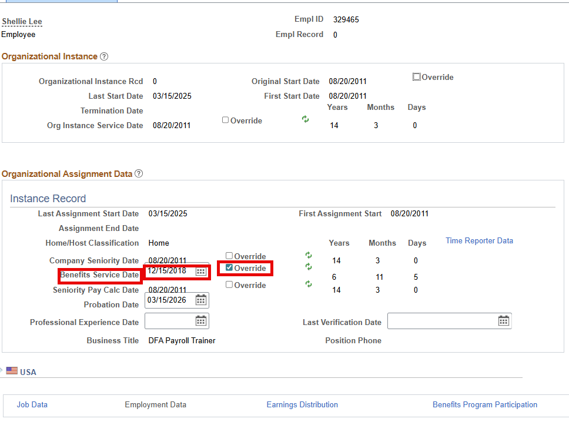
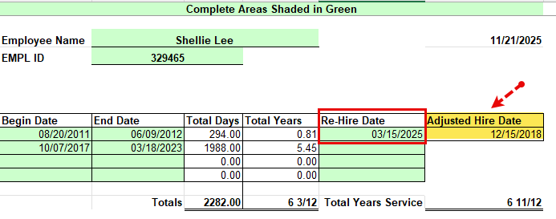
Benefits Service Dates
Upon the rehire of an employee, it is essential to update their Benefits Service Date. To determine the accurate Benefits Service Date please utilize the Cumulative Leave Worksheet. https://info.share.nm.gov/files/Cumulative%20Leave%20Worksheet.xls
The Benefits Service Date drives the Annual Leave Accrual rate. Failure to update this field will result in the employee over- or under-accruing annual leave.
Timely Updates: If the benefit service date is not updated upon rehire and the information is backdated, this will not fix leave already accrued. You must coordinate with Central Payroll to ensure annual accruals are corrected.

Slide 13
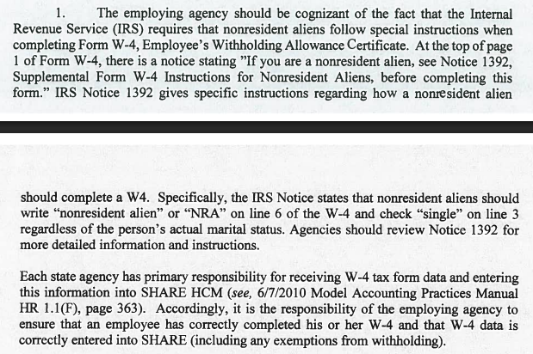
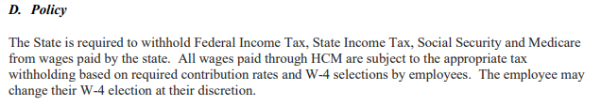
FICA & Medicare Exemption Memo
On the Central Payroll Website
Dates to July 1, 2014
MAPS HR 2.6 Tax Withholding

Slide 14
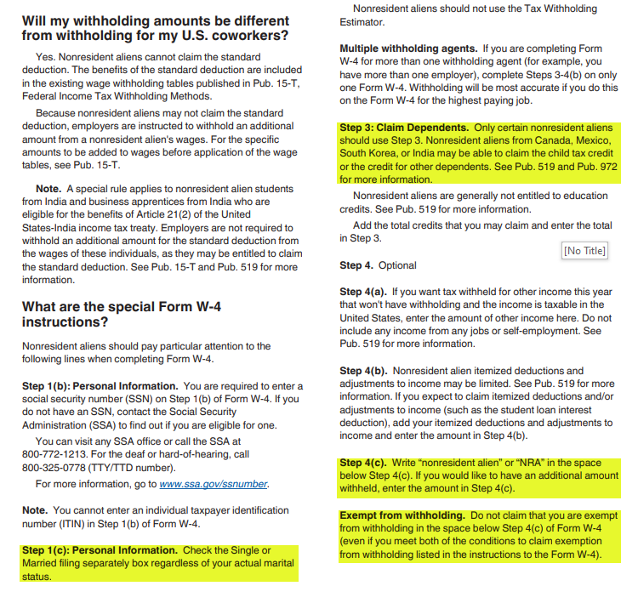
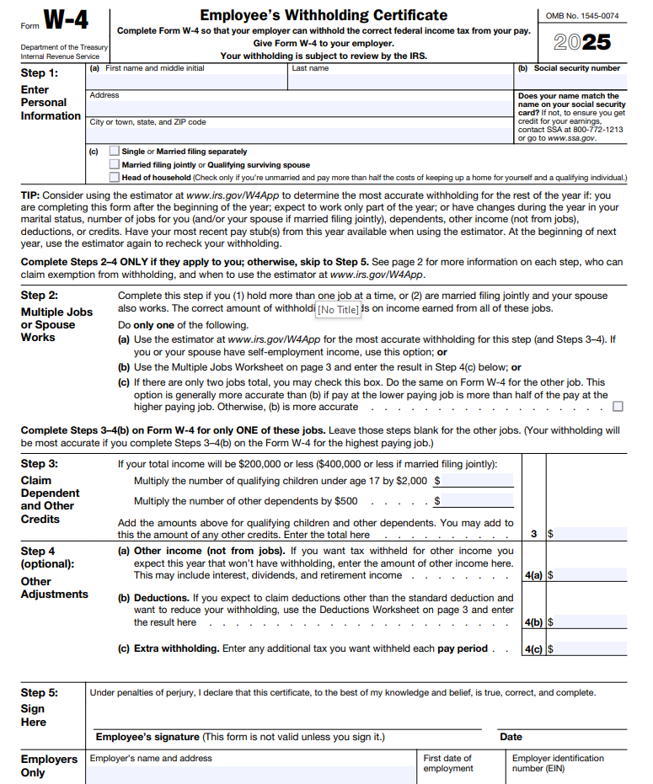
Special withholding for Nonresidential Alien using W-4
https://www.irs.gov/pub/irs-pdf/n1392.pdf

Slide 15

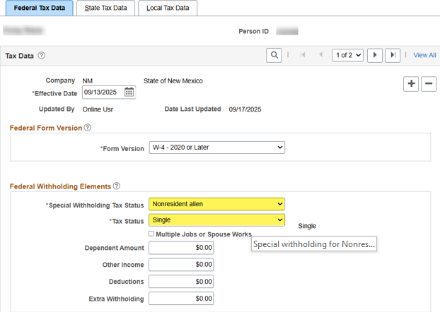
Input Non-resident Alien W-4 into HCM
Update Employee Tax Data
Navigation: Menu -> Payroll for North America -> Employee Pay Data USA -> Update Employee Tax Data
Insert a new effective dated row.
Change “Special Withholding tax status” dropdown to “Nonresident Alien”.

Slide 16
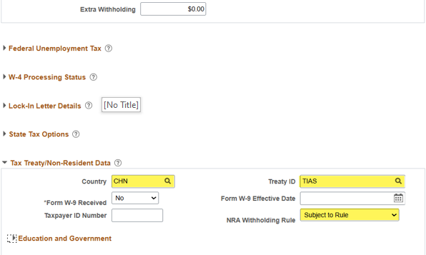
Required Tax Treaty/Non-Resident Data Information
Enter the country (the country employee is from) and Treaty ID (TIAS). The message that there is no VISA set up for this employee can be ignored.
Ensure that the “NRA withholding rule” dropdown is set to “Subject to Rule”.
Save.

Slide 17
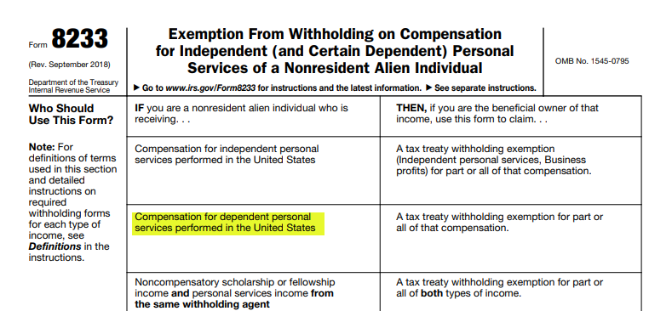
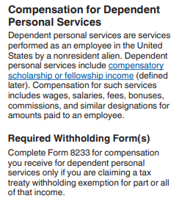

Visa Holders
Form 8233
https://www.irs.gov/pub/irs-pdf/f8233.pdf
Instructions for 8233
https://www.irs.gov/pub/irs-pdf/i8233.pdf
Must be completed annually to be valid
Nonresident Alien Individual

Slide 18
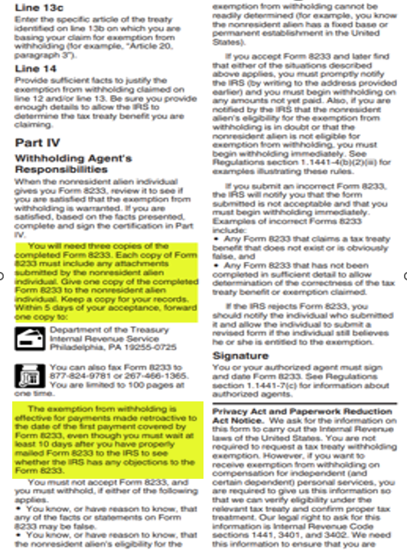
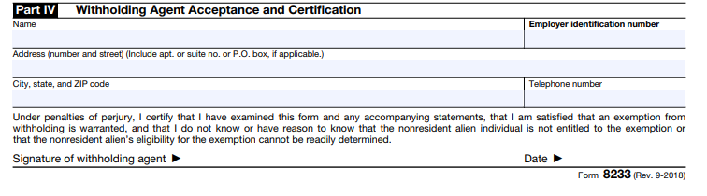
Additional Agency Requirements for form 8233
Agencies are responsible for reviewing
information for accuracy
Agencies must submit a completed form
with documentation to the IRS within 5
days.
The IRS may object to the tax treaty.
Agencies must wait 10 days after mailing
to input data into HCM.

Slide 19

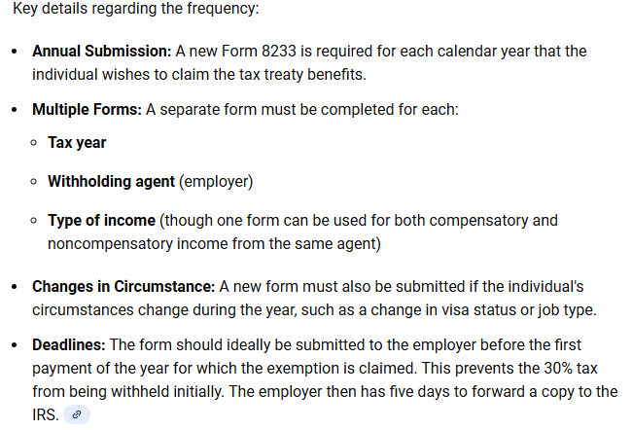
Form 8233 things to remember

Slide 20
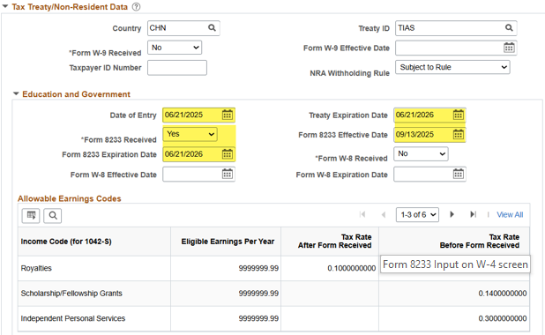
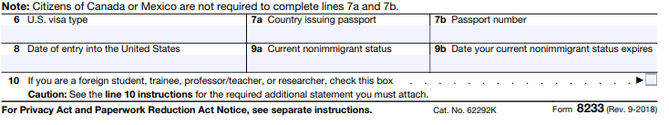
Form 8233
Form 8233 Input on W-4 Screen
If the employee has a tax treaty (form 8233) then the highlighted fields need to be updated on Update Employee Tax Data.
Information is from form 8233 box 8 and box 9b.
Notes:
Suzette’s slides

Slide 21
Payroll Reconciliation
Payroll Reconciliation
Collaboration between the agency HR and Financial Accounting.
Completed bi-weekly after payroll posts. Adjustments to the financial posting maybe needed to correct accounting.
Issues are caused when:
Payroll journals are changed due to incorrect data input or budget constraints.
Timing for transfers from one agency to another.
Garnishments withheld from paychecks but not immediately remitted to creditor.

Slide 22
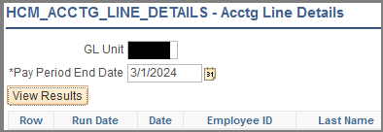
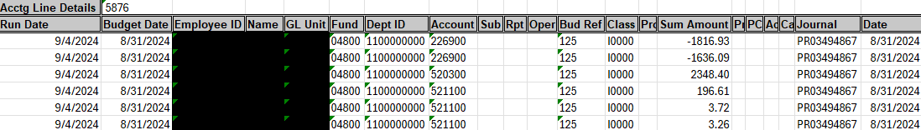
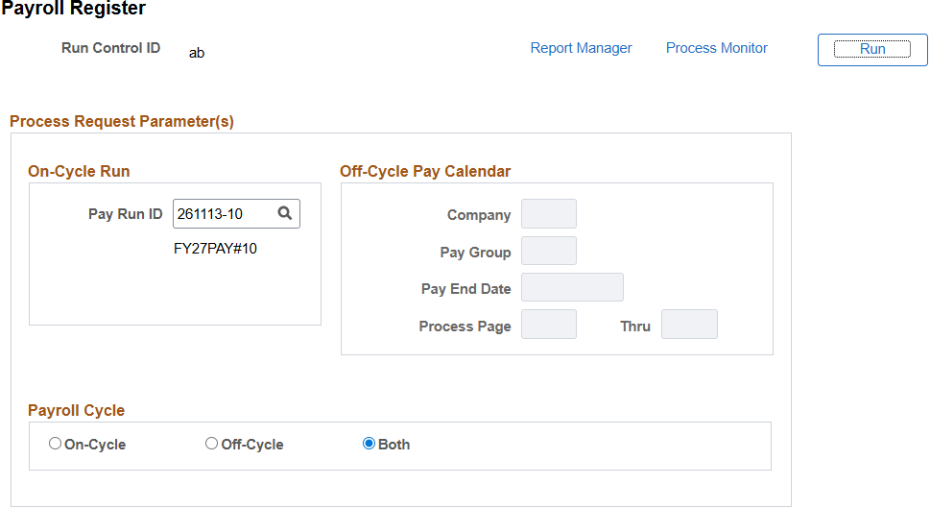
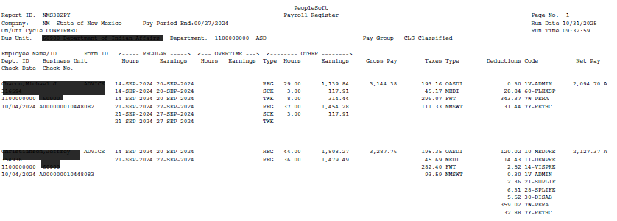
HR should verify Accounting Lines to Payroll Register
Payroll Reconciliation
Start by running the reports shown.

Slide 23
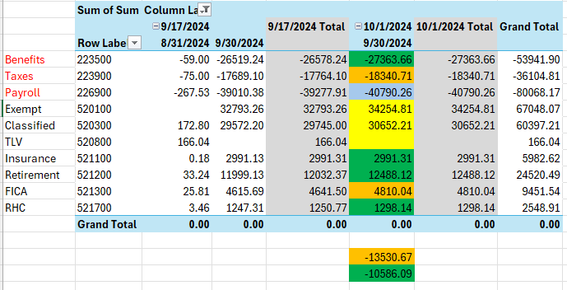
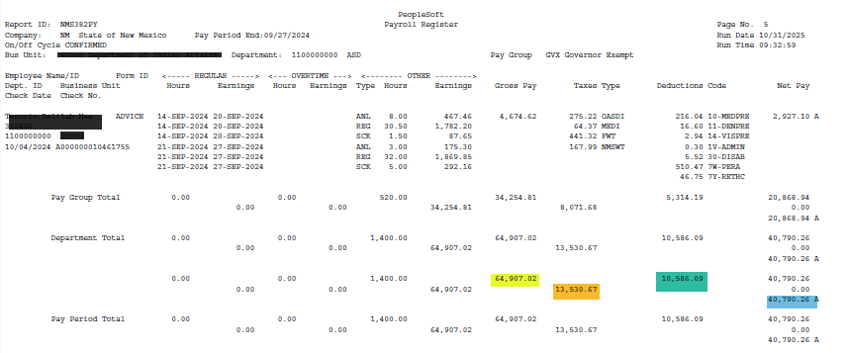
Create pivot from accounting line data using the run date and budget date in columns.
Payroll Reconciliation
Using the final page of the payroll register pay period total line.

Slide 24
Accounting team will verify that the HCM accounting matches what is posted in FIN.
Payroll Reconciliation
In FIN run NMS_GL_JOURNAL_LINE
Create pivot for Payroll journals. Compare the FIN pivot to the HCM pivot.
Pull in AP journals.
Verify that AP journals match liabilities.
The most common cause of out of balances in the FIN data is due to an employee transfer or a garnishment. The accounting team may need your assistance with running some garnishment queries that only HR staff can run.

Slide 25
Other Issues to Consider
Are all employees being paid?
Are employees paid at the correct rate of pay?
Do all employees have correct hours?
Are the benefits correct?
Are the taxes being taken out?
Are PERA/ERB/RHC taken at correct rate?
Are the expenses charged to the correct funding?
Are the correct leaves being used?
Are the correct TRC codes used?

Slide 26
Year End Processes
Clean up for calendar year end
If agencies have collected overpayments directly from an employee, you must notify CPB of those collections. If your agency had an overpayment of wages that had to be collected outside of payroll, CPB must include those paybacks in W-2 reporting. Central payroll must also refund any FICA , PERA, or RHC contributions that maybe associated with those collections.
FICA max—some employees maybe reaching out due to OASDI no longer being withheld from their paychecks. If the employee’s wages exceed $176,100.00 any amounts earned over that cap will not be taxed for OASDI. The excess is still subject to Fed Med (Medicare) contributions.
PERA max—a handful of employees are reaching the max contribution limits for PERA. CPB is reaching out to agencies that have employees at max. We are requesting that the PERA contributions be changed to no retirement to ensure that excess contributions are not taken, but the wages are still reported. CPB will also provide the information on the amount of contributions that need to be refunded due to cap being met mid pay cycle. All employees will need to have their PERA changed back to contributing the first pay period of 2026.

Slide 27
W-2 Requests/Issues
Production of W-2 is the responsibility of CPB.
Agencies should ensure that terminated employees correct address is in HCM.
If CPB notifies agencies of a mismatch from Social Security, agencies will need to get a copy of employee’s social security card and match the information in HCM to what is on the card.
If an employee passed away, agencies should review the Business Unit in HCM to ensure that they receive the deceased W-2.
Active employees with access to HCM can receive their W-2 electronically. Please remind all employees that they need to select electronic W-2. This will allow employees to access their W-2 information quicker, and saves the State time and money.
DO NOT accept any request for duplicate W-2 prior to February 15th. If a terminated employee requests a duplicate W-2 prior to February 15th, verify the address in HCM, and inform them that their W-2 will be mailed to their address in HCM by January 31. If they have not received it by February 15th they can then request a duplicate. Do not complete the form and hold it for submission in February.

Slide 28
Leave Accrual
Personal Days
Personal Days must be used by December 31.
Any personal time not used by December 31 will be lost.
New accruals will be added to the payline PPE 01/02/2026 and will require approval.
The hours awarded for personal days may need to be adjusted depending on the employee’s schedule work hours.
Personal days cannot be split. The day must be taken as a whole. Any split days must be corrected in the system before December 31.

Slide 29
Leave Accrual
Annual Leave
Excess Annual leave above allowable maximum will be removed following PPE 01/02/2026.
Any excess annual leave must be used by January 2,2026 or it will be lost.
Sick Leave Buy Back
In accordance with Subsection H. (1) of 1.7.7.10 NMAC, employees who have excess of 600 hours of unused sick leave are entitled to be paid for unused sick leave at 50% of their hourly rate of pay up to 120 hours. Employees are entitled to participate in this program only once per fiscal year per employee. Employees who are eligible and did not participate in July maybe able to participate in January. The buy back will occur PPE 01/16/2026.

Slide 30
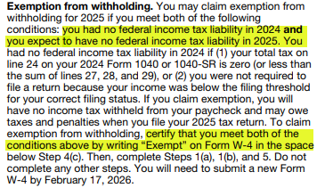
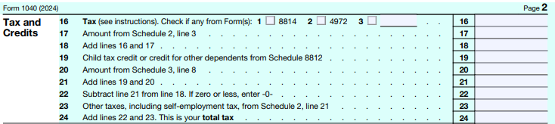
Claiming Exempt on W-4
Tax Estimator:
https://www.irs.gov/individuals/tax-withholding-estimator
Prior years tax return
Form 1040 line 24 must be zero.
Must be completed annually to be valid

Slide 31
Notification of Employee Death
Agencies must inform the Central Payroll Bureau as soon as they become aware of an employee's death. Failing to do so can have serious consequences for the employee's beneficiaries. There is a limited window for reversing any funds with the bank, and delays could result in the loss of money sent to the deceased employee.
Additionally, postponing the notification may cause beneficiaries to receive their payments later than anticipated during this sensitive time.
Procedure for Addressing the Death of an Employee
Do not terminate the employee; this is the responsibility of Central Payroll.
Access 'Maintain Time Reporter Data' and assign to the ‘INACTIVE’ workgroup, effective the day after the last paid day. For example, if the employee passed away after working on Tuesday, the effective date would be Wednesday.
Immediately inform Central Payroll of the employee’s passing. Complete the Notification of Employee Death form and submit it via the Financial Services System (FSS):
FSS Link https://platform.dfa.nm.gov
Select Add New Request Form Type Deceased Notification.
Approve all payable time up to the inactivation date.
Determine recipients for final payments, including hours worked and terminal leave payouts. Work with the payee to submit required documentation to Central Payroll.
Submit the Terminal Leave Verification (TLV) request through FSS: https://platform.dfa.nm.gov

Slide 32
Deceased Beneficiaries
Required Documentation
Spouse must fill out Substitute W-9 and a notarized copy of Affidavit of Deceased Employee’s Spouse for Final Payment.
Personal representative of the deceased employee’s estate, personal representative must submit a Substitute W-9 and a certified copy of the Letters Testamentary or Letters of Administration appointing the personal representative.
Successor of the deceased employee, the successor must submit a Substitute W-9 and a notarized copy of the Affidavit of Deceased Employee’s Successor for Final Payment.
HR must receive death certificate, and proof of beneficiary. Marriage license, Court document, or other form indicating they are the rightful heir. CPB will no longer except life insurance or PERA beneficiary forms.

Slide 33
Action Items
Verify the address for any terminated employee’s W-2 mailing.
Deceased employees need to have their location code reset to the agency.
New W-4 for any non-resident employee or any employee that is claiming exempt.
Remind employee’s that W-2 can be received electronically.
Select an FSS agency administrator if on has not been identified.

Slide 34
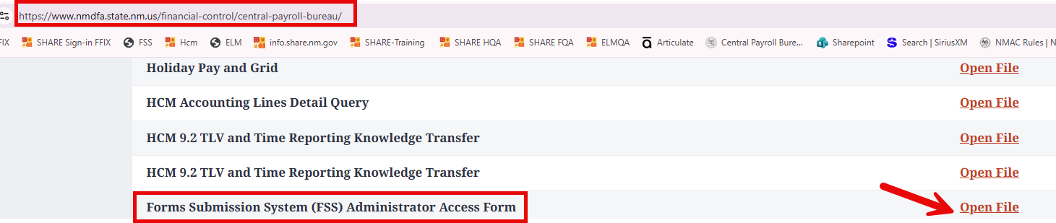
Forms Submission System (FSS) Administrator Access
Each agency is required to designate an FSS Administrator by completing the Forms Submission System Administrator Access Agreement form. This form is available at the following link:
https://www.nmdfa.state.nm.us/financial-control/central-payroll-bureau/ under the Resources section.
Responsibilities:
Grant access to the Forms Submission System (FSS) and manage user updates.
Conduct periodic audits to ensure that terminated employees no longer have access to the system.
Engage in training sessions with CPB trainers to fully understand the roles and responsibilities associated with the administrative position.
The FSS Administrator will be accountable for overseeing the requests submitted by their agency to CPB, ensuring that all requests marked as “Returned” are addressed promptly. This involves either correcting and resubmitting these requests or canceling, as necessary.

Slide 35
New Forms
Coming Soon
CPB will be working on new forms for submissions. Current forms are not rounding per pay period causing penny issues within HCM. The new forms will address these differences when you submit paperwork.
Current forms carry forward fractional cents into the next payperiod when additional pay is for multiple pay periods. Rounding should occur on a bi-weely basis and not carry forward these payments.
The fractional cents cause issues with PERA reporting and CPB has to correct forms before they can process.

Slide 36
Payroll 101
Payroll 101 Course coming soon!
We are excited to announce that we are finalizing the Payroll 101 course, which will be available for enrollment very soon.
This course will provide a comprehensive overview of Payroll 101. The topics we will explore include Timesheets, Form Submission Systems, and the responsibilities of the Central Payroll Bureau and various agencies. This knowledge will equip participants with the essential skills necessary for effective payroll management.

Slide 37
CPB Trainers
Central Payroll Trainers Open Hours
The Central Payroll Training team will hold an open Teams meeting weekly on Wednesdays from 2pm to 4pm.
Anyone can join at anytime within those hours to ask questions regarding Central Payroll Forms, existing requests in the FSS or the FSS in general.
This is also a great way to share best practices with you peers regarding the FSS and the forms.
Teams Meeting Link: https://tinyurl.com/CPBTrainers
Just a note, this will be an open forum where people from any State agency can join, so please refrain from sharing sensitive information during this time.
Notes:
Will need to verify with Elizabeth Jaramillo if we are allowed to use TinyURL.

Slide 38
Payroll Resources
Central Payroll Trainers
Alex Guzman, Payroll Trainer Supervisor P:(505)469-2910 E: Alejandro.Guzman@dfa.nm.gov
Claudette Romero, Payroll Trainer P:(505)376-3067 E: Claudette.Romero@dfa.nm.gov
  Preferred E-mail: CPBTrainers@dfa.nm.gov
Central Payroll Web page
https://www.nmdfa.state.nm.us/financial-control/central-payroll-bureau
Department of Finance & Administration YouTube Channel
https://www.youtube.com/@nmdfa8097

Slide 39
Thank You

