Slide 1
SHARE Navigation:
Procurement
New Mexico
Department of Finance and Administration

Slide 2
Before we get started…
Agenda
Talk about SHARE and procurement
Personalize our home page
Budget Overview
IPR > Requisition
Requestion > PO
Invoice > Voucher
Back to PO
  Activity Summary
  Header Comments
  Document Status
Journal Drill Down
SHARE Queries
Additional Resources
You might not have access to everything we discuss in this session.
Use SHARE to conduct research. It houses all required documentation and every transaction that has occurred.
Practice makes proficient.
My way might be different than your way.
I went wild with the arrows, enjoy!

Slide 3
What is SHARE? What is Procurement?
SHARE is the State’s ERP system – the software that integrates core business functions (HR, Finance, Budgeting, Training) into a single platform.
It is New Mexico’s book of record, the place where all financial transactions are recorded. The components of a book of record include the general ledger, accounts payable/receivable, payroll, and supporting documentation.
Procurement is the process of acquiring goods or services to meet business needs.
Procurement is guided by MAPs. MAPS ensures consistent, standardized, and compliant practices to prevent misuse of taxpayer funds

Slide 4
Definitions
Requisition / Internal purchase request (IPR)
  A request submitted within an organization to initiate the procurement needs
  This is where you are gathering PO documentation (3 quotes, SWPA, contract, etc.), identifying the funding string, and obtaining signatures/approvals to procure
Purchase Order
  A legally binding document between the buyer and seller. It clearly defines the terms of the transaction.
Invoice
  Formal document issued by the seller requesting payment for goods or services
Voucher
  Internal document used in Accounts Payable to collect, organize, and authorize payment of an invoice
Supplier / Vendor
  The company you’re buying from and who’s sending you an invoice
Remittance address
  The address where payments are sent to ensure funds are processed correctly and efficiently
Encumbered
  Funds that have been set aside for a specific use
Obligated
  Legally binding commitment to pay for goods or services
Encumbrance Balance / Remaining balance
  Outstanding amount still owed to the vendor – the portion not yet paid.
  Remaining balance = total PO amount, less amounts already paid

Slide 5
Procurement Lifecycle (oversimplified!)
Not all agencies are the same, you might do it differently.
Budget is created in SHARE
  This is where funding strings are created
Create a Requisition
  Identify a need (Staples office supplies) & gather the documentation to create a requisition.
  Identify the funding string to ensure there’s enough budget
PO is created based on the Requisition and supporting documents
Dispatched PO is sent to the vendor (Staples)
Vendor (Staples) processes the order and sends an invoice
Goods/services are received
Create a voucher in SHARE to process payment
  If the invoice was higher than initially planned, do a Change Order
Close the PO, disencumber any remaining balances

Slide 6
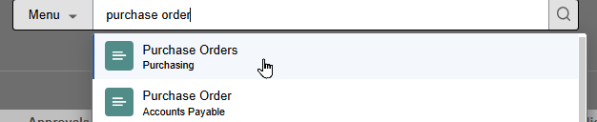
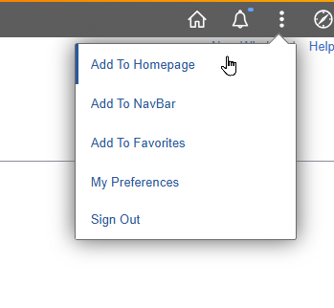
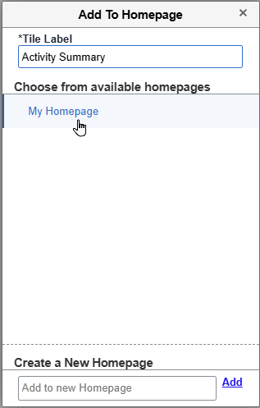
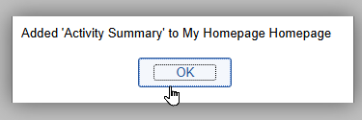
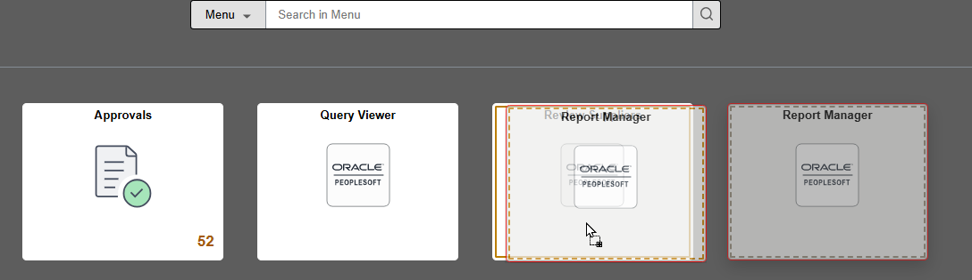
Personalize
Homepage
Create Tiles on your Homepage for your most frequent locations
To add a location, first navigate there. Click the three dots on the top left and Add to Homepage. Click on My Homepage, and you will be notified when complete.
Click and Drag tiles on your home page to organize them in the order you’d like.

Slide 7
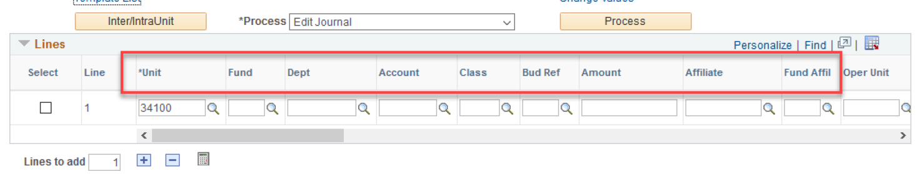
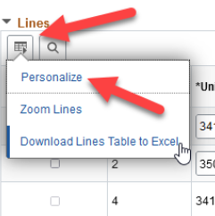
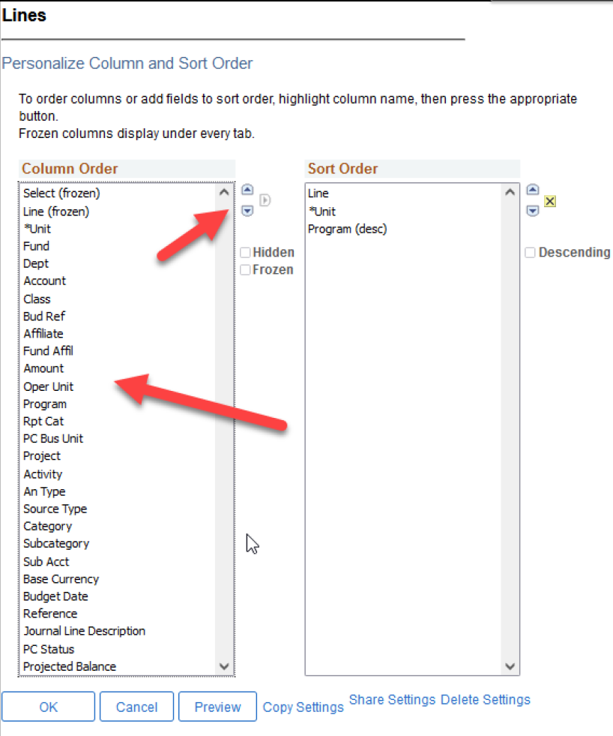
Personalize
Chart Fields
Chart fields can be personalized to a users’ preferences.
Click the Personalize button and adjust the fields to your liking. Change the order in the column section.
This can be done on vouchers, purchase orders, requisitions, journal entries, etc.
Note: this is particularly useful when you’re exporting these tables to Excel. Avoid extra columns by personalizing these fields.

Slide 8
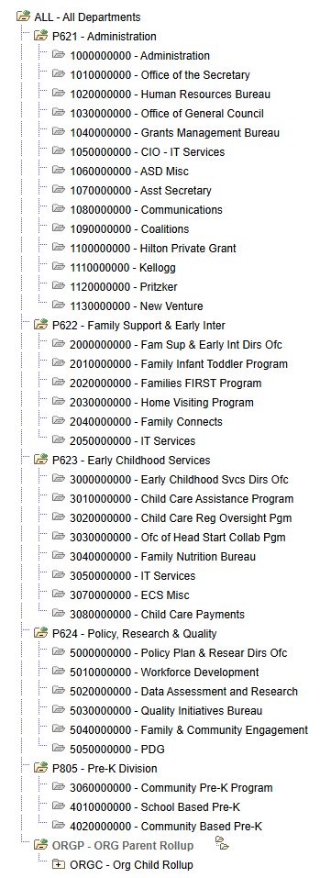
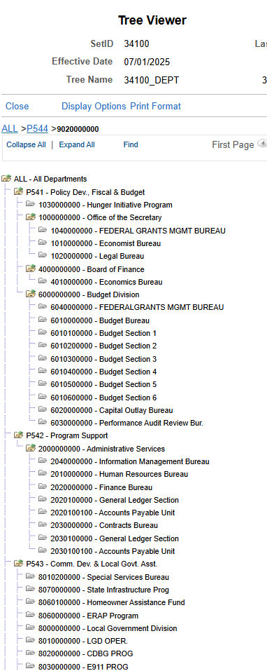
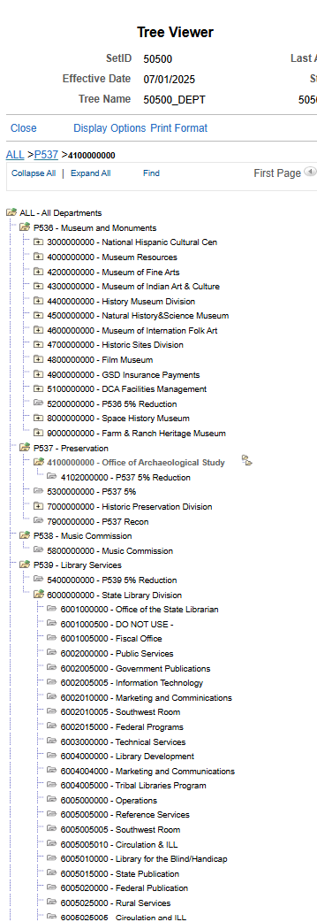
Tree Viewer
Understand how your agency is organized

Slide 9
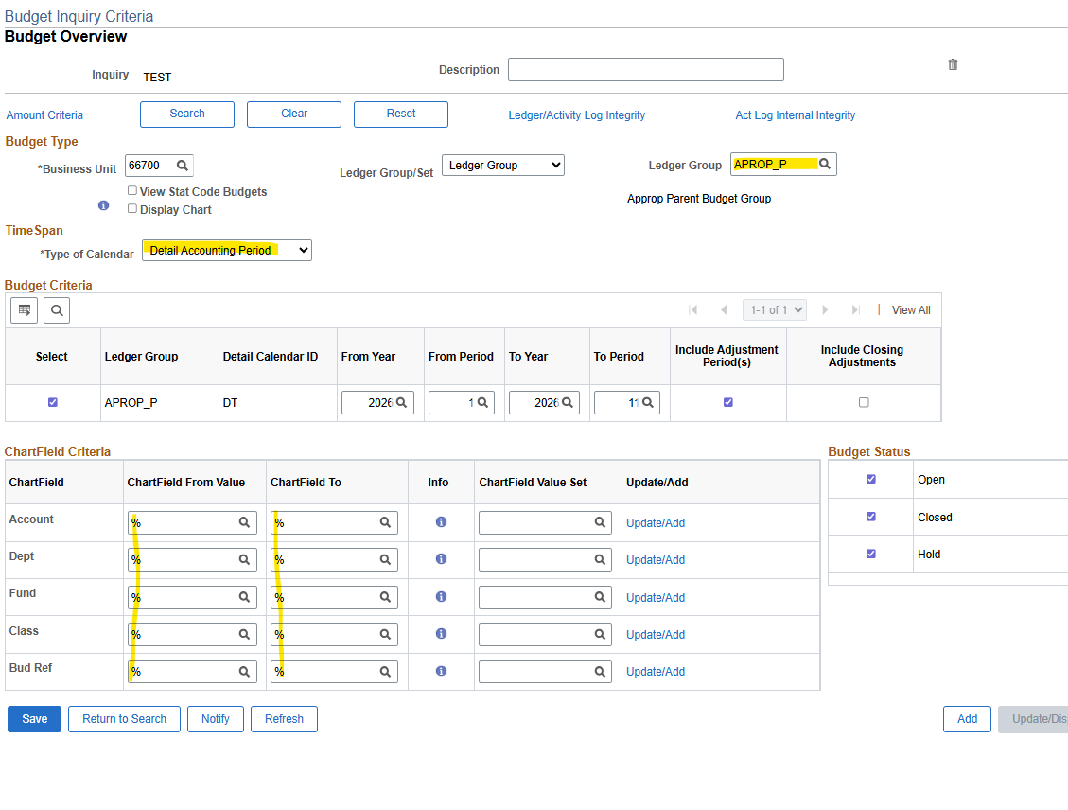
Budget Overview
This report will show the balances for each period for all the 200’s, 300’s and 400’s and 500’s if the wild card (%) was used for each fund.
You can continue to ‘drill-in’ on any amount in blue.
Enter Information for:
Ledger Group – Most should be APROP_P
  (if you are doing department-based budgeting, then it would be DEPT.)
Type of Calendar: Detail Accounting Period
From Year and To Year/From Period and To Period/Include Adjustment Period
Enter the Bud Ref you are reviewing (should never leave this blank), or %
Account should be 200/300/400/500 or % for all of them
  NOT the actual account code (example: 547900)

Slide 10
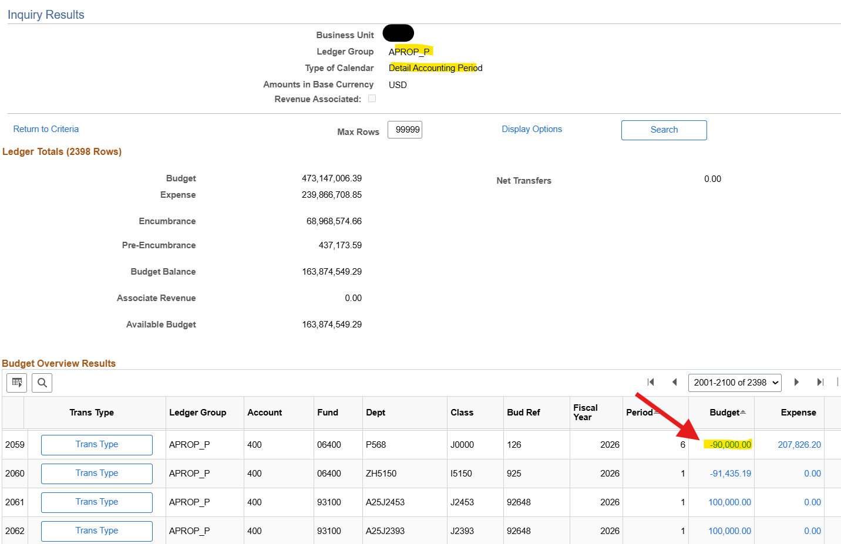
Note: Max your rows using 9s and click search again. You can export the entire dataset or identify a specific entry to research.

Slide 11
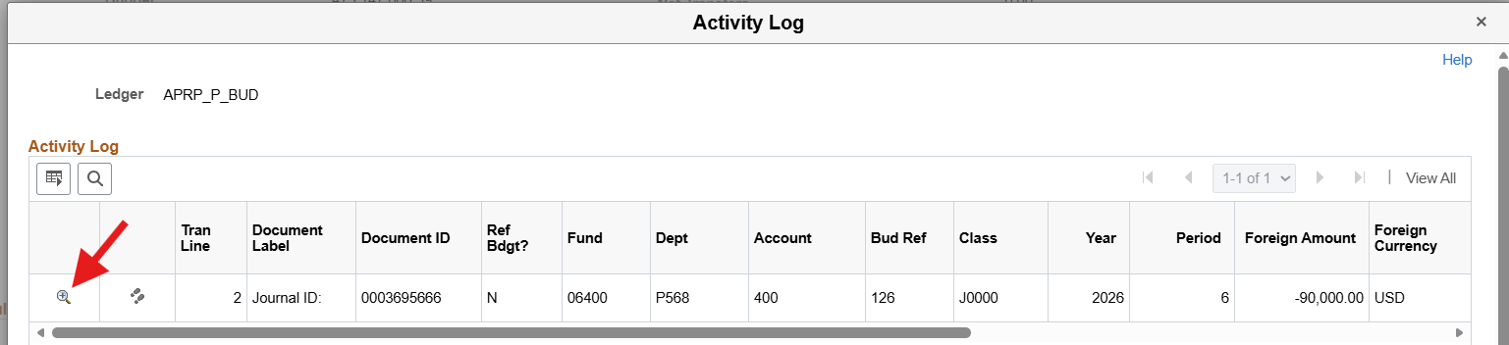
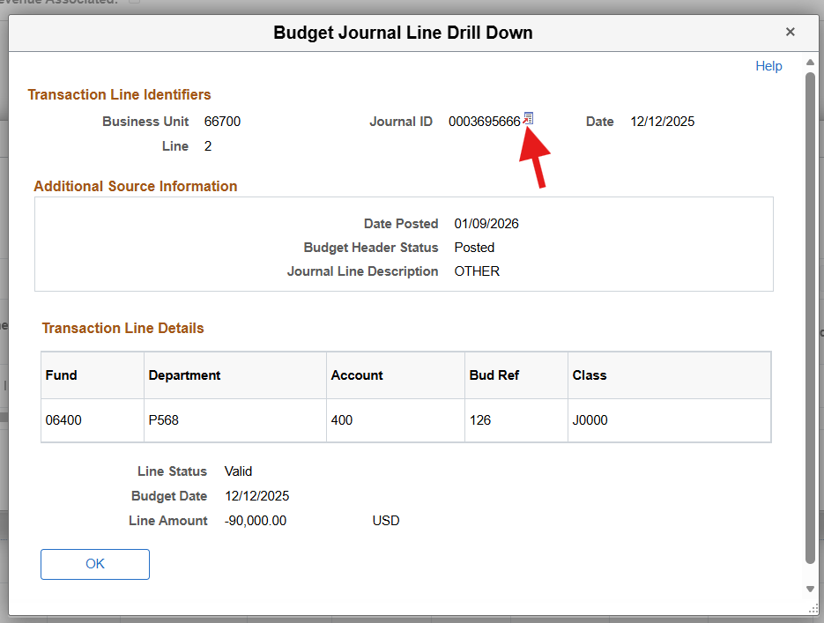
Click on the dollar amount and the system will come back with the journal id applicable for that transaction.
Now – I want to look at the journal – click on the magnifying glass.
The system will come back with a little more detail. But to go to the actual journal, click on the red arrow by the journal id.

Slide 12
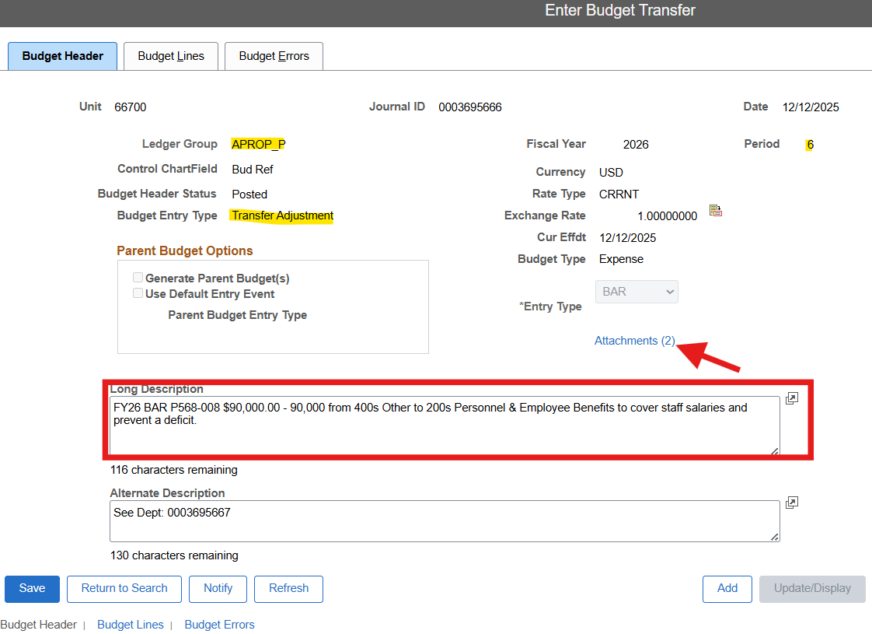

Slide 13
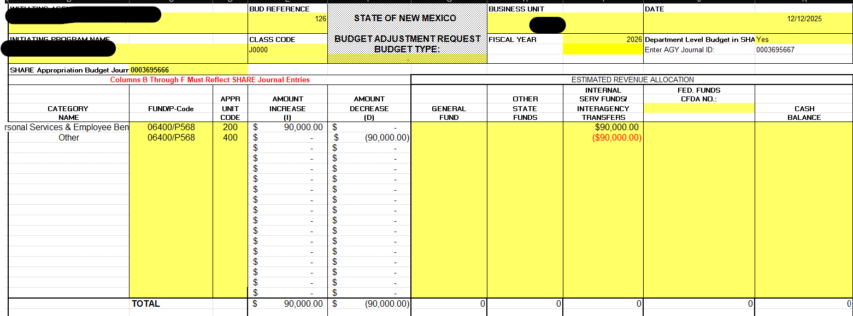
Budget Journal Attachments:

Slide 14
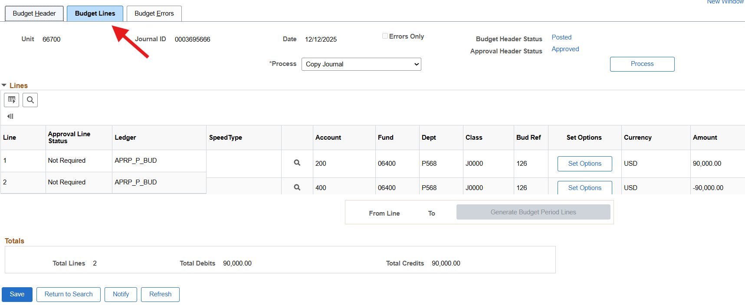
Ties to support showing an increase in 200s and decrease in 400s

Slide 15
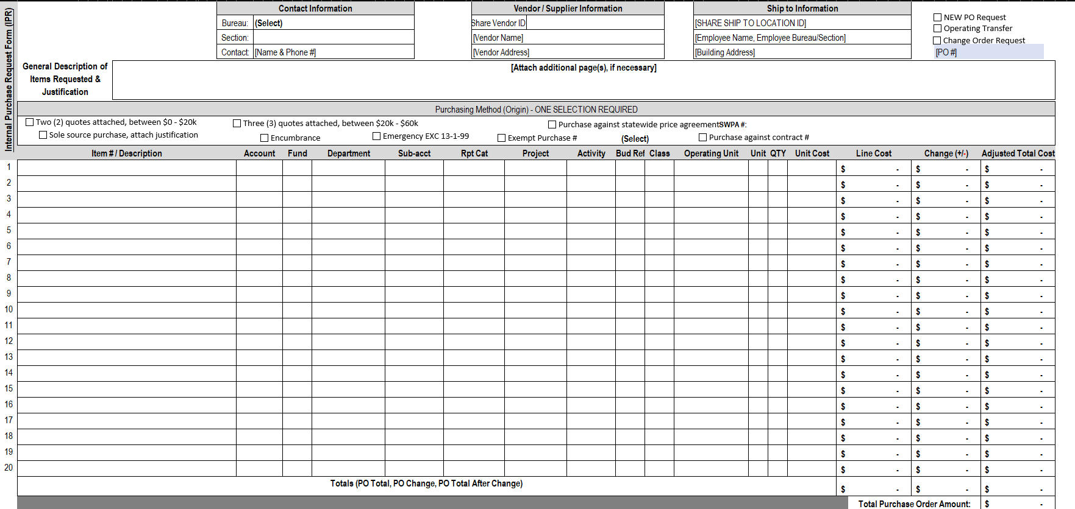
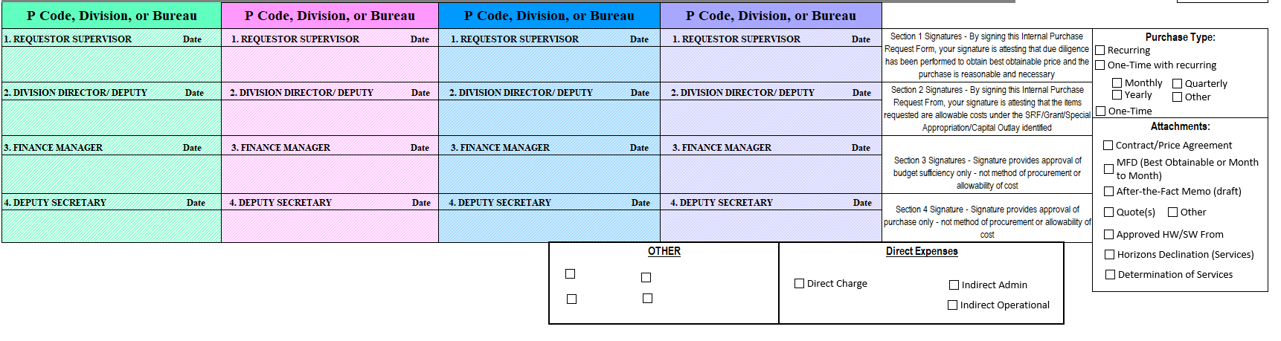
Requisition / IPR
Every agency has some version of this - a guide to help navigate procurement requirements. Each requirement is addressed in this example. I particularly like the layout of the funding string.
Food for thought – if you have something like this for ISTEs, you can avoid missing critical chartfields!

Slide 16
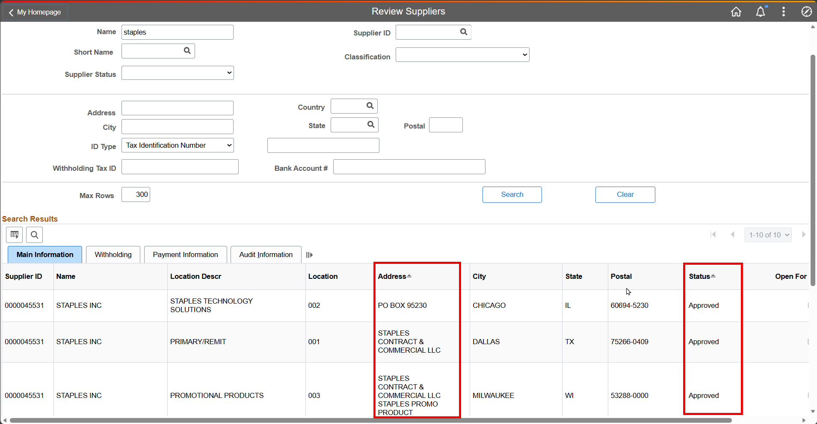
Once you’ve filled out your IPR / Req template, confirm your supplier is in SHARE with an Approved status. Confirm SHARE Address = remittance address

Slide 17
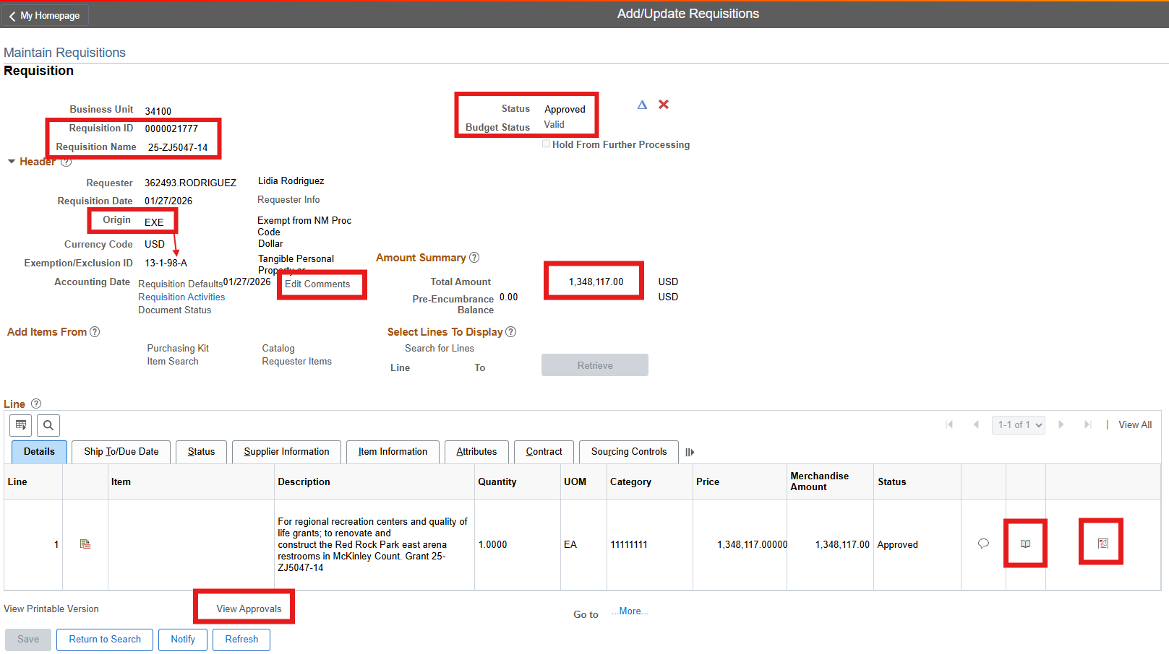

Slide 18
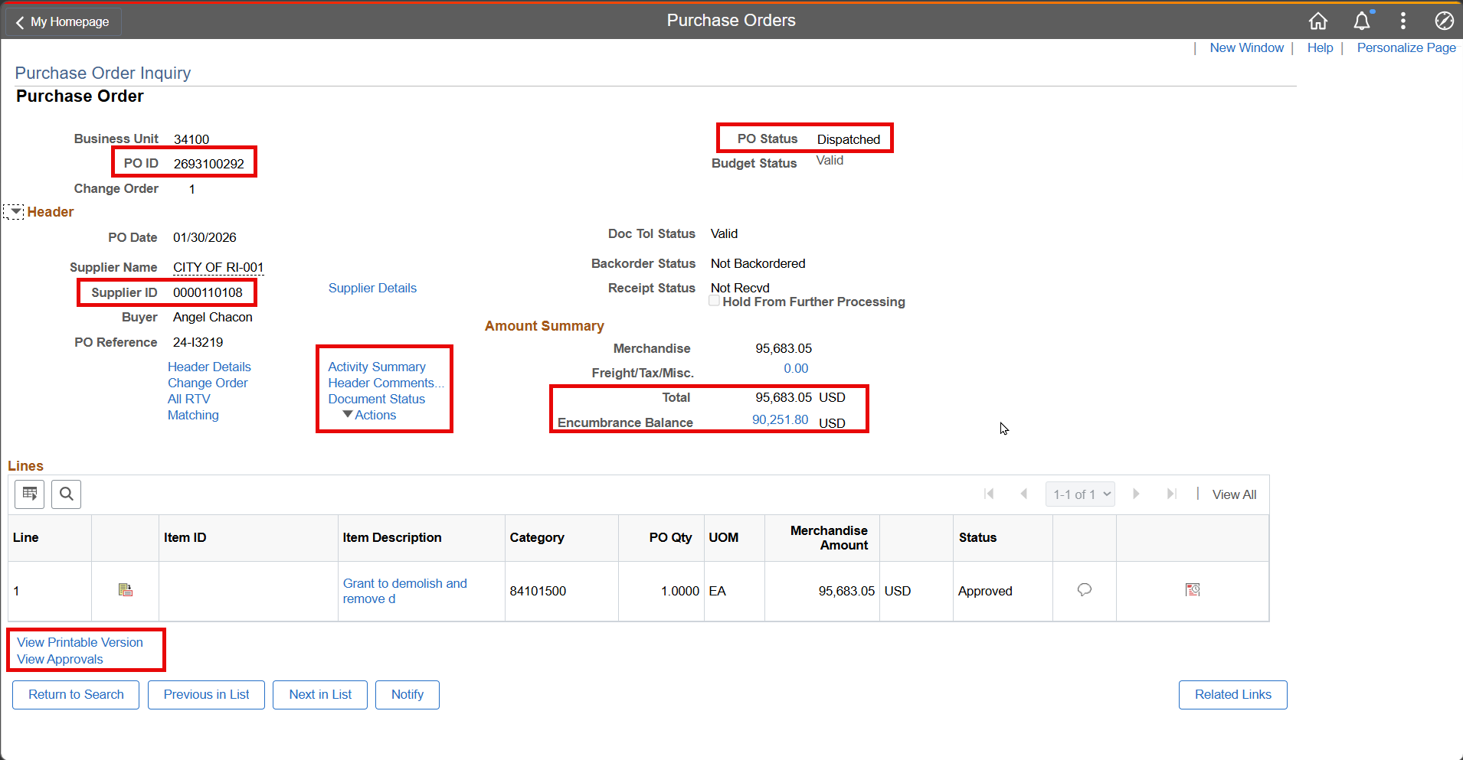

Slide 19
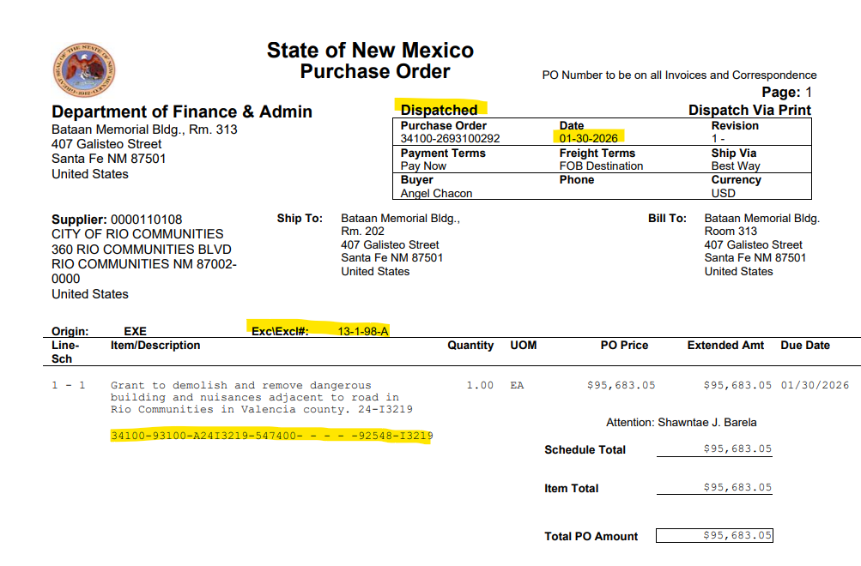

Slide 20
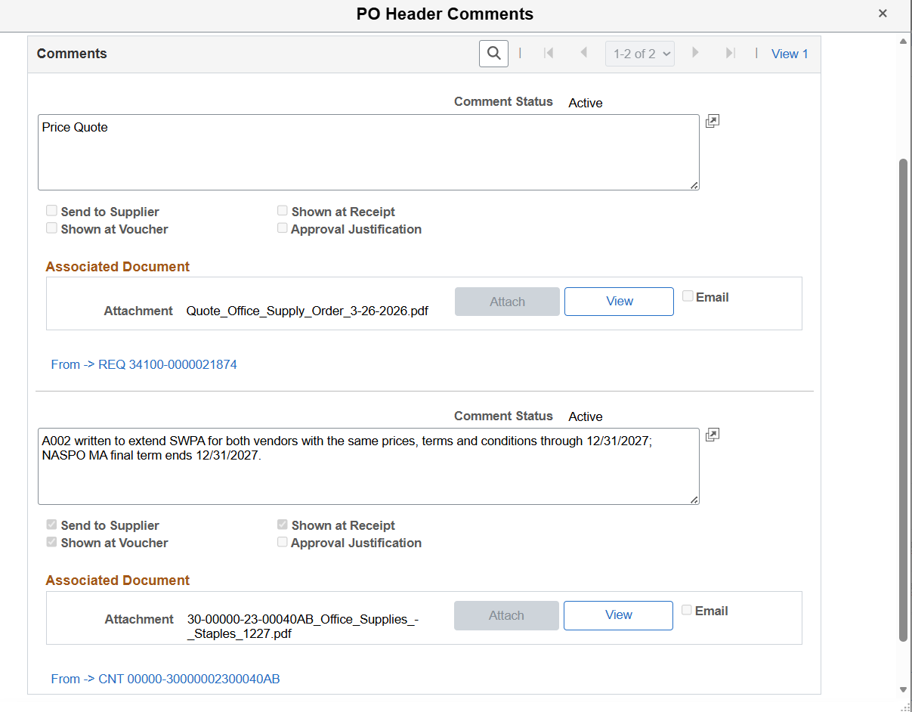

Slide 21
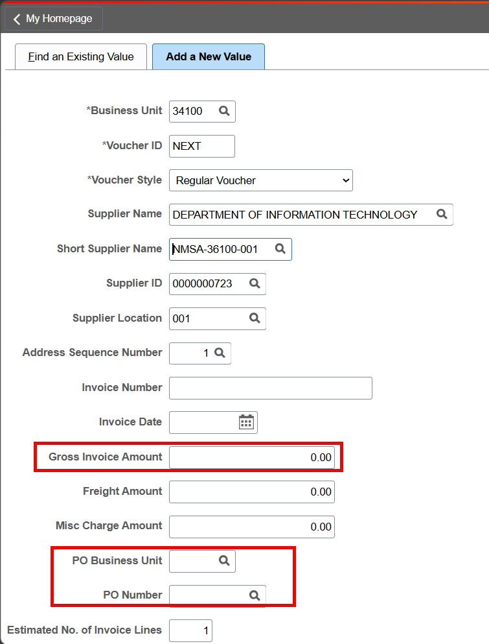
This is where the PO is matched to a voucher. Once a PO is matched, it will populate each PO line, including the funding string.
It is important to verify the funding string at this point and correct the PO if necessary. Otherwise, a JE will be required to correct mistakes.
ISTEs are an exception, where a PO is not matched to the voucher.
Note: Gross amount is entered on this screen, see the next slide for more.

Slide 22
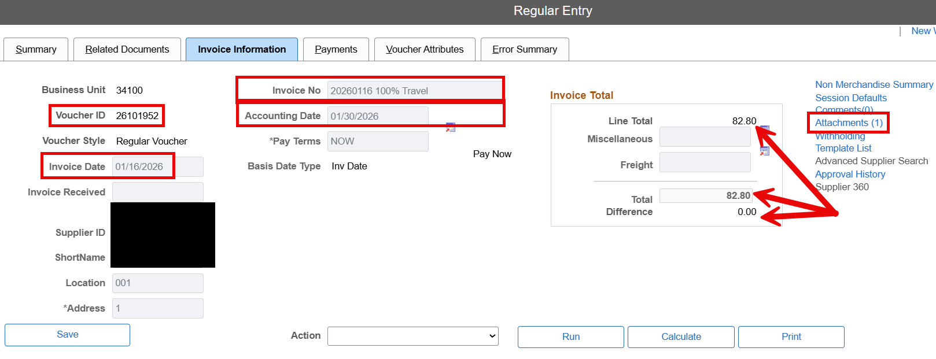
Continued: Individual line amounts are entered on this screen. The difference is calculated here to ensure the gross amount = sum of each voucher line.

Slide 23
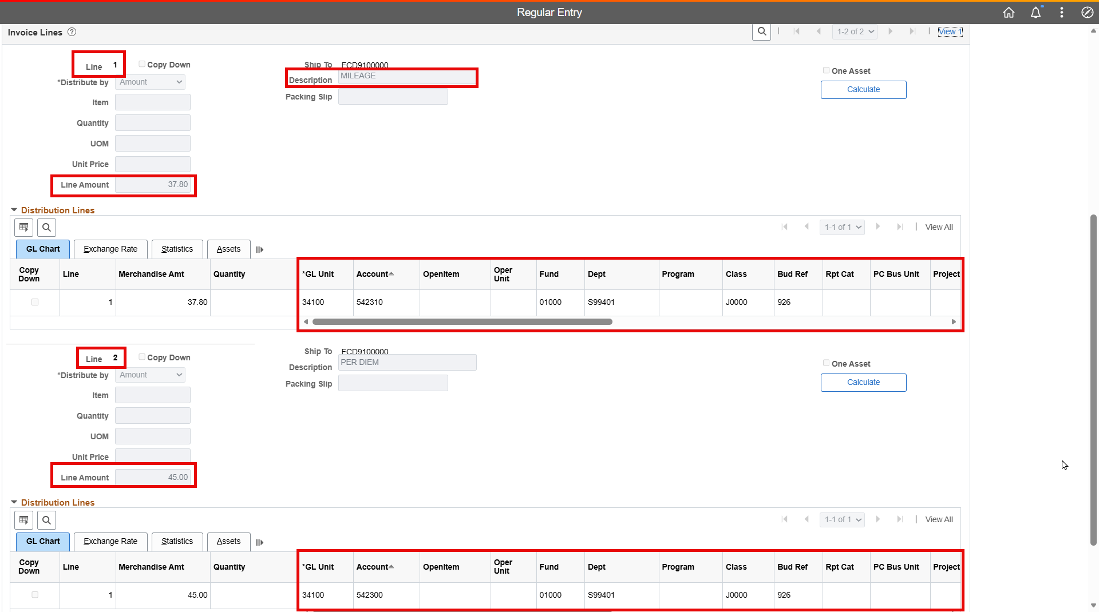
Does your description correspond to your account code?

Slide 24
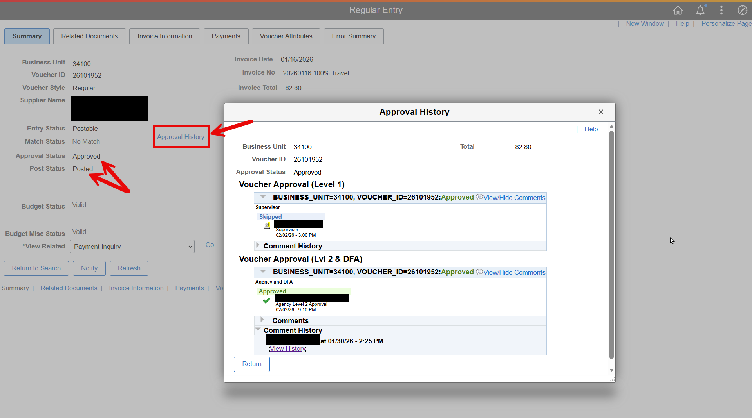

Slide 25
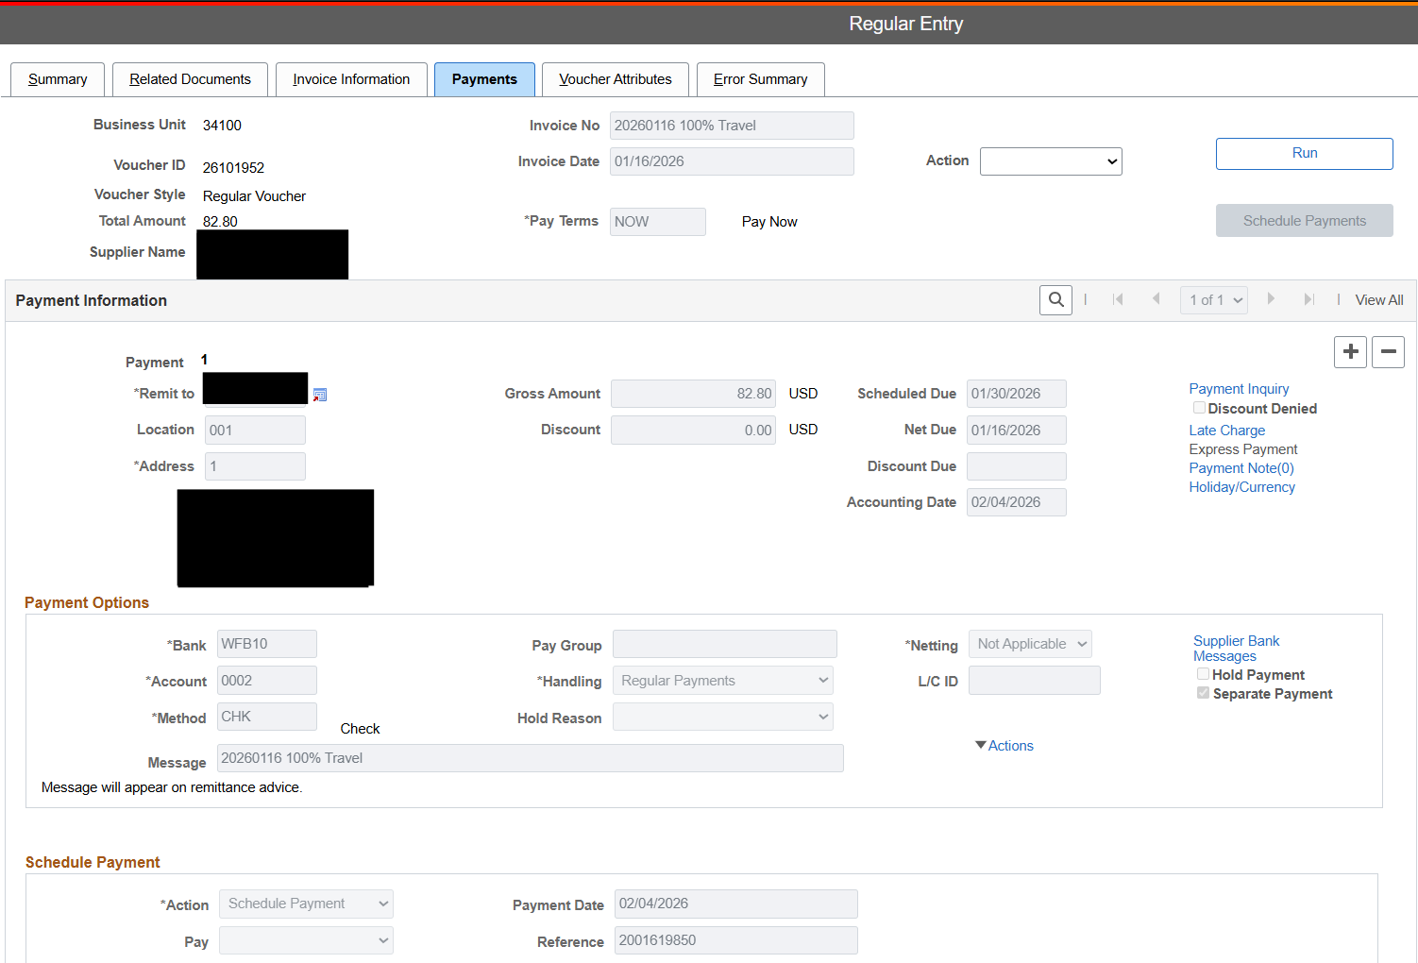
Does your Remit To address match your invoice Remittance Address?

Slide 26

Example 1:
PO total: $95,683.80
Encumbrance Balance: $90,251.80
Invoiced (difference): $5,431.25
One (1) PO Line

Slide 27
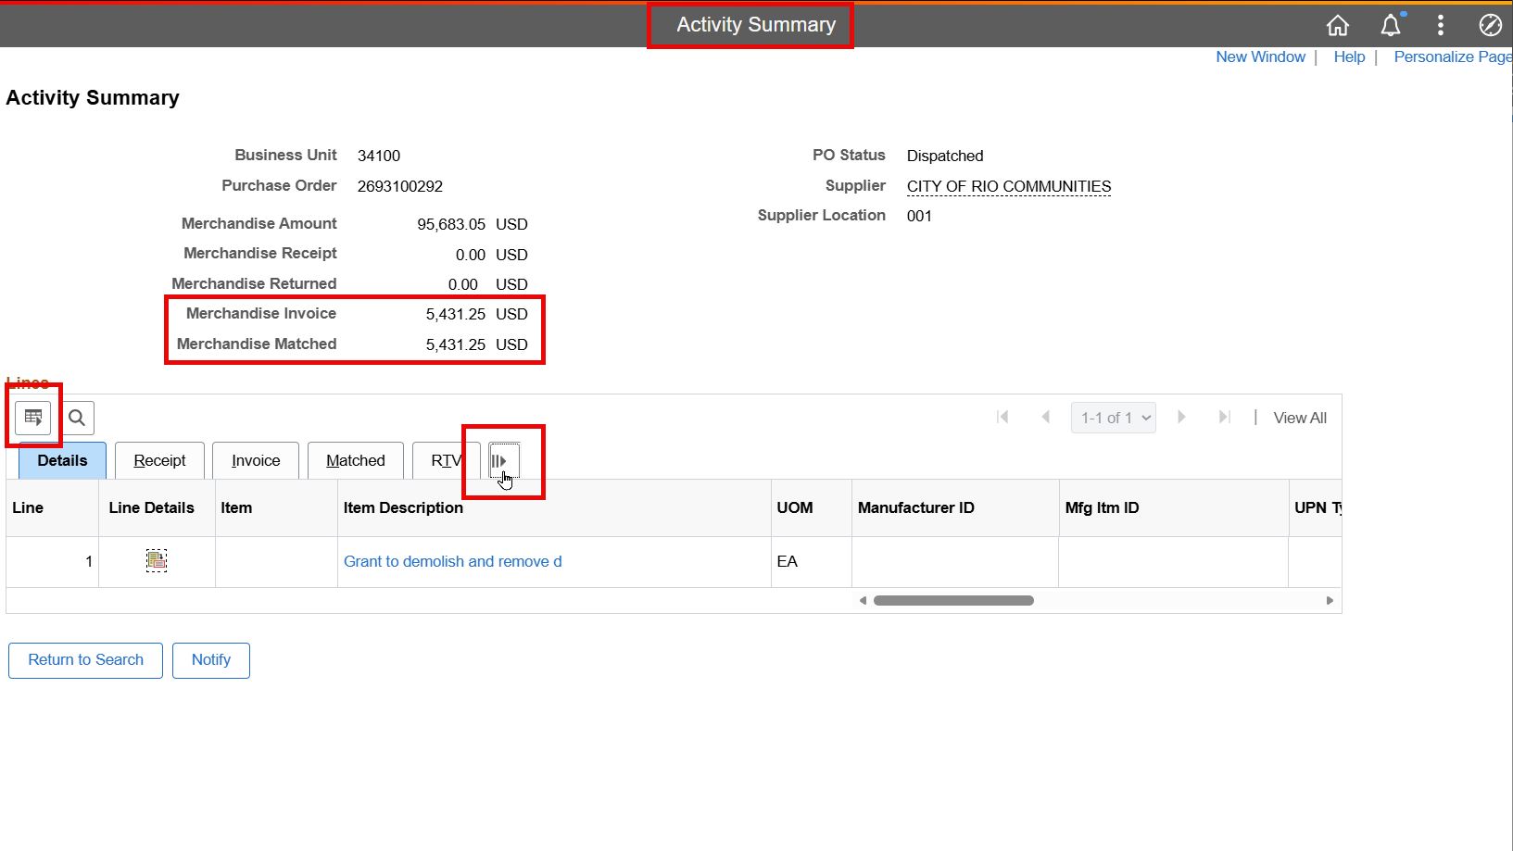
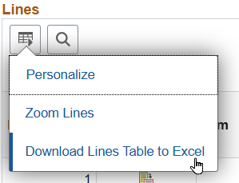
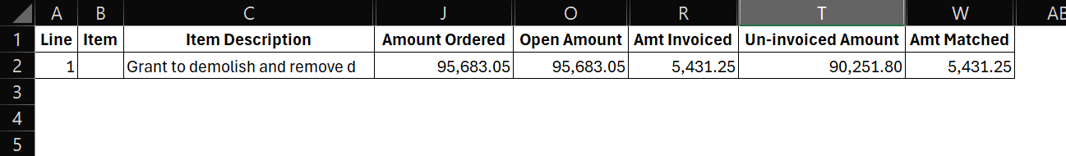
Note: this is another area to personalize your fields! Look at how many columns I had to hide when I exported this table to Excel!
PO total = Merchandise Amount, Amount Ordered, Open Amount
Amount Invoiced = Vouchered
Un-invoiced Amount = Encumbrance Balance

Slide 28
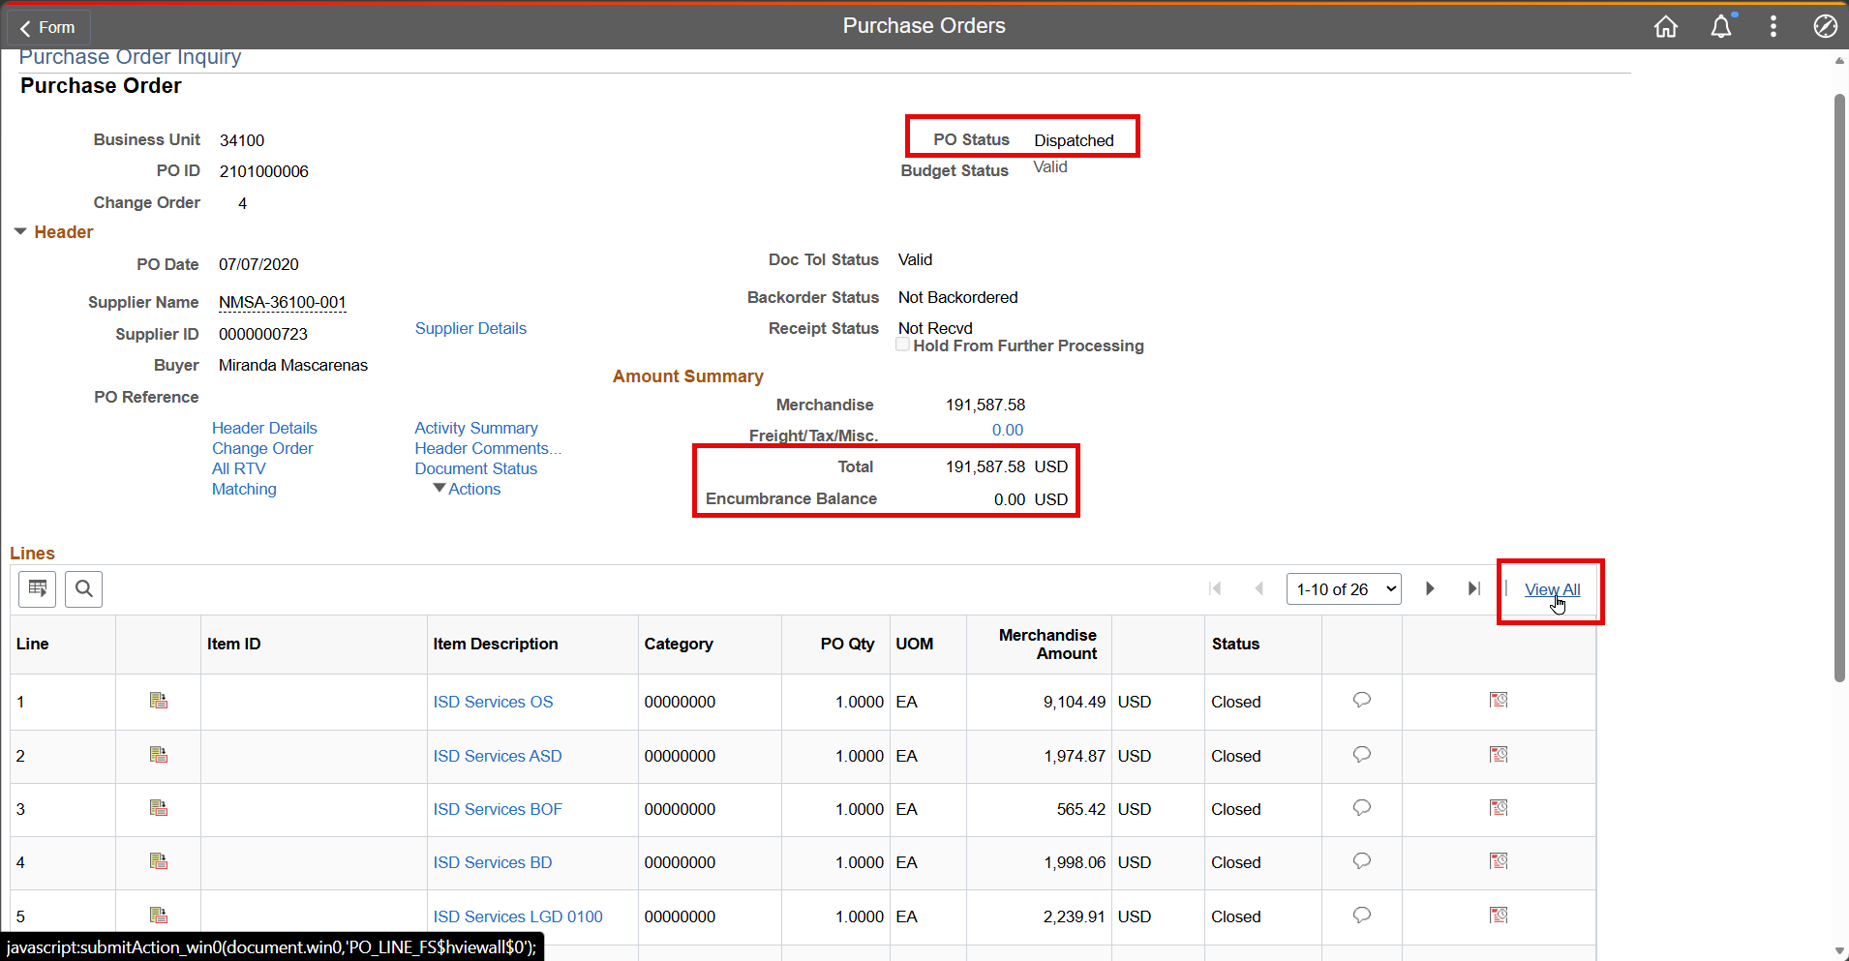

Example 2:
PO total: $191,587.58
Encumbrance Balance: $0.00
Invoiced (difference): $191,587.58
26 PO Lines

Slide 29
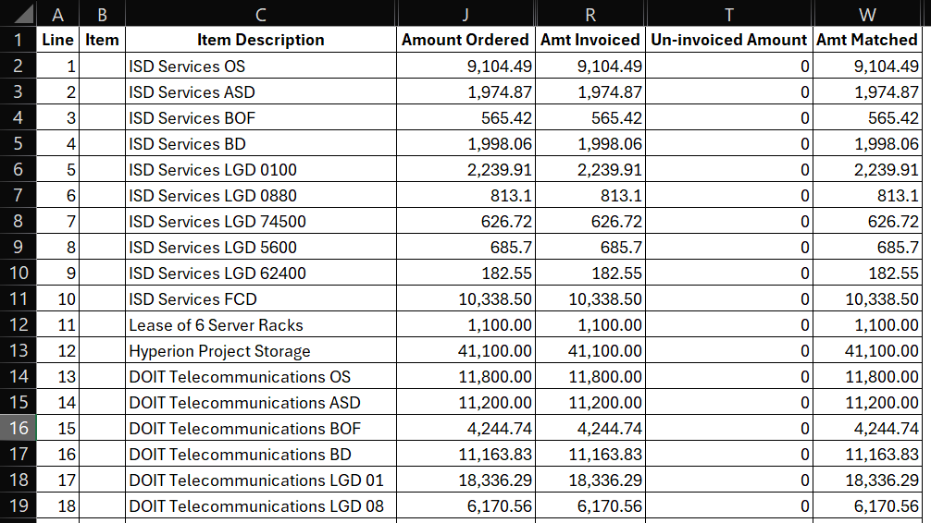
PO total = Merchandise Amount, Amount Ordered, Open Amount
Amount Invoiced = Vouchered
Un-invoiced Amount = Encumbrance Balance

Slide 30
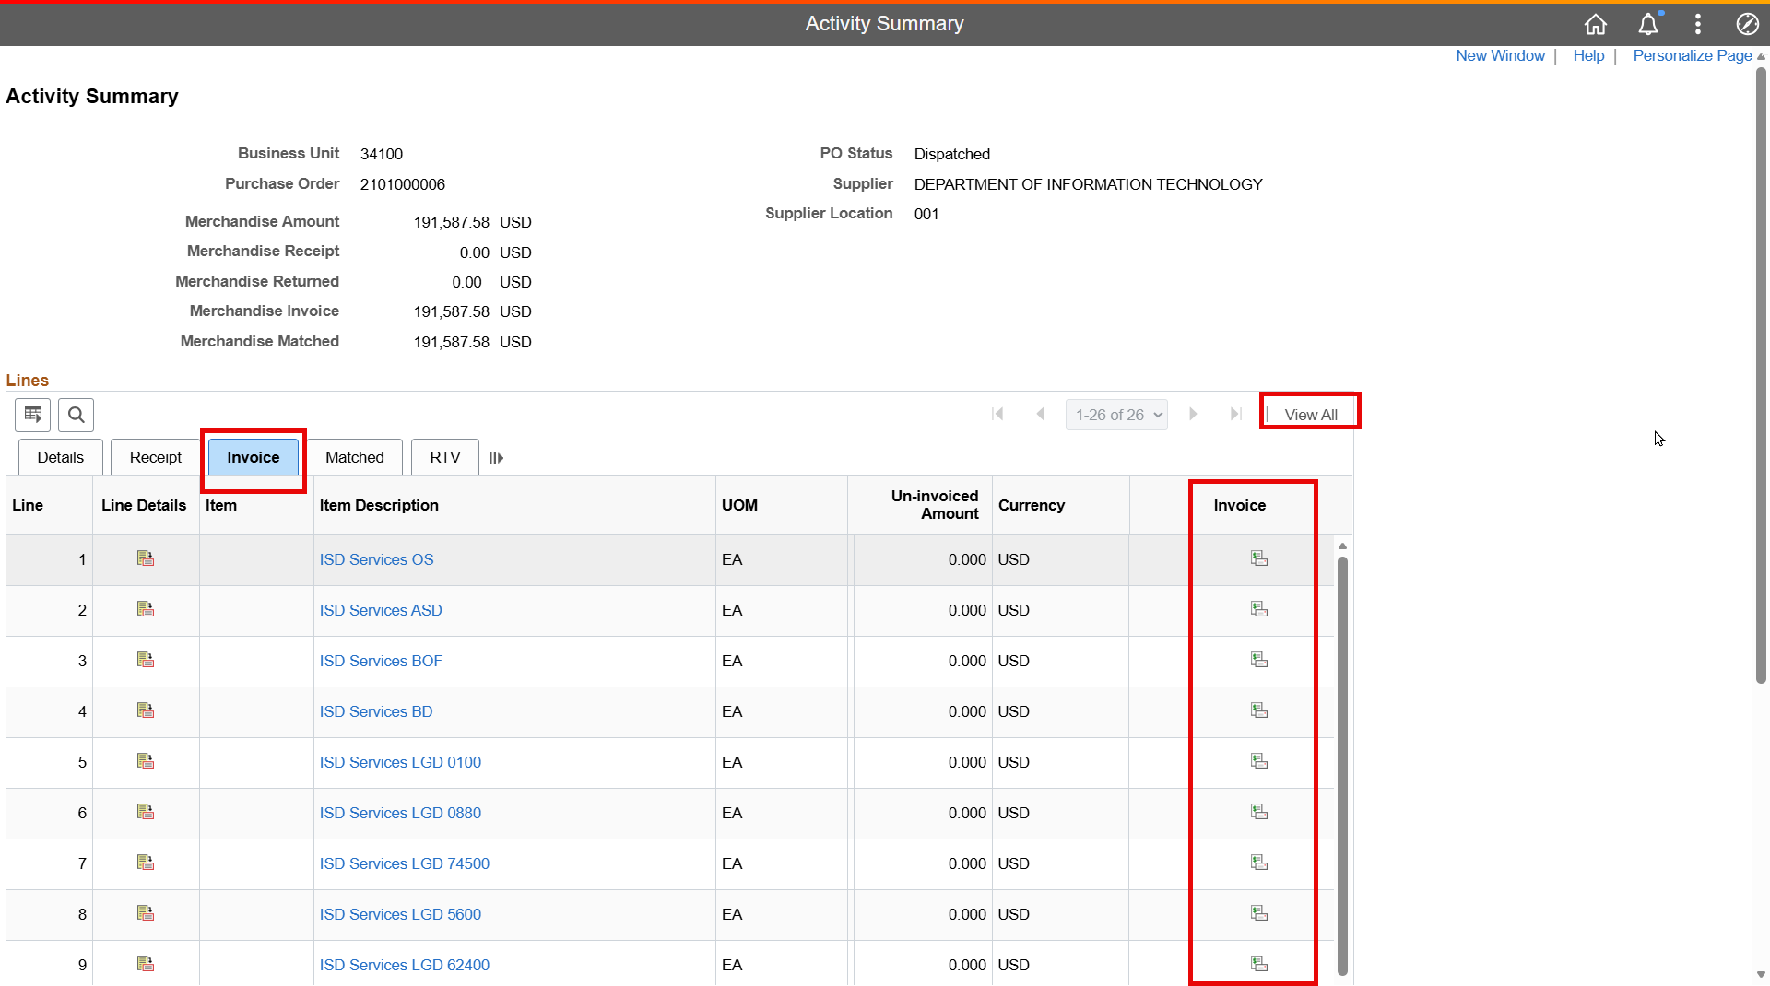

Slide 31
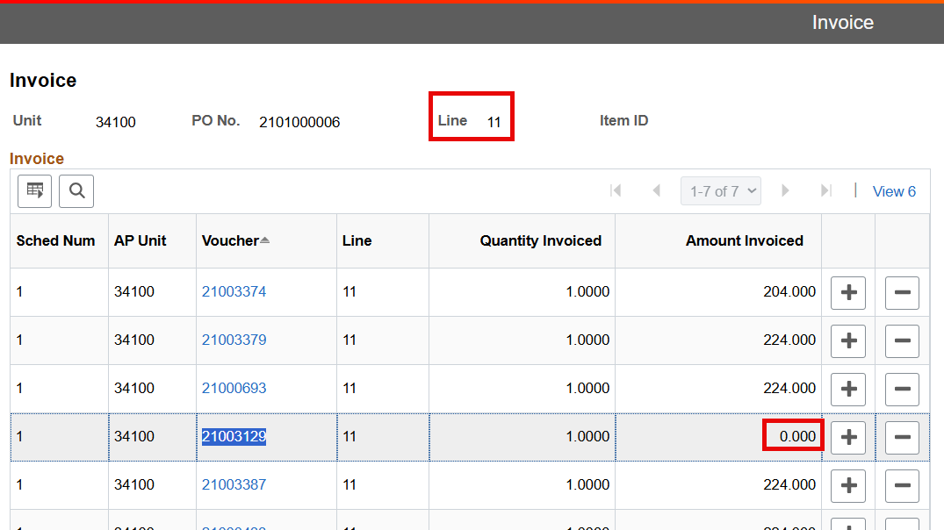

Slide 32
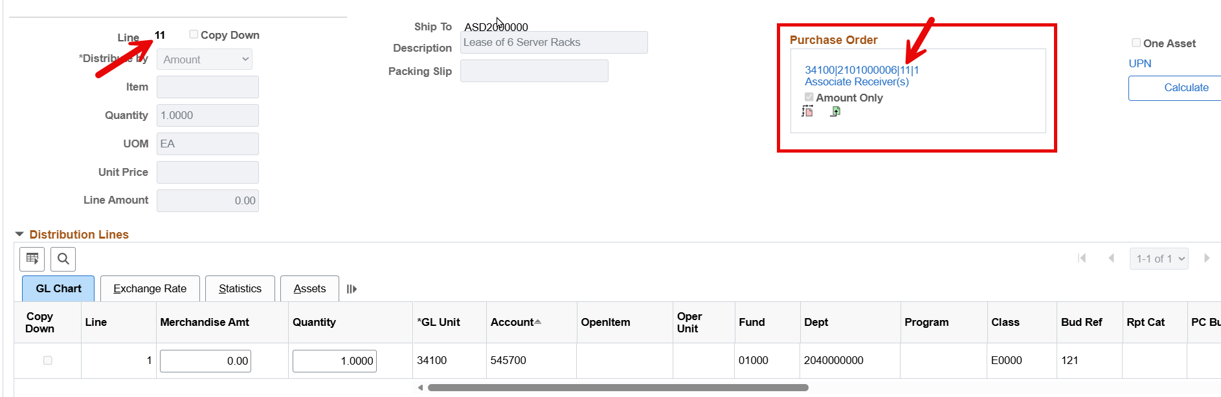
Note: notice that here, the voucher line and PO line are both 11. The purchase order number pointed to in the red box will be your primary focus, as the voucher line number will not always match.

Slide 33

Example 2:
PO total: $191,587.58
Encumbrance Balance: $0.00
Invoiced (difference): $191,587.58
26 PO Lines

Slide 34
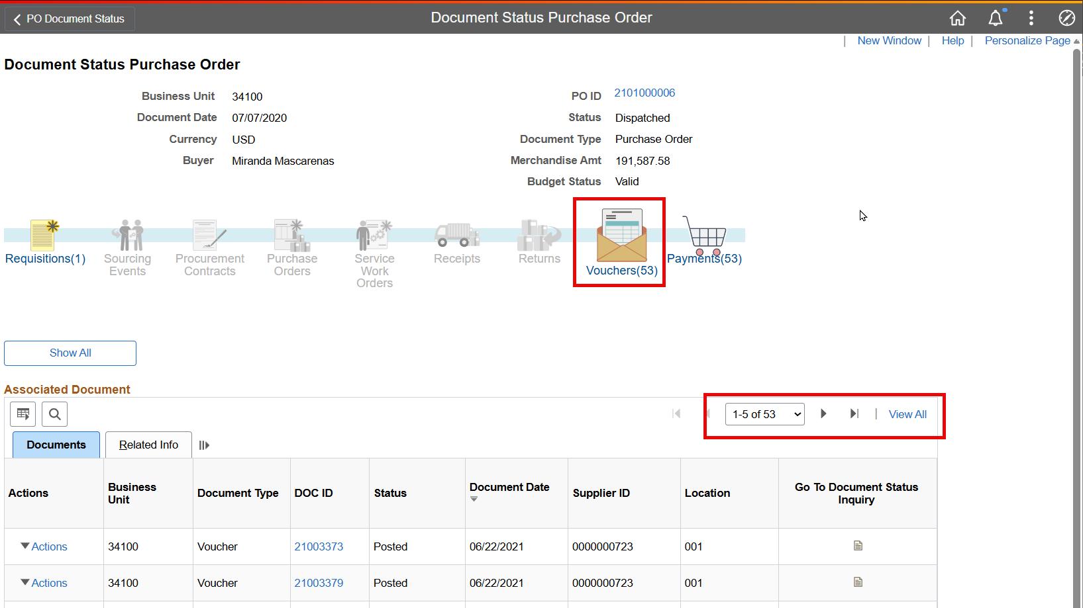
Note: copy the voucher number, open a new window, and paste the voucher number into a voucher search.

Slide 35
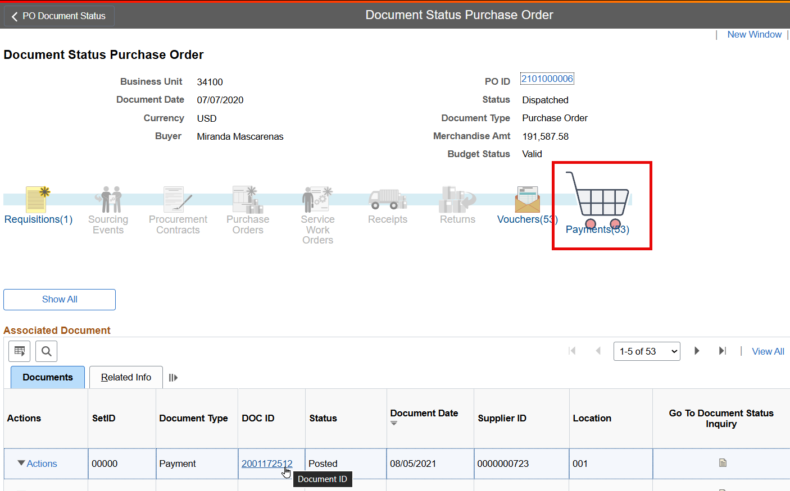
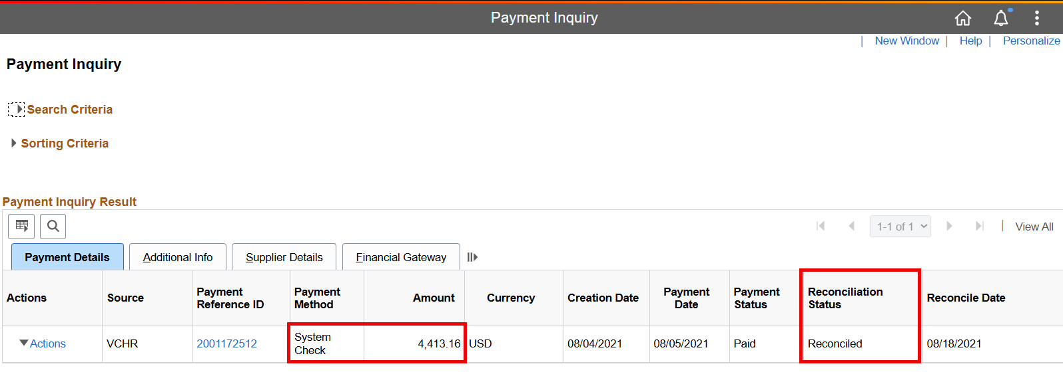
Pro tip: Run a query to determine reconciliation status on all vouchers
NMS_OUTSTANDING_WARRANTS

Slide 36
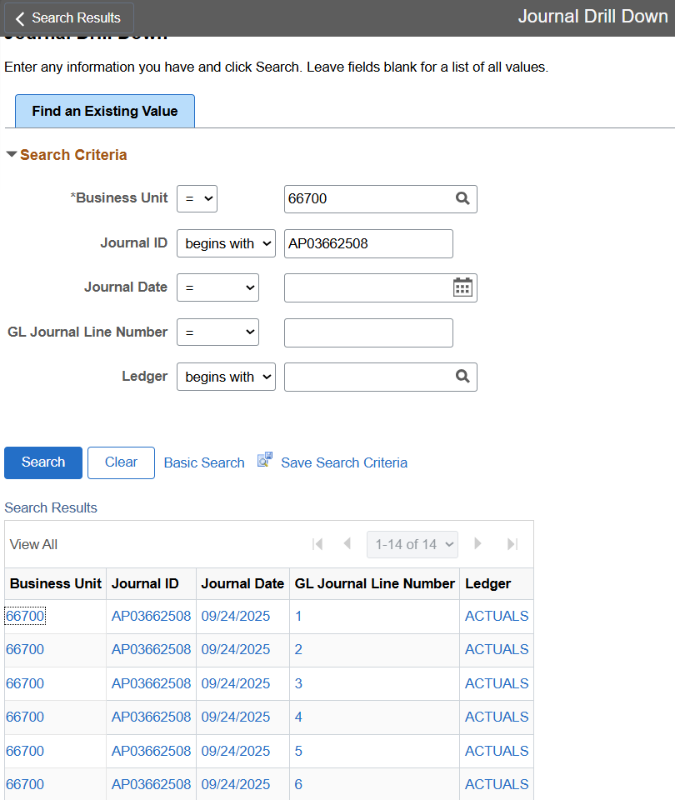
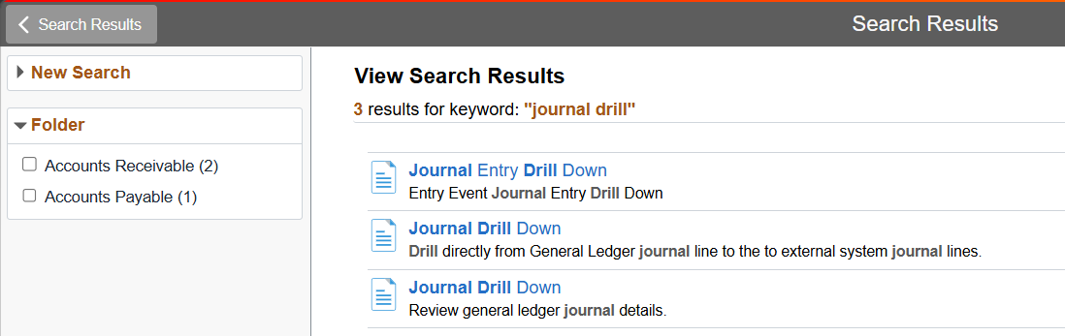
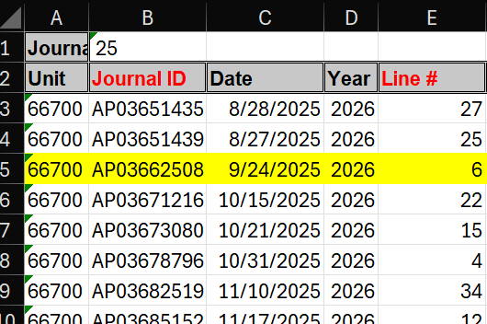

Slide 37
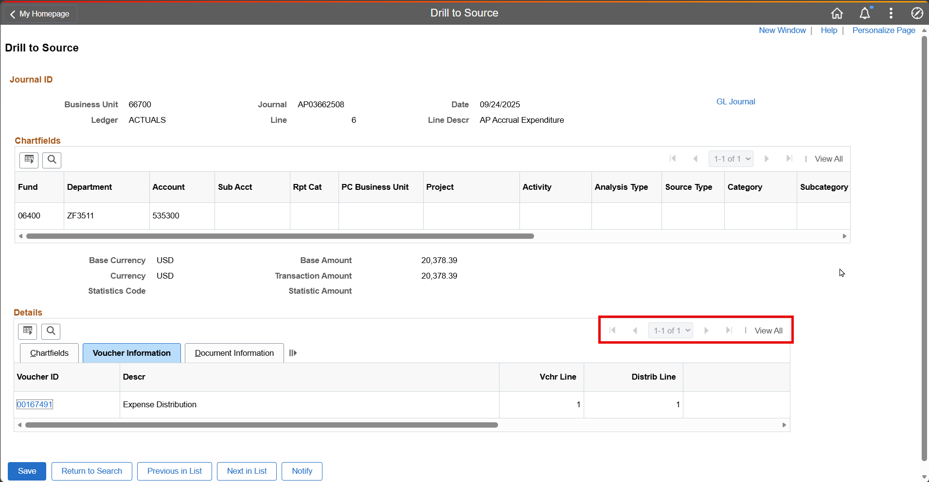

Slide 38
  SHARE Queries
Chart Field Descriptions
CHART_OF_ACCTS_CURRENT
DEPTS_BY_AGENCY
FUND_LISTING_DESC1
Accounts Payable/Procurement
NMS_REQUISITION_LISTING
NMS_PO_LISTING_DESCR
NMS_VCHR_REVIEW_DESCR1
NMS_AP_VCHRS_DENIED
NMS_VCHR_BUDGET_ERROR
NMS_VCHR_MATCH_EXCEPTIONS
NMS_AP_JRNL_DETAIL_FUND
  Do not rely on AP queries. The GL is your book of record and is the basis of all reporting and reconciling.
General Ledger
NMS_GL_JOURNAL_LINE
Cash
NMS_OUTSTANDING_WARRANTS
NMS_BANK_TRANS_SEARCH_BY_AMT
NMS_DFA_CASH_REPORT_V3_PUB
NMS_AR_DJ_ENTRIES_CASH_REMED
Historical
NMS_HST_GL_JOURNAL_LINE
NMS_ARC_PYMNT_BY_PYMNT_DT

Slide 39
Additional Resources:
YouTube SHARE Training Videos | New Mexico Department of Finance and Administration
info.share.nm.gov/fin-jobaids.html
info.share.nm.gov/fin-training.html
Manuals | New Mexico Department of Finance and Administration
Year End Closing | New Mexico Department of Finance and Administration

Slide 40
How to obtain a voucher info via PO module

Slide 41
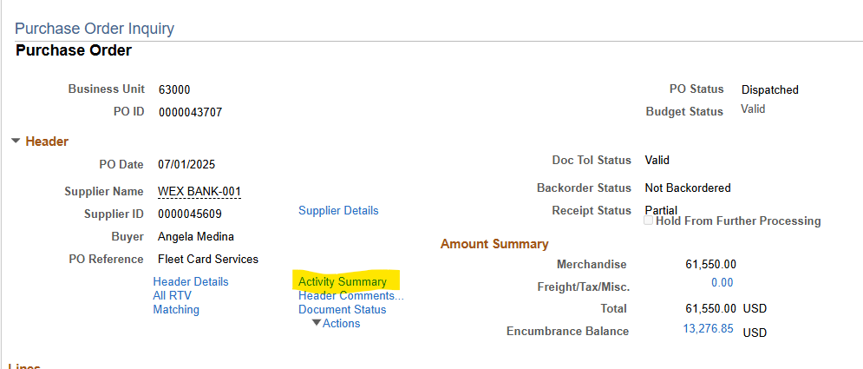
Click on Activity Summary

Slide 42
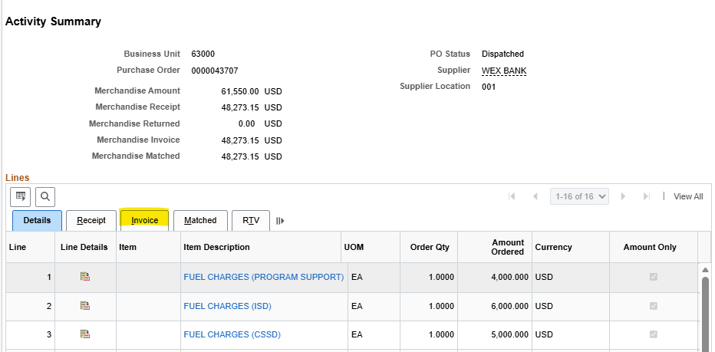
Click on the invoice tab

Slide 43
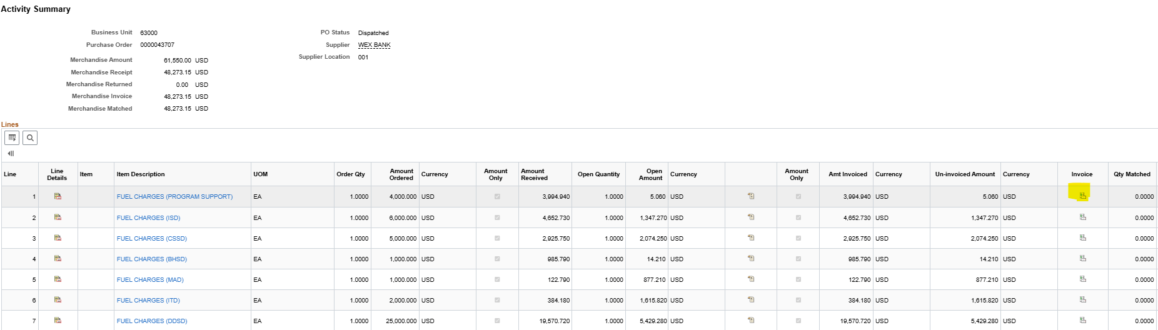
Click on the Invoice icon

Slide 44
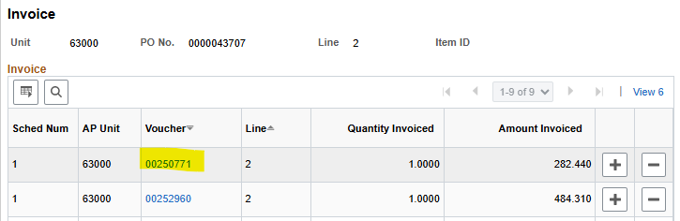
Click on the voucher #

Slide 45
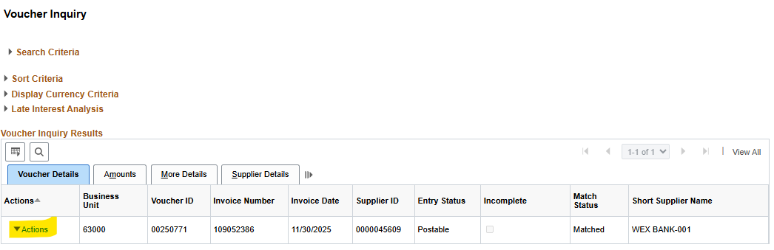
Click on Actions

Slide 46

Click on View attachments

Slide 47


Click on the File Name & the voucher will come up

Slide 48


Click on Actions
Click on Payment Information and this will provide you with the payment date, amount, and payment reference ID.

Slide 49


Click on Payment Reference ID
Payment status is provided at this level as well as the voucher module

