Slide 1


Department of Finance and Administration
Audit & Compliance Module Overview

Slide 2
Budget Sheets and
Agency Workflow

Slide 3
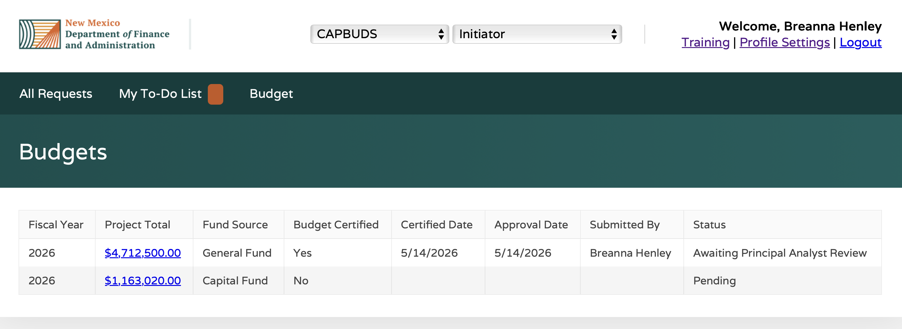
Budget Sheets
The “Budget” tab will bring you to a grid that shows the budget(s) that need to be completed for your agency.

Slide 4
Agency Workflow
“Initiator” conducts the first agency review/edit of the budget.
  At this stage, the budget is “Pending” status.
“Approver” conducts the second (final) agency review/edit.
  After this review, the budget is sent to DFA for review.
Following DFA’s approval of General Fund and CDPF budgets only, an Allotment Form for your agency will be available for the “Approver” to review and sign.
  After the agency “Approver” signs, the Allotment Form is routed through DFA for signature.

Slide 5
Agency Initiator Review/Edit

Slide 6
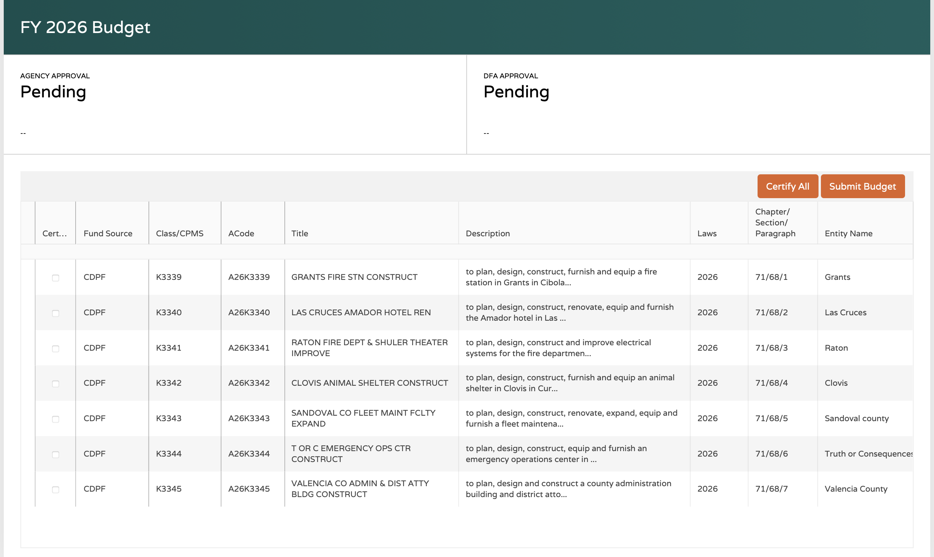
Agency “Initiator” Review/Edit
Click on a budget you would like to review to open the review grid:
Each line item must be certified for the budget to move forward.
Scroll horizontally to see all columns in the grid.

Slide 7
Agency “Initiator” Review/Edit
Edits may be requested for certain budget details, indicated by a pencil icon:
AIPP (Art in Public Places)
  If a project has AIPP, you will see 1% of the total funds in this column. You may request to remove it which will adjust your overall budget total and you will need to allocate the AIPP to a budget category. Justification is required to request an AIPP change.
Budget Categories
  Budget is automatically entered into the 400s category, but you may request for budget to moved. If you add budget to another category, you must remove it from the 400s to ensure the total matches.
Reversion Date
  Reversion dates may be requested to be 2-year or 4-year projects. A change here will automatically update the BudRef to the appropriate reversion date. Justification is required to request a reversion date change.
BudRef
  BudRef may be requested to change, which will change the corresponding reversion date. Justification is required to request a BudRef change.

Slide 8
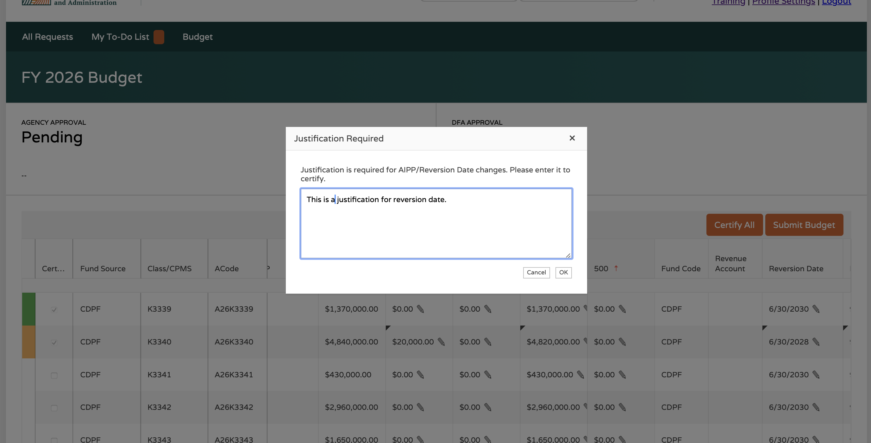
Agency “Initiator” Review/Edit
For AIPP and Reversion Date/Bud Ref change requests, you will be prompted to enter justification for the change as you certify the row:

Slide 9
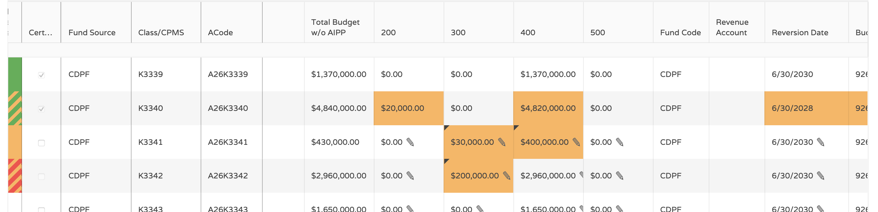
Agency “Initiator” Review/Edit
As you make updates, the grid will reflect changes requested through color-coded highlights:
Green = Certified with no change
Green + Yellow = Certified with changes
Yellow = Change made and not certified
Red + yellow = Unacceptable change made and not certified
***Changes will not save automatically – you must certify before leaving the page to save your changes!

Slide 10
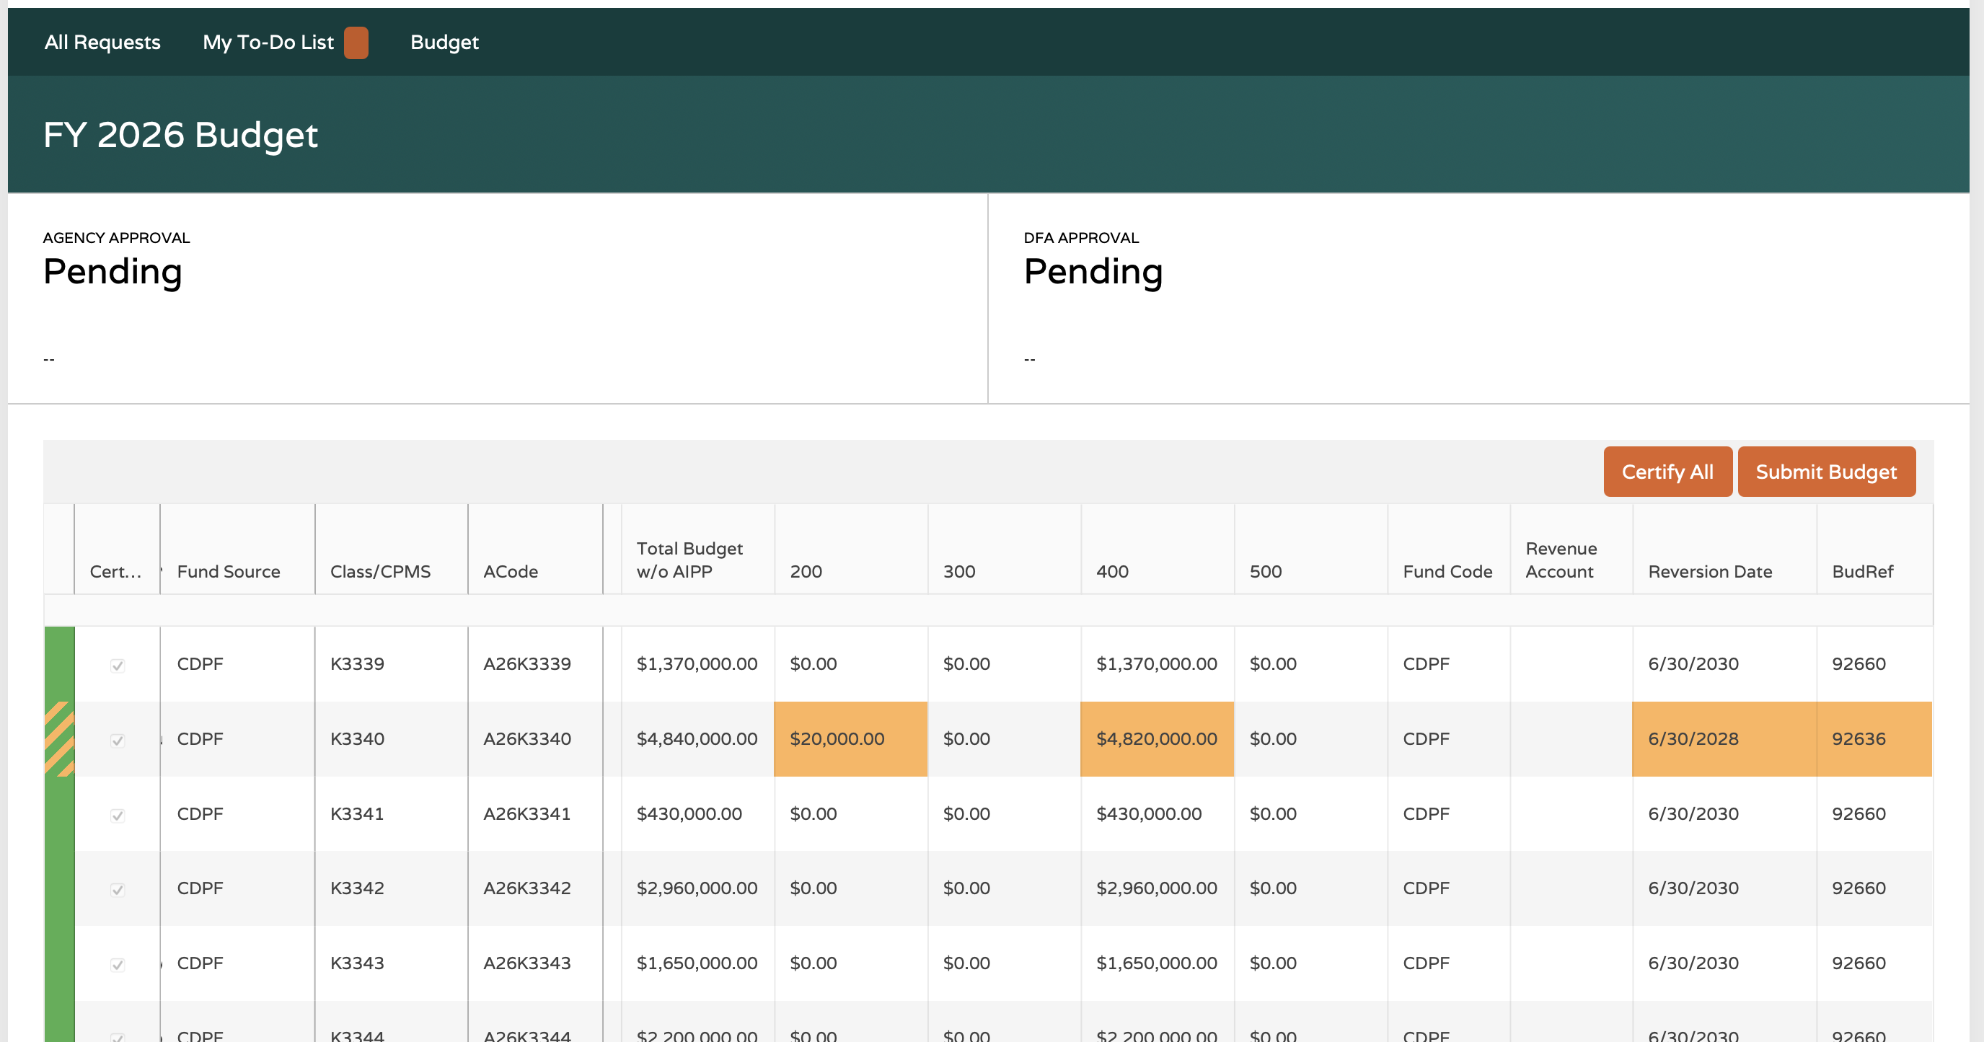
Agency “Initiator” Review/Edit
Once all line items have been certified, click “Submit Budget” to send to the agency “Approver” for review.

Slide 11
Agency Approver Functions

Slide 12
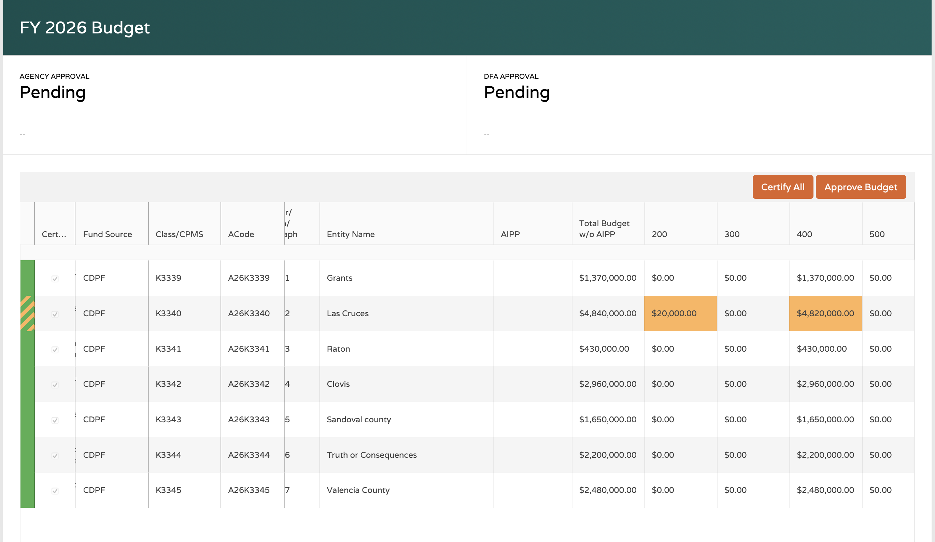
Agency “Approver” Review/Edit
The agency “Approver” is responsible for reviewing the information submitting by “Initiator” and clicking “Approve Budget” to submit to DFA.

Slide 13
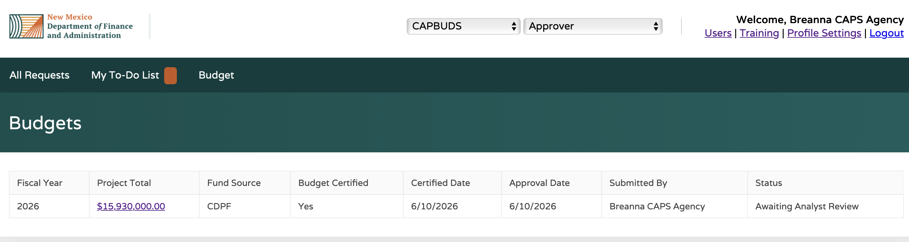
Agency “Approver” Review/Edit
Once submitted, the status will be updated based on DFA’s review:
  Awaiting Analyst Review
  Awaiting Principal Analyst Review
Then, Allotment Form is generated and needs to be signed by Agency Approver

