Slide 1


Department of Finance and Administration
Bond Tracking System

Slide 2

INTRODUCING
Bond Tracking System
A centralized, unified system designed for managing transactions, draw requests, and
loading each appropriation across agencies.
The system will be accessible from an internet browser using state email address
Multi-factor authentication by text or email is required
This may be one of multiple modules a user will have access to

Slide 3

Bond Tracking System
Key Functions
The Bond Tracking System empowers the Board of Finance and agency partners to manage and oversee the financial activities related to projects funded by bonds—from initial requests to approvals. The system’s components include:
Project Details
Project profiles highlight appropriation details, including expenditure progress and draw request history, conditions, reauthorizations, and reversions.
Request Submission and Tracking
Empowers agencies to submit draw requests directly and track the status of their request, ensuring a streamlined process for communicating needs.
Payment Processing
The Bond Tracking System generates CSV files for the Board of Finance to upload to SHARE for payment processing to ensure a smooth transition from approved draw requests to payments.
Historical Data and Reporting
Reporting capabilities and historical data storage provide insights into past appropriations, request volumes and processing times, helping users understand and improve request processing.
1
2
3
4

Slide 4
Bond Tracking System: Agency User Roles
Agency User Roles
The Bond Tracking System allows for three agency roles. These are:
Agency Employee
An agency employee can initiate a draw request for projects the agency oversees.
If a request is denied by a signer or BOF, the employee will receive notification and have the ability to correct or delete the draw request.
Agency Signer
An Agency Signer can approve or deny draw requests initiated by Agency Employee for project the agency oversees.
Agency Dual
A Dual Role can initiate and approve or deny draw requests for projects the agency oversees.
This role cannot approve or deny a request that they initiated.

Slide 5
Bond Tracking System: BOF User Roles
Board of Finance User Roles
The Bond Tracking System allows for one BOF role:
Admin
A Board of Finance Admin can approve or deny draw requests for all projects.
If a request is denied by a signer or BOF, the employee will receive notification and have the ability to correct or delete the draw request.
BOF Admins can upload projects to the system and correct all details related to that project.

Slide 6
Viewing Projects

Slide 7
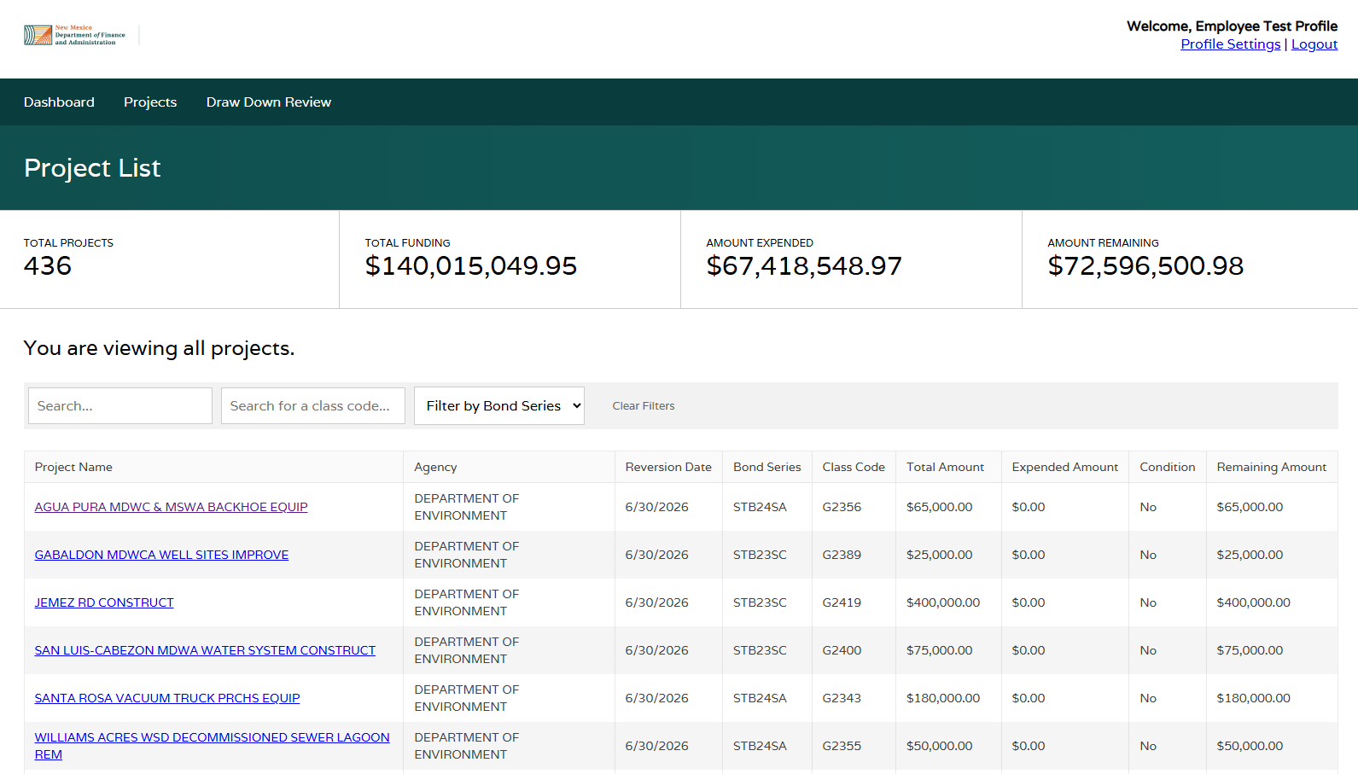
Bond Tracking System: Viewing Projects
In the “Projects” tab, users can view a list of projects. Agency users can only view projects for their respective agency.
Search functions and filters have been implemented to find projects quickly.
From here, a project can be clicked to enter the “Project Profile” and view all details.
EMPLOYEE VIEW (same for signer)

Slide 8
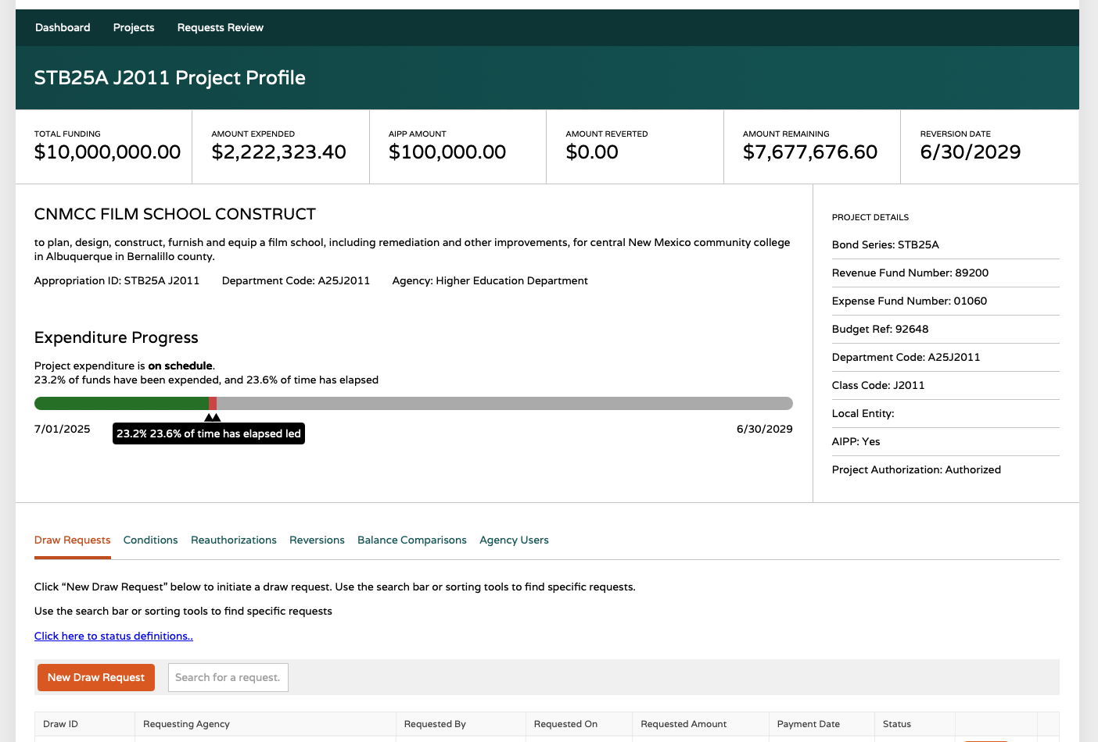
Bond Tracking System: Viewing Projects
“Project Profile” details appear once a project is selected. In the project profile, users can:
View project details.
View/Submit Draw Requests.
View project history, including previously requested draws, conditions, and reauthorizations.
EMPLOYEE VIEW (same for signer, with the exception of submitting a draw request)

Slide 9
Agency Draw Request Submission Process

Slide 10
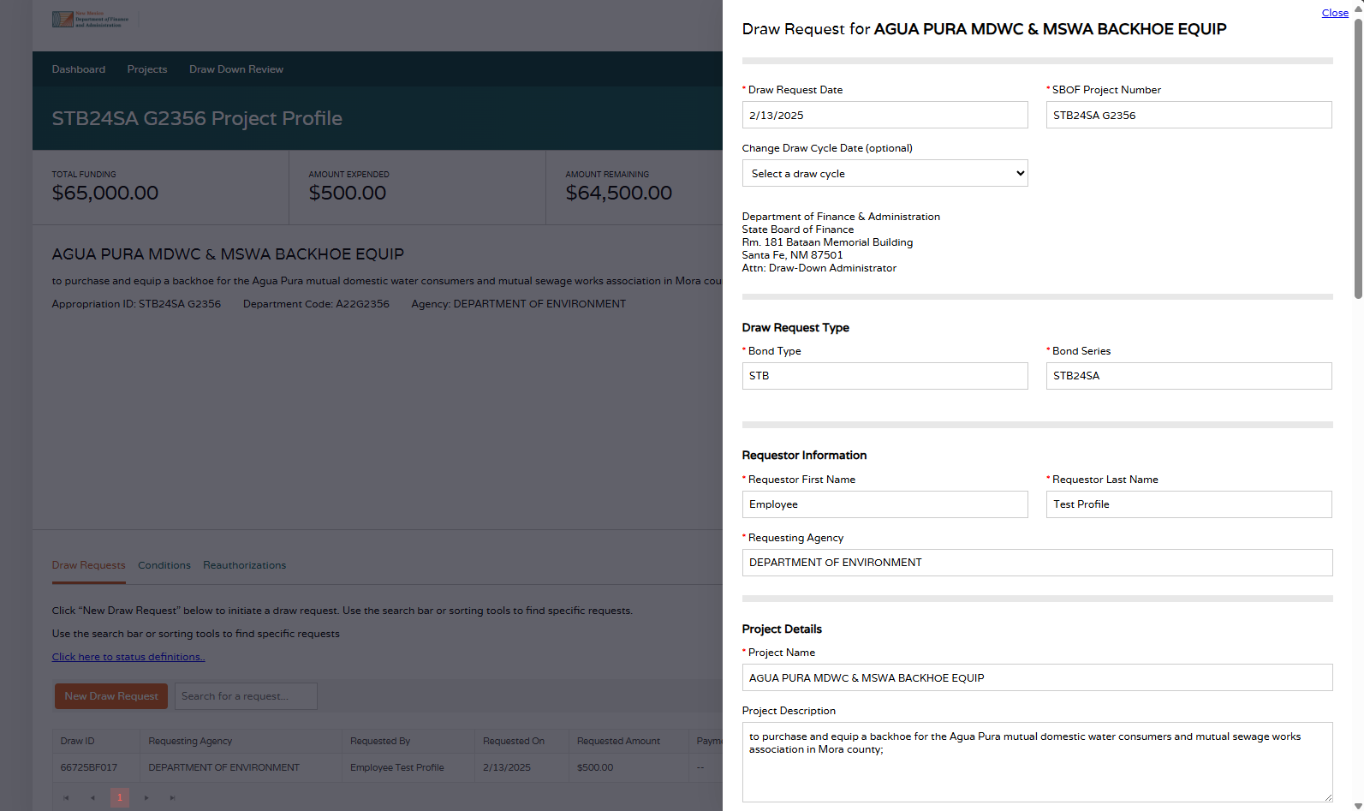
Bond Tracking System: Draw Request Process
Employees submit a draw request by clicking “New Draw Request” under the Draw Requests tab in the Project Profile.
Most information is pre-populated:
  Draw Request Date
  SBOF Project Number
  Draw Cycle Date
    Employees may modify the Draw Cycle Date to one previous or one future draw cycle to accommodate holidays or other reasons approved by BOF.
  Draw Request Type Section
  Requestor Information Section
  Project Details Section
  Payment Information Section
    Some projects may be missing information in this section. If so, Employees will be prompted to fill in the fields.
Notes field is optional.
Employee is required to upload supporting documentation (see next slide).
EMPLOYEE VIEW

Slide 11
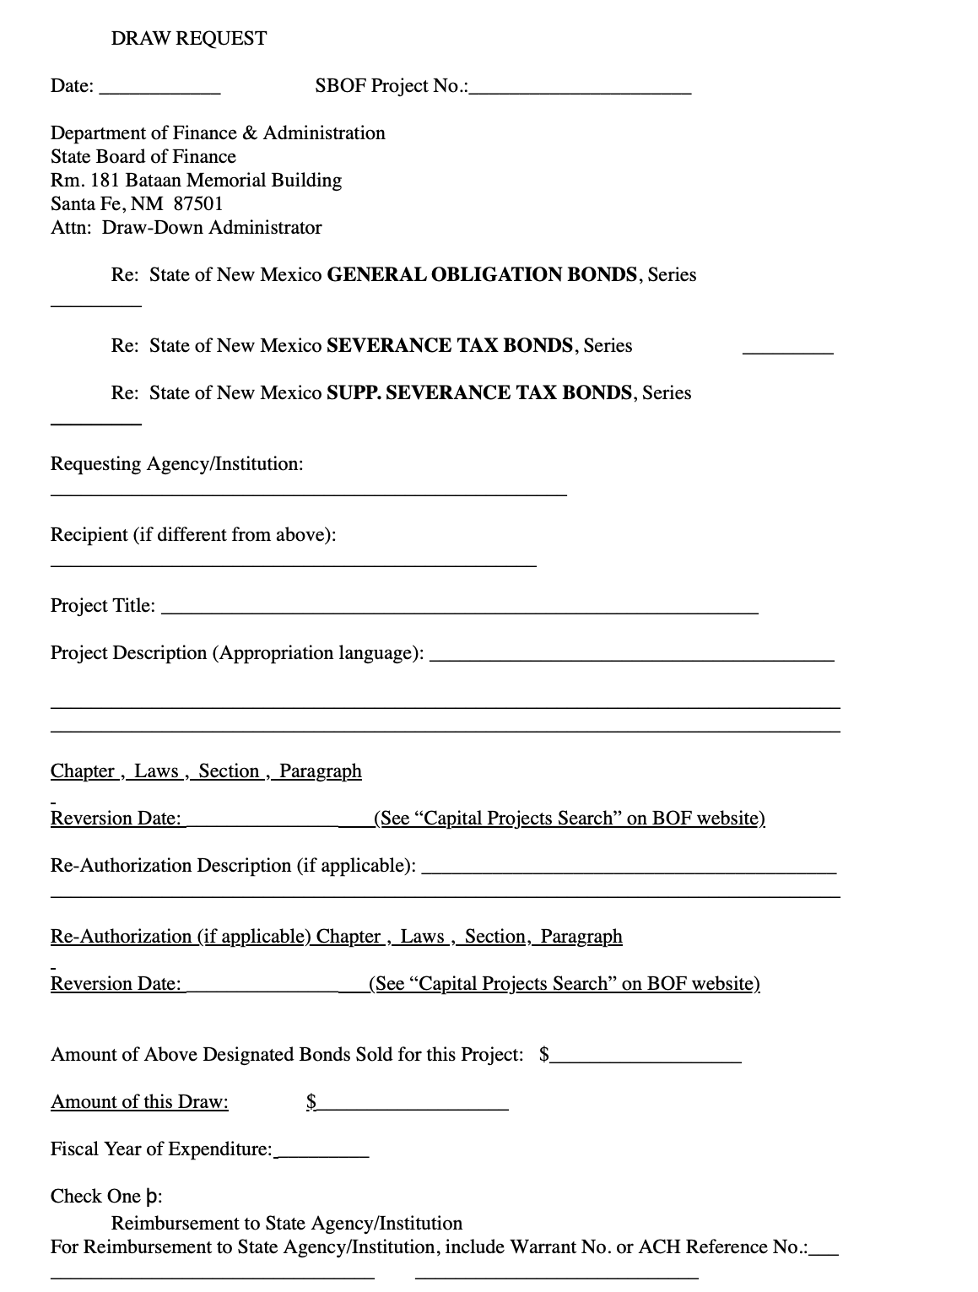
Bond Tracking System: Draw Request Process
Paper copy draw requests forms are no longer needed and do not need to be uploaded into the system.
Employee is required to provide the necessary back-up documentation:
  For OPRs with no conditions:
    SHARE Voucher Report
  For OPRs with conditions:
    SHARE Voucher Report
    Conditions clearance
  For Higher Education Institution Payment Voucher:
    Proof of Amount
    Higher Education Department Approval
    Board of Finance Approval (if applicable)
  For all other Payment Vouchers:
    Proof of Amount
EMPLOYEE VIEW

Slide 12
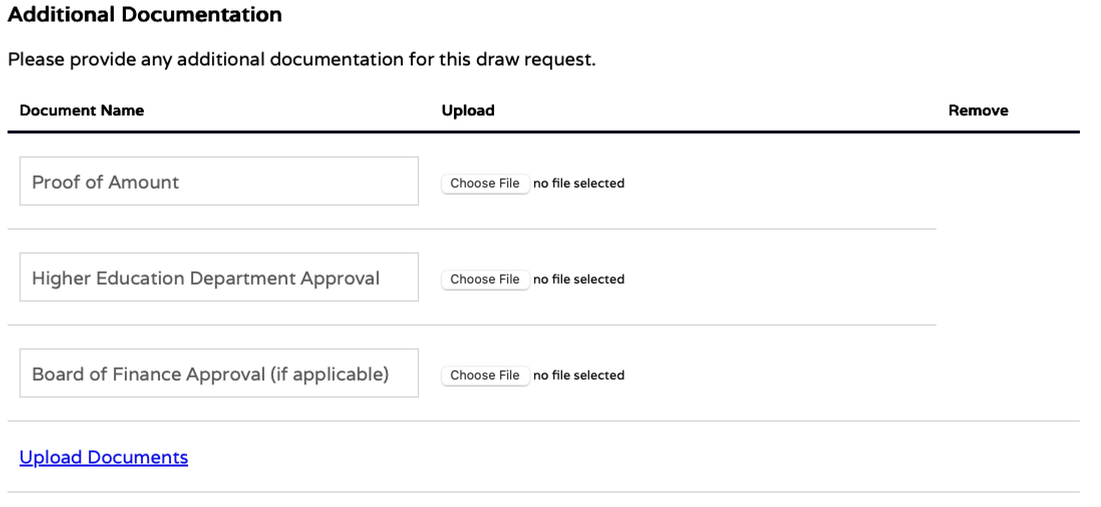
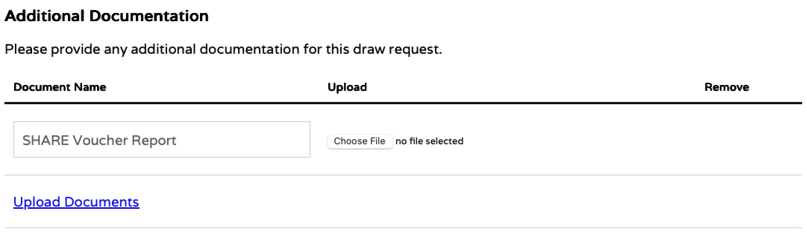
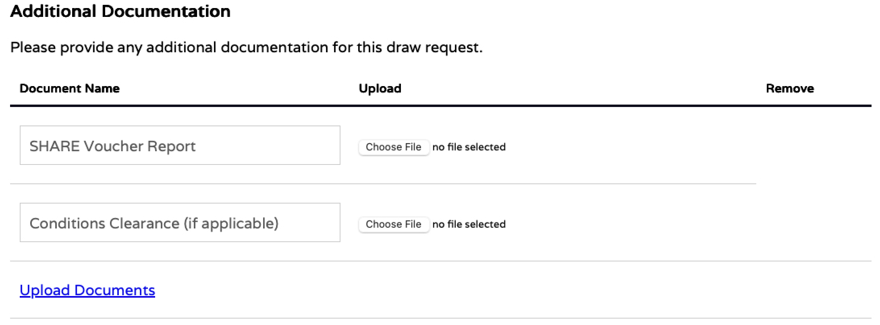
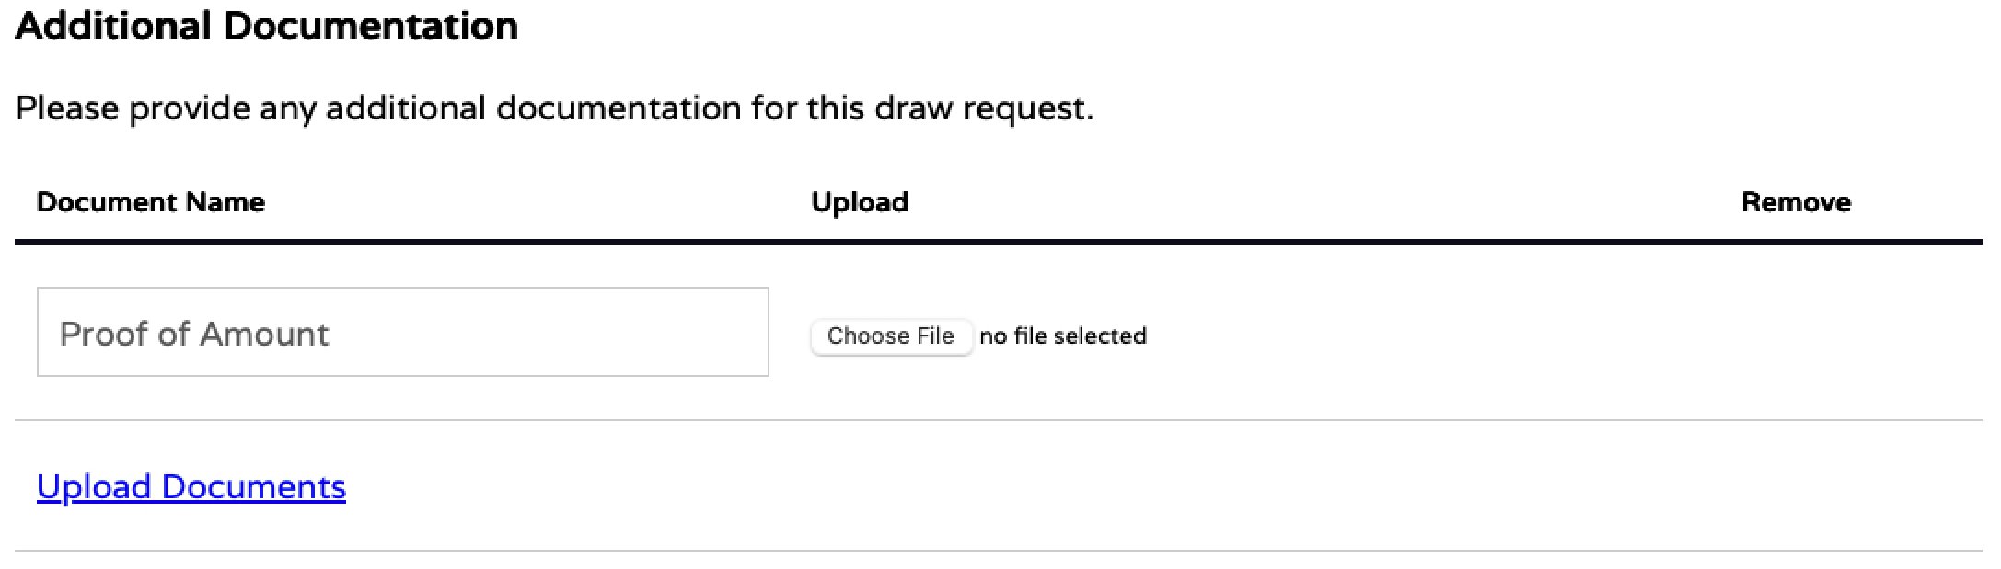
Bond Tracking System: Draw Request Process
The system will prompt you which documents to submit based on your project and entity type:
  For Higher Education Institution Payment Voucher:
  For OPRs with no conditions:
  For OPRs with conditions:
  For all other Payment Vouchers:
EMPLOYEE VIEW

Slide 13
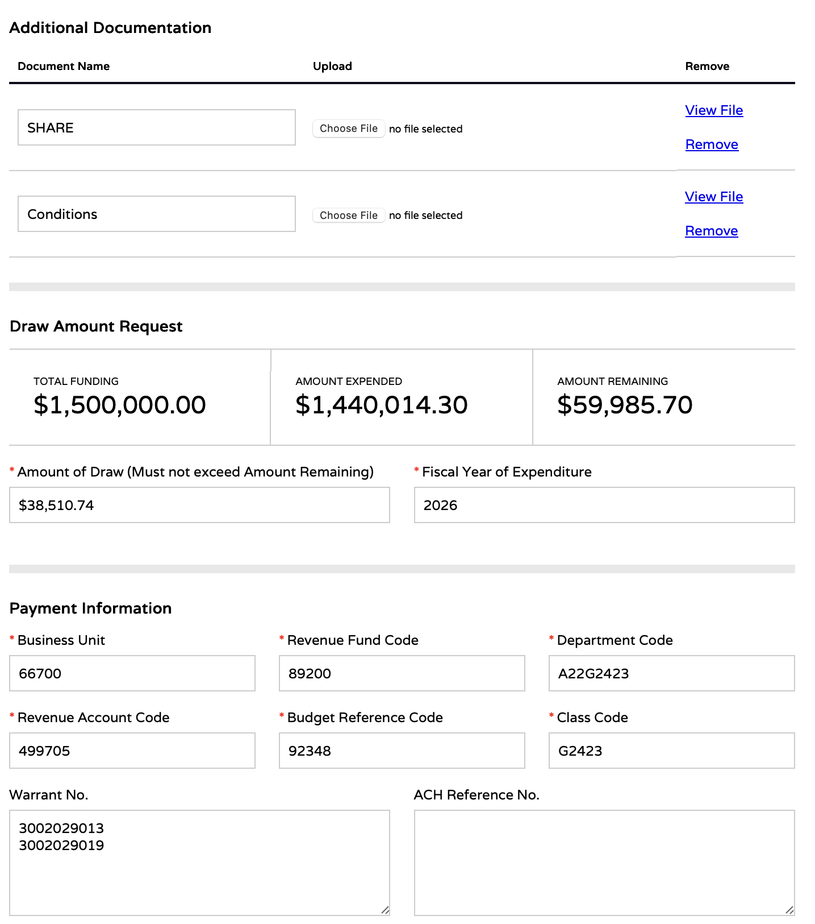
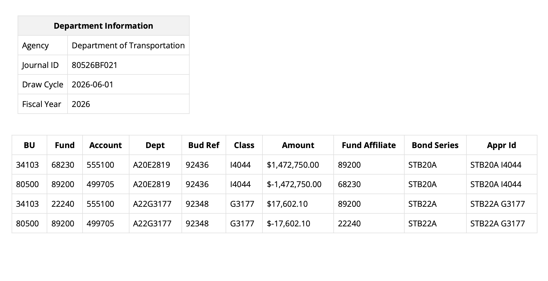
Bond Tracking System: Draw Request Process
Draw requests give the Board of Finance all the information needed to perform a draw.
Reports are generated to use as backup for SHARE entry:

Slide 14
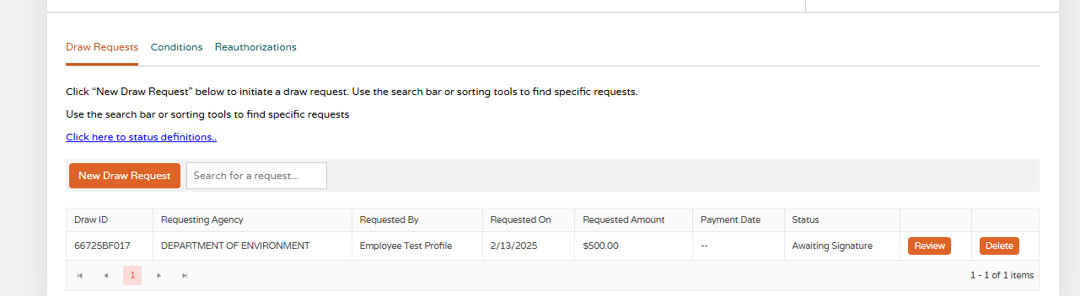
Bond Tracking System: Draw Request Process
Once the Employee submits a new draw request, an email is sent to Signer and it will appear in their queue for signature.
The Status updates to “Awaiting Signature.”
EMPLOYEE VIEW

Slide 15
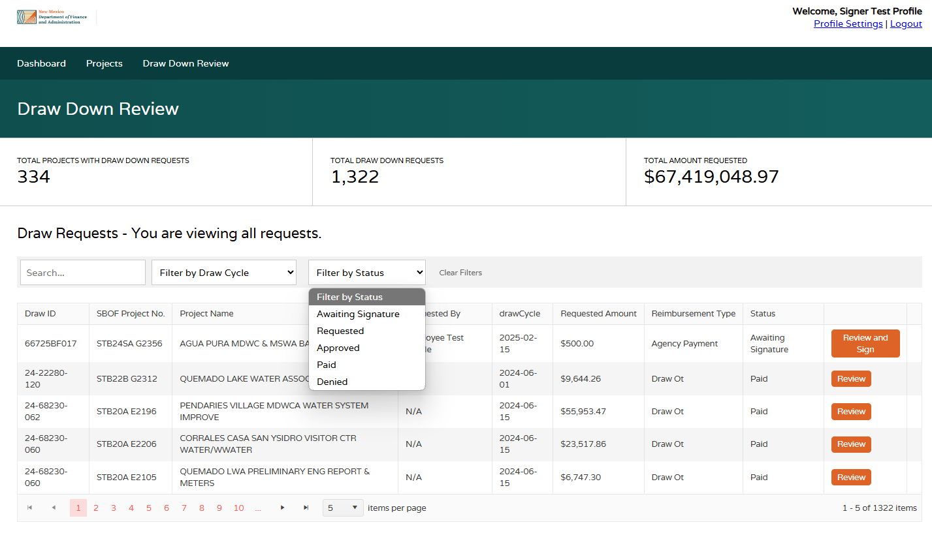
Bond Tracking System: Draw Request Process
Signers log in and goes to “Draw Down Review” tab to sees a grid of Draw Requests for the agency.
The default view is set to view all requests with those “Awaiting Signature” at the top. Users can filter to other status to see certain requests.
Signers will click “Review and Sign” to approve/deny a Draw Request.
SIGNER VIEW

Slide 16
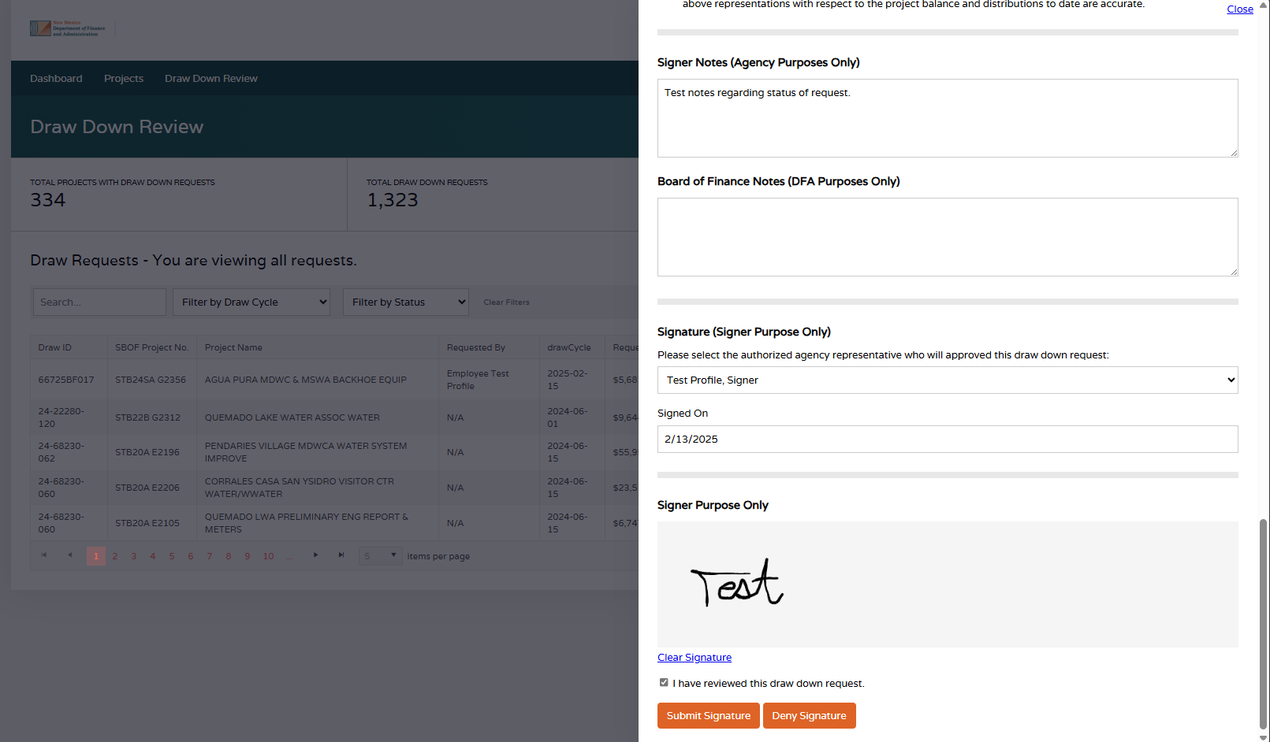
Bond Tracking System: Draw Request Process
Signer can review the draw request and add comments.
Signers are required to submit their signature and check box that they have reviewed the request. They may submit:
Submit Signature
  Request is approved and submitted to BOF
Deny Signature
  Request needs correction or is otherwise denied back to the Employee
SIGNER VIEW

Slide 17
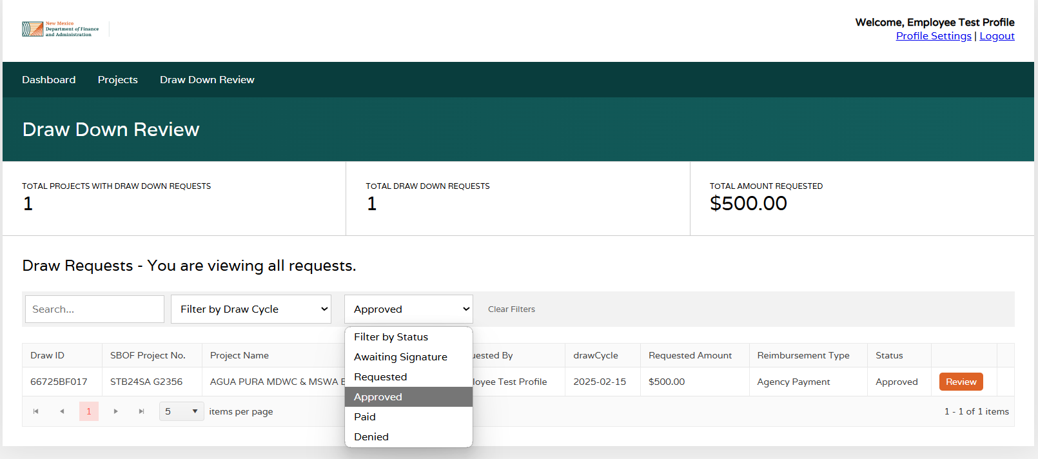
Bond Tracking System: Draw Request Process
Employees and Signers can visit the “Draw Down Review” tab and filter the status of all Draw Requests.
“Status” reflects DFA Bond Tracking Draw Request process:
Awaiting Signature: Draw Requests has been initiated by the Employee and is awaiting signature by the agency’s Signer.
Requested: Draw Requests has been approved by the Signer and submitted to BOF for review.
Approved: Draw Requests has been approved by BOF.
Paid: Draw Requests has been paid and has been entered in SHARE.
Denied: Draw Requests was denied. In this status, agency “Employee” roles may resubmit. Please see notes from BOF and make corrections before resubmitting.
Employees may delete a request if the status is “Awaiting Signature” or “Denied”. This action can be taken in the Project Profile. If you need assistance, please reach out directly to the BOF.
EMPLOYEE VIEW (same for Signer)

Slide 18
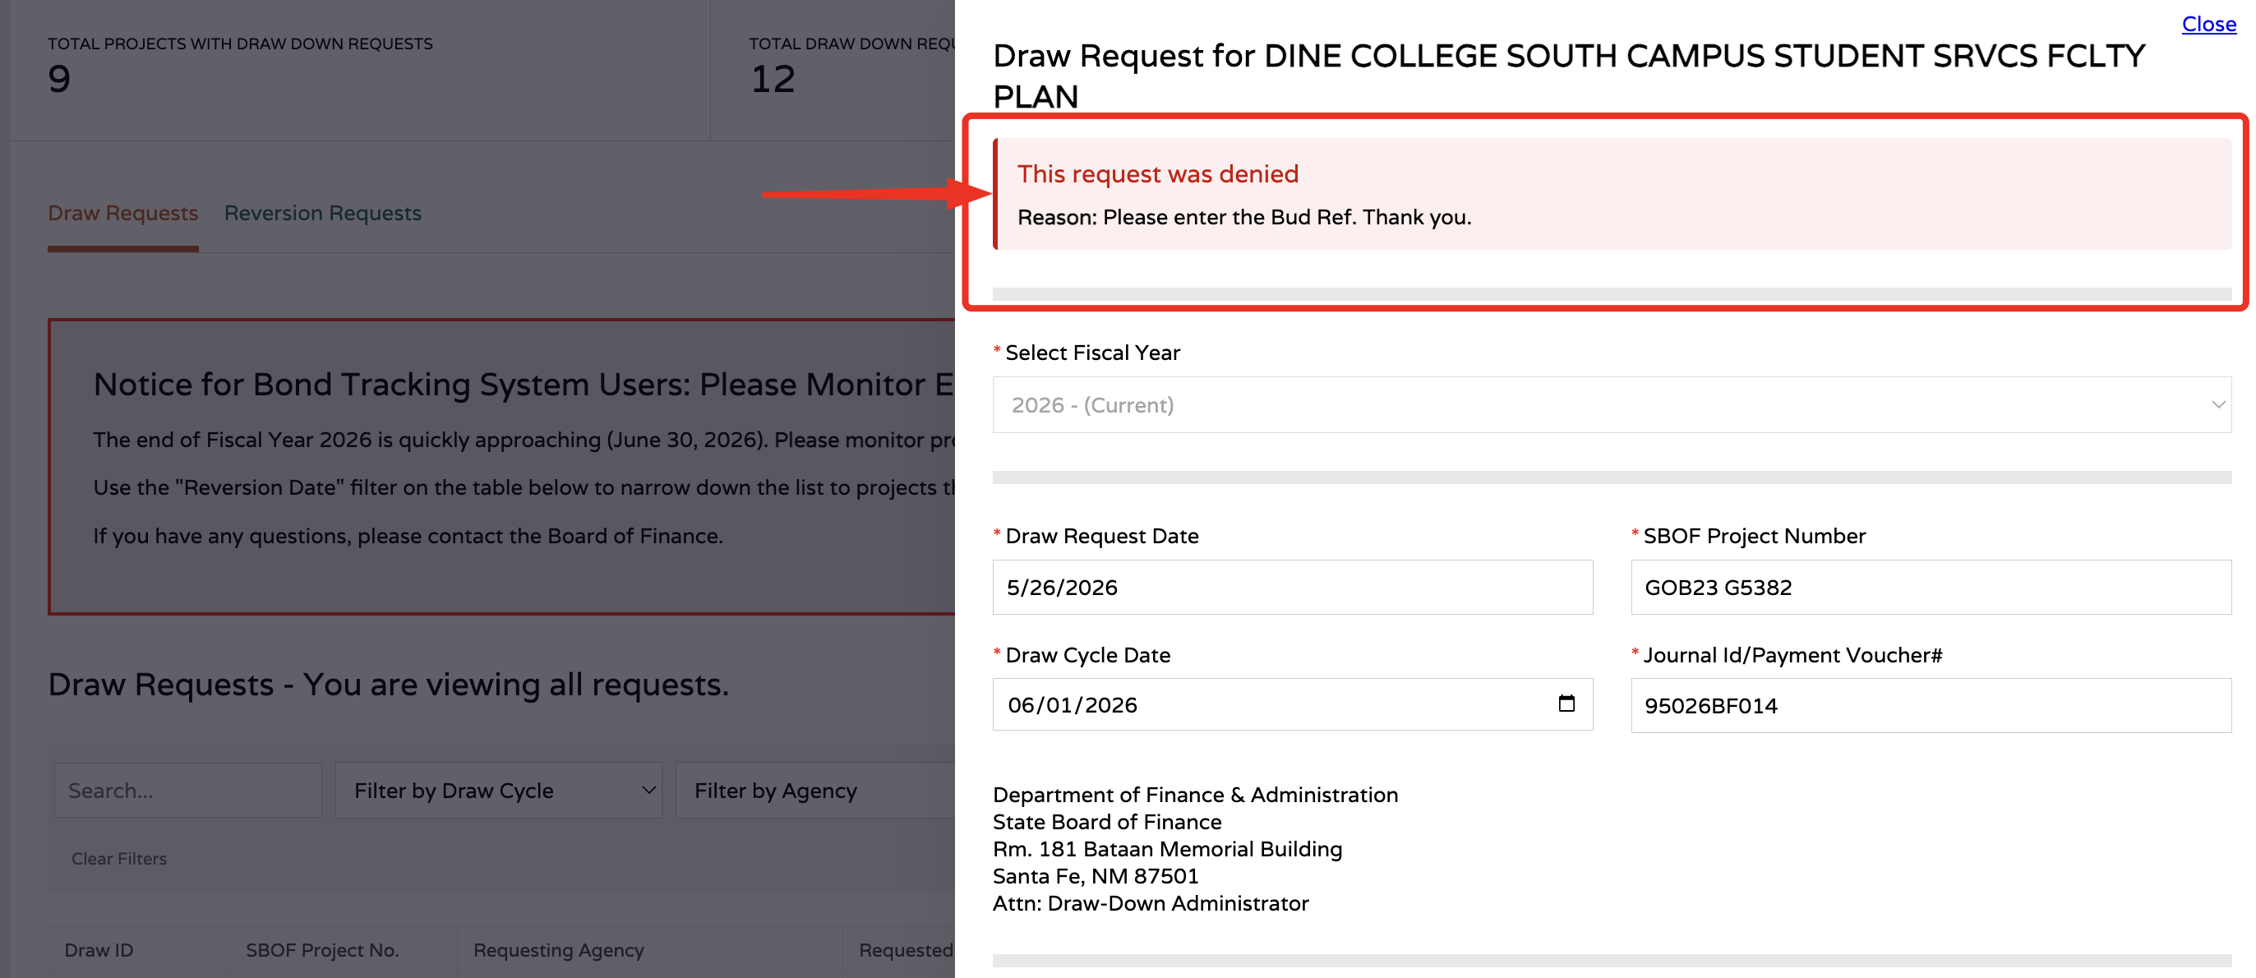
Bond Tracking System: Draw Request Process
Agency “Employee” roles may resubmit a denied draw request—do resubmit, the system requires the “Signer” role to also deny the request back to the “Employee”.
Please see denial reason from BOF and make corrections before resubmitting.
If you need assistance, please reach out directly to the BOF.
EMPLOYEE VIEW (same for Signer)

Slide 19
Initiating a Reversion Throughout the Year

Slide 20
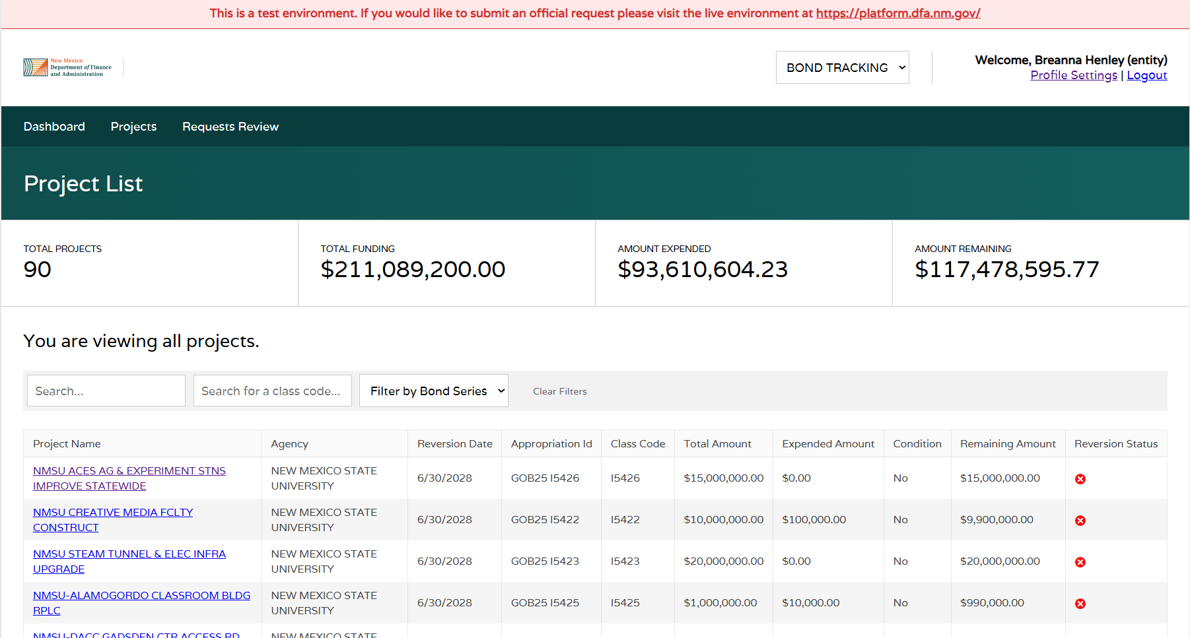
Bond Tracking System: Reversions
The workflow for reverting a project throughout the year is similar to a draw request: “Employee” roles can initiate the request, it is then routed to the agency “Signer” role, and then to Board of Finance.
To initiate a reversion, “Employee” should identify the project to revert under the “projects” tab, then click into the project.

Slide 21
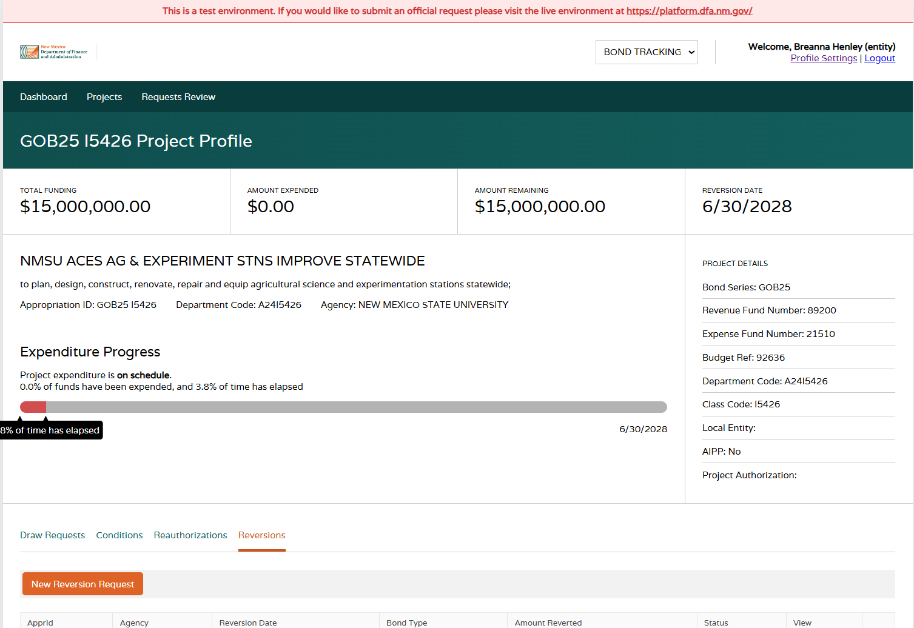
Bond Tracking System: Reversions
In the project profile, click the “reversions” tab and select “New Reversion Request” to begin a reversion.

Slide 22
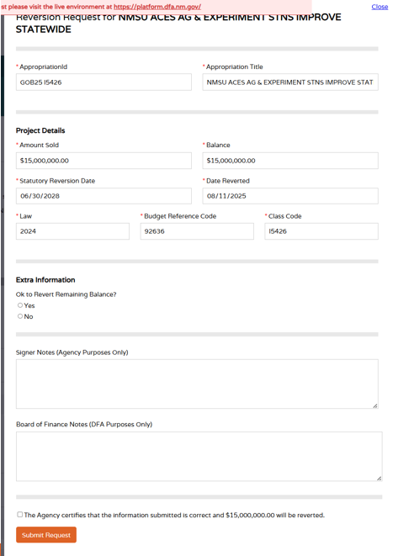
Bond Tracking System: Reversions
After initiating a new reversion request, a modal form will pop up for completion.
Once submitted, the request will route to agency “Signer” role, and then on to Board of Finance.

Slide 23
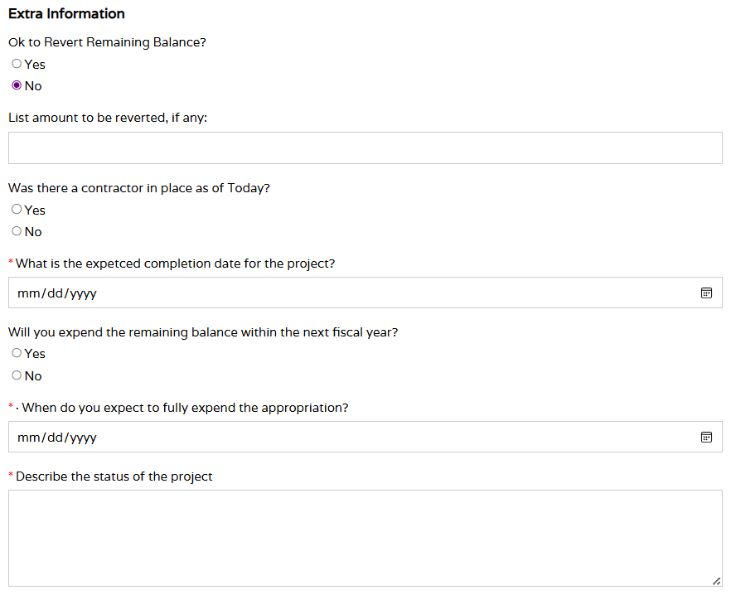
Bond Tracking System: Reversions
GOB projects require additional information if the request is to not revert the full balance of the appropriation.

Slide 24
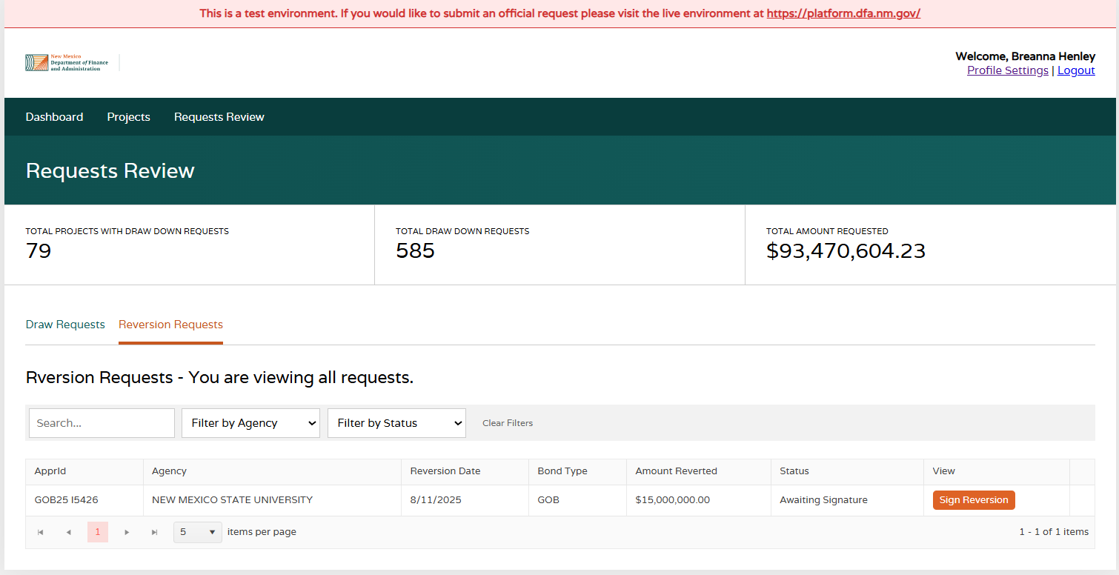
Bond Tracking System: Reversions
“Signer” roles will find submitted reversion requests by going to the “Requests Review” page and viewing the “Reversion Requests tab”.
Once approved by Board of Finance, the project profile will still be viewable, but the project will be closed and no draw requests can be submitted for the project.

Slide 25
End of Year Reversions

Slide 26
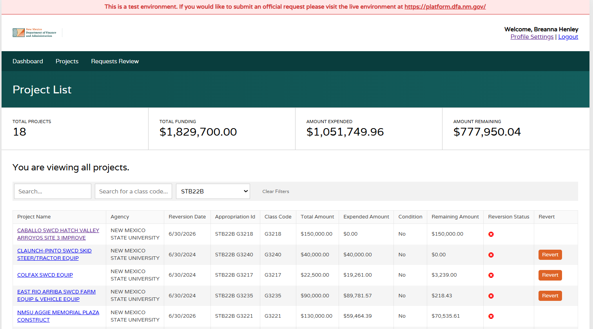
Bond Tracking System: Reversions
During the end of the year “Signer” roles can utilize a quick reversion feature. This step by-passes the need for “Employee” roles to initiate the reversion.
From July 1-Sept 1, a “revert” button will appear in the projects dashboard for projects that are reverting.

Slide 27
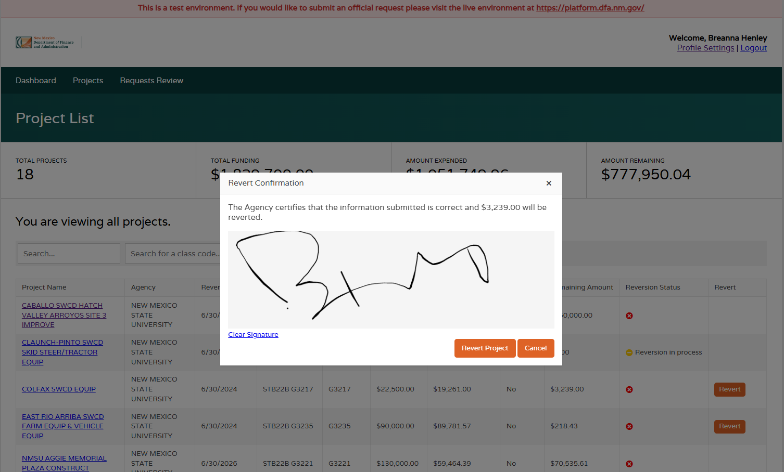
Bond Tracking System: Reversions
After clicking “revert”, a pop-up box will appear to confirm the balance of the reversion.
Once submitted, the request will route to Board of Finance for approval.

Slide 28
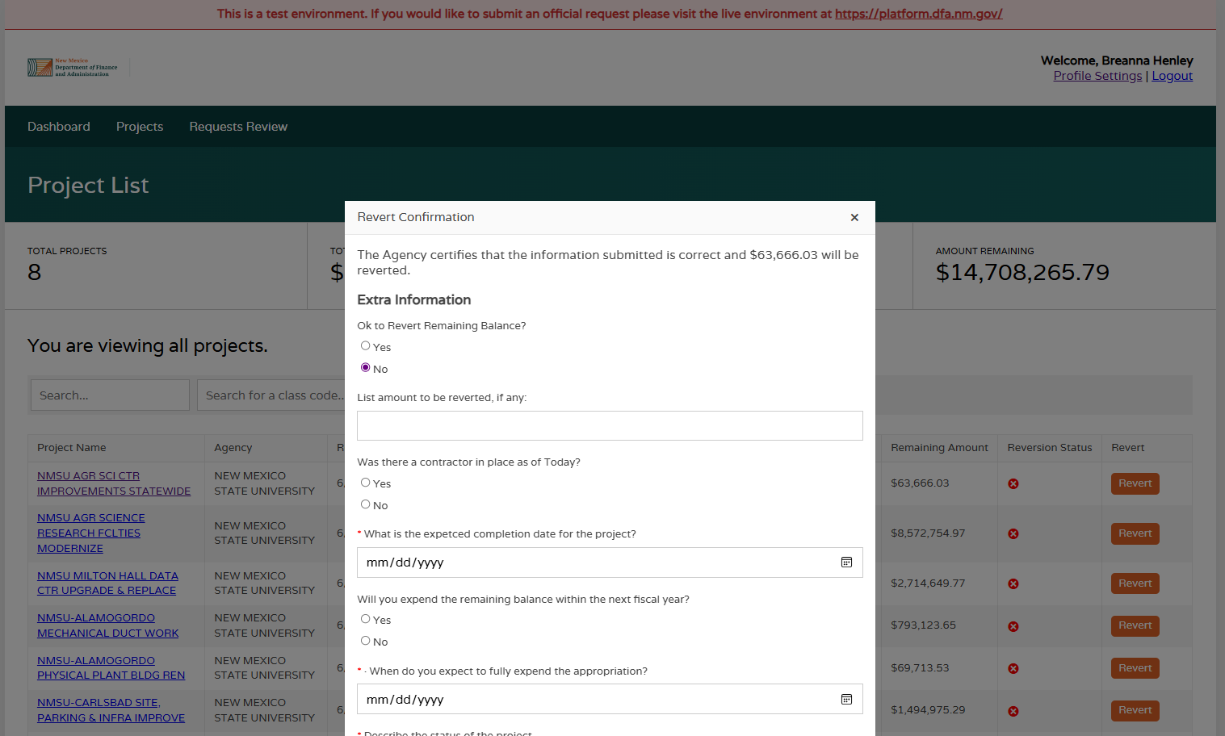
Bond Tracking System: Reversions
Just like reverting projects throughout the year, GOB projects require additional information if the request is to not revert the full balance of the appropriation.

Slide 29
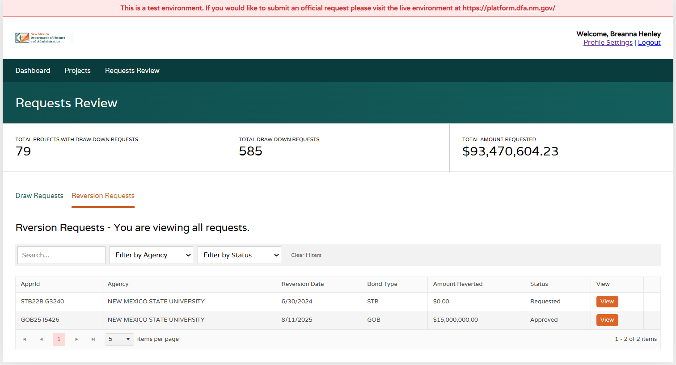
Bond Tracking System: Reversions
Requested reversions will appear in the “Requests Review” page under the “Reversion Requests” tab. Until Board of Finance reviews, the request will be in “Requested status”.
Once approved by Board of Finance, the project profile will still be viewable, but the project will be closed and no draw requests can be submitted for the project.

Slide 30
Notifications

Slide 31
Bond Tracking System: Notifications
Email notifications are sent to the Employee and Signer roles at the time a request is denied.
Email notifications are sent to the Signer role when a request has is pending their signature 3 days before the draw cycle ends, and on the day the draw cycle ends.
BOF has the capabilities to send reminder emails at their own discretion.

Slide 32

Questions?
Contact Jeannette Gallegos at NM Board of Finance at jeannette.gallegos@dfa.nm.gov, or support@rtsolutions.com

