Slide 1

MAPs Update Fiscal Year 2027
State Controller’s Office

Slide 2
FIN 9.3.D.3 & 7
State Appropriations
Added language to D.3 to require adequate security for the disbursements of loans or credit facilities. This may include collateral, pledged revenue or other security instruments.
Section D.7 establishes accounting requirements for credit facilities or loans, to ensure compliance with state accounting practices and GASB.

Slide 3
FIN 9.4.D.1, 6 & 9
Federal Grant Policy
Adds a requirement for agencies to use the DFA template for subrecipient agreements and contracts related to federal awards (1).
2 CFR 200.331, 332,
Appendix II
Defines the term “equipment” for state purposes (6).
2 CFR 200.1,
200.313, 200.436
Updates the single audit threshold to $1,000,000 (9).
2 CFR 200.501(a)
Mandates booking a 15% de minimis indirect cost rate unless a negotiated rate exists (9).
2 CFR 200.1 (MTDC),
200.414(f)

Slide 4
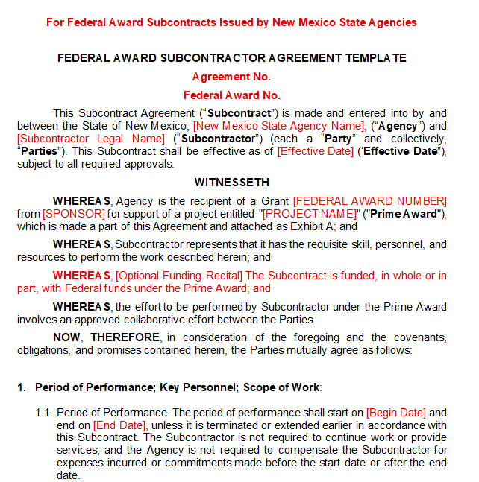
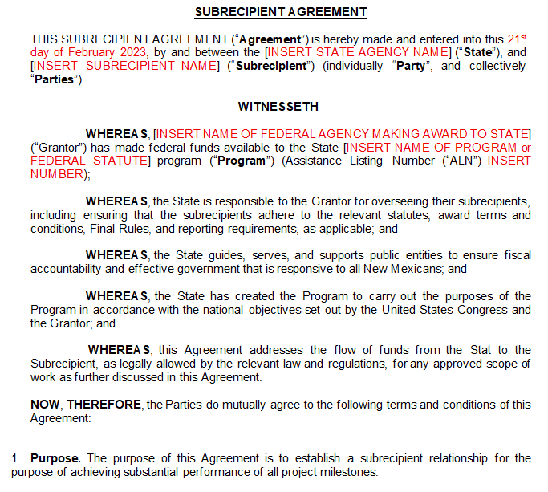

Slide 5
MAPs 9.4(D)(1) Pre-Award Requirements
Use of subrecipient agreements, cooperative agreements, fixed amount awards, and contracts.
MANDATORY Subrecipient Grant Agreement and Subcontractor Award Templates
The purpose of this new requirement is to ensure agencies are in compliance with 2 CFR 200 Appendix II, among other 2 CFR 200 guidelines.
Under Appendix II, every subaward and contract funded with Federal dollars must include specific provisions that are in line with the Uniform Guidance compliance requirements.
The goal is to create consistency across agencies and reduce audit and compliance risk by standardizing the required federal provisions and minimizing the chance of omissions.
This is to be applied PROSPECTIVELY – applicable to any awards signed in FY27 and forward.
As Federal regulations change, these templates will follow suit. Be diligent about identifying updates released by US OMB and NM DFA. OMB’s DRAFT does contain updates 200.327

Slide 6
MAPs 9.4(D)(1) Pre-Award Requirements
Modifications to the Template
Modifications are permitted only to meet specific requirements set forth by federal awarding agencies or programs and must retain all DFA-required provisions.
Exhibits are to be adapted and/or added to the specific award, grant provisions, and relevant parts of Part 200, which can vary depending on the funding type.
  Examples for Subrecipient Agreements:
    Include a section related to Cost Share requirements in the Scope of Work Exhibit
    Include an additional Exhibit for your agency’s Subrecipient Monitoring Policy
    Include an additional Exhibit for Subrecipient Reporting requirements
    Include an additional Exhibit for Special Conditions
  Examples for Subcontracts
    Include an additional Exhibit for Mandatory Federal Provisions Exhibit based on the Federal awarding agency or program (at a minimum must comply with Appendix II of Part 200)
Red Font – add or remove as applicable (i.e. Insurance).

Slide 7
MAPs 9.4(D)(1) Pre-Award Requirements
In Addition to the Template
In Addition to the Template
Subrecipient vs. Contractor Determination (Required)
Subcontracts:
  NM State Procurement Code requirements & documentation
Subrecipients:
  Risk Assessment for each subrecipient (Required)
  Compliance Plan (Recommended)
    It is a living document in tandem with the agreement that identifies the HOW.
    This can include a written narrative of HOW the entity plans to comply with the requirements in the Template, the entity’s Internal Controls, and project and reporting timelines.
    A Compliance Plan can assist the subrecipient by identifying in clear language the expectations of the award
    A Compliance Plan can assist the Agency program staff with subrecipient monitoring, desk reviews, audits, etc.
    Examples of Compliance Plan contents:
      Please identify your plan to track and submit financial data and other cost information that demonstrates cost-effective practices and ties to program performance goals.
      Please identify your existing internal controls for the following: Evaluating and Monitoring Subcontractor compliance; Compliance with Federal statutes, regulations, & terms and conditions of the Grant Agreement
      Please identify the written procurement procedures your entity will follow.
      Please provide a project timeline, identifying all necessary administrative actions to project completion.

Slide 8
What now?
Download the required agreements from the DFA website
Federal Grant Management Resources - New Mexico Department of Finance and Administration
Current Awards
Review current agreements and contracts for:
Contract vs. Subrecipient Determination documentation
Subrecipient Risk Assessment for each entity
Appendix II provisions.
Amend current agreements and contracts as necessary
See the DFA template to revise PSC agreements in alignment with Federal requirements
New Awards
Review the NOFO, NoA, and Terms and Conditions of new awards
Add award-specific provisions as an Exhibit
Consider implementing a Compliance Plan in addition to Subrecipient Agreements

