Slide 1
Lodgers’ Tax FACTS

Slide 2
Statutes and Rules for Lodgers’ Tax
Two Source Documents for Guidance
Enacted in 1969, the Lodgers’ Tax Act (Sections 3-38-13 through 3-38-25, NMSA 1978)
Enacted in 1996, Lodgers’ Tax Quarterly Report (Rule 2 NMAC 105.2)
Notes:
There are two Source Documents for Guidance
Enacted in 1969, the Lodgers’ Tax Act
Enacted in 1996, Lodgers' Tax Quarterly Report Rule

Slide 3
What is Lodgers’ Tax?
Note: Lodgers' Tax is also known as Occupancy Tax
New Mexico’s Lodgers’ Tax Act authorizes municipalities and counties—by ordinance—to impose an optional occupancy tax of up to 5% of gross taxable rent on commercial lodging accommodations. The law requires that revenues collected from the first 30 days of a stay be allocated to tourism-related uses, with minimum percentages tied to the tax rate and county classification (e.g., 25–50% for advertising and promotion). Collections exceeding these requirements may be used for other purposes allowed under NM Stat § 3‑38‑21.
This statutory framework allows local governments to generate discretionary funding for tourism promotion—while ensuring clear legal limits and transparent use of the tax proceeds.
Notes:
Local Governments in New Mexico have the option of imposing a Lodgers' Tax on rentals of motels and hotel rooms, camps and several other rental settings.
Every vendor providing lodging within the county or municipality that imposes a Lodgers' Tax is responsible for collecting that tax.

Slide 4
Determining whether an expenditure is an appropriate use of Lodgers' Tax revenues
When asking the following questions,
Will the event or use of funds bring people from out of town?
Will the out-of-town visitors stay at motels, hotels, motor or trailers court or other lodging facilities?
Will out-of-town visitors be eating at local restaurants?
Will out-of-town visitors’ frequent other stores, sites or attractions in the local area?
Answering “Yes”, the proposed event or use of funds is reasonably expected to generate tourism activity, including overnight lodging, dining, and purchasing goods or services within the community, then expenditures is an appropriate use of Lodgers’ Tax Revenues.
Such tourism‑related impacts fall within permissible uses of Lodgers’ Tax revenue under New Mexico law, as they demonstrate that the expenditure supports or is likely to support tourism, visitor activity, and local economic benefit.
Notes:
Before use of any Lodgers' Tax revenue, here are a few items to consider.
Will the event or use of funds bring people from out of town?
Will the out-of-town visitors stay at motels, hotels, motor or trailers court or other lodging facilities?
Will out-of-town visitors be eating at local restaurants?
Will out-of-town visitors’ frequent other stores, sites or attractions in the local area?

Slide 5
Highlighted Statutory Definitions
Section 3-38-14
“Lodging” refers to a short-term dwelling (temporary quarters).
“Temporary lodging” means lodgings for the purpose of housing a vendee within proximity of the vendee’s employment or job location.
“Vendee” means a person or the person’s agent furnishing lodgings in the exercise of the taxable service of lodging.
“Person” means a corporation, firm, other body corporate, partnership, association or individual. A “Person” does not include the federal government, state government, or any political subdivision of the state.
Notes:
Here are some highlighted statutory definitions to help define “temporary lodging.
HB117 enacted during the 2020 Regular Legislative Session added the definition “temporary lodging”.
LGD’s interpretation is that if the vendee is housing/lodging within the boundaries of the municipality, then the imposed tax is applicable.
Tips for identifying “temporary lodging”:
Contact local businesses that hire employees from outside the local area. Those businesses may be able to get information out to their non-local employees regarding the Lodgers' Tax requirement.
Enter into agreements with rental associations (such as Airbnb) to have them collect the tax on local government’s behalf.
As new lodging vendors apply for a business license, they should be informed of your local ordinance requirements regarding Lodgers' Tax.
If your entity will be taxing “temporary lodging” be sure to update your local ordinance to accommodate this new group of Lodgers' Tax payers and then publish a notice in your local newspapers.

Slide 6
Vendee Exemptions
Section 3-38-16
The occupancy tax shall not apply:
If vendee has been a permanent resident of the taxable premises for a period of at least 30 consecutive days, unless those premises are temporary lodging.
If vendee has entered into a written agreement for lodgings at the taxable premises for a period of at least 30 consecutive days, unless those premises are temporary lodging.
If rent paid by vendee is less than $2 a day.
If lodging accommodations are at institutions of the federal government, state or any political subdivision; at religious, charitable, educational or philanthropic institutions.
To clinics, hospitals or other medical facilities; or to privately owned and operated convalescent homes.
Notes:
Note that vendee exemptions DO NOT apply to “temporary lodging”.
Legislative amendment related to “temporary lodging” appears to be targeting lodging associated with oil industry boom.
According to an article written by “World Population Review” New Mexico is the second largest oil producing state in the U.S.

Slide 7
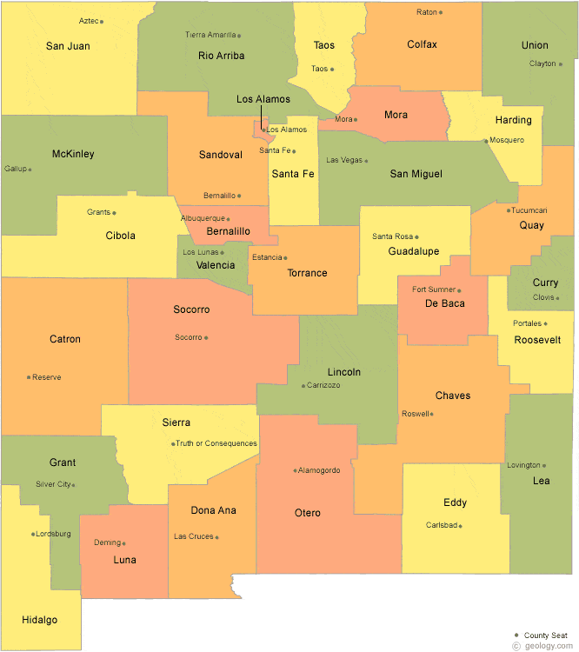
Who Can Impose Lodgers' Tax?
Section 3-38-15: Authorization of tax; limitations on use of proceeds
Imposed Through Local Ordinance
Municipalities may impose by ordinance an occupancy tax for revenues on lodging within the municipality, of no more than 5% of gross taxable rent.
The board of county commissioners of a county may impose by ordinance an occupancy tax for revenues on lodging within that part of the county outside of the incorporated limits of a municipality of no more than 5% of gross taxable rent.
Notes:
Lodgers' Tax is a local imposed tax and is collected locally.

Slide 8
Ordinance Requirements
Section 3-38-20
The municipalities and counties ordinance imposing an occupancy tax shall;
Have a procedure for licensing each vendor and for refusing a vendor a license after an
opportunity has been given to the vendor of a public hearing, as the case may be;
B. State the rate or other amount of the occupancy tax; the times, place and method for the
payment of the occupancy tax proceeds to the municipality or county;
1. the accounts and other records to be maintained in connection with the occupancy tax.
2. procedure for making refunds and resolving disputes relating to the occupancy tax.
3. the procedure for preservation and destruction of records.
4. inspection and investigation; vendor audit requirements; applicable civil and criminal
penalties.
5. procedures of liens, distraint and sales to satisfy such liens.
Provide other rights, privileges, powers, immunities and other details relating to any such
vendor licenses, the collection of the occupancy tax and the remittance of the proceeds
thereof to the municipality or county.
Notes:
Licensing for each vendor
State the rate being collected (not to exceed 5%).
Ordinance should spell out all the details to the “Lodgers License”
Reminder: Don’t forget that if your entity will be taxing “temporary lodging” be sure to update your local ordinance to accommodate this new group of lodger taxpayers and then publish a notice in your local newspapers.

Slide 9
What are the limitations on the use of Lodgers' Tax Proceeds?
Section 3-38-15: Authorization of tax; limitations on use of proceeds
Section 3-38-15.D: Occupancy tax collected based on the first 30 days of rental shall be used only for promotional purposes (advertising, publicizing and promoting tourist-related facilities and attractions and tourist-related events) based on the following:
  Tax of 2% or less – at least 25% of proceeds for this purpose
  Tax > 2% and not in Class A county – at least 50% of proceeds for this purpose from the first 3% of tax and not less than 25% of proceeds in excess of 3% (formula on next slide)
  Tax > 2% and Class A county – at least 50% of proceeds for this purpose
Section 3-38-15.E: Occupancy tax collected based on the first 30 days of rental in excess of the requirements of Section 3-38-15.D may be used for any purpose authorized in Section 3-38-21.
Notes:
This section of Lodgers' Tax Act applies to the first 30 days of rental.

Slide 10
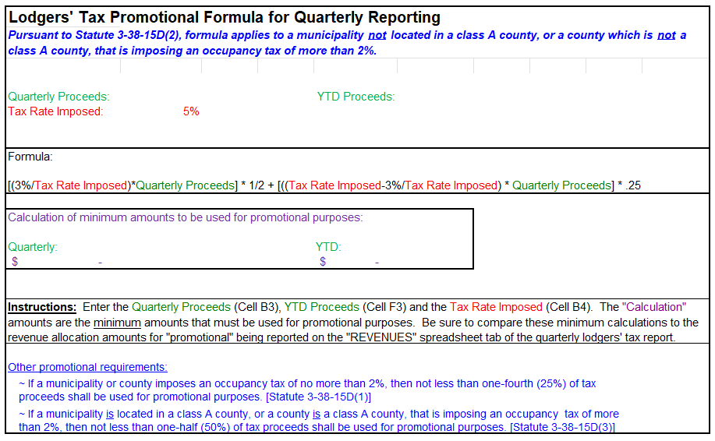
Promotional Formula for quarterly reporting
Excel spreadsheet can be found under “Lodgers' Tax Distribution” section on this link: http://www.nmdfa.state.nm.us/Financial_Distribution.aspx
Notes:
This spreadsheet is posted on website and can be used to confirm that revenues are being properly allocated for promotional uses

Slide 11
What are Other Eligible Uses of
Lodgers' Tax?
After meeting the requirements for promotional purposes:
Section 3-38-15.H: Payment of principal and interest on outstanding bonds.
Section 3-38-21: Eligible uses of tax proceeds as follows:
  Taxes from first 30 days of rental:
    Collecting and otherwise administering the tax, including audits.
    Establishing, operating, purchasing, constructing, otherwise acquiring, reconstructing, extending, improving, equipping, furnishing or acquiring real property or any interest in real property for the site or grounds for tourist-related facilities and attractions or tourist-related transportation systems of the municipality, the county in which the municipality is located or the county.
    Providing police and fire protection and sanitation service for tourist-related facilities, attractions and events located in the respective municipality or county.
Notes:
The tourist-related facilities and attractions or tourist-related transportation systems MUST be owned by the municipality imposing the tax or the county in which the municipality is located or owned by the county imposing the tax.
Providing police, fire protection and sanitation services at any tourist-related attraction or event within the local government imposing the tax.
Common Question: What does the word “operating” mean in Section 3-38-21? Response: Operating expenses typically imply money that must be spent regularly to support the day-to-day operations of an organization or facility. The operating expenses in this section relate to real property for the site or grounds for tourist-related facilities and attractions or tourist-related transportation systems of the municipality imposing the tax. It would be a good idea for the municipality imposing the tax to include in their local ordinance a definition of what that municipality has determined are allowable operating expenses.

Slide 12
What are Other Eligible Uses of
Lodgers' Tax ?
After meeting the requirements for promotional purposes:
Section 3-38-21: Eligible uses of tax proceeds as follows:
  Taxes from first 30 days of rental:
    Providing a required minimum revenue guarantee for air service to the municipality or county to provide easy access for tourists to visit tourist-related facilities, attractions and events.
    “Minimum revenue guarantee” is the amount of money guaranteed by a municipality or county to be earned by an airline providing air services to and from their locality.
  Taxes from the 31st and subsequent days of rental:
    For any municipality or county purpose.
    Provided that the use is stated in the local ordinance imposing the tax.
Notes:
The 2016 Legislative amendment allows a local government to use occupancy tax proceeds to provide a “minimum revenue” guarantee for air service to promote tourism travel.
HB117 enacted during the 2020 Regular Legislative Session added Section 3-38-21.B which allows a local government to determine the use of the occupancy tax from 31st and subsequent day rentals as long as the allowable uses are clearly stated in the local ordinance.

Slide 13
Can Lodgers' Tax be used for Contracting Services?
Section 3-38-21.1
The governing body of a municipality or county may contract for the management of programs and activities funded with revenue from the Lodgers' Tax.
The governing body shall require periodic reports to the governing body, at least quarterly, listing the expenditures for those periods. Within ten days of receiving the reports, the governing body shall furnish copies of them to the advisory board. Funds provided to the contracting person or governmental agency shall be maintained in a separate account established for that purpose and shall not be commingled with any other money.
A person or governmental agency with whom a municipality contracts under this section to conduct an authorized activity shall maintain complete and accurate financial records of each expenditure of the tax revenue made and upon request of the governing body of the municipality or county shall make such records available for inspection.
The occupancy tax revenue spent for a purpose authorized by the Lodgers' Tax Act may be spent for day-to-day operations, supplies, salaries, office rental, travel expenses and other administrative costs only if those administrative costs are incurred directly for that purpose.
A person or governmental agency with whom a local governmental body contracts under this section may subcontract with the approval of the governing body of the municipality or county and subcontractor shall be subject to the same terms and conditions as the contractor regarding separate financial accounts, periodic reports and inspection of records.
Notes:
A typical contracting service is with local organizations such as a Chamber of Commerce whose main purpose is to promote tourism in the municipality or county.
Quarterly Lodgers' Tax reports are often filed by, or with the assistance of, contractors such as the Chamber of Commerce.
LGD will soon be working on a “Lodgers' Tax Module” within the Local Government Budget Management System (LGBMS) and counties and municipalities with these type of contracts should start thinking about whether or not they want to have contractors obtain LGBMS accounts for completing the quarterly Lodgers' Tax reports, or if the reporting function will stay with the local finance office.

Slide 14
Can Lodgers' Tax be Used for Revenue Bonds?
Section 3-38-23
A. Revenue bonds may be issued at any time or from time to time by a municipality or county to defray wholly or in part the costs of anyone, all or any combination of revenue bonds.
B. The revenue bonds may be payable from and such payment may be secured by a pledge of and lien on the revenues derived from Lodgers' Tax.
C. The revenue bonds shall bear interest at a rate or rates and the first interest payment may be for any period authorized in the Public Securities Act.

Slide 15
Collection of taxes Section 3-38-17
Who are the Responsible Parties?
Every vendor providing lodging within the county or municipality that imposes a lodgers’ tax is responsible for collecting that tax.
Every vendor providing lodgings in a municipality or county imposing an occupancy tax shall collect the proceeds thereof on behalf of the municipality or county and shall act as a trustee therefor.
The tax shall be collected from vendees in accordance with the ordinance imposing the tax and shall be charged separately from the rent fixed by the vendor for the lodgings.
Counties and municipalities are responsible for ensuring accurate and timely revenue collections from vendors, auditing vendors, expending tax proceeds only as allowed by statute, and reporting to DFA/LGD on a quarterly basis.
Municipalities and counties have two years to expend collected revenues and typically expend carryover funds in each annual budget.
Notes:
Statute does not state what happens if tax proceeds are NOT expended within the 2-year requirement. LGD recommends that local governments in this situation seek a legal opinion from their legal counsel.

Slide 16
How are Advisory Boards Created?
Section 3-38-22
The county commission chairman/mayor of every county and municipality that imposes an occupancy tax pursuant to the Lodgers' Tax Act shall appoint a five-member advisory board that consists of;
Two members who are owners or operators of lodgings subject to the occupancy tax within
Two members who are owners or operators of industries located within the county or municipality that primarily provide services or products to tourists
One member who is a resident of the county or municipality and represents the general public.

Slide 17
What are the Responsibility of Advisory Boards?
Section 3-38-22
Shall advise the respective governing bodies on the expenditure of funds authorized by for advertising, publicizing and promoting tourist attractions and facilities in the respective counties and municipalities.
Shall submit to the mayor and council or county commission recommendations
for the expenditures of funds to be used for advertising, publicizing and promoting
tourist-related attractions, facilities and events in the respective counties and
municipalities.

Slide 18
Financial Reporting Section 3-38-17.2
Who do Municipalities and Counties Report To?
Municipalities or county imposing and collecting an occupancy (lodgers) tax shall;
Provide to the advisory board any portion of any proposed budget, report or audit filed or received by the governing body that relates to the expenditure of occupancy tax funds within ten days of the filing or receipt of such proposed budget, report or audit by the local governing body.
Report to the local government division of the department of finance and administration on a quarterly basis any expenditure of occupancy tax funds pursuant to Sections 3-38-15 and 3-38-21 NMSA 1978 and shall furnish a copy of this report to the advisory board when it is filed with the division.
  Refer to Lodgers' Tax Quarterly Report Rule 2 NMAC 105.2
  Report Quarterly through Lodgers’ Tax Module
Notes:
If you are new to Lodgers' Tax reporting, use the form posted on LGD’s website (link on slide) to acquaint yourself with the information required to correctly report your LT items. Once you are familiar with the needed information, this can then mbe entered into the LT module.
For those of you who haven’t been reporting on Lodgers' Tax, please note that it is a statutory requirement and LGD gets requests for this information. For example the NM Tourism Dept and UNM Bureau of Business & Economic Research use the data for tourism forecasting.

Slide 19
Who Enforces Lodgers' Tax?
Section 3-38 -17.3
An action to enforce the Lodgers' Tax Act [3-38-13 to 3-38-24 NMSA 1978] may be brought by:
1. The attorney general or the district attorney within the jurisdiction of the county.
2. A vendor who is collecting the proceeds of the Lodgers' Tax.
A district court may issue a writ of mandamus or an injunction or other legal reparation to enforce the provisions of the Act.
The court shall award costs and attorney fees to the prevailing party.
Notes:
Lodgers' Tax enforcement powers do not fall on LGD, therefore, we cannot provide legal opinions on this statute. We can help with general questions on where to find something in the statute but will recommend that you get a legal opinion from your local government’s legal counsel.
LGD’s scope is limited to the Lodgers' Tax quarterly report and audit filing requirements.

Slide 20
Lodgers' Tax Module
Benefits of Lodgers' Tax Module
Separate Excel form no longer required.
When local entity reports year to date actuals for funds 21400, 24000 & 24100 on the quarterly financial report, LGBMS sends automatic reminder to submit Lodgers' Tax details.
Year to date actuals associated with lodger tax funds will require user to enter details regarding;
  Event name, description and dates
  Expenditure type (promotional and non-promotional)
Lodgers' Tax Module will follow the same workflow as LGBMS Quarterly Report submissions;
  Data validation
  Comments
  Tracking of data submission, review and acceptance

Slide 21
Audit of vendors Section 3-38-17.1.
When Are Audits Necessary?
Condition | Audit Requirement
> $250,000 annual occupancy tax | Mandatory yearly random vendor audits
< $250,000 annual occupancy tax | Required random vendor audits
Any vendor, any time | Audit allowed for “good cause”
After audit completion | Report must be filed with DFA LGD annually
  Email to your assigned budget analyst; or,
  Mail to:
  DFA Local Government Division, attn: “Your Budget Analyst”
  Bataan Memorial Bldg Ste 202
  407 Galisteo St
  Santa Fe, NM 87501
Notes:
Local governments imposing the Lodgers' Tax may choose to conduct their own audit of lodging vendors or may contract with an auditor.

Slide 22
How are Delinquencies Handled?
Section 3-38-18
The governing body of the municipality or county shall, by ordinance, provide that a vendor is liable for the payment of the proceeds of any occupancy tax that the vendor failed to remit to the municipality or county;
1. due to failure to collect the tax, a vendee shall be issued a civil penalty in an amount
equal to the greater of ten percent of the amount due or one hundred dollars
($100).
The municipality or county may bring an action in law or equity in the district court for the collection of any amounts due, including without limitation penalties thereon;
1. interest on the unpaid principal at a rate of not exceeding one percent a month,
2. reasonable attorneys' fees incurred in connection therewith.

Slide 23
How are Penalties for not Remitting Tax Handled?
Section 3-38-19
The governing body of the municipality or county shall, by ordinance, provide for penalties for failure to pay the tax by;
Creating a misdemeanor and imposing a fine of not more than five hundred dollars ($500)
Or imprisonment for not more than ninety days or both for a violation by any person of the provisions of the occupancy tax ordinance for a failure to pay the tax.

Slide 24
Lodgers' Tax Highly Summarized
Enacted in 1969, the Lodgers' Tax Act enables an optional tax, imposed at the city or county level, on persons using commercial lodging accommodations.
The tax provides revenues to administer the taxing program and to promote tourist-related events and other activities including advertising for promotion of events and supporting tourist-related facilities.
The Act requires a five-member Lodgers' Tax Advisory Board appointed by the mayor or county commission chairman.

Slide 25
Frequently Asked Questions
Can we use the Lodgers' Tax for our museum that we own for the museum's advertising?
A: Yes, as long as the advertising is intended to promote visitors to the museum.
2. Are we required to have an advisory board?
A: Yes, pursuant to Section 3-38-22 NMSA 1978, the mayor or county commission chairman of every local government that imposes an occupancy tax pursuant to the Lodgers' Tax Act shall appoint a five-member advisory board: 2 members who are owners or operators of lodging establishments + 2 members who are owners or operators of industries that primarily provide services or products to tourists + 1 member who is a resident and represents the general public.

Slide 26
Frequently Asked questions
(Continued)
3. Any issues collecting Lodgers' Tax from Airbnb properties? I know that Airbnb does collect taxes for the owner, but Airbnb doesn't process those taxes to the municipality. How can they collect the taxes and have no liability for keeping the monies?
A: Collecting from short-term renters such as those that use the services of vendors such as Airbnb can pose a challenge.
The Village of Ruidoso has developed a process for identifying short-term rental properties and working with associated vendors and is available to discuss their process with other local governments. Please contact Village Finance Office at (575)-258-4343.
The Town of Taos has had a Voluntary Collection Agreement with Airbnb since 2016 and another agreement with VRBO. Please contact Town Finance Office at (575) 737-6342.

Slide 27
Frequently Asked questions
(Continued)
4. So, all counties and municipalities must conduct audits annually?
A: Yes, any county or municipality imposing a Lodgers' Tax must conduct annual audits of a random selection of lodging vendors. Audit requirements are based on the level of annual Lodgers' Tax proceeds so please refer to Section 3-38-17.1 NMSA 1978 for requirements.
5. How do we enforce compliance by the hotel to comply with an audit? We are hung up with two that will not comply.
A: Pursuant to Section 3-38-19 NMSA 1978, the governing body of the municipality or county shall, by ordinance, provide for penalties for failure to pay the tax by; creating a misdemeanor and imposing a fine of not more than five hundred dollars ($500); or imprisonment for not more than ninety days or both for a violation by any person of the provisions of the occupancy tax ordinance for a failure to pay the tax. It is highly recommended that you ask your legal counsel to review these and all sections of the Lodgers' Tax Act to give you advice as to how to enforce compliance.

Slide 28
Frequently Asked questions
(Continued)
6. Do you have examples of contracts with chambers of commerce, specifically the scope of work in the contract?
A: No, DFA/LGD does not collect contracts between local governments and chambers of commerce; however, it is highly recommended that you contact one of the larger municipalities, who likely have a contract that you can use as a template for your local government.
7. Do RV parks need to be collecting Lodgers' Tax?
A: Yes, if a renter is at the RV park for less than 30 days, or if more than 30 days and the renter is categorized as a “temporary lodger” because they are renting for the purpose of being within proximity of their employment or job location. Refer to definitions under Section 3-38-14 NMSA 1978 and ensure that these definitions and requirements within the Lodgers' Tax Act are clearly stated within your local ordinance. It’s the local government’s responsibility to make sure all lodging establishments, including RV parks, are aware of and follow the local ordinance.

Slide 29
Frequently Asked questions
(Continued)
8. Are funds allowed to be used for advertising for events put on by local businesses?
A: Yes, if the event is intended to promote tourism to the locality and the local government’s Lodgers' Tax Advisory Board has determined it is an allowable event.

