Slide 1
Schedule of Expenditures and Federal Awards (SEFA) Discussion
Lauren Conley
Federal Reporting and Compliance Bureau
FCD, Department of Finance and Administration

Slide 2
What is the SEFA & why is it important?
Recipients of federal awards prepare this public facing document to demonstrate the total amount expended during the audit period (fiscal year) for each federal program or cluster of programs.
It is supplemental information to the basic Financial Statements.
As the basis for the Single Audit, it is audited to ensure the data is fairly stated, in all material respects, in relation to the financial statements as a whole.
It is populated by data from the General Ledger.

Slide 3
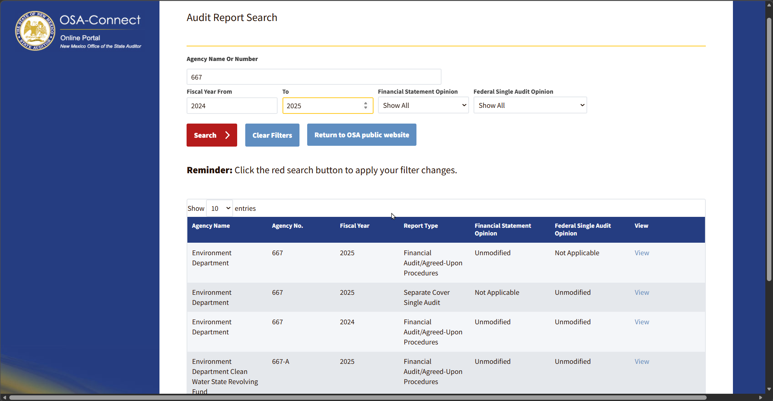
https://osaconnect.osa.nm.gov/auditReportSearch.html

Slide 4
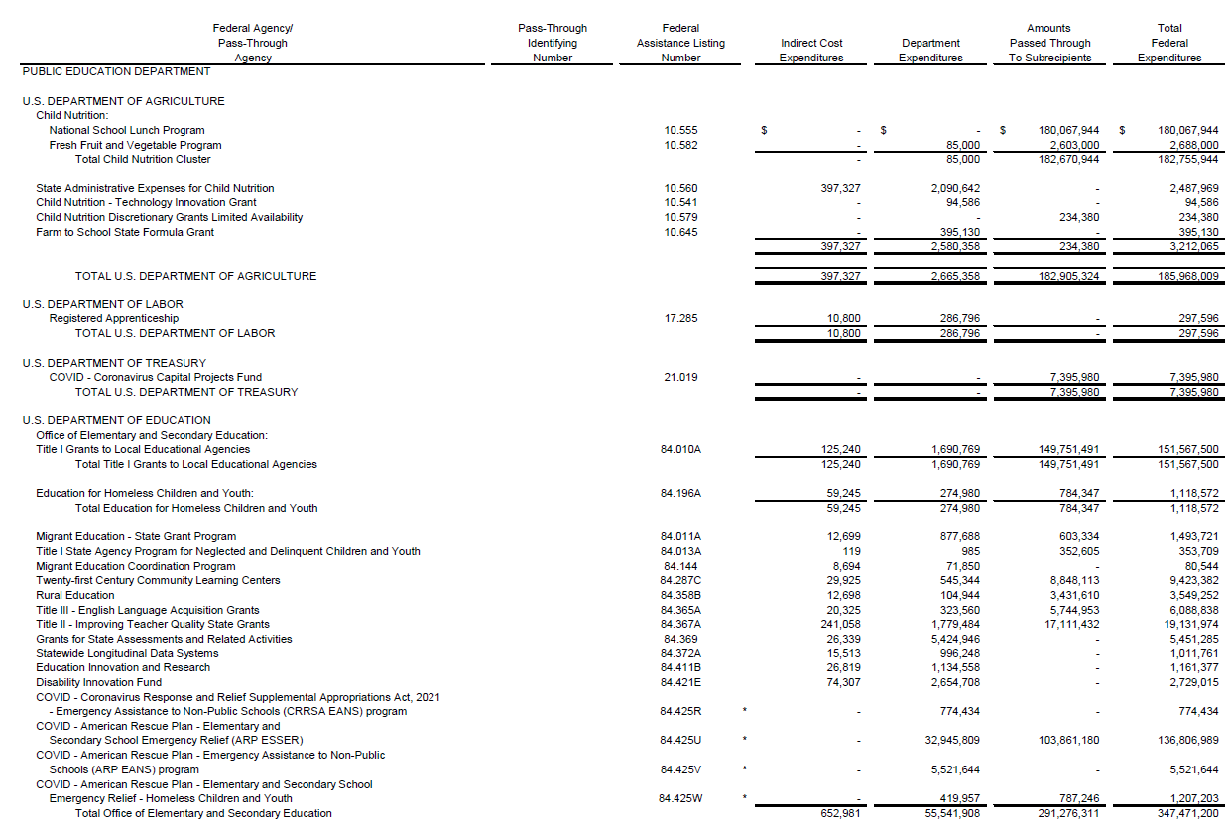
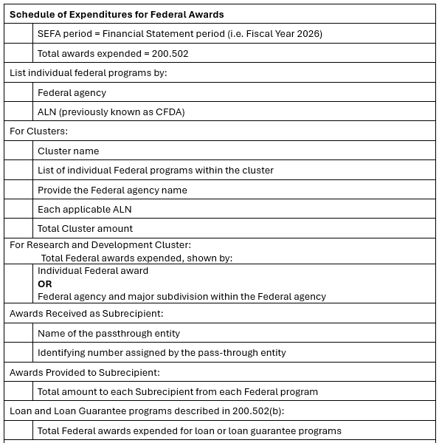
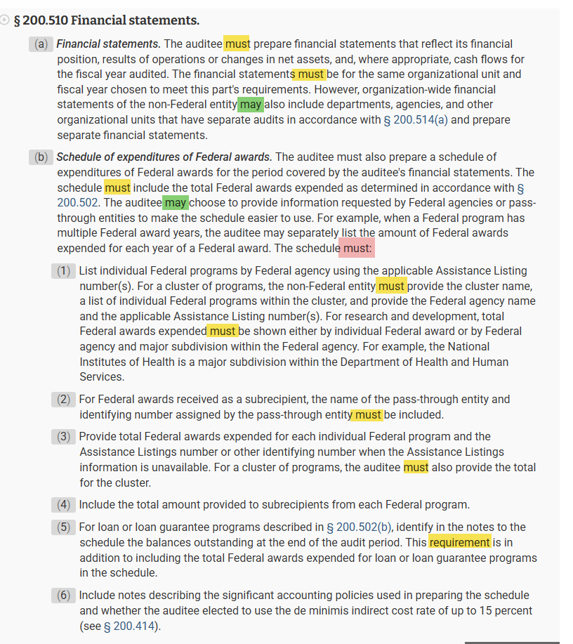

Slide 5
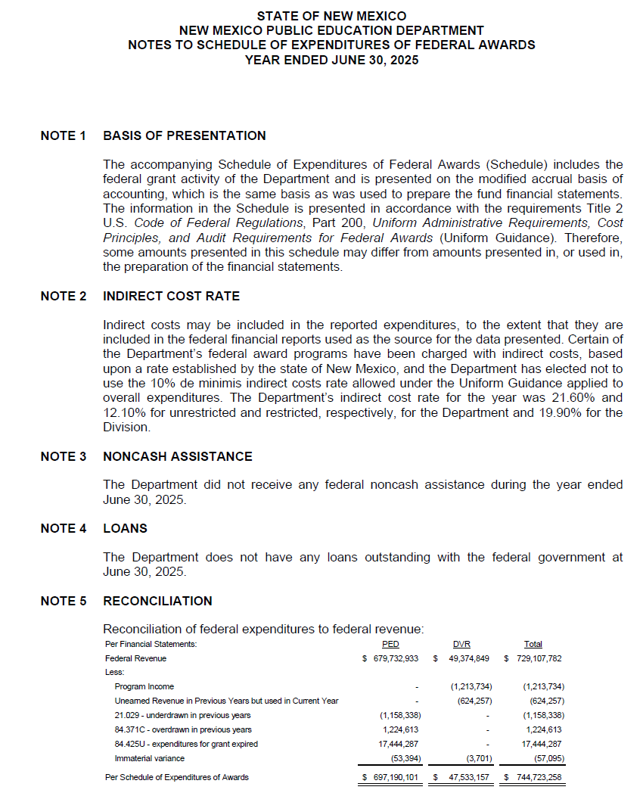
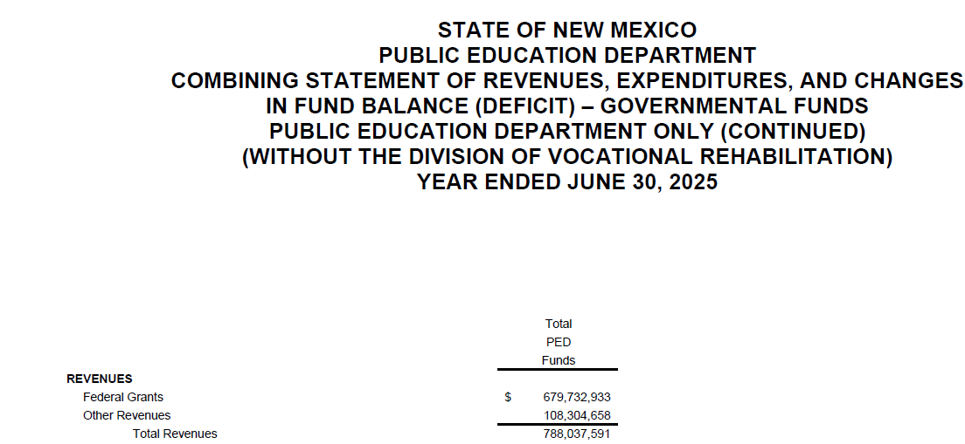
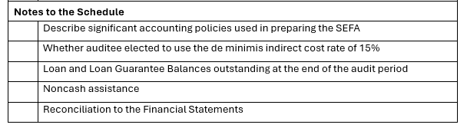
Note: A reconciliation is required to compare the Financial Statements to the SEFA, all of which should tie to the GL.
This reconciliation can be either in the Notes or at the end of the SEFA.

Slide 6
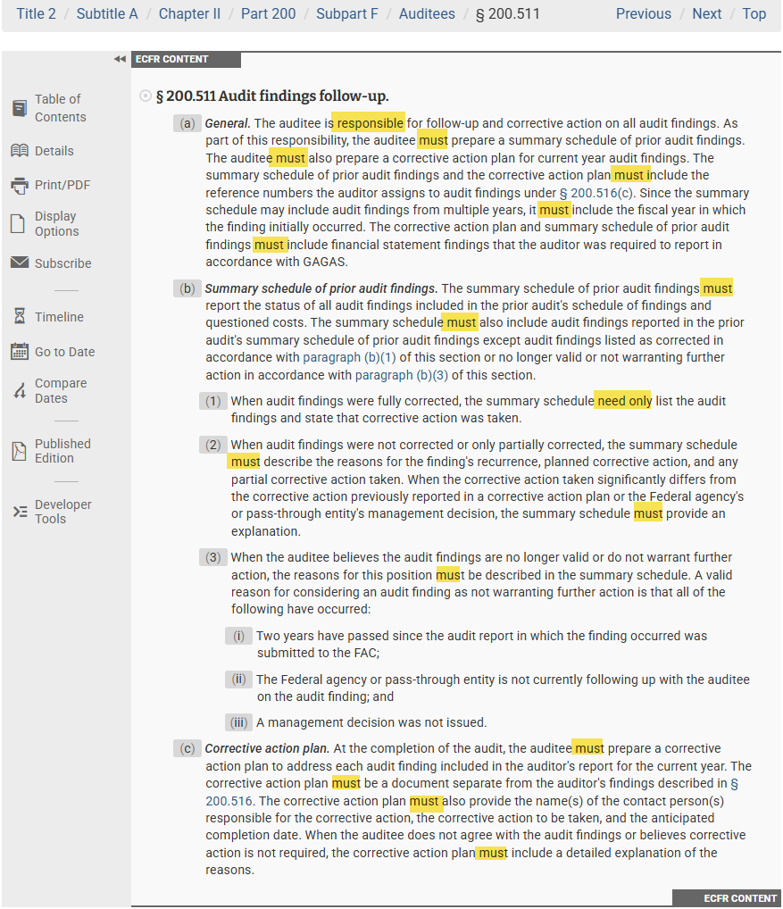
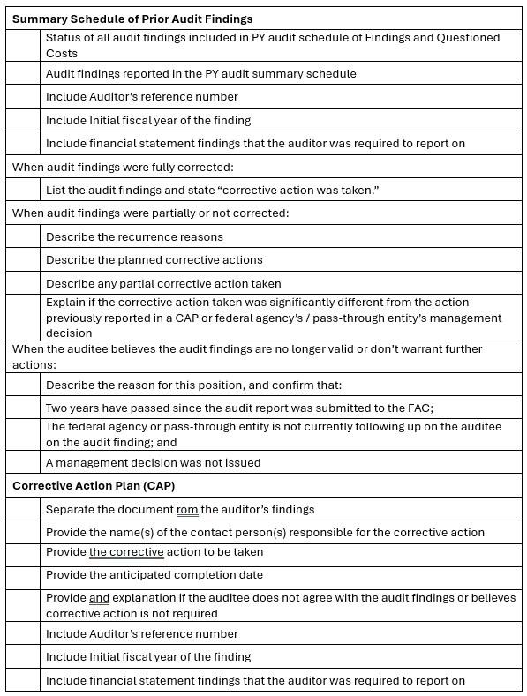

Slide 7
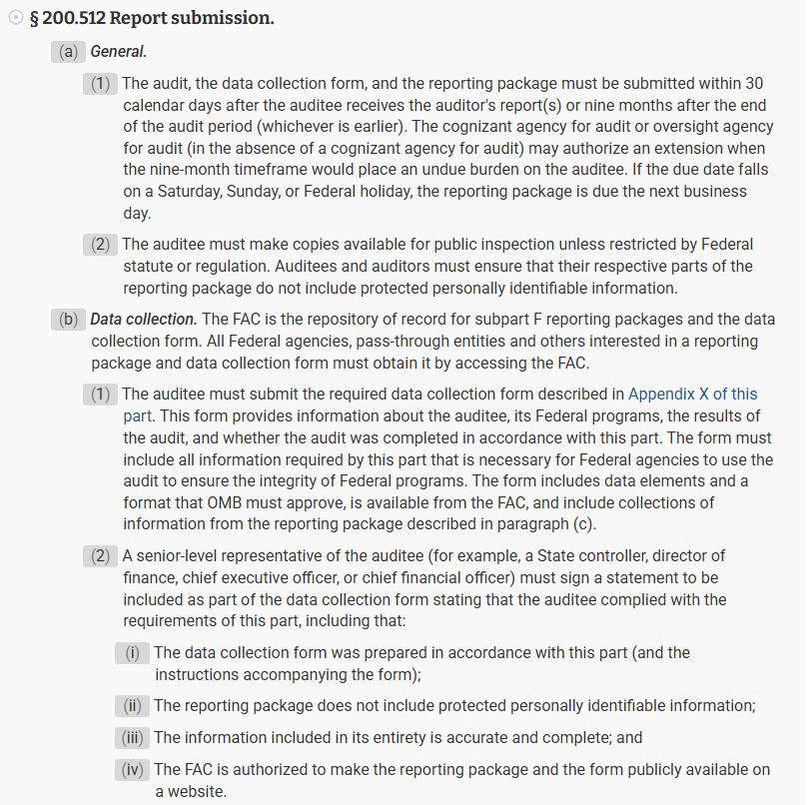
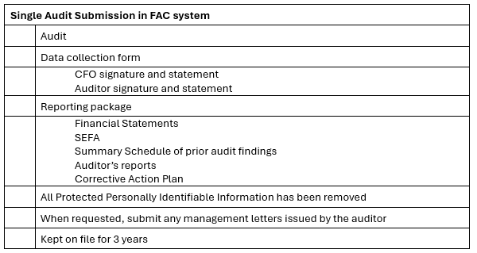
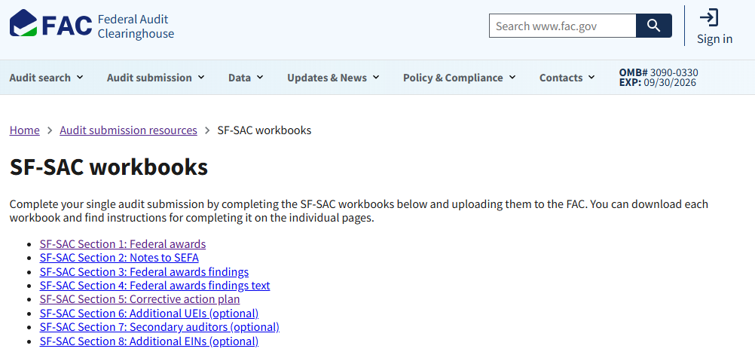
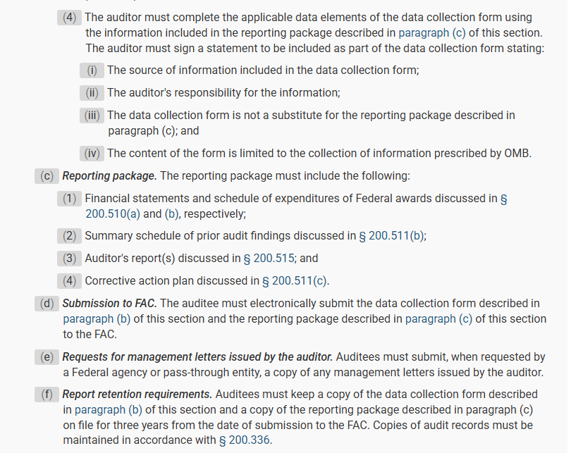
https://www.fac.gov/audit-resources/sf-sac/

Slide 8
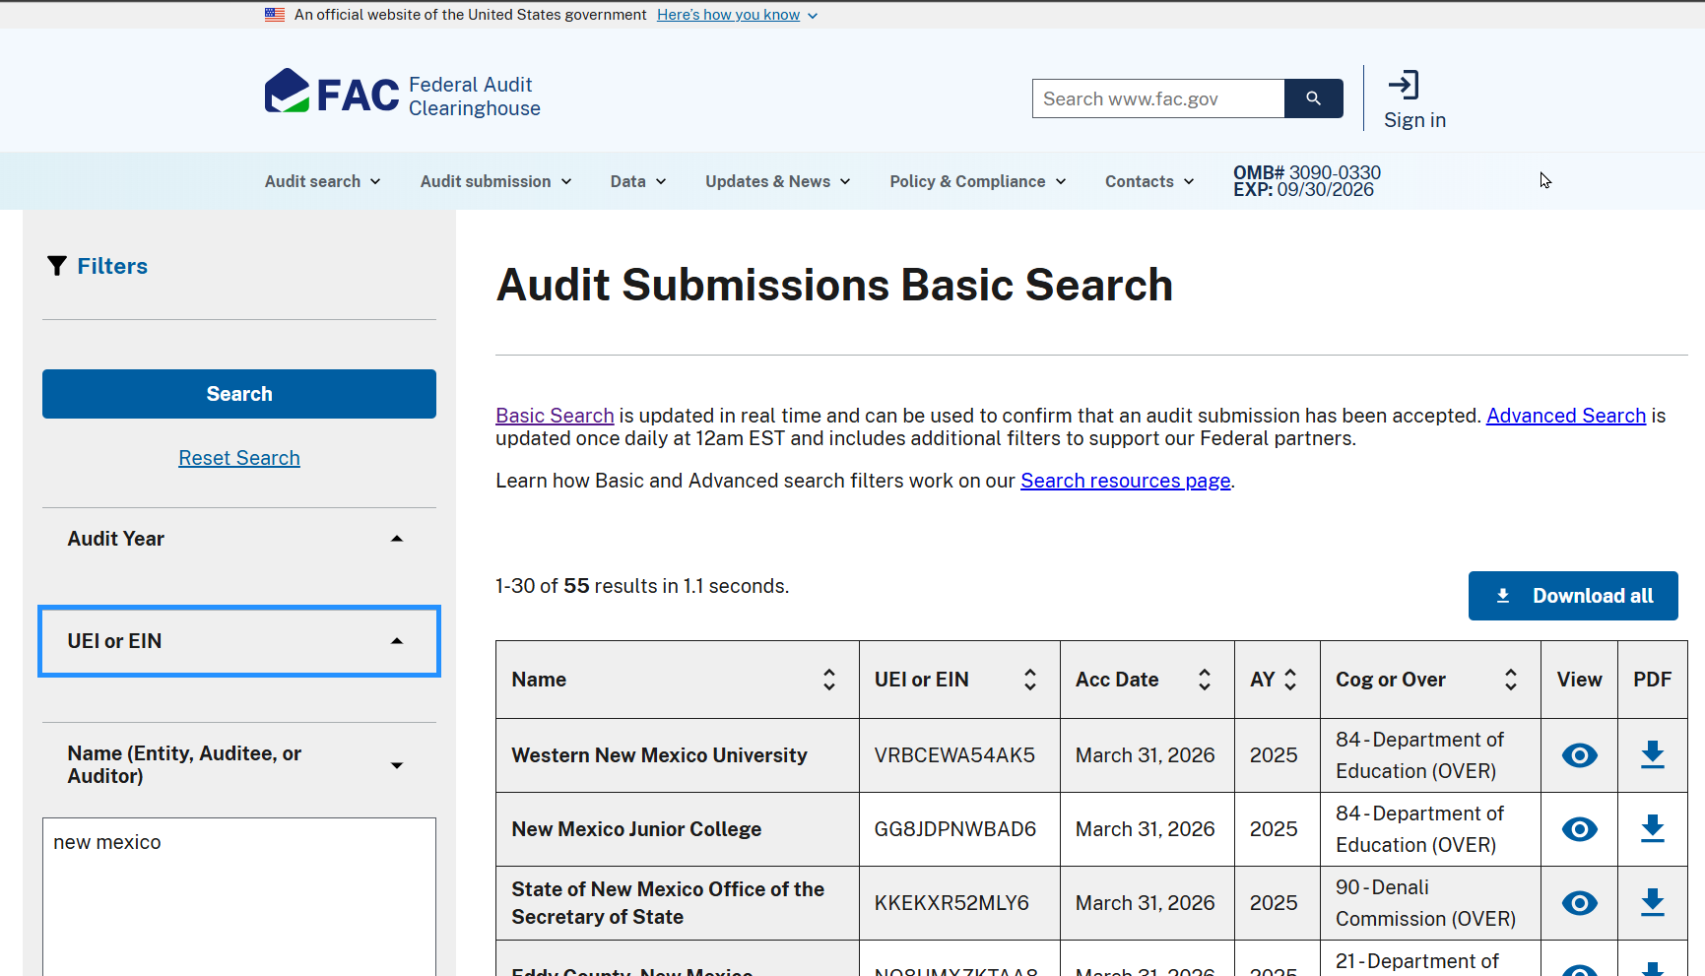
Federal Audit Clearinghouse

Slide 9
What is your role?
EVERYONE who touches a Federal grant is involved!
It begins with an award
The agency has identified the need for an award, read the NOFO, applied for it, and received the NOA. Our budget analyst has entered it into the system, and a funding string(s) has been provided to track the award revenue and expenses in SHARE.
Subrecipients, contractors, and vendors have been identified
Determining the difference between contractors and subrecipients is critical. They are treated very differently and have drastically different compliance requirements. Documentation of that determination is also important. DFA website has a standard checklist.
Now we’re ready to procure a good or service
We submit a requisition or “internal purchase request.” A purchase order (PO) has been created, and we ensure the funding string is accurate (i.e. Are the splits accurate, is indirect cost coded correctly, etc.?)
Time to spend the money
Services are performed / goods are provided / Subrecipients submitted payment requests, and we pay the invoice – procurement enters a voucher matched to the PO. The system generates an accounting entry that is posted to the General Ledger.
& don’t forget about Payroll
It is a similar process with Payroll. Employees use Combo Codes that hit the grant’s funding string. Payroll journal entries hit the General Ledger bi-weekly. If an employee forgets to use a Combo Code, their salaries do not get recognized as a grant expenditure.
Time to receive the money
Staff have compared the GL list of expenses to Program’s tracking to ensure that everything was captured correctly - Sometimes the GL has a missing expense and sometimes Program misses an expense. Once differences are resolved, a packet is complied of supporting documentation for each expense, and a drawdown is prepared to request reimbursement for allowable expenses that hit the grant. Every allowable expense should have a corresponding revenue.
SEFA data is populated all year long!
The GL is the source for SEFA data, and the coding is established when a PO is created and reinforced when we pay an invoice. Corrections can be made, but only during the current fiscal year. Errors that don’t get fixed now, cannot be fixed later.

Slide 10
How do you track your awards?
It’s very important to have a master list of all your awards, special appropriations, capital outlay, and other funding sources beyond General Fund recurring appropriations. ONE file that answers every award question.
This file can be used by everyone from the Cabinet Secretary to the AP new-hire.
Assign an owner who will make updates according to Notice of Award, amendments, and by request of key individuals.
Edit, add, or remove columns to fit your agency and its users, and as the award landscape evolves.
Reference it for meetings, reports, and the SEFA!

Slide 11
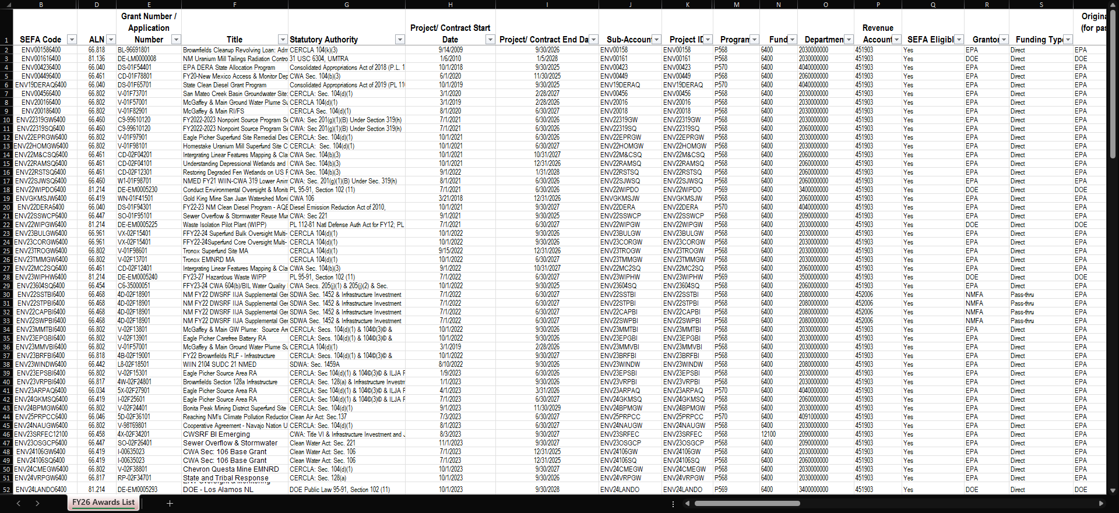
Tracking

Slide 12
SEFA Code | Revenue Account | Pending Federal Awards / Allotments | Bureau Financial Manager
Federal Award Status | SEFA Eligible | Indirect Allowable? | Program Grant Manager
ALN | Grantor | Will grant have sub-recipients? | Program Financial Manager
Grant Number / Application Number | Funding Type | A-133 or UGG | Award on Cert List?
Title | Originating Federal Agency (for pass-thru funding types only) | Fiscal Report Type | ARPA Funding
Statutory Authority | Application Amount (Fed&Match) | FFR Submissions Frequency | BIL Funding
Project/ Contract Start Date | Approved Supplemental Coverage for Anticipated Award | Draw Down Financial System | Competitive Grant
Project/ Contract End Date | Grant Agreement Federal Share | ASAP or Financial System Lookup | Formula Grant
Sub-Account | Calculated Fed % | REQUIRED Draw Down Frequency
Project ID | Grant Agreement Federal Project Cost (no match) | Amendment # | Record Retention Schedule # of years
Project ID Status | Grant Agreement Cash Match Project Cost | Last Amendment Date | Records Destruction Date
Program | Grant Agreement In-kind Match Project Cost | Did Report Requirements Change?
Fund | Grant Agreement Total Project Cost | Final FFR Submitted
Department | Federal Amount Awarded / Allotted | Final FFR Date

Slide 13
How do you track your spending and draws?
Regardless of how, do it all in one place.
Program
  Finances – Internal data
    Budget vs Expenses
    Subrecipient and Contract activity
    POs and Vouchers, payment status, Funding string accuracy
    Employee travel
    Purchases have been made and you’re ready to be reimbursed for those expenses
  Payroll
    Timesheets, Combo Codes, TPIDs
    Time and Effort – certifications
  Assets
    Acquisitions, Donations, Disposals, & Theft > Notify Finance of any changes!
Finance
  Accounts Payable, Procurement
    POs - keeping tabs on PO activity- closure or change orders, ensuring funding string accuracy,
    Vouchers - paying invoices on the correct PO line
    Entry denials
  Accounts Receivable, Drawdown Tracker
    Stages of the draw: DD Packet created, Submitted, Stuck in the portal (i.e. “Defend the Spend” review), etc.
    FD journals for every draw receipt, Deposit ID, Payment ID, Deposit sequence (same deposit ID, different payment ID), amounts, funding string
    Checks to deposit
    Adjustments & Reversions
  Assets
    Asset listing; Capitalized vs Expensed

Slide 14
How do you reconcile your spending & draws?
Monthly! Right?!
Regardless of how, do it monthly, and all in one place.
Pull the compliance supplement, identify compliance requirements. Ensure that both Finance and Program are meeting expectations.
Finance
  Payroll & Procurement
    Reconcile HCM and Voucher Report to the GL. Identify adjustments that have been, or need to be, made.
  Accounts Receivable
    Reconcile drawdown portal(s), bank transaction report, DJ report, and GL
  Assets
    Does your Asset listing match your balance sheet accounts on the GL?
Program
  Payroll – HCM Reports
    Confirm that Grant-funded Employees = Grant Funding string
    Are employees on that report allowable?
    Are employees using the correct combo codes; is their TPID set up correctly? Have you worked with HR AND Finance to correct issues?
  Procurement – Voucher reports
    Confirm your POs and Travel vouchers have the correct chartfields
    Are the expenditures allowable for the grant?
    Confirm your vouchers were matched to the correct PO
    Subrecipients – does your internal Subrecipient tracker match SHARE?

Slide 15
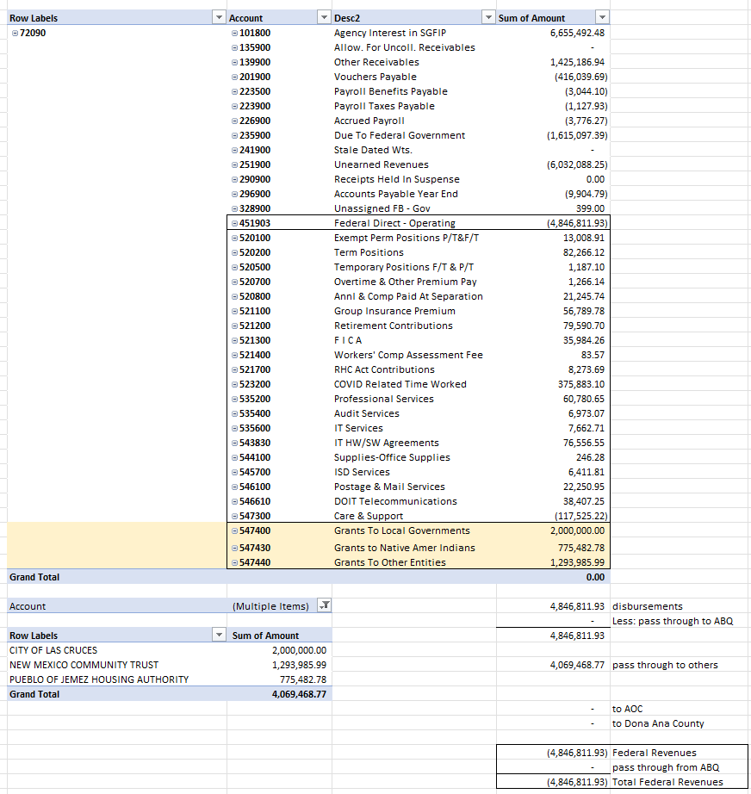
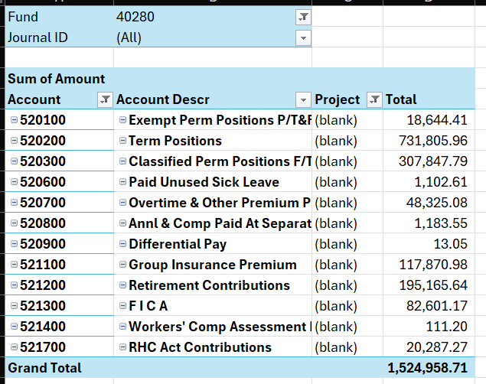
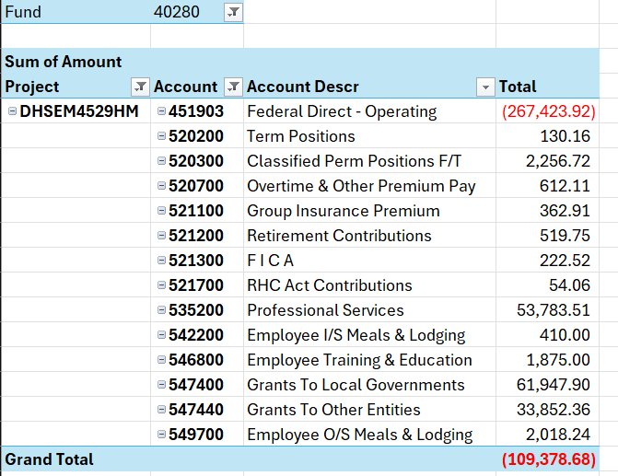



Filtered for federal fund, but missing Grant ID ☹
Federal Revenue code: 451903
Expense code: starts with a 5
Why doesn’t revenue = expense?

Slide 16
Communication = Budget + Program + Finance
Talk to each other! Identify key contacts to relay information to. Who do you reach out to when changes occur?
Do you recurring meetings with all key players at the table?
  This gives everyone an opportunity to discuss priorities, the why, and the how.
  Would a meeting like this require a culture change? Get leadership on board!
As a team, Program, Finance, and Budget should all be on the same page all the time. We are all working together to achieve the same goals. We play an equal part in that achievement, together!
Notes:
“they never told us” is NOT an excuse.

Slide 17
Audit Definitions
The auditee provides the evidence and documentation, while the auditor validates it, tests it, and certifies its compliance with federal requirements. This separation ensures accountability and transparency in federal award spending
Government Audit: an engagement that provides an opinion on financial statements as well as testing and reporting on compliance with laws and regulations that authorize the spending of public funds.
Single Audit: An audit of entities expending federal assistance that has two main components: (1) auditing financial statements and SEFA, and (2) a compliance audit of major federal awards.
Major Program: Individual or clusters of programs identified as being high risk or high dollar value via a Risk-based approach. 2 CFR 200.518 prescribes how to determine the difference between a major, type A, or type B program.
Risk assessment: the process by which an auditor obtains an understanding of an entity and its environment, including its internal control, in order to evaluate the likelihood of material misstatement
Risk-based approach: Tailoring the audit scope, procedures, and focus to the highest-risk areas of the program. This approach includes consideration of current and prior audit experience, oversight by federal agencies, and inherent risk.
Materiality: Misstatements, including omissions are considered material if there is a substantial likelihood that, individually or in the aggregate, they would influence the judgment made by a reasonable user based on the financial statements.
Audit Population: the entire set of data from which an auditor selects a sample to test.
Audit Sampling: Selecting items from a population to apply audit procedures to; approaches to sampling include statistical and judgmental
Internal Control: The mechanisms, rules, and procedures implemented by an organization to ensure the integrity of financial reporting, promote operational efficiency, encourage adherence to policies and laws, and prevent fraud. It is continuous, dynamic, and involves people at every level.
Test of Controls: audit tests used to obtain evidence about the operating effectiveness of a control by determining how, by whom, and with what level of consistency controls have been applied. TOCs include inquiry, inspection, observation and reperformance; evaluating the effectiveness of internal controls; meant to reduce ToD testing
Test of Details: substantive audit procedures that are applied to transaction classes, account balances, and disclosure items in order to substantiate the amounts and disclosures reflected in the F/S; verifies account balances and transactions for accuracy

Slide 18
How do auditors know what to audit?
The SEFA is the starting point for auditors identify Major Programs to review. They will assess internal controls and outline the audit’s scope and timeline. Then, they gather evidence through testing transactions, reviewing documentation, and verifying adherence to federal regulations and program rules.
The UG provides guidance on applying a “risk-based approach” to program selection. Major programs are determined in accordance with formulas prescribed in 2 CFR 200.518. Type A programs are generally high dollar amounts and/or high risk and complexity. Type B is everything else.
At a minimum, auditors must audit all Type A (not identified as low risk) and all high-risk Type B programs. Auditing additional programs may be necessary.
Per 200.514, auditors must
  Ensure the financial statements and SEFA are presented fairly and accurately under GASB and confirm that the SEFA appropriately aligns with the overall financial report.
  Assess internal controls over federal programs using guidance from COSO and GAO standards. They must perform enough control testing to support a low assessed level of control risk for major programs.
  If controls are weak or likely ineffective, auditors may increase substantive testing. Auditors must report any significant deficiencies or material weaknesses, assume maximum control risk, and conduct extra compliance testing.

Slide 19
Auditor’s Guidance
It’s an open book test!
Audit requirements apply to recipients and subrecipients of federal financial assistance. Contractors have more limited requirements.
2 CFR 200, Subpart F
  The UG states that the auditor must determine whether the auditee has complied with federal statutes, regulations, and the T&Cs of federal awards that may have a direct and material effect on each of its programs and form an opinion on compliance
OMB Compliance supplement
  Provides Auditors with guidance and program-specific instructions for how to evaluate Auditees that is distinct from what is required in 2 CFR Part 200
  In the absence of a Compliance Supplement, Auditors evaluate all 12 Compliance Requirements
Generally Accepted Government Auditing Standards (GAGAS), Yellow Book
  GAGAS contains requirements and guidance to assist auditors in objectively obtaining and evaluating sufficient, appropriate evidence and reporting the results. When auditors conduct their work in this manner and comply with GAGAS in reporting the results, their work can lead to improved government management, better decision making and oversight, effective and efficient operations, and accountability and transparency for resources and results.
Standards for Internal Control in the Federal Government, Green Book
  The Green Book provides the framework for establishing and maintaining an effective internal control system that safeguards public resources.
Individual Award Agreements and Federal Agency Regulations
  The auditor must determine whether the auditee has complied with Federal statutes, regulations, and the terms and conditions of Federal awards that may have a direct and material effect on each of its major programs. This includes the NOFO, Notice of Award, Federal Agency Terms and Conditions, and other Award-specific manuals and guidelines.

Slide 20
Common SEFA mistakes
SEFA Does Not Reconcile to the General Ledger
  SEFA expenditures do not match accounting records.
  Adjustments made at year‑end are not reflected on the SEFA.
  Program staff track costs separately and fail to reconcile with Finance.
Incorrect or Missing ALNs (CFDA Numbers)
  ALN on the SEFA does not match what is on the Notice of Award.
  Wrong cluster code listed.
Missing ALNs for subawards or pass‑through funds.
  Missing or Incorrect Pass-Through Entity Information
  The SEFA lists the federal agency when funds actually came from a state pass‑through.
  Pass‑through identifying number (Grant ID) is missing.
  Subrecipient information omitted entirely
Incomplete or Incorrect Subrecipient Amounts
  Amounts passed to subrecipients are omitted.
  Only total program expenditures listed—no break‑out for subrecipients.
  Subrecipient list not updated throughout the year.
Failing to Capture All Awards
  New grants not added to the SEFA during the year.
  Small federal awards forgotten (“It’s only $10,000”).
  Pass‑through awards not communicated to Finance.

Slide 21
Your agency charges $85,000 of equipment purchases to a federal grant. However, the award specifies that equipment over $5,000 must receive prior approval.
  What auditors find:
    Purchases lack prior approval.
    SEFA includes the full $85,000 under “expenditures.”
  Outcome:
    Adjustment required; costs may be disallowed.
    SEFA misclassification likely results in a finding.
    Agency may need to refund unallowable costs.
Your agency passes $750,000 to a nonprofit but performs no monitoring, and the subrecipient never submits required reports.
  Auditor review shows:
    No risk assessments performed.
    No review of single audit results.
  Outcome:
    Subrecipient monitoring finding.
    SEFA might show pass‑through amounts that cannot be supported.
    Corrective action plan required.
Fiscal and Program staff do not reconcile expenditures to the ledger until year‑end.
  What auditors find:
    Errors that went undetected for months.
  Outcome:
    Control deficiency—timely reconciliations missing.
    Program may be flagged as higher risk in future years
Treasury Offset Program (TOP) intercepts an agency’s drawdown because another agency owes a federal debt due to unallowable expenses. Staff do not notice, so the wrong agency bears the offset.
  Impact:
    Agency A must ask the legislature for a deficiency because their expenses exceed their revenue
    Agency B recorded federal expenditures that were unallowable
    Both agencies have poor internal controls and audit findings, & the legislature is mad at both of them
Finance assumes Program staff are reconciling drawdowns. Program assumes Finance is reconciling drawdowns. No one actually reconciles them to expenditures in the general ledger and Discrepancies build up for an entire year.
  Impact:
    Major SEFA errors.
    Findings for lack of internal controls.
    Increased risk of federal paybacks.

Slide 22
Final Thoughts…
Don’t wait until the auditor arrives
Maintain centralized grant file documentation
Maintain monthly draws, reconciliations and document differences
Program, Finance, and Budget must be in constant communication
Prior year is only a starting point – requirements and clusters change
The SEFA is a year-long process, not an event at Year End!

Slide 23
Sources & Resources
  Home - NM Office of the State Auditor
  Federal Grant Management Resources | New Mexico Department of Finance and Administration
  Becker Professional Education. (2022). CPA Exam Review: Auditing (V 4.2). Becker Professional Education
  Specific Guidelines for Various Data Elements – ALNs, Identification Numbers and Program Names- Reporting Requirements for Annual Financial Reports
  Single Audits FAQs | Office of Inspector General | Government Oversight | U.S. Department of Health and Human Services
  OFFICE OF RECOVERY PROGRAMS Introduction to Single Audits and the Compliance Supplement
  eCFR :: 2 CFR Part 200 -- Uniform Administrative Requirements, Cost Principles, and Audit Requirements for Federal Awards

Slide 24
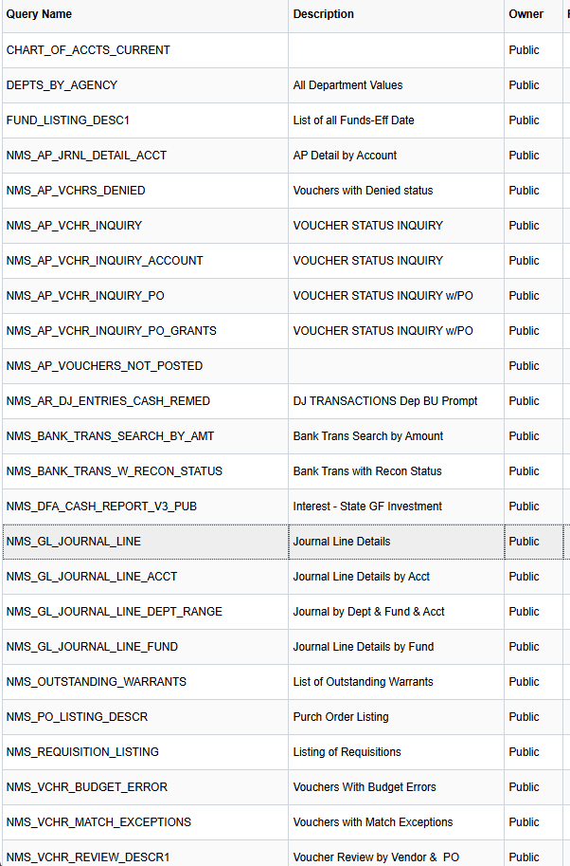
Queries:
NMS_VCHR_REVIEW_DESCR1 Note: do an Xlookup formula to pull in Invoice # from NMS_VCHRS_BY_ENTRY_DATE
To conduct balance research, you may need to run multiple years' worth of GL reports to identify the beginning of the issue.
To learn more about pivot tables and Excel, see Excel Basics using SHARE FSCM for videos and slides. Practice makes proficient!
HCM reports require additional SHARE access that I do not have. Contact your HR for those queries.

Slide 25
Based on the Survey :
Subrecipient / Contractor Determination Checklist
SAM.gov Resources
Combo Codes:
  Contact your agency’s HR and DFA Central Payroll, keep Finance involved!!!
  Also see Payroll 101 training in SHARE ELM
FFATA Reporting Resources
Excel trainings
Thank you! See you next time!☺

