Slide 1
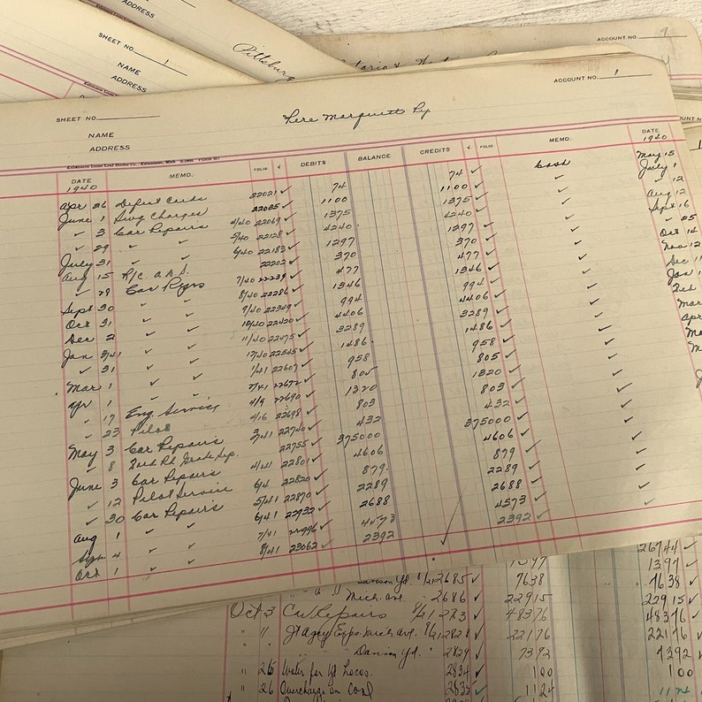

Accounting 101

Slide 2
Expectations for this session:
What to expect
  Lots of questions - questions are encouraged in the Q&A!
  The slides and recording
    YouTube SHARE Training Videos - New Mexico Department of Finance and Administration
  New vocabulary and definitions
  The Accounting Cycle, account types, debits & credits, journal entries, adjusting entries, closing entries
What not to expect
  Time to frantically take notes
    Absorb the new vocabulary and concepts now, come back to the slides later.
  Every question to get answered immediately
    Questions in the Q&A will get answered after the break
    We may refer you to ACFR for further guidance
  To be an accounting expert by lunch today
    Memorization and Repetition required
  To get your debits and credits right every time

Slide 3
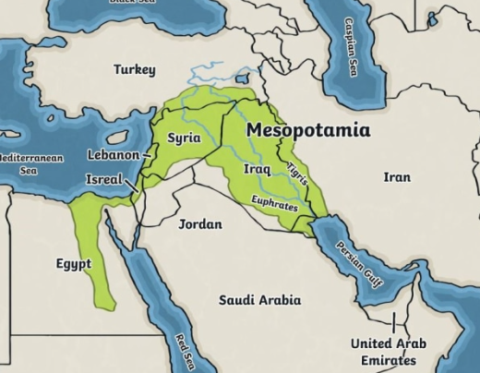
Accounting: The Language of Business
Accounting is a systematic way to record and organize financial transactions.
It is simply keeping track of money in a clear and
consistent way.
Written language developed from the practical need to manage goods, credit, and resources. The earliest use of systemic recordkeeping dates back to ancient Mesopotamia (present-day Iraq) to record agricultural products!
Just like any language, accounting has grammar, vocabulary, rules, and purpose. A CFO, an auditor, a program manager, and a legislator can all look at the same financial statements and understand what’s going on. Accounting gives everyone a common “dialect” to discuss performance, stewardship, and risk.
Notes:
A common accounting misconception is that it is math. We use Excel to do the math for us.

Slide 4
The Foundation
Definitions:
An account is the category, or bucket, to organize each transaction. Accounts are the fundamental building block of a journal entry, the GL, and financial statements.
A list of all account names used to record transactions of a company is referred to as a chart of accounts (CHART_OF_ACCTS_CURRENT).
The account balance is the net amount after all entries (debits and credits) have been posted. The current balance will tell a story depending on the account type – cash on hand, liabilities owed, revenue earned, etc.
  A listing of all general ledger accounts and their balances at a specific point in time is called a Trial Balance. It is used internally to ensure total debits equal total credits before preparing financial statements.
Journal entries (JE) make up the data in the general ledger. These are the individual transactions that increase and decrease account balances.
  Record / recognize / book means to formally enter it into the accounting system so that it becomes part of the organization’s financial statements.
The general ledger (GL) is the central record of all financial transactions (NMS_GL_JOURNAL_LINE, periods 0-998).
  The GL is the foundation of Financial Statements, and the Financial Statements are the basis of an Auditor’s Opinion.
Financial Statements are formal reports that convey an entity’s financial activities and performance over a specific period of time. They summarize information from all major account types.
An Auditor’s Opinion is a formal statement made by an independent auditor as to whether a government’s financial statements are presented fairly, in accordance with GAAP. It communicates the reliability of the financial statements.

Slide 5
Account Type | Account Number | Normal Balance | DR/CR sign | Business Financial Statement | Government-wide Financial Statement | Government Fund Financial Statement
Asset | 1XXXXX | Debit | + | Balance Sheet | Statement of Net Position | Balance Sheet – Governmental Funds
Liability | 2XXXXX | Credit | - | Balance Sheet | Statement of Net Position | Balance Sheet – Governmental Funds
Fund Balance/ Net Position/ Equity | 3XXXXX | Credit | - | Balance Sheet | Statement of Net Position | Balance Sheet – Governmental Funds
Revenue | 4XXXXX | Credit | - | Income Statement | Statement of Activities | Statement of Revenues, Expenditures, and Changes in Fund Balances
Expense | 5XXXXX | Debit | + | Income Statement | Statement of Activities | Statement of Revenues, Expenditures, and Changes in Fund Balances
Notes:
Lots of bank space for taking notes!

Slide 6
The Accounting Cycle
The agency receives an invoice and procurement staff enter vouchers into SHARE.
Collect and analyze data from transactions and events
Journalize transactions and post to the GL
Prepare an unadjusted trial balance
Prepare adjustments
Prepare an adjusted trial balance
Prepare financial statements
Close the accounts
Prepare a post-closing trial balance
Reconcile accounts
Determine which account codes to reflect the events that occurred
Assess each
debit and credit
Confirm that all accounts were closed and balances rolled forward to the next period/fiscal year correctly.
The invoice is for contractual services that we are not going to pay cash for right away.
Revenues and Expenditures are closed at $0.00 and the net amount is recognized as fund balance/net position/equity
DR: Expense (+), 300s
CR: Accounts Payable (-)
Use adjusted TB to combine account categories and identify total account balances
SHARE batches multiple vouchers into one JE periodically throughout the day.
Revenue Example: Match grant drawdown amounts in the portal to revenue recorded and cash received
Expense Example: Match Federal expenditures in the GL to internal trackers to ensure all invoices were captured. Once a drawdown is performed, confirm revenue = expenditures
Identify abnormal account balances and correct entry errors
Book an accrual to report expenditures incurred but not reported via voucher
Check to make sure each account has a normal balance and that debits = credits

Slide 7
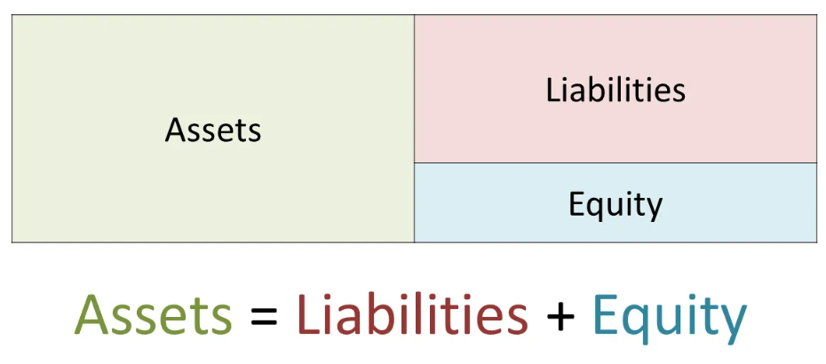
Account Types – Balance Sheet / Statement of Net Position
Accounting Elements Expanded | IFRS and US GAAP
The relationship between the three balance sheet accounts is called the accounting equation. This equation illustrates how resources relate to obligations.
From a governmental perspective, fund balance / net position is the remaining resources after liabilities are paid. It is the government’s residual assets available for future use.
1 - Asset
  Resources the government owns or controls that provide future benefit (i.e. the sale of asset).
2 - Liability
  An obligation owed to another party that will require cash in the future.
3 - Fund Balance / Net Position / Equity
  The difference between an asset and a liability. Primarily focuses on proper sub-classification.
    Fund balance is the accrual basis equivalent of equity in governmental fund financial statements, while Net position is the equity equivalent in government-wide/proprietary fund reporting.
Notes:
Equity is used by for-profit businesses, while FB & NP are used in governmental accounting
No low level chartfields in SHARE for B/S accounts
The key element of an asset is “control.” It is not an asset if the entity doesn’t have exclusive ability to use (control) it.
The key element of a liability is the involvement of another party.

Slide 8
Account Types – Income Statement / Statement of Activities
Accounting Elements Expanded | IFRS and US GAAP
4 - Revenues
  Resources received by the government, such as taxes, fees, fines, grants, and charges for services.
  Note: Some inflows are Other Financing Sources (e.g., bond proceeds, transfers), not revenues.
5 - Expenditures/Expenses
  Resources used by the government for current operations or capital items.
  Recognized when the liability is incurred (modified accrual).
  Note: Non‑cash costs like depreciation and amortization appear as expenses in government‑wide statements, not as expenditures.
Timing is everything! We will talk more about revenue and expenditure/expense recognition in relation to the basis of accounting we use in state government.
In government‑wide statements and proprietary funds, the difference between revenues and expenses are shown as the “Change in Net Position,” which reflects how the government’s overall financial position has increased or decreased during the period.
In governmental fund financial statements, you’ll see the net difference as either an “Excess” or a “Deficiency” to indicate revenues over or under expenditures.

Slide 9
Elements of Financial Statements
Account Types
STATEMENT OF NET POSITION
1 - Asset
  Short Term
    Cash
    Accounts Receivable, Due from Federal government
  Long Term
    Land, art
2 - Liability
  Short Term
    Vouchers payable, Due to Federal government
    Accrued payroll
  Long Term
    GO bonds, SBITAs
3 - Fund Balance/Net Position
  Fund balance: restricted, committed, assigned, unassigned, nonspendable
  Net position: net investment in capital assets, restricted net position, unrestricted net position
STATEMENT OF ACTIVITIES
4 - Revenue
  State, Federal sources (grants)
  Investment income
  Fees, taxes, permits, licenses
  Appropriations = Transfers In (499105)
5 - Expenditure
200s, 300s, 400s (budgeting)
  Grants to local entities, tribal entities, individuals
  Employee travel
  Salaries and benefits

Slide 10
Match the terms with the appropriate definition:
Assets
Liabilities
Equity/Fund Balance
Revenues
Expenditures
Outflows of resources
Inflows of resources
Resources owed to another entity
Net resources
Resources of an entity
Notes:
1. E; 2. C; 3. D; 4. B; 5. A

Slide 11
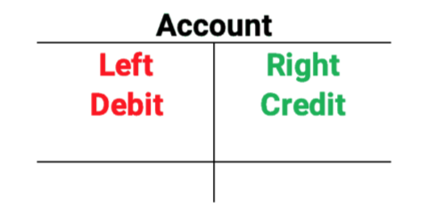
Definitions:
Debits and Credits
Transactions have the effect of increasing and decreasing account balances, but accountants use the terms “debit” and “credit” instead.
Debit is abbreviated as (DR) and Credit as (CR)
Common mistake: one might assume the term “debit” always means increase and “credit” always means decrease.
  This assumption is only true for Assets (1) and Expenses (5).
Debits are recorded as a (+) and Credits are recorded as a (-).
  You cannot depend on a +/- to mean increase or decrease!
Debits and Credits simply mean
left side and right side.
T-accounts help to visualize this concept.
Instead of describing an account balance as going up or down, accountants use the terms “debit” and “credit” to show how a transaction affects the account.
Notes:
Abbreviations:
DR = debit
CR = credit

Slide 12
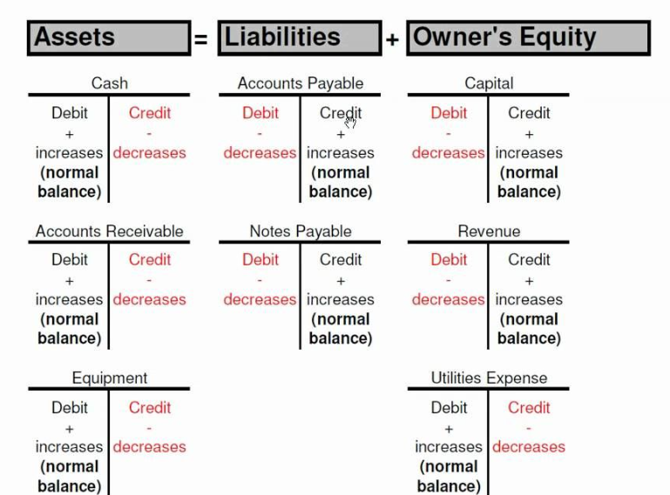

Debits and Credits
Natural Balances
A natural balance refers to the side of a T‑account where increases are recorded.
Natural Debit Balance
  1 – Asset (DR)
  5 – Expense (DR)
  Shown as a (+) in the GL
Natural Credit Balance
  2 - Liabilities (CR)
  3 - Fund Balance/NP(equity) (CR)
  4 - Revenue (CR)
  Shown as a (-) in the GL
Understanding the natural balance, the anchor, helps us know where to record increases and decreases, how accounts behave, and how to read general ledger activity.

Slide 13
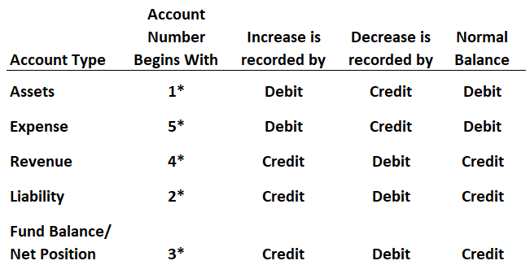

Slide 14
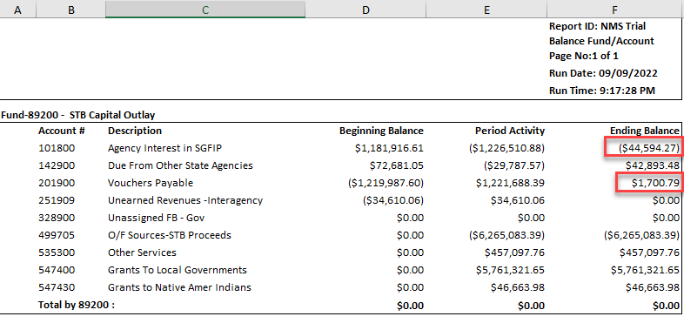
Normal vs. Abnormal Balances

Slide 15
Recording Transactions = Journal Entries
Think of recording a transaction as if you're writing a sentence form of the accounting language. Every English sentence uses at least one noun and one verb, and every accounting sentence uses at least one debit and one credit. Debits and credits describe what happened and keep the accounting equation in balance.
Account types
  Every transaction affects at least two account types: assets, liabilities, revenues, expenditures/expenses, or fund balance/net position. The natural balance of each account type determines whether a debit or credit increases it.
Journal Entries
  Journal entries are the formal way we record financial activity. They answer three simple questions:
    What account code are we using?
    What account is increasing? (Debit or credit?)
    What account is decreasing? (Debit or credit?)
  Each journal entry must balance: total debits = total credits.
General ledger
  Once recorded, journal entries flow into the general ledger, which acts as the master record of all accounts. The ledger summarizes every debit and credit for each account.
Financial Statements
  The general ledger rolls up into the financial statements, showing the results of all journal entries over time.
The first step to every journal entry is to identify WHAT account codes are affected, and then we must determine HOW those accounts are affected.

Slide 16
Transactions using T-Accounts
During the accounting period
The first step to every journal entry is to identify WHAT account codes are affected, and then we must determine HOW those accounts are affected.
Equipment
1XXXXX
Cash
101800
Transaction 1(a): purchase equipment
  Your agency purchases equipment with $30,000.00 cash. The agency has an increase in equipment (an asset) and a decrease in cash (an asset).
    Note: Not a true reflection of transactions that occur in SHARE due to Actuals and Full Accrue ledgers.
Transaction 2: pay salaries to employees
  Your agency pays $100,000.00 for their accountant’s salary and benefits for work performed in the current period. The agency has in increase to salaries, retirement, and life insurance premiums (expenses), and a decrease to cash (an asset).
30,000.00
(30,000.00)
30,000.00
(30,000.00)
Classified Perm Positions F/T
520300
Insurance Premium
521100
50,000.00
25,000.00
50,000.00
25,000.00
Retirement
521200
Cash
101800
25,000.00
(100,000.00)
25,000.00
(100,000.00)

Slide 17


Vouchers payable
201900
Transaction 3: purchase supplies on account
  Your agency purchases supplies on account for $2,300.00. The agency has an increase in supplies expense (an expense) and an increase in amounts owed to the supplier (a liability).
Transaction 4: pay vendor for supplies purchased on account
  Your agency pays the vendor with cash (an asset) for the outstanding amount previously owed to the vendor (a liability). The agency has a decrease in cash and a decrease in amounts owed.
(2,300.00)
2,300.00
0.00
Supplies Expense
544100
Vouchers payable
201900
2,300.00
(2,300.00)
2,300.00
(2,300.00)
Vouchers payable
201900
Cash
101800
2,300.00
(2,300.00)
2,300.00
(2,300.00)

Slide 18


Accounts Receivable
Due From Federal Gov’t
145900
Transaction 5(a): grant reimbursement request (drawdown) on account
  Your agency performs a drawdown request for a Federal award reimbursement of $30,000.00. The agency recognizes an increase in amounts owed to the agency (a receivable, asset), and an increase in grant revenue.
Transaction 6: cash received for drawdown request
  Your agency deposits the $30,000.00 cash received for the federal award reimbursement within 60 days. The agency recognizes an increase in cash (an asset) and the amount owed to the agency is reduced (an asset). Revenue has already been recognized.
30,000.00
(30,000.00)
0.00
Accounts Receivable
Due From Federal Gov’t
145900
Revenue
Federal Direct – Operating
451903
30,000.00
(30,000.00)
30,000.00
(30,000.00)
Accounts Receivable
Due From Federal Gov’t
145900
Cash
101800
30,000.00
(30,000.00)
30,000.00
(30,000.00)

Slide 19
Transaction 1: purchase equipment
Account Type | Account | Account Descr | Amount
Asset (1) | 184900 | Machinery And Equipment | 24,000.00
Asset (1) | 101800 | Agency Interest in SGFIP | (24,000.00)
Transaction 2: pay salaries to employees
Account Type | Account | Account Descr | Amount
Expense (5) | 520300 | Classified Perm Positions F/T | 50,000.00
Expense (5) | 521200 | Retirement Contributions | 25,000.00
Expense (5) | 521100 | Group Insurance Premium | 25,000.00
Asset (1) | 101800 | Agency Interest in SGFIP | (100,000.00)
Transaction 3: purchase supplies on account
Account Type | Account | Account Descr | Amount
Expense (5) | 544100 | Supplies-Office Supplies | 2,300.00
Liability (2) | 201900 | Vouchers Payable | (2,300.00)
Transaction 4: pay vendor for supplies purchased on account
Account Type | Account | Account Descr | Amount
Liability (2) | 201900 | Vouchers Payable | 2,300.00
Asset (1) | 101800 | Agency Interest in SGFIP | (2,300.00)
Transaction 5: drawdown request on account
Account Type | Account | Account Descr | Amount
Asset (1) | 145900 | Due From Federal Government | 24,000.00
Revenue (4) | 451903 | Federal Direct - Operating | (24,000.00)
Transaction 6: cash received for drawdown request
Account Type | Account | Account Descr | Amount
Asset (1) | 145900 | Due From Federal Government | (24,000.00)
Asset (1) | 101800 | Agency Interest in SGFIP | 24,000.00

Slide 20
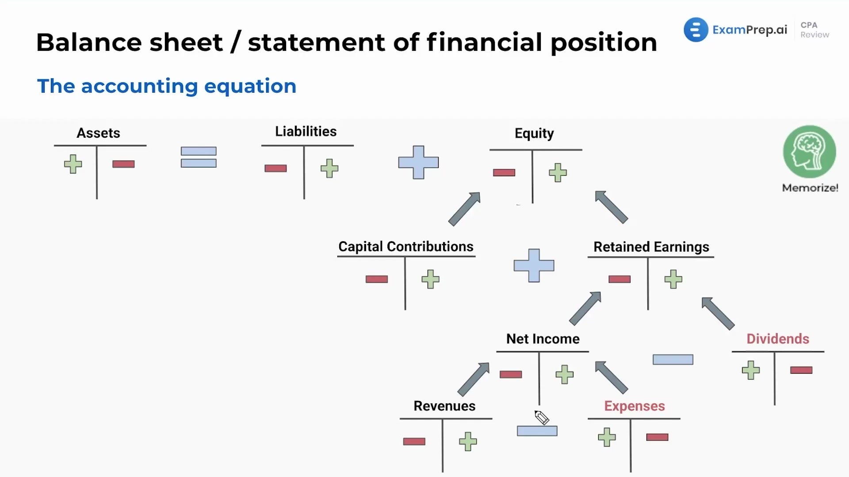
Notes:
Not governmental accounting focused in this graphic, so our focus is A, L, Q, R, E

Slide 21
Let’s take a break
Q&A will be answered when we get back!

Slide 22
Basis of Accounting
Revenue and Expense Reporting
Investors use net income when predicting future profits. Accounting for revenues and expenses consistently makes it easier to compare the same reports across fiscal years and across many different entities.
The basis of accounting prescribes when revenues and expenditures or expenses are booked and when they are reported in the financial statements.
Cash Basis
Record revenues and expenses in the period cash is received or paid.
Even if you provide services and have “earned” revenue, you don’t record it until you receive cash.
Accrual Basis
Record revenues in the period in which they become earned, whether received or not.
Modified Accrual Basis
Used primarily by Governmental Funds
Expenditures are generally recorded in the same way as accrual accounting, when incurred, regardless of cash. Some exceptions to this rule.
The timing of recognizing revenues depends on whether the event is short-term or long-term
Revenues must be both measurable and available, meaning you can reasonably estimate the amount and can collect the cash within 60 days (MAPs FIN 11.1.D.5).
Expenses are recognized in the period in which the goods or services are received or consumed.
You receive goods or services, so you record the expense even though you haven’t paid cash.
You provide services on credit, so you recognize revenue even if cash hasn’t been received.
Notes:
Modified Accrual: i.e. MAPs receivable rules related to payment beyond 60 days
Short term – recorded when they are both measurable and available
Long term – recorded when they are earned (accrual basis).

Slide 23
Ending the Accounting Cycle
Adjusting entries have two broad types of categories:
Prepayments / Deferrals
Prepaid expenses – to purchase an asset in the current period that will be recorded as an expense in future periods
Deferred inflows (outflows) – amounts received (paid) and recognized in the current period that cannot be recorded as revenue (expense) until a future period.
Accruals
Accrued expenses – to record an expense in the current period that will be paid in a future period
Accrued revenues – to record a revenue in the current period that will be collected in cash in a future period
Adjusting entries
  are meant to record events that have occurred but were not yet recorded.
  commonly done to correct timing issues for transactions that cross periods, or to correct a prior accounting period mistake.
  generally occur at the end of an accounting period (monthly/quarterly/ annually)
  are an integral part of accrual basis accounting.

Slide 24

Adjusting Entries - Prepaid Expenses
Prepaid Insurance
10,000.00
5,000.00
Transaction 1(b): Equipment Depreciation
  Your agency purchases equipment with $24,000.00 cash. It was determined to have a useful life of 60 months (5 years).
  At year‑end, 6 months have passed since the purchase, and an adjusting entry is necessary to record depreciation expense.
    Depreciation reduces the asset value indirectly by affecting an account called Accumulated Depreciation.
  To calculate 6 months of depreciation expense, we divide (6/60 months) and multiply by the purchase amount of $24K = $2,400.00.
Transaction 6: Prepaid Insurance
  Your agency purchases a 12‑month insurance policy for $10,000.00, paying the full amount in cash at the start of the year. Because the payment provides a future benefit, it is recorded as a prepaid asset, not an immediate expense.
  At year‑end, 6 months have passed, meaning half of the insurance coverage has been “used up,” and an adjusting entry is required to recognize the portion that has now become an expense.
  To calculate 6 months of insurance expense, divide the time used (6/12 months) and multiply by the total prepaid amount of $10,000.00 = $5,000.00.
  This adjusting entry reduces the Prepaid Insurance asset and records Insurance Expense for the portion of coverage that relates to the current period. Leave the remaining $5,000 on the balance sheet as a prepaid asset to be expensed in the next period.)
5,000.00
Depreciation Expense
Accumulated Depreciation
2,400.00
2,400.00
2,400.00
2,400.00
Prepaid Insurance
Cash
10,000.00
10,000.00
Original entry
10,000.00
10,000.00
Insurance Expense
Prepaid Insurance
5,000.00
5,000.00
Adj. entry
5,000.00
5,000.00

Slide 25
Adjusting Entries - Deferred Inflows
FY26 Revenue
30,000.00
30,000.00
0.00
Transaction 5(b): drawdown request on account at YE
  At the end of FY26, your agency performs a drawdown request for a Federal award reimbursement of $30,000.00. The agency recognizes an increase in amounts owed to the agency (a receivable, asset), and an increase in grant revenue.
    The revenue is measurable (amount is known) and earned (eligibility requirements met – 60 days (MAPs FIN 11.1.F.5))
  The grantor agency informs the government that the reimbursement will not be processed until 90 days after year-end.
    Under modified accrual, revenue must be measurable and available. Therefore, the current revenue doesn’t meet the availability test.
Accounts Receivable
Revenue
30,000.00
30,000.00
Original entry
5(a)
30,000.00
30,000.00
Revenue
Deferred Inflows
30,000.00
30,000.00
FY26
Adjusting entry
30,000.00
30,000.00
FY27 Revenue
FY27 Cash
30,000.00
30,000.00
FY27
Revenue Recognition
30,000.00
30,000.00
Notes:
MAPs FIN 11.1.F.5 - If the receivable has not been received within 60 days of being established, the uncollected balance should be moved to deferred revenue.
Adjustment Required – Reclassify Revenue as Deferred Inflow by increasing the liability account (DR), deferred revenue, and decreasing the revenue account (CR)

Slide 26
Adjusting Entries - Accruals
An accrual is recording revenue or expense before cash changes hands. Accruals ensure financial statements reflect the economic activity that actually occurred during a period.
Accruals ensure the revenue and assets are recorded in the correct period for accurate financial reporting.
A revenue accrual occurs when a government or organization has earned revenue but has not yet received the cash. The entity should record an asset (AR, not cash) and revenue for the amount expected to be received.
An expense accrual represents a liability for goods or services that have already been received, but payment will occur later. The entity should record an expense and a liability for the amounts expected to be paid.

Slide 27
5 - Expense
2 - AP Accrual
Scenario 1 – Expense Accrual
Your agency encumbered $100.00 on PO#11111 during FY26 for goods that were delivered on 6/30. You booked an accrual on 7/30 because you had not received the invoice by the voucher deadline of 7/29.
The invoice was received for only $50.00 on August 18th, before the 9/28 deadline to pay obligations established through the accruals process.
Because you received the invoice and will pay before 9/28, you can use FY26 funds.
100.00
50.00
100.00
50.00
50.00
50.00
0.00
1 - Cash
50.00
50.00
Journal ID | Date | Line # | Account | Account Descr | Dept | Fund | Class | Bud Ref | Amount | Source | Ledger Grp | Notes
11111111 | 6/30/2026 | 1 | 546800 | Employee Training & Education | 2001000000 | 19301 | I0000 | 126 | 100.00 | CFR | ACTUALS | To recognize the Expense
11111111 | 6/30/2026 | 2 | 296900 | Accounts Payable Year End | 2001000000 | 19301 |  |  | (100.00) | CFR | ACTUALS | To Accrue the Expense as a Liability
Voucher – not matched to PO, use the accrual account code initially used against that expense
Journal ID | Date | Line # | Account | Account Descr | Dept | Fund | Affiliate | Bud Ref | Amount | Source | Ledger Grp | Notes
AP | 6/30/2026 | 1 | 296900 | Accounts Payable Year End | 2001000000 | 19301 |  |  | 50.00 | OPR | ACTUALS | To reduce the Accrual
AP | 6/30/2026 | 5 | 101800 | Agency Interest in SGFIP |  | 19301 | 39401 |  | (50.00) | OPR | ACTUALS | To reduce cash NEVER hard key cash account
Journal ID | Date | Line # | Account | Account Descr | Dept | Fund | Class | Bud Ref | Amount | Source | Ledger Grp | Notes
26AUD2222 | 6/30/2026 | 1 | 296900 | Accounts Payable Year End | 2001000000 | 19301 |  |  | 50.00 | CFR | ACTUALS | To reduce the remaining balance of the initial Accrual
26AUD2222 | 6/30/2026 | 2 | 546800 | Employee Training & Education | 2001000000 | 19301 | I0000 | 126 | (50.00) | CFR | ACTUALS | To reduce the overstated expenditure
Notes:
cash T account was wrong on the recording! Revised here!

Slide 28
Scenario 2 – Expense Accrual
Your agency encumbered $100.00 on PO#11111 during FY26 for goods that were delivered on 6/30. You booked an accrual on 7/30 because you had not received the invoice by the voucher deadline of 7/29.
The invoice was received for only $50.00 on October 10th, after the 9/28 deadline to pay FY26 obligations established through the accruals process. Paid from a Reverting fund.
Because the 9/28 deadline was missed, your agency owes the general fund that balance in FY26, and the vendor in FY27.
5 - Expense
2 – AP Accrual
100.00
50.00
100.00
50.00
100.00
0.00
2 – GF Payable
1 – Cash (FY27)
100.00 FY26
100.00
FY27 100.00
0.00
100.00
Journal ID | Date | Line # | Account | Account Descr | Dept | Fund | Class | Bud Ref | Amount | Source | Ledger Grp | Notes
11111111 | 6/30/2026 | 1 | 546800 | Employee Training & Education | 2001000000 | 19301 | I0000 | 126 | 100.00 | CFR | ACTUALS | To recognize the Expense
11111111 | 6/30/2026 | 2 | 296900 | Accounts Payable Year End | 2001000000 | 19301 |  |  | (100.00) | CFR | ACTUALS | To Accrue the Expense as a Liability
Journal ID | Date | Line # | Account | Account Descr | Dept | Fund | Affiliate | Bud Ref | Amount | Source | Ledger Grp | Notes
26AUD2222 | 6/30/2026 | 1 | 296900 | Accounts Payable Year End | 2001000000 | 19301 |  |  | 100.00 | CFR | ACTUALS | To reduce the Accrual
26AUD222 | 6/30/2026 | 2 | 234900 | Due To State General Fund | 2001000000 | 19301 |  |  | (-100.00) | CFR | ACTUALS | To reclass the liability from an Accrual to a Payable
Bonus Scenario 3
10/17, FY27, If paid from a Non-Reverting fund, offset the FY26 expense to Misc. Revenue
Journal ID | Date | Line # | Account | Account Descr | Dept | Fund | Affiliate | Bud Ref | Amount | Source | Ledger Grp | Notes
22222222 | 10/17/2026 | 1 | 296900 | Accounts Payable Year End | 2001000000 | 19301 |  |  | 100.00 | CFR | ACTUALS | To reduce the Accrual
22222222 | 10/17/2026 | 2 | 4xxxxx | Misc. Revenue | 2001000000 | 19301 |  |  | (-100.00) | CFR | ACTUALS | To offset the expense that occurred in FY26
Notes:
Will not discuss scenario 2 in session

Slide 29
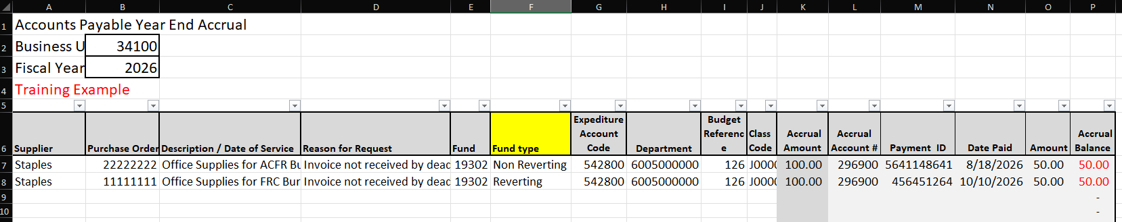
Keeping Track of Accruals
Accounts Payable Accrual Form
Include additional columns as needed (i.e. Fund Type)
Filter by Expenditure and Accrual account codes for entry organization
  AP YE Accrual account codes:
    296900, 233900, 233500, 233700, 235900
    Depends on who you are paying and financial statement reporting purposes
Notes:
Will not discuss during training. Only for reference.

Slide 30
Expense and Liability Accruals
FY 26 YE Closing Instructions CDS 1.4
Fiscal year 2026 vouchers missing the 7/29/26 deadline must be accrued in accounts 296900, 233500, 233700, 233900, 235900 by 8/28/26.
Accrual journals must be supported by documentation demonstrating the existence of obligation (i.e., invoice, contract, payment reconciliation, etc.).
If the agency determines the accrual balance is overstated, a journal entry can be done in period 998 to reduce the accrual if the financial audit is not finalized.
Accruals for FY26 must be paid no later than 9/28/26
To pay the obligation through the payment voucher process must be done by 9/28/26.
  To relieve the accrual, the payment voucher must have an invoice or equivalent documentation required by pre-audit, and either SHARE journal entry, GL query, trial balance report or screenshot of the available account balance.
Expenditures missing the 9/28 deadline must be paid against the agency’s fiscal year 2027 budget
If there is a remaining balance in the account after 9/28, a journal entry to reduce the 296900 accrual is required to eliminate the balance by 10/16/26.
Notes:
Will not discuss in training – only for reference

Slide 31

Closing Entries
Closing entries transfer the balances of temporary accounts (revenues, expenses) to the balance of the Fund Balance / Net Position account(s).
  All revenues have a credit balance, so we debit each revenue account to reduce it from revenues, then credit fund balance/net position to increase its balance by the sum of all revenue accounts.
  All expenses have a debit balance, so we credit each expense account, and debit fund balance/net position by the sum of all expense credits.
  The balance of retained earnings is the total net income over the life of the company
Permanent accounts carry a cumulative balance throughout the life of the entity – assets, liabilities, and equity.
  You may have an Accounts Receivable balance on your books for 10+ years until someone researches the balance and reduces it by what was actually paid (if ever)!
Revenue
$250,000.00
$250,000.00
$250,000.00
$250,000.00
Fund Balance
$1,000,000.00
$1,000,000.00
$400,000.00
Expense
$154,267.50
$500,153.00
$45,579.50
$300,000.00
$600,000.00
$400,000.00
Notes:
In for profit company financial statements, revenues and expenses get moved to an account called retained earnings. Not applicable to govt’s because they don’t operate on a for-profit basis.

Slide 32
Financial Statements
General Overview
Each statement tells a story over a different period of time. Some statements capture what happened during the year, like a movie, while others show where the government stands at a single moment, like a photo.
Balance Sheet
  Represents the financial position of the company at a single point in time.
Income Statement
  Reports the entity’s revenues and expenses over a period of time, the fiscal year.
Statement of Cash Flows
  Measures activities involving cash receipts and cash payments over a period of time. Each transaction is classified into 3 categories – operating, investing, and financing. Only reported for proprietary funds in governmental accounting.
Notes to the Financial Statements
  Detailed disclosures that explain accounting policies, commitments, contingencies, and provide context for the numbers in the financial statements.
Management’s Discussion & Analysis (MD&A)
  A narrative overview prepared by management that explains financial highlights, trends, and significant changes in government operations.
Auditor’s report
  An independent auditor’s formal opinion on whether the financial statements are presented fairly in accordance with applicable accounting standards. An audit opinion adds credibility to an entity’s financial statements.
  Note: an Auditor is not an employee of the entity. They are hired by the entity as an independent party to express a professional opinion. If an auditor finds mistakes or fraudulent reporting behavior, they require the entity to correct all significant information before issuing financial statements.
Audit trail
  Documented evidence that shows the source, path, and authorization of financial transactions, allowing users and auditors to trace activity back to its origin.
Notes:
Very minimal discussion during presentation, only to tie in closing entries to F/S types

Slide 33
Modified Accrual Basis of Accounting
Modified Accrual Accounting - How It Works, Rules
Assets
+
Deferred Outflows
Deferred Inflows
Liabilities
Fund Balance/Net Position
+
+
Governments focus on
  current financial resources,
  legal compliance, and
  budget authority.
Because of these priorities, governmental funds do not measure long‑term assets and liabilities (like capital assets or long‑term debt).
This unique reporting model requires a different Accounting equation:
Modified Accounting Equation
Assets + Deferred Outflows =
Liabilities + Deferred Inflows + Fund Balance/Net Position

Slide 34
Definitions:
Financial Statements – Governmental Accounting
Governmental Fund Financial Statements
  Used for governmental funds (general fund, special revenue, debt service, etc.)
  Basis of accounting: Modified Accrual
  Measurement focus: current financial resources
  Reports:
    Balance Sheet – Governmental Funds
      Current assets, current liabilities, and fund balances (no long term)
    Statement of Revenues, Expenditures, and Changes in Fund Balance
      Current resource inflows and outflows and changes in fund balance
Government-Wide Financial Statements
  Basis of accounting: Full Accrual
  Measurement focus: economic resources
  Reports:
    Statement of Net Position
      All assts, liabilities, and net position
    Statement of Activities
      Program revenues, program expenses, and net cost of services
Proprietary and Fiduciary Fund Financial Statements
  Basis of accounting: Full accrual
  Measurement focus: economic resources
Required Supplementary Information (RSI)
  Information required under GASB (such as budgetary comparison schedules and pension/OPEB schedules) that supplements the basic financial statements.
Annual Comprehensive Financial Report (ACFR)
  The ACFR includes the basic financial statements and required supplementary information in its financial section. In addition to the financial section, an ACFR also includes an introductory and statistical section.
Notes:
Will not discuss in presentation.

Slide 35
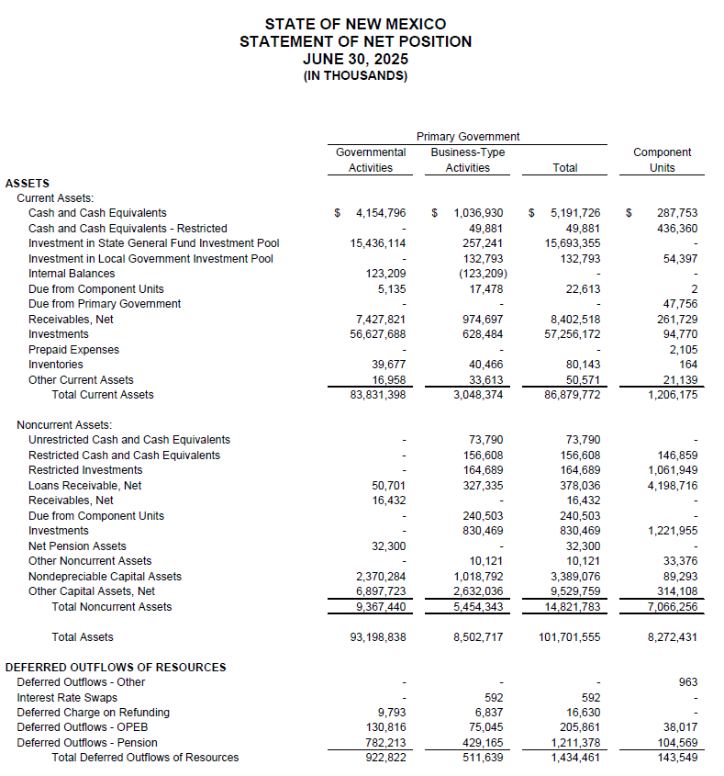
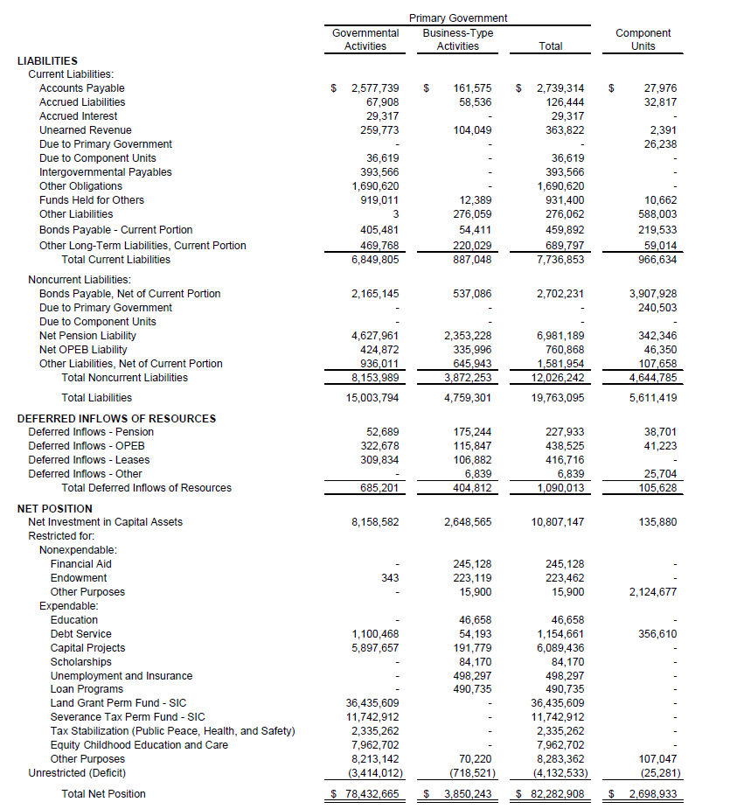

Slide 36
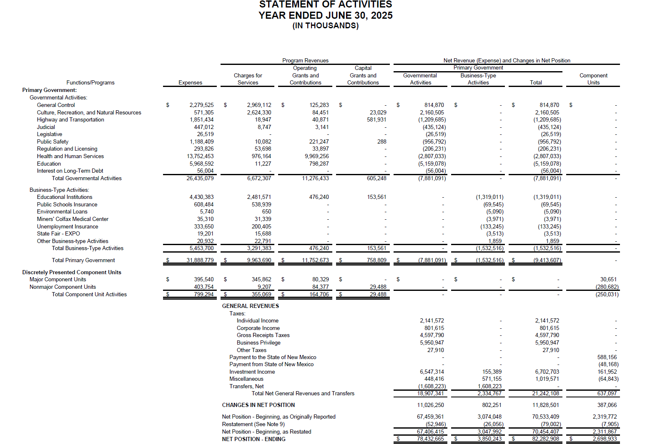

Slide 37
Sources and Resources
Accounting Elements Expanded | IFRS and US GAAP
Modified Accrual Accounting - How It Works, Rules
Modified Accrual vs. Full Accrual Accounting in Government | GovtIntel
Spiceland, J. D., Thomas, W. M., & Herrmann, D. (2015). Financial Accounting (4th ed.). McGraw-Hill Education.
DFA ACFR Unit! ☺

