Slide 1

FY 2027 CDPF Application
Capital Development Program Fund
Fund information
Application details
Timelines

Slide 2

Panelists
Wesley Billingsley
Division Director
Infrastructure Planning and Development Division
Scott Wright
Deputy Division Director
Infrastructure Planning and Development Division
Jesse Guillen
Bureau Chief, Capital Planning and Policy Bureau
Infrastructure Planning and Development Division
c. 505.538.5114
Jayden Weist
Local ICIP Coordinator,
Capital Planning and Policy Bureau
Infrastructure Planning and Development Division
c. 505.695.8575

Slide 3

Agenda
● Fund Information
● Application Details
● Application Examples
● Timeline
● Live Example
● Q&A

Slide 4

GENERAL CDPF INFORMATION
CDPF created in 2024
  “to fund capital projects with a total cost of less than five million dollars ($5,000,000) and only the planning and design of capital projects with a total cost greater than that amount.”
  FY 2025 Funds - $23.8M
  FY 2026 Funds - $26.5M
  FY 2027 Funds - $30.9M (estimated)
  Process
    Application
    Scoring
    Recommendation
    Inclusion in Capital Bill
    Funding Available
Notes:
Funds are projected to continue increasing. With a couple of years we will have over $50m available each year.
Will go into process in more detail.

Slide 5

Use of Funds
Planning and Design
No prior funding is necessary, but clear budget details and a cost estimate are required to show readiness
The application must demonstrate the ability to procure, plan and design the project within two years of award
Project Completion
A minimum of 25% of construction funding for the total project or useable phase is required.
The application must demonstrate the ability to complete the project or useable phase within two years of award
Notes:
Kim

Slide 6
Ineligible and Discouraged Uses
Ineligible Uses:
Demolition, unless part of a complete construction project
Vehicles, including emergency, commercial, or other
Equipment and furnishings, unless part of a larger complete construction project
An asset that will be maintained or operated by an entity that is not the one requesting the funding
Discouraged Uses:
Projects that can be funded through Water Trust Board, Colonias, Tribal Infrastructure Fund, etc.
Full points not awarded, can still apply.
Notes:
Asset – For these projects, the asset must be operated and maintained by the entity requesting the funding
TIF, WTB, and Colonias all have more available funding than CDPF, so more likely to be funded through there. WTB recently reduced the match requirement for local entities, reducing the burden some had at applying.
Discouraged uses – can still apply for funding. If the project is of a high enough quality, it may still receive a high enough score that it will be recommended for funding

Slide 7
Application Details
Project Information to Gather
ICIP Year and Rank (required)
Project Description
Total Project Cost (with certified estimate)
Total Funding Secured (with sources and amounts)
Amount Requested
Notes:
ICIP – Required for application
Project Description – Detailed description of the project.

Slide 8
Application Details (cont’d)
What is a Useable Phase?
As included in the Grant Management Guidelines, a “useable phase” means a distinct portion of a capital project that has been sufficiently completed and meets all applicable safety, operational, and regulatory requirements such that it can be safely and effectively occupied, operated, or used for its intended purpose, even if other phases of the overall project are still to be initiated or completed.

Slide 9
APPLICATION
EXAMPLES
  Scoring:
  Project Information – 40 points
  Financial Information – 30 points
  Project Readiness – 20 points
  Project Benefits and Community Impact – 10 points
  Project Information most important. Detailed response necessary for maximum points.
Notes:
Scoring for both Planning and Design and Project Completion applications is the same
The project information section is the most important part of the application. Here you will provide a detailed description of the project and the work remaining to complete the project or the useable phase. If it is for a planning and design application, you will provide a detailed description of the overall project, the P&D activities to completed with this funding, and how this work will advance the project towards construction. The couple of slides show an example of a poor description and a more comprehensive one.

Slide 10

APPLICATION
EXAMPLES (con’t)
A description that provides all of the requested details and gives a full and clear picture of the project is more likely to receive a higher score.
Notes:
Scoring for both Planning and Design and Project Completion applications is the same
The project information section is the most important part of the application. Here you will provide a detailed description of the project and the work remaining to complete the project or the useable phase. If it is for a planning and design application, you will provide a detailed description of the overall project, the P&D activities to completed with this funding, and how this work will advance the project towards construction. The couple of slides show an example of a poor description and a more comprehensive one.

Slide 11
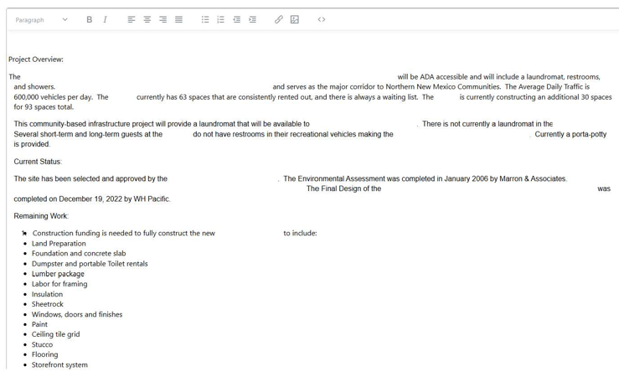
APPLICATION
EXAMPLES (con’t)
Notes:
Scoring for both Planning and Design and Project Completion applications is the same
The project information section is the most important part of the application. Here you will provide a detailed description of the project and the work remaining to complete the project or the useable phase. If it is for a planning and design application, you will provide a detailed description of the overall project, the P&D activities to completed with this funding, and how this work will advance the project towards construction. The couple of slides show an example of a poor description and a more comprehensive one.

Slide 12
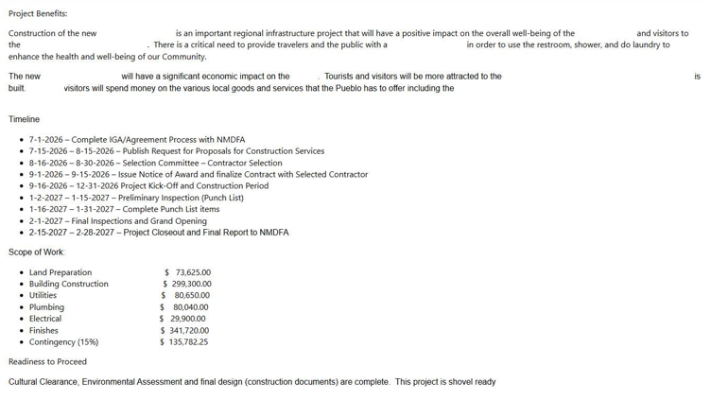
APPLICATION
EXAMPLES (con’t)
Notes:
Scoring for both Planning and Design and Project Completion applications is the same
The project information section is the most important part of the application. Here you will provide a detailed description of the project and the work remaining to complete the project or the useable phase. If it is for a planning and design application, you will provide a detailed description of the overall project, the P&D activities to completed with this funding, and how this work will advance the project towards construction. The couple of slides show an example of a poor description and a more comprehensive one.

Slide 13
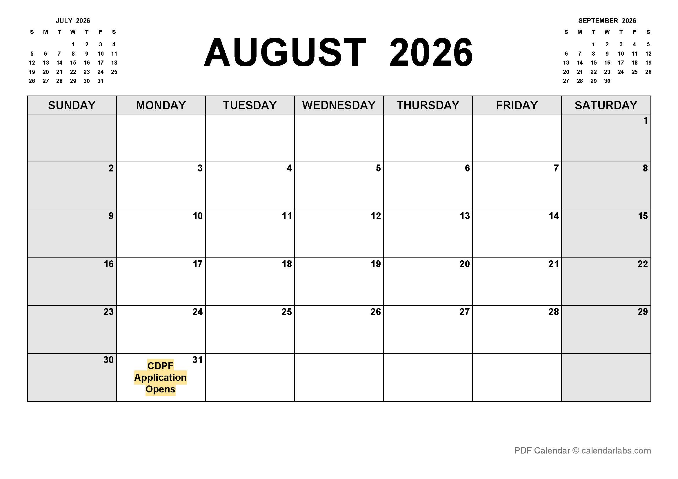

Application opens August 31, 2026
CDPF GRANT TIMELINE AUGUST

Slide 14
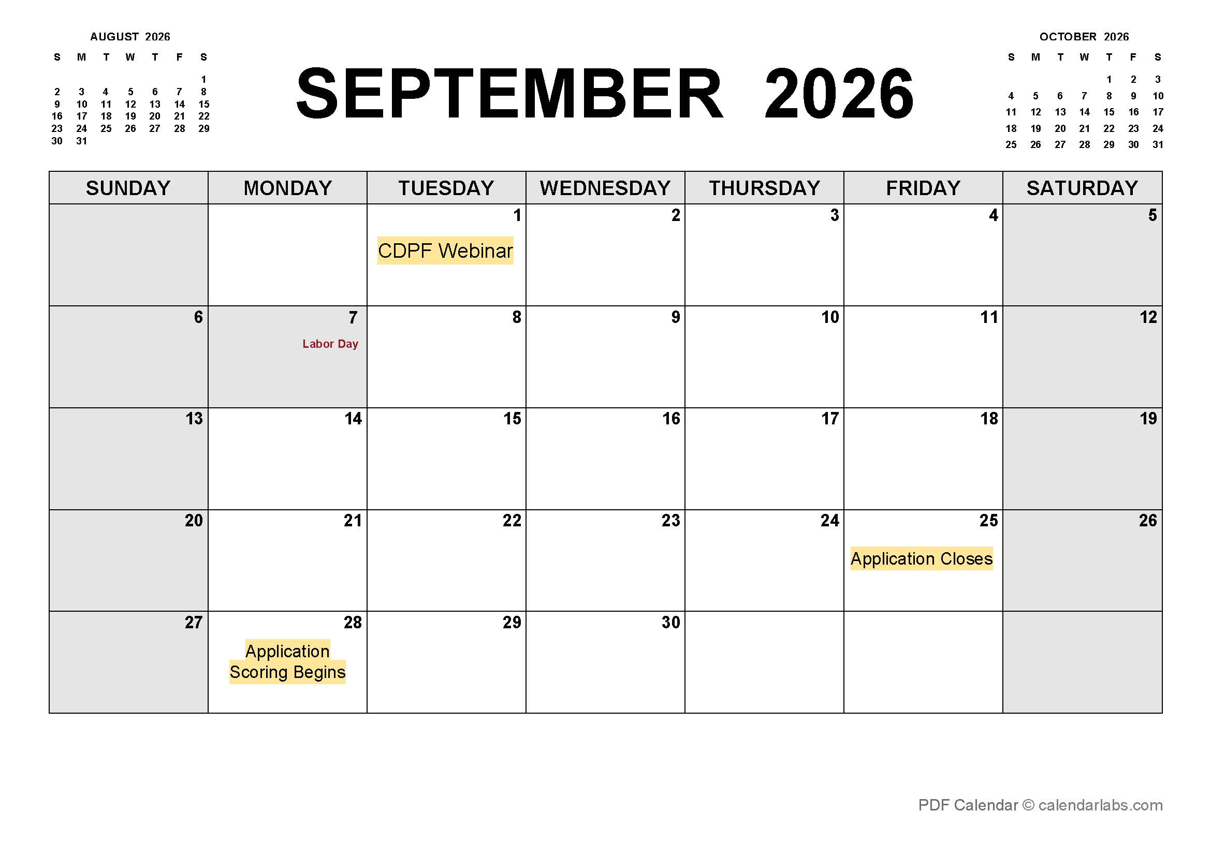
CDPF GRANT TIMELINE SEPTEMBER
Application Webinar – September 1, 2026
Application Closes – September 25, 2026
Application Scoring Begins – September 28, 2026

Slide 15
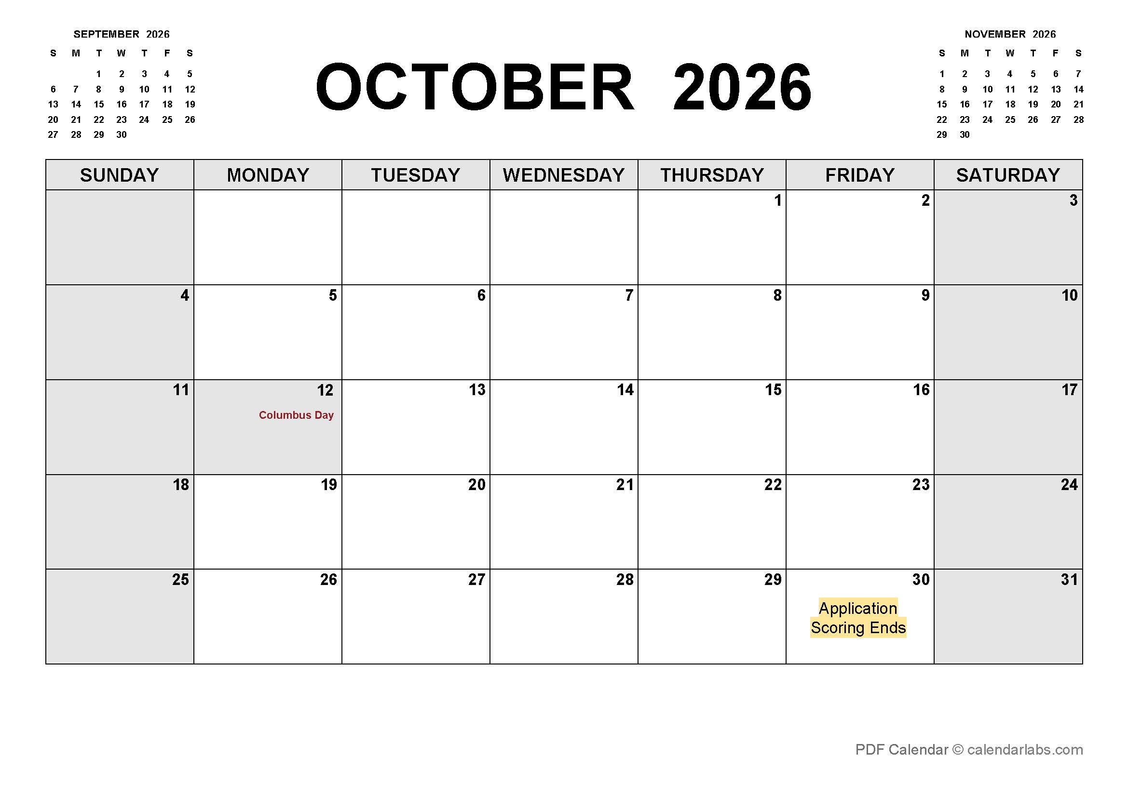
CDPF GRANT TIMELINE OCTOBER
Application scoring ends – October 30, 2026
Notes:
Each application will receive at least two scores, up to three if the oversight agency will be one other than DFA.

Slide 16
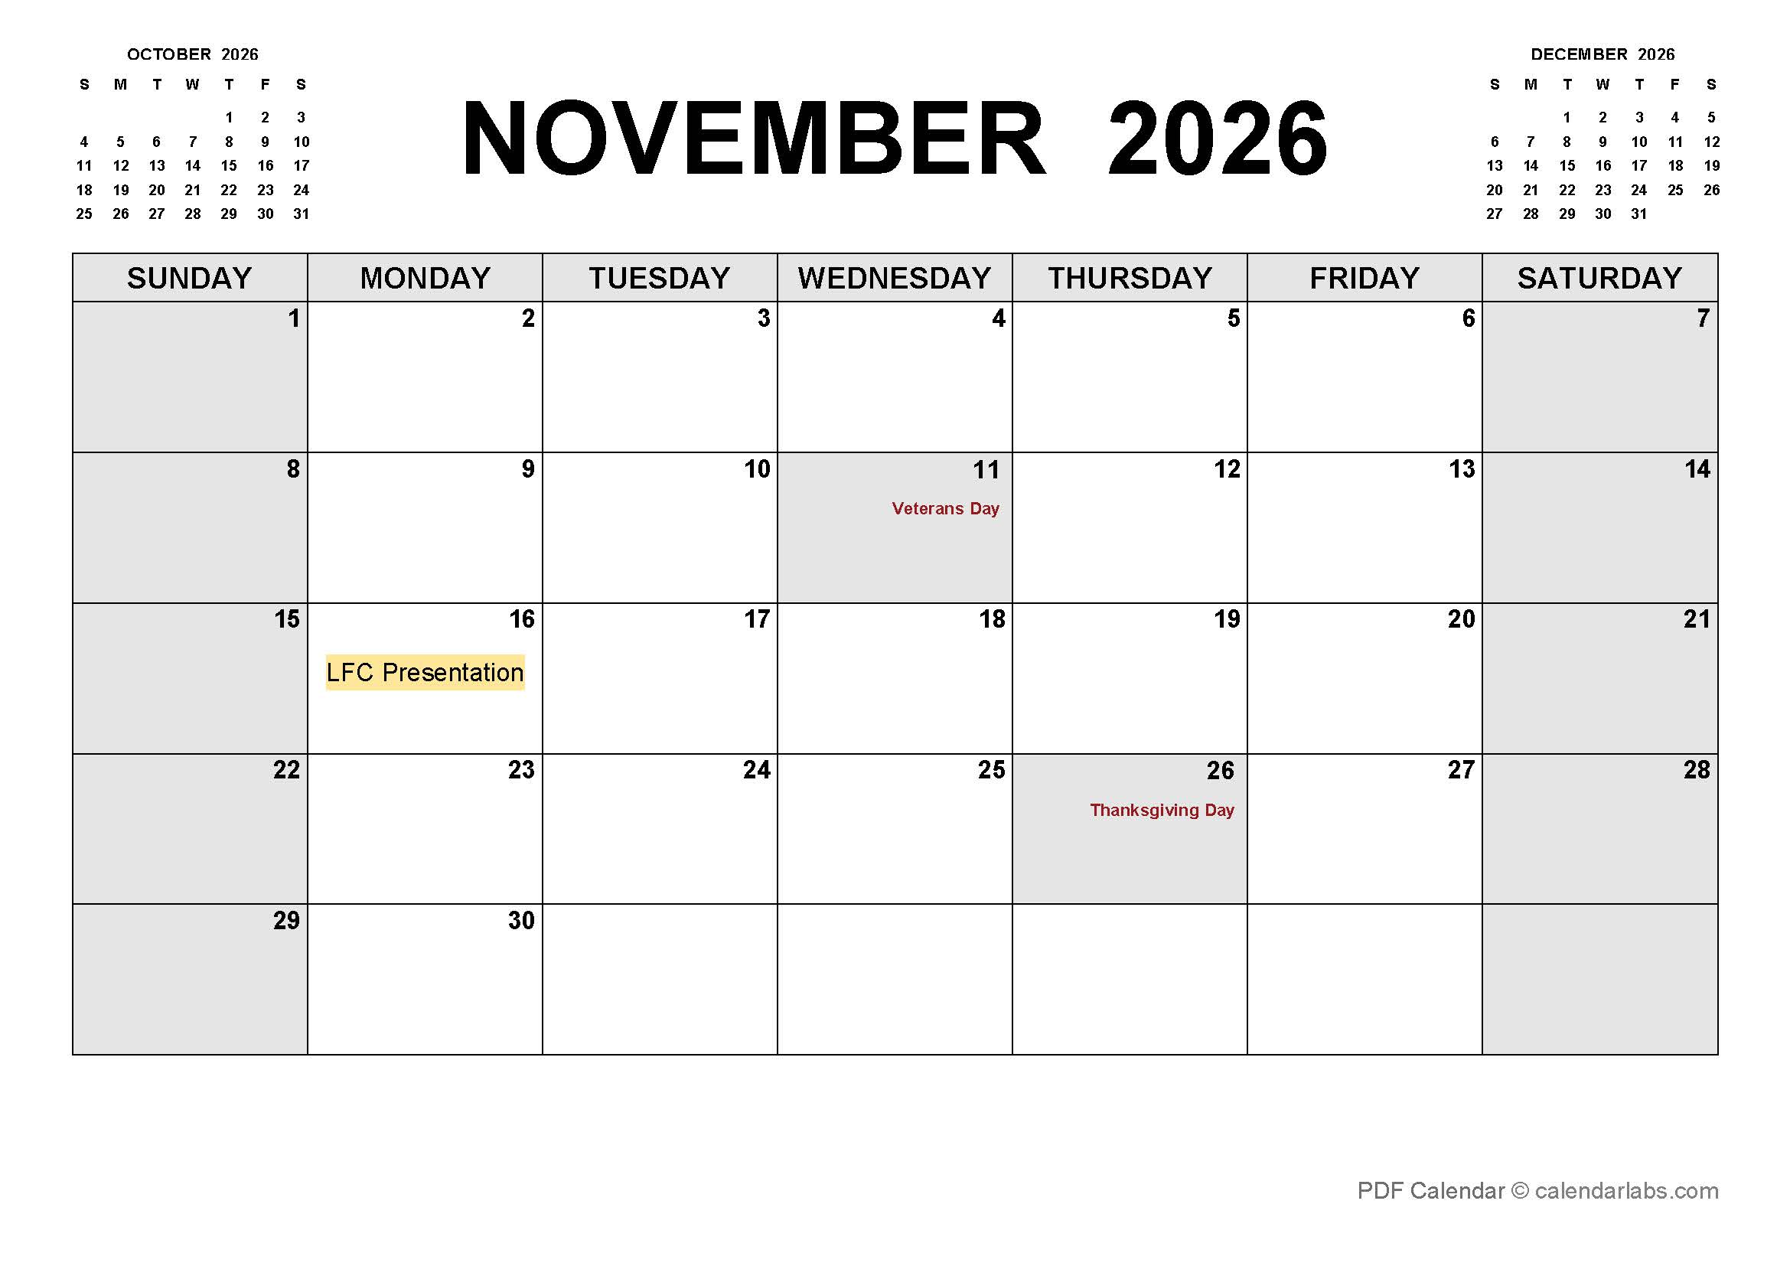
CDPF GRANT TIMELINE NOVEMBER
LFC Presentations – Week of November 16, 2026
Notes:
The recommended projects will be provided to LFC in time for them to present them at the November hearings.

Slide 17

CDPF Grant Timeline 2027
CDPF projects included in the 2027 Capital Outlay bill
Bill voted on by both chambers of the legislature
The bill is signed by the Governor by mid-April, 2027
NEW – questionnaires completed by entities beginning in May
Funds available for use on July 1, 2027 from the relevant Stage Agency

Slide 18
Key Takeaways
Application currently open
Open to project completion applications and planning and design applications
  Project completion is for complete or useable phases of less than $5M
  Planning and design is for projects with a total cost of $5M and more
  Application closes September 25 – no extensions
  Successful applications will be able to access the funding July 1, 2027
    Timing needs to be taken into account when submitting the budget

Slide 19

Application Live Example

Slide 20
Audience Q&A
Notes:
1. What do I do if my costs increase?

Slide 21
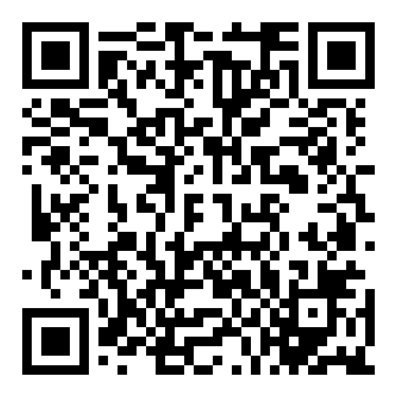
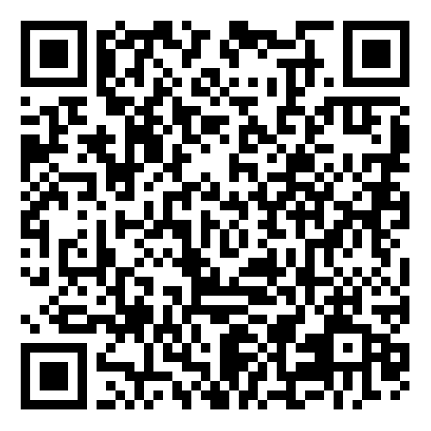
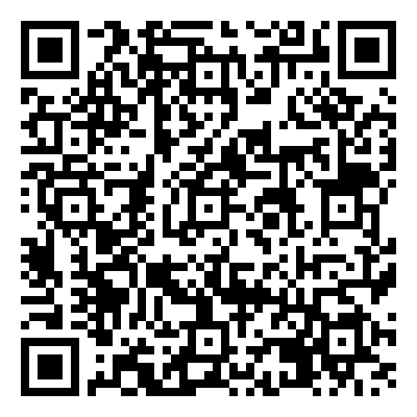
Links and Resources
Sign-up for IPDD news!
IPDD Request for Technical Assistance
Link to IPDD website
Notes:
IPDD Constant Contact Sign-up - https://www.nmdfa.state.nm.us/ipdd-constant-contact-sign-up/
IPDD TA Intake Form - https://app.smartsheet.com/b/form/66412c7084994ffe8266f8371ea2874b
IPDD website - https://www.nmdfa.state.nm.us/infrastructure-planning-and-development-division/

Slide 22
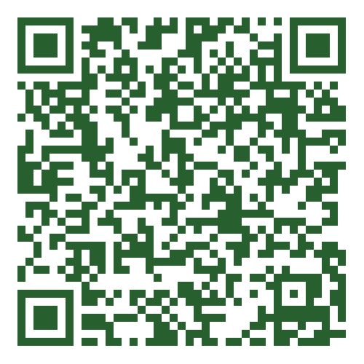
Tell us how we did and how we can improve!
Notes:
Link to Training Survey - https://app.smartsheet.com/b/form/53790b3686a246dd9a8c57267e952271

