Slide 1
Federal Award
Subrecipient Monitoring
Lauren Conley
Federal Reporting and Compliance Bureau
Department of Finance and Administration

Slide 2
Pass-through entity
An organization that gives a subaward to another entity to carry out part of a federal program. Its authority and responsibilities flow through the subaward agreement, meaning it remains accountable for how the subrecipient uses the federal funds.
Contract
for the purpose of Federal financial assistance, a legal instrument by which a recipient or subrecipient conducts procurement transactions under a Federal award. For additional information on subrecipient and contractor determinations, see § 200.331. See also the definition of subaward in this section.
Contractor means an entity that receives a contract.
Subaward
an award provided by a pass-through entity to a subrecipient for the subrecipient to contribute to the goals and objectives of the project by carrying out part of a Federal award received by the pass-through entity.
Subrecipient
Means an entity that receives a subaward from a pass-through entity to carry out part of a Federal award. The term subrecipient does not include a beneficiary or participant. A subrecipient may also be a recipient of other Federal awards directly from a Federal agency.
Primary Recipient
Receives federal funding directly from a federal agency
It does not include payments to a contractor, beneficiary, or participant. A subaward may be provided through any form of legal agreement consistent with criteria in with § 200.331, including an agreement the pass-through entity considers a contract.

Slide 3
Subrecipient vs. subcontractor determination
This determination evaluates whether the entity receiving funds is carrying out part of the federal program (subrecipient) or providing goods/services through a procurement relationship (contractor). Determining the correct classification is critical because it dictates which federal requirements apply.
Subrecipient Monitoring
Monitoring is a management tool used to evaluate whether a project or subrecipient is meeting its goals, achieving required performance outcomes, using funds appropriately, and following federal laws, regulations, and award terms.
Monitoring Plan
A structured guide describing how a pass‑through entity will monitor subrecipient performance and fiscal management, including methods, frequency, and documentation.
Performance Reporting
Required reporting that provides updates on project progress, outcomes, and achievement of performance goals.
Financial Reporting
Reporting that documents expenditures, obligations, cash flow, and financial compliance under the federal award.
Corrective Action Plan (CAP)
A written plan explaining how an entity will address audit findings, deficiencies, or areas of noncompliance.
Risk Assessment
A risk assessment is designed to help the pass‑through entity understand how likely a subrecipient is to encounter compliance challenges.

Slide 4
Policy
Establishes the rules and expectations
Procedure
Process
Step‑by‑step instructions that explain how to carry out a policy.
Shows the full workflow and how separate tasks connect
Internal Controls
The safeguards built into processes and procedures.
Explains what must be done and why.
“All subrecipients must undergo a risk assessment prior to receiving federal funds.”
Provides clear instructions for staff
Ensures consistency across the organization
Reduces errors or variation in practice
“How to complete a risk assessment: Review audit reports, check SAM.gov, score risk factors, document results.”
Procedures turn policy requirements into actions.
Ensures accuracy & compliance at each step
“A supervisor must approve all subrecipient monitoring reports before they are finalized.”
End‑to‑end workflows that describe how work moves from start to finish.
“The subrecipient monitoring process includes risk assessments, desk reviews, site visits, follow‑up, and closeout.”
A process may include multiple steps, multiple staff, policies, procedures, and internal controls.

Slide 5
What is subrecipient monitoring and why does it matter?
Because a subrecipient is carrying out part of the federal award, the pass-through entity is responsible for the management of those funds used by the subrecipient.
Effective monitoring matters because any noncompliance by a subrecipient can become a liability for the pass‑through entity.
  Strong monitoring protects federal funds, reduces the risk of audit findings, and helps ensure projects achieve their intended outcomes.
  Weak monitoring, on the other hand, can lead to questioned costs, compliance findings, and even repayment of federal funds.

Slide 6
A Subaward Scenario based on a true story
Overview:
  The New Mexico Department of Homeland Security and Emergency Management (DHSEM) receives an annual federal allocation under the State Homeland Security Grant Program (SHSGP). The purpose of SHSGP is to strengthen statewide preparedness and response capabilities at the local level.
Why DHSEM Subawards SHSGP Funds
  DHSEM does not conduct local emergency response operations. Instead, SHSGP requires that activities—training, equipment acquisition, exercises, planning—occur within counties, tribes, municipalities, and regional response teams.
  Subawards allow funding to reach the entities who directly carry out homeland security functions.
Examples of SHSGP subawards
  Counties receiving funds for interoperable communications, hazmat gear, EOC upgrades
  Tribal governments implementing preparedness training and community exercises
  Regional teams (IMTs, Bomb Squads, Search & Rescue, Hazmat) acquiring specialized equipment
  Local law enforcement conducting LETPA activities

Slide 7
A Subaward Scenario
The PTE’s Responsibilities
DHSEM remains responsible for:
Ensuring SHSGP funds are used only for approved purposes
Verifying procurement compliance and equipment eligibility
Reviewing performance reports and exercise documentation
Conducting risk assessments, desk reviews, and site visits
Ensuring subrecipients meet DHS/FEMA requirements
Subrecipient monitoring ensures federal funds strengthen New Mexico’s homeland security as intended while keeping DHSEM compliant under 2 CFR 200.

Slide 8
Pass-through Entity Responsibilities (2 CFR 200.332)
Subrecipient eligibility and pre-award verification
  Suspension & debarment
  Confirm audit requirements
  Subrecipient v. contractor determination
  Indirect cost rate verification
  Consistent documentation
Subaward Identification requirements
  UEI, FAIN, award dates, performance period, budget period, LN, agency info, project description, indirect cost rate, access requirements, and closeout terms
  Consistent documentation
Risk Evaluation
  Assess prior experience with the same or similar awards, audit results, personnel/system changes, federal monitoring history
  Consistent documentation
Ongoing, risk-based, monitoring
  Financial and performance report reviews
  Ensuring corrective actions on significant developments
  Site visits, desk reviews, technical assistance
  Consistent documentation
Single Audit Responsibilities
  Verify subrecipient single audit requirements
  Review audit reports
  Issue management decisions for audit findings pertaining to the federal award provided to the subrecipient from the PTE
  Consistent documentation
Enforcement and remedies
  Take enforcement actions for noncompliance
  Impose specific conditions when appropriate
  Consistent documentation
The key point: monitoring is not optional. It’s a regulatory requirement covered in the Compliance Supplement. And if it’s not documented, it didn’t happen.

Slide 9
Prior to making a subaward
Refer to flow chart in excel file -

Slide 10
Suspension and Debarment
200.332(a), 180.300
Compliance Supplement 2025 - Verify that the subrecipient is not excluded or disqualified in accordance with 2 CFR 180.300. Verification methods are provided in 2 CFR 180.300, which include confirming in SAM.gov that a potential subrecipient is not suspended, debarred, or otherwise excluded from receiving Federal funds. (2 CFR 200.332(a)).
Debarment - generally excludes a party from participating in covered federal transactions for a specified period.
Suspension - typically a temporary action that may be imposed while an investigation or proceeding is underway.
Suspension and debarment are mechanisms used to protect federal programs from parties that are not presently responsible, with the intention to protect the federal government's interests rather than serve as punishment.
Policies outline the frequency with which verification takes places, how that verification is documented and the acceptable methods of verification. Your procedure should establish who performs the task, what documentation is retained, and where it is stored.
Entities can be suspended or debarred for a variety of violations, including delinquent federal taxes exceeding $3,000, fraud, bribery and federal criminal law violations. Suspensions can last up to 12 months, whereas debarments are usually 3 years in length.
What entity was checked?
When the check occurred?
What system, source, or method was used?
What did the search show?
Who completed or reviewed the verification?

Slide 11
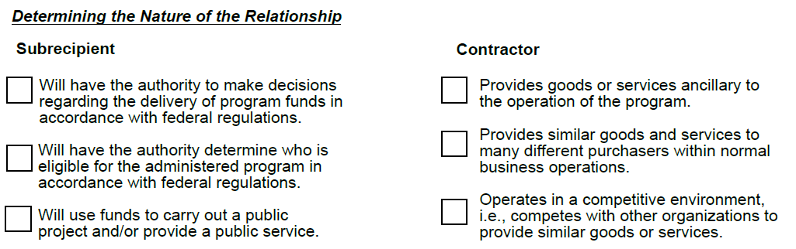
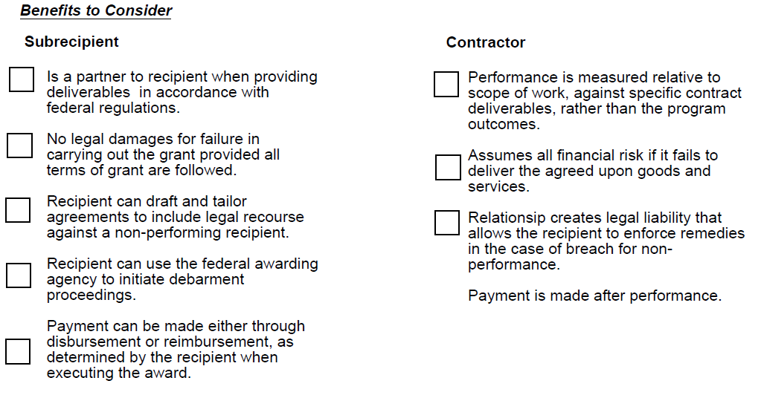
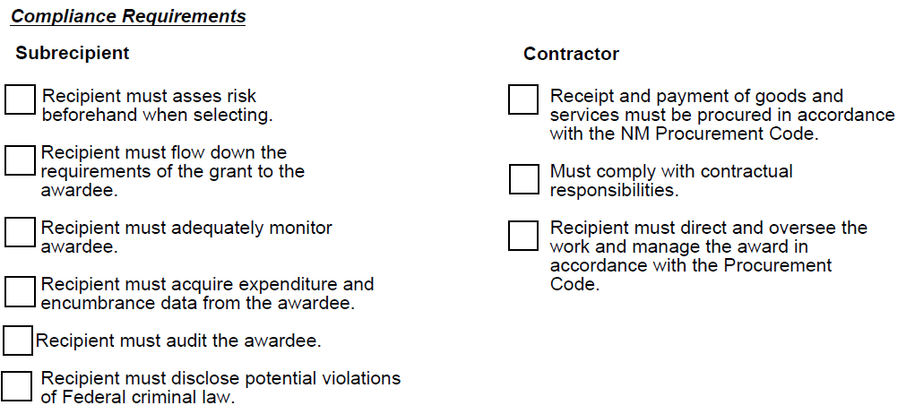
Subrecipient vs. Contractor Determination

Slide 12
The Relationship
Characteristics of a Subcontractor
Provides goods or services within normal business operations
Characteristics of a Subrecipient
Determines who is eligible to receive what Federal assistance
Provides similar goods and services to many other different purchasers
Normally operates in a competitive environment
Provides goods or services that are ancillary (supporting primary activities) to the operation of the federal program
Is not subject to compliance requirements of the federal program as a result of the agreement, though similar requirements may apply for other reasons
Has its performance measured in relation to whether objectives of a Federal program were met
Has responsibility for programmatic decision-making
Is responsible for adherence to applicable Federal program requirements specified in the Federal award
In accordance with its agreement, uses the Federal funds to carry out a program for a public purpose specified in authorizing statute, as opposed to providing goods or services for the benefit of the pass-through entity.
A subaward is distinct from a contract in that a subaward is an award provided by a recipient of a federal award to a subrecipient to carry out part of a federal award on behalf of the recipient. Recipients may make subawards through any form of legal agreement, including an agreement that the recipient considers a contract. See 2 CFR 200.331 for more information on the differences between contracts and subawards.
The substance of the relationship is more important than the form of agreement between the recipient (state agency) and entity.
Even if the grantee issues a contract to an entity, but the relationship meets the characteristics of a subaward, the contract is considered a subaward and monitoring requirements are applicable.

Slide 13
Risk-based Evaluation & Monitoring
200.332(c)
Before issuing a subaward, pass‑through entities must determine how much oversight a subrecipient will need. Federal regulations recognize that not all subrecipients carry the same level of risk, so monitoring must be tailored.
A formal risk assessment helps the pass‑through entity identify vulnerabilities early and plan appropriate monitoring activities.
This typically happens before entering into the subaward agreement, and periodically thereafter.
Considerations:
  Subrecipient’s prior experience with the same or similar subawards
  Results of previous audits
  Personnel or system changes
  The extent and results of any Federal agency monitoring (for example, if the subrecipient also receives Federal awards directly from the Federal agency).
A risk assessment should encompass internal controls, fiscal responsibility, and the subrecipient’s capacity to manage and comply with the requirements of the federal award.
This proactive approach helps reduce audit findings, improve performance, and strengthen partnerships.

Slide 14
Risk Assessment
A risk assessment is designed to help the pass‑through entity understand how likely a subrecipient is to encounter compliance challenges.
The eligibility component of risk assessment is determining whether the subrecipient has the capacity, controls, experience, and compliance history necessary to safely receive federal funds; everything else in risk assessment is ongoing monitoring, not pre‑award eligibility.
Pre‑Award Eligibility Risk Assessment:
Evaluates whether the subrecipient is eligible, capable, and safe to receive federal funds.
Focuses on:
Internal controls
Audit history
Staffing & systems
Federal experience
SAM.gov eligibility
Organizational capacity
Post‑Award Risk Assessment:
Evaluates changes and emerging risks after award issuance.
Focuses on:
New audit findings
Report accuracy and timeliness
Site visit/desk review results
Financial inconsistencies
Performance issues
Staffing/system changes

Slide 15
Subaward indirect cost rate
200.332(b)(4)
The pass-through entity is responsible for ensuring there is an approved indirect cost rate negotiated between the subrecipient and the federal government.
If no approved cost rate exists, there are two options:
  De minimis indirect cost rate of 15%
  Negotiated rate between the pass-through entity and the subrecipient.
    These rates may be based on a prior negotiated rate between a different pass-thru entity and the subrecipient, in which case the pass-through entity is not required to collect information justifying the rate but may elect to do so

Slide 16
Subaward Audit Compliance
2 CFR 200.332(g)
Verify that the subrecipient is audited as required by Subpart F
This is a pre‑award eligibility check, because a pass‑through entity must confirm whether the subrecipient:
Meets the Single Audit threshold,
Has completed the required audit,
Is not suspended/debarred, and
Has no disqualifying audit issues that would prevent receiving federal funds.
If the subrecipient has not met required audit obligations, you cannot proceed with a subaward until the issue is resolved.

Slide 17
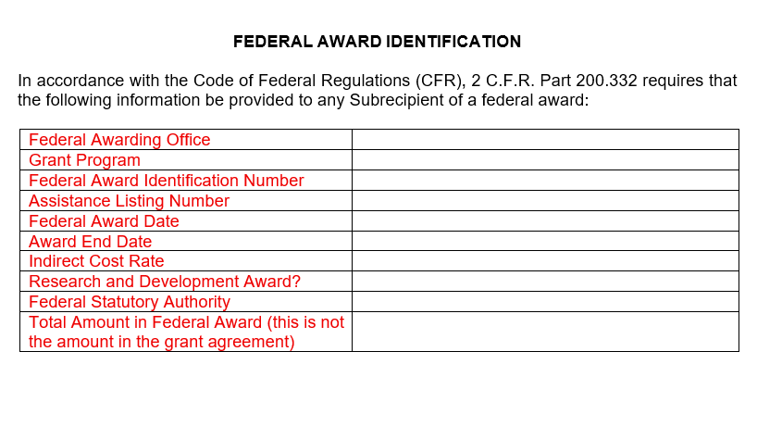
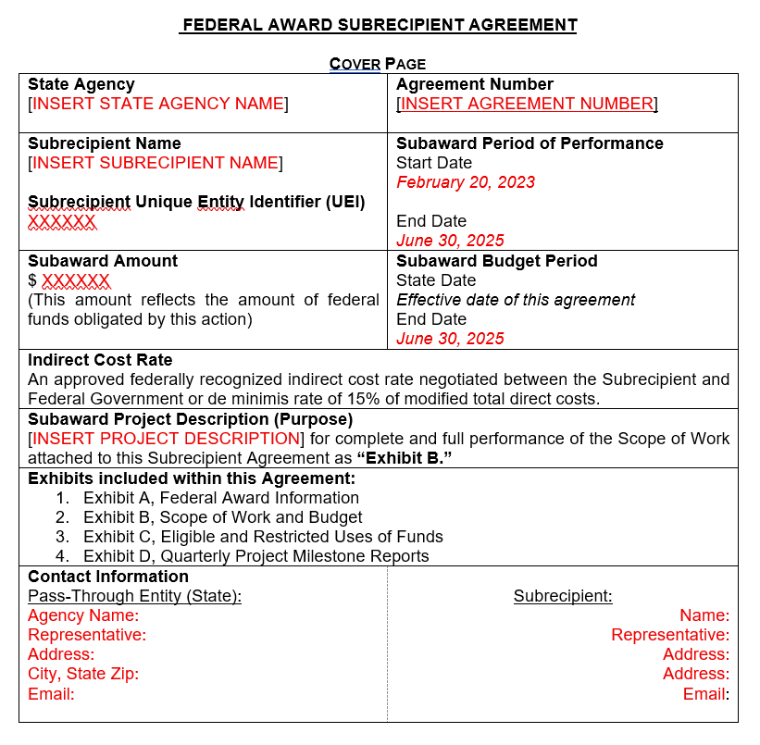
1
2
11
5
6
14
3
14
4
4
17
7
16
15
Add 8 & 9 here as applicable
Subaward must include:
Subrecipient name
Subrecipient UEI
FAIN
Federal Award Date
Subaward Period of Performance (start/end)
Budget Period (start/end)
Amount of Federal funds obligated in this action
Total amount obligated to the subrecipient
Total Federal award committed to the subrecipient
Federal award project description (FFATA compliant)
Federal agency name
Pass-through entity name
Pass-through entity contact information
ALN title and number
Dollar amount under each ALN at disbursement
R&D designation (yes/no)
Indirect cost rate
All applicable federal requirements
Any additional pass-through entity requirements
10
12
13
18-19 indicated within the agreement

Slide 18
Monitoring
Refer to flowchart in excel file

Slide 19
Annual Monitoring Calendar & Workflow
Q1: Pre‑Award Activities
Eligibility screening
Risk assessment
Establish monitoring plan
Kickoff with subrecipients
Q2: Monitoring Begins
Desk reviews (quarterly or semi-annual depending on risk)
Accountability calls, check-ins
Q3: Mid-Year Checkpoint
Site visits for moderate/high-risk entities
Follow-up on CAPs
Q4: Closeout
Final desk reviews
Annual post‑award risk assessment
Audit review and updates to tracking log
Update monitoring plan for next year

Slide 20
Key aspects of Monitoring
We monitor based on risk because it would be virtually impossible to monitor every action and transaction of our subrecipients. The solution is to prioritize the highest risk situations that may be in greatest need of oversight.
Establishes a productive relationship between the two parties to monitor performance, compliance, and project progress
Assess the management of grant funds and identifies areas of non-compliance and non-performance that may require corrective action or technical assistance
Identifies weaknesses and constructive ways to address those
Recognizes strengths and successes in meeting performance measures, goals, and objectives that may be shared with the public

Slide 21
Subrecipient Monitoring Plans
A strong subrecipient monitoring plan makes oversight structured, clear, and defined. It lays out the “who, what, when, and how” of monitoring in a way that creates consistency and clarity.
A monitoring plan should:
  Help guarantee compliance with federal requirements, the grants terms and conditions, and T&Cs in the subaward agreement
  Assess and mitigate programmatic and financial risk
  Determine the scope, type, and frequency of monitoring

Slide 22
Monitoring Methods
Site Visits
(including virtual)
To review the capacity, performance, and compliance in person
Send advance notice and agenda
Review financial systems, internal controls, procurement, inventory, and project activities
Interview staff and inspect documentation
Issue a formal visit report documenting strengths, issues, and required corrective actions
Desk Reviews
To remotely assess compliance and financial accuracy without conducting a site visit.
Focus on examinations of documentation and financial systems surrounding the grant program
Request specific documents: financial reports, invoices, procurement records, Time and Effort documentation, performance reports
Report and Data Submission Reviews
To validate the accuracy, completeness, and timeliness of required reporting
Review periodic reports (financial, programmatic, performance)
Compare submitted data to source documentation
Check for inconsistencies, errors, or omissions
Confirm deadlines are met and follow up on missing data
Milestone Reviews and Evaluations
To ensure the project is progressing as planned and meeting federally required milestones.
Review project timeline, milestones, and expected deliverables
Check whether each milestone is met and documented
Assess any delays or risks impacting schedule
Adjust monitoring or support based on milestone performance
To support subrecipients proactively and reduce future compliance issues.
Schedule recurring calls, emails, or virtual check-ins
Provide clarification on rules or documentation
Document all monitoring decisions and communications.
Other methods to obtain and share performance status, data, and provide technical assistance
Send formal emails, letters, or notices summarizing reviews, findings, deadlines, and next steps.
Use consistent templates to ensure clarity.
Identify federal requirements and award terms under review
Coordinate with staff schedules for tour and interview availability

Slide 23
Identify Monitoring Subject Areas
Decide which subject areas should be included in your monitoring plan. Subject areas will vary depending on the federal agency/PTE’s priorities, prior findings, and/or risk level.
Monitoring Financial Reports (200.332(d))
Comparison between the costs incurred with drawdowns to ensure both sets of documentation agree
Monitoring Progress and Program Reports
(200.332(d)(1))
Compared to the Financial report for consistency
Monitoring Administrative Requirements
Internal Controls Review
Accounting Systems Review
Allowability Review
Procurement Systems Review
Inventory Process Review
Audit Resolution Review Process
Record Retention Review
At the same time, this documentation is reviewed for alignment with the budget and compliance with cost principles and financial management practices
Review their compliance with program requirements governing the grant
Ensure deadlines for subrecipient reporting allow for PTE review
Examine if they carried out the activities detailed in the application, scope of work in the agreement, NOFO, NoA, Terms and Conditions, etc.
Ensure deadlines for subrecipient reporting allow for PTE review
Notes:
For example, a PTE may choose to perform a comprehensive review for high-risk grantees and only monitor major compliance subject areas for lower-risk grantees

Slide 24
Monitoring Administrative Requirements
Internal Controls Review
Look for evidence of
See required policies in the Risk Assessment Example provided
Accounting Systems Review
Allowability Review
Procurement Systems Review
Compare amounts in their accounting system (general ledger), not an internal tracker
Compare their total expenditures to PTE’s total expenditures for that subaward using the GL
Sample transactions included in their recent financial reports
Documentation may include bills (invoices), payroll, cancelled checks, chart of accounts, etc.)
Also using their GL, ensure federal and non-federal funds can be identified separately
Review written procedures for determining allowability of costs
Review transactions in their recent financial report to confirm they follow their policies and procedures
Review transactions in their recent financial reports to confirm their procedures promote compliance with cost principles such as allowability, necessary and reasonable, and allocable.
Focus on approval signatures, the order in which the process was performed, travel rates used
Focus on whether salaries are reasonable, allowability of fringe benefits, timesheet records reflect expenses charged.
Review samples of procurements for compliance with 200.317-327
Focus on:
procurement competition
procurement threshold
contract cost
price analysis
key controls
documented processes
policies, and procedures
Also look to understand changes made to those and why.

Slide 25
Monitoring Administrative Requirements
Audit Resolution Review Process
Record Retention Review
Review property management controls
Review inventory controls
Focus on:
insurance coverage
real property
equipment
supplies
intangible property
property records
disposition
Maintenances of property (including policies and procedures)
Trust fund (200.316)
Inventory Process Review
200.310-316
Confirm they have obtained the required audits
Review:
Policies and procedures related to audit resolutions
Corrective Action Plans
copy of the most recent audit report
Evidence of corrective action plan implementation
Records demonstrating resolution of underlying concern
State requirements
Federal requirements
5 years from the date financial report was submitted
3 years
Review Records Access controls to ensure records are available only to authorized personnel

Slide 26
Escalation & Enforcement
2 CFR 200.339
When to Escalate:
Repeated noncompliance
Unresolved audit findings
Misuse of funds
Missing documentation
Failure to implement CAP
Available Enforcement Actions:
Additional specific conditions
Withhold or freeze funds
Disallow costs for all or part of the activity associated with the noncompliance of the recipient or subrecipient.
Suspend award activities
Terminate the award
Refer to oversight/audit authorities
Documentation Requirements:
All escalations must appear in the monitoring plan (Sheet 10)
CAP progress tracked (Sheet 17)
The Federal agency or pass-through entity may implement specific conditions if the recipient or subrecipient fails to comply with the U.S. Constitution, Federal statutes, regulations, or terms and conditions of the Federal award. See § 200.208 for additional information on specific conditions. When the Federal agency or pass-through entity determines that noncompliance cannot be remedied by imposing specific conditions, the Federal agency or pass-through entity may take one or more of the available enforcement actions.

Slide 27
Other subaward requirements
Federal Funding Accountability and Transparency Act (FFATA)
  Report first-tier subawards made under federal grants that are funded at $30,000.00 or more that meet the reporting conditions in the award term
  Report their executives’ compensation for all new federal grants that are funded at $30,000 and meet the reporting conditions in the award term
  Report executive compensation data for their first-tier subrecipients that meeting reporting conditions set forth in the award term

Slide 28
2025 Compliance Supplement
M. Subrecipient Monitoring
Audit Objectives
1. Obtain an understanding of internal control, assess risk, and test internal control as required by 2 CFR 200.514(c).
2. Determine whether the PTE identified the subaward and applicable requirements at the time of the subaward (or subsequent subaward modification) in the terms and conditions of the subaward and other award documents sufficient for the PTE to comply with federal statutes, regulations, and the terms and conditions of the federal award.
3. Determine whether the PTE monitored subrecipient activities to provide reasonable assurance that the subrecipient administered the subaward in compliance with the terms and conditions of the subaward.
4. Determine whether the PTE resolved audit findings specifically related to the award and issued a management decision for audit findings that affect the subawards it issues to the subrecipient.
5. Determine whether the PTE verified the subrecipient is audited as required by 2 CFR Part 200, Subpart F.

Slide 29
2025 Compliance Supplement
M. Subrecipient Monitoring
Audit Procedures – Internal Control
1. Perform procedures to obtain an understanding of internal control sufficient to plan the audit to support a low assessed level of control risk for the program.
2. Plan the testing of internal control to support a low assessed level of control risk for subrecipient monitoring and perform the testing of internal control as planned. If internal control over some or all of the compliance requirements is likely to be ineffective, see the alternative procedures in 2 CFR 200.514(c)(4), including reporting a significant deficiency or material weakness in accordance with 2 CFR 200.516, assessing the control risk at the maximum and considering whether additional compliance tests and reporting are required because of ineffective internal control.
3. Consider the results of the testing of internal control in assessing the remaining risk of noncompliance. Use this as the basis for determining the nature, timing, and extent (e.g., number of transactions to be selected) of substantive tests of compliance.
Audit Procedures – Compliance
1. Review the PTE’s subrecipient monitoring policies and procedures to gain an understanding of the PTE’s process to
  identify subawards,
  evaluate risk of noncompliance, and
  perform monitoring procedures based upon identified risks.
2. Review the PTE’s subrecipient verification methods to ensure subrecipients are not excluded or disqualified in accordance with 2 CFR 180.300 (2 CFR 200.332(a)).
3. Review subaward documents including the terms and conditions of the subaward to ascertain if, at the time of subaward (or subsequent subaward modification), the PTE made the subrecipient aware of the award information required by 2 CFR 200.332(b) sufficient for the PTE to comply with federal statutes, regulations, and the terms and conditions of the award.
4. Review the PTE’s documentation of monitoring the subaward and consider if the PTE’s monitoring provided reasonable assurance that the subrecipient used the subaward for authorized purposes in compliance with federal statutes, regulations, and the terms and conditions of the subaward.
5. Select a sample of subrecipients and ascertain if the PTE verified that subrecipients expected to be audited as required by2 CFR Part 200, Subpart F, met this requirement (2 CFR 200.332(g)).
6. Select a sample of subrecipient audits with audit findings and review the management decision to verify it was issued in compliance with 2 CFR 200.521(a), (d), and (e), and that the subrecipient takes timely and appropriate action on deficiencies detected through audits (2 CFR 200.332(e)(2).

Slide 30
Time and Effort
Megan Otto, NGMA
Below is flow that references the specific CFR requirement.
1. Employee records their time to the appropriate grant(s) and non-grant activities. The record should account for their total compensated activity and support how salary is distributed between grants and other activities.
2 CFR 200.430(g)(1) – Requires personnel records to accurately reflect the work performed, total compensated activity, and distribution of salary among applicable grants/cost objectives.
2. Employee reviews and certifies the timesheet to confirm it accurately reflects the work performed.
2 CFR 200.430(g)(1) – Requires personnel charges to be supported by the organization’s official records and a system of internal controls that provides reasonable assurance the charges are accurate, allowable, and properly allocated.
3. Timesheet is reviewed/approved according to your organization’s policies and procedures, with corrections made as needed.
2 CFR 200.430(g)(1) – Requires the records to comply with the organization’s established accounting policies and procedures and be supported by adequate internal controls.
4. Payroll is processed and salary/fringe is charged to the appropriate grant(s).
2 CFR 200.403 and 200.405 – Costs must be adequately documented and allocated to Federal awards based on the benefit received.
5. Retain the records, including timesheets, approvals, payroll records and any adjustments.
2 CFR 200.334 – Generally requires Federal award records and supporting documentation to be retained for three years from submission of the applicable financial report.
For nonexempt employees, I’d also make sure the system captures total hours worked each day. 2 CFR 200.430(g)(3) specifically requires daily total hours for nonexempt employees.

Slide 31
Source of Governing Requirements
§ 200.331
§ 200.332
§ 200.333
§ 200.303
§ 200.501-521
The Single Audit Act
Federal Funding Accountability & Transparency Act (FFATA)
federal agency regulations
terms and conditions of the award

Slide 32
Suspension & Debarment – MyFedTrainer
Subrecipient Monitoring – MyFedTrainer
Subrecipient Monitoring Toolkit | Office for Sponsored Programs
Subrecipient Monitoring Handbook | NCPRO
Guide for Monitoring Subrecipients | OSC
AGA Financial and Administrative Monitoring Tool

