Slide 1
Budget Adjustment Requests (BARs)
Local Government Division | Bryce Roth | October 1, 2026
Notes:
Title layout. Replace title and the division/presenter/date line.

Slide 2
Types of BARs
What are the two types of BARs in LGBMS?

Slide 3
Budget Adjustment Requests
There are two type of budget adjustment requests (BARs)
Local or Maintenance BAR. A local or maintenance budget adjustment request is a budget transfer between expenditure line items within the same fund that does not increase or decrease the total expenditure budget for that fund. This kind of adjustment does not require DFA’s approval and is automatically approved if it is balanced. However, you must follow your internal policy and procedures.
State BAR. A State budget adjustment request requires DFA’s approval. There are different types of adjustments that fall within this category of a State BAR, the main types of these adjustments are:
  Adding a new fund to your quarterly report or approved budget.
  Modifications to existing line items that affect the approved budgeted amount by Transfers between funds.
Supporting documentation is required for State BARs. An approved and signed resolution by the governing body must be uploaded to the BAR in LGBMS. If no resolution is uploaded to the BAR, it will be returned so the signed resolution can be uploaded and then resubmitted.
Separate local/maintenance BARs from State BARs.

Slide 4
Budget Adjustment Requests … continued
State BAR requirements
A State budget adjustment request must have an approved and signed resolution. Follow State and local government resolution approval requirements and processes.
Resolution guidelines:
Resolutions should contain the reason for the adjustment.
The resolution should have monetary values of the adjustments. This helps maintain transparency.
A schedule, spreadsheet, or LGBMS generated BAR report should be included or referenced in the resolution for BARs with multiple adjustment lines. Include LGBMS chart of account numbers with adjustment amounts to reduce questions or confusion during the review and approval process.
Resolution amounts must reconcile with the amounts entered in the BAR in LGBMS.
Create one BAR per resolution. There should not be multiple resolutions for one BAR.
Local BARs that don’t require a resolution may be combined into one BAR --- Local BARs ONLY. Be sure you follow your local government requirements for local BARs (a resolution may not be required).

Slide 5
Validations in the Adjustment Module
LGBMS validation of BARs.

Slide 6
BAR Validations
LGBMS BAR validations
LGBMS will check if an adjustment will result in a negative fund balance.
LGBMS will also check if transfer adjustments will result with transfers in and transfers out being out of balance. This is indicated by a Total Transfers amount of anything other than zero on the adjustment recap report.
What happens when a BAR does not pass validation?
In the case of a negative fund balance, LGBMS will give a warning bar indicating the BAR has a negative fund balance. The fund will not be identified. Use the adjustment recap report to find the fund with the negative fund balance to determine what action needs to happen. LGMBS will allow the BAR to be submitted to Analyst. Your analyst can help identify the issue and return the BAR for correction. Be sure to resubmit the BAR once corrections are complete.
For Transfers not netting to zero validation error, LGBMS will give a warning bar about the error. The adjustment recap report or the Transfers Report will be necessary to determine where the transfers are out of balance. LGBMS will also allow submittal to Analyst with the validation error. Your analyst will return the BAR for correction and resubmittal.
Use the Adjustment Module recap and transfers report to identify the validation errors.

Slide 7
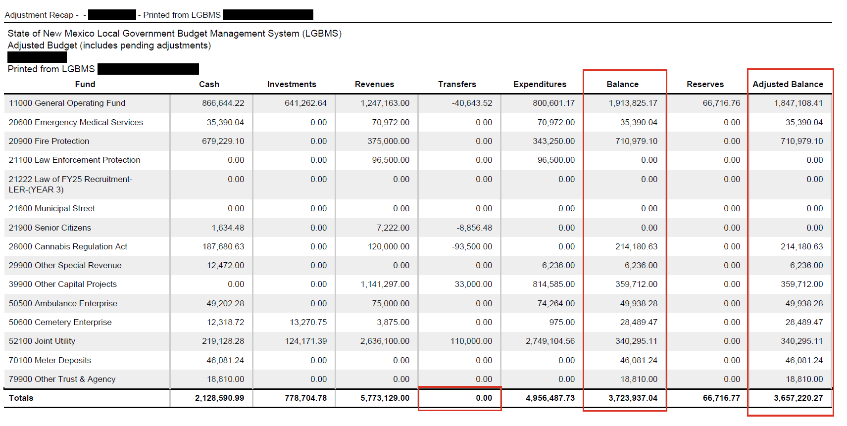
BAR Validations … continued
Adjustment recap example:

Slide 8
BAR Submittal Recommendations
Recommendations for BARs
Review your budget regularly. You should review your budget each quarter at a minimum. Reviewing monthly is recommended.
Submit BARs before submitting your quarterly report to maintain accuracy and best practice.
Submit BARs timely. Once you have the approved and signed resolution, submit the BAR. BARs can be submitted in LGBMS at any time. Don’t wait to submit several BARs together.
Keep BAR lines to a minimum. BARs with many lines take significantly longer to review and reconcile than BARs with fewer lines. Analysts must reconcile each BAR with the resolution and supporting documentation.
Separate local BARs from State BARs.
Submitting BARs frequently will make them more manageable when reconciling, reviewing, and approving.
Review your Adjustment Module frequently for unsubmitted BARs (still in Entity status).
KEYNOTE: Use LGBMS to generate the supporting documentation for the resolution. Using the LGBMS generated BAR report as the resolution supporting document (include it in the resolution approval process). This will make the approval of State BARs proceed quickly and accurately.

Slide 9
BAR Submittal Checks
Before submitting, does your resolution and supporting documentation include?
Date
Local government name
Approval signature
Reason for the adjustment
Reconcile your BAR before submitting
Be sure that your amounts in the BAR (LGBMS) reconcile to the amounts on the resolution supporting documentation.
It is recommended to enter the BAR in LGBMS before the resolution is approved to ensure the amounts being approved in the resolution reconcile and are correct. The BAR report can be used as the supporting document for the resolution.

Slide 10
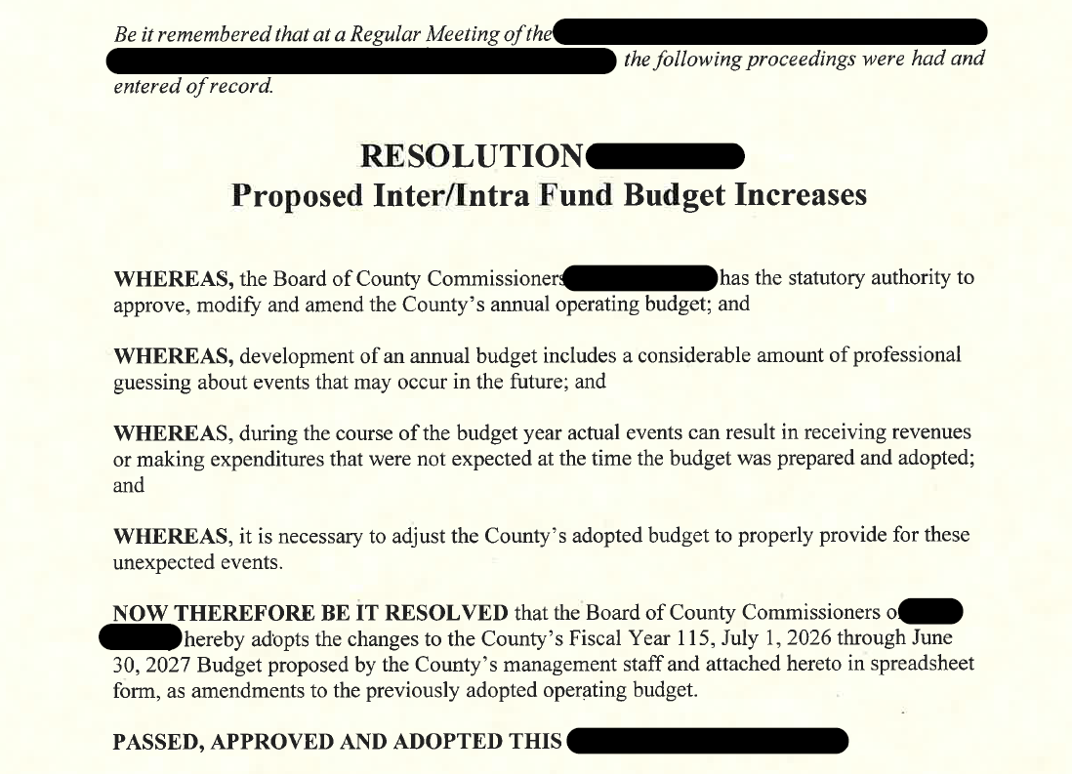
Resolution example
Resolution example:

Slide 11
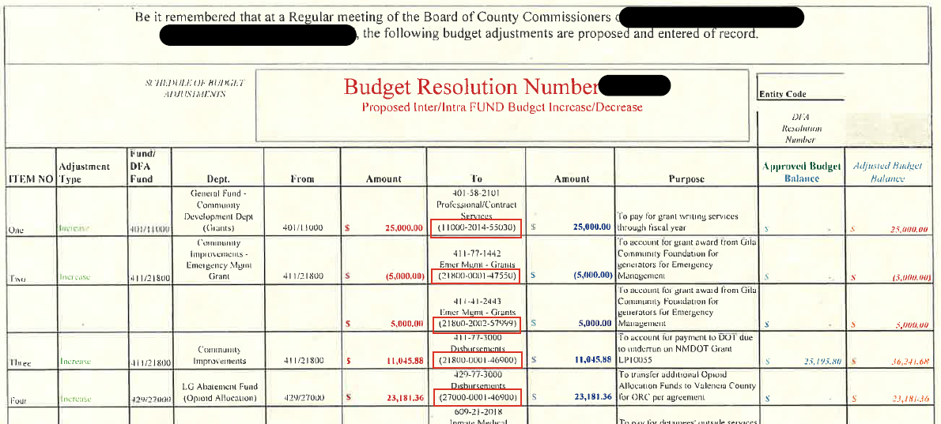
Resolution Supporting Document example
Supporting Document example:

Slide 12
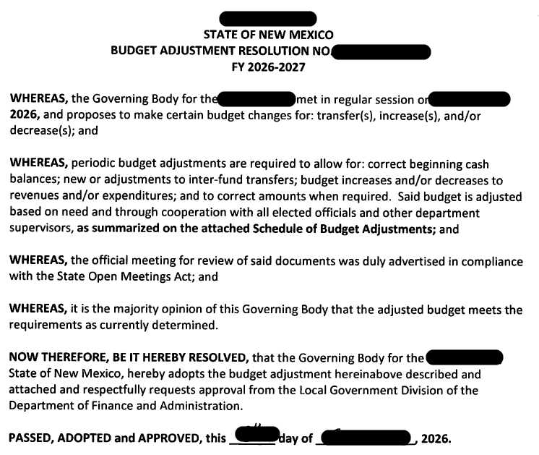
Resolution example
Resolution example:

Slide 13
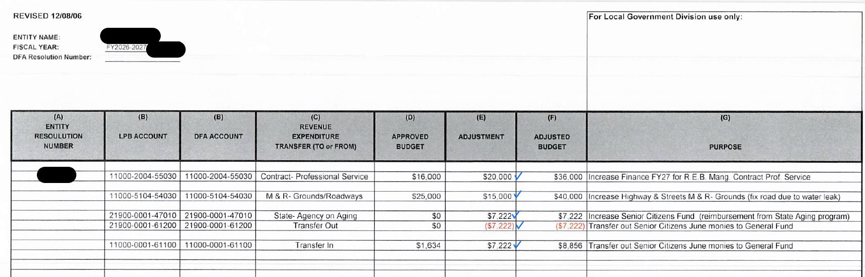
Resolution Supporting Document example
Supporting Document example:

Slide 14
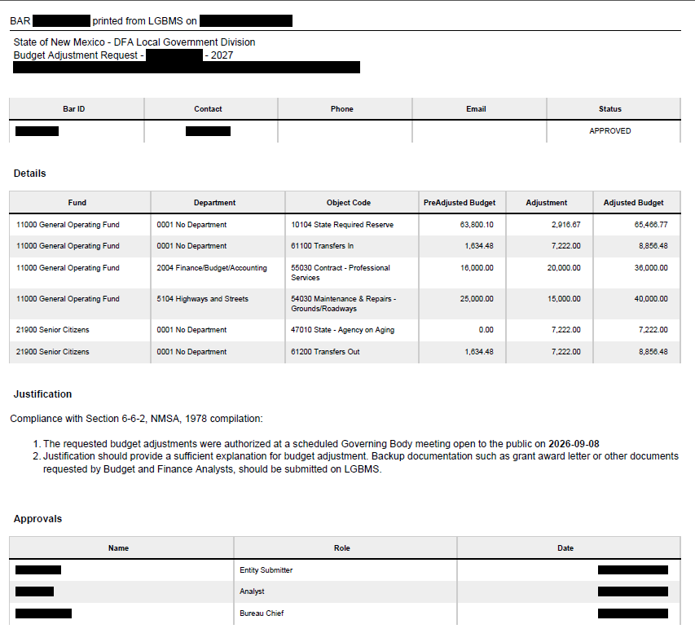
Resolution Supporting Document example
Supporting Document example:

Slide 15
BAR Corrections
BAR Corrections – Common Errors
Resolution not uploaded to the BAR.
Resolution not signed or font signatures used (must be an actual signature).
BAR amounts are more than the resolution and supporting document amounts.
BAR is missing amounts or lines when compared to the resolution and supporting documents.
No supporting documentation uploaded.
BAR Corrections and Resubmittal Process
When a BAR is returned to be corrected, your analyst will explain what corrections are needed. Contact your analyst if clarification is needed.
Corrections should be completed quickly, and the BAR resubmitted in LGBMS.
The entity must make the corrections. Analysts at DFA cannot make changes to your BAR, quarterly report, budget, or any other module in LGBMS.

Slide 16
Entering BARs in the Adjustment Module
Entering BARs in LGBMS
Review the instructions for entering BARs in the LGBMS User Manual. Here’s a link to the User Guide: https://www.nmdfa.state.nm.us/wp-content/uploads/2023/10/REVISED-LGBMS-Entity-User-Guide-October-2023.pdf
Link to video training for entering BARs: https://www.youtube.com/watch?v=_KS_XXrLlf0&list=PL9zQ343fcksE-RGeHlzDUa5DTcxaPhuIX&index=6
Quick Steps:
  Create the budget adjustment request container. Enter the title/description, resolution date, and resolution number.
  Manually enter adjustment items or import using a CSV file.
  Upload approved and signed resolution and any supporting documentation.
  Check for validation errors.
  Submit to Analyst for review and approval.

Slide 17


Notes:
Stephanie - This concludes our presentation. Does anyone have any questions? If you like to reach out privately, here is your analyst contact information.

Slide 18
Budget & Finance Bureau | Local Government Division
Your Assigned Analyst Is Your First Point of Contact
www.nmdfa.state.nm.us/local-government
Paul Chavez Supervisor
Kathleen Coates Supervisor
(505) 819-1620
paul.chavez@dfa.nm.gov
(505) 487-3907
kathleen.coates@dfa.nm.gov
Jennifer Gallegos
Bureau Chief
(505) 690-8464
jennifer.gallegos@dfa.nm.gov
Budget & Finance Bureau
407 Galisteo St., Santa Fe
(505) 827-4985
Bryce Roth Budget & Finance Analyst
Stephanie Ortiz Budget & Finance Analyst
(505) 470-7041
bryce.roth@dfa.nm.gov
(505) 470-8751
stephanie.ortiz@dfa.nm.gov
Sai Yeruva Budget and Finance Analyst
Candice Mirabal Budget & Finance Analyst
(505) 709-0758
saisharvani.yeruva@dfa.nm.gov
(505) 500-9382
candice.mirabal@dfa.nm.gov
Harold Quintana Budget & Finance Analyst
(505) 396-1783
harold.quintana@dfa.nm.gov
Annie Delgado Budget & Finance Analyst
(505) 500-9801
annie.delgado@dfa.nm.gov
Notes:
Stephanie – I’m turning it over to Bryce as he will be presenting on BARS.

