Slide 1

Lodgers’ Tax Module Training

Slide 2
Statutes and Rules
Two Source Documents for Guidance
Enacted in 1969, the Lodgers’ Tax Act (Sections 3-38-13 through 3-38-25, NMSA 1978)
Enacted in 1996, Lodgers Tax Quarterly Report (Rule 2 NMAC 105.2)

Slide 3
What is a Lodgers’ Tax?
Note: Lodgers’ Tax is also known as Occupancy Tax
Allows an optional tax revenue for municipalities or counties on persons using commercial lodging accommodations
More information about the Lodgers’ Tax Ordinance and the proper administration of Lodgers’ Tax revenue is available at this link.

Slide 4
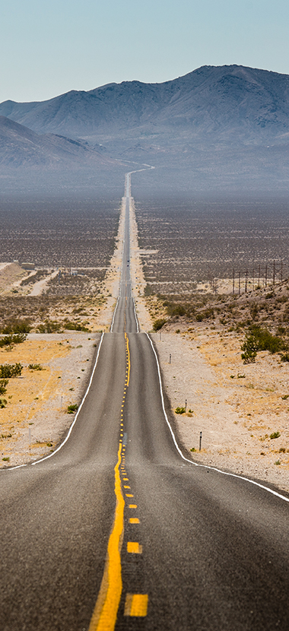
“30 Days” vs. “More Than 30 Days”
First 30 Consecutive Days of Lodging
Lodgings and tax apply to stays under 30 consecutive days—any stay shorter than this is subject to lodgers’ tax.
1.Advertising, publicizing, and promoting tourist attractions, facilities, event
2.Defraying costs of tax collection and audits
Funding tourist infrastructure, police, fire protection, sanitation
3.Supporting air service guarantees and debt service on tourism bonds

Slide 5

“30 Days” vs. “More Than 30 Days”
Day 31 and Beyond (More Than 30 Days)
Stays of 30 consecutive days or more are exempt from lodgers’ tax.
Exemption applies once a written agreement is reached or occupancy exceeds 30 days.
For those rare cases where tax is paid beyond 30 days (if not documented as a long-term lease), the law allows municipalities to use revenues from day 31+ for any municipal or county purpose, provided the local ordinance permits it (NM Stat § 3‑38‑21(B)).

Slide 6
Benefits of the Lodgers’ Tax Module
When local entity reports year to date actuals for funds 21400, 24000 & 24100 on the quarterly financial report, LGBMS sends automatic reminder to submit Lodgers Tax details.
There are two ways of entering most LT information:
  Manual Entry
  Utilizing a Template to Import
Year to date actuals associated with lodger tax funds will require user to enter details regarding;
  Event name, description and dates
  Expenditure type (promotional and non-promotional)
Lodgers Tax Module will follow the same workflow as LGBMS Quarterly Report submissions;
  Data validation
  Comments
  Tracking of data submission, review and acceptance
Lodgers’ Tax Module

Slide 7
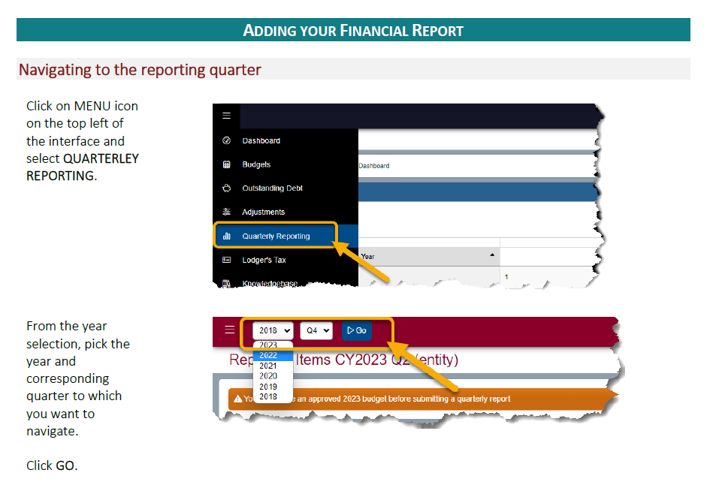
Navigating to the
LT Module
From the Main Navigation Bar
Choose the correct Year and Quarter

Slide 8
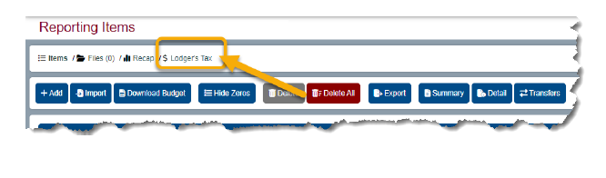
Lodgers’ Tax Module
Lodgers’ Tax is available as one of the Reporting Items within the Quarter

Slide 9
Lodgers’ Tax Module
Lodgers’ Tax is available as one of the Reporting Items within the Quarter

Slide 10
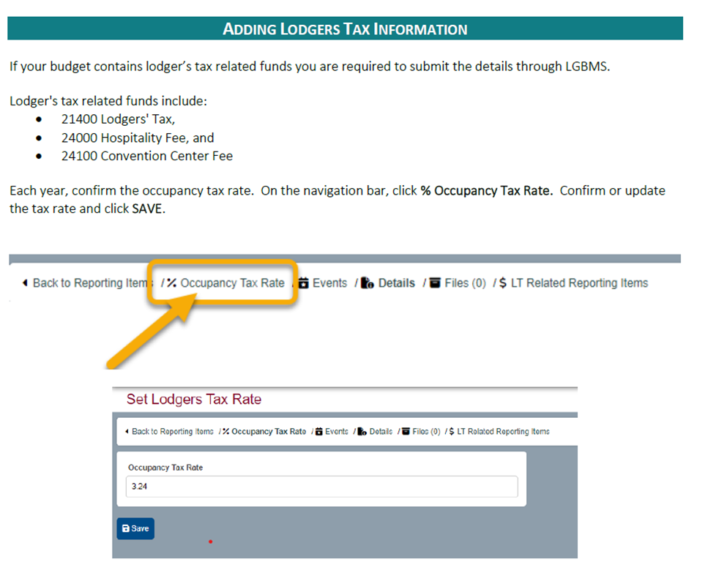
Entering Your Lodger’s Tax Information
Entering the LT % Rate
When entering the % Occupancy Tax Rate use a whole number.
A few examples:
1) If the rate is two percent, enter
2) If the rate is three and one-half percent, enter 3.5.
Must Be Entered

Slide 11
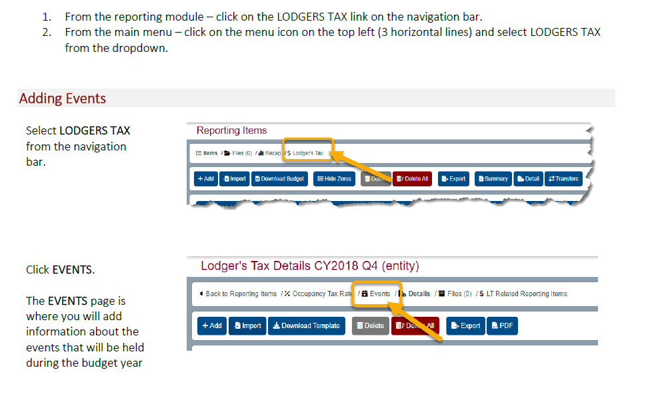
Entering Events
Events are added in the lodgers’ tax module to help explain sudden increases in lodging revenue. Major events—such as festivals, conferences, tournaments, or seasonal celebrations—bring a surge of visitors, which leads to higher occupancy and short‑term rental activity. Tracking these events makes it easier to understand and clearly communicate the reasons behind revenue spikes from one reporting period to the next.

Slide 12
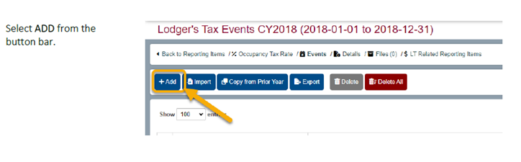
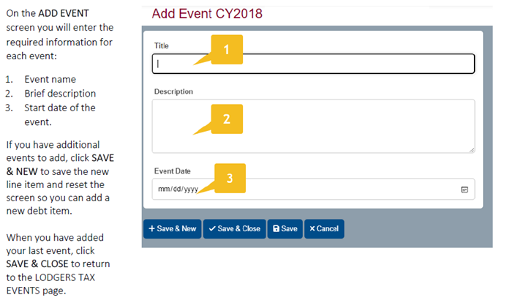
Events cont.
Events Can Be Manually Entered

Slide 13
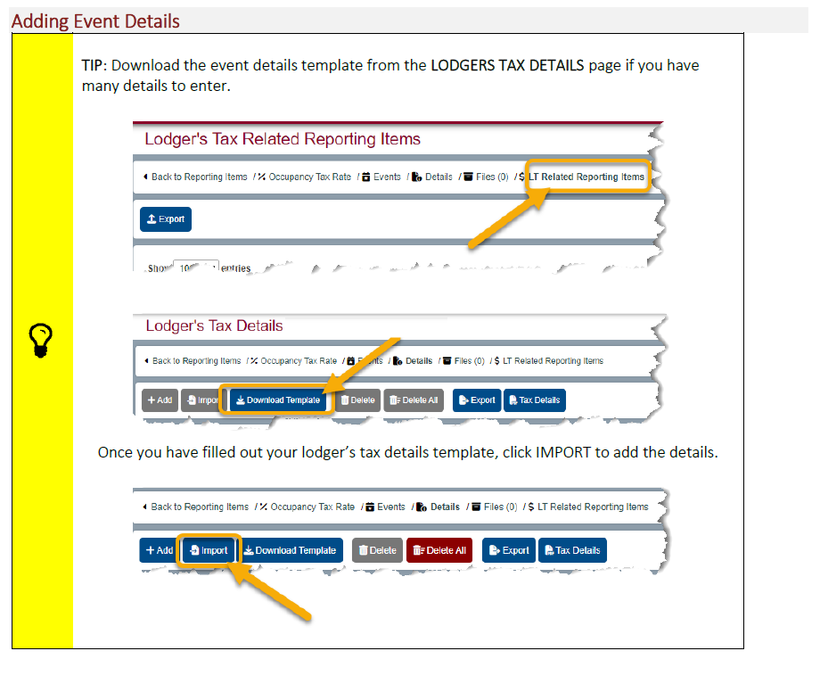
Events cont.
Events Can Be Imported

Slide 14
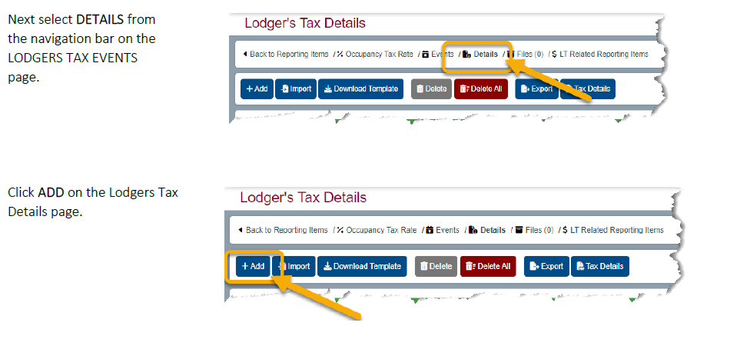
Lodgers’ Tax Details
Entering accurate lodgers’ tax details is important because it allows us to properly match your reported revenue with the tax owed. Complete information helps us confirm accuracy, resolve discrepancies quickly, and ensure consistent, reliable reporting for everyone.

Slide 15
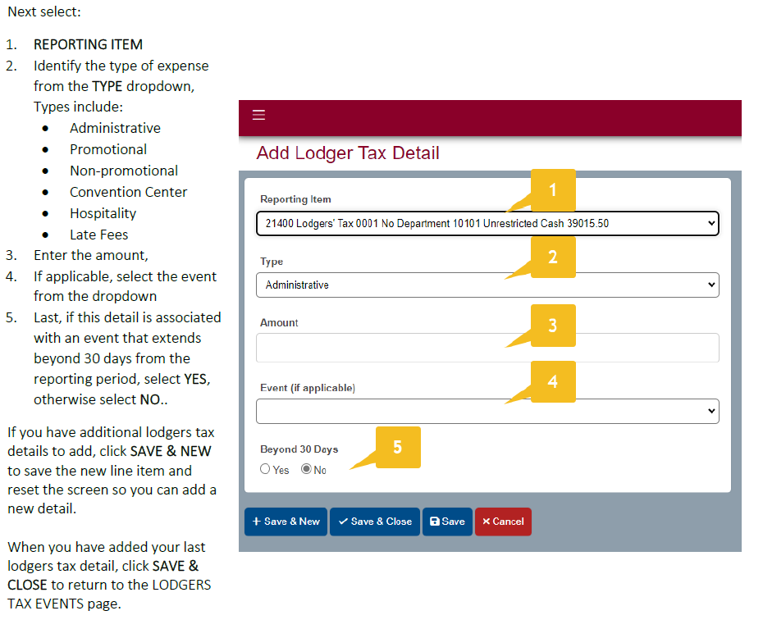
Details cont.
Details Can Be Manually Entered

Slide 16
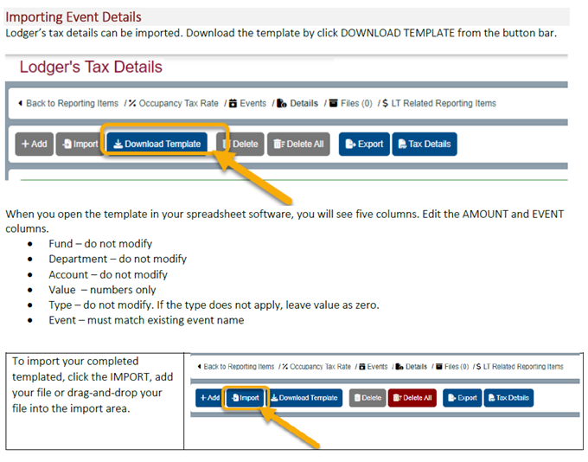
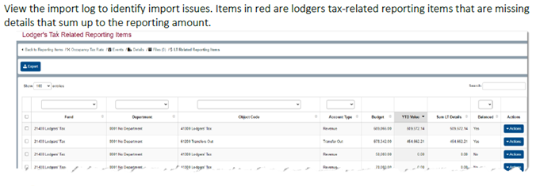
Details cont.
Events Can Be Imported
Be sure to view the import log for any errors.

Slide 17
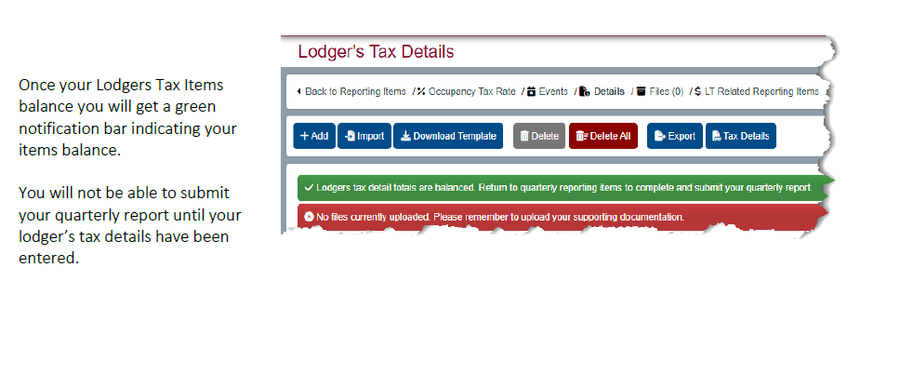
Reconciling LT Details

Slide 18
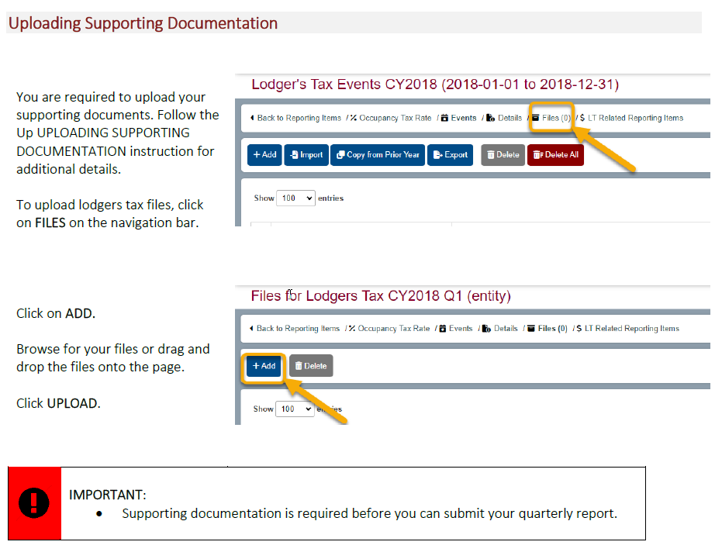
Uploading Supporting Documentation
The Lodgers’ Tax Ordinance, Ordinance amendments or updates must be uploaded in the first quarter.
Event documentation that explains unusual revenue changes (festival schedules, contracts, etc.).
Any correspondence that clarifies reported amounts or discrepancies.
Policies, resolutions, or administrative rules related to lodgers’ tax.

Slide 19

Examples of Common Lodgers’ Tax Reporting Errors in LGBMS
MISSING LODGERS’ TAX RATE CERTIFICATION DOCUMENT
What we noticed. Your quarterly submission does not include an uploaded document (often a certification, ordinance excerpt, or governing-body documentation) that clearly shows the current Lodgers’ Tax/occupancy tax rate in effect for the reporting period. LGBMS requires entities to upload supporting documents as part of the Lodgers’ Tax reporting workflow.
How to correct it. Upload a clear rate-supporting document in the Lodgers’ Tax module Files area, ensuring the effective date and adopted rate are visible. Supporting documentation is required before submission in the Lodgers’ Tax workflow.

Slide 20
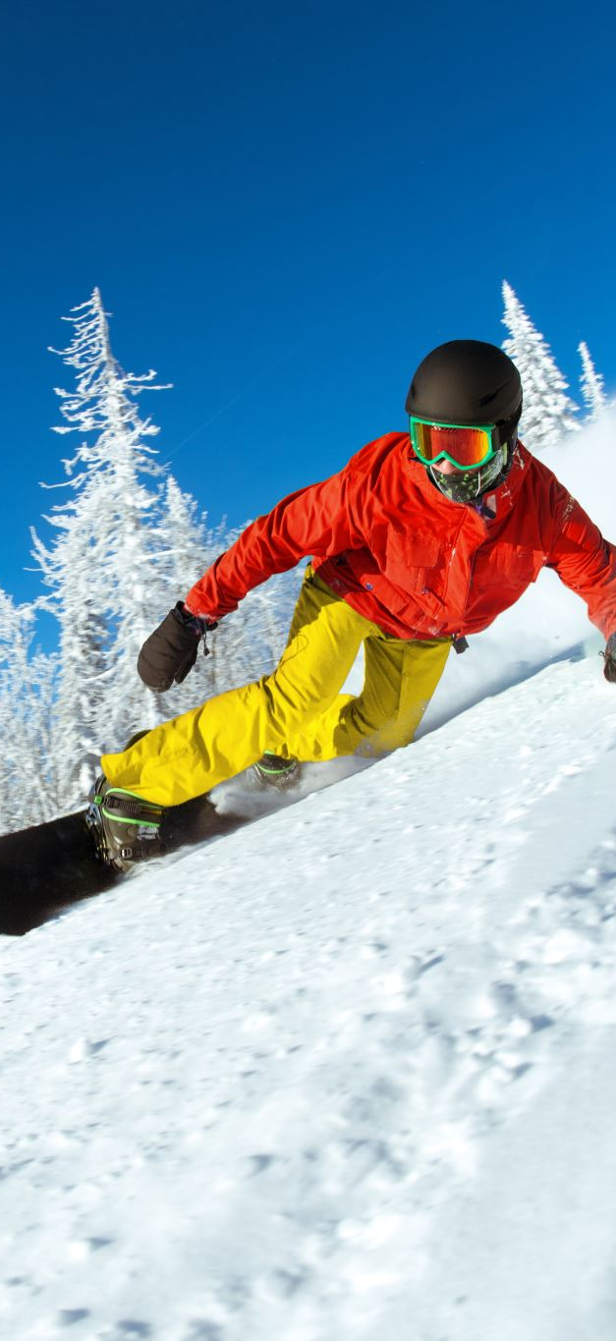
Lodgers’ Tax revenue recorded to the wrong account or object code
What we noticed. Lodgers’ Tax revenue was posted to a non–Lodgers’ Tax account/object code (or crosswalked into the wrong revenue line), even though it belongs in the Lodgers’ Tax revenue account structure for Fund 21400.
How to correct it. Correct this issue by ensuring Lodgers’ Tax revenue is posted to the proper LT revenue accounts (41300 for 1–30 days and 41304 for 31‑plus days) instead of miscellaneous categories, and by keeping the predefined account strings unchanged when using an import template.

Slide 21

Lodgers’ Tax rate not updated for the current year in LGBMS
What we noticed. The % Occupancy Tax Rate field in LGBMS is blank,
outdated, or still reflects the prior fiscal year’s rate. LGBMS instructs entities each year to confirm/update the occupancy tax rate through the “% Occupancy Tax Rate” field
How to correct it. In the LGBMS Lodgers’ Tax module, open % Occupancy Tax Rate, confirm the current year rate, and save the update as directed in the user guide.

Slide 22

Convention Center Fee revenue not recorded separately from Lodgers’
Tax revenue
What we noticed. Convention Center Fee revenue was included in (or
combined with) Lodgers’ Tax revenue rather than being tracked as a distinct revenue stream.
How to correct it. Correct this issue by recording Convention Center Fee revenue in the proper Convention Center Fee fund and account structure (fund 24100 with revenue code 41302) instead of combining it with Lodgers’ Tax revenue, and then ensuring your Lodgers’ Tax reporting matches the totals shown in the separate Convention Center Fee fund.

Slide 23

Lodgers’ Tax revenue incorrectly reported as Hospitality Fee revenue
What we noticed. Lodgers’ Tax receipts (occupancy tax) were labeled or entered as “Hospitality Fee” revenue, or were recorded in the Hospitality Fee fund instead of the Lodgers’ Tax fund.
How to correct it. Correct this issue by reclassifying the revenue so that Lodgers’ Tax receipts are reported only as Lodgers’ Tax and Hospitality Fee receipts are reported only when applicable, and then confirming that the correct fund (24000) and revenue code (41301) are used so the revenue type matches the proper account structure.

Slide 24
Things to Note:
DFA cannot provide legal opinions or determine whether your documentation meets statutory requirements. Because the Lodgers’ Tax Act does not authorize DFA/LGD to approve eligible uses of lodgers’ tax revenue, you should consult your legal counsel for guidance on compliance with the Act.
When a county or municipality collects more than $250,000 in lodgers’ tax revenue, the governing body is required to conduct random audits of vendors to verify compliance.
Special Revenue Funds such as the Lodgers’ Tax Fund are used to track revenue sources that are legally restricted and must be spent only for their designated purposes.
If you have questions regarding audit compliance, please consult your advisory board.
LGBMS – New coding for 31‑plus‑day activity will be:
Revenues: Fund 21400, Department 0001, Object 41304
Expenditures: Fund 24100, Department 2002, Object 57200

