Slide 1
Off Cycle Processing
Off-cycle requests for current employees must meet the minimum threshold of one full scheduled workday (8 hours) of unpaid regular hours. Requests for missing overtime, standby time or shift differentials will not be processed.
For involuntarily terminated employees, this minimum-hour requirement does not apply. Instead, off-cycle payment may be requested if the employee was involuntarily terminated and has hours worked or leave time requiring payment.
Payments will normally be issued according to the payment method selected by the employee in HCM, either direct deposit or manual warrant. Requests that do not meet the required thresholds will not be processed, and outstanding time will be processed with the next regular payroll cycle.
Standard processing for off-cycle payments occurs daily beginning the Wednesday before payday, through the following Wednesday prior to 11:00 a.m., unless otherwise adjusted for accelerated payroll schedules.

Slide 2
5-Day Payout involuntarily terminated employees
For involuntarily terminated employees, this minimum-hour requirement does not apply. Instead, off-cycle payment may be requested if the employee was involuntarily terminated and has hours worked or leave time requiring payment.
For 5‑day payouts of involuntary terminations, agencies may request a manual warrant when operationally necessary; otherwise, the employee’s existing payment method will be used.
Any requests for 5-day payouts submitted during on-cycle (regular payroll) must be processed through a payment voucher and cannot be paid through the off-cycle payroll process.

Slide 3
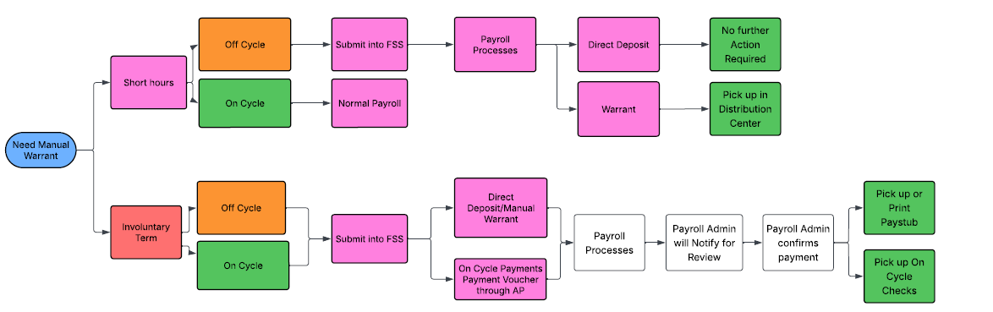
Payment Processing Flowchart

Slide 4

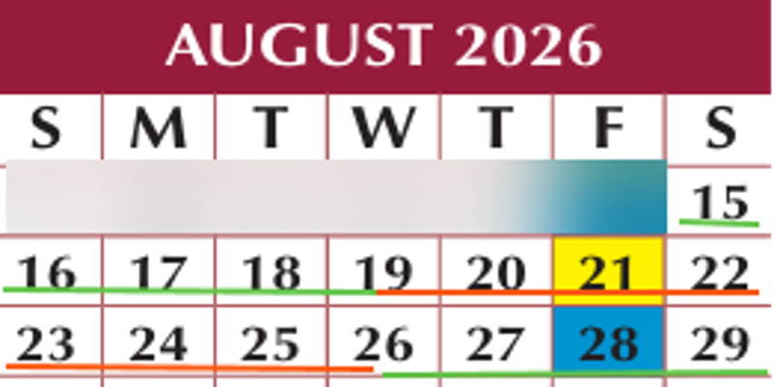

Off/On Cycles in the Pay Period
Off-Cycle
On-Cycle
Payments issued during On-Cycle will be paid via payment voucher.

Slide 5

SOP – 5-Day Final Pay Payout
Involuntarily Terminated Employees

Slide 6
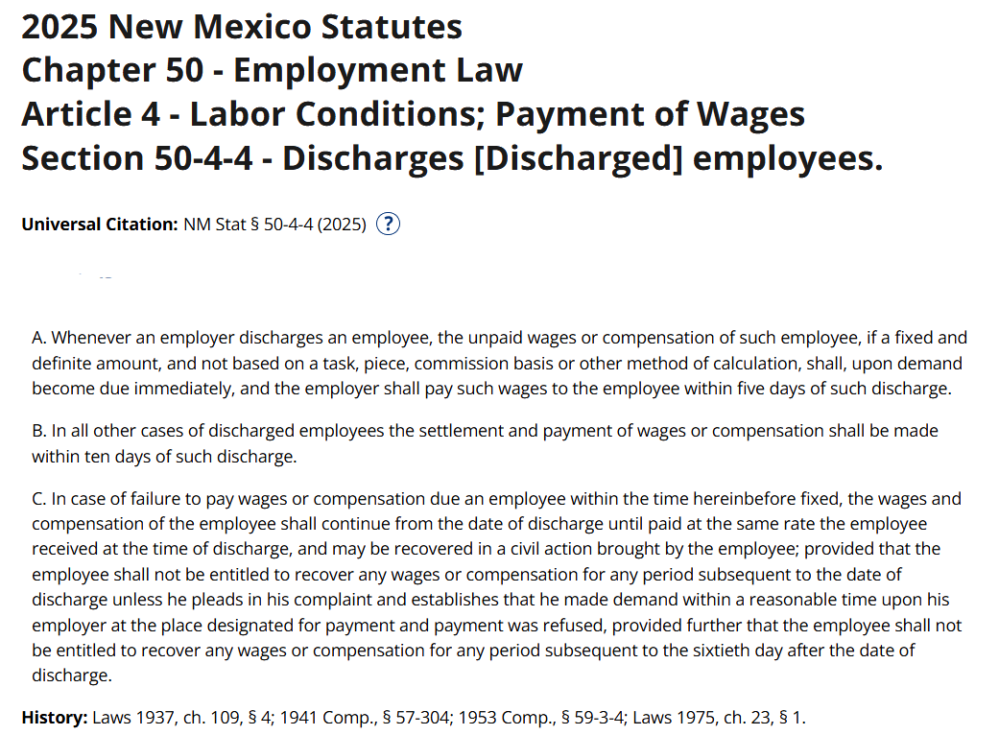
Purpose
To ensure compliance with New Mexico Statute § 50-4-4 regarding timely payment of wages to terminated employees and to outline agency responsibilities when an employee is involuntarily terminated.

Slide 7
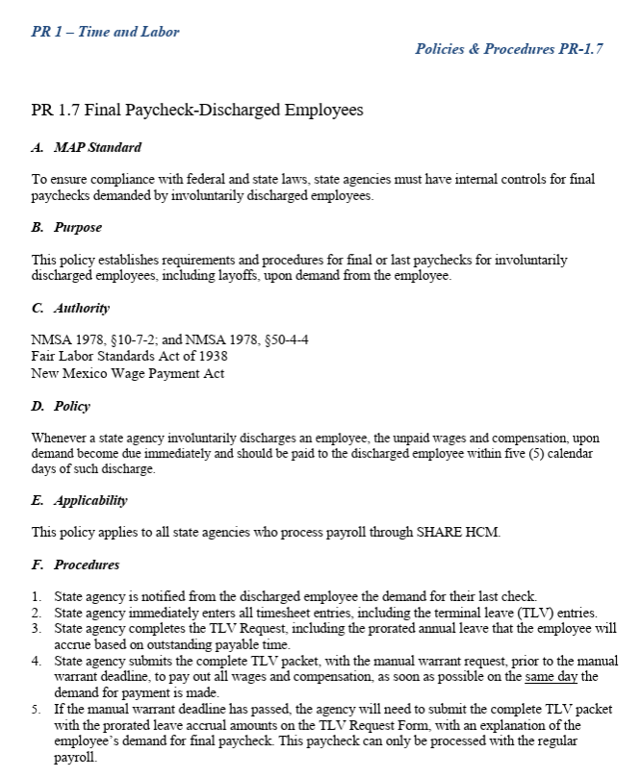
Legal Requirements
Upon discharge, all unpaid wages that are fixed and definite become due immediately upon demand.
If the employee does not demand immediate payment, the employer must issue all wages within five (5) calendar days of discharge.
Wages due include regular wages, TLV payouts, and any other earned compensation.
The State of New Mexico does NOT have an exemption to this statute.
Reference: MAPS PR 1.7
https://www.nmdfa.state.nm.us/wpcontent/uploads/2025/07/Model_Accounting_Practices_Manual___2026.pdf

Slide 8
Agency Responsibilities
Immediately Notification to Central Payroll
Submission of Forms via FSS
Upload Required Documents Promptly

Slide 9
Required Documentation
TLV Request Form
(Submit via FSS)
TLV Report
Run in HCM
Menu→Time and Labor→NMS Terminal Leave Report
(Submit via FSS)
Accrual Worksheet
(Submit via FSS)
Off Cycle Payment Request Form
(Submit via FSS)
Query Report:
NMS_TL_PAYTM_OUTSTANDING_EE
(Submit via FSS)
Documentation must be complete, accurate, and uploaded with the final pay request.
(Submit via FSS)

Slide 10
Payment Requirements
Demand for Immediate Pay – Pay Due Immediately
No Demand – Pay Within 5 Calendar Days

Slide 11
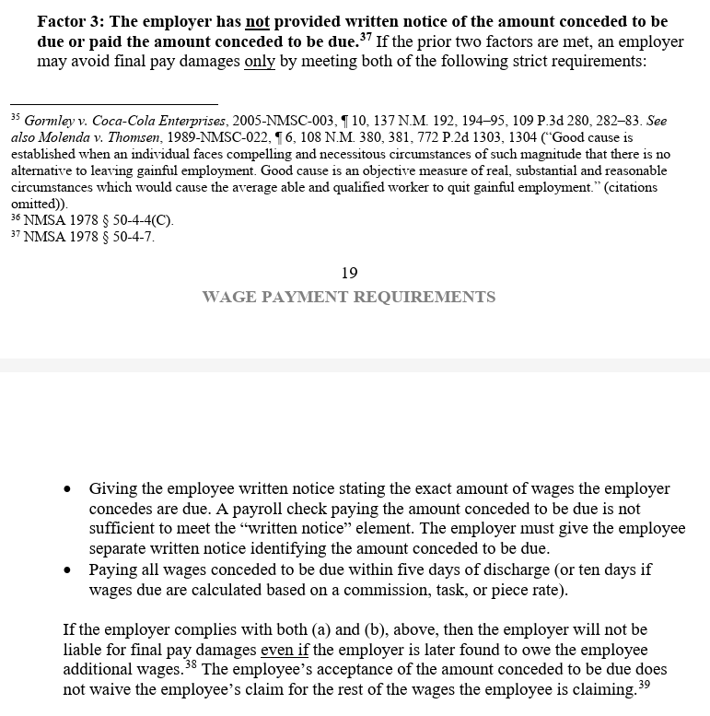
Payment Requirements
If an employer misses the WPA’s relevant five- or ten-day deadlines for paying wages due, the employer is liable for WPA final pay damages only if each of the following three factors are met.
Factor 1: The employee was discharged.
Factor 2: The employee made a demand for payment of wages within a reasonable time, and the employer refused to pay. NMSA 50.4.4
Factor 3: The employer has not provided written notice of the amount conceded to be due NMSA 50.4.7 and paid the amount conceded to be due. NMSA 50.4.4
Source reference:
https://www.dws.nm.gov/Portals/0/DM/LaborRelations/LRD_Investigations_Manual_2025.pdf

Slide 12
Documentation Retention
Date and time of discharge
Date and time of any demand for immediate pay
Proof of FSS submission
All submitted final pay documents
Communications with Payroll

Slide 13
References
MAPS PR 1.7
https://www.nmdfa.state.nm.us/wp-content/uploads/2025/07/Model_Accounting_Practices_Manual___2026.pdf
FSS Platform: https://platform.dfa.nm.gov/

